Slide 1
Paradigm shift on bifurcation treatment by contemporary DES
: overcoming limitation on technique & lesion
HS(Hyo-Soo) Kim, MD/PhD/FAHA
Cardiovascular Center,
SNU(Seoul National University) Hospital, Seoul, Korea
SNU-H (Seoul National University Hospital)

Slide 2
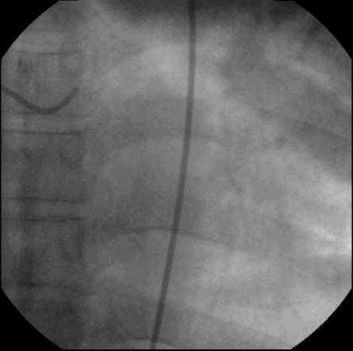
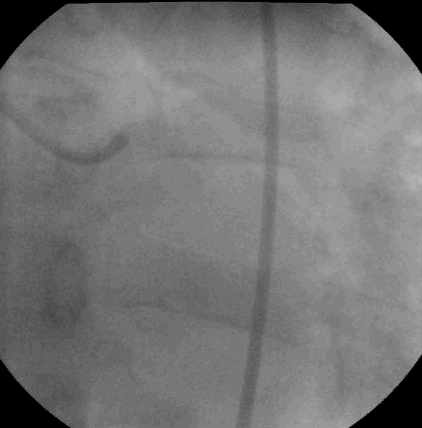
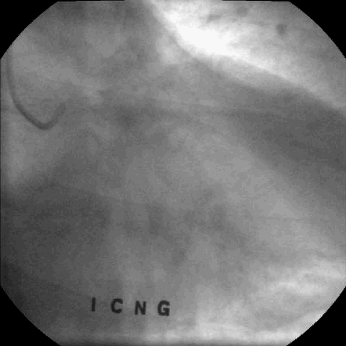
Limitation of Bifurcation Stenting with OLD DES
1-stent cross-over at LM bifurcation
PCI to LM-LAD with Cypher 3.5X18
Follow-up CAG : patent stent
SNU-H (Seoul National University Hospital)

Slide 3
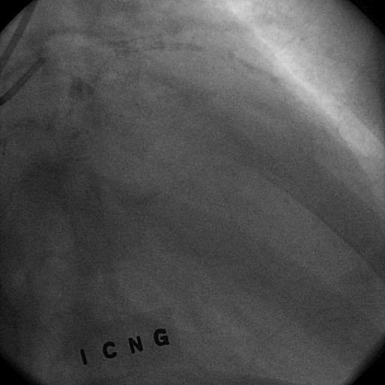
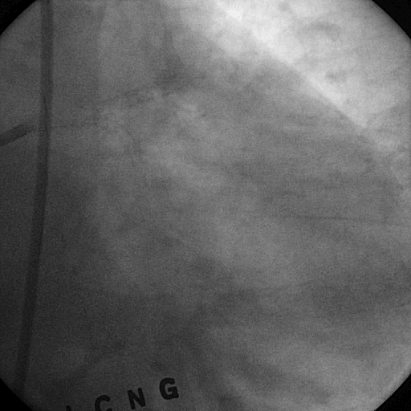
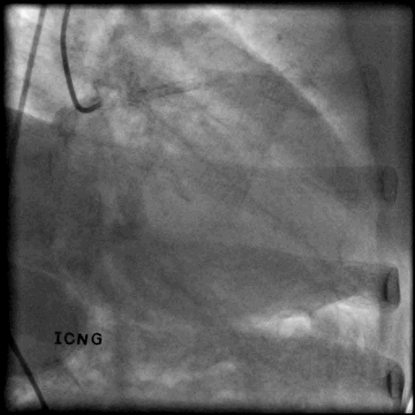
Limitation of Bifurcation Stenting with OLD DES
2-stent technique at LM bifurcation
2-stenting with Crush/FKB at LM bifurcation (Cypher)
Follow-up CAG : Restenosis
SNU-H (Seoul National University Hospital)

Slide 4
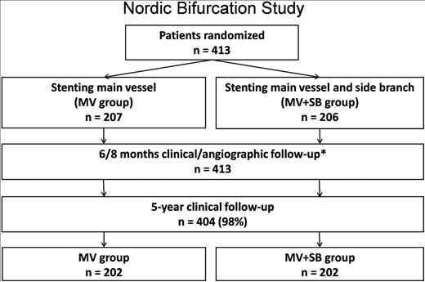
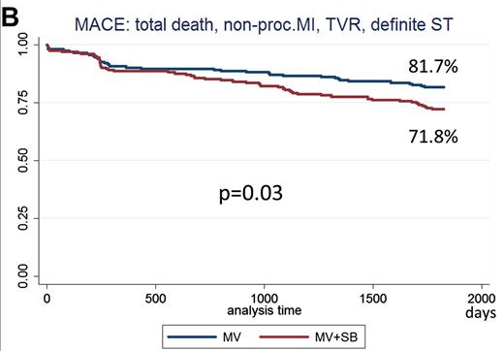
Two Limitations in Bifurcation PCI with OLD DES
(1) Technique – 1-stent vs. 2-stent
NORDIC-I 5-YR outcome (Cypher Select)
Systemic 2-stenting results in Worse Outcome in Coronary Bifurcation Lesions
SNU-H (Seoul National University Hospital)
Maeng et al. J Am Coll Cardiol. 2013

Slide 5
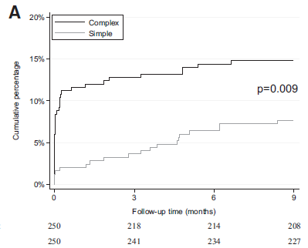
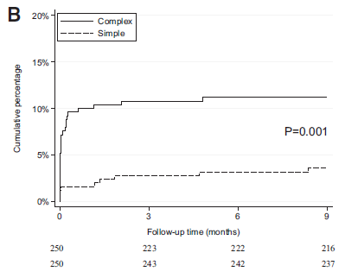
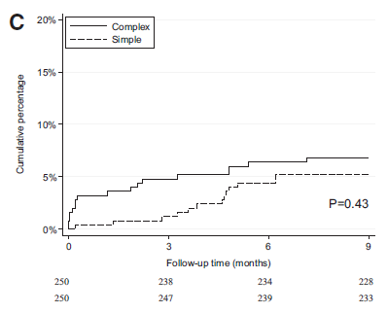
Two Limitations in Bifurcation PCI with OLD DES
(1) Technique – 1-stent vs. 2-stent
BRITISH Bifurcation Trial – BBC ONE (Taxus)
Simple Group : 1-stent crossover ± provisional T-stenting at side branch
Complex Group : Elective 2-stent technique (Crush or Cullotte)
All death, MI, TVF
MI
TVF
Systemic 2-stenting results in Worse Outcome in Coronary Bifurcation Lesions
SNU-H (Seoul National University Hospital)
Hildick-Smith et al., Circulation, 2010

Slide 6
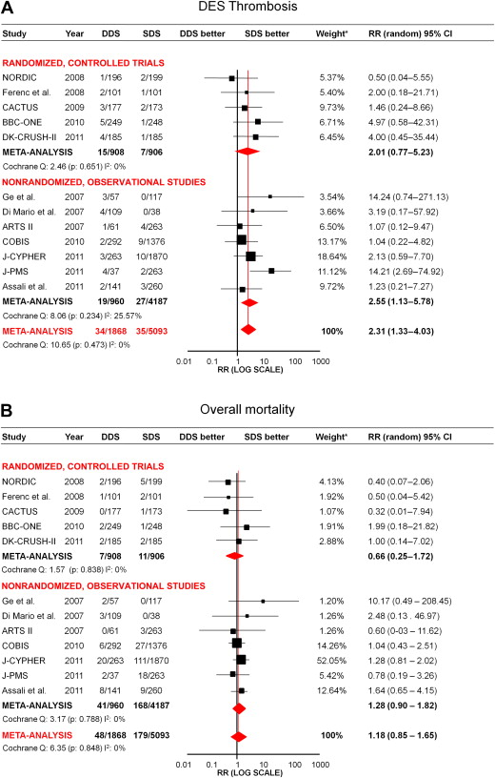
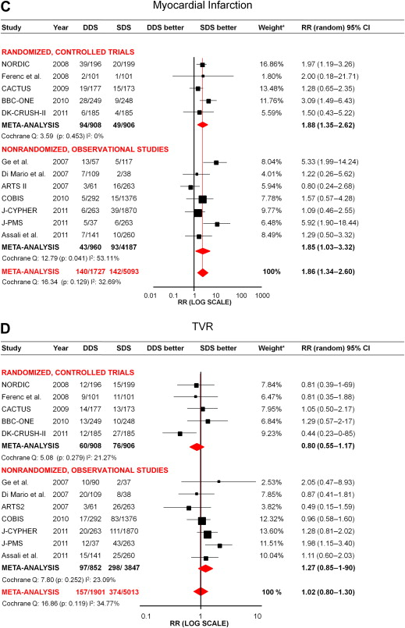
Two Limitations in Bifurcation PCI with OLD DES
(1) Technique – 1-stent vs. 2-stent
Stent Thrombosis
SES
Meta-analysis
of 5 RCTs
1-stent crossover is better than
2-stent technique in bifurcation lesions
SES
SES
PES
SES
Myocardial Infarction
SES
SES
SES
PES
SES
SNU-H (Seoul National University Hospital)
Zimarino et al. J Am Coll Cardiol. 2013

Slide 7
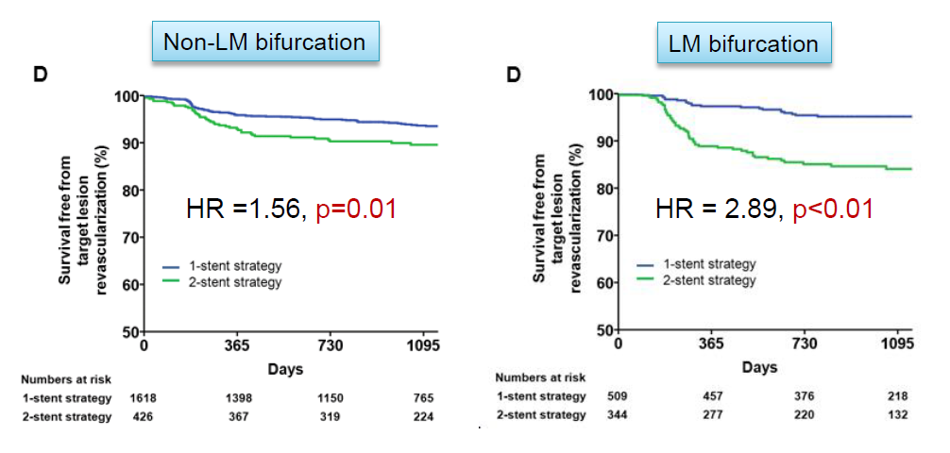
Two Limitations in Bifurcation PCI with OLD DES
(2) Technique & Lesion – 1-stent vs. 2-stent in LM
Target Lesion Revascularization
OLD DES
1-stent
1-stent
2-stent
2-stent
Systemic 2-stenting results in Worse Outcome in Left Main Bifurcation Lesions
SNU-H (Seoul National University Hospital)
Song et al. JACC cardiovasc interv. 2014

Slide 8
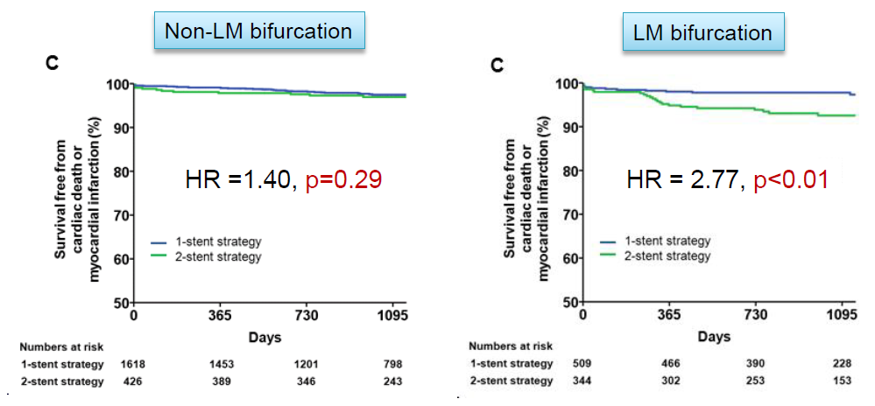
Two Limitations in Bifurcation PCI with OLD DES
(2) Technique & Lesion – 1-stent vs. 2-stent in LM
Cardiac Death or MI
OLD DES
1-stent
1-stent
2-stent
2-stent
Systemic 2-stenting results in Worse Outcome in Left Main Bifurcation Lesions
SNU-H (Seoul National University Hospital)
Song et al. JACC cardiovasc interv. 2014

Slide 9
Paradigm of
Bifurcation PCI with old DES
Two-stent tech is worse than one-stent.
LM is worse than non-LM bifurcation.
(limitations on tech & lesion)
these limitations applicable to new DES?

Slide 10
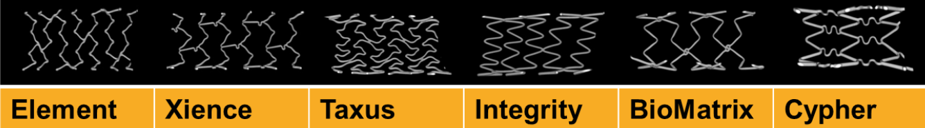
Impact of Stent Design on Bifurcation PCI
Medium diameter | 8 crowns 2 cells | 6 crowns 3 cells | 9 crowns 3 cells | 10 crowns 2 cells | 9 crowns 3 cells | 7 crowns 7 cells
Large diameter | 10 crowns 2 cells | 9 crowns 3 cells | 9 crowns 3 cells | 10 crowns 2 cells | 9 crowns 3 cells | 7 crowns 7 cells
Number of connectors may limit
maximal cell opening for SB intervention.
SNU-H (Seoul National University Hospital)

Slide 11
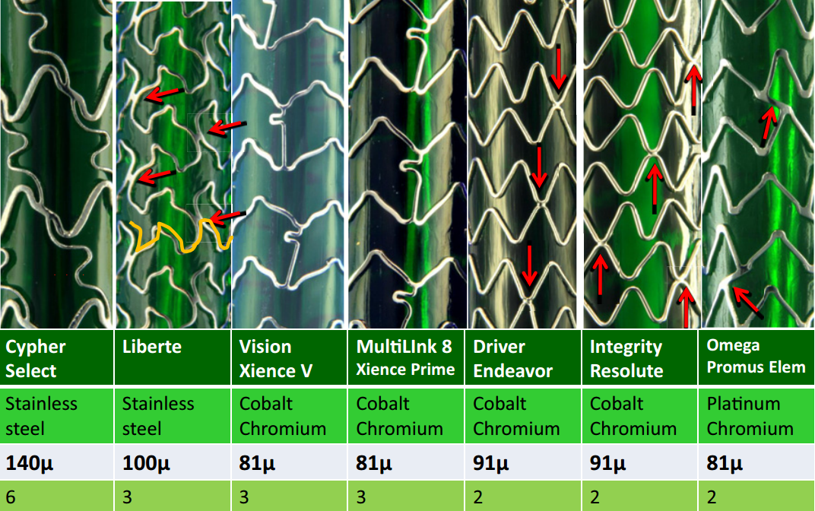
Impact of Stent Design on Bifurcation PCI
Strut thickness
No of connectors
Joan et al. JACC CV INT 2011.
Newer DES - Lesser connectors and Thinner strut
➔ Better procedural outcomes of SB intervention
SNU-H (Seoul National University Hospital)

Slide 12
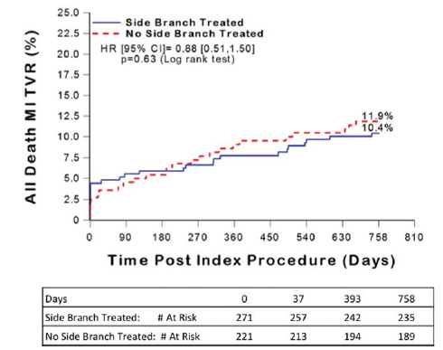
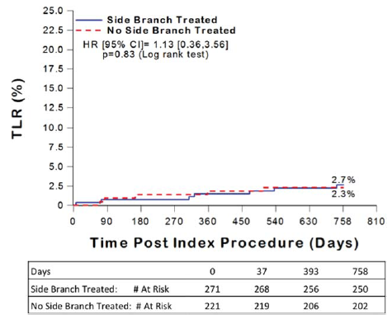
Emerging, but inconclusive evidences in
New DES era (1)
One vs Two stenting for bifurcation
SPIRIT-V Bifurcation Sub-study (Xience V)
Xience V
Xience V
1-stent
2-stent
1-stent
2-stent
Side branch treatment with Xience V stent showed comparable outcome with main vessel only treatment
SNU-H (Seoul National University Hospital)
Dzavık et al. CCI 2013

Slide 13
Performance of newer DES in bifurcation PCI
Insight from COBIS II, EXCELLENT, RESOLTUTE registries
COBIS II
(2003.01~2009.12)
EXCELLENT
(2008.04~2010.05)
RESOLUTE KOREA (2009.01~2010.06)
2897 Patients with Bifurcation PCI
Prospectively Enrolled
3056 Patients with EES implanted
Prospectively Enrolled
1998 Patients with ZES-R implanted
Prospectively Enrolled
919 Patients with Bifurcation Lesion
2475 Patients with
1st generation DES
422 Patients with
2st generation DES
316 Patients with Bifurcation PCI
(2nd Generation DES)
Preliminary Analysis
Clinical outcome analysis at 3-year Follow-up
Primary Analysis Endpoint | Stent-oriented composite outcome | Target Lesion Failure (Composite of Cardiac death, Target vessel MI, TLR)
Major Secondary Analysis Endpoint | Patient-oriented composite outcome | Composite of Any death, Any revascularization, Any MI, CVA
SNU-H (Seoul National University Hospital)
JM Lee,,, HS Kim. in preparation

Slide 14
Patient Profiles (old vs new stent) in COBIS-II
 | 1st Generation DES (n=2475) |  |  | 2nd Generation DES (n=422)
 | 1-stent (n=1802) | 2-stent (n=673) | P value | 1-stent (n=325) | 2-stent (n=97) | P value
Demographics
Age, years | 62.0 ± 10.2 | 62.5 ± 10.2 | 0.239 | 62.5 ± 10.4 | 62.5 ± 11.4 | 0.998
Age > 65 years | 706 (39.2%) | 281 (41.8%) | 0.244 | 139 (42.8%) | 44 (45.4%) | 0.651
Male | 1303 (72.3%) | 472 (70.1) | 0.285 | 236 (72.6%) | 72 (74.2%) | 0.754
Coexisting Condition
Diabetes Mellitus | 509 (28.2%) | 207 (30.8%) | 0.220 | 102 (31.4%) | 22 (22.7%) | 0.099
Hypertension | 1032 (57.3%) | 388 (57.7%) | 0.864 | 194 (59.7%) | 61 (62.9%) | 0.572
Dyslipidemia | 582 (32.3%) | 209 (31.1%) | 0.555 | 91 (28.0%) | 24 (24.7%) | 0.527
Peripheral vascular disease | 25 (1.4%) | 12 (1.8%) | 0.470 | 2 (0.6%) | 0 (0.0%) | 0.439
Chronic Kidney Disease | 49 (2.7%) | 22 (3.3%) | 0.466 | 10 (3.1%) | 0 (0.0%) | 0.080
Cardiac Risk Factors
Current Smoker | 474 (26.3%) | 154 (22.9%) | 0.082 | 84 (25.8%) | 21 (21.6%) | 0.401
Previous MI | 106 (5.9%) | 55 (8.2%) | 0.040 | 7 (2.2%) | 5 (5.2%) | 0.119
Previous CVA | 121 (6.7%) | 51 (7.6%) | 0.452 | 13 (4.0%) | 4 (4.1%) | 0.957
Previous PCI | 228 (12.7%) | 144 (21.4%) | <0.001 | 33 (10.2%) | 9 (9.3%) | 0.800
Previous CABG | 17 (0.9%) | 11 (1.6%) | 0.148 | 1 (0.3%) | 1 (1.0%) | 0.363
Family history of CAD | 54 (3.0%) | 13 (1.9%) | 0.146 | 12 (3.7%) | 3 (3.1%) | 0.780
LVEF < 50% | 292 (19.6%) | 104 (19.4%) | 0.912 | 50 (17.2%) | 8 (9.6%) | 0.092
Clinical Indication of PCI |  |  | 0.002 |  |  | 0.005
Stable angina | 662 (36.7%) | 222 (33.0%) |  | 110 (33.8%) | 34 (35.1%)
Unstable angina | 643 (35.7%) | 292 (43.4%) |  | 103 (31.7%) | 38 (39.2%)
Acute myocardial infarction | 456 (18.4%) | 139 (20.7%) |  | 107 (32.9%) | 20 (20.6%)
NSTEMI | 232 (12.9%) | 84 (12.5%) |  | 50 (15.4%) | 17 (17.5%)
STEMI | 224 (12.4%) | 55 (8.2%) |  | 57 (17.5%) | 3 (3.1%)
Silent ischemia | 36 (2.0%) | 17 (2.5%) |  | 4 (1.2%) | 4 (4.1%)
SNU-H (Seoul National University Hospital)
JM Lee,,, HS Kim. in preparation

Slide 15
Patient Profiles (old vs new stent) in COBIS-II
 | 1st Generation DES (n=2475) |  |  | 2nd Generation DES (n=422)
 | 1-stent (n=1802) | 2-stent (n=673) | P value | 1-stent (n=325) | 2-stent (n=97) | P value
Complexity of CAD
Angiographic disease extent |  |  | <0.001 |  |  | 0.054
1VD | 866 (48.1%) | 221 (32.8%) |  | 146 (44.9%) | 33 (34.0%)
2VD | 710 (39.4%) | 322 (47.8%) |  | 139 (42.8%) | 44 (45.4%)
3VD | 225 (12.5%) | 130 (19.3%) |  | 40 (12.3%) | 20 (20.6%)
Left main disease | 292 (16.2%) | 229 (34.0%) | <0.001 | 87 (26.8%) | 32 (33.0%) | 0.232
Bifurcation at Left Main | 397 (22.0%) | 292 (43.4%) | <0.001 | 112 (34.5%) | 52 (53.6%) | 0.001
No. of stented lesion/patients | 1.33 ± 0.59 | 1.41 ± 0.66 | 0.003 | 1.34 ± 0.58 | 1.59 ± 0.77 | 0.001
No. of used stents | 1.55 ± 0.81 | 2.68 ± 1.02 | <0.001 | 1.62 ± 0.88 | 2.65 ± 0.97 | <0.001
At least 1 ISR | 55 (3.1%) | 44 (6.5%) | <0.001 | 6 (1.8%) | 2 (2.1%) | 0.891
Total occlusion of MV (pre-PCI) | 178 (9.9%) | 41 (6.1%) | 0.003 | 50 (15.4%) | 3 (3.1%) | 0.001
Total occlusion of SB (pre-PCI) | 72 (4.0%) | 30 (4.5%) | 0.607 | 16 (4.9%) | 4 (4.1%) | 0.745
Acute coronary syndrome | 1099 (61.0%) | 431 (64.0%) | 0.164 | 210 (64.6%) | 58 (59.8%) | 0.387
Primary PCI | 227 (12.6%) | 56 (8.3%) | 0.003 | 77 (23.7%) | 7 (7.2%) | <0.001
Maintaining DAPT at last follow-up | 635 (35.2%) | 375 (55.7%) | <0.001 | 161 (49.5%) | 61 (62.9%) | 0.021
SNU-H (Seoul National University Hospital)
JM Lee,,, HS Kim. in preparation

Slide 16
Lesion and Procedural Profiles
 | 1st Generation DES (n=2475) |  |  | 2nd Generation DES (n=422)
 | 1-stent (n=1802) | 2-stent (n=673) | P value | 1-stent (n=325) | 2-stent (n=97) | P value
Vessel involved |  |  | <0.001 |  |  | 0.007
LM bifurcation | 397 (22.0%) | 292 (43.4%) |  | 112 (34.5%) | 52 (53.6%)
LAD/Dg | 1040 (57.7%) | 326 (48.4%) |  | 151 (46.5%) | 34 (35.1%)
LCX/OM | 264 (14.7%) | 34 (5.1%) |  | 44 (13.5%) | 7 (7.2%)
RCA bifurcation | 101 (5.6%) | 21 (3.1%) |  | 18 (5.5%) | 4 (4.1%)
Medina classification |  |  | <0.001 |  |  | <0.001
True bifurcation | 798 (44.3%) | 506 (75.2%) |  | 130 (40.0%) | 68 (70.1%)
1.1.1 | 496 (27.5%) | 318 (47.3%) |  | 85 (26.2%) | 39 (40.2%)
1.0.1 | 139 (7.7%) | 48 (7.1%) |  | 14 (4.3%) | 10 (10.3%)
0.1.1 | 163 (9.0%) | 140 (20.8%) |  | 31 (9.5%) | 19 (19.6%)
Nontrue bifurcation | 1004 (55.7%) | 167 (24.8%) |  | 195 (60.0%) | 29 (29.9%)
1.0.0 | 280 (15.5%) | 15 (2.2%) |  | 50 (15.4%) | 1 (1.0%)
0.1.0 | 382 (21.2%) | 38 (5.6%) |  | 78 (24.0%) | 10 (10.3%)
1.1.0 | 309 (17.1%) | 54 (8.0%) |  | 59 (18.2%) | 5 (5.2%)
0.0.1 | 33 (1.8%) | 60 (8.9%) |  | 8 (2.5%) | 13 (13.4%)
Stent type |  |  | <0.001 |  |  | 0.225
SES | 992 (55.0%) | 422 (62.7%) |  | - | -
PES | 614 (34.1%) | 208 (30.9%) |  | - | -
ZES-Sprinter | 194 (10.8%) | 41 (6.1%) |  | - | -
EES | - | - |  | 272 (83.7%) | 76 (78.4%)
ZES-Resolute | - | - |  | 53 (16.3%) | 21 (21.6%)
Others | 2 (0.1%) | 2 (0.3%) |  | - | -
SNU-H (Seoul National University Hospital)
JM Lee,,, HS Kim. in preparation

Slide 17
Lesion and Procedural Profiles
 | 1st Generation DES (n=2475) |  |  | 2nd Generation DES (n=422)
 | 1-stent (n=1802) | 2-stent (n=673) | P value | 1-stent (n=325) | 2-stent (n=97) | P value
Stenting Techniques
1-stent technique | 1802 (100.0%) | - |  | 325 (100.0%) | -
2-stent technique | - | 673 (100.0%) |  | - | 97 (100.0%)
T-stenting | - | 245 (36.4%) |  | - | 32 (33.0%)
Crush | - | 323 (48.0%) |  | - | 46 (47.4%)
Kissing or V stenting | - | 87 (12.9%) |  | - | 10 (10.3%)
Culottes | - | 15 (2.2%) |  | - | 7 (7.2%)
Others | - | 3 (0.4%) |  | - | 2 (2.1%)
Side Branch Stenting Strategy
Provisional 2-stenting | - | 219 (32.5%) |  | - | 29 (29.9%)
Elective 2-stenting | - | 454 (67.5%) |  | - | 68 (70.1%)
Devices Used
Main vessel
Total stent length, mm | 28.9 ± 12.3 | 29.7 ± 12.4 | 0.136 | 27.0 ± 12.5 | 27.6 ± 13.2 | 0.709
Maximal stent diameter, mm | 3.17 ± 0.40 | 3.25 ± 0.36 | <0.001 | 3.27 ± 0.48 | 3.23 ± 0.44 | 0.499
Side branch
Total stent length, mm | - | 22.3 ± 9.2 |  | - | 20.2 ± 9.2
Maximal stent diameter, mm | - | 2.91 ± 0.37 |  | - | 2.94 ± 0.38
Adjunctive NC ballooning
MV | 378 (21.0%) | 191 (28.4%) | <0.001 | 76 (23.4%) | 20 (20.6%) | 0.568
SB | 137 (7.6%) | 111 (16.5%) | <0.001 | 22 (6.8%) | 11 (11.3%) | 0.141
Procedural Outcomes
MV Final TIMI flow < 3 | 13 (0.7%) | 2 (0.3%) | 0.226 | 2 (0.6%) | 0 (0.0%) | 0.439
SB Final TIMI flow < 3 | 47 (2.6%) | 4 (0.6%) | 0.002 | 12 (3.7%) | 0 (0.0%) | 0.077
Procedural success
MV | 1772 (98.3%) | 669 (99.4%) | 0.042 | 321 (98.8%) | 97 (100.0%) | 0.272
SB | 1208 (67.0%) | 664 (98.7%) | <0.001 | 219 (67.4%) | 96 (99.0%) | <0.001
SNU-H (Seoul National University Hospital)
JM Lee,,, HS Kim. in preparation

Slide 18
QCA Analysis (old vs new stent) in COBIS-II
 | 1st Generation DES (n=2475) |  |  | 2nd Generation DES (n=422)
 | 1-stent (n=1802) | 2-stent (n=673) | P value | 1-stent (n=325) | 2-stent (n=97) | P value
Bifurcation angle (°) | 58.8 (45.0-75.8) | 60.6 (46.7-81.0) | 0.032 | 60.1 (46.1-79.8) | 64.0 (43.7-80.5) | 0.873
Pre-intervention
MV RD, mm | 3.0 (2.7-3.3) | 3.0 (2.7-3.4) | 0.097 | 3.1 (2.8-3.5) | 3.1 (2.9-3.5) | 0.771
SB RD, mm | 2.4 (2.3-2.7) | 2.4 (2.3-2.7) | 0.701 | 2.5 (2.3-2.7) | 2.5 (2.3-2.8) | 0.946
MV MLD, mm | 0.9 (0.6-1.3) | 1.0 (0.7-1.4) | 0.001 | 0.9 (0.6-1.4) | 1.1 (0.7-1.5) | 0.004
SB MLD, mm | 1.5 (0.9-1.9) | 1.0 (0.7-1.4) | <0.001 | 1.6 (1.1-2.0) | 1.0 (0.6-1.4) | <0.001
MV diameter stenosis, % | 68.1 (58.7-78.7) | 66.2 (56.4-76.8) | 0.002 | 69.2 (57.9-80.0) | 64.3 (53.2-74.3) | 0.004
SB diameter stenosis, % | 40.7 (22.9-59.1) | 59.4 (46.9-71.5) | <0.001 | 36.0 (17.5-57.0) | 61.7 (47.2-73.3) | <0.001
MV lesion length, mm | 15.8 (10.0-24.4) | 17.4 (10.4-28.5) | 0.009 | 13.2 (8.9-20.8) | 14.7 (6.7-21.9) | 0.407
SB lesion length, mm | 0.0 (0.0-5.2) | 8.3 (4.1-15.4) | <0.001 | 0.0 (0.0-4.7) | 7.5 (3.7-14.8) | <0.001
Post-Intervention
MV RD, mm | 3.0 (2.8-3.3) | 3.1 (2.8-3.5) | 0.046 | 3.2 (2.9-3.5) | 3.2 (2.9-3.4) | 0.675
SB RD, mm | 2.4 (2.3-2.7) | 2.5 (2.3-2.8) | 0.003 | 2.5 (2.3-2.7) | 2.5 (2.3-2.9) | 0.235
MV MLD, mm | 2.6 (2.3-2.9) | 2.7 (2.4-3.0) | 0.298 | 2.7 (2.4-3.0) | 2.8 (2.4-3.1) | 0.733
SB MLD, mm | 1.5 (1.1-2.0) | 2.3 (2.0-2.6) | <0.001 | 1.6 (1.1-2.1) | 2.5 (2.1-2.7) | <0.001
MV residual stenosis, % | 14.2 ± 13.2 | 14.4 ± 11.1 | 0.740 | 13.5 ± 12.7 | 12.5 ± 13.7 | 0.492
SB residual stenosis, % | 39.9 ± 22.9 | 8.2 ± 15.5 | <0.001 | 38.8 ± 24.0 | 6.4 ± 15.7 | <0.001
MV acute gain, mm | 1.7 (1.3-2.1) | 1.6 (1.3-2.0) | 0.007 | 1.7 (1.3-2.2) | 1.5 (1.1-2.0) | 0.003
SB acute gain, mm | -0.03 (-0.29-0.32) | 1.3 (1.0-1.6) | <0.001 | -0.05 (-0.32-0.26) | 1.3 (1.0-1.8) | <0.001
SNU-H (Seoul National University Hospital)
JM Lee,,, HS Kim. in preparation

Slide 19
Outcomes of old vs new stent (in COBIS-II)
Comparison of 1-stent vs 2-stent techniques for bifurcation
TLF in 1st Generation DES
TLF in 2nd Generation DES
HR 2.08 (1.64-2.64), p<0.001
Log rank p<0.001
HR 1.57 (0.64-3.81), p=0.322
Log rank p=0.318
2-stent
2-stent
1-stent
1-stent
■ No. at Risk
■ No. at Risk
1-Stent | 1802 | 1674 | 1564 | 1415 | 1279 | 1074
2-Stent | 673 | 612 | 552 | 512 | 469 | 394
1-Stent | 325 | 300 | 266 | 229 | 141 | 58
2-Stent | 97 | 89 | 74 | 64 | 32 | 11
SNU-H (Seoul National University Hospital)
JM Lee,,, HS Kim. in preparation

Slide 20
Outcomes of old vs new stent (in COBIS-II)
Comparison of 1-stent vs 2-stent techniques for bifurcation
POCE in 1st Generation DES
POCE in 2nd Generation DES
HR 1.62 (1.35-1.93), p<0.001
Log rank p<0.001
HR 1.31 (0.68-2.54), p=0.420
Log rank p=0.419
2-stent
2-stent
1-stent
1-stent
■ No. at Risk
■ No. at Risk
1-Stent | 1802 | 1656 | 1526 | 1388 | 1250 | 1046
2-Stent | 673 | 600 | 534 | 490 | 449 | 376
1-Stent | 325 | 300 | 263 | 225 | 139 | 56
2-Stent | 97 | 89 | 74 | 64 | 32 | 11
SNU-H (Seoul National University Hospital)
JM Lee,,, HS Kim. in preparation

Slide 21
Outcomes of old vs new stent (in COBIS-II)
Independent Predictors for Target Lesion Failure
 | 1st Generation DES (n=2475) |  |  |  | 2nd Generation DES (n=422)
 | Adjusted HR | 95% CI | P value |  | Adjusted HR | 95% CI | P value
Previous CABG | 2.308 | 1.013-5.256 | 0.046 | Chronic renal failure | 7.535 | 1.673-33.932 | 0.009
Simultaneous PCI to other lesion | 2.178 | 1.433-3.309 | <0.001 | Left main bifurcation | 6.425 | 2.355-17.535 | <0.001
Chronic renal failure | 2.162 | 1.263-3.699 | 0.005 | Side branch lesion length | 1.063 | 1.024-1.104 | 0.001
Two stenting technique | 1.966 | 1.494-2.588 | <0.001 | Two stenting technique | 0.756 | 0.107-5.372 | 0.780
Left main bifurcation | 1.714 | 1.261-2.329 | 0.001 | Angle between MB-SB | 0.965 | 0.943-0.986 | 0.002
Acute myocardial infarction | 1.569 | 1.186-2.078 | 0.002 | Final kissing balloon | 0.318 | 0.114-0.891 | 0.029
Diabetes mellitus | 1.420 | 1.077-1.872 | 0.013
Reference diameter of main vessel | 0.678 | 0.499-0.920 | 0.013
SNU-H (Seoul National University Hospital)
JM Lee,,, HS Kim. in preparation

Slide 22
EES vs SES in COBIS II
2,897 patients with bifurcation coronary lesion enrolled in COBIS II
775 PCI with PES
309 PCI with ZES
51 PCI with others
1,762 PCI with EES or SES
348 EES (136 LM PCI)
1,414 SES (433 LM PCI)
Matching variables: age, gender, diabetes, hypertension, dyslipidemia, smoking, previous PCI, previous AMI, left main disease, multivessel disease, 2-stent PCI, Hb, Cr, true bifurcation, main vessel lesion length/reference diameter, side branch lesion length/reference diameter
1:3 propensity score match
326 w EES
122 LM
978 w SES
376 LM
SNU-H (Seoul National University Hospital)
YJ Cho,,, HS Kim. in revision

Slide 23
EES vs SES: 2-stent or 1-stent PCI for bifurcation
YJ Cho,,, HS Kim. in revision
(%)
(%)
2-stent : MACE
20
20
1-stent : MACE
SES
HR = 1.30 [0.69 – 2.48]
P = 0.420
10
HR [95% CI], 0.23 [0.07 – 0.74]
P = 0.013
10
EES
0
yrs
0
yrs
0
1
2
0
1
2
No. at Risk
SES
213
178
151
SES
765
697
617
EES
69
57
32
EES
257
214
139
(%)
(%)
20
2-stent : TVR
20
1-stent : TVR
SES
HR = 1.15 [0.56 – 2.36]
P = 0.703
10
HR = 0.25 [0.08 – 0.80]
P = 0.019
10
EES
0
yrs
0
yrs
0
1
2
0
1
2
No. at Risk
SES
213
178
151
SES
765
697
617
EES
69
57
32
EES
257
214
139
Notes:
Figure 4. Clinical Outcomes of the Matched Population According to the Stenting Strategy.

Slide 24
EES vs SES: LM or non-LM PCI
YJ Cho,,, HS Kim. in revision
(%)
(%)
20
LM : MACE
20
Non-LM : MACE
HR [95% CI], 0.45 [0.19 – 1.06]
P = 0.067
10
SES
10
HR = 1.04 [0.51 – 2.11]
P = 0.918
EES
0
yrs
0
yrs
0
1
2
0
1
2
No. at Risk
SES
376
330
289
SES
602
545
479
EES
122
105
68
EES
204
166
103
(%)
(%)
20
LM : TVR
20
Non-LM : TVR
HR = 0.33 [0.12 – 0.93]
P = 0.036
10
SES
10
HR = 1.03 [0.49 – 2.18]
P = 0.934
EES
0
yrs
0
yrs
0
1
2
0
1
2
No. at Risk
SES
376
330
289
SES
602
545
479
EES
122
105
68
EES
204
166
103
Notes:
Clinical Outcomes of the patients with left main and non-left main bifurcation lesions among matched Population.

Slide 25
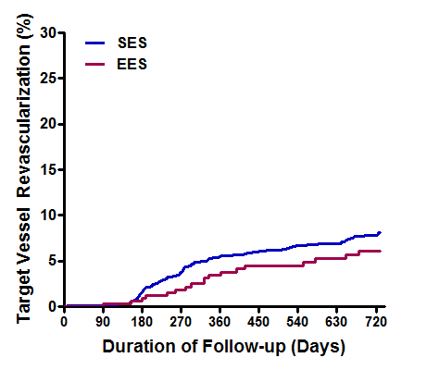
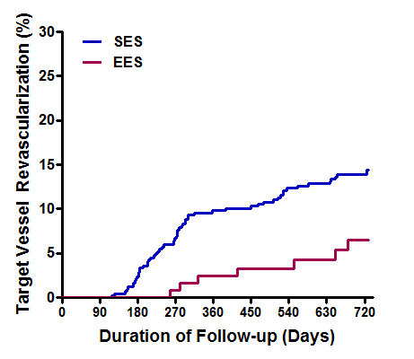
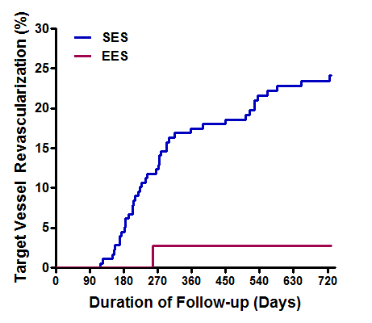
EES vs SES in COBIS II
LM bifurcation
by 2-stent technique
Overall Bifurcation
LM bifurcation
EES vs SES
HR 0.80 [95% CI, 0.51 – 1.27]
P = 0.345
EES vs SES
HR 0.39 [95% CI, 0.18 – 0.86]
P = 0.019
SES
EES vs SES
HR 0.11
[95% CI, 0.02 – 0.79]
P = 0.028
SES
SES
EES
EES
EES
Difference in performance between EES vs SES for bifurcation lesion becomes greater
when lesion becomes more complex
SNU-H (Seoul National University Hospital)
YJ Cho,,, HS Kim. in revision

Slide 26

Sites of TLR : EES vs SES in COBIS II
1-stent technique
2-stent technique
SES (n=248)
SES (n=185)
Left main
EES (n=97)
Left main
EES (n=39)
SES: 3 (1.2%)
EES: 1 (1.0%)
SES: 1 (0.5%)
EES: 0 (0%)
LAD
LAD
SES: 4 (1.6%)
EES: 1 (1.0%)
SES: 12 (6.5%)
EES: 1 (2.6%)
LCx
LCx
SES: 3 (1.2%)
EES: 2 (2.1%)
SES: 23 (12.4%)
EES: 1 (2.6%)
Procedural outcome of SB intervention is important in complex bifurcation intervention.
(LM lesion requiring 2-stent technique)
SNU-H (Seoul National University Hospital)
YJ Cho,,, HS Kim. in revision

Slide 27
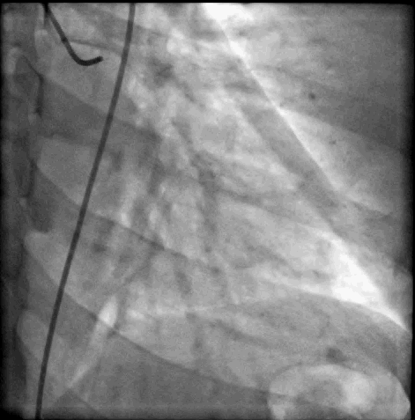
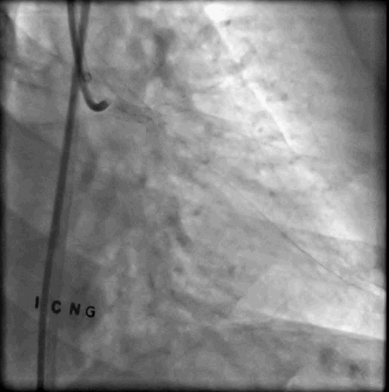
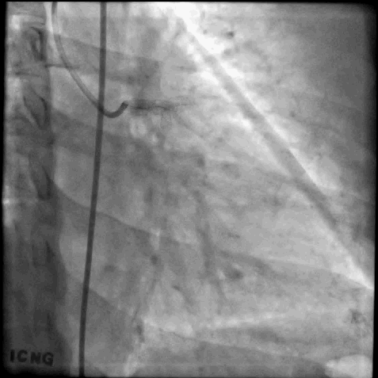
Multi-Stent Technique at LM bifurcation
- New DES -
2011/09/21
Triple Kissing stent with Promus element at LM-LAD/LCX/RI
2013/11/06
Follow-up CAG : patent stent
SNU-H (Seoul National University Hospital)
SNU-Hospital (Seoul National University)

Slide 28

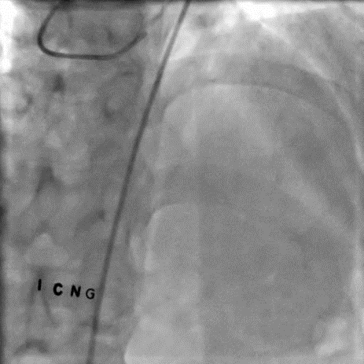
Multi-Stent Technique at LM bifurcation
- New DES -
RAO Caudal
AP Cranial
SNU-H (Seoul National University Hospital)

Slide 29
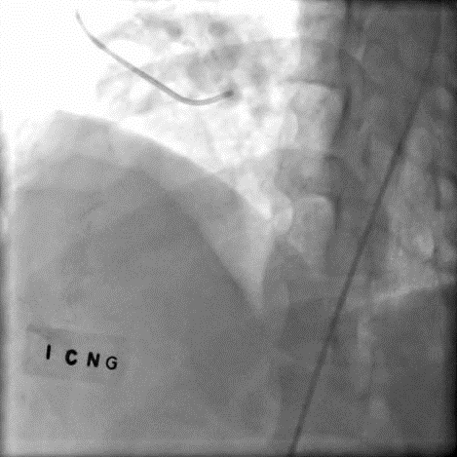
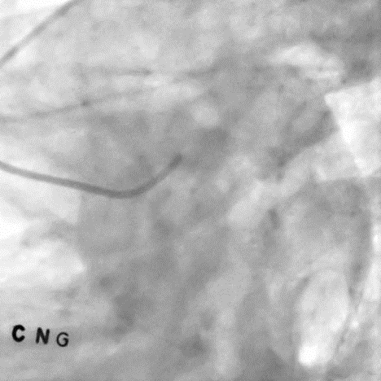
Multi-Stent Technique at LM bifurcation
- New DES -
LAO Cranial
LAO Caudal
SNU-H (Seoul National University Hospital)

Slide 30
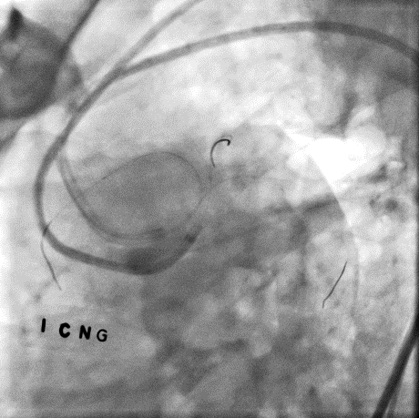
Two guiding catheter engagement to LCA
JL4, 8FR via right femoral artery to LAD & LCX
JL4, 7FR via left femoral artery to R.I.
SNU-H (Seoul National University Hospital)

Slide 31
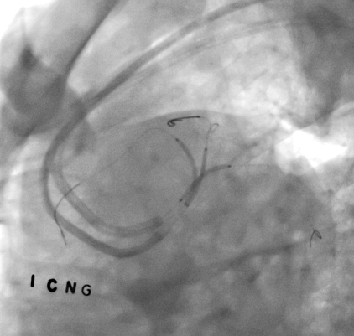
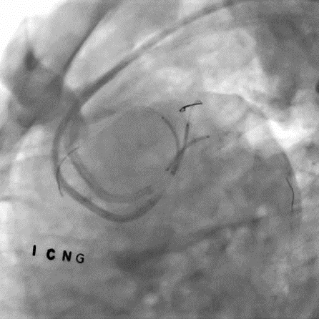
Triple Kissing DES Implantation to Trifurcation
LM-RI: Promus Element: 3.0x20 mm
LM-LAD: Promus Element 3.5x24 mm
LM-LCX:Promus Element 3.5x20 mm
SNU-H (Seoul National University Hospital)

Slide 32
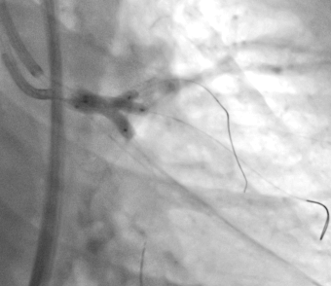
Adjunctive Triple Kissing Ballooning
LM-LAD: MEO-CROSS 3.5x15 mm (3.5 mm)
LM-RI: TREK 3.0x15mm (3.5 mm)
LM-LCX: Sequent 3.5x15mm (3.5 mm)
SNU-H (Seoul National University Hospital)

Slide 33
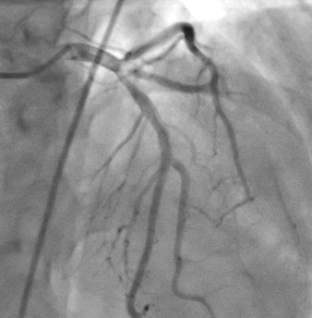
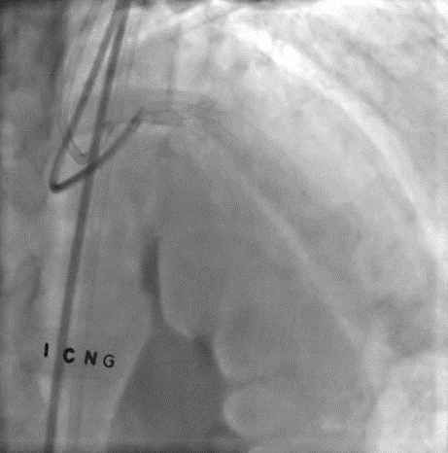
Multi-Stent Technique at LM bifurcation
- New DES -
SNU-H (Seoul National University Hospital)

Slide 34
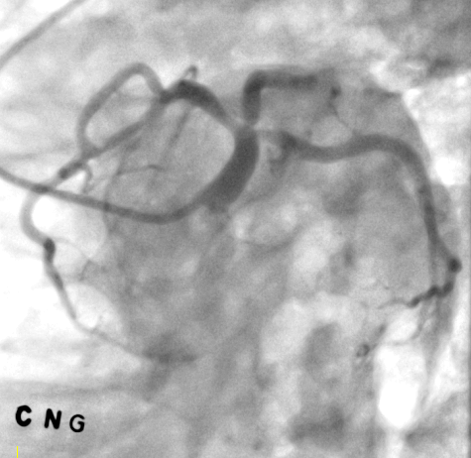
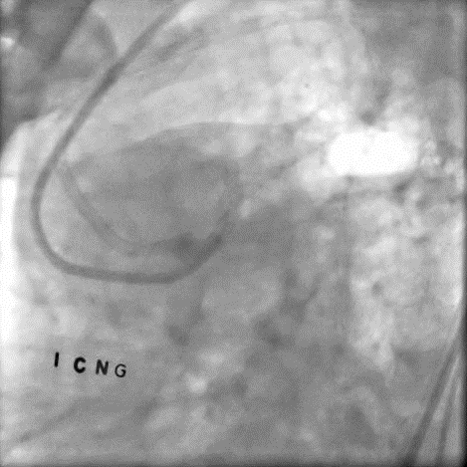
Final Angiography (LAD Caudal)
SNU-H (Seoul National University Hospital)

Slide 35
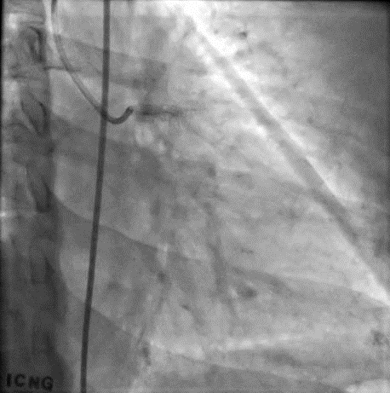
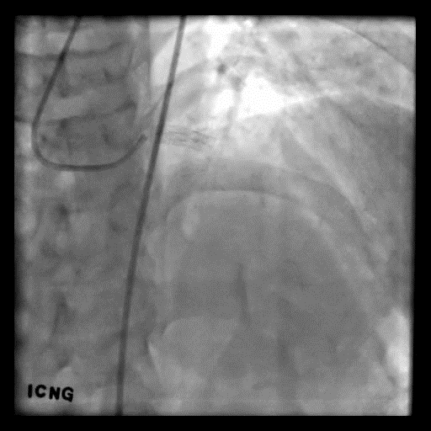
26M Follow-Up CAG
RAO Caudal
AP Cranial
SNU-H (Seoul National University Hospital)

Slide 36
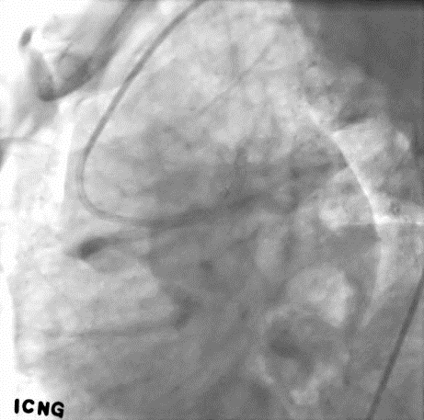
26M Follow-Up CAG
LAO Cranial
LAO Caudal
SNU-H (Seoul National University Hospital)

Slide 37
Conclusions
Bifurcation PCI with new DES
Old DES for bifurcation PCI : limitations on tech & lesion
  Two-stent tech is worse than one-stent
  LM is worse than non-LM bifurcation
New DES for bifurcation PCI : free from limitations
  Two-stent = one-stenting
  LM = non-LM
Superior efficacy and safety of newer generation DES might change the paradigm of bifurcation PCI in terms of technique & lesion.
SNU-H (Seoul National University Hospital)

Slide 38
Paradigm shift on bifurcation treatment by contemporary DES : overcoming limitation on technique & lesion
Hyo-Soo Kim, MD/PhD/FAHA
Cardiovascular Center,
Seoul National University Hospital, Seoul, Korea

Slide 39
Paradigm Shift of
Bifurcation Intervention
Using New Contemporary DES
Hyo-Soo Kim, MD/PhD/FAHA
Cardiovascular Center,
Seoul National University Hospital, Seoul, Korea
.
SNU-H (Seoul National University Hospital)

Slide 40
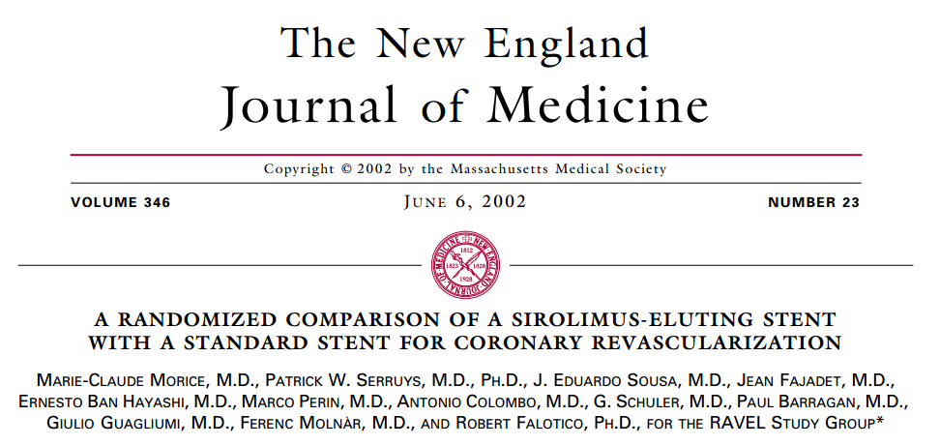
Opening of DES era
SNU-H (Seoul National University Hospital)

Slide 41
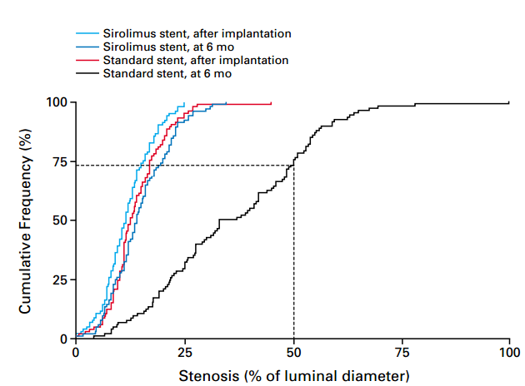
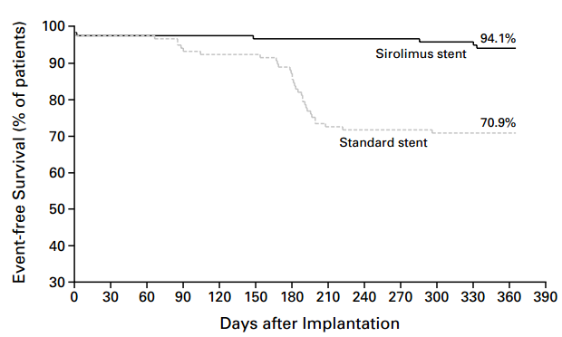
Dramatic Reduction of Restenosis
SNU-H (Seoul National University Hospital)
N Engl J Med, 2002; 346 (23)

Slide 42
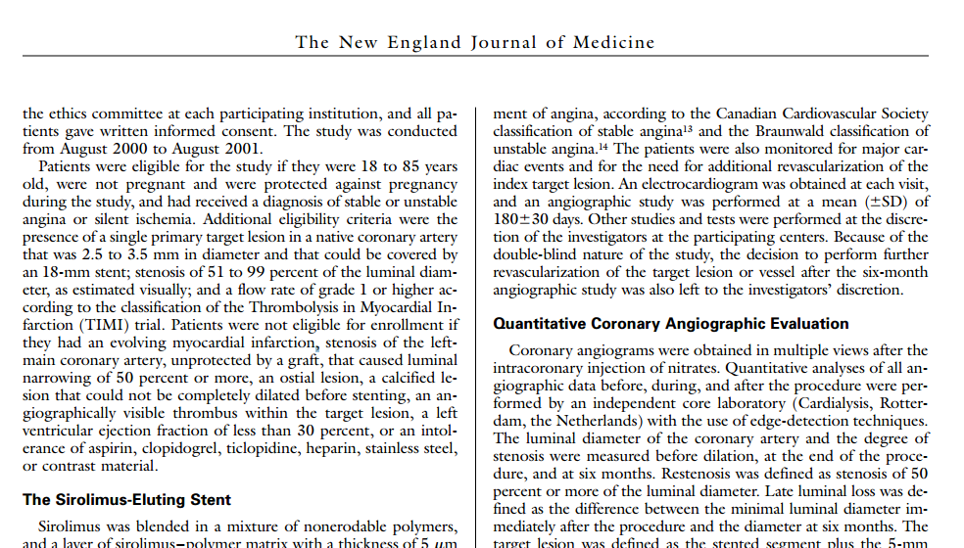
However, bifurcation was still challenging
Bifurcation lesions were excluded
SNU-H (Seoul National University Hospital)

Slide 43
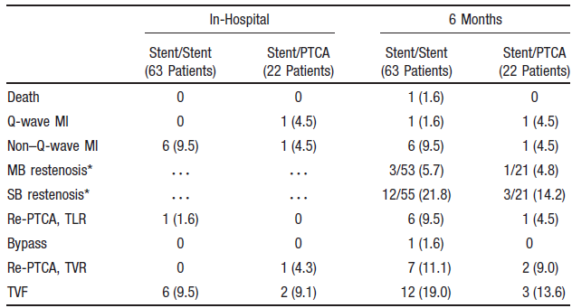
High restenosis rate after bifurcation PCI, even in DES era
RCT for bifurcation PCI
Stent/Stent vs Stent/PTCA (sirolimus-eluting stents)
SNU-H (Seoul National University Hospital)
Circulation. 2004;109:1244-1249

Slide 44
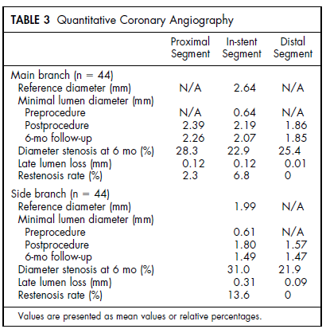
Restenosis Rate after bifurcation PCI in DES Registry
RESEARCH registry (Sirolimus-eluting stents)
Real world bifurcation restenosis
SNU-H (Seoul National University Hospital)
Am J Cardiol 2004;91:115–118

Slide 45
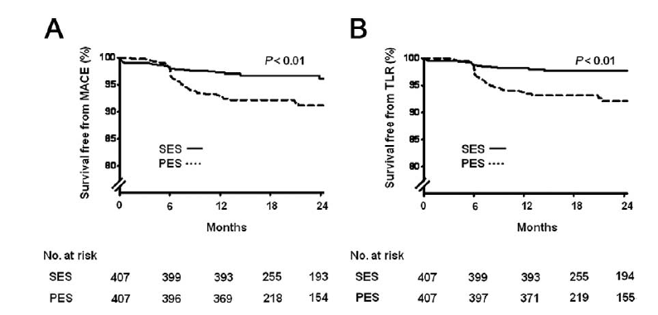
Korean Bifurcation Registry
Korea COBIS (Coronary Bifurcation Stenting) I registry
Comparisons between SES and PES
Propensity-score matched population
MACE
TLR
SNU-H (Seoul National University Hospital)
J Am Coll Cardiol 2010;55:1743–50

Slide 46
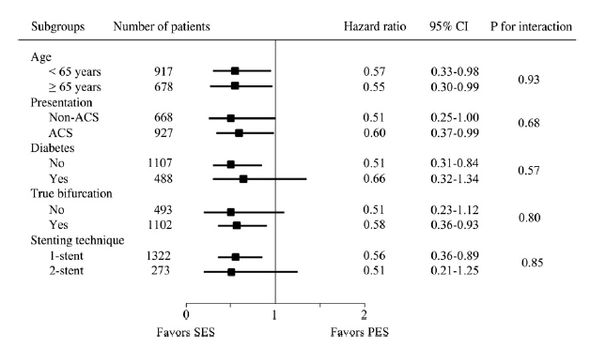
1st generation DES - COBIS subgroup
Between the 2 most popular 1st generation DES, SES was superior to PES for bifurcation intervention
SNU-H (Seoul National University Hospital)
J Am Coll Cardiol 2010;55:1743–50

Slide 47
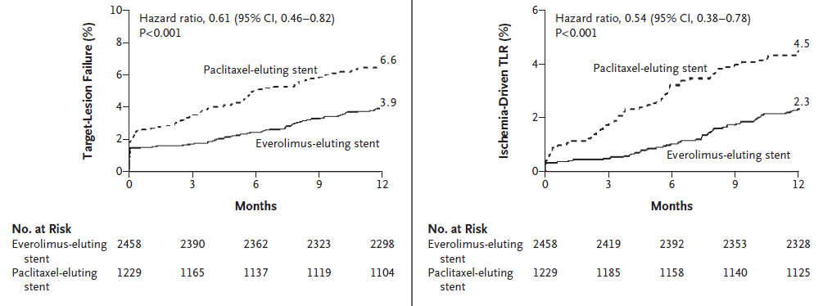
2nd generation DES
SPIRIT IV study
Better outcomes with EES (everolimus-eluting stent) than with PES
Target Lesion Failure
Ischemia-Driven TLR
SNU-H (Seoul National University Hospital)
n engl j med 362;18 may 6, 2010

Slide 48
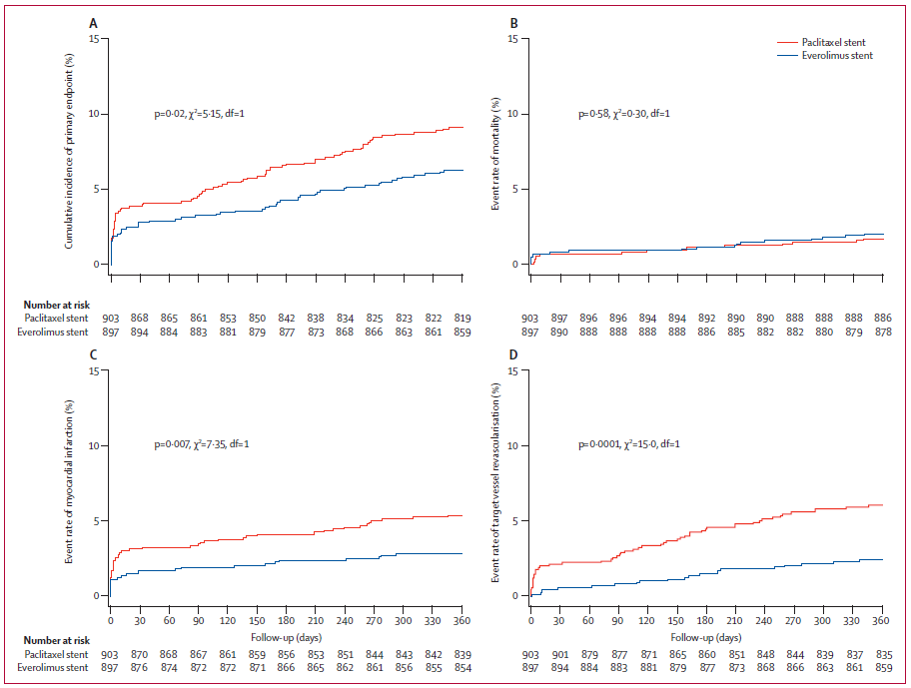
1st vs 2nd generation DES (1)
COMPARE study
  Single center RCT: EES vs PES (n = 1800)
  Better outcome with EES
MACE
TVR
PES
PES
EES
EES
SNU-H (Seoul National University Hospital)
Lancet 2010; 375: 201–09

Slide 49
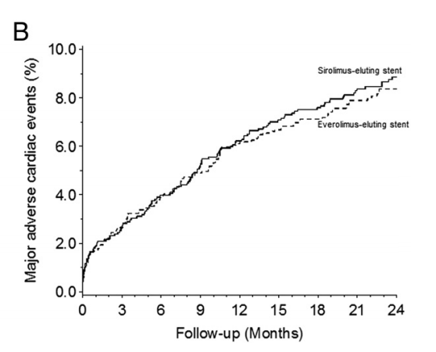

1st vs 2nd generation DES (2)
SORT OUT IV study
  Single center RCT, EES vs SES: non-inferiority study (N = 2,774)
  Bifurcation lesion 12.5% included
MACE
TLR
SES 8.7%
SES 3.5%
EES 8.3%
EES 2.9%
HR 0.94 (0.73-1.22)
HR 0.81 (0.53-1.23)
SNU-H (Seoul National University Hospital)
Jensen et al. JACC 2012.

Slide 50

1st vs 2nd generation DES (3)
EXCELLENT RCT (Efficacy of Xience/Promus Versus Cypher to Reduce Late Loss After Stenting)
  Multicenter RCT, EES vs SES (3:1) (n=1443)
Target Lesion Failure
SNU-H (Seoul National University Hospital)
KW Park et al. JACC 2011.

Slide 51

EES vs SES: meta-analysis
Meta-analysis of 11 RCTs (12,869 patients)
  BASKET-PROVE, ESSENCE-DIABETES, EXCELLENT, ISAR-TEST 4, SORT OUT IV, SEA-SIDE, LONG-DES III, RESET, X-AMI, APPENDIX-AMI
Repeat Revascularization
Favors EES over SES
SNU-H (Seoul National University Hospital)
KW Park et al. Am Heart J 2013.

Slide 52
However, limited data for Complex Lesions
SPIRIT IV RCT
  Bifurcation lesion – less than 10%
  Left main lesion - excluded
COMPARE study
  Bifurcation lesion – 17%
  Left main lesion – 2%
SORT OUT IV study
  Bifurcation lesion – 12.5%
  Left main lesion – 2%
EXCELLENT RCT
  Bifurcation lesion – 10.8%
  Left main lesion - excluded
SNU-H (Seoul National University Hospital)

Slide 53

RCT for bifurcation: EES vs SES
SEA-SIDE study (n = 150)
  Only provisional TAP strategy was used
  LM lesion 17%
Target Bifurcation Failure
SNU-H (Seoul National University Hospital)
Burzotta et al. JACC CV INT 2011

Slide 54

RCT for bifurcation: EES vs SES
SES 145, EES 148 patients – 1 year f/u
  Only provisional SB intervention
  LM lesion - 10%
SNU-H (Seoul National University Hospital)
Pan et al. CCI 2013.

Slide 55

LM bifurcation: EES vs PES
ULMD Florence registry (n = 390)
  EES 166, PES 224 patients
  2-stent PCI: 36%
MACE
SNU-H (Seoul National University Hospital)
Valenti et al. JACC 2012.

Slide 56

LM bifurcation: EES vs SES (vs CABG)
PRECOMBAT-2 study
  Non-randomized study, SES (n=327) vs EES (n=334)
TVR
MACCE
SES
SES
EES
EES
CABG
CABG
SNU-H (Seoul National University Hospital)
Kim YH et al. JACC CV INT 2012.

Slide 57
Summary so far…
Overall, newer EES is better than PES and even SES
For bifurcation or LM lesions,
  EES is not inferior to SES
  EES may be better than PES
  The bottom line is lack of conclusive data
SNU-H (Seoul National University Hospital)

Slide 58



Another consideration
- Stenting Technique
Crush
T-stent
Culotte
SNU-H (Seoul National University Hospital)
Iakovou et al. JACC 2005.

Slide 59


Simple vs Complex Stenting
Nordic Bifurcation Study – RCT (n = 413)
Procedural Outcomes
Clinical Outcomes
MV – main vessel stenting only (simple)
MV+SB – main and side branch PCI (complex)
SNU-H (Seoul National University Hospital)
Circulation. 2006;114:1955-1961.

Slide 60


Simple vs Complex:
British Bifurcation Study
RCT (n=500), 9-months F/U
Mortality+MI+TLF
TLF
SNU-H (Seoul National University Hospital)
Circulation. 2010;121:1235-1243.

Slide 61

RCTs for bifurcation PCI strategy
Systematic 2-stent technique failed to show better outcomes compared to 1-stent technique.
SNU-H (Seoul National University Hospital)
Circulation. 2010;121:1235-1243.

Slide 62


Simple vs Complex
Korean COBIS II registry
Multicenter Korean bifurcation registry
Non-LM = 2,044, LM = 853 patients
Target Lesion Failure
Non LM bifurcation
LM bifurcation
SNU-H (Seoul National University Hospital)
Song et al. JACC CV INT 2014.

Slide 63
Simple is better?
DES used in studies for stent technique
  Nordic Study (RCT) – SES
  British Bifurcation study (RCT) – PES
  COBIS II registry – 77.2% used SES or PES
SNU-H (Seoul National University Hospital)

Slide 64
Unsolved questions..
Would EES and SES be still comparable in complex (bifurcation or LM) coronary lesions?
Would complex stenting technique be better when using contemporary newer DES (EES)?
SNU-H (Seoul National University Hospital)

Slide 65


EES-bifurcation study
Retrostpective, single-center study (N= 319)
MACE
TVR
SNU-H (Seoul National University Hospital)
Kherada et al. IJC 2014.

Slide 66

Two Limitation in Bifurcation PCI with OLD DES
(2) Technique & Lesion – 1-stent vs. 2-stent in LM
GISE-SICI Survey (Multicenter, Retrospective)
MACE : Death, MI, TLR
Systemic 2-stenting results in Worse Outcome in Left Main Bifurcation Lesions
SNU-H (Seoul National University Hospital)
Palmerini et al. Circulation cardiovasc interv. 2008

Slide 67

Two Limitation in Bifurcation PCI with OLD DES
(2) Technique – 1-stent vs. 2-stent in LM
1-Stent Crossover is Better than 2-Stent in
Left Main Bifurcation
SNU-H (Seoul National University Hospital)
Karrowniet al. J InvasiveCardiol. 2014

Slide 68

Two Limitation in Bifurcation PCI with OLD DES
(3) Lesion – LM vs. Non-LM Bifurcation
J-Cypher Registry – 5-YR Follow-up Data
Left Main Bifurcation showed worse clinical outcome than Non-LM bifurcation
SNU-H (Seoul National University Hospital)
Toyofuku et al. JACC cardiovasc interv. 2013

Slide 69



Two Limitation in Bifurcation PCI with OLD DES
(3) Lesion – LM Bifurcation, PCI vs CABG
Multicenter registry in Korea
CABG showed less risk of TVR than PCI in LM Bifurcation
SNU-H (Seoul National University Hospital)
Chang et al. Heart. 2011

Slide 70

Two Limitation in Bifurcation PCI with OLD DES
(3) Lesion – LM Bifurcation, PCI vs CABG
PRECOMBAT Trial (Sirolimus-eluting stent)
Unprotected Left main with
MACCE : Death, MI, TVR, CVA
PCI with 1st generation stent in LM bifurcation showed comparable outcome with CABG at 1-year
SNU-H (Seoul National University Hospital)
SJ Park et al. NEJM. 2011

Slide 71

Emerging, but inconclusive evidences in
New DES era (2)
One vs Two stenting for bifurcation
2-Stenting is better than 1-stenting in 2nd generation DES?
NORDIC-BALTIC Bifurcation IV Trial
1.8%
4.6%
p=0.09
SNU-H (Seoul National University Hospital)
Kumsars et al. presented at TCT 2013

Slide 72

Emerging, but not conclusive evidences in
New DES era (3)
2-Stenting in 2nd generation DES , better than 1st?
EES Bifurcation study (Retrospective)
Target Vessel Revascularization
2-stenting with 2nd generation DES showed superior outcome than 1-stenting
SNU-H (Seoul National University Hospital)
Kherada et al. IJC. 2014

Slide 73



Emerging, but not conclusive evidences in
New DES era (4)
MACE
Cardiac Death
2-stenting with Biomatrix showed worse outcome than 1-stenting
SNU-H (Seoul National University Hospital)
KG Oldroyd et al. TCT 2014

Slide 74

Two Limitation in Bifurcation PCI with OLD DES
(1) Technique – 1-stent vs. 2-stent
Meta-analysis of 42 Studies
with
BMS
&
1st Generation DES
Systemic 2-stenting results in Worse Outcome in Coronary Bifurcation Lesions
SNU-H (Seoul National University Hospital)
Zamani et al. Catheter Cardiovasc Interv. 2011

