Slide 1


Smoking Paradox for Clopidogrel :
: Is It a Myth or Truth?
JCR 2016
Dec 9, 2016
Jung-Won Suh, MD
Department of Internal Medicine
Cardiovascular Center
Seoul National University Bundang Hospital
Seoul National University College of Medicine

Slide 2
Smoking & Platelet reactivity
The effects of smoking on the PK & PD of clopidogrel have been controversial.
The data on the association of smoking and platelet responsiveness to ADP blockers like clopidogrel are inconsistent and controversial with studies variably showing :
  No association
  Positive (higher on-treatment platelet reactivity in smokers)
  Negative (lower on-treatment platelet reactivity in smokers)
Sibbing D, JACC 2016

Slide 3
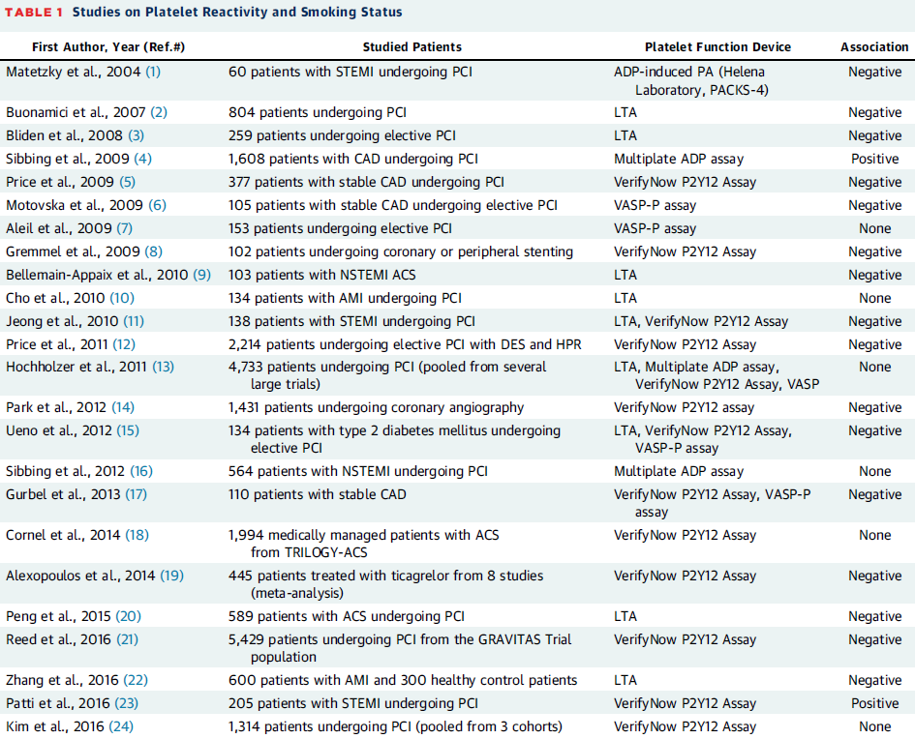

Slide 4
New smoker’s paradox
Regarding the ‘negative association’, this unexpected benefit of an enhanced clopidogrel response was termed as the “new smoker’s paradox”.
A potential mechanism might be related to the induction of CYP1A2 & CYP2B6 activity by smoking, which in turn may accelerate the in vivo bioactivation of clopidogrel.
Numerous confounders between smoking and platelet reactivity may have influenced the results of the previous studies.
Sibbing D, JACC 2016

Slide 5
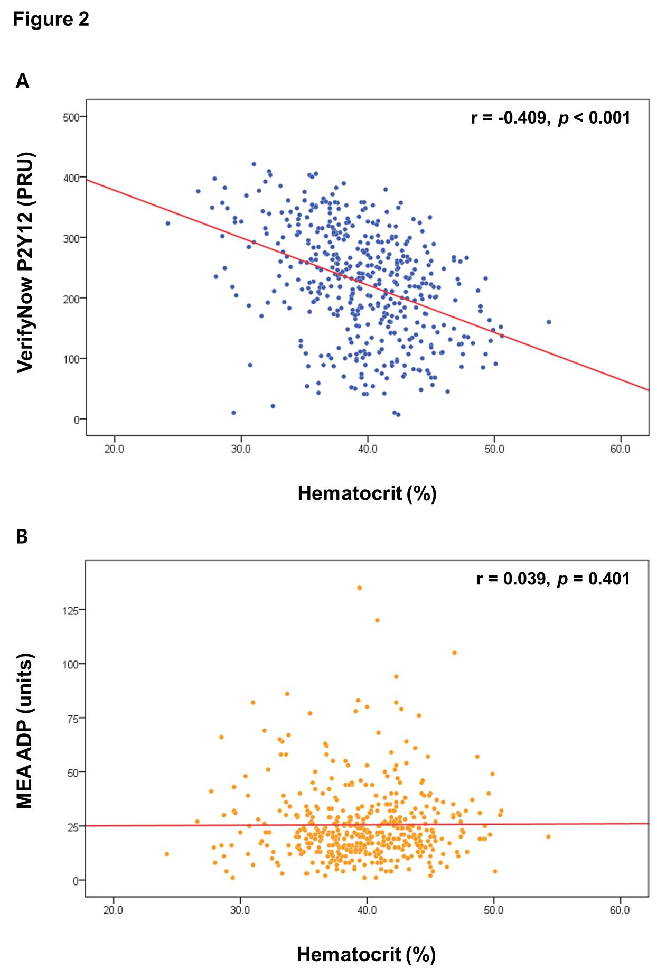
Correlation with hematocrit
: PRU (VerifyNow) vs. MEA-ADP (Multiplate)
r = -0.409, p < 0.001
r = 0.039, p = 0.401
PRU & Hct
MEA ADP & Hct
Kim YG, Suh JW, et al. PLos One 2014

Slide 6
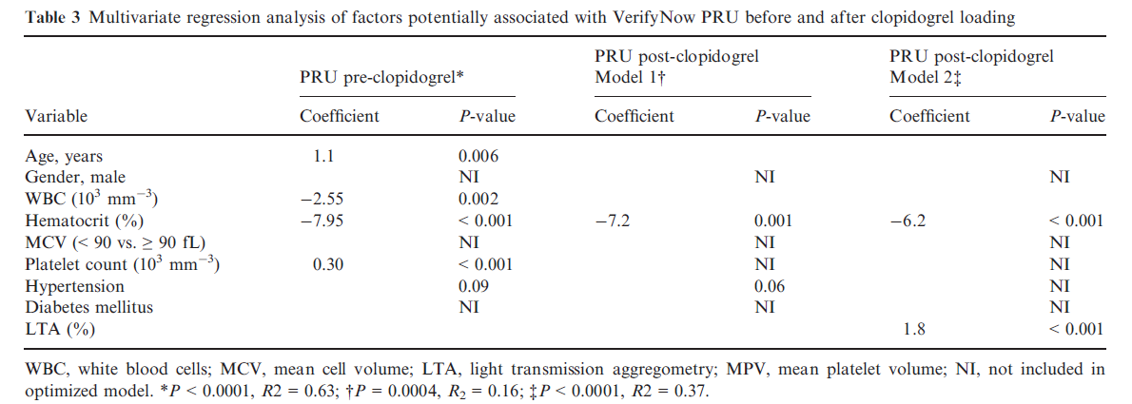
Correlation with hematocrit
: PRU (VerifyNow) vs. peak aggreation% (LTA)
The effect of hematocrit on VerifyNow PRU values is an in vitro phenomenon that is independent of intrinsic change in ADP-induced platelet reactivity and clopidogrel responsiveness.
Kakouros N, et al. JTH 2013;10:1814-22.

Slide 7
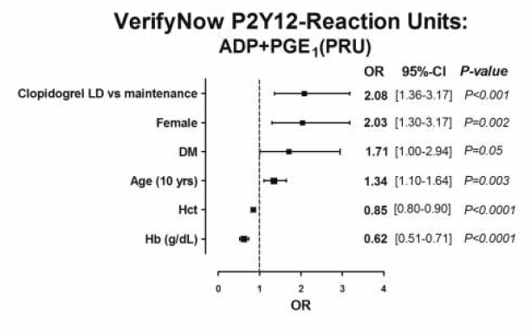
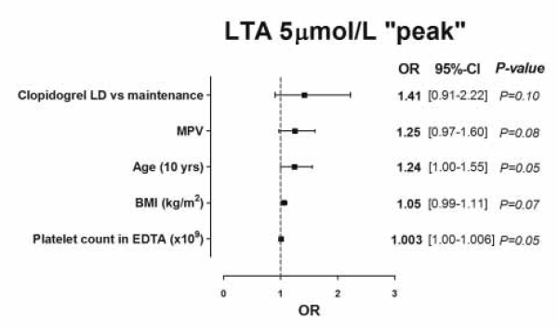
Correlation with hematocrit
: PRU (VerifyNow) vs. peak aggreation% (LTA)
Hematocrit level is not associated with LTA peak aggregation
Elsenberg et al. Thromb Haemost 2009;102: 719–727.

Slide 8
Meta analysis : Hct (Hb)- PRU correlation
379 Studies identified in search
52 from Pubmed (Medline)
323 from Scopus
4 from other sources
50 Excluded (duplicates)
329 Studies after duplication removed
278 Studies excluded due to
Irrelevant topics
Review articles
Aspirin tests
51 Studies retrieved for full article review
42 Studies did not report correlation coefficient
9 Studies included for the meta-analysis
Kim YG, Suh JW, et al., unpublished

Slide 9
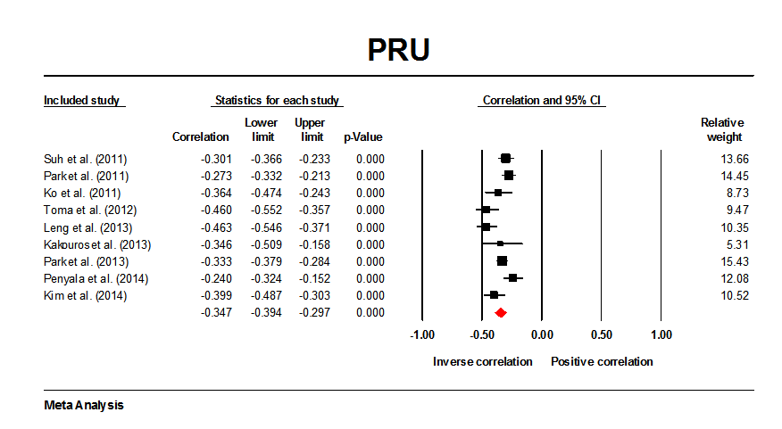
Meta analysis : Correlation b/w Hct (Hb) & PRU
Kim YG, Suh JW, et al., in submission

Slide 10
Smoking and Clopidogrel Response Revisited

Slide 13
Non-smokers (never+former) vs. Current smokers

Slide 14
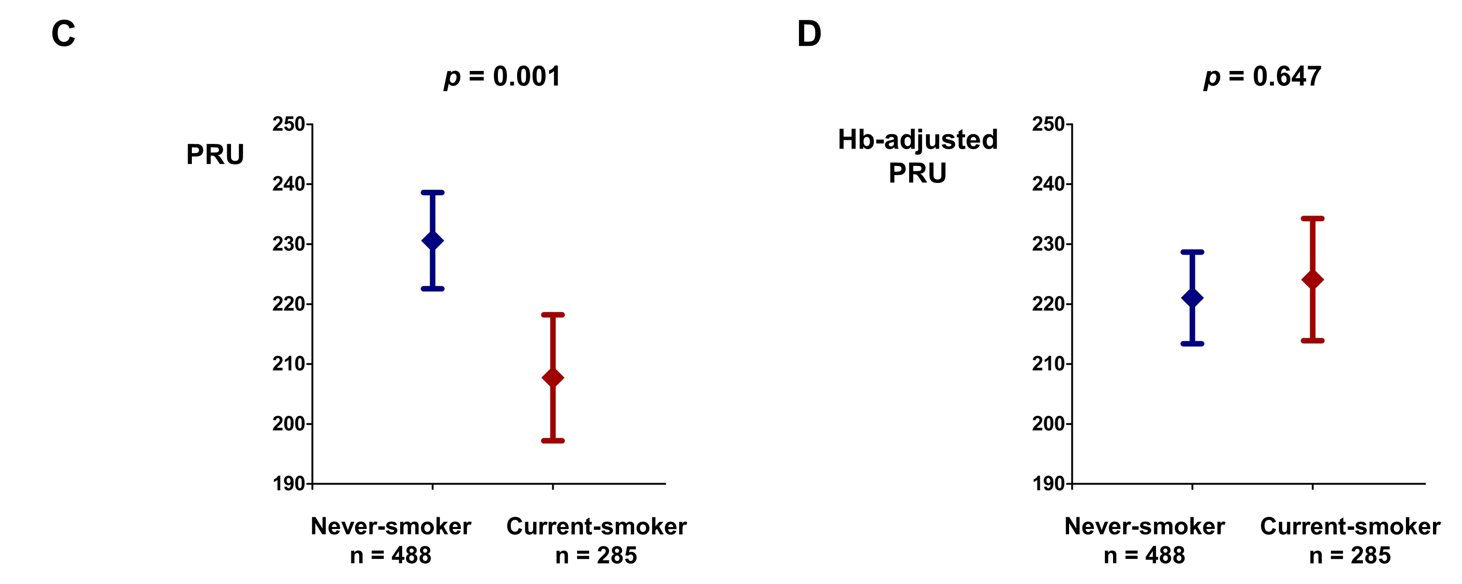
Never-smokers vs. Current smokers

Slide 15
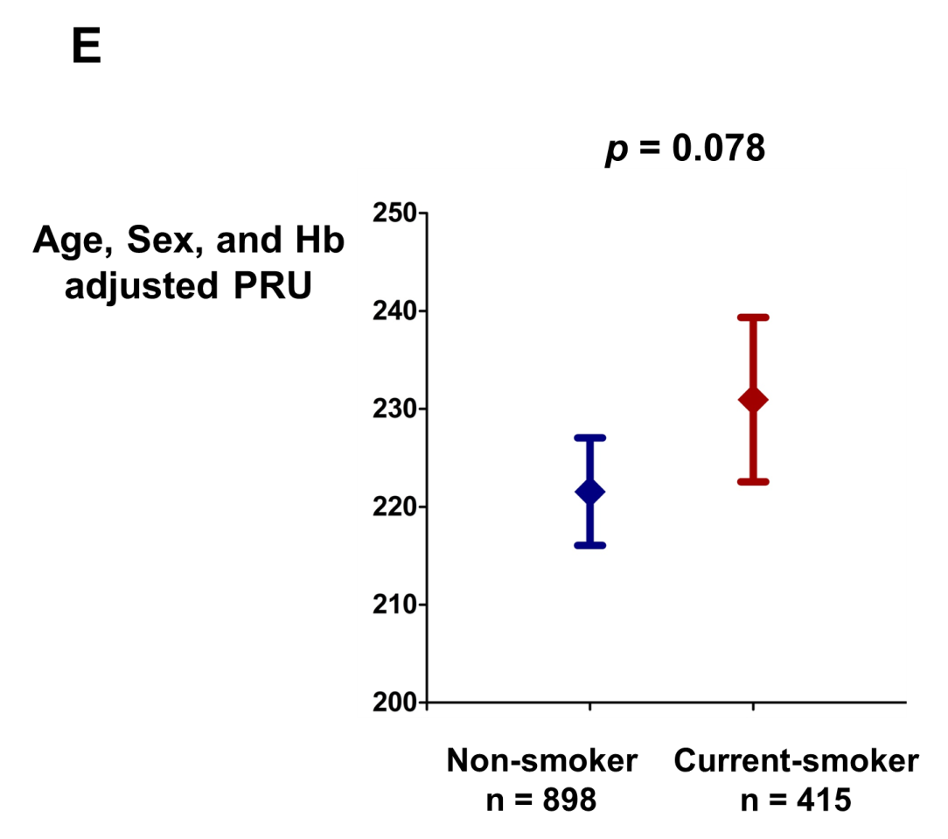
Age, sex, and Hb-adjusted PRU

Slide 16
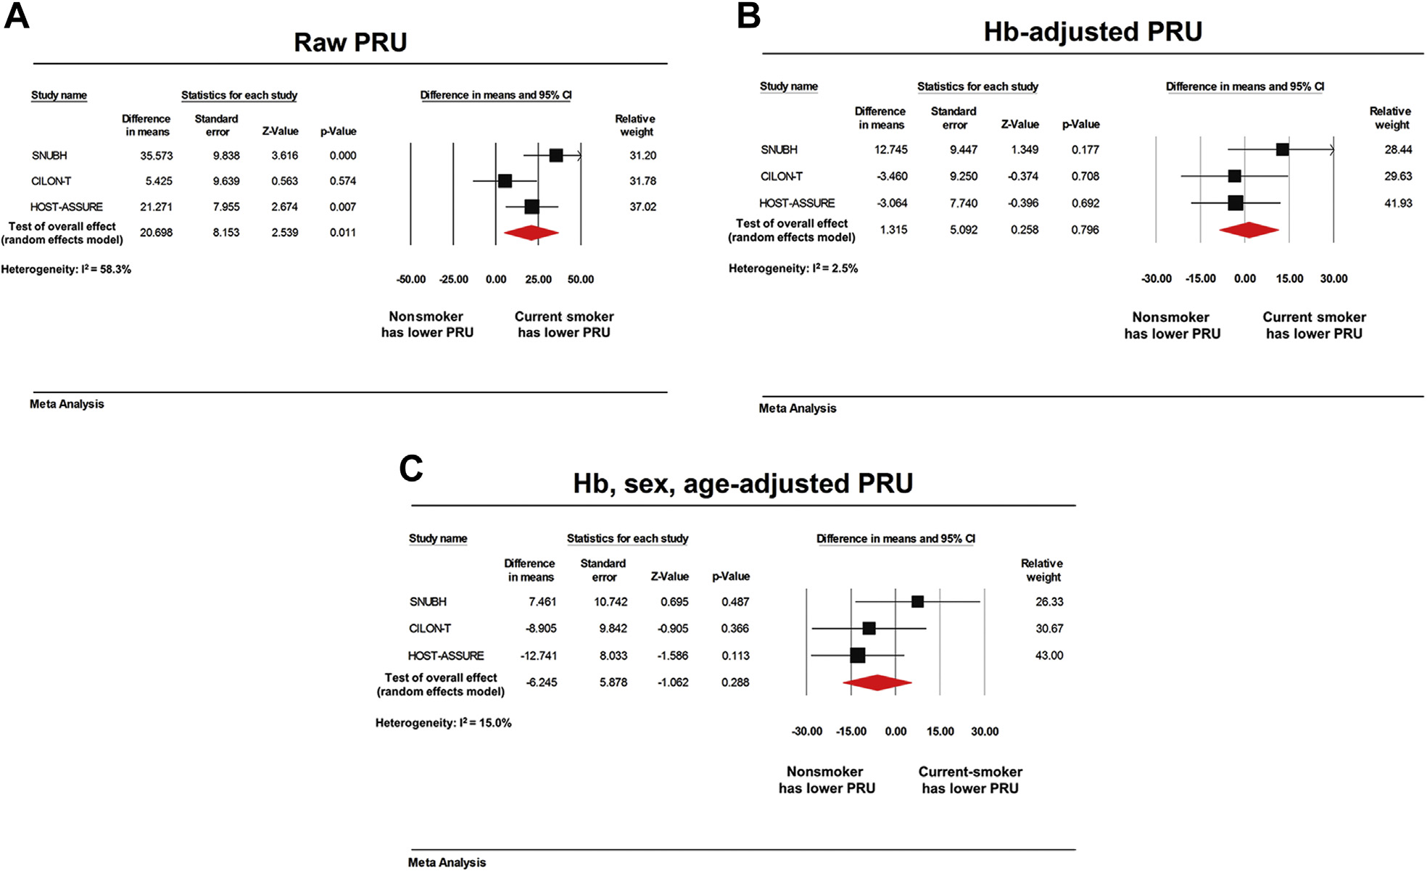
Cohort-level meta analysis

Slide 17
Comparison of MEA ADP Assay Results

Slide 18
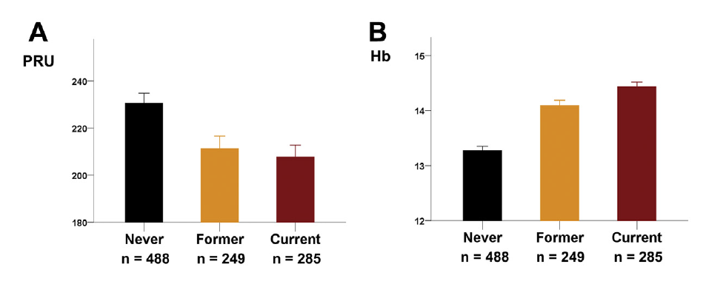
PRU and Hb Levels of Never, Former, and Current Smokers

Slide 19
Regression coefficient between PRU and Hb = -21.4 PRU per 1g/dL Hb
 | Estimated difference in PRU | Observed difference in PRU | Observed difference in Hb
Never vs. Former | 17.54 | 19.27 | -0.82
Never vs. Current | 24.82 | 22.87 | -1.16
Former vs. Current | 7.27 | 3.60 | -0.34
Non-smoker vs. Current | 19.05 | 17.92 | -0.89

Slide 20
Summary
In accordance with previous studies, PRU was significantly lower in current smokers.
There was no difference in PRU between current smokers and non-smokers after adjusting hemoglobin as a covariate.
The impact of adjusting Hb on the predictive value of PRU, such as MACE, should be examined.
The reason for the inverse association b/w PRU and Hb should be elucidated and corrected if possible.

Slide 21
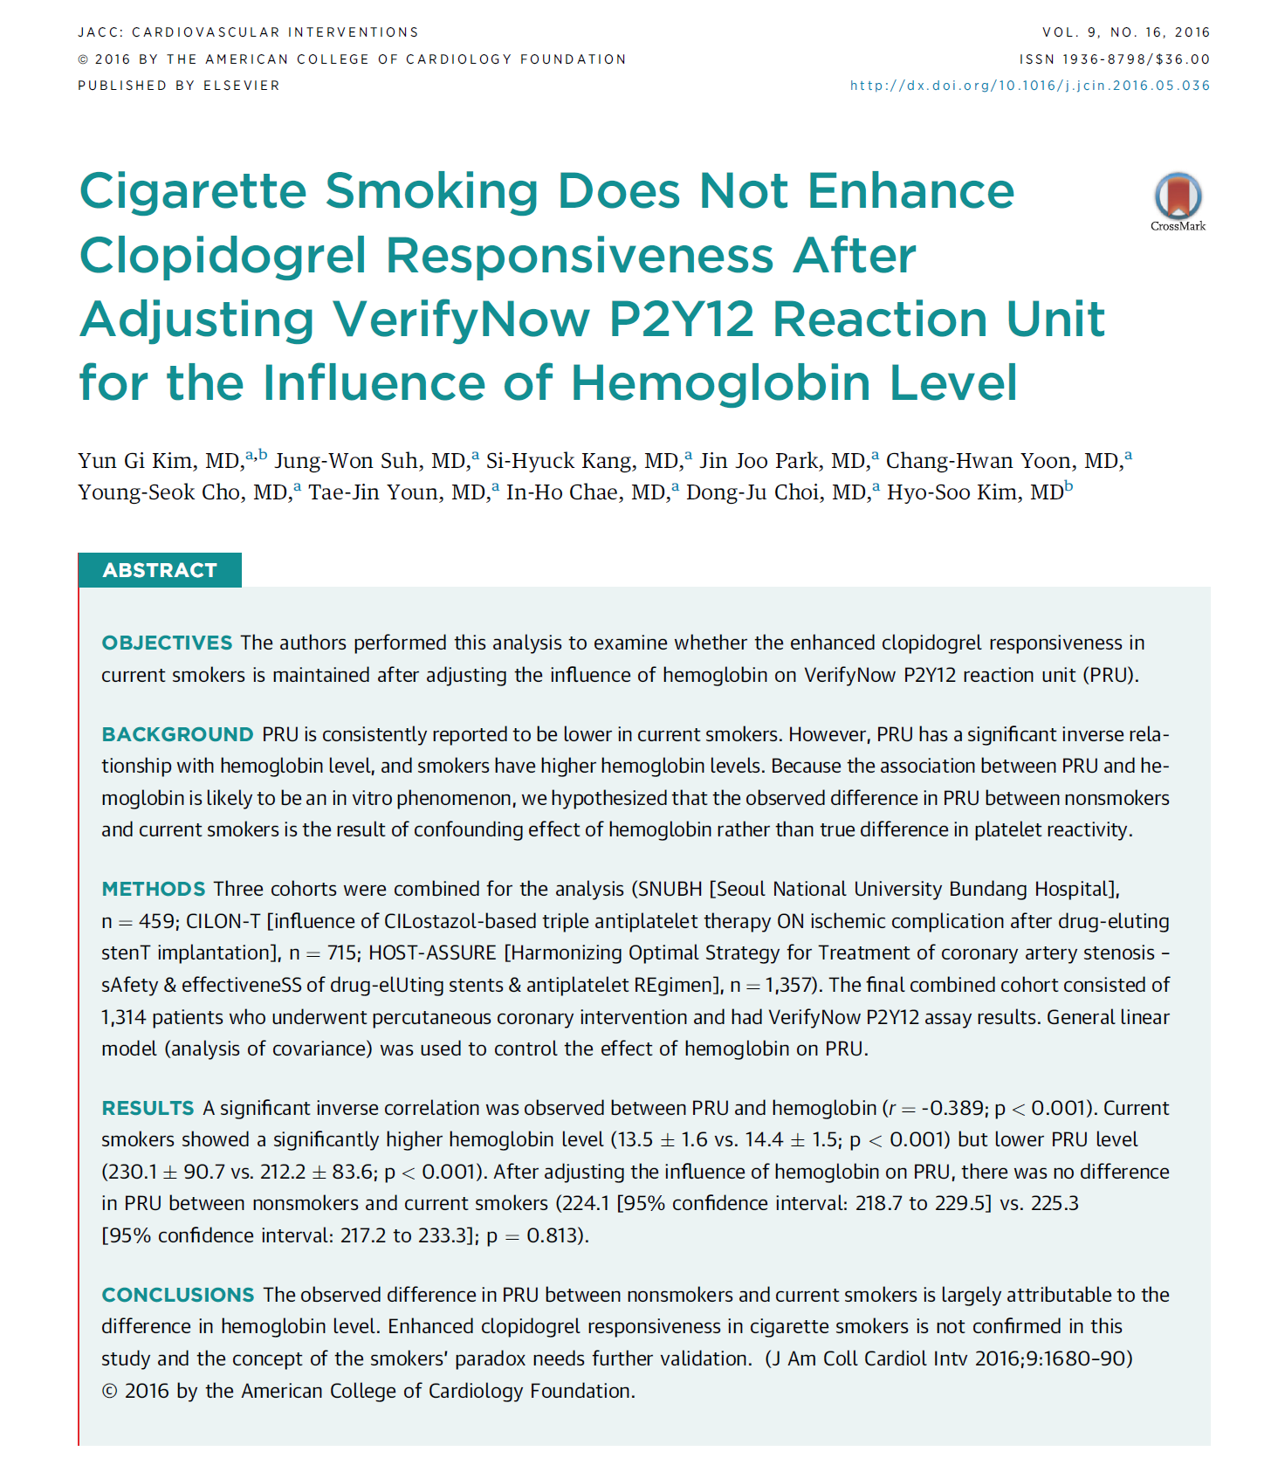

Slide 22
Conclusion
There is and will be a debate about whether cigarette smoking enhances clopidogrel response.
Cigarette smoking is a strong risk factor for thrombosis and is associated with an increased hemoglobin level, which increase the viscosity of blood rendering it more vulnerable to thrombosis.
More evidence is needed to confirm the enhanced clopidogrel response in smokers.
If we consider prothrombotic effect of smoking and many other deleterious effects, cessation of smoking should be our recommendation to patients taking clopidogrel.

Slide 23

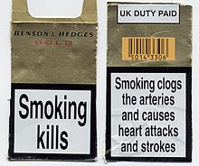

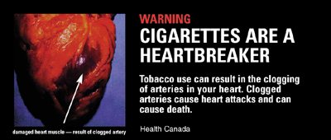
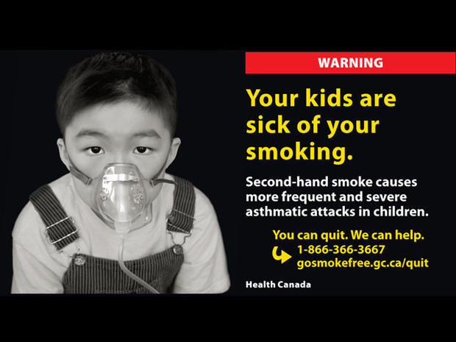



Slide 24
Thank you for your kind attention !!
JCR 2016
Dec 9, 2016
suhjw1@gmail.com

Slide 25
Back-up slides

Slide 26
The PARADOX Study
A prospective, randomized, double-blind, double-dummy, placebo-controlled, crossover study to investigate the influence of smoking status on the PK and PD of clopidogrel and prasugrel.
Gurbel PA, et al, JACC 2013

Slide 27
The PARADOX Study
Device-reported inhibition of platelet aggregation (IPA) trended lower in nonsmokers than smokers.
Device-reported IPA was lower in clopidogrel-treated smokers than prasugrel-treated smokers
VASP phosphorylation and platelet reactivity index were higher in nonsmokers than in smokers (p=0.005, and p=0.042, respectively).
Greater antiplatelet effects were present after prasugrel treatment regardless of smoking status (p<0.001 for all comparisons).
Gurbel PA, et al, JACC 2013

