Slide 1




Should Multivessel Disease in STEMI be
Treated? When, and what is gained?
Department Academic Cardiology
National Institute for Health Research, Leicester Cardiovascular Biomedical Research Unit
Tony Gershlick
Professor Interventional Cardiology
University Hospitals of Leicester UK

Slide 2
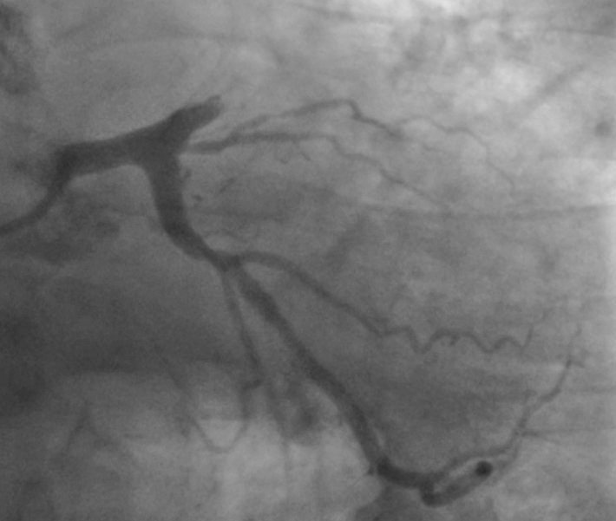
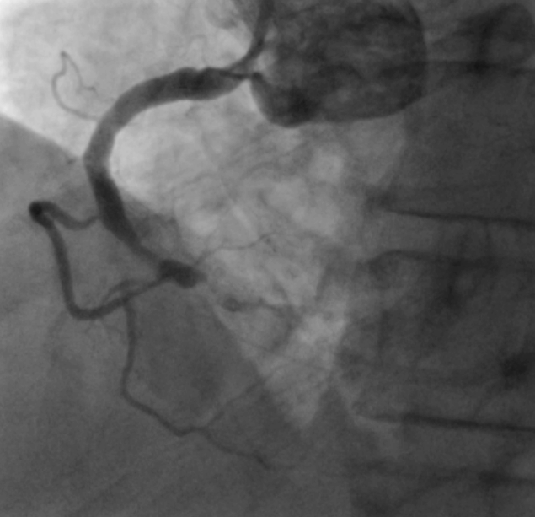

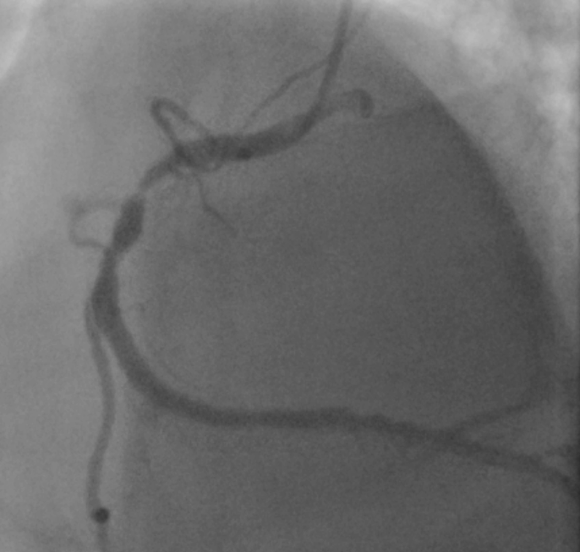
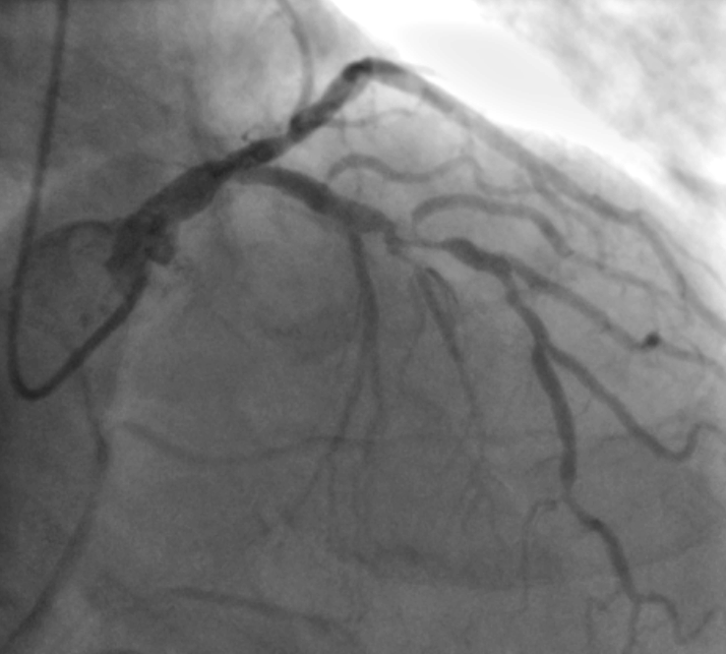
2

Slide 3
What do we know ?
Multi-vessel disease found at time of P-PCI is not uncommon

Slide 4
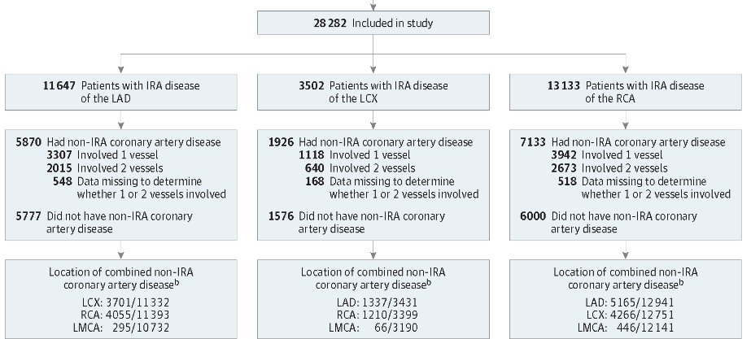
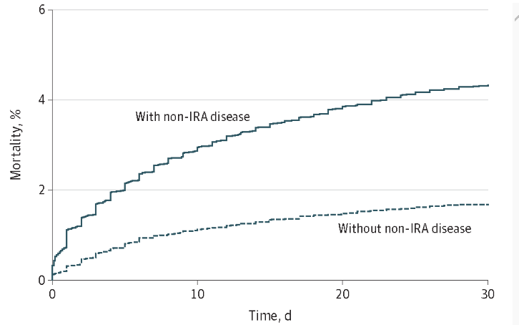
Extent, Location, and Clinical Significance of Non–Infarct-Related Coronary Artery Disease Among Patients With ST-Elevation Myocardial Infarction FREE
Duk-Woo Park,
JAMA. 2014;312(19):2019-2027
IRA -LAD
IRA -Cx
IRA -RCA
% N-IRA
50.3 %
54.9%
54.3%

Slide 5
What do we know ?
Multi-vessel disease found at time of P-PCI is not uncommon
Patients with MVD do worse

Slide 6
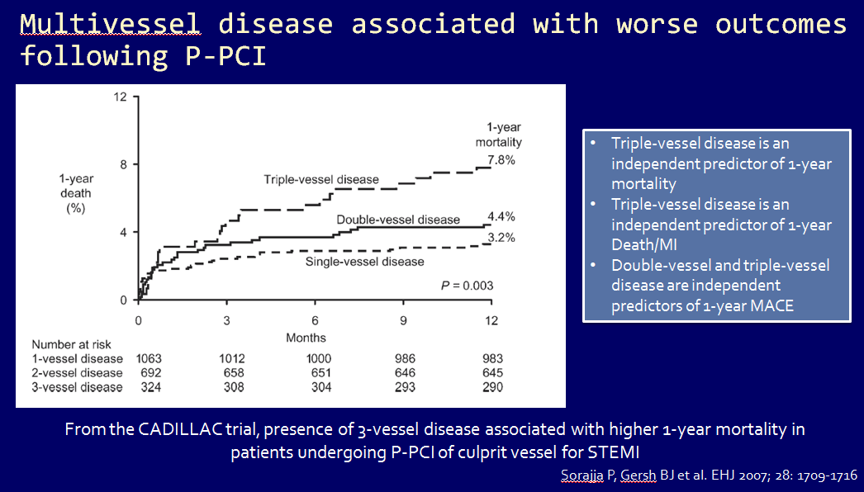

Slide 7
Potential advantages of initial MV-PCI
  Treating the MVD may lead to better outcomes
  Plaque instability may be widespread and events in N-IRA may lead to recurrent ischemia/infarction …… Plaque stabilization
Decrease infarct size by increasing collateral flow
Reduce recurrent MI pan inflammatory paradigm
Reduce recurrent ischaemia

Slide 8
Potential disadvantages of initial MV-PCI
“Unstable” Situation
Increase Infarct Size
Highly Pro-thrombotic & Inflammatory Milieu – Additional Risk
Risk Of Double Jeopardy If Complication From N-IRA PCI
Coronary Spasm – Overestimation Of Stenosis Severity In N-IRA
Increased Contrast Volumes (risk of CIN) / Radiation Exposure
Limited Ability To Discuss Options
Increase Cost No Benefit Clinical
Why do the lesion ? It isn’t the reason the patient is on the table !

Slide 9
At present guidelines recommend
treating N-IRA lesion only
Based on non randomised data (registries, meta-analyses)

Slide 10
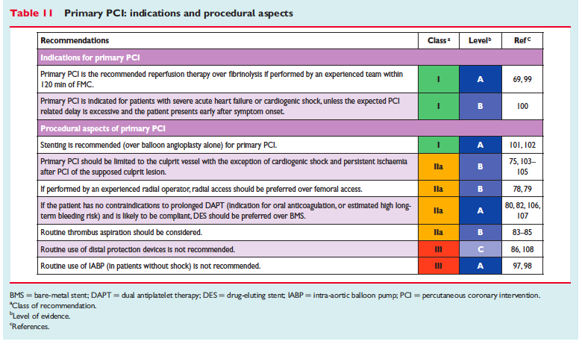

ESC STEMI Guidelines

Slide 11
Problems with Registry data
Several are small and single-centre.
Many are historical and do not reflect contemporary PCI practice or optimum medical therapy
Confounding factors – were patients undergoing MV-PCI older & sicker? Some studies excluded shock while others didn’t
Differences in treatment strategies & outcomes assessed
CASE SELECTION

Slide 12
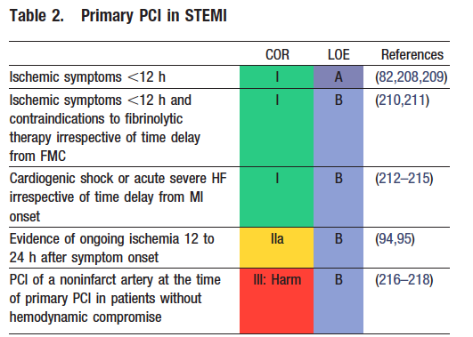

ACC/AHA STEMI Guidelines

Slide 13
Recent RCTs
(PRAMI, CvLPRIT and DANAMI-3-PRIMULTI) have changed thinking,
demonstrating decreased MACE rate with complete rather than culprit-only re-vasularisation

Slide 14
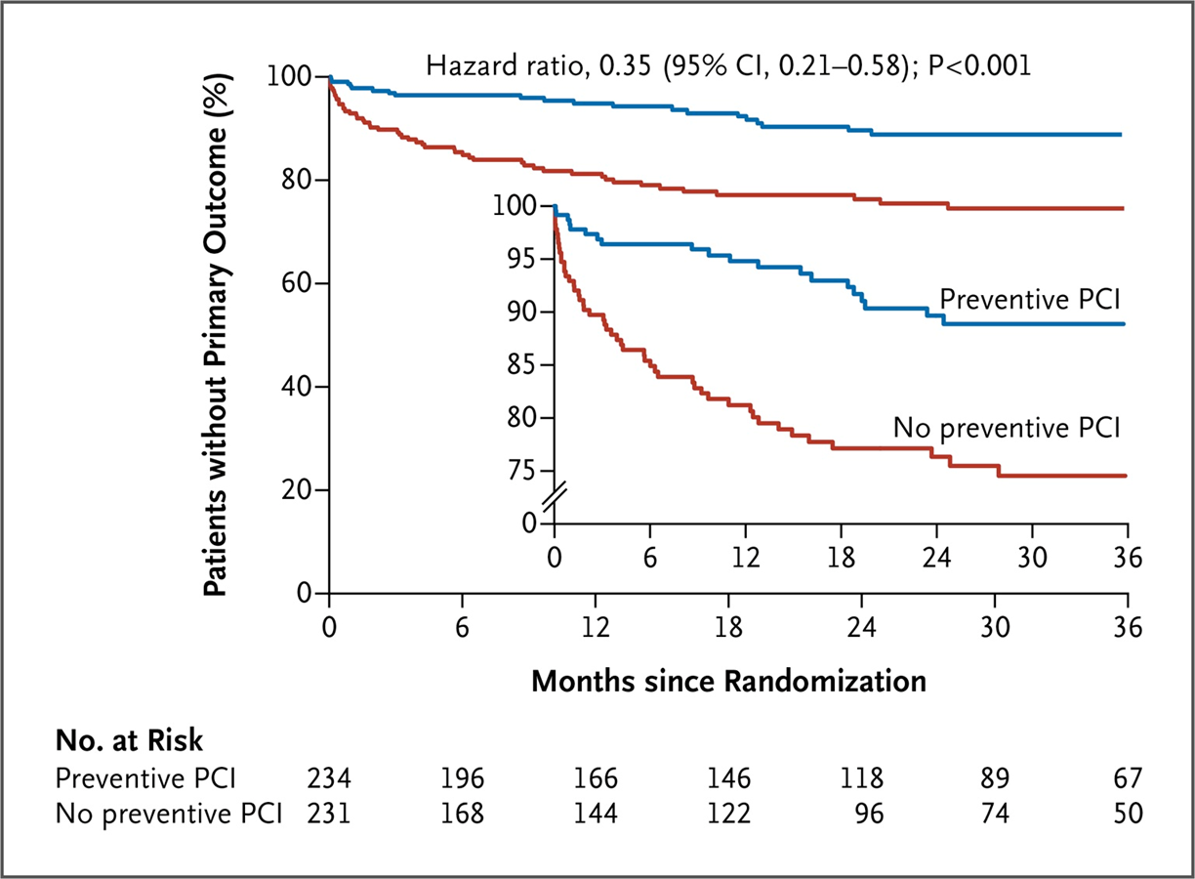
PRAMI
During Index procedure
Odd end points
Stopped early
Freedom from Death from Cardiac causes, non fatal MI, or refractory angina
Wald DS et al. N Engl J Med 2013;369:1115-1123

Slide 15
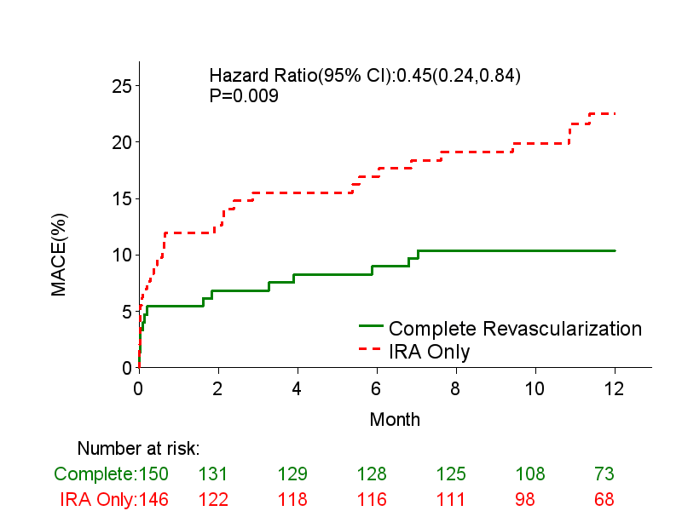
CvLPRIT
During INDEX ADMISSION
Small trial
MACE incl Revasc
(open trial)
CvLPRIT CMR
CvLPRIT Nuclear
- Not ischaemia driven
MACE at 12 months

Slide 16
ACC/AHA STEMI Guidelines
Changed after CvLPRIT/PRAMI

Slide 17
What do we know ?
What do we NOT know ?
Multi-vessel disease found at time of P-PCI is not uncommon
Is there an impact on hard end points death/ re AMI ?
How do we choose the lesion Angio/FFR/VH/OCT
Patients with MVD do worse
Should it be done as IP/ planned re-admission
Registry data biased
Are all patients/lesions at same risk ? (risk score)
RT data suggestive benefit

Slide 18
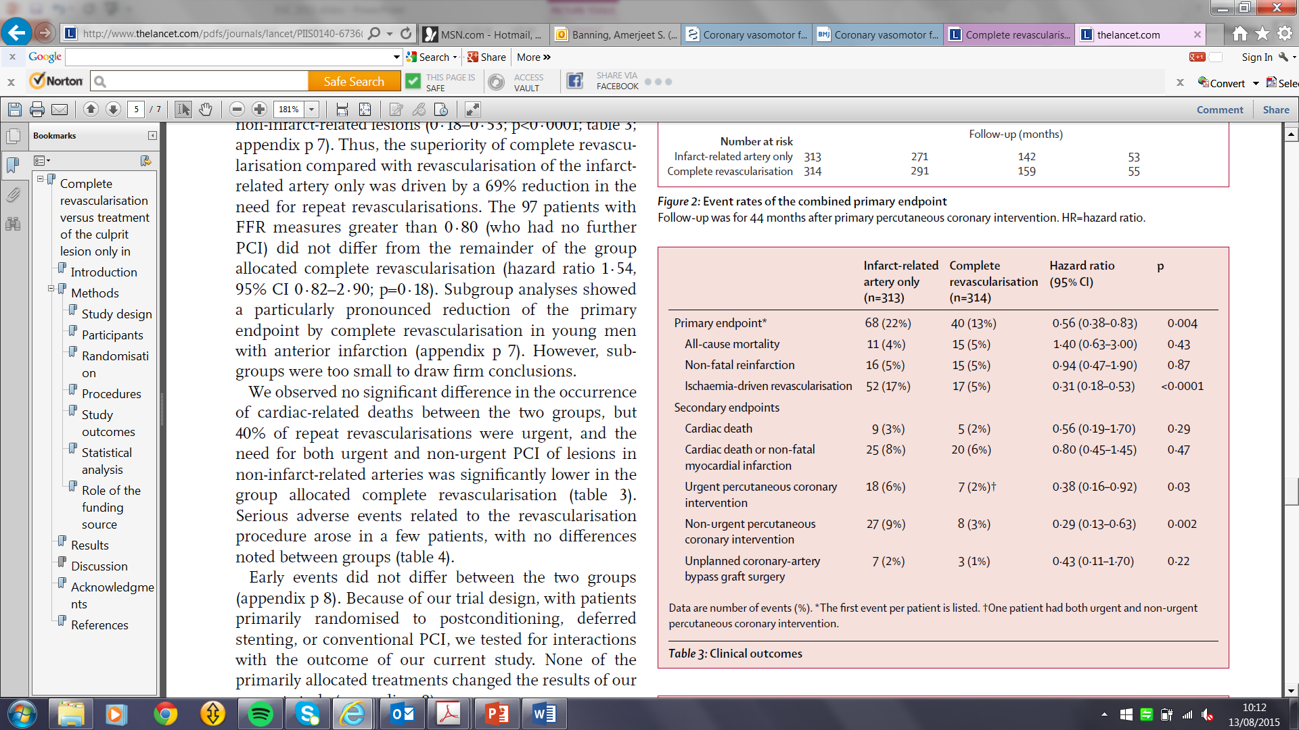
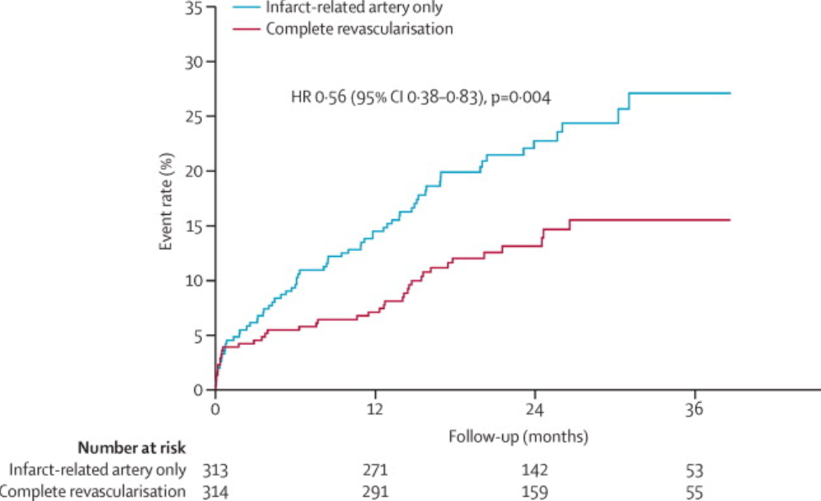
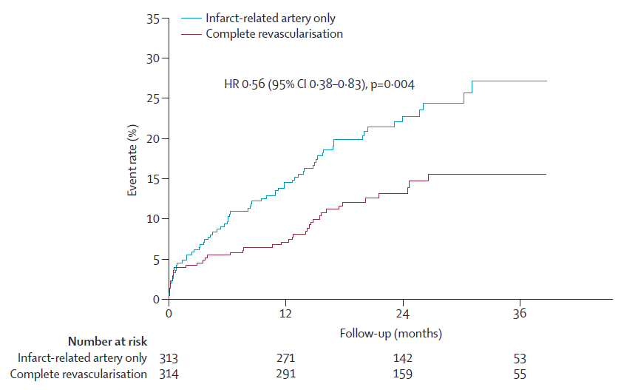
DANAMI-3-PRIMULTI

Slide 19


NEED APPROPRIATE POWER TO DEMONSTRATE EFFECT ON HARD END POINTS
DEATH / AMI/ RE ADMISSION WITH HEART FAILURE
TRIALS IN PROGRESS
COMPLETE Trial
N= 3900
COMPARE-ACUTE
N- 885
N=4000

Slide 20
What do we know ?
What do we NOT know ?
Multi-vessel disease found at time of P-PCI is not uncommon
RT data suggestive benefit
Is there an impact on hard end points death/ re AMI ?
How do we choose the lesion ? Angio/FFR/VH/OCT
Patients with MVD do worse
Should it be done as IP/ planned re-admission
Registry data biased
Are all patients/lesions at same risk ? (risk score)

Slide 21
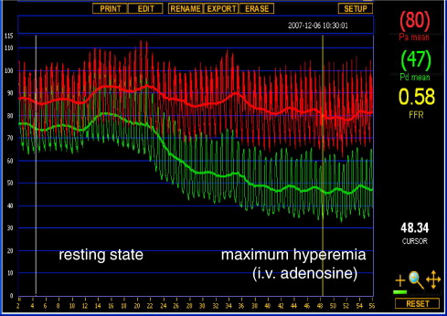
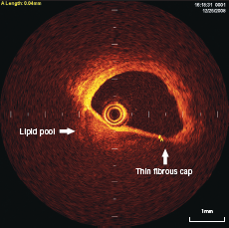
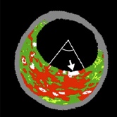
How can we decide which N-IRA lesion needs treatment?
Coronary Angiography
“by eye”
Fractional Flow Reserve
“Haemodynamic significance”
Intracoronary Imaging
“Plaque Composition”

Slide 22
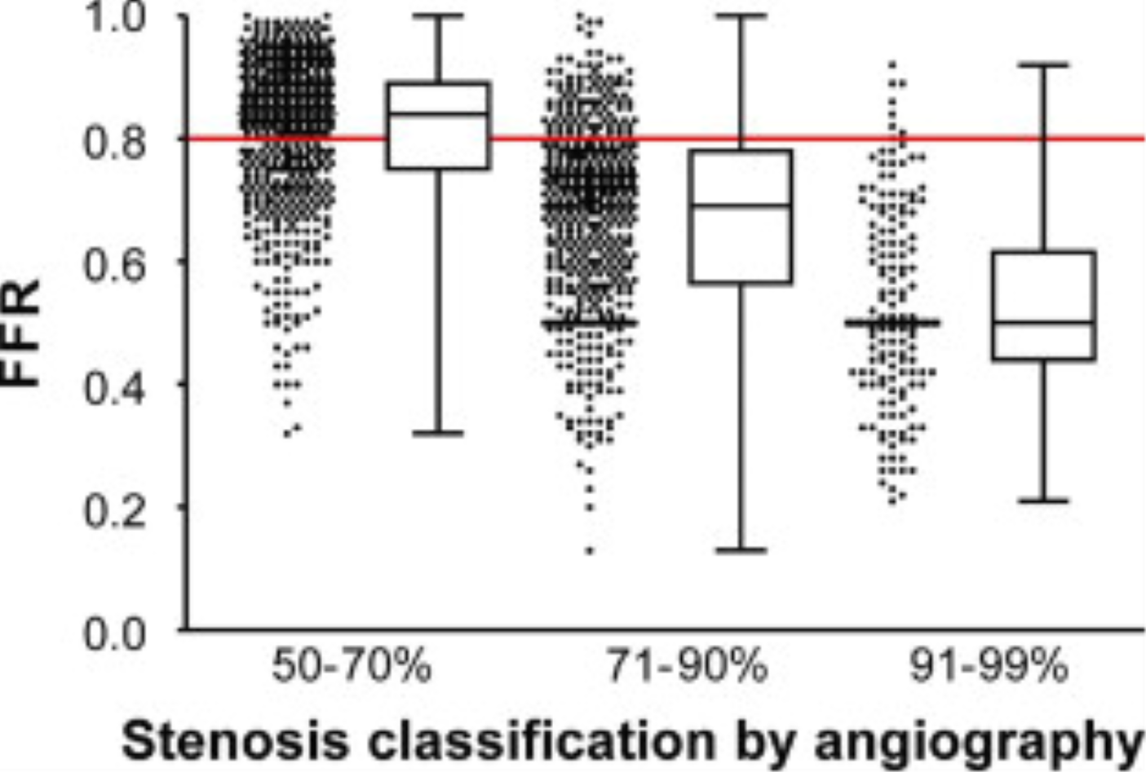
Comparison of angiographic and haemodynamic significance of coronary stenosis from the FAME study
FAME -2 trial
 | FFR<0.80 | FFR >0.80
50 -7 0% | 65% | 35%
71 – 90% | 80% | 20%
90 – 95% | 96% | 4%
Tonino P JACC 2010; 55: 2816-2821

Slide 23
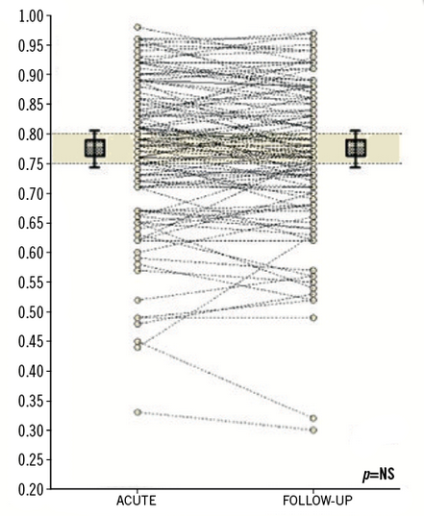
Stability of FFR assessment of N-IRA lesions in STEMI with MVD
Is FFR VALID IN ACS (in N-IRA) ?
112 non-culprit lesions assessed acutely and 35 +/- 24 days after ACS
Ntaliansis et al. JACC Interv 2010; 3: 1274

Slide 24
What do we know ?
What do we NOT know ?
Multi-vessel disease found at time of P-PCI is not uncommon
RT data suggestive benefit
Is there an impact on hard end points death/ re AMI ?
How do we choose the lesion ? Angio/FFR/VH/OCT
Patients with MVD do worse
Should it be done as IP/ planned re-admission
Registry data biased
Are all patients/lesions at same risk ? (risk score)

Slide 25
COMPLETE Trial
N= 3900
On going trials
COMPARE-ACUTE
N- 885
≥ 70% stenosis or
≥ 50% with FFR < 0.80
≥ 50%
Questions
Impact on hard end points
When –
Hospital Admission
Re-Admission
How select eye /FFR
RANDOMIZED
Within 72 h of index Primary PCI
R
2
1
FFR Guided during index
admission
R
Optimal Medical Therapy Alone
Staged PCI of all suitable
non-culprit lesions
Optimal Medical Therapy Alone
composite of all-cause mortality, non-fatal MI, any revascularisation or stroke
12 month
Primary Outcome:
CV Death / MI
Only staged
Not FFR guided
Post lytic
Can excl lesion if decide needs doing
Only in-patient CR, no staged group
Not powered for hard endpoints
FFR used as adjunct for decision making not formally compared.

Slide 26

FLOWER- MI
N= 1170
N=4000
ANGIO assessment
One or more non-culprit lesions (non-culprit vessels at least 2.5mm) on angiography (50-99%)
STEMI patients with successful culprit lesion PCI (primary, rescue or pharmaco-invasive) + ≥ 50% stenosis in at least one additional non-culprit lesion
R
R
Index admission
FFR-guided PCI
to non-culprit lesions*
Angio-guided PCI
(during the index hospital admission†)
FFR-guided PCI
(during the index hospital admission †)
Optimal Medical Therapy Alone
Primary outcome:
Death or non-fatal MI or any repeat revascularization
at 12 months
Primary outcome:
all-cause death and non fatal MI 1 year
Only In patient
FFR randomised
No OMT
Repeat revasc
Only In patient
FFR guided

Slide 27
What do we know ?
What do we NOT know ?
Multi-vessel disease found at time of P-PCI is not uncommon
RT data suggestive benefit
Is there an impact on hard end points death/ re AMI ?
How do we choose the lesion ? Angio/FFR/VH/OCT
Patients with MVD do worse
Should it be done as IP/ planned re-admission
Registry data biased
Are all patients/lesions at same risk ? (risk score)

Slide 28
Impact of angiographic complexity of N-IRA stenosis in MVD with STEMI on long-term outcomes
High N-IRA SYNTAX score related to higher all-cause death, CV-death and MACE (composite of CV death, re-infarction (fatal or non-fatal MI), target vessel revascularization for ischemia, or stroke
Su MI et al. PLOS one 2014; 9(10): e109828. doi:10.1371/journal.pone.0109828

Slide 29
Impact of site of infarct on outcomes in MVD and STEMI
Plus clinical factors
Age
Sex
DM
Etc
Engstrom T et al. Lancet 2015; 386: 665-671

Slide 30
Trend towards
Complete Re-vascularisation in patient presenting with PCI for STEMI
But
Many Qs still to answer -
  Is there impact on hard end points (death, MI, Sig Heart Failure)
  Do as an in- patient or bring back
  How do we choose the lesion to treat (eye / FFR / OCT)
  Do all patients benefit (risk weighted outcomes)

Slide 31
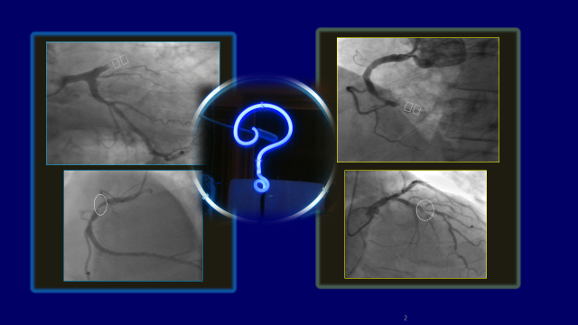
What do I do ?
Absolutely consider if ECG, symptoms, haemodynamics don’t settle
If it is angiographically tight (>95%)
Do it there and then or during hospital admission
Low threshold for FFR

Slide 34
Prime-time N=2500
50-99 % stenosis in one or more N-IRA BY EYE
R
Group A: In-patient Complete
Group B: Staged Complete
Group C: Conservative management
IP FFR
IP FFR
> 0.8
< 0.8
< 0.8
> 0.8
PCI of N-IRA lesions during index admission
Re-admitted 6-8 weeks
PCI of N-IRA lesions
Registry
Registry
Follow-up.
PCI of N-IRA lesions only if continuing symptoms and objective evidence of ischaemia (stress echo/MPS/CMR)

Slide 35
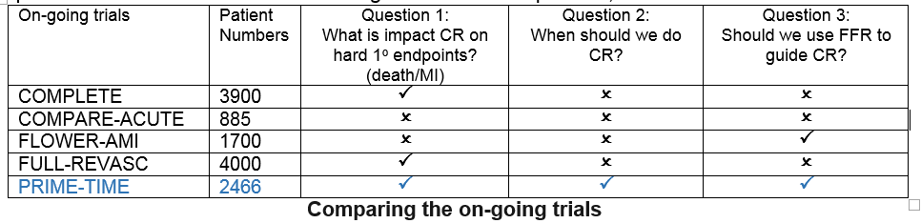

Slide 36
PRIMULTI: FFR guided complete revascularisation.
97 patients (1/3 rd) in CR group had FFR measurement >0.80, with no further PCI to N-IRA lesions
Comparison with remainder of group allocated to CR showed no difference in primary endpoint (HR=1∙54, 95% CI 0∙82–2∙90; p=0∙18 ).
BUT these patients were included as an ITT so diluting the risk in the CR arm
No comparison made between FFR+/CR patients and culprit-only patients.
FFR performed 2 days after primary PCI index procedure.
Difference in primary endpoint driven by reduced need for emergent and non-emergent revascularisation in the CR group.
Engstrom T et al, Lancet 2015; 386: 665–71

Slide 37
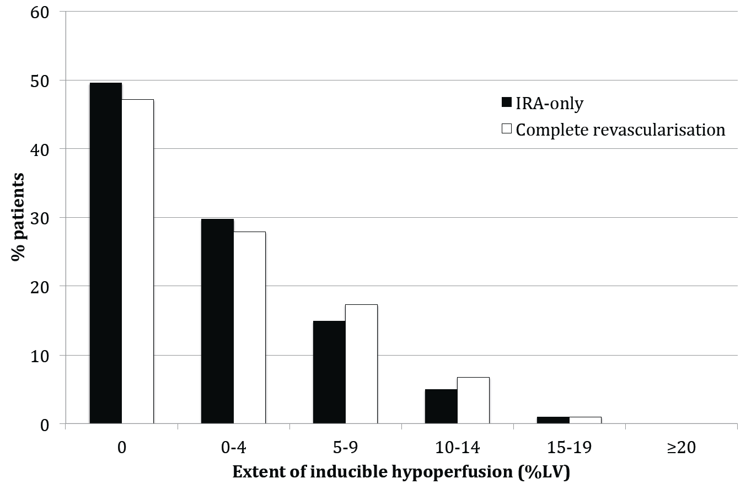
CvLPRIT nuclear sub-study: ischaemic burden
ischaemic burden of >15% was seen in only 1.5% both culprit-only and complete p=0.70

Slide 39
Baseline characteristics
214 patients (106 staged MV-PCI, 108 conservative after pPCI) enrolled in six
centers from 2009 till 2013 Follow-up 38 months (median)
No significant differences between baseline characteristics of both groups
Low risk patients
Ejection fraction at discharge (%) | 48.7±8.9
Killip class | 1.1 ±0.3
Symptom onset to primary PCI time (min) | 229±64
LAD as infarct artery (%) | 35
Non-culprit artery stenosis ≥95% (%) | 6.1
Non-culprit stenosis (%) | 80±10.1

Slide 40
Primary composite endpoint
 | PCI (n=106) | Conservative (n=108) | Hazard ratio (95% CI) | p-value
All-cause mortality / nonfatal MI / stroke | 17 (16,0%) | 15 (13,9%) | 1.35 (0.66 - 2.74) | 0.407
All-cause mortality | 6 (5,7%) | 7 (6,5%) | 0.91 (0.30 - 2.70) | 0.859
Nonfatal MI | 11 (10,4%) | 8 (7,4%) | 1.71 (0.66 - 4.41) | 0.269
Stroke | 0 | 3 (2,8%)
4 (3,8%) periprocedural infarctions in PCI group with good prognosis.
Generally, no difference in outcomes between complete and cuprit-only revascularisation, however this was a selected low risk cohort of patients
Good LVEF (low infarct size)
Low percentage of LAD culprit-artery STEMI
Low percentage of patients with N-IRA stenosis >95%

Slide 41
STEMI presentation with evidence of MVD
50-99% stenosis in one or more N-IRA
PPCI of Culprit artery
Observer recorded estimate of stenosis severity by angiography in N-IRA
R
Group A: In-patient Complete
Group B: Staged Complete
Group C: Conservative management
FFR measurement of N-IRA
FFR measurement of N-IRA
Follow-up.
PCI of N-IRA lesions only if continuing symptoms and objective evidence of ischaemia (stress echo/MPS/CMR)
FFR≤0.80
FFR>0.80
FFR≤0.80
FFR>0.80
PCI of N-IRA lesions during index admission
Follow-up in registry
Re-admission in 4-8 weeks with repeat FFR of N-IRA lesion
Follow-up in registry
FFR≤0.80
FFR>0.80
PCI of N-IRA lesions during staged admission
Follow-up in registry

Slide 42
Comparing Angiographic and FFR assessment of N-IRA lesions in the clinical studies.
Study | Angiographic severity criteria (Diameter stenosis, %) | Proportion of angio-significant N-IRA lesions with negative FFR measurement.
Dambrink JE et al, 2010 | N-IRA DS ≥ 50% | 45.1%
Engstrom T et al, 2015 DANAMI-3-PRIMULTI | N-IRA DS ≥ 50% | 31%
Smits P et al, 2015. COMPARE-ACUTE | N-IRA DS ≥ 50% | 59.0%
FFR assessment of angiographically significant N-IRA lesions in STEMI with MVD shows FFR>0.80 in 30-60% of cases
In both Dambrink et al and PRIMULTI studies, the angio-positive/FFR-negative patients (who did not undergo PCI to N-IRA lesions) were included in the complete revascularisation groups in ITT analysis
No analysis of FFR-positive/PCI only complete revascularisation vs. culprit-only revascularisation.
Thus, effect of complete revascularisation may have been masked by including FFR-negative/non-complete revascularisation patients in the complete revascularisation groups.

Slide 43
What do we know ?
What do we NOT know ?
Multi-vessel disease found at time of P-PCI is not uncommon
Is there an impact on hard end points death/ re AMI ?
Should it be done as IP/ planned re-admission
Patients with MVD do worse
How do we choose the lesion Angio/FFR/VH/OCT
Registry data biased
Are all patients/lesions at same risk ? (risk score)
RT data suggestive benefit

Slide 44
COMPLETE Trial: Trial Design
STEMI with successful culprit lesion PCI (primary, rescue or pharmacoinvasive) +
≥ 70% stenosis or ≥ 50% with FFR < 0.80
RANDOMIZED
Within 72 h of index Primary PCI
Staged Non-culprit lesion PCI+OMT
Staged PCI of all suitable
non-culprit lesions
N=1950
Optimal Medical Therapy Alone
No further revsac of non-culprit lesions (OMT Alone)
N=1950
ALL patients receive OMT (ASA, Ticagrelor, Statin, Beta Blocker, RF Modification)
Follow-up: Discharge, 30 Days, 6 months, then Annually
Primary Outcome: CV Death / MI
Key Secondary Outcome: CV Death/MI/Ischemia driven revascularization
Clinicaltrials.gov NCT0174049
Funded by CIHR, AstraZeneca and Boston Scientific

Slide 45

Primary PCI for STEMI or high-risk NSTEMI
Residual non-culprit disease
Exclude:
Previous CABG
Left main disease
Shock
One or more non-culprit lesions (non-culprit vessels at least 2.5mm) on angiography (50-99%)
ANGIO assessment
Randomization
Eligible but not randomised
Index admission
FFR-guided PCI
to non-culprit lesions*
Initial conservative management of non-culprit lesions
Registry follow-up
Trial follow-up for all-cause mortality and non fatal MI at 30d and at least 1 year
OVERVIEW

Slide 46

FLOWER- MI :
FLOW Evaluation to guide Revascularization
in multi-vessel ST-elevation Myocardial Infarction
Primary objective : to determine whether, in STEMI patients
with MVD amenable to PCI during the index admission, the use of FFR in addition to angiography will improve cardiovascular outcomes, compared with the current
practice of angiography-guided PCI, by improving the appropriateness
of revascularisations
Secondary objectives : to assess the safety and the
cost-effectiveness of the FFR-guided strategy compared to the
angiography-guided strategy
PI: Dr Etienne Puymirat (European Hospital of Georges Pompidou-FACT)
Executive Coordinators are N. Danchin (HEGP-FACT); B. De Bruyne (Aalst)
OVERVIEW

Slide 47
FLOWER-MI
STEMI patients with successful culprit lesion PCI (primary, rescue or pharmaco-invasive)
and ≥ 50% stenosis in at least one additional non-culprit lesion
50 centres
1,170 patients
Enrolment : 30 months
Randomization
1:1
Complete revascularisation
Angio-guided PCI
(during the index hospital admission†)
+
OMT
Complete revascularisation
FFR-guided PCI
(during the index hospital admission †)
+
OMT
Follow-up : Discharge, 1, 6 and 12 months
Primary Efficacy Outcome: Death or non-fatal MI or any repeat revascularization
at 12 months
OVERVIEW
† complete revascularization is encouraged to be done during the index procedure but if that is not possible can be performed during another
procedure as soon is possible and before discharge from the hospital

Slide 48
PRIMULTI: use of FFR to guide N-IRA PCI
In 1/3 of patients assessed with FFR, the N-IRA lesion was not haemodynamically significant.
MACE reduction predominantly due to a reduction in need for non-urgent ischaemia-driven revascularisation.
The Death, MI rate was not significantly different between the 2 groups
- trial may be underpowered to detect these differences
- These endpoints may not be related to degree of ischaemia in the territory of the N-IRA.
- plaque morphology at N-IRA may influence propensity towards repeat MI.

Slide 49
Further studies in management of multivessel disease in STEMI
 | COMPLETE | COMPARE-ACUTE | FLOWER-AMI | FULL-REVASC
Number of patients | 3900 | 885 | 1170 | 4000
Randomisation | 1:1 randomisation to staged N-IRA PCI (FFR-guided) or culprit-only PCI. | 2:1 randomisation to FFR-guided CR or culprit-only PCI. | 1:1 randomisation to angio-guided vs FFR guided N-IRA PCI | 1:1 randomisation to index admission FFR-guided N-IRA PCI or culprit-only PCI.
Primary outcome | 12 month CV-Death and non-fatal MI. | 12 month composite of all-cause mortality, non-fatal MI, any revascularisation or stroke | 12 month compositeDeath or non-fatal MI or any repeat revascularisation | 30 day and 12 month all-cause mortality or non-fatal MI.
Pros | Powered for hard endpoints. |  | Direct comparison of angio and FFR guided complete revascularisation. | Powered for hard endpoints.
Cons | No assessment of in-patient CR. FFR used as adjunct for decision making, not formally compared. Includes patients initially thrombolysed and subsequent rescue or pharmacoinvasive management (heterohgenous culprit lesion management). | Not powered for hard endpoints FFR used as adjunct for decision making, not formally compared. Only in-patient CR, no staged group. | Not powered to detect difference in hard endpoints No culprit-only group . Includes patients initially thrombolysed and subsequent rescue or pharmacoinvasive management (heterohgenous culprit lesion management). | No staged PCI of N-IRA lesions. FFR not formally compared with angio-guided strategy.

Slide 50
COMPARE-ACUTE Trial
885 patients
Presentation with STEMI treated by primary PCI within 12 hr of symptom onset
at least one stenosis of >50% in a non-IRA on QCA or visual estimation of baseline angiography and judged feasible for treatment with PCI by the operator.
Randomised 2:1 to:
- FFR-guided revascularisation of N-IRA lesions either during index procedure or within index admission (all lesions with FFR<0.80 treated)
- conservative management with PCI of N-IRA lesions driven by ongoing symptoms / non-invasive assessment (guidelines group).
Primary outcome measure: 12 month composite of all-cause mortality, non-fatal MI, any revascularisation or stroke (MACCE).

Slide 51
CvLPRIT Nuclear sub-study: 200 patients MPS @ median 6 weeks
Resting Infarct
Infarct extent
Larger resting perfusion defect (infarct extents) at 6 weeks MPS in the IRA-only group:
- median IRA = 10.3%, Median complete = 8.8% p=0.049
Trend towards more extensive resting defects in territory of the IRA
- culprit-only median = 8.8%, complete median = 5.9% p=0.09

Slide 53
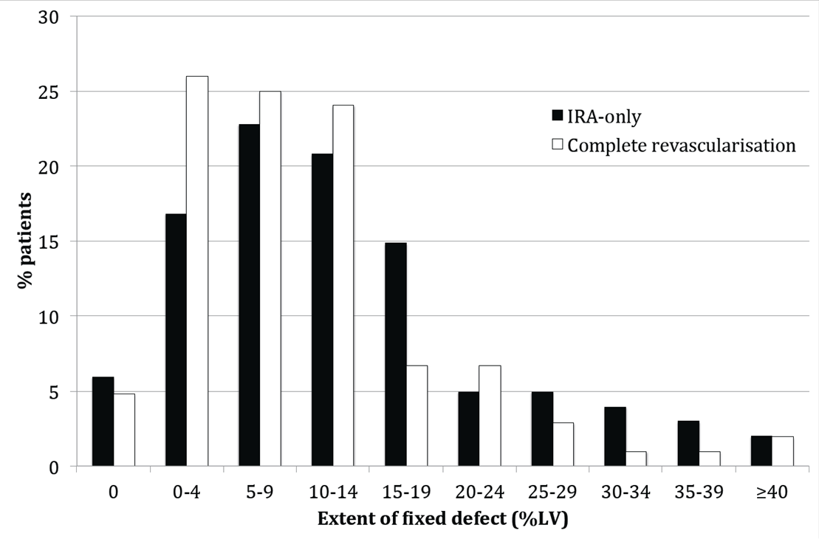
CvLPRIT Nuclear sub-study: infarct extent
Larger resting perfusion defect (infarct extents) at 6 weeks MPS in the IRA-only group:
culprit-only = 10.3%, Median complete = 8.8% p=0.049
Trend towards more extensive resting defects in territory of the index event:
culprit-only median = 8.8%, complete median = 5.9% p=0.09
Kelion A et al. 2015

Slide 54

Department Academic Cardiology
National Institute for Health Research, Leicester Cardiovascular Biomedical Research Unit
The COMPLETE Trial
Expectations….
Tony Gershlick
Professor Interventional Cardiology
University Hospitals of Leicester UK

Slide 55
ANOTHER NARROWING IS FOUND AT THIS TIME IN 40-50% OF PATIENTS

Slide 56
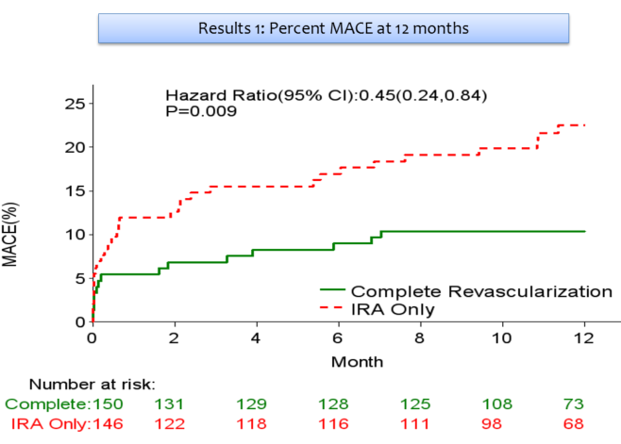
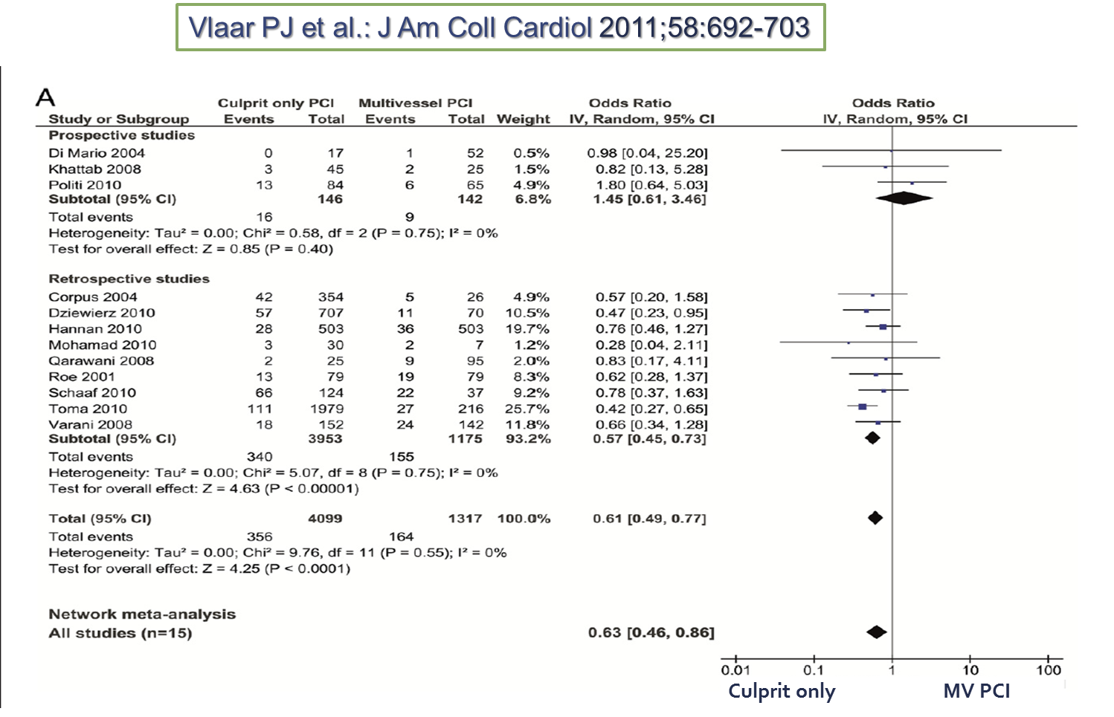
CvLPRIT : HR 0.45
PRAMI : HR 0.35

Slide 57
MVD in the setting of AMI- it appears a simple question
STEMI
Significant N-IRA lesion
Will the patient be better off/worse off
if it is treated or not ?

Slide 58
What are the questions ?
Which patients ?
Should we actually do the N-IRA ? impact
How do we decide if it needs doing ?
If so- when ?
COMPLETE

Slide 59
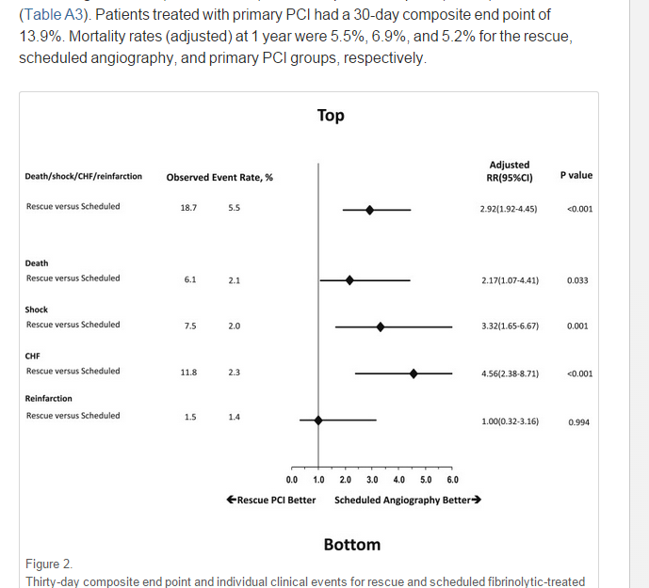
Which patients ?
A trial should contain only P-PCI patients
Outcomes of a pharmacoinvasive strategy for successful versus failed fibrinolysis and primary percutaneous intervention in acute myocardial infarction (from the STrategic Reperfusion Early After Myocardial Infarction [STREAM] study).
Welsh RC1, Am J Cardiol. 2014 Sep 15;114(6):811-9

Slide 60

encourages bias towards a lower risk population
and creating possible imbalance in post PPCI, pre randomisation treatment
Which patients ?
Should we actually do the N-IRA ?
How do we decide if it needs doing ?
If so- when ?

Slide 61
Which patients ?
Should we actually do the N-IRA ?
How do we decide if it needs doing ?
If so- when ?
END POINTS

Slide 62
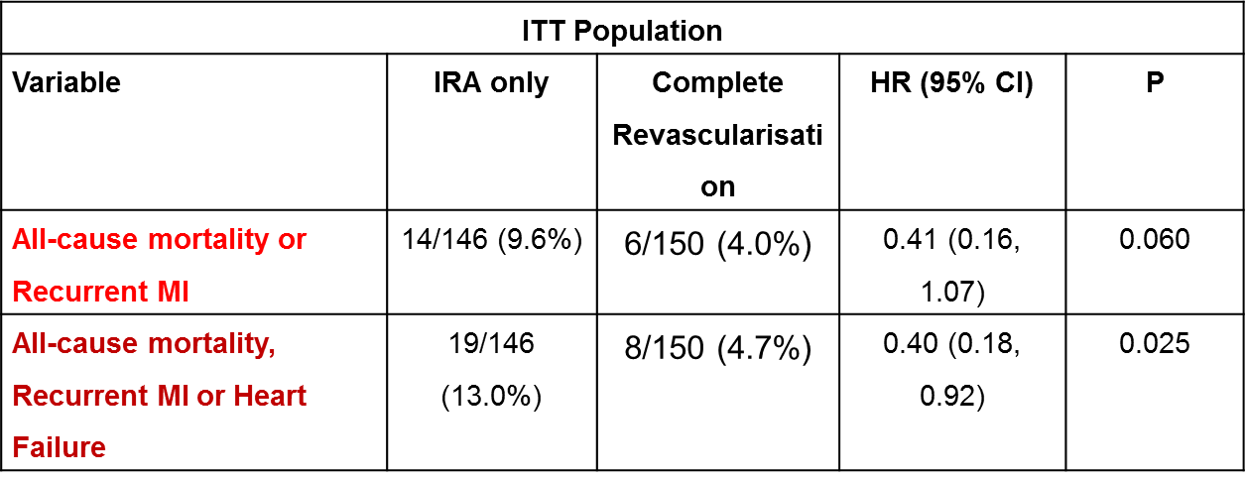
All the trials to date have been small and powered for composite MACE
- death , new MI , HF, need for revascularisation-
CvLPRIT

Slide 63
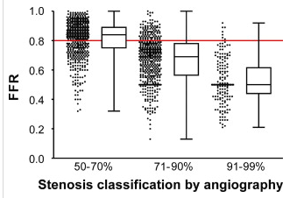

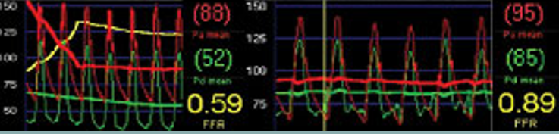
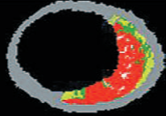
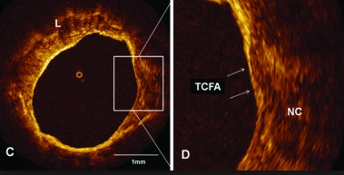
By eye
Which patients ?
Should we actually do the N-IRA ?
How do we decide if it needs doing ?
If so- when ?
FFR
Vulnerable plaque

Slide 65
The complete re-vascularisation group
Which patients ?
Should we actually do the N-IRA ?
How do we decide if it needs doing ?
If so- when ?
At the time of the procedure ( PRAMI )
Optional but pre discharge ( CvLPRIT )
Bring patient back as planned readmission 2 / 4 / 6 /8 weeks ( test )
?

Slide 66
COMPLETE Trial
N= 3900
On going trials
COMPARE-ACUTE
N- 885
≥ 70% stenosis or
≥ 50% with FFR < 0.80
≥ 50%
P-PCI
Hard end points
When
How select
RANDOMIZED
Within 72 h of index Primary PCI
R
2
1
FFR Guided during index
admission
R
Optimal Medical Therapy Alone
Staged PCI of all suitable
non-culprit lesions
Optimal Medical Therapy Alone
composite of all-cause mortality, non-fatal MI, any revascularisation or stroke
12 month
Primary Outcome:
CV Death / MI
Only staged
Not FFR guided
Post lytic
Can excl lesion if decide needs doing
Only in-patient CR, no staged group
Not powered for hard endpoints
FFR used as adjunct for decision making not formally compared.

Slide 67
FLOWER- MI
N= 1170
Just/about to start
N=4000
ANGIO assessment
One or more non-culprit lesions (non-culprit vessels at least 2.5mm) on angiography (50-99%)
STEMI patients with successful culprit lesion PCI (primary, rescue or pharmaco-invasive) + ≥ 50% stenosis in at least one additional non-culprit lesion
P-PCI
Hard end points
When
How select
R
R
Index admission
FFR-guided PCI
to non-culprit lesions*
Angio-guided PCI
(during the index hospital admission†)
FFR-guided PCI
(during the index hospital admission †)
Optimal Medical Therapy Alone
Primary outcome:
Death or non-fatal MI or any repeat revascularization
at 12 months
Primary outcome:
all-cause death and non fatal MI 1 year
Only In patient
FFR randomised
No OMT
Repeat revasc
Only In patient
FFR guided

Slide 68
Prime-time N=2500
50-99 % stenosis in one or more N-IRA BY EYE
R
Group A: In-patient Complete
Group B: Staged Complete
Group C: Conservative management
IP FFR
IP FFR
> 0.8
< 0.8
< 0.8
> 0.8
PCI of N-IRA lesions during index admission
Re-admitted 6-8 weeks
PCI of N-IRA lesions
Registry
Registry
Follow-up.
PCI of N-IRA lesions only if continuing symptoms and objective evidence of ischaemia (stress echo/MPS/CMR)

