Slide 1



Complex Cardiovascular Therapeutics
CCT
A new technique of IVUS guided CTO PCI
Satoru Otsuji, M.D.
Higashi Takarazuka Satoh Hospital
Osaka Medical College
Japan

Slide 2

Careful analysis of coronary angiogram / MSCT
In-stent restenosis
Use of CrossBoss as primary crossing strategy
Yes
Proximal cap ambiguity
IVUS-guided entry
Yes
No
No
Poor quality distal vessel
Yes
Interventional collaterals present
No
No
Yes
Antegrade wire based
approach
Retrograde
approach
Successful
crossing
If suitable reentry zone
Primary Intentional knuckle wire / ADR with Stingray:
Ambiguous course in CTO
Tortuous CTO segment
Heavy calcification
Use of intentional knuckle wire/ADR after failed wiring:
Length > 20 mm
Previous failed attempt
Dissection-reentry (CrossBoss / Stingray
Parallel
wiring +/- IVUS-guided wiring
Consider stopping if > 3 hr; 3.7x eGFR ml contrast; Air Kerma > 5 Gy unless procedure well advanced.

Slide 3
Complex Cardiovascular Therapeutics
CCT
IVUS application to antegrade approach
IVUS guided entry to the CTO
IVUS guided to the true lumen wiring
Notes:
There are two methods for applying IVUS to the antegrade approach. One is the method of identifying entry of the CTO, especially in non stamp lesion at the bifurcation. The other is IVUS guided re-entry method that would be achieved by introducing guide wire into the plaque or true lumen from subintima under IVUS guidance.

Slide 4
Complex Cardiovascular Therapeutics
CCT
Advantages of IVUS guided entry
Precise orientation of the entry of the CTO (key factor for successful wire cross)
Realizing plaque characteristics (aid for guide wire selection)
Need for appropriate side branch to IVUS catheter insertion is a limitation

Slide 5
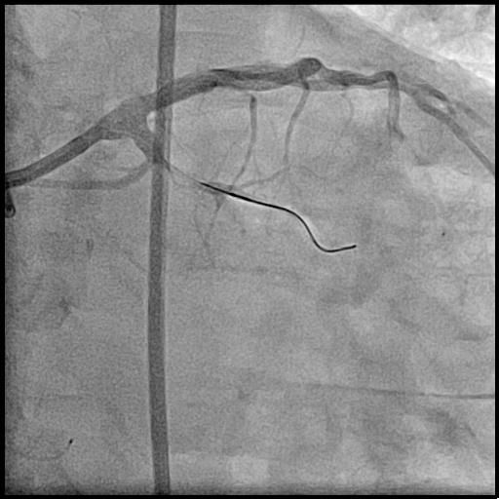
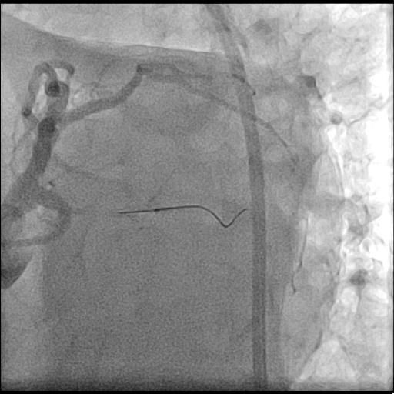
Complex Cardiovascular Therapeutics
LCX CTO lesion retry case
CCT
Notes:
Let me introduce the case. This case is LAD ostium CTO lesion. It is somewhat difficult to determine the entry of the CTO by angiography. A small lump was seen at the distal left main. It is the ostium? We cannot realize definitely even in multiple angle angiography.

Slide 6
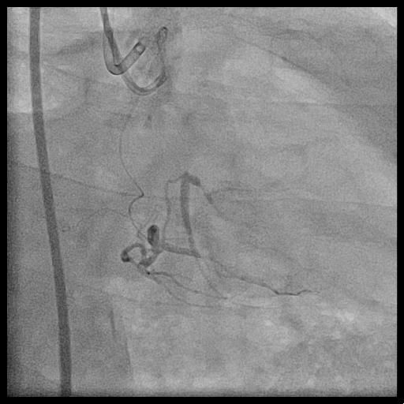
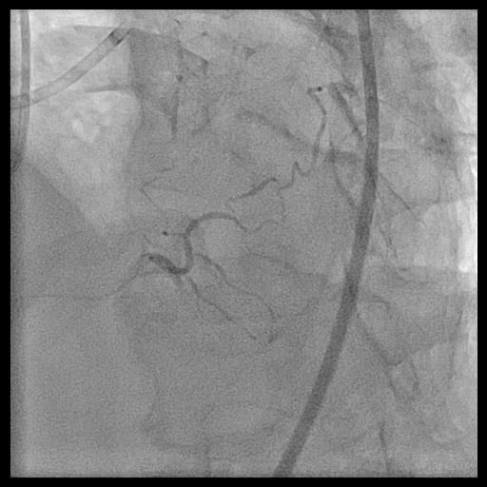
Complex Cardiovascular Therapeutics
Collateral from RCA
CCT

Slide 7
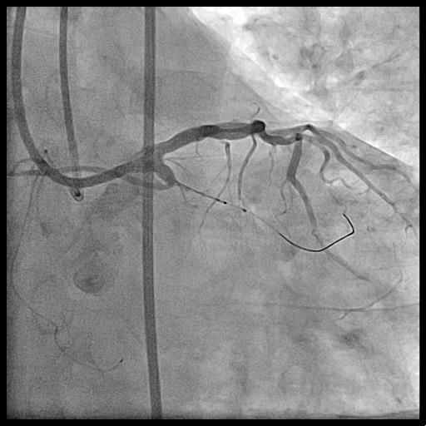
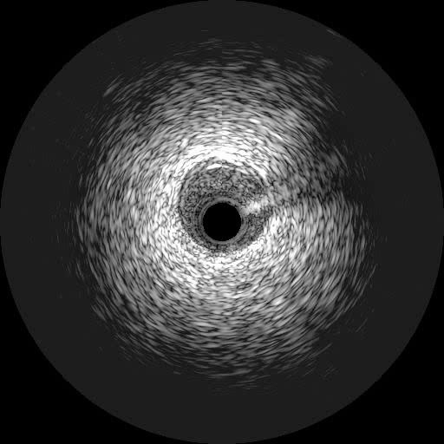
Complex Cardiovascular Therapeutics
IVUS estimation of the entry
CCT

Slide 8
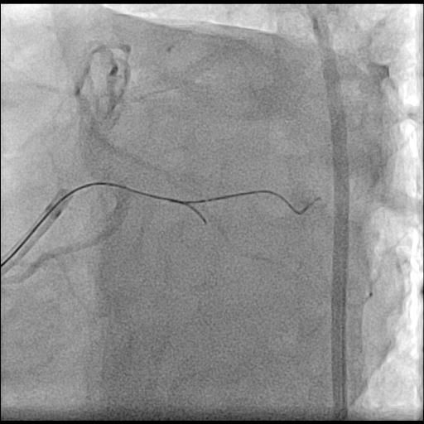
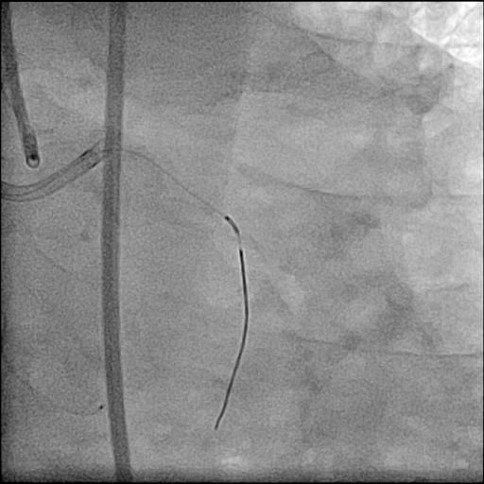
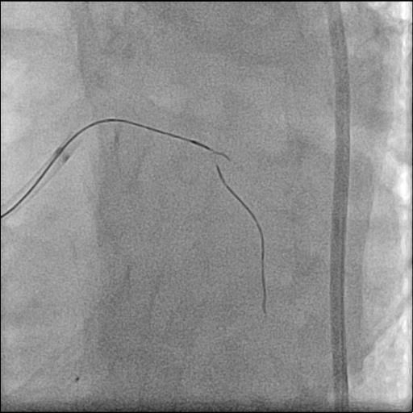
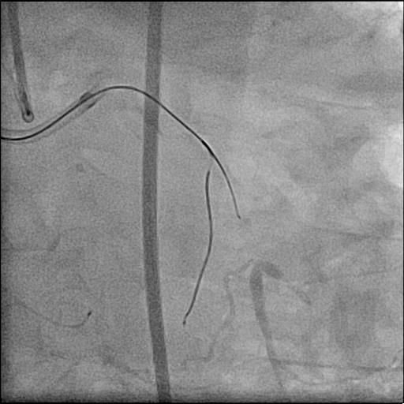
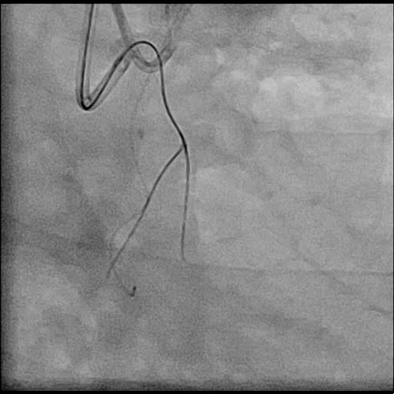
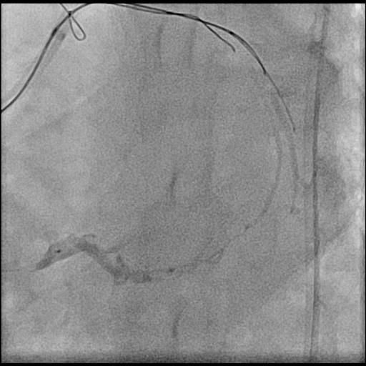
Complex Cardiovascular Therapeutics
Procedure
CCT

Slide 9
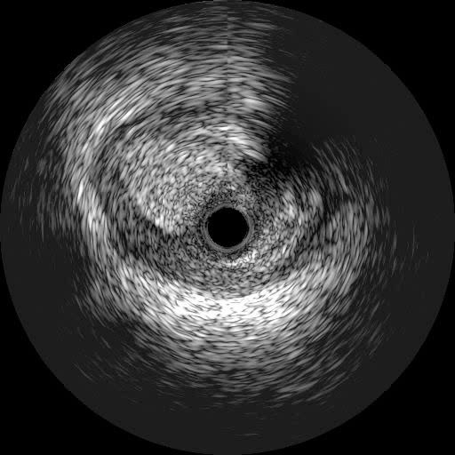
Complex Cardiovascular Therapeutics
Why unsuccessful?
CCT
Determined the entry by IVUS
Overlapping IVUS position to angiography
Manipulated guide wire to estimated line
Didn’t manipulate GW under simultaneous IVUS guidance

Slide 10
Complex Cardiovascular Therapeutics
CCT
Disadvantages of original or non simultaneous IVUS guided entry
IVUS insertion to the side branch sometimes changes angle between main branch and side branch from the original angulation.
IVUS itself will be a resistance for a second micro catheter insertion and restricts second micro catheter position.
Therefore, wire direction will be changed from the original ideal route and second micro catheter position will not be ideal for IVUS guided entry.
Notes:
Calcium shadow sometimes interfere

Slide 11
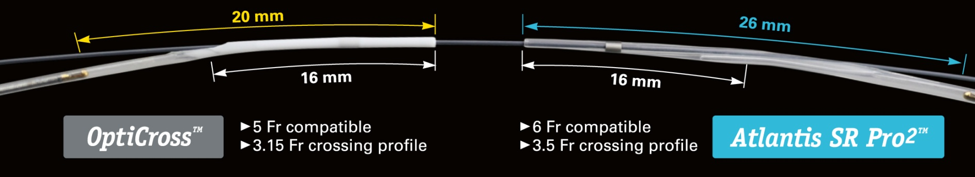
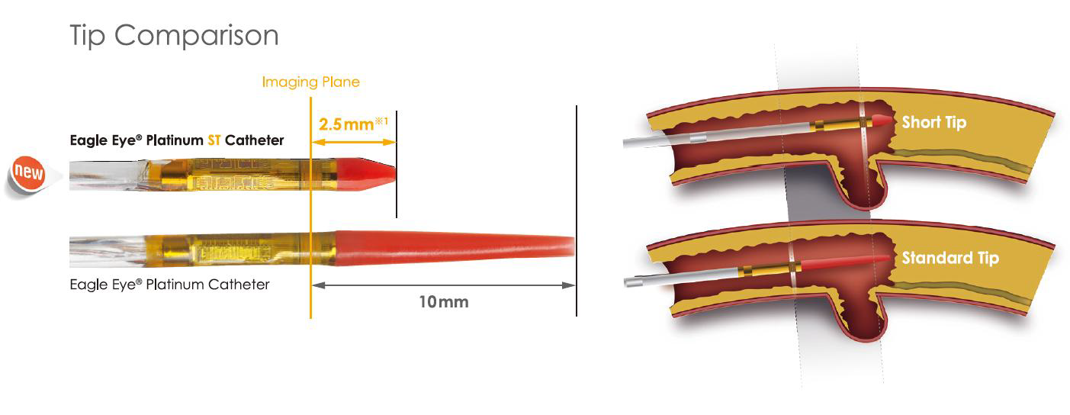
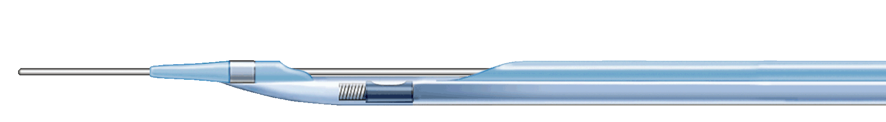
Complex Cardiovascular Therapeutics
IVUS catheters
CCT
1mm
Sensor location 9mm
Notes:
Three kinds of IVUS catheter are now available. Opticross is the most slender system. When using 7Fr guide, we can introduce IVUS catheter, Corsair and Finecross together. It is the only catheter for this purpose. Lengthe from tip to transducer is 20mm. That is still long to insert the false lumen and short small branch. Volcano catheter has a most short tip. The length from tip to the transducer is 2.5mm of the new one. Because of the phased array system, guide wire on the IVUS catheter is not delineated. Therefore, it is not necessary to differentiate second wire from the first one. However, the catheter profile is 3.5Fr. That is still bulky to introduce it into the small branch or subintima. And the frequency is 20 MHz, therefore the image is rough than the 40 MHz image. There are some chance to mistake false lumen to the true lumen if the IVUS catheter located beneath thin intima. Navifocus WR has a unique structure. The guide wire is fixed on the catheter because of the WR system.

Slide 12
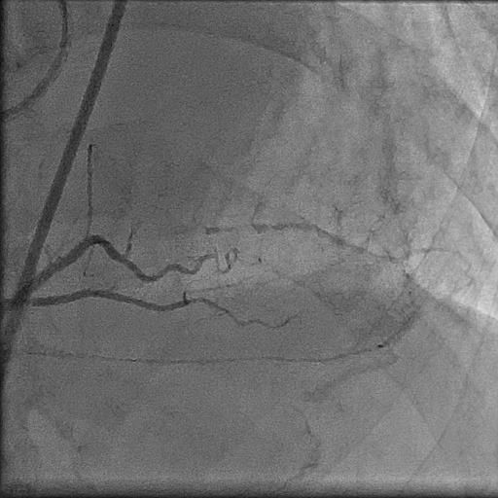
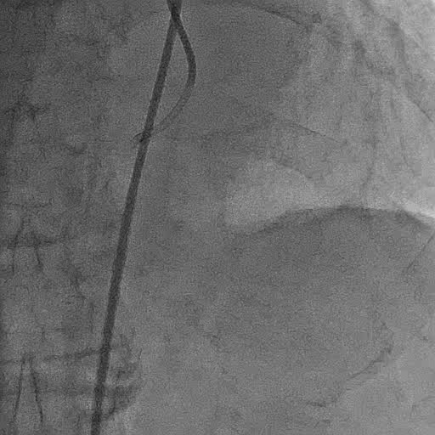
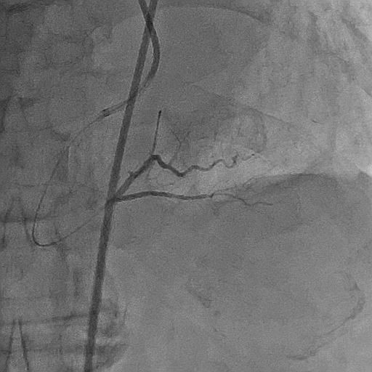
Complex Cardiovascular Therapeutics
RCA distal CTO
CCT
Notes:
However, IVUS image clearly showed the entry. LAD was seen at 6 o’clock and you can see the guide wire caught the true lumen through the fibro-calcium cap of the entry.

Slide 13
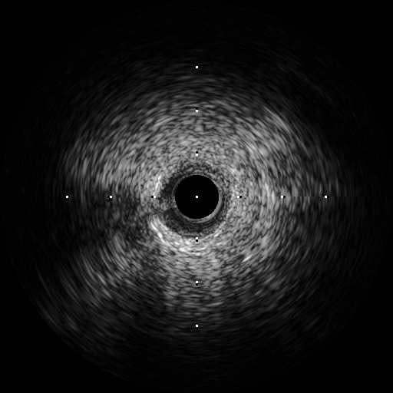
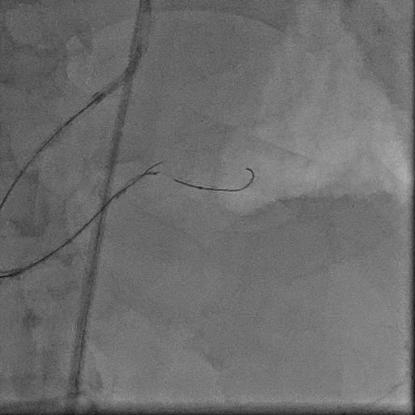
Complex Cardiovascular Therapeutics
IVUS guided entry (new method)
CCT
GAIA 1st
SASUKE
SION blue
IVUS; Opticross

Slide 14
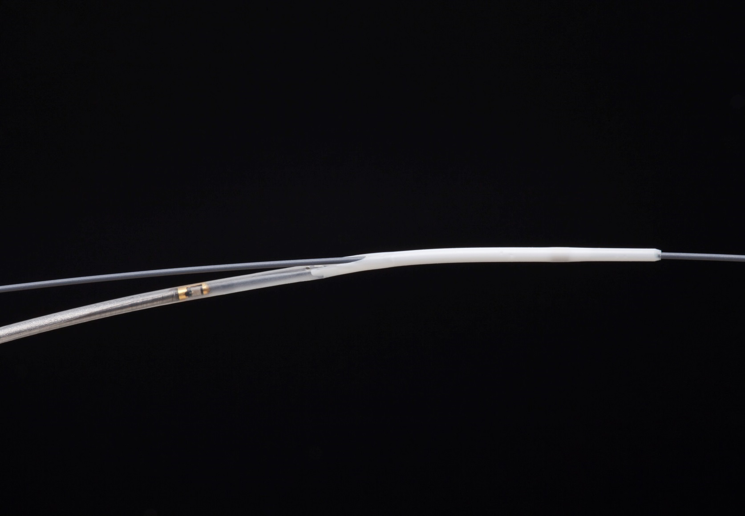
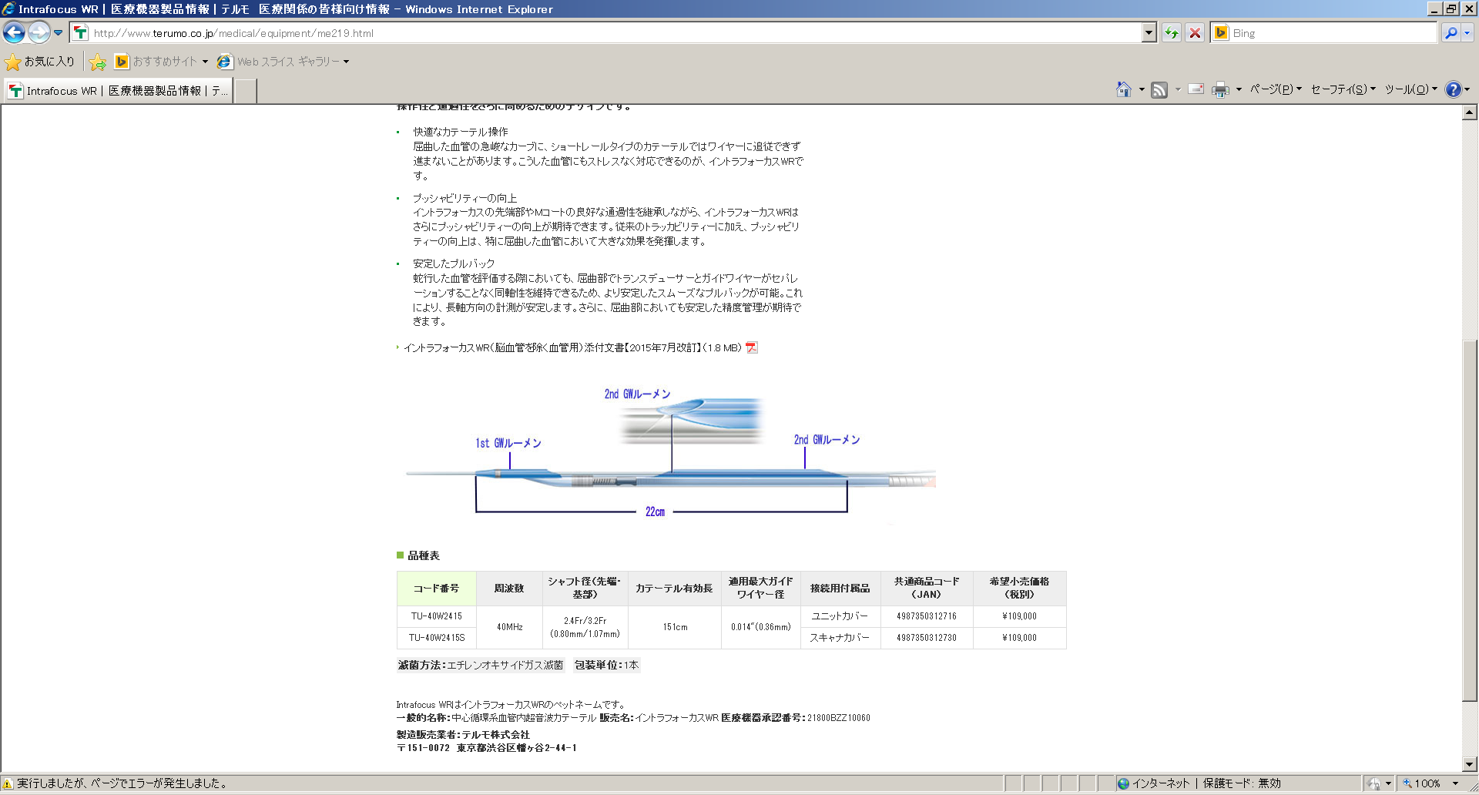
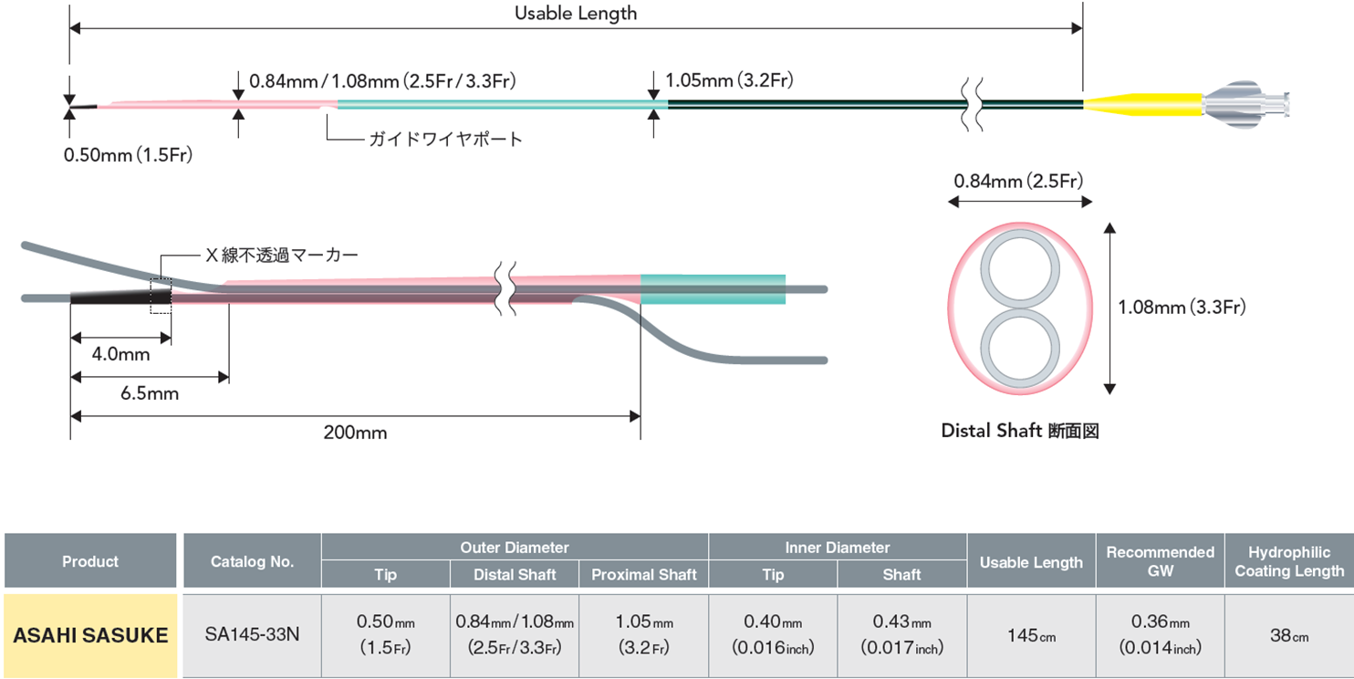
Complex Cardiovascular Therapeutics
Devices for new method
CCT
Opticross
GAIA 1st
SASUKE
Navifocus WR
SION blue
1st GW lumen
2nd GW lumen
ASAHI SASUKE
Radiopaque marker

Slide 15

Complex Cardiovascular Therapeutics
CCT
IVUS and micro catheter on a single wire
6.5mm
0.84mm(2.5Fr)
4.0mm
GAIA 1st
SASUKE
SION blue
Sensor location
9mm
6.5mm
2.5mm
9mm
4mm

Slide 16
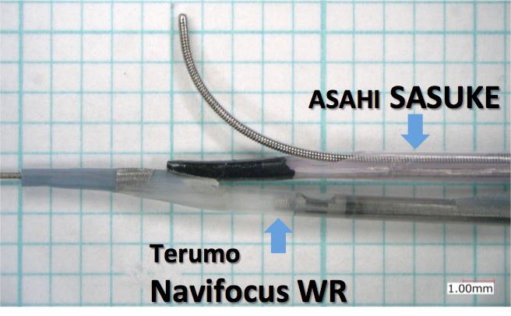
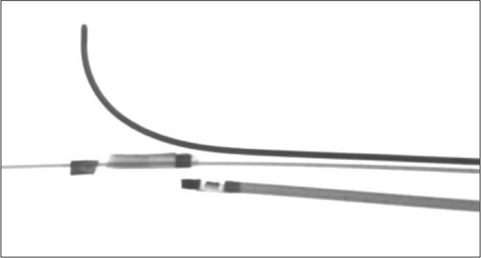
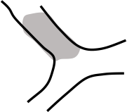
Complex Cardiovascular Therapeutics
Exit position
CCT
Fluoroscopic image

Slide 17
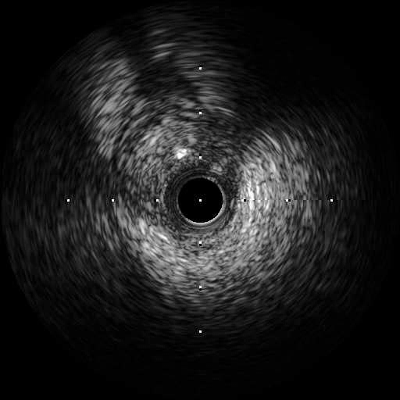
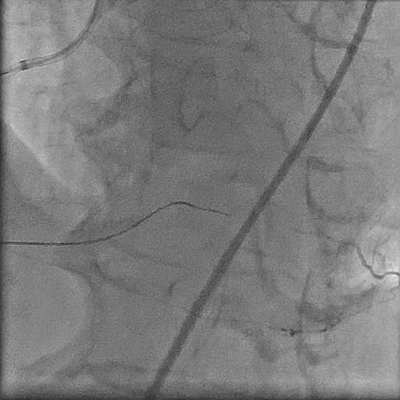
Complex Cardiovascular Therapeutics
Real time IVUS guided wiring
CCT

Slide 18
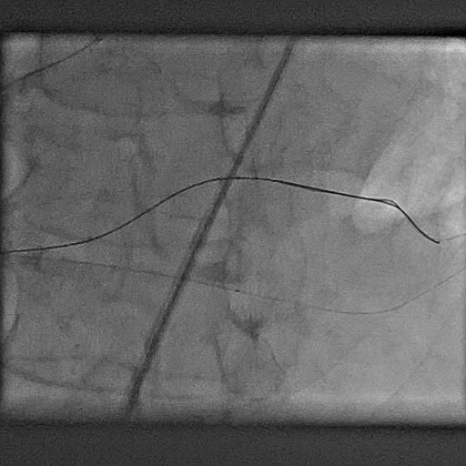
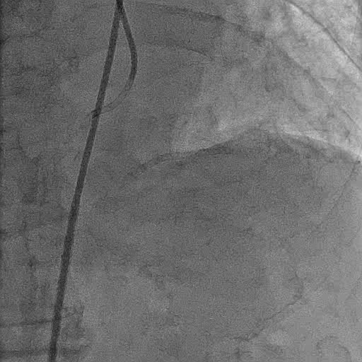
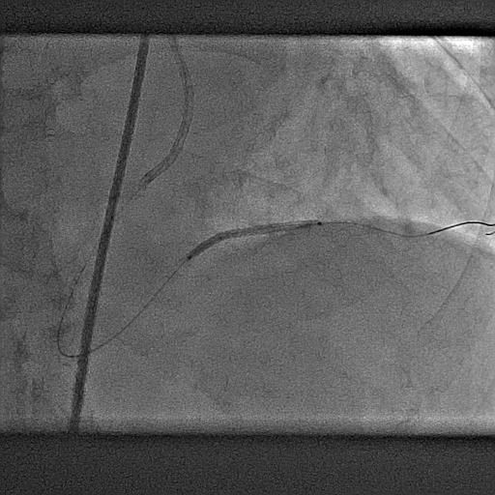
Complex Cardiovascular Therapeutics
Stenting and final angiogram
CCT

Slide 19
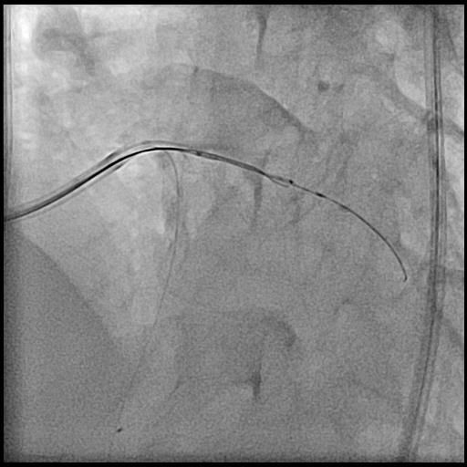
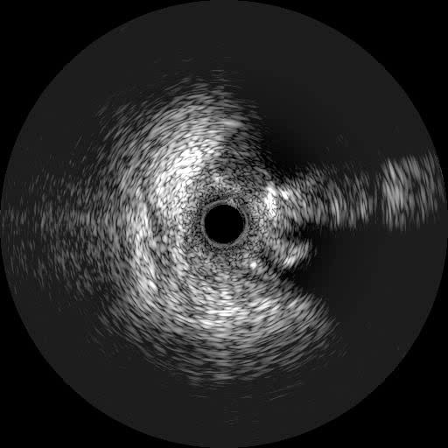
Complex Cardiovascular Therapeutics
IVUS guided true lumen wiring
(new method)
CCT
SASUKE
IVUS; WR
GAIA 2nd
Conquest pro 12

Slide 20
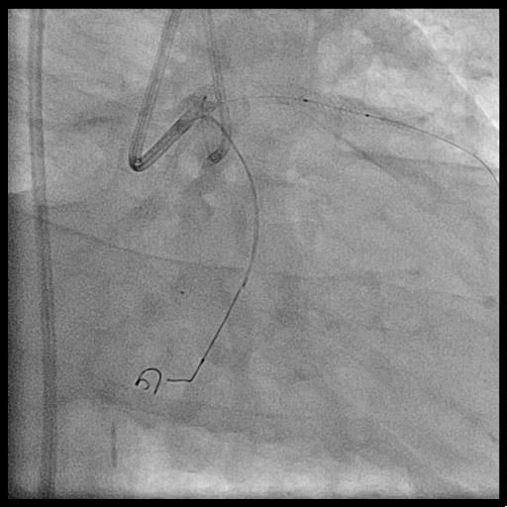
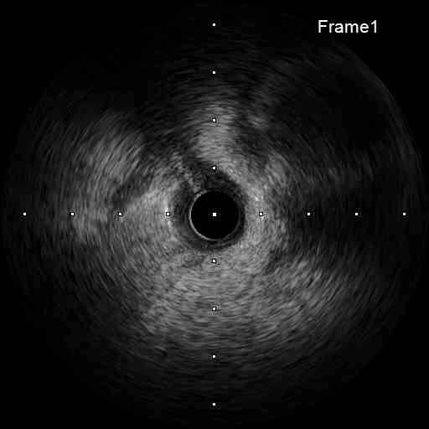
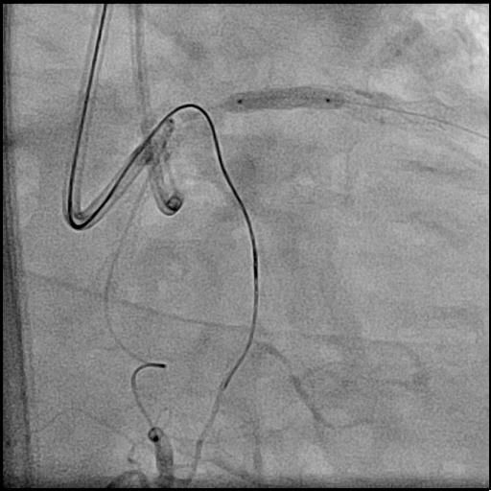
Complex Cardiovascular Therapeutics
IVUS from the distal small branch
CCT

Slide 21
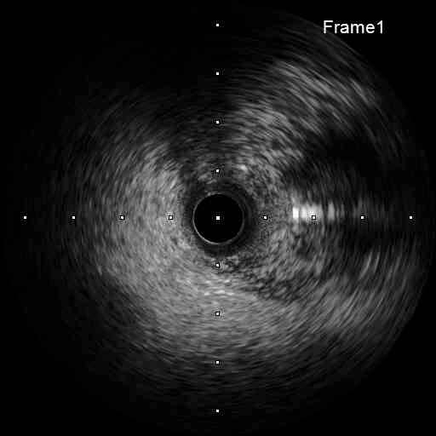
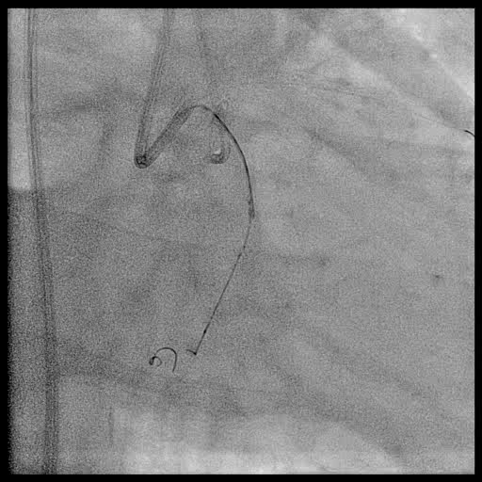
Complex Cardiovascular Therapeutics
IVUS guided true lumen wiring
(new method)
CCT

Slide 22
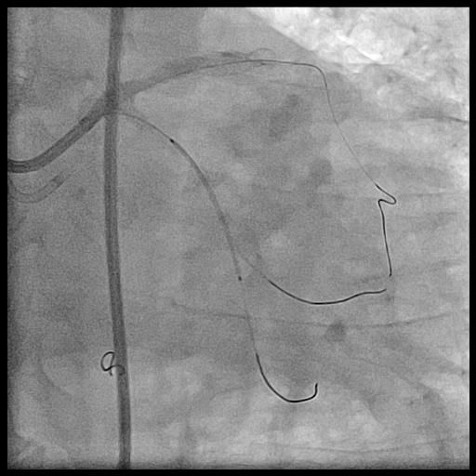
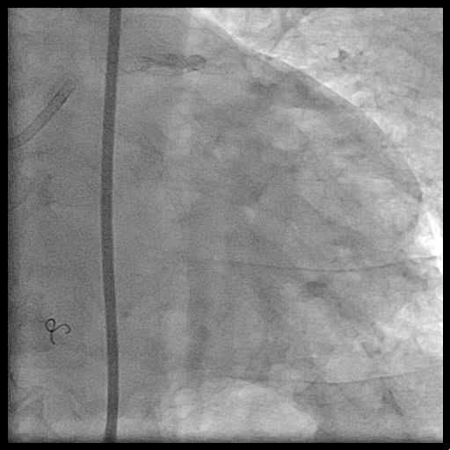
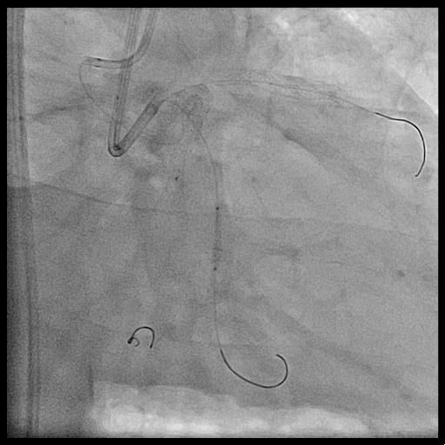
Complex Cardiovascular Therapeutics
Stenting and final angiogram
CCT

Slide 23
Complex Cardiovascular Therapeutics
Ideal IVUS catheter and micro catheter
CCT
IVUS
Small profile
Short monorail (short length from tip to transducer)
IVUS in the probing sheath
Micro catheter
A two lumen micro catheter with a short range between first and second port

Slide 24
Complex Cardiovascular Therapeutics
Message
CCT
Simultaneous IVUS guided wiring navigates guide wire to the correct direction
Coaxial alignment of IVUS and micro catheter on a single wire provides effective back up force and facilitates IVUS guided
A unique structure of SASUKE micro catheter which has a short segment between its tip and the second exit port can minimize wire movement that contributes effective true lumen entry from the nearest point

