Slide 1
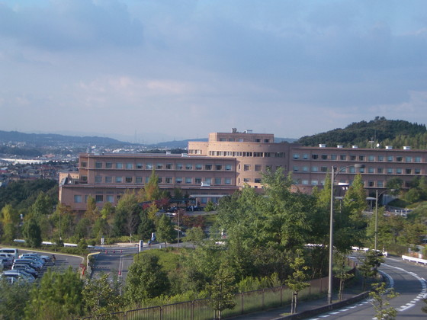
Primary angioplasty; subsequent infarct-related coronary artery occlusion
Manabu Shirotani, MD, PhD
Kindai University Nara Hospital, Nara, Japan
COI; none
Notes:
Ladies and Gentlemen and Mr. Chairperson, Good Morning! I’d like to express my deep gratitude to Dr. Moo Hyun Kim for letting me have a presentation in such a wonderful conference. Today, I’d like to talk about the change in patterns of IRA occlusion following reperfusion therapy in acute myocardial infarction as the development of treatment method.

Slide 2
Reperfusion Therapy in AMI
IRA recanalization
Myocardial contractility ↑
Mortality and morbidity ↓
Notes:
As everybody knows, quick reperfusion therapy is performed to recover the heart contraction and thereby to reduce mortality and morbidity.

Slide 3
Clinical deterioration
IRA occlusion
myocardial dysfunction ↑
severe hypotension
death
malignant arrhythmia
Notes:
But once the vessel is blocked again, myocardial function gets worse and it sometimes accompany malignant arrhythmia or hypotension leading to death.

Slide 4
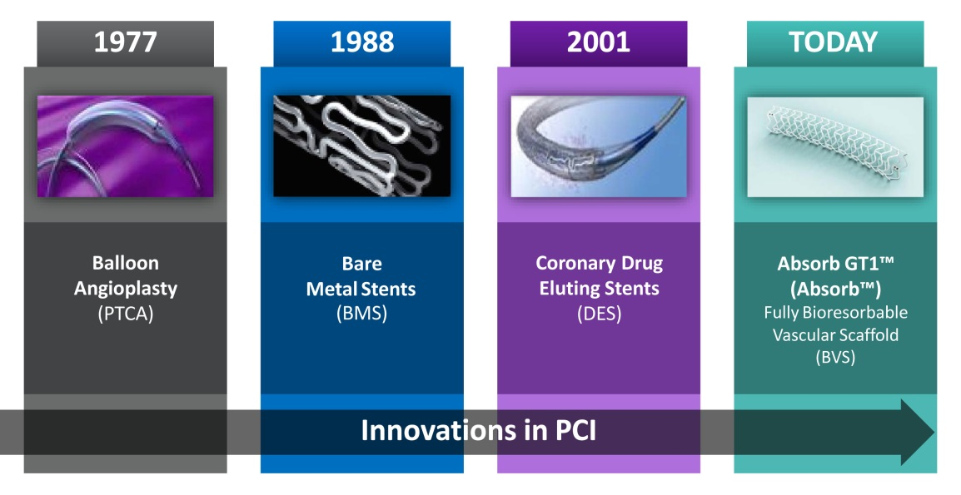
Reperfusion Method for AMI
Thrombolysis in 1980’s
  Streptokinase, urokinase, t-PA
Balloon angioplasty
Stent
  Bare metal stent
  Drug-eluting stent
Bioresorbable vascular scaffold
Notes:
Reperfusion therapy has changed a lot; ….
BVS; … without leaving foreign bodies in the vessel.

Slide 5
Thrombolysis era
Intravenous thrombolysis
  streptokinase
  recombinant tissue-type plasminogen activator (rt-PA)
Success rate; 75%
Reocclusion rate; 5-6% in 18-36 hrs
  Reiner JS et al. J Am Coll Cardiol 1994;24:1439-44.
  Gibson CM et al. J Am Coll Cardiol 1995;25:582-9.

Slide 6
Balloon only (pre-stenting) era
Early (< 24hr) coronary occlusion
  47/191 (25%) mostly in the cath lab
  Predictors
    Undersized inflation
    RCA
    pPCI within 3hrs from onset
Shirotani M et al. Am Heart J 1993;125:931-8.
Notes:
We move to the ballon era; we still had early coronary occlusion in 25% of patients in our study mostly in the cath lab.. Without stents, we used to repeat ballooning for hours in those patients.

Slide 7
Early occlusion increases pre-discharge reocclusion.
P = 0.013
balloon angioplasty
Notes:
…
You were more likely to have another occlusion before discharge.

Slide 8
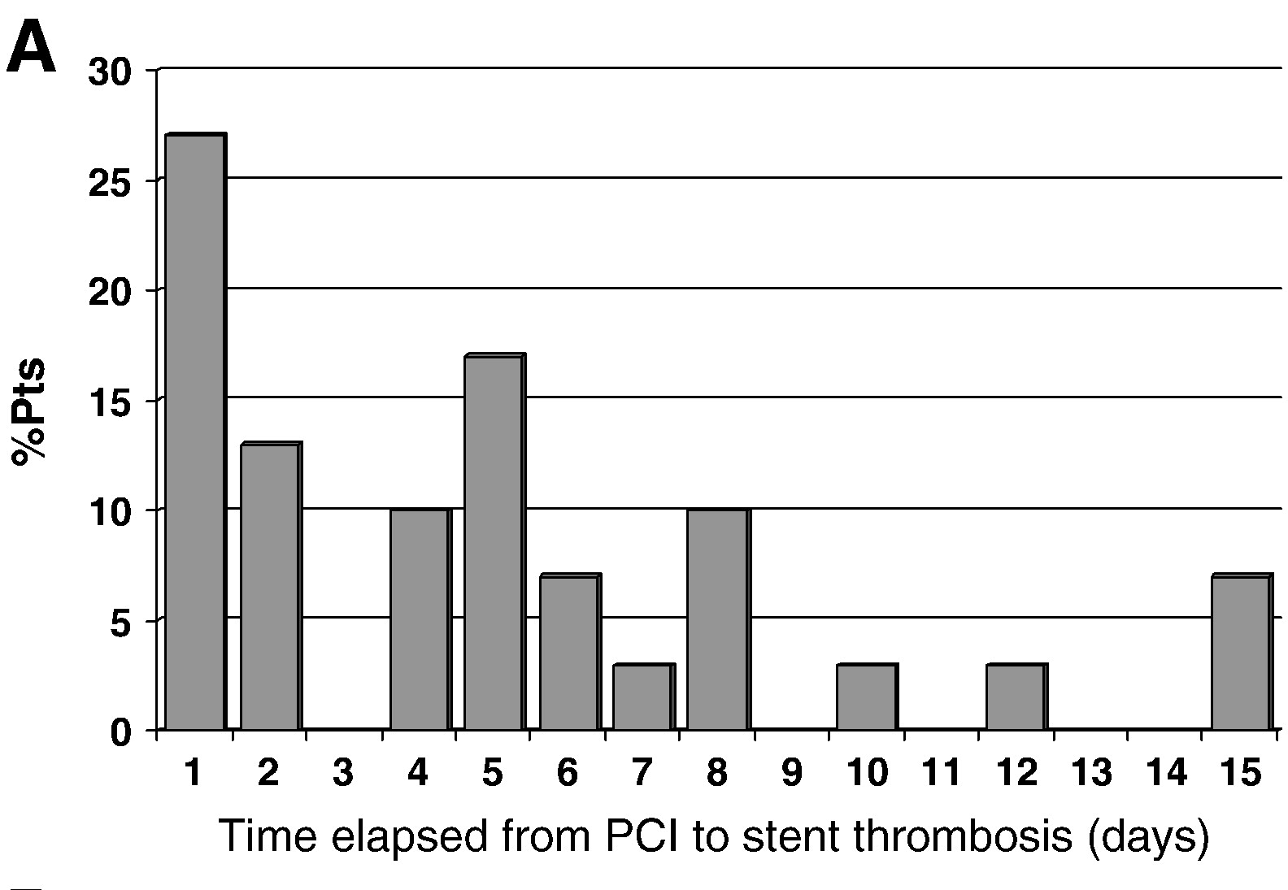
Time to stent thrombosis
Beinart R et al. Am Heart J 2010;159:118-24. BMS:DES= 6:4
Notes:
After stent was introduced, the time span of thrombosis became wider; we pay attention not only to acute but also to subacute thrombosis.

Slide 9
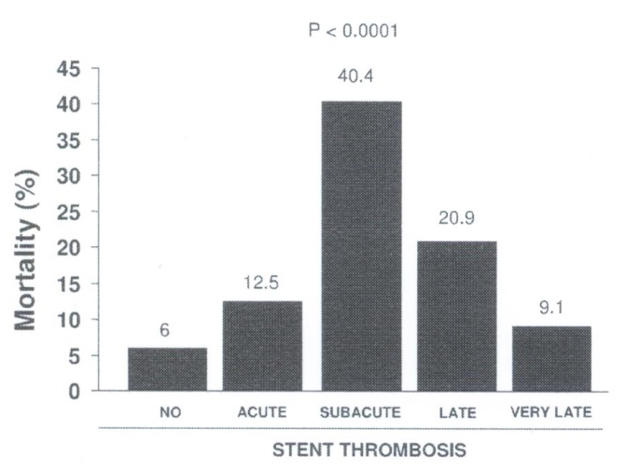
Timing of ST and mortality up to 6yr
De Luca G et al. Thromb Haemost 2013;110:826-33. BMS:DES= 37:63
Notes:
As this figure shows subacute thrombosis is complicated with quite high mortality rate. We now noticed the importance of dual antiplatelet medication for a long time.

Slide 10
Multivariate predictors of stent thrombosis < 30days
 | OR | 95% CI | p
Serum creatinine (mg/dl) (per 0.1mg/dl increase) | 1.65 | 1.17 to 2.33 | 0.005
LMCA or LAD as IRA | 26.97 | 1.41 to 514.59 | 0.029
White blood cells (per 1000/microl increase) | 1.28 | 1.02 to 1.61 | 0.037
Multi-vessel disease | 5.57 | 0.89 to 34.90 | 0.067
Eosinocytes (per 20/microl increase) | 0.88 | 0.73 to1.06 | 0.174
Uemori N et al. Angiology Open Access 2014;2:136. BMS only
Notes:
At our hospital, …

Slide 11
Multivariate predictors of
ST < 30days
 | OR | 95% CI | P
All patients
STEMI | 6.3 | 2.1-18 | 0.0008
Multivessel coronary artery disease | 5.9 | 1.9-21 | 0.003
Killip ≥2 | 2.9 | 1.3-6.6 | 0.008
Patients with STEMI
Multi-vessel coronary artery disease | 5.5 | 1.6-19 | 0.007
Infarct-related artery—left anterior descending | 2.9 | 1.1-2.5 | 0.03
Prior myocardial infarction | 2.2 | 0.9-5.6 | 0.08
Primary percutaneous coronary intervention | 2.4 | 0.9-6.5 | 0.09
Beinart R et al. Am Heart J 2010;159:118-24. BMS:DES= 6:4

Slide 12
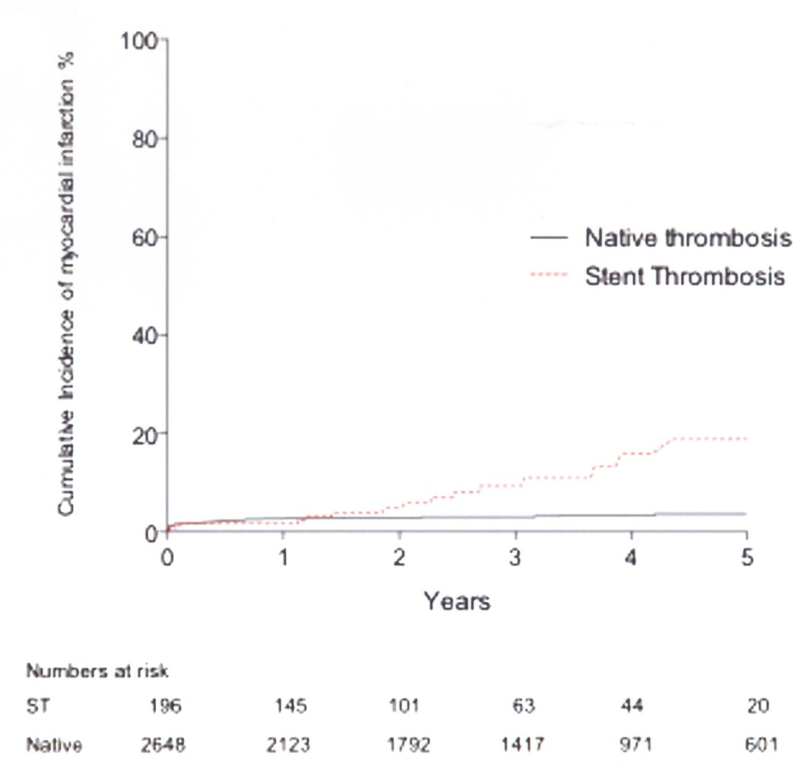
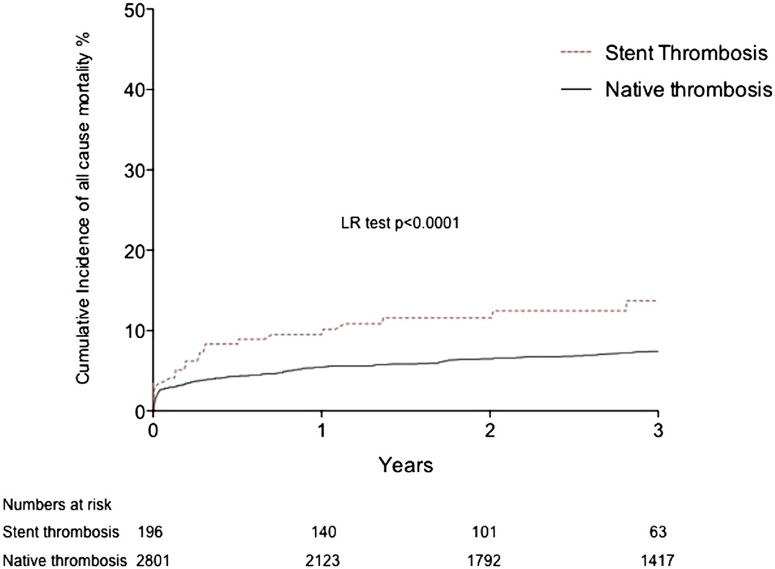
Incidence of another MI and death
recurrent MI
mortality
Jones DA et al. Am J Cardiol 2013;112:1347-54.
Notes:
And another important point is that stent thrombosis, as compared to native thrombosis, is more likely to cause recurrent MI and death.

Slide 13
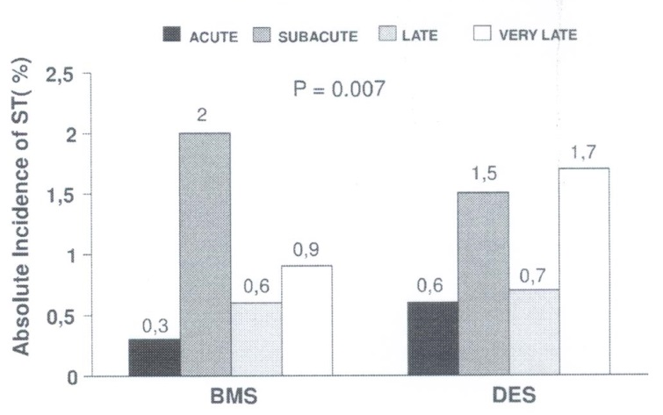
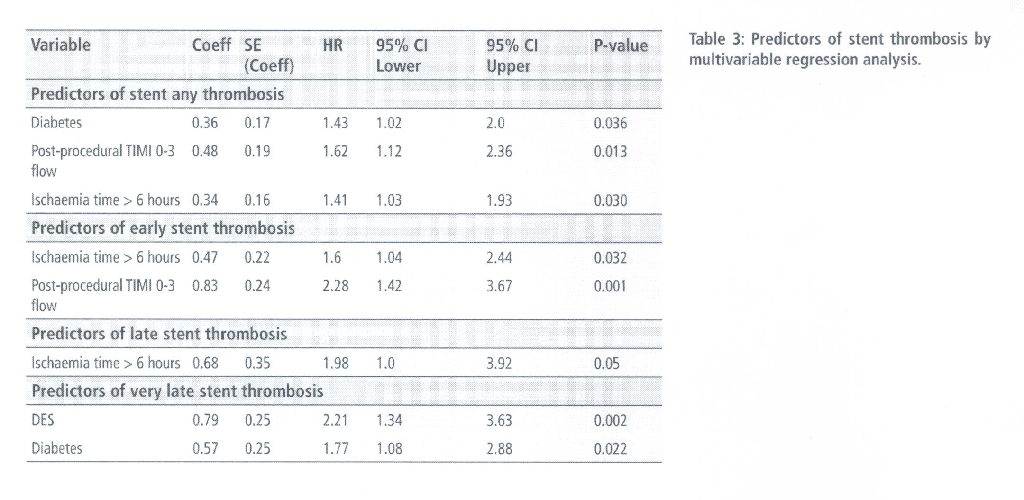
BMS vs. DES
De Luca G et al. Thromb Haemost 2013;110:826-33.
Notes:
When you compare DES with BMS, stent thrombosis happens more frequently in the very late phase over 1 year.

Slide 14
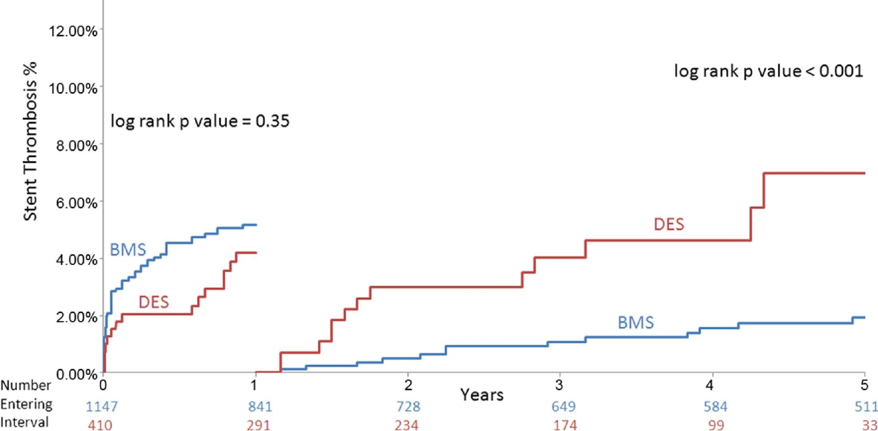
Stent thrombosis in STEMI
BMS < DES
Brodie B et al. JACC Cardiovasc Interv 2012;5:1043-51.
Notes:
This slide clearly shows the difference. DES contains much higher rate of stent thrombosis after 1 year.

Slide 15
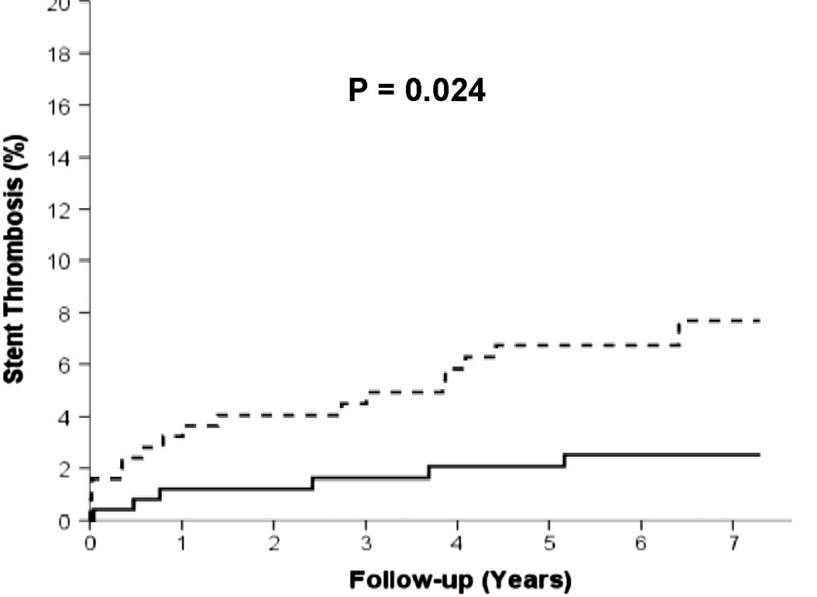
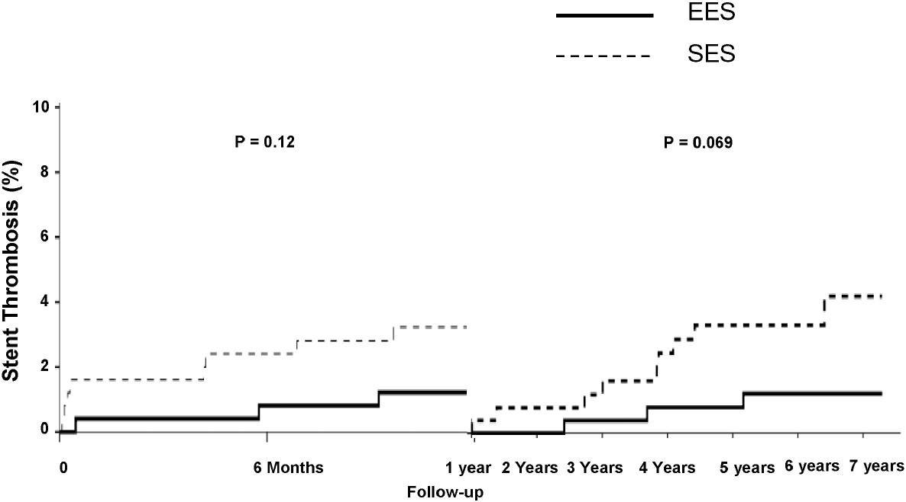
Stent thrombosis; EES vs. SES
(RACES-MI trial)
adjusted HR = 0.29
SES
EES
Di Lorenzo E et al. Int J Cardiol 2016;202:177-82.
Notes:
However, the results are a little bit changing with the new generation DES. ST is tended to be less frequent for 7 yrs with everolimus eluting stents. : we don’t now if very late catch-up will take place with this stent over 10yrs or longer.

Slide 16
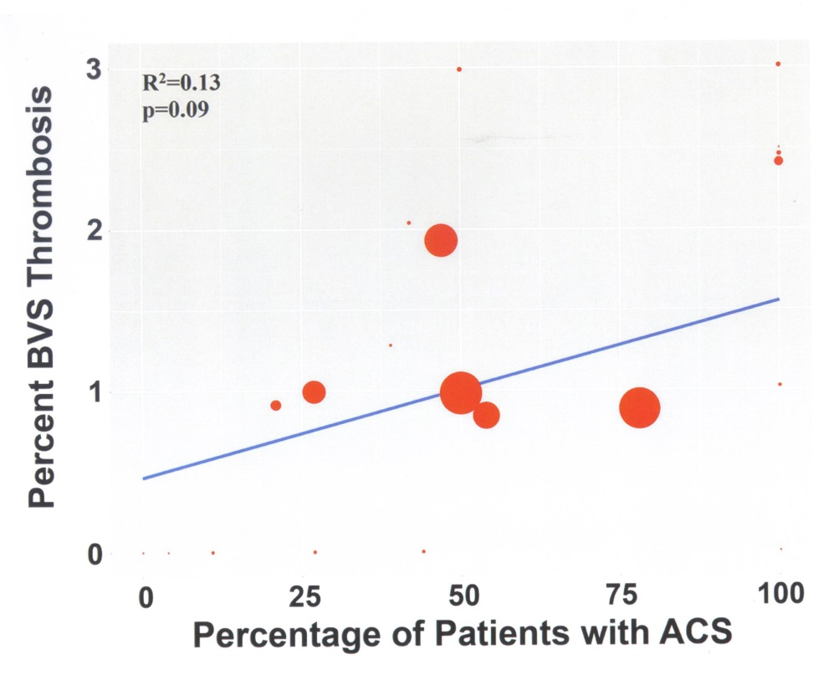
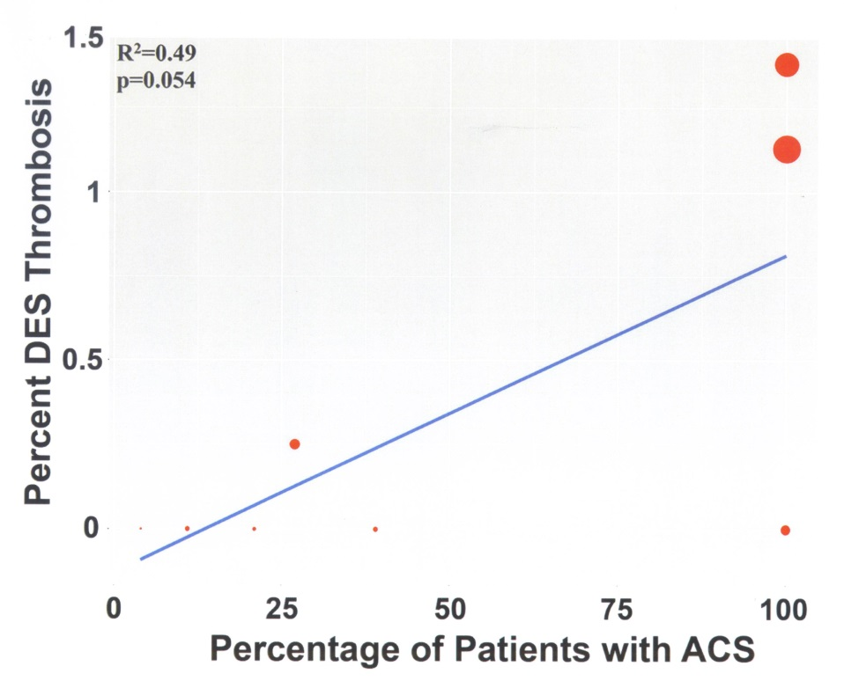
Scaffold thrombosis (meta-analysis)
BVS
DES
Bioresorbable Vascular Scaffold
Lipinski MJ et al. JACC Cardiovasc Interv 2016;9:12-24.
Notes:
Now BVS has been launched. These figures show the relationship between device thrombosis and the proportion of ACS patients in each study population. The size of each plot shows the number of study population. Unlike studies about DES including many patients, not much follow-up data is yet available concerning patients with ACS treated with scaffold..

Slide 17
Summary 1
As the development of reperfusion therapy and handy devices, coronary patency has improved.
However, the timing of thrombosis has shifted in the later phase and it still influences cardiac mortality.
  Balloon vs. stent (acute to subacute, late)
  BMS vs. DES (late to very late)

Slide 18
Summary 2
New generation DES may improve long coronary patency, however, we still need longer follow-up assessment.
  Neoatherosclerosis?
  Longer DAPT prescription?
More data collection is awaited for scaffold thrombosis after BVS use in AMI.

Slide 19
Conclusions
A longer follow-up may be required to assess the efficacy and safety of new coronary devices.
Additional studies will improve BVS patency by clarifying its relationship to lesion characteristics or implantation techniques.
Notes:
…
So, we still need to get together for better treatment.

Slide 20

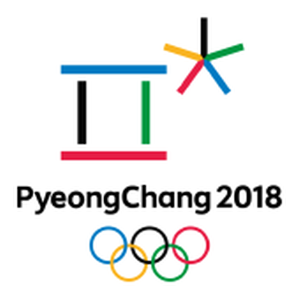

Thank you for your attention!

Slide 21
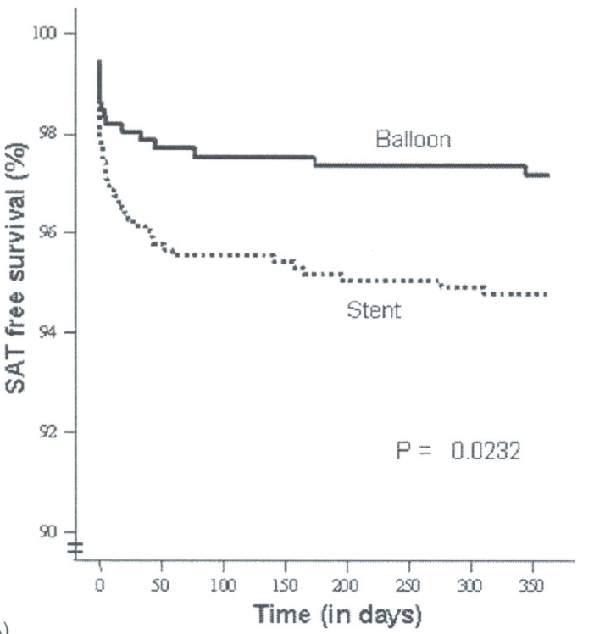
Subacute thrombosis after pPCI
Smit JJJ et al. Thromb Haemost 2006;96:190-5.
Notes:
SAT <1Yr
Only univariate

Slide 22
Prevention of EST
Statin for those with hs-CRP> 2 mg/dl

Slide 23
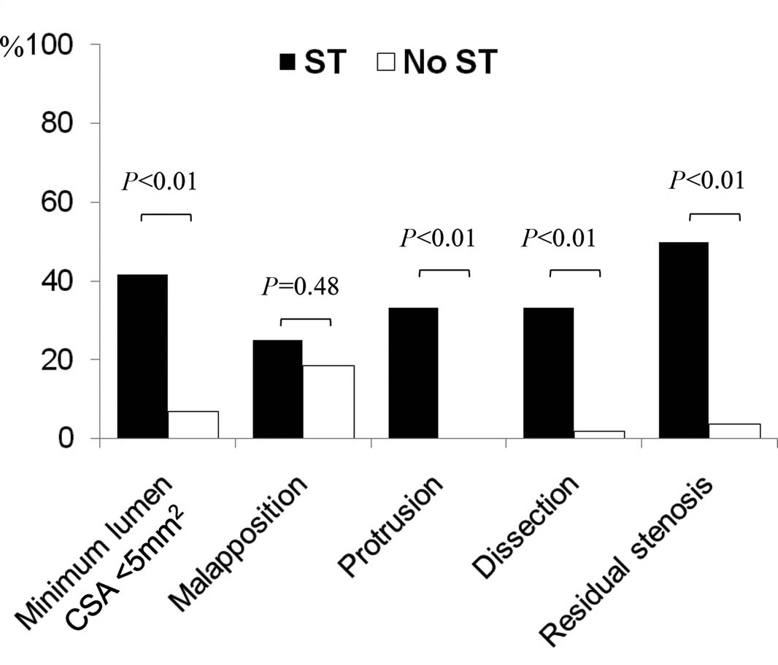
Predictors of EST (HORIZONS-AMI)
Choi SY et al. Circ Cardiovasc Interv 2011;4:239-47. BMS:DES= 1:3

