Slide 1
Is BVS Ready to Use
in Daily Practice ?
Seung-Jung Park, MD, PhD
Professor of Medicine, University of Ulsan College of Medicine,
Heart Institute, Asan Medical Center, Seoul, Korea

Slide 2
Current DES Is Good !
However…
Notes:
The original promise has been fulfilled, of VRT regarding vessel restoration has been demonstrated by RCT and registry in whose procedural success efficacy safety and event rate were comparable to DES.

Slide 3
Remaining Issues of Metallic Stent Events
Very Late Thrombosis / Restenosis
SPIRIT III: TLF at 5 years
30%
25%
1-year HR
XIENCE V (n=669)
20%
TAXUS Express (n=332)
19.0%
0.56 [0.34, 0.90]
TLF (%)
p=0.01
Δ6.3%
15%
9.2%
10%
12.7%
Δ3.8%
5-year HR
5%
0.64 [0.46, 0.89]
5.4%
p=0.008
0%
0
6
12
18
24
30
36
42
48
54
60
Months
Number at risk
XIENCE V | 669 | 646 | 616 | 601 | 582 | 571 | 565 | 548 | 537 | 529 | 521
TAXUS | 332 | 310 | 288 | 274 | 269 | 262 | 255 | 248 | 243 | 231 | 223
Stone GW et al. JACC 2011 (abstract)

Slide 4
Remaining Issues of Metallic Stent Events
Very Late Thrombosis / Restenosis
Possible Causes
Uncovered stent struts (thrombosis)
Persistent stimulation of SMCs, from adherent fibrin and/or loss of normal vessel curvature
Abnormal shear stress from stent struts
Chronic inflammation due to foreign body reactions and polymer hypersensitivity
Positive remodeling with late strut malapposition
Strut fracture
Neoatherosclerosis

Slide 5

Updated Analysis of IRIS-DES Registry
17,196 patients, median 3.3 years
SES
Pr-CoCr-EES
CoCr-EES
No-BES
PtCr-EES
Bi-BES
Re-ZES
Preliminary Data Analysis of IRIS DES Registry, AMC
Notes:
Bi-BES, biomatrix, No-BES, Nobori,
Pr-CoCr-EES, XIENCE PRIME, CoCr-EES, cobalt-chromium everolimus-eluting stent(s) XINECE
PtCr-EES, platinum-chromium everolimus-eluting stent(s);
Re-ZES, Resolute zotarolimus-eluting stent(s);
SES, sirolimus-eluting stent(s).

Slide 6
Target-Vessel Failure (TVF) at 3 year
CV Death, Target MI, or Clinically indicated TVR
Preliminary Data Analysis of IRIS DES Registry, AMC

Slide 7
MACE at 3 year
Any Death, Any MI, or Any TVR
Preliminary Data Analysis of IRIS DES Registry, AMC

Slide 8
Contemporary PCI with
Second-Generation DES
Good enough ! in the efficacy and safety outcomes with current DESs.
No difference ! between the different DESs.

Slide 9
Bio-absorbable Vascular Scaffold
(BVS)
What’s New ?
Why do We have to Consider ?
Notes:
The original promise has been fulfilled, of VRT regarding vessel restoration has been demonstrated by RCT and registry in whose procedural success efficacy safety and event rate were comparable to DES.

Slide 10
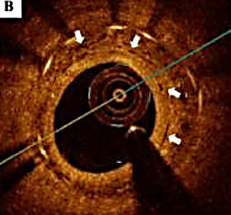
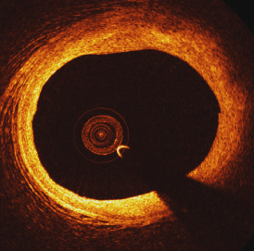
Disappear !
Human Imaging at 5 Year
Metallic DES
BVS
Atherosclerosis 2014;237:23e29
Images courtesy of S Windecker, ABSORB Cohort B 5 Yrs

Slide 11
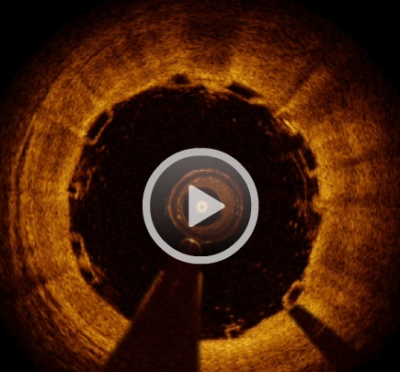
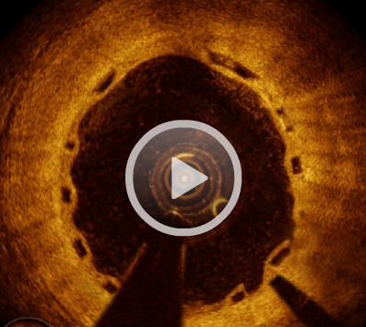
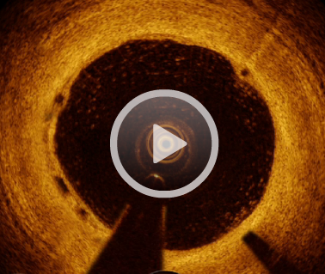
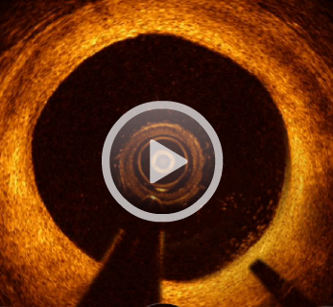
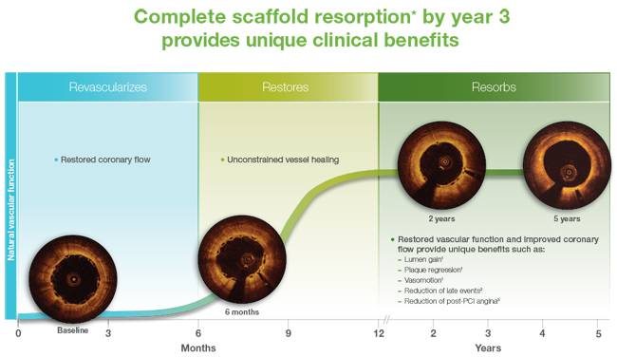
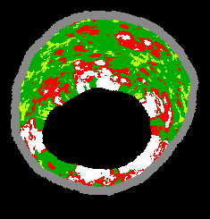
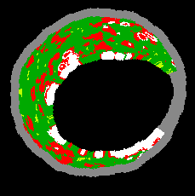
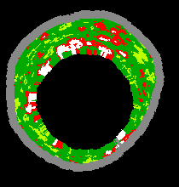
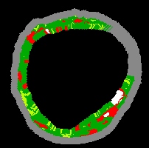
Plaque Stabilization
and Lumen Enlargement
1 month
6 month
2 year
5 year
c/o Patrick Serruys

Slide 12
BVS Hypothesis Is,
30%
XIENCE V (n=669)
SPIRIT III
TAXUS Express (n=332)
25%
Absorb BVS (theoretical)
20%
19.0%
TLF (%)
15%
9.2%
10%
12.7%
~2%/yr event rate after year 1
5%
7.2%
5.4%
0%
5.3%
0
6
12
18
24
30
36
42
48
54
60
Months
Number at risk
XIENCE V | 669 | 646 | 616 | 601 | 582 | 571 | 565 | 548 | 537 | 529 | 521
TAXUS | 332 | 310 | 288 | 274 | 269 | 262 | 255 | 248 | 243 | 231 | 223
Spirit III: Gada H et al. J Am Coll Cardiol Intv 2013;6:1263–6

Slide 13
Clinical
Evidences
Notes:
The original promise has been fulfilled, of VRT regarding vessel restoration has been demonstrated by RCT and registry in whose procedural success efficacy safety and event rate were comparable to DES.

Slide 14
ABSORB II, 1-year
P=0.69
P=0.47
P=0.08
Patrick W Serruys, et al, Lancet Sep 14, 2014

Slide 15
ABSORB III, 1-year
P=0.16
P=0.18
P=0.50
P=0.29
Stephan G Ellis, et al. NEJM 2015

Slide 16
ABSORB III, 1-year
Device Thrombosis
 | Absorb (N=1322) | Xience (N=686) | p-value
Device Thrombosis (def*/prob) | 1.54% | 0.74% | 0.13
- Early (0 to 30 days) | 1.06% | 0.73% | 0.46
- Late (> 30 to 1 year) | 0.46% | 0.00% | 0.10
- Definite* (1 year) | 1.38% | 0.74% | 0.21
- Probable (1 year ) | 0.15% | 0.00% | 0.55
Ellis SG et al. N Engl J Med. 2015;373:1905-15

Slide 17
Clinical Evidences
REPARA¹
GABI-R²
RAI³
IT-DISAPPEARS⁴
France ABSORB⁵
ABSORB III⁸
ABSORB Japan⁹
ABSORB China¹⁰
ABSORB-FIRST¹¹
GHOST EU¹²
ABSORB II¹³
ASSURE¹⁴
PRAGUE-9¹⁵
ABSORB Extend¹⁶
TROFI II⁶
ESTROFA-BVS⁷
ABSORB Cohort B¹⁷
Efficacy and Safety
of BVS is Comparable
to 2nd Generation of DES.
^{1.}Hernandez, F., REPARA, EuroPCR 2015; ²Hamm, C., GABI-R, EuroPCR 2016; ³Cortese, B., RAI, EuroPCR 2016; ⁴Petronio A.S., IT-DISSAPEARS, EuroPCR 2016 ⁵Koning C., France ABSORB, EuroPCR 2016; ⁶Serruys, P.W.,TROFI II, ESC2015; ⁷De La Torre Hernandez, J., ESTROFA BVS, EuroPCR 2015; ⁸Kereiakes, D., ABSORB III, TCT 2015; ⁹Kimura, T., ABSORB Japan, ESC 2015; ¹⁰Gao, R., ABSORB China, TCT 2015; ¹¹Seth, A., ABSORB FIRST, TCT 2015; ¹²Capadanno, D., GHOST-EU Propensity Matched Analysis, TCT 2015; ¹³Chevalier, B., ABSORB II, TCT 2015; ¹⁴Schwencke, C., ASSURE, TCT 2015; ¹⁵Kocka V., PRAGUE-19, EuroPCR 2016 ¹⁶ C.J., ABSORB EXTEND, TCT AP 2015; ¹⁷Serruys, P.W., ABSORB Cohort B, TCT 2015. Cohort B OCT images - courtesy of RJ van Geuns, Erasmus Medical Center, Netherlands

Slide 18
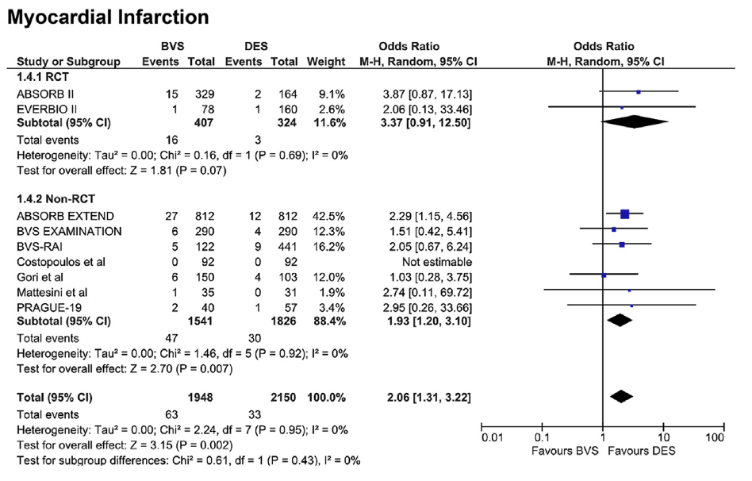
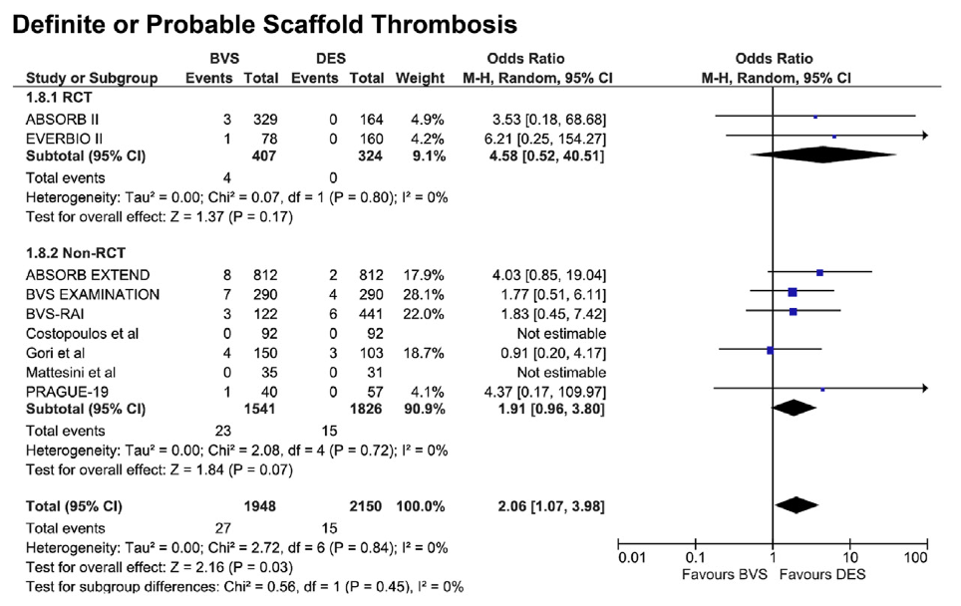
1 Year Met-Analysis Suggest
Increased Risk of ST with Absorb
MI
Def/Prob ST
Lipinski et al. JACC Cardiovasc Interv 2016;9(1):12-24

Slide 19
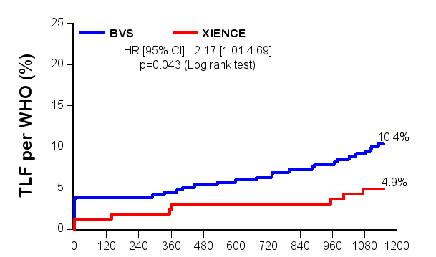
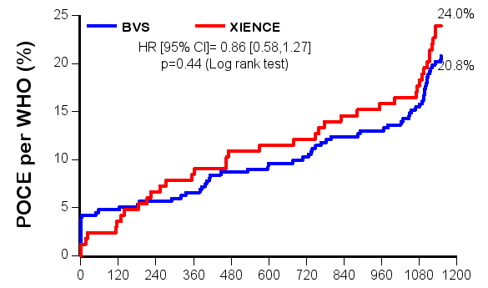
ABSORB II, 3-year
Device-Oriented
Composite Endpoints
(Cardiac Death, TV-MI, CI-TLR)
Patient-Oriented
Composite Endpoints
(Any Death, Any-MI,
Any Revascularization)
25
25
Absorb
Xience
Absorb
Xience
24.0%
20
HR [95% CI]
2.17 [1.01, 4.69]
p=0.043
20
HR [95% CI]
0.86 [0.58, 1.27]
p=0.44
15
15
10.4%
Device oriented clinical endpoint (%)
Patient oriented clinical endpoint (%)
10
10
4.9%
20.8%
5
5
0
0
Time to event (days)
Time to event (days)
Patrick W Serruys et al, Lancet 2016; http://dx.doi.org/10.1016/S0140-6736(16)32050-5

Slide 20
ABSORB II, 3-year
Scaffold or Stent Thrombosis
 | Absorb 335 patients | Xience 166 patients | p value
Definite | 2·5% (8) | 0·0% (0) | 0·06
Acute (0–1 day) | 0·3% (1) | 0·0% (0) | 1·0
Sub-acute (2–30 days) | 0·3% (1) | 0·0% (0) | 1·0
Late (31–365 days) | 0·0% (0) | 0·0% (0) | 1·0
Very late (>365 days) | 1·8% (6) | 0·0% (0) | 0·19
Definite or probable | 2·8% (9/320) | 0·0% (0/159) | 0·03
Acute (0–1 day) | 0·3% (1) | 0·0% (0) | 1·0
Sub-acute (2–30 days) | 0·3% (1) | 0·0% (0) | 1·0
Late (31–365 days) | 0·3% (1) | 0·0% (0) | 1·0
Very late (>365 days) | 1·8% (6) | 0·0% (0) | 0·19
Patrick W Serruys et al, Lancet 2016; http://dx.doi.org/10.1016/S0140-6736(16)32050-5

Slide 21
ABSORB II, 3-year
Secondary Clinical Endpoints
 | Absorb 325 patients | Xience 161 patients | Relative Risk | p value
Device-oriented composite endpoint [DOCE] | 10.5% | 5.0% | 2·11 [1·00, 4·44] | 0·04
Cardiac death | 0.9% | 1.9% | 0·50 [0·10, 2·43] | 0·40
Target vessel MI | 7.1% (23) | 1.2% (2) | 5.70 [1.36, 23.87] | 0.0061
Periprocedural MI (WHO) | 3.9%(13) | 1.2% (2) | 3.22 [0.74, 14.11] | 0.16
Spontaneous MI (WHO extended) | 3.1% (10) | 0% (0) | NC [NC] | 0.06
Clinically indicated TLR | 6.2%(20) | 1.9% (3) | 3.30 [1.00, 10.95] | 0.036
Patient-oriented composite endpoint [POCE] | 20.9% | 24.2% | 0·86 [0·61, 1·22] | 0·40
All-cause death | 2.5% | 3.7% | 0·66 [0·23, 1·87] | 0·57
Any MI | 8.3% | 3.1% | 2.68 [1.05, 6.82] | 0.03
Any revascularization | 15.1% | 20.5% | 0.74 [0.49, 1.10] | 0.13
Patrick W Serruys et al, Lancet 2016; http://dx.doi.org/10.1016/S0140-6736(16)32050-5

Slide 22
ABSORB II, 3-year
What We’ve Learned from These Data
Scaffold VLST continues to occur 1-3 years out (1.8%)
DOCE somewhat worse (10.4% vs 4.9%, p=0.043)
Angiographic late loss is similar or slightly worse
Vasomotion occurs with Xience (between struts)??
Late CSA increases somewhat more (IVUS)

Slide 23
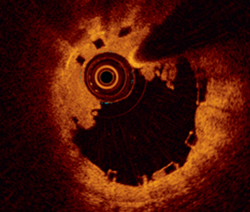
Is BVS Thrombosis
the Real Achilles Heel ?
Notes:
The original promise has been fulfilled, of VRT regarding vessel restoration has been demonstrated by RCT and registry in whose procedural success efficacy safety and event rate were comparable to DES.

Slide 24
BVS Thrombosis Rate
Tamburino et al.
EXTEND Registry
GABI-R Registry
FRANCE Registry
REPARA Registry
RAI Registry
EXPAND Registry
GHOST-EU Registry
AMC Registry
Ielasi et al.
Vaquerizo et al.
IT-DISAPPEARS
UNDERDOGS
Ortega-Paz et al.
Naganuma et al.
Wiebe et al.
Gori et al.
Lesiak et al.
EVERBIO II
ABSORB CHINA
ABSORB II
ABSORB JAPAN
ABSORB III

Slide 25
BVS Thrombosis Rate
RCT
Real world registry
Complex
Lesion
Tamburino et al.
EXTEND Registry
GABI-R Registry
FRANCE Registry
REPARA Registry
RAI Registry
EXPAND Registry
GHOST-EU Registry
AMC Registry
Ielasi et al.
Vaquerizo et al.
IT-DISAPPEARS
UNDERDOGS
Ortega-Paz et al.
Naganuma et al.
Wiebe et al.
Gori et al.
Lesiak et al.
EVERBIO II
ABSORB CHINA
ABSORB II
ABSORB JAPAN
ABSORB III

Slide 26
Who Is Thrombogenic,
The Scaffold or the Doctor ?
Notes:
The original promise has been fulfilled, of VRT regarding vessel restoration has been demonstrated by RCT and registry in whose procedural success efficacy safety and event rate were comparable to DES.

Slide 27
BVS Thrombosis Reduced
with Improved Technique !
0
BVS-specific Protocol
1
Thrombosis,
KM Estimate
(%)
2
3
Early Experience
4
Log Rank p=0.023
5
0
100
200
300
400
Days
Patients
Early Experience | 369 | 369 | 369 | 369 | 369
Absorb-specific | 292 | 292 | 281 | 217 | 155
Puricel, S. et l. J Am Coll Cardiol. 2016; 67(8):921–31

Slide 28
Recommended Technique
BVS Specific Protocol
P
Pre-Dilation
Pre-dilation with noncompliant balloon, 1:1 with the RVD.
BVS of the same size
as the RVD at 10 to 12 atm.
Post-dilation with noncompliant balloon with a maximum of 0.5mm larger at 14 to 16 atm.
S
Sizing
Appropriately
P
Post-Dilation
Puricel, S. et l. J Am Coll Cardiol. 2016; 67(8):921–31,
4 German and Swiss centers -BVS specific protocol

Slide 29
PSP Use by Trial
(As-Treated Population)
EXTEND 108/772 (14.0%)
ABSORB-II 21/324 (6.5%)
ABSORB-Japan 35/258 (13.6%)
ABSORB-China 32/237 (13.5%)
ABSORB-III 96/1224 (7.8%)
29

Slide 30
Significant Improvement of Outcomes
In GHOST-EU At 1 Year With Completed PSP
PSP (n=156)
No PSP (n=1071)
Event Rate %
Brugaletta, S., GHOST-EU PSP Analysis, TCT 2016.

Slide 31
PSP Analysis - TLF At 3-Years
(Absorb Patients, As-Treated Population)
15%
Non-PSP
Log-rank p = 0.08
(PSP vs Non-PSP)
Proper sizing
11.9 %
12%
Proper post-dil
PSP
11.1 %
9%
TLF Rate (%)
6.3 %
6%
5.4 %
3%
0%
0
180
365
540
730
910
1095
Time Post Index Procedure (Days)
 | 0 | 365 | 730 | 1095
Non-PSP | 2549 | 2375 | 1289 | 268
Proper Sizing | 2261 | 2125 | 1195 | 223
Proper post-dil | 365 | 341 | 219 | 24
PSP | 297 | 280 | 186 | 20
0-365 days population: A-EXTEND, A-II, A-Japan, A-China, A-III
366-730 days population: A-EXTEND, A-II, A-Japan, A-China
731-1095 days population: A-II

Slide 32
PSP Analysis – Def/Prob ST At 3-Years
(Absorb Patients, As-Treated Population)
5%
Non-PSP
Log-rank p = 0.13
(PSP vs Non-PSP)
Proper sizing
4%
Proper post-dil
PSP
3.4 %
3%
3.3 %
Scaffold
Thrombosis Rate (%)
2%
1%
0.8 %
0.7 %
0%
0
180
365
540
730
910
1095
Time Post Index Procedure (Days)
 | 0 | 365 | 730 | 1095
Non-PSP | 2549 | 2483 | 1354 | 291
Proper Sizing | 2261 | 2211 | 1247 | 238
Proper post-dil | 365 | 357 | 227 | 26
PSP | 297 | 290 | 192 | 21
0-365 days population: A-EXTEND, A-II, A-Japan, A-China, A-III
366-730 days population: A-EXTEND, A-II, A-Japan, A-China
731-1095 days population: A-II

Slide 33
100% PSP Completed
AMC Registry (All-comer, n=105)
 | In-hospital | 6 months
Patients | 105 | 43
All Death | 0 | 0
Non-cardiac Death | 0 | 0
Cardiac Death | 0 | 0
Any MI | 4 (3.8%) | 4 (3.8%)
Q-MI | 0 | 0
Non-Q MI | 4 (3.8%) | 4 (3.8%)
All Revascularization | 0 | 0
TVR | 0 | 0
TLR | 0 | 0
TVF | 4 (3.8%) | 4 (3.8%)
TLF | 4 (3.8%) | 4 (3.8%)
MACE | 4 (3.8%) | 4 (3.8%)
DoCE | 4 (3.8%) | 4 (3.8%)
PoCE | 4 (3.8%) | 4 (3.8%)
Definite or probable | 0 | 0
Acute (0–1 day) | 0 | 0
Sub-acute (2–30 days) | 0 | 0
Late (31–180 days) | 0 | 0

Slide 34
Current Status of Absorb
BVS-Specific Implantation Protocol (PSP) is mandatory to achieve procedural success and fovourable clinical outcomes
Absorb is ready to be implanted in almost all patients, but not all patients/lesions.
Notes:
The original promise has been fulfilled, of VRT regarding vessel restoration has been demonstrated by RCT and registry in whose procedural success efficacy safety and event rate were comparable to DES.

Slide 35
Unresolved
Mechanical Issues of BVS
Complex lesions; calcified or tortuous, long lesion, bifurcation, left main
Stretchability and fracture
Overlapping
Side branch
Relatively high late loss

Slide 36
BVS Oversizing in Small Vessel
3.0mm device In 2.5mm RVD
BVS Undersizing
In Large Vessel
3.0mm device in
3.8mm RVD
Under-expansion Larger Footprint
Smaller MLD/MLA
Low Embedment
Malapposion
Smaller Footprint
Vessel Damage
Struts Fracture

Slide 37
One Size Does Not Fit All
in Contemporary PCI Practice
How to Use Hybrid BVS
  Minimizing the length of permanent metallic stents.
  Long lesion with proximal larger lumen diameter; distal BVS and proximal DES
  Long lesion with distal small vessel diameter; distal DEB and/or DES and proximal BVS
  Aorto-ostial long lesions; DES for ostium and BVS for distal vessel.

Slide 38
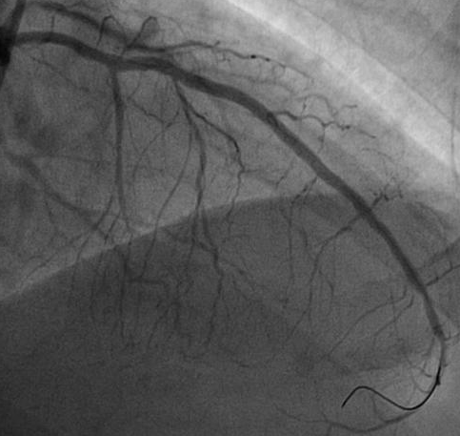
BVS in Diffuse Long Lesion
Full Metal Jacket
Hybrid DES/BVS
DES

Slide 39
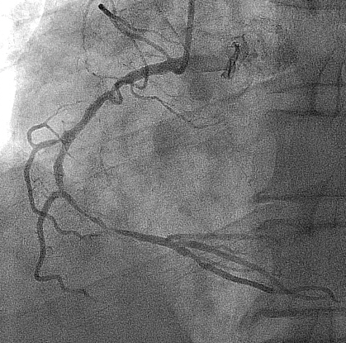
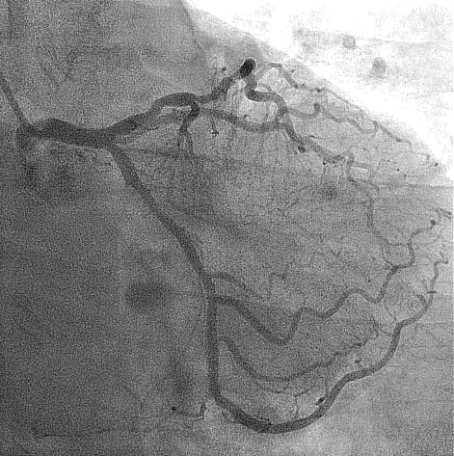
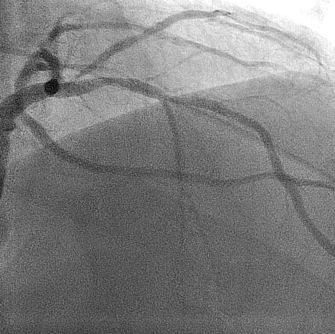
68 y/o male, Stable angina, 2-Vessel Disease,
Diffuse Long in RCA, Tandem Lesions in LAD
FFR 0.78
Notes:
pmLAD diff50

Slide 40
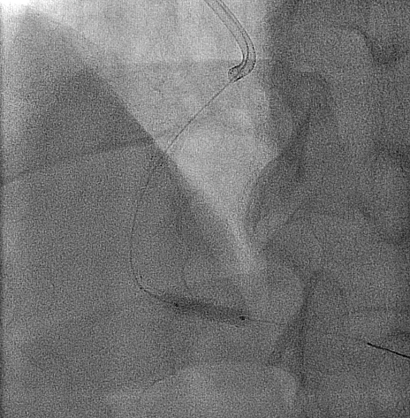
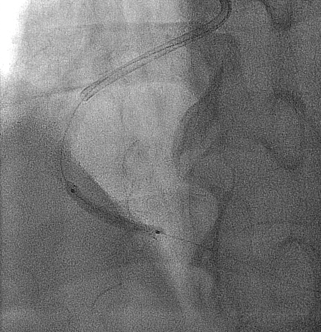
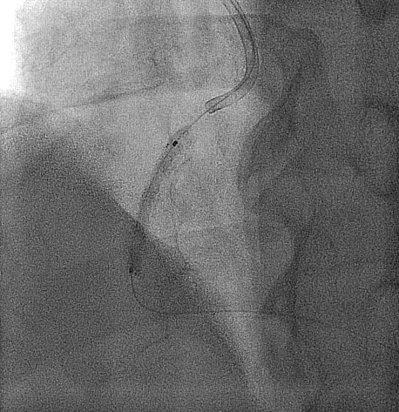
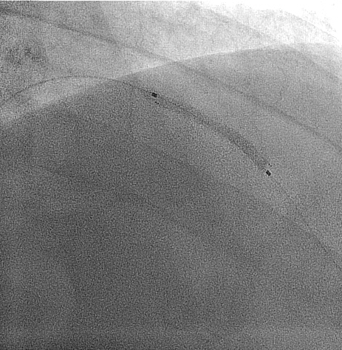
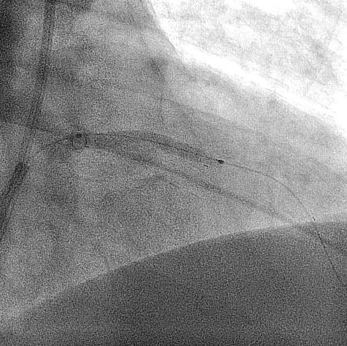
Multiple Overlapping BVSs,
3 Absorbs for RCA, 3.0x15 mm + 3.5x23 mm + 3.5x28 mm
2 Absorbs for LAD,
3.0x28 mm + 3.5x28 mm
Notes:
Pre balloon & BVS inflation할 때는 LAO view로만 촬영. 나머지는 RAO cranial로 촬영되어 있음.
40

Slide 41
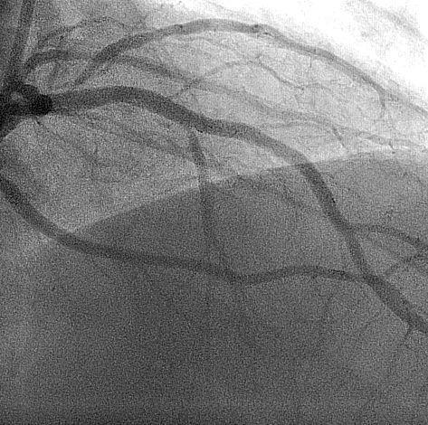
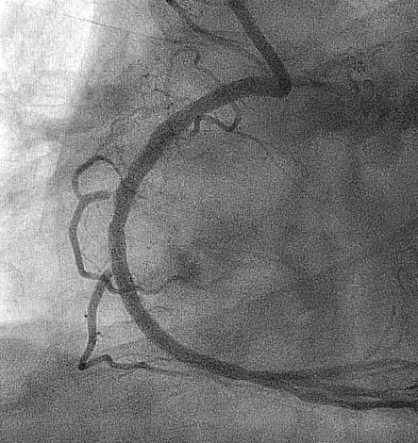
MutiVessel, Multiple Overlapping Absorbs
5 BVSs in A Patient,
2 Absorbs
3 Absorbs
Notes:
marker

Slide 42
Appropriate Use of Absorb in Current Practice
Appropriate
Not Yet
Young Age <70 years
Diabetes
STEMI
Multi-vessel Disease
Long Lesion
Bifurcation (Provisional)
CTO
Bifurcation (2 stents)
Severe Calcification
ISR
Notes:
The original promise has been fulfilled, of VRT regarding vessel restoration has been demonstrated by RCT and registry in whose procedural success efficacy safety and event rate were comparable to DES.

Slide 43
What do I need to Know to Use the
Absorb Scaffold Appropriately?
Is Imaging guided BVS implantation mandatory ?
What are the early results in complex lesions compared to those of 2nd Generation DES ?
Is one year DAPT enough ?
Are the long term results really better with Absorb ?

Slide 44
Is Imaging Guided
BVS implantation Mandatory ?

Slide 45
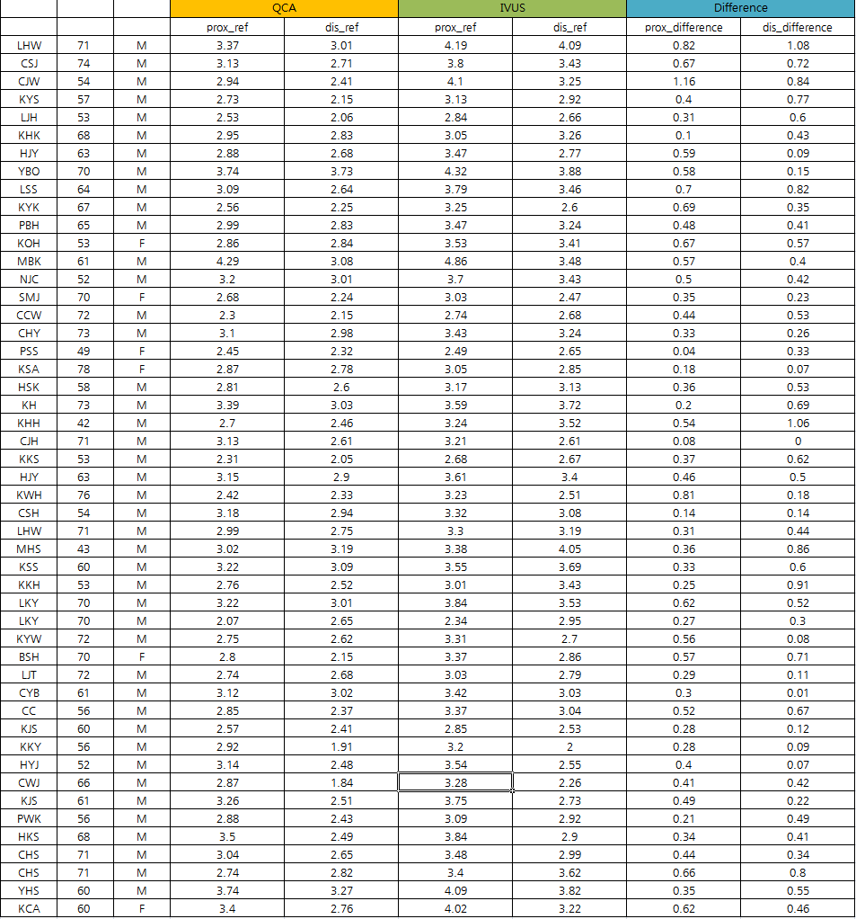
QCA vs. IVUS Difference (n=52)
in Reference Vessel Diameter (RVD)
Proximal Difference 0.44±0.08 mm
Distal Difference 0.45±0.11 mm
< 0.5 mm Larger RVD by IVUS
Compared to QCA

Slide 46
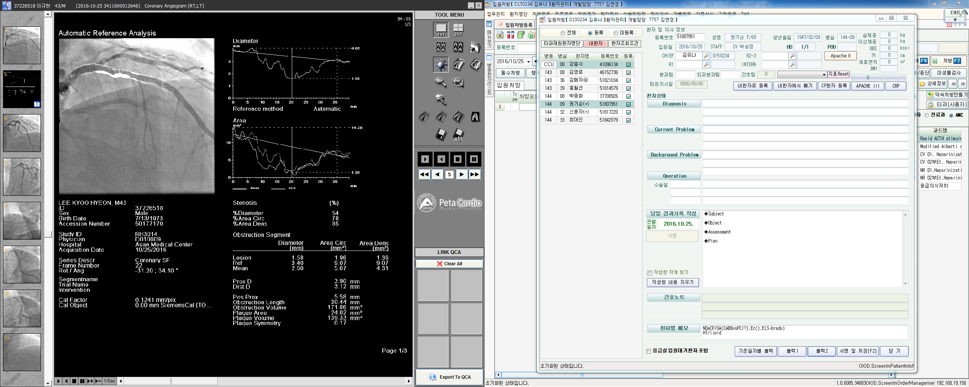
How to Do QCA guided Absorb ?
QCA Proximal RD
3.7 mm
QCA
Distal RD
3.0 mm
P
3.0x 20 mm NC balloon pre-dilation
S
3.5x 28 mm Absorb deployed
P
3.5 mm NC balloon post-dilation for distal part and 4.0x 15 mm NC balloon post-dilation for proximal part
Notes:
proximal reference 0.42
distal reference 0.42

Slide 47
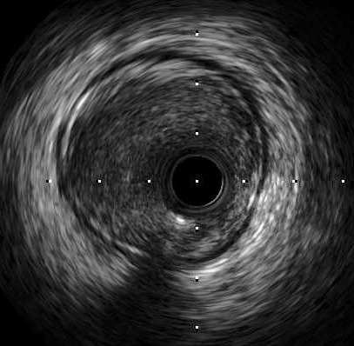
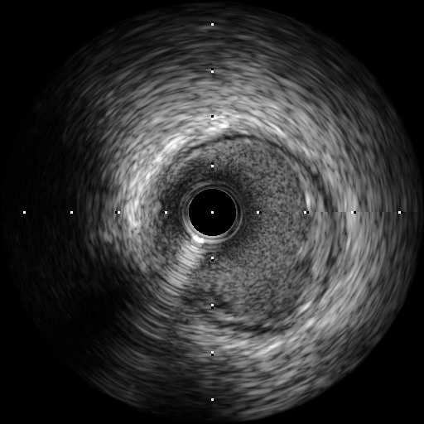
How to Do IVUS guided Absorb ?
Exactly Same Procedure !
QCA Proximal RD
3.7 mm
QCA
Distal RD
3.0 mm
IVUS RD
4.2 mm
IVUS RD
3.5 mm
P
3.0x 20 mm NC balloon pre-dilation
S
3.5x 28 mm Absorb deployed
P
3.5 mm NC balloon post-dilation for distal part and 4.0x 15 mm NC balloon post-dilation for proximal part
Notes:
proximal reference 0.42
distal reference 0.42

Slide 48
AMC PSP
QCA Guided
IVUS Guided
Pre-
Dilation
Pre-dilation with NC balloon, 1:1 matched QCA RVD
Pre-dilation with NC balloon, 1:1 matched distal RVD
P
S
Sizing
Absorb, 1:1 matched
proximal QCA RVD
Absorb, 1:1 matched
distal RVD
P
Post-
Dilatation
Post-dilation with NC balloon, 0.5 mm larger size
(but ≤ +0.5mm, >14atm).
IVUS guided Post-dilation with NC balloon

Slide 49
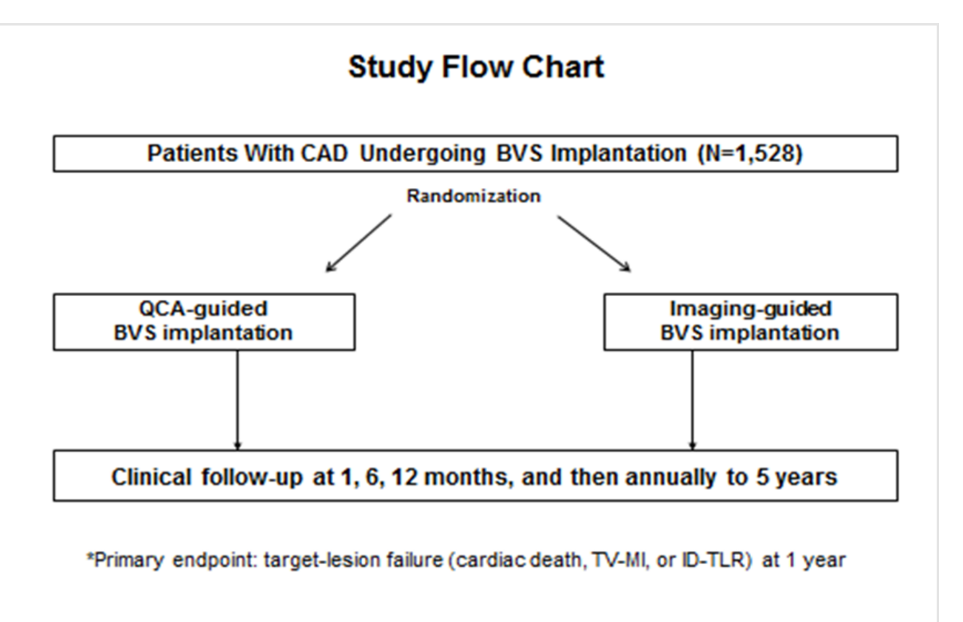
QCA guided vs. Imaging guided
GUIDE-BVS

Slide 50
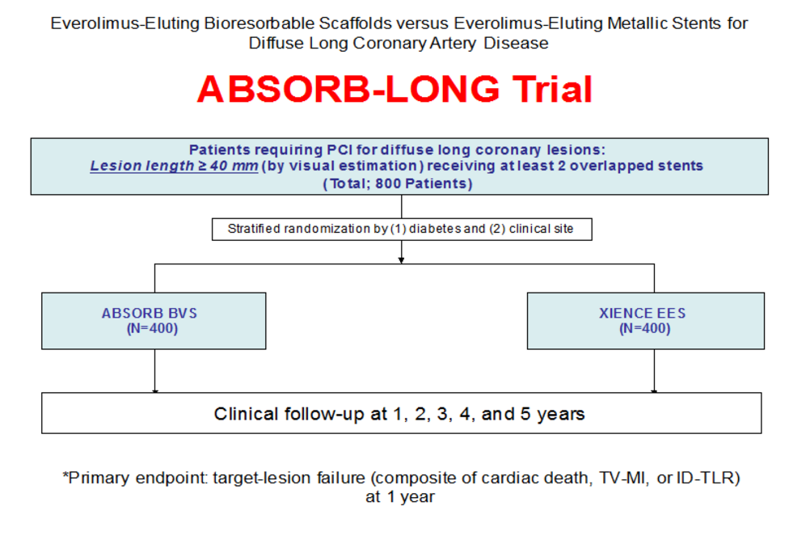
BVS for Long Lesion (>40mm)

Slide 51
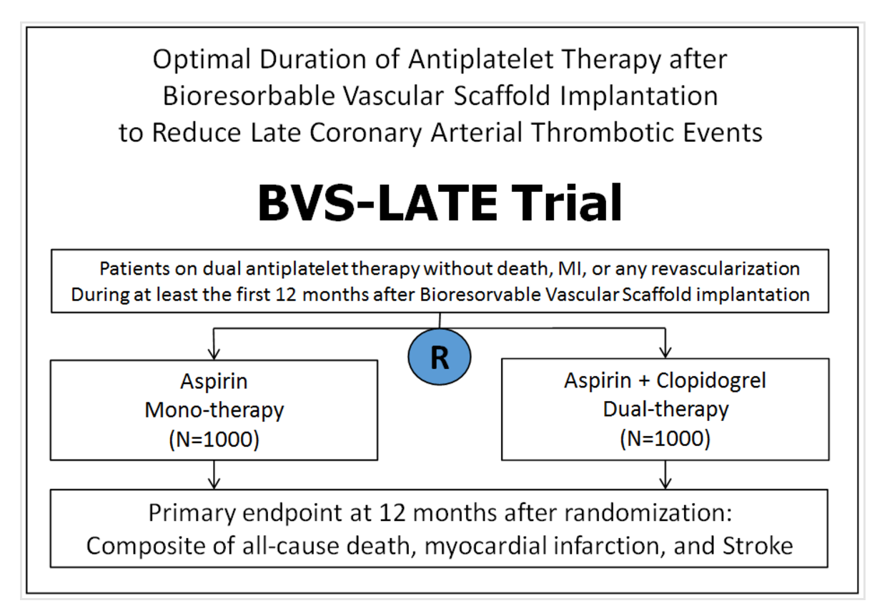
How Long DAPT ?
BVS-LATE trial

Slide 52
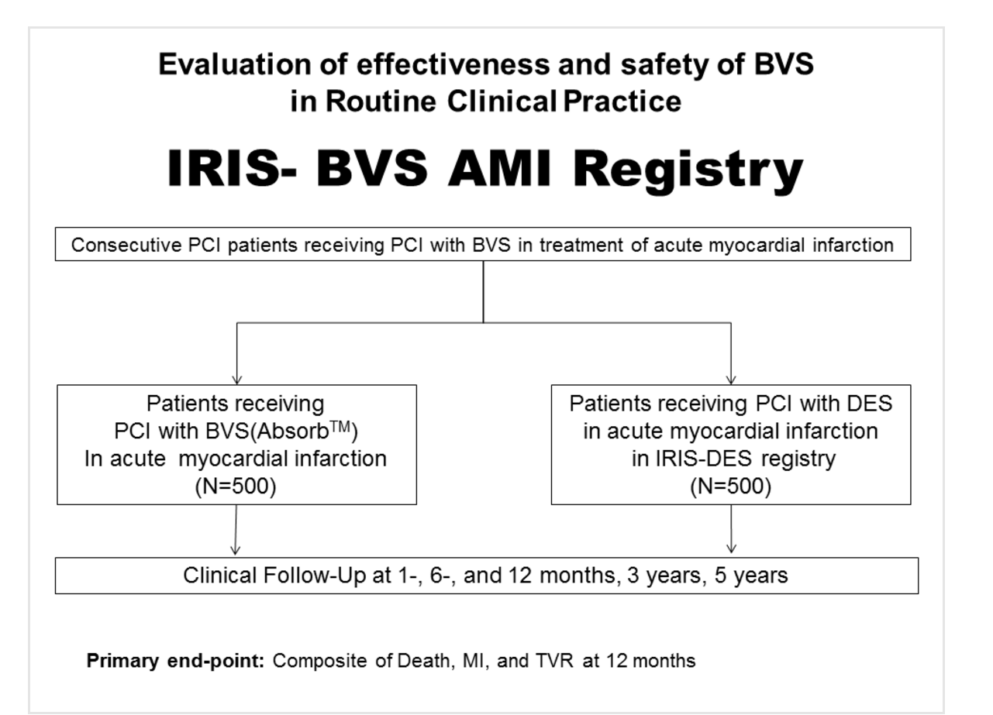
BVS for AMI patients
IRIS-BVS AMI Registry

Slide 53
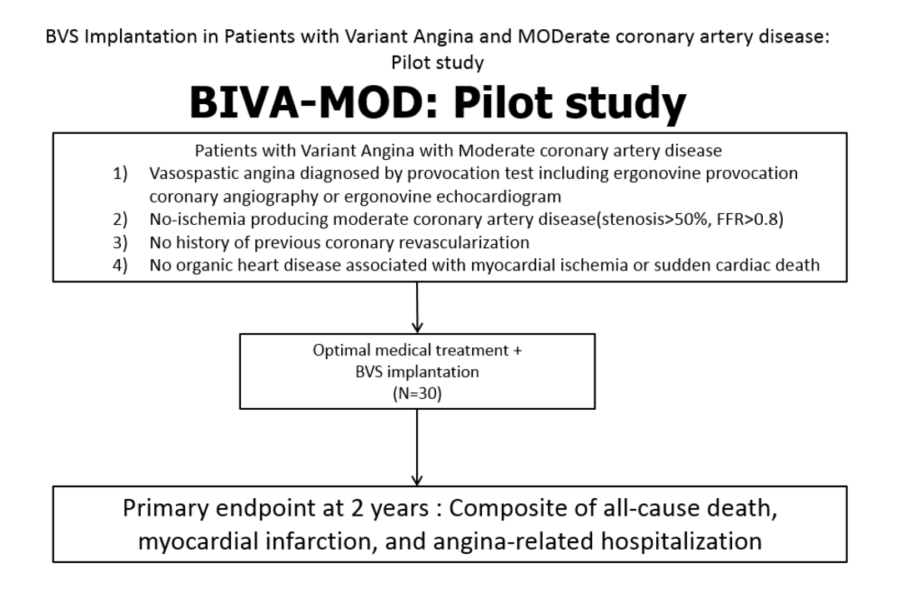
BVS for Variant Angina
BIVA-MOD: Pilot study

Slide 54
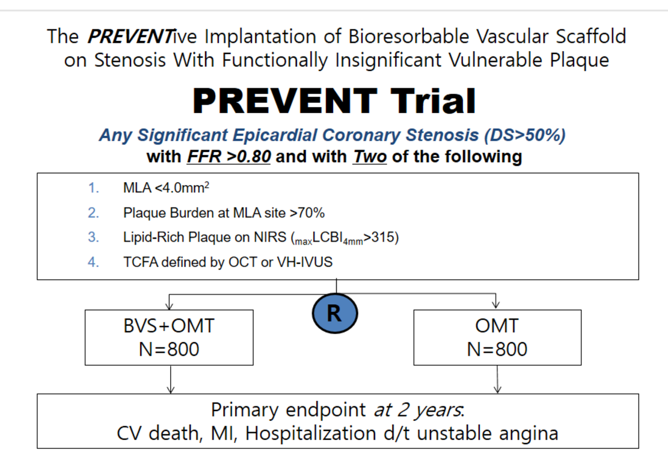
BVS for Vulnerable Plaque
PREVENT Trial

Slide 55
What do I need to Know to Use the
Absorb Scaffold Appropriately?
Is Imaging guided BVS implantation mandatory ?
What are the early results in complex lesions compared to those of 2nd Generation DES ?
Is one year DAPT enough ?
Are the long term results really better with Absorb ?
We Will Have More Answer
From Randomized Studies in Near Future.

Slide 56

Thank You !!
summitMD.com

Slide 58
Bio-absorbable Vascular Scaffold
(BVS)
From Concept
to Clinical Evidence
Notes:
The original promise has been fulfilled, of VRT regarding vessel restoration has been demonstrated by RCT and registry in whose procedural success efficacy safety and event rate were comparable to DES.

Slide 59
Metallic Stent Events Beyond 1 year
Very Late Thrombosis / Restenosis
Possible causes
Uncovered stent struts (thrombosis)
Persistent stimulation of SMCs, from adherent fibrin and/or loss of normal vessel curvature
Abnormal shear stress from protruding struts and/or loss of cyclic strain relief (compliance mismatch)
Chronic inflammation due to late foreign body reactions and polymer hypersensitivity
Positive remodeling with strut malapposition
Strut fracture
Neoatherosclerosis

Slide 60
SPIRIT III: Target Lesion Failure @5 years
30%
XIENCE V (n=669)
5-year HR
TAXUS Express (n=332)
0.64 [0.46, 0.89]
25%
p=0.008
1-year HR
20%
0.56 [0.34, 0.90]
19.0%
TLF (%)
p=0.01
Δ6.3%
15%
9.2%
10%
12.7%
Δ3.8%
5%
5.4%
~2%/yr event rate after year 1
0%
0
6
12
18
24
30
36
42
48
54
60
Months
Number at risk
XIENCE V | 669 | 646 | 616 | 601 | 582 | 571 | 565 | 548 | 537 | 529 | 521
TAXUS | 332 | 310 | 288 | 274 | 269 | 262 | 255 | 248 | 243 | 231 | 223
TLF = cardiac death, target vessel MI, or ischemic-driven TLR
Stone GW et al. JACC 2011 (abstract)

Slide 61
Target Lesion Failure
100%
Absorb BVS (n=1322)
Xience CoCr-EES (n=686)
80%
6.0% vs. 7.7%
Diff [95% CI] =1.7% [-0.5% to 3.9%]
P_{superiority}=0.16
60%
TLF (%)
40%
20%
0%
0
1
2
3
4
5
6
7
8
9
10
11
12
13
No. at Risk:
Months Post Index Procedure
Absorb
1322
1254
1230
1218
1196
Xience
686
661
651
643
634
Ellis SG et al. N Engl J Med. 2015;373:1905-15

Slide 62
PREVENT Trial
Any Epicardial Coronary Stenosis (< 40 mm) with
FFR ≥0.80 and with Two of the following
Plaque Burden >70%
MLA ≤4.0mm²
TCFA by OCT or VH-IVUS
Lipid-Rich Plaque on NIRS (_{max}LCBI_{4mm}>315)
R
BVS+OMT
N=800
OMT
N=800
Primary endpoint at 2 years:
CV death, MI, Hospitalization d/t unstable angina
OCT sub-study/ NIRS sub-study, (300 patients in each arm at 2 years)

Slide 63
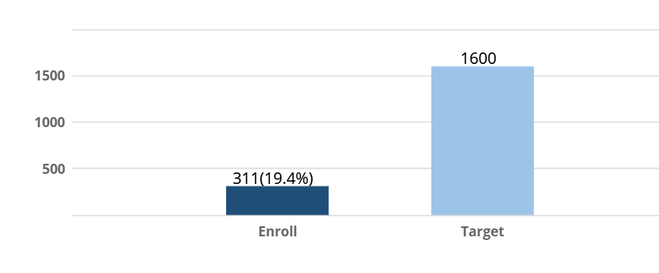
Current Patients Enrollment
2016 Oct.

