Slide 1

TAVR in 2017
Past, Present and Future
E Murat Tuzcu, MD
Professor of Medicine
Chief Academic Officer
Chief, Cardiovascular Medicine
Cleveland Clinic Abu Dhabi
No financial COI

Slide 2
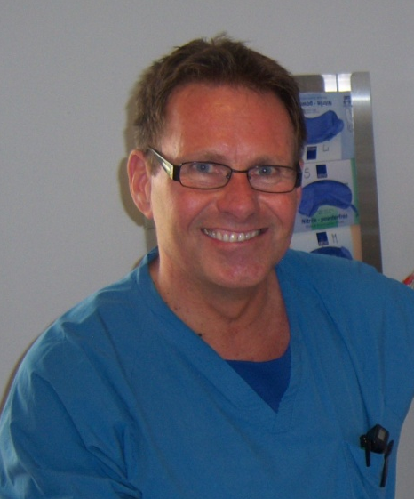
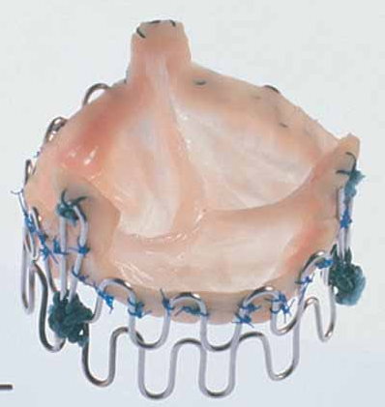
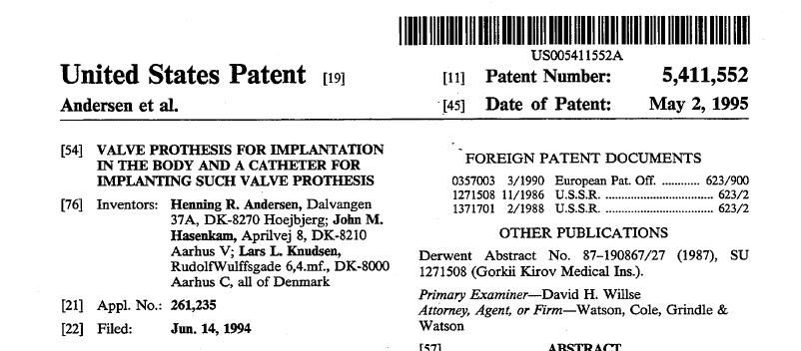
Andersen Valve
1992

Slide 3
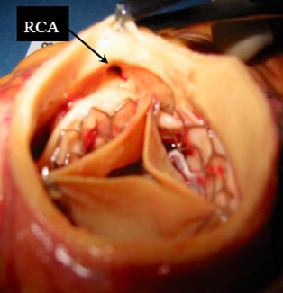
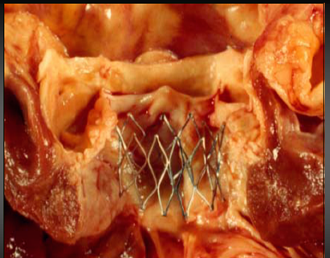
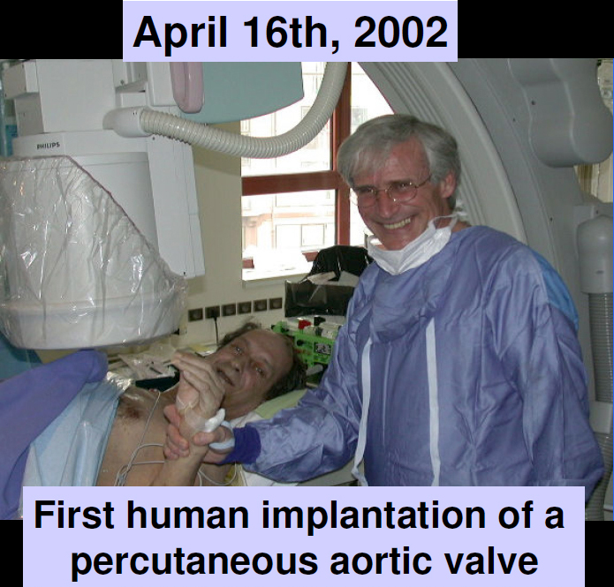
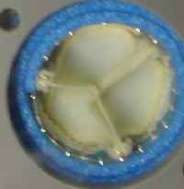
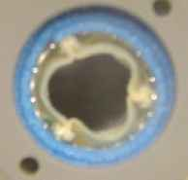
Transcatheter Aortic Valve Replacement
April 16, 2002
Dr. Alain Cribier

Slide 4
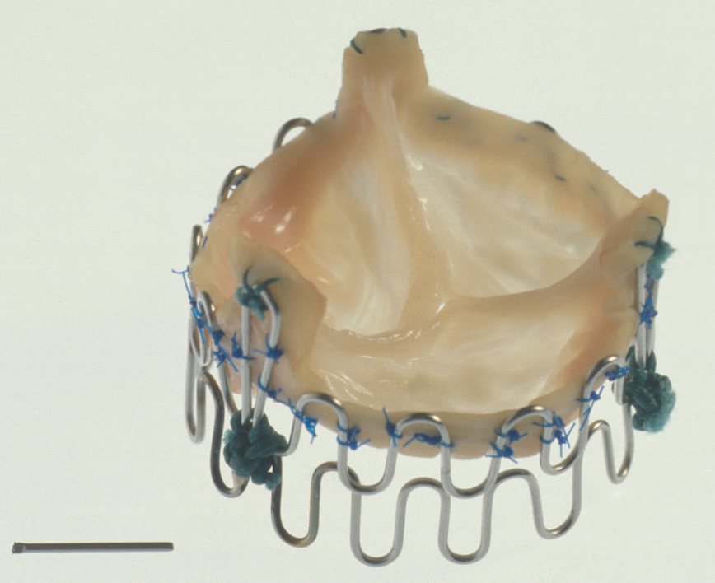
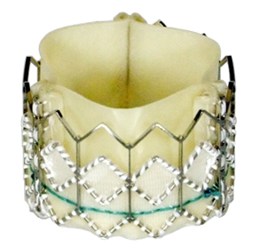
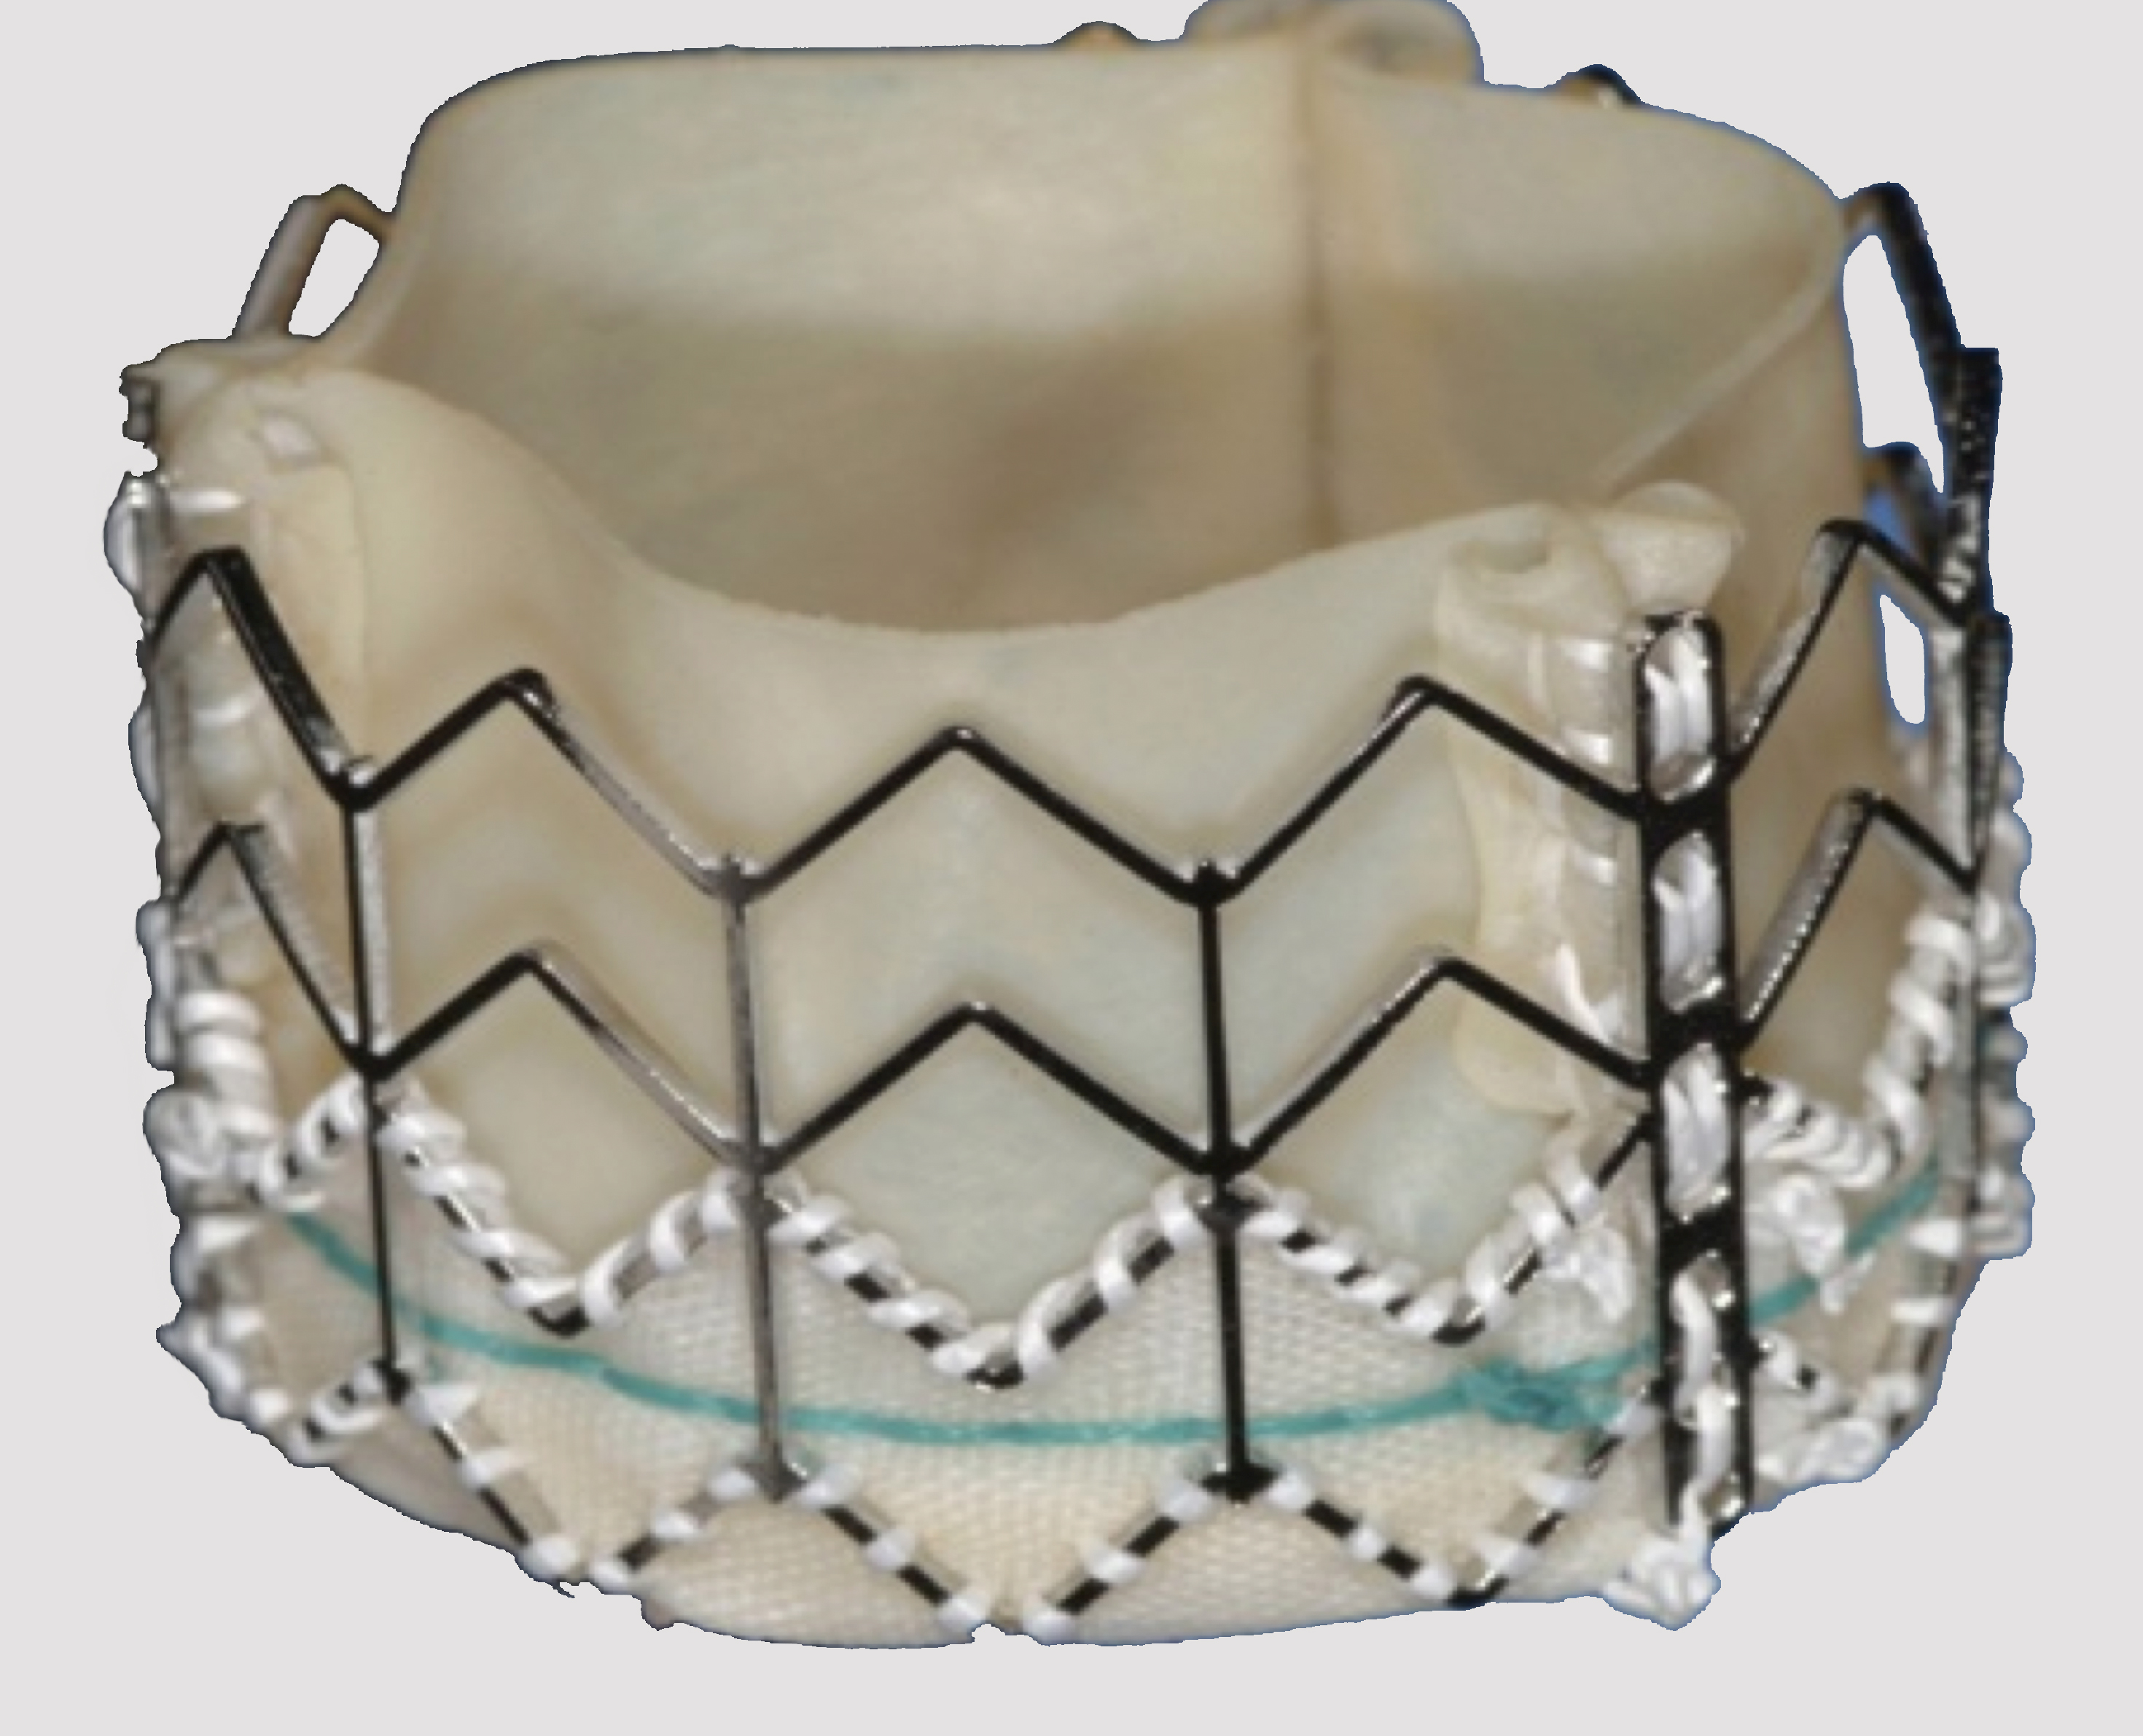
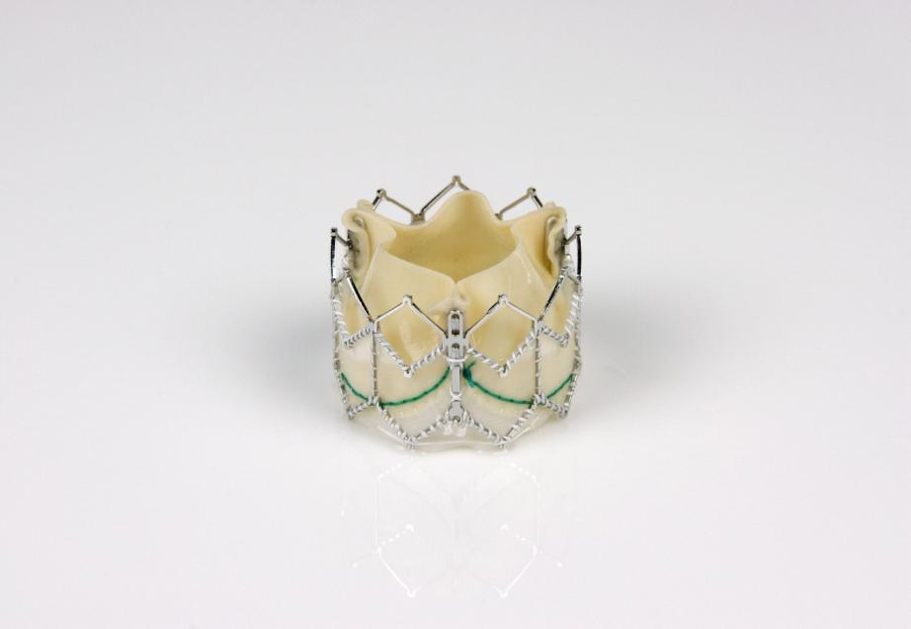
Edwards Transcatheter Valve Evolution
Untreated
Equine Tissue
Untreated
Equine Tissue
Treated
Bovine Tissue
TFX Treated
Bovine /CC
Bovine/CC Skirt lower 1/3
Andersen
Pig implant, 5/89
Cribier-Edwards™
FIM, 4/15/02
Edwards SAPIEN™
8/07
Sapien XT™
1/10
Sapien 3™
2013
Notes:
4
4
4

Slide 5
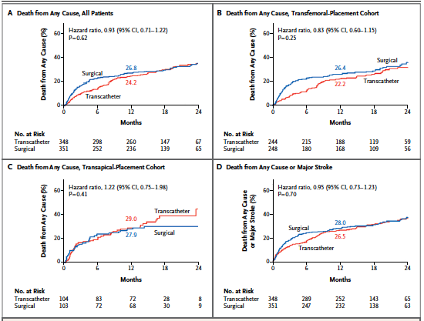
PARTNER-A: TAVR vs SAVR
Mortality, CV Mortality, Hospitalization, Stroke
Smith et al. NEJM 2011

Slide 6
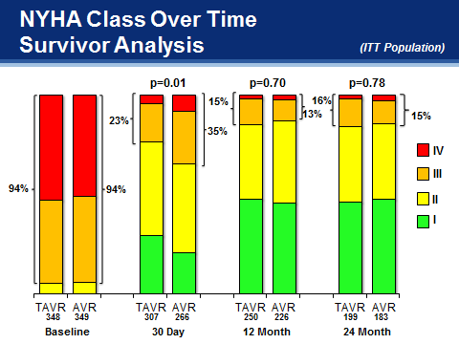
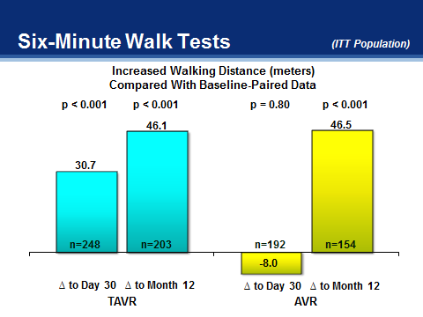
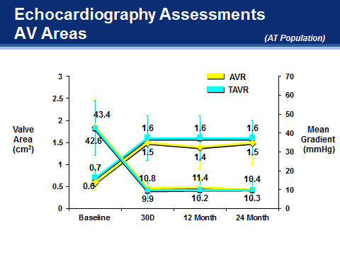
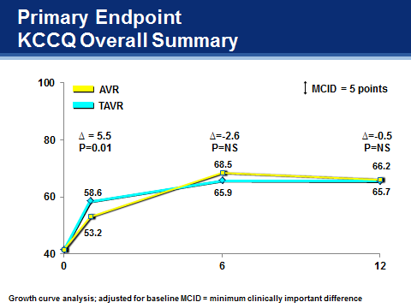
PARTNER-A: TAVR vs SAVR
NHYA, 6 minute walk, KCCQ, AVA
Smith et al. NEJM 2011
Notes:
Focusing on endpoints that reflect four dimensions of benefit, it is clear in this graphical representation of similar data that both AVR and TAVR markedly improve valve area and gradient, NYHA Class, KCCQ QOL parameters, and 6MWD.

Slide 7
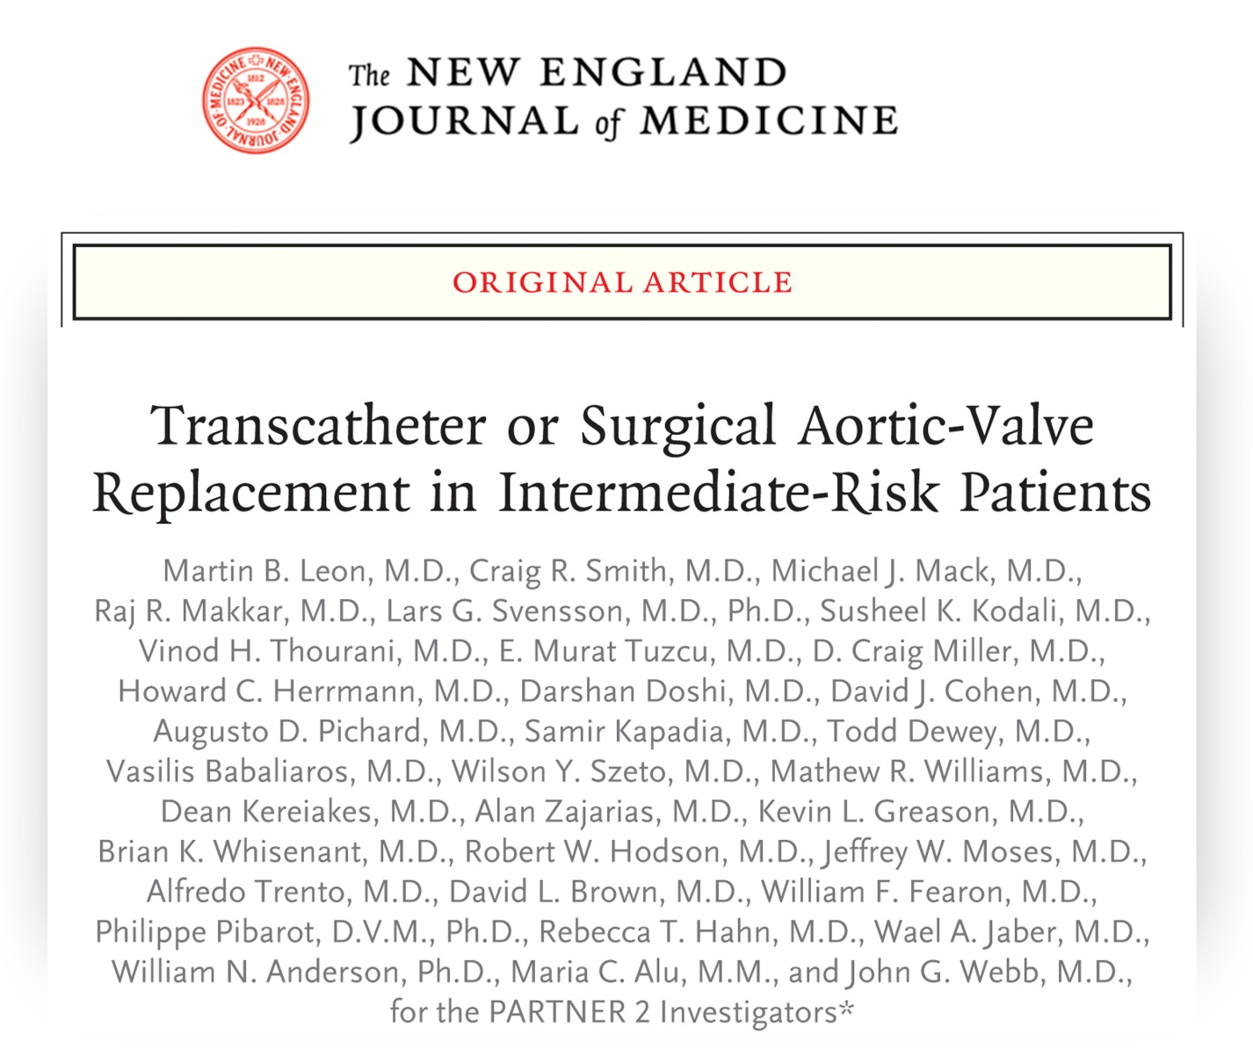
The PARTNER 2A Trial
NEJM On-line

Slide 8
TF Primary Endpoint (AT)
All-Cause Mortality or Disabling Stroke
1
50
TF Surgery
HR: 0.78 [95% CI: 0.61, 0.99]
TF TAVR
p (log rank) = 0.04
40
30
All-Cause Mortality or Disabling Stroke (%)
20.0%
20
15.8%
7.5%
16.3%
10
11.7%
0
4.5%
0
3
6
9
12
15
18
21
24
0
Number at risk:
Months from Procedure
TF Surgery
722
636
624
600
591
573
565
555
537
TF TAVR
762
717
708
685
663
652
644
634
612

Slide 9
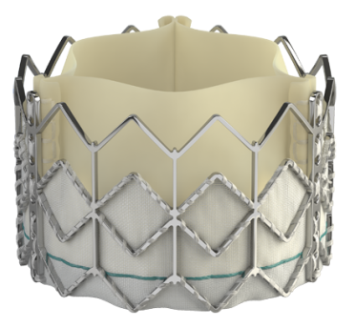
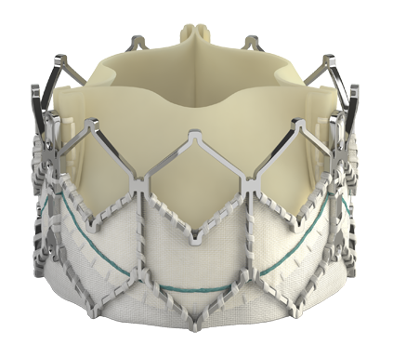
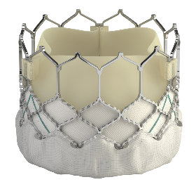
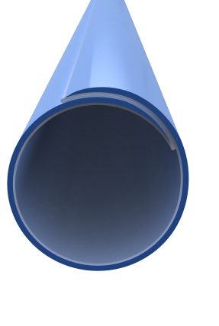

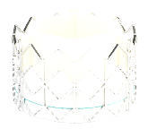








PARTNER SAPIEN Platforms
Device Evolution
Valve Technology | SAPIEN |  | SAPIEN XT |  |  | SAPIEN 3
Sheath Compatibility
Available Valve Sizes
 | 23 mm | 26 mm |  |  |  | 20 mm | 23 mm | 26 mm | 29 mm
22-24F
16-20F
14-16F
  23mm
  26mm
  29mm*
*First Implant Oct 30, 2012

Slide 10
Mortality and Stroke: S3i
At 30 Days (As Treated Patients)
Mortality
Stroke
%
O:E = 0.21
(STS 5.3%)
%

Slide 11
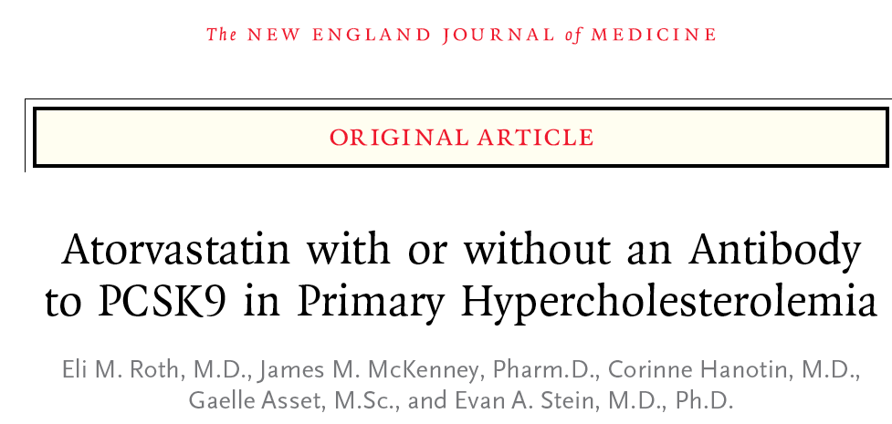
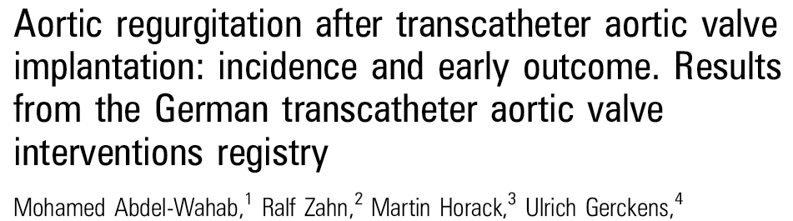
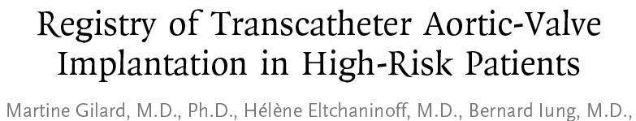

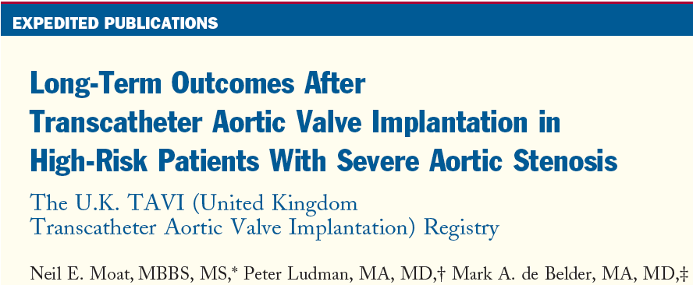
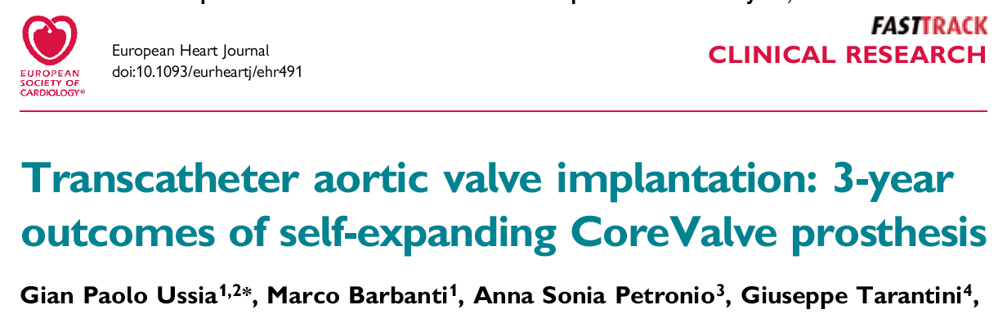

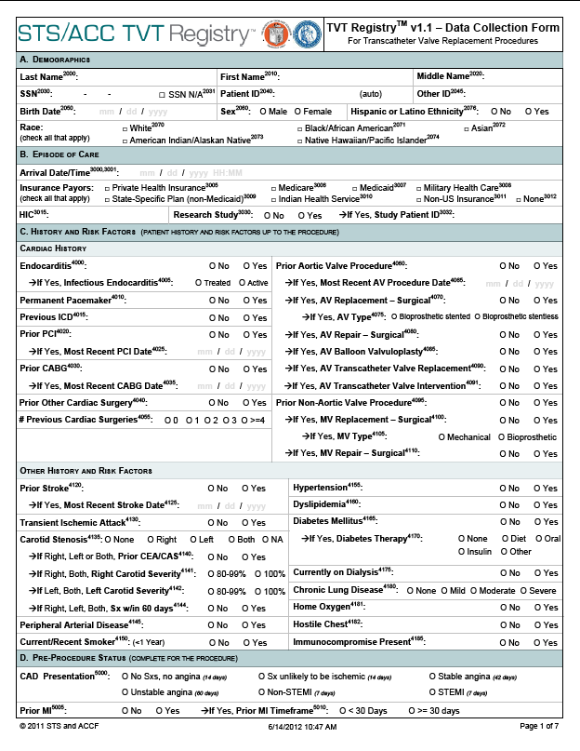



TAVR Registries
et al. Heart 2011:97;899-906
et al. NEJM 2012:366;1705-15
French TAVI Registry
et al. Heart 2011:97;899-906
Italian TAVI Registry
et al. JACC 2011:58;2130-8
A Snapshot from the Ongoing Australia-New Zealand Medtronic CoreValve® Registry
Ian T. Meredith
On behalf of the Australia-New Zealand Investigators

Slide 12
TAVR
Challenges
Stroke
Aortic regurgitation
Vascular injury / access
Annulus rupture/ Ao dissection
Coronary obstruction
Conduction abnormality
Durability
Appropriate use / Risk creep
Teamwork
Innovation

Slide 13
TAVR
Challenges
Stroke
Aortic regurgitation
Vascular injury / Access
Annulus rupture/ Ao dissection
Coronary obstruction
Conduction abnormality
Durability
Appropriate use / Risk creep
Teamwork
Innovation

Slide 14
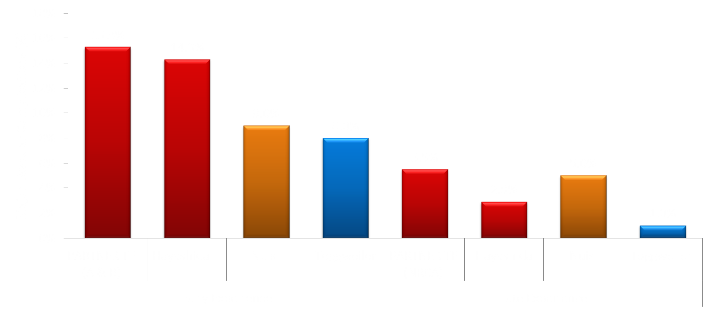
Impact of Experience and “New” TAVR
Systems on Vascular Complications
Fearon, ACC 2013; Hayashida, JACC Card Int 2011; 4(8): 851-8;
Nuis, AJC 2011; 107: 1824-29; Toggweiler, JACC 2012; 59(2): 113-8

Slide 15
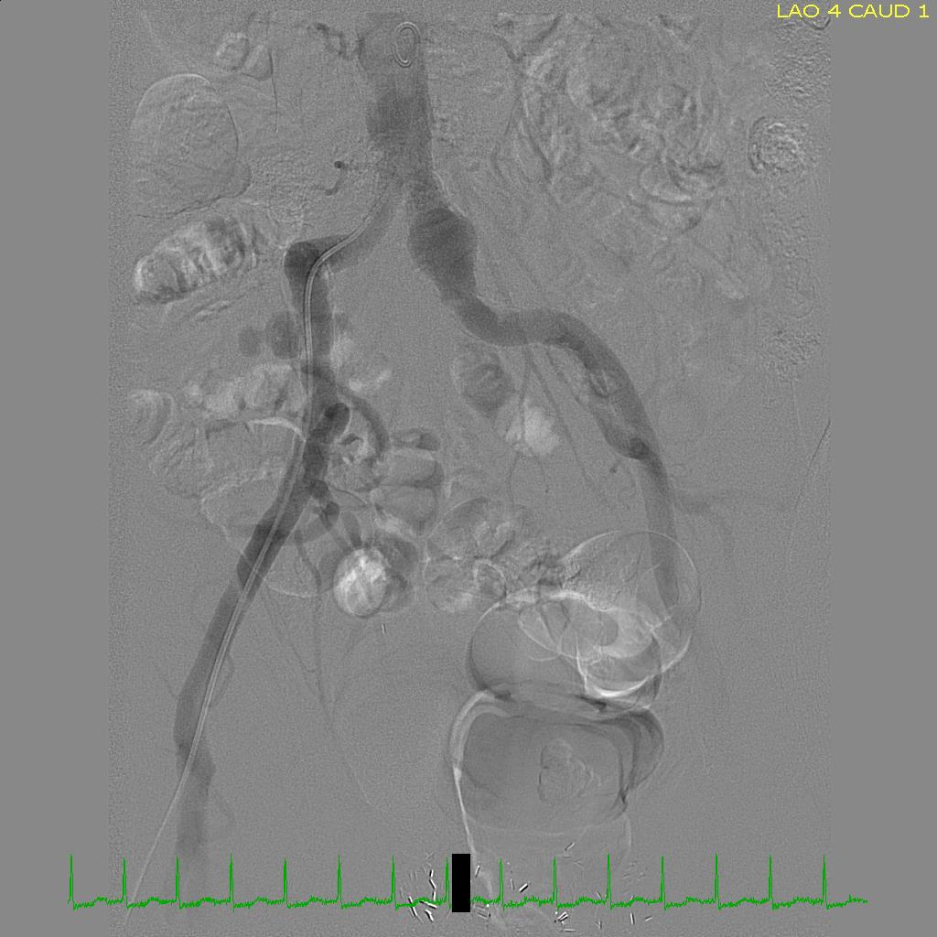
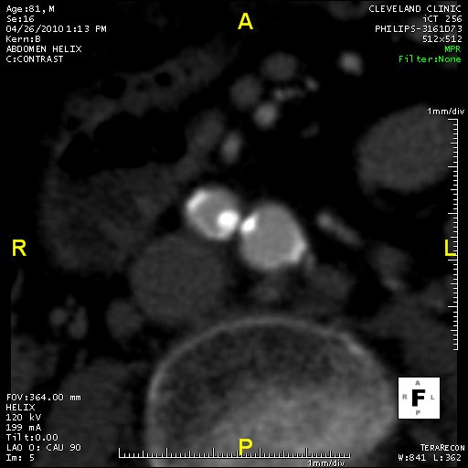
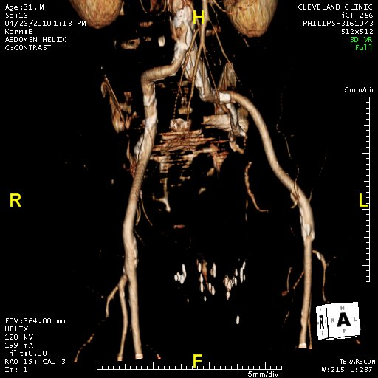
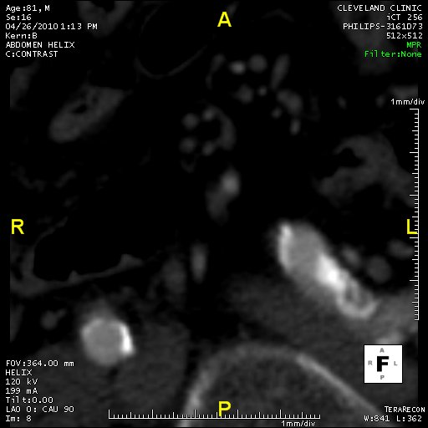
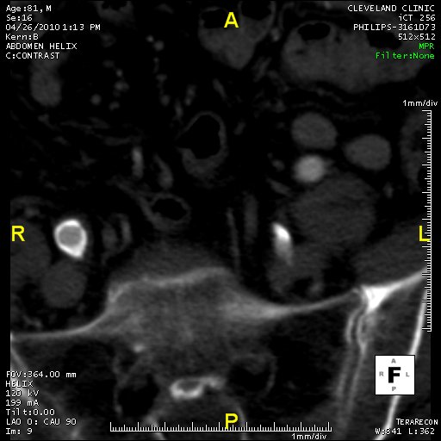
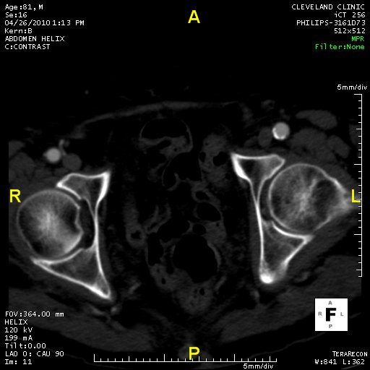
Assessment of Vasculature for Access
Intermediate
Large
No calcium
No tortuosity
Too small
Severe calcification
Severe tortuosity
Poor
Excellent
Adequate size, Moderate calcium, Moderate tortuosity
(IVUS, Stiff wires, “trial”)

Slide 16
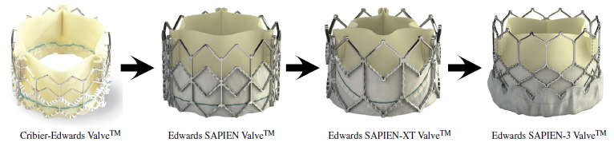
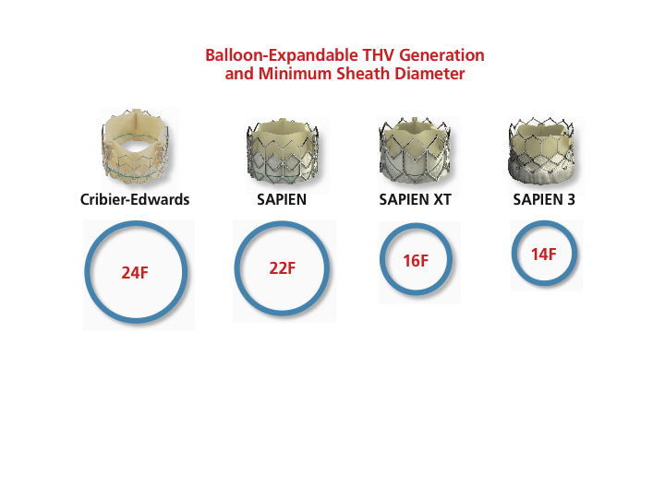
Evolution of the Edwards Balloon-Expandable Transcatheter Valves
Cribier-Edwards
SAPIEN
SAPIEN XT
SAPIEN 3
2002
2006
2009
2013
* Sheath compatibility for a 23 mm valve

Slide 17
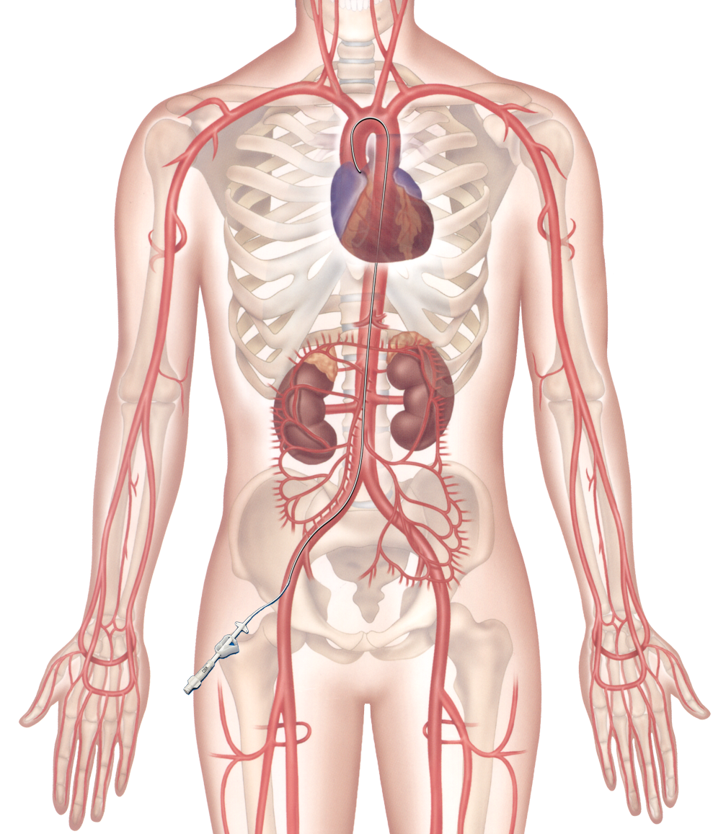
TAVR – 2016
Access Alternatives
Transcarotid
Transmediastinal
Direct
aortic
Transsubclavian
Transapical
Transcaval
Iliac-aortic
conduits
Transvenous
(Antegrade)
Transfemoral
Notes:
17
This is the Bulleted List slide.
To create this particular slide, click the NEW SLIDE button on your toolbar and choose the BULLETED LIST format. (Top row, second from left)
The Sub-Heading and footnote will not appear when you insert a new slide. If you need either one, copy and paste it from the sample slide.
If you choose not to use a Sub-Heading, let us know when you hand in your presentation for clean-up and we’ll adjust where the bullets begin on your master page.
Also, be sure to insert the presentation title onto the BULLETED LIST MASTER as follows:
Choose View / Master / Slide Master from your menu.
Select the text at the bottom of the slide and type in a short version of your presentation title.
Click the SLIDE VIEW button in the lower left hand part of your screen to return to the slide show. (Small white rectangle)

Slide 18
TAVR
Challenges
Stroke
Aortic regurgitation
Vascular injury / Access
Annulus rupture/ Ao dissection
Coronary obstruction
Conduction abnormality
Durability
Appropriate use / Risk creep
Teamwork
Innovation

Slide 19
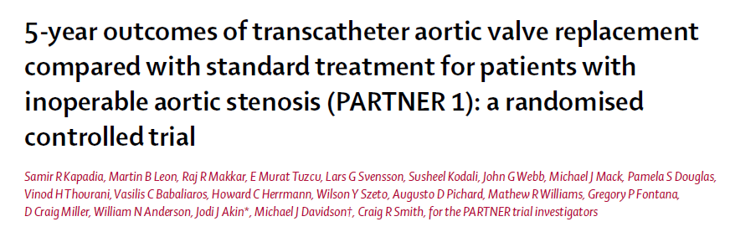
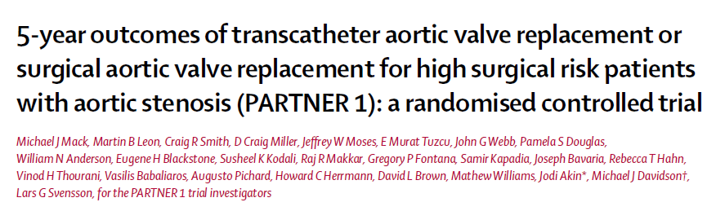
PARTNER 5-year FU in Lancet
(March, 2015)

Slide 20
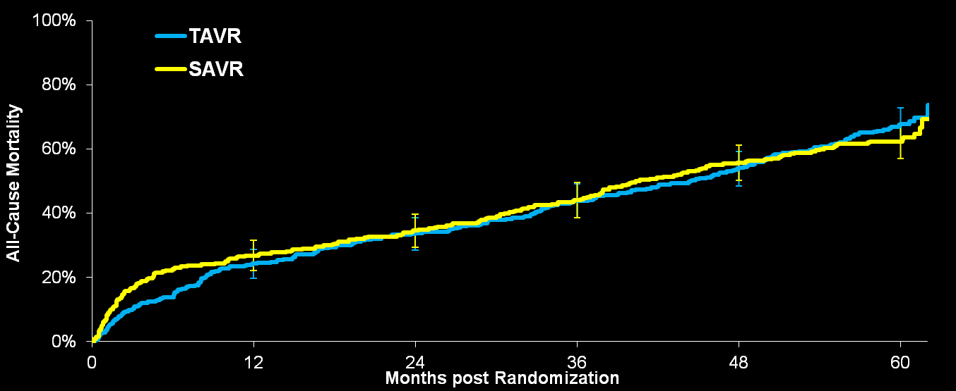
All-Cause Mortality at 5 Years (PARTNER A)
  HR [95% CI] =
  1.04 [0.86, 1.24]
  p (log rank) = 0.76
67.8%
62.4%
Error Bars Represent 95% Confidence Limits
No. at Risk
TAVR | 348 | 262 | 228 | 191 | 154 | 61
SAVR | 351 | 236 | 210 | 174 | 131 | 64
Mack ACC 20015

Slide 21
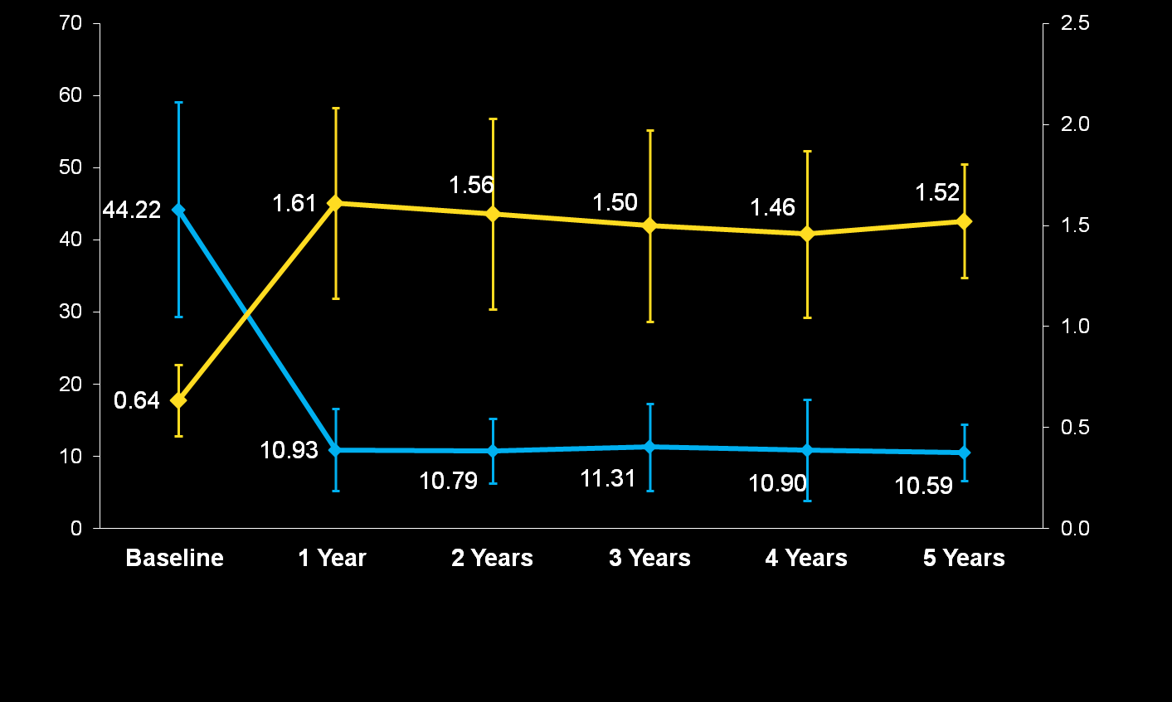
Mean Gradient & Valve Area (AT)
EOA
Mean Gradient
  Error bars = ± 1 Std Dev
Mean Gradient (mmHg)
Valve Area (cm²)
159 | 86 | 70 | 44 | 31 | 15
163 | 91 | 71 | 46 | 31 | 15
N =
Mack ACC 20015
Notes:
21

Slide 22
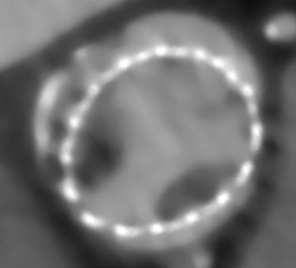
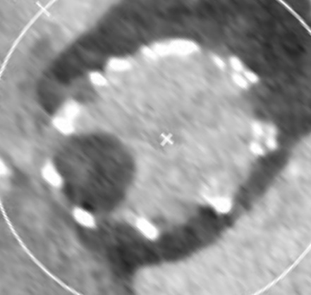
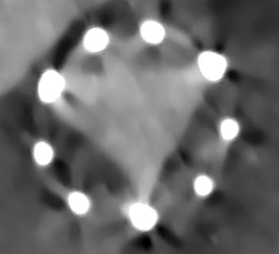
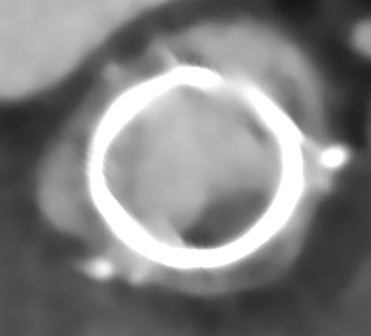
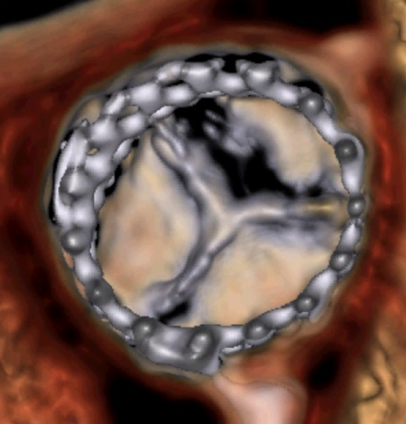
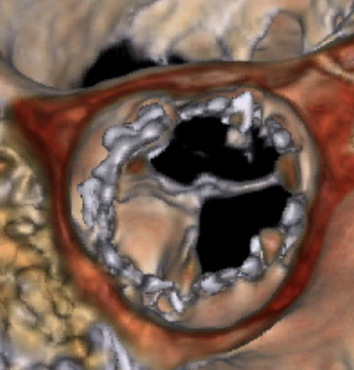
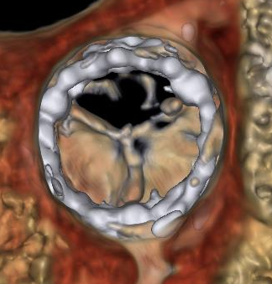





Reduced leaflet motion was observed in all valve types including surgical bioprostheses
Corevalve
Portico
Sapien
Perimount surgical valve
Diastole
Systole

Slide 23
Who Should Have TAVR?
Operable AS patients
Inop pts
Surgery (AVR)
TAVR ???
TAVR
or
AVR
TAVR
or
AVR
TAVR
Futile
65-80%
15-25%
5-10%
Low
Risk
Intermed
Risk
High
Risk
Extreme
Risk*
Too
Sick
TAVR in 2016
No
Preferred
“Equipoise”
Acceptable
Acceptable
Notes:
23
This is the Bulleted List slide.
To create this particular slide, click the NEW SLIDE button on your toolbar and choose the BULLETED LIST format. (Top row, second from left)
The Sub-Heading and footnote will not appear when you insert a new slide. If you need either one, copy and paste it from the sample slide.
If you choose not to use a Sub-Heading, let us know when you hand in your presentation for clean-up and we’ll adjust where the bullets begin on your master page.
Also, be sure to insert the presentation title onto the BULLETED LIST MASTER as follows:
Choose View / Master / Slide Master from your menu.
Select the text at the bottom of the slide and type in a short version of your presentation title.
Click the SLIDE VIEW button in the lower left hand part of your screen to return to the slide show. (Small white rectangle)

Slide 24
TAVR
Challenges
Stroke
Aortic regurgitation
Vascular injury / Access
Annulus rupture/ Ao dissection
Coronary obstruction
Conduction abnormality
Durability
Appropriate use / Risk creep
Teamwork
Innovation

Slide 25
Current and Future TAVR Systems
Sapien 3
Evolut R
Shanghai Valve
Trinity
Colibri
Inovare
Thubrikar
Valve Medical
Syntheon Verso
Triskele
BioValve
MyVal
HLT
NVT (Nautilus)
J - Valve
Xeltis
Zurich TEHV
Direct Flow
Lotus
Portico
Symetis
Engager
Jena Valve
Centera
Venus A Valve

Slide 26



Atthapan et al. Eurointervention 2011;11:1034-43

Slide 27

New TAVR Devices
30-Day Mortality
Meta-analysis of ~20 non-randomized, mostly FIM, industry sponsored studies
5.7% at 30-days
Atthapan et al. Eurointervention 2016;11:1034-43

Slide 28

New TAVR Devices
30-Day Stroke
Meta-analysis of ~20 non-randomized, mostly FIM, industry sponsored studies
2.4% at 30-days
Atthapan et al. Eurointervention 2016;11:1034-43

Slide 29

New TAVR Devices
Moderate-Severe AR
Meta-analysis of ~20 non-randomized, mostly FIM, industry sponsored studies
3.2% at 30-days

Slide 30

New TAVR Devices
Pacemaker Rate
Meta-analysis of ~20 non-randomized, mostly FIM, industry sponsored studies
13.5% at 30-days

Slide 31

The train has left the station, and it ain’t coming back

