Slide 1
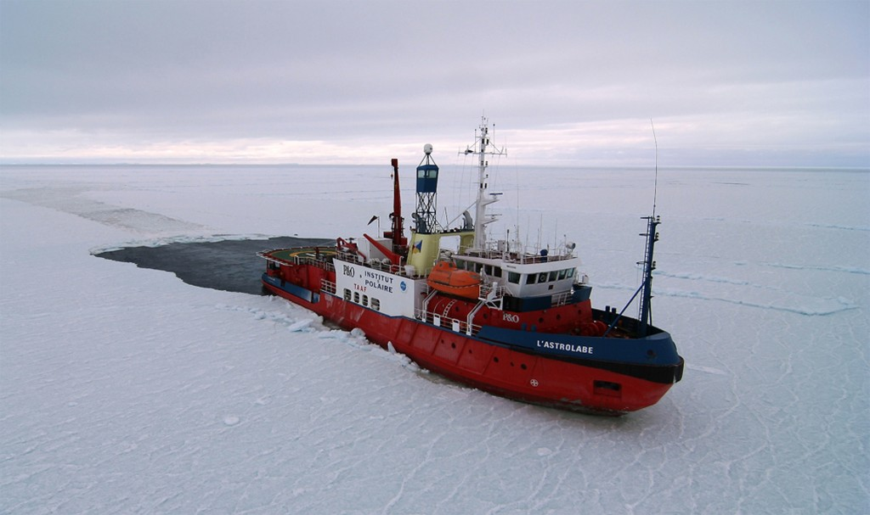
Prediction of Guidewire Crossing of CTO by Pre-Procedural Coronary CT Angiography
KCCT (Korean CTO CT multicenter registry) Score as a Tool for Assessing Difficulty in CTO PCI
Jin-Ho Choi, Cheol-Woong Yu, Hyun-Jong Lee, Jon Suh, Nae-Hee Lee, Sang-Min Park
Samsung Medical Center, Sejong General Hospital, Korea University Anam Hospital, and Soonchunhyang University Bucheon Hospital
2016-12-10, JCR, Busan, Korea

Slide 2
Prediction of Guidewire Crossing of CTO by Pre-Procedural Coronary CT Angiography
KCCT (Korean CTO CT multicenter registry) Score as a Tool for Assessing Difficulty in CTO PCI
Jin-Ho Choi, Cheol-Woong Yu, Hyun-Jong Lee, Jon Suh, Nae-Hee Lee
Samsung Medical Center, Sejong General Hospital, Korea University Anam Hospital, and Soonchunhyang University Bucheon Hospital
2016-07-21, TOPIC, Tokyo, Japan

Slide 3
Prediction of Guidewire Crossing of CTO by Pre-Procedural Coronary CT Angiography
KCCT (Korean CTO CT multicenter registry) Score as a Tool for Assessing Difficulty in CTO PCI
Jin-Ho Choi, Cheol-Woong Yu, Hyun-Jong Lee, Jon Suh, Nae-Hee Lee
Samsung Medical Center, Sejong General Hospital, Korea University Anam Hospital, and Soonchunhyang University Bucheon Hospital
2016-06-18, CTO-Club, Nagoya, Japan

Slide 4
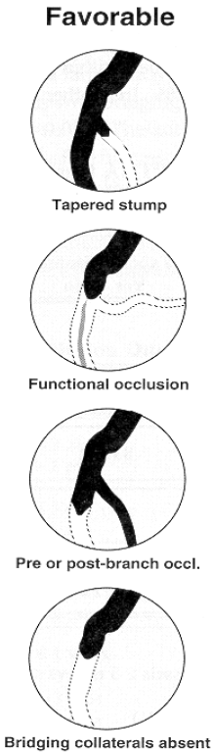
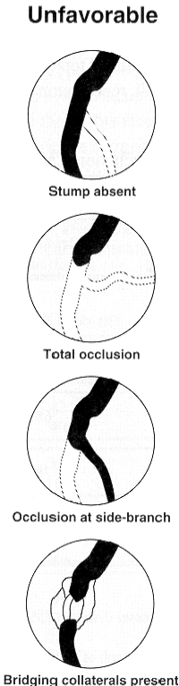
(Traditional) angiographic predictors of CTO PCI success
Favorable
Unfavorable
But, the prediction power is not high!

Slide 5
How to utilize CT for CTO PCI
Before PCI, CT imaging tell us …
  Nature of CTO plaque (Choi JH, Circ J 2011)
  Physiology of CTO (Choi JH, Circ Img 2014; Choi JH, JACC Intv 2015)
  How to plan PCI procedure (case series)
  How to predict PCI procedural success
During PCI, imaging tell us …
  Right course of wire (with CT-angio hybrid system)

Slide 6
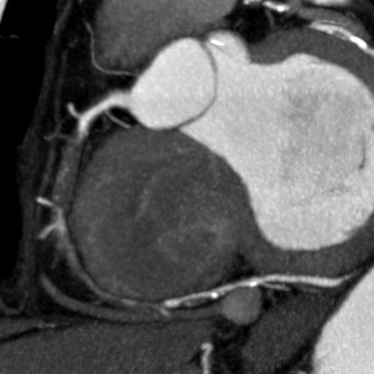
Use of coronary CT for prediction of CTO PCI success
Potential anchor balloon site
Large ostium with horizontal position
‘Tapered’ entry site
No calcification
Straight CTO line
‘Island btw. CTO and distal STO
Distal exit target, distal vessel size (length and diameter), and side branch

Slide 7
Methods
Retrospective multicenter registry
  Samsung Medical Center
  Sejong General Hospital
  Korea University Anam Hospital
  Soonchunhyang University Bucheon Hospital
Inclusion criteria
  Consecutive CTO PCI case with pre-procedural CT within 6 week, Jan 2007 ~ May 2015
Exclusion criteria
  AMI within 90 days by CT acquisition time
  Occlusion of bypass graft or small vessel (diameter < 2.0 mm)
  Inadequate imaging quality

Slide 8
Data Analysis
Coronary CT angiography
  Dedicated workstation (Terarecon iNtuition)
  Automatic vessel tracking and manual modification. All views from CPR rotated by 360 degree and thin-slab MIP with free 3-dimensional rotation.
  The whole CTO plaque was assessed by cross-sectional views with 1-mm interval to assess the maximal luminal and vessel area of CTO, remodeling index, and semi-quantitative extent of calcification
  CT-QCA: lumen area and lesion length.
Invasive coronary angiography
  Anatomical characteristics – stump shape, side branch, collateral
  QCA
PCI
  Time for wire crossing and the end of PCI procedure
  Time for wire crossing <= 30 min
  Final procedural success (TIMI 3 flow with DS < 30%)
Notes:
CCTA analysis was done with an automatic vessel tracking and manual modification,
lengths of each coronary vessel including major branches were measured.
Index of myocardial ischemia was defined as FFR ≤ 0.80

Slide 9
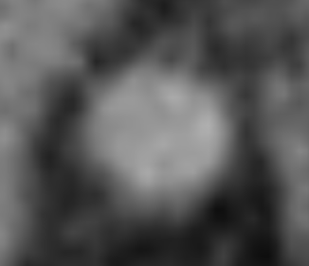
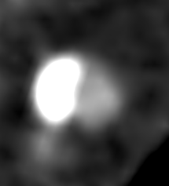
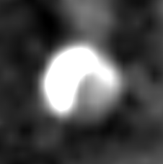

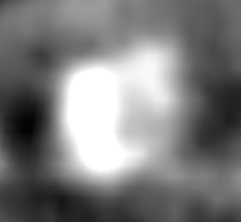

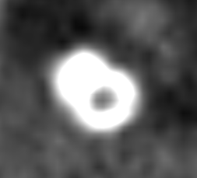
% Calcification CSA (cross-sectional area) ≥ 50% suggests potentially unsuccessful PCI
Cross-sectional Calcium
0%
< 50%
> 50%
100% (full moon)
Crescent moon
Half- and Half-moon
Circular

Slide 10
Cross-sectional calcium: semi-quantitative assessment
Central vs peripheral calc
None
Central involved
Central sparing
≥2.5 mm
0,0
< 180 deg
1,1
< 180 deg
0,1
Applied for vessel diameter ≥2.5 mm
RCA with motion artifact may be excluded
Severe calc (CT-RECTOR wise): central calc =1,2 and/or periph calc = 2,3
≥ 180 deg
1,2
≥ 180 deg
0,2
360 deg (full-moon)
360 deg
0,3
2,3

Slide 11
1. Blunt proximal entry site
Tapered proximal entry site
2. Proximal adjacent side branch
No side branch adjacent to proximal entry site
3. Occlusion length
4. Bend > 45 degree in CTO segment
> 45⁰
Bend ≤ 45 degree or bend in non-CTO segment
5. Calcification
Central calcification (360⁰ and CSA = 100%)
Peripheral calcification: maximal encircling ≥ 180⁰ and CSA ≥ 50%
Mild calcification with encircling < 180⁰ or CSA < 50%
No calcification
Total score (sum of all points) = points
Category: □ Easy (0) □ Intermediate (1) □ Difficult (2) □ Very difficult (3) □ Extremely difficult (≥4)
Notes:
CCTA analysis was done with an automatic vessel tracking and manual modification,
lengths of each coronary vessel including major branches were measured.
Index of myocardial ischemia was defined as FFR ≤ 0.80

Slide 12
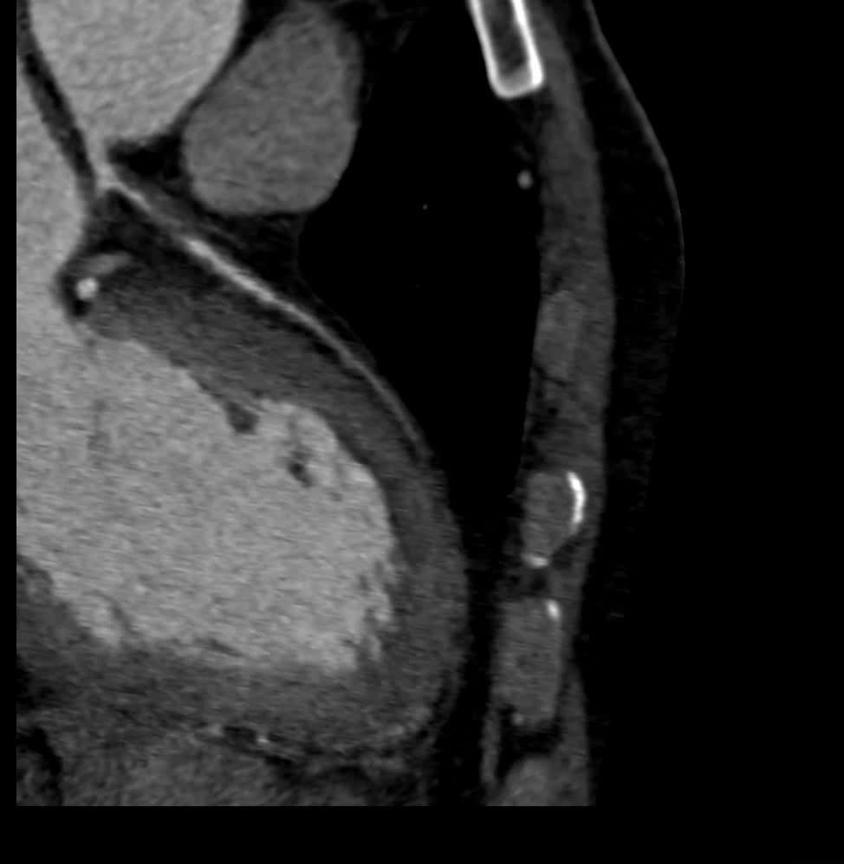
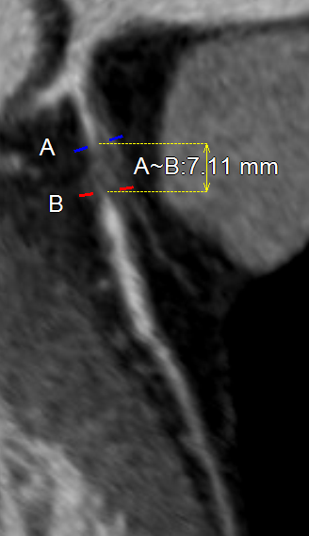
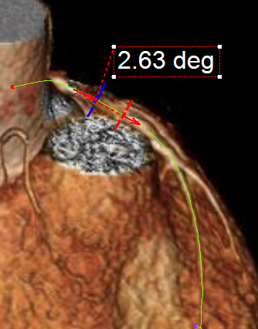
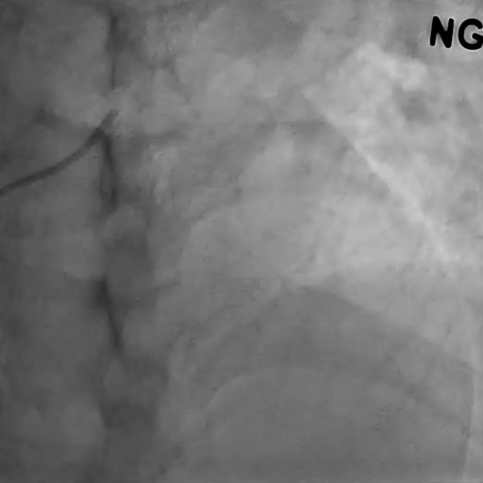
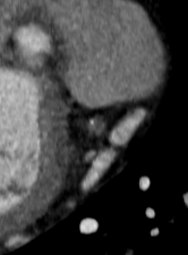
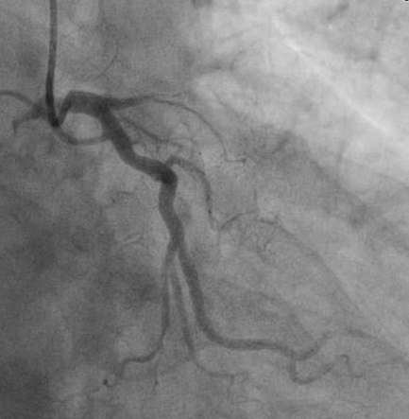
Successful guidewire crossing ≤ 30 min
A
B
C
D

Slide 13
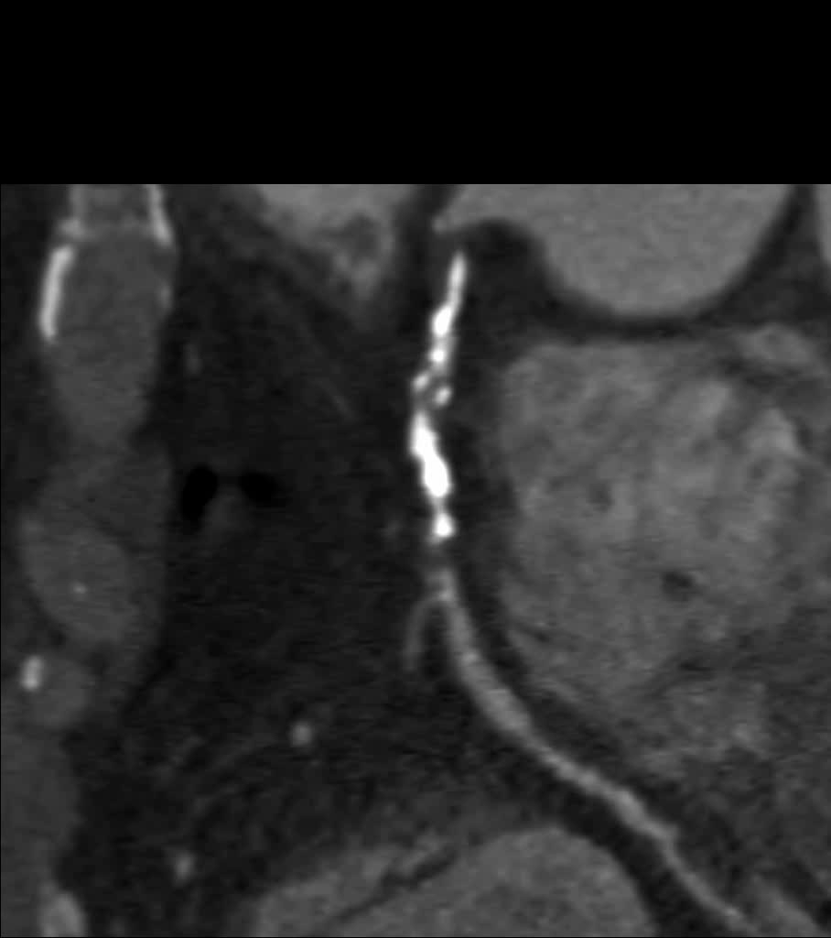
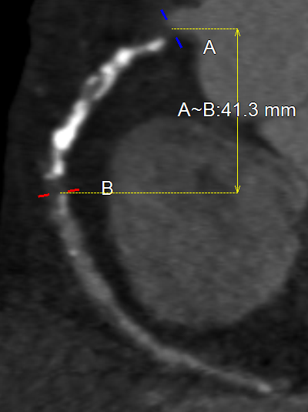
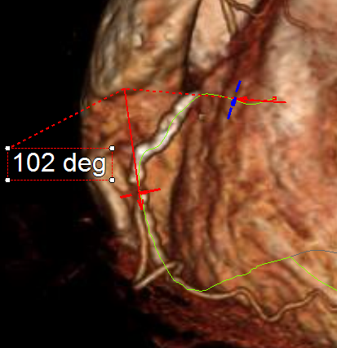
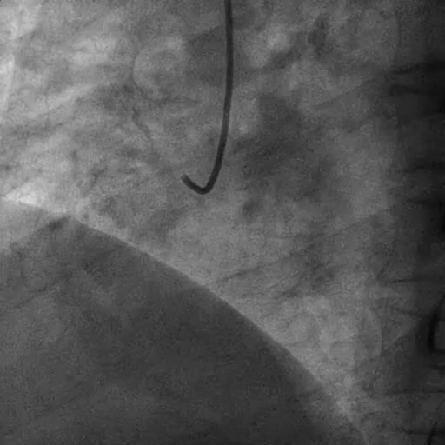
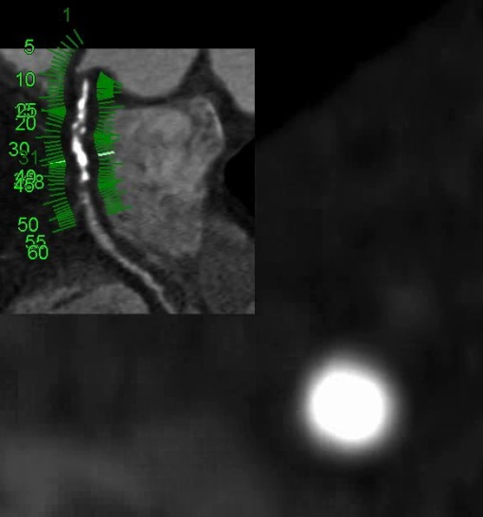
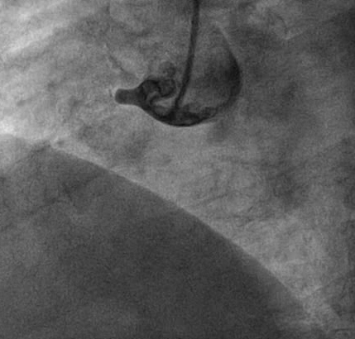
Fail to cross guidewire ≤ 30 min
E
F
G
H

Slide 14
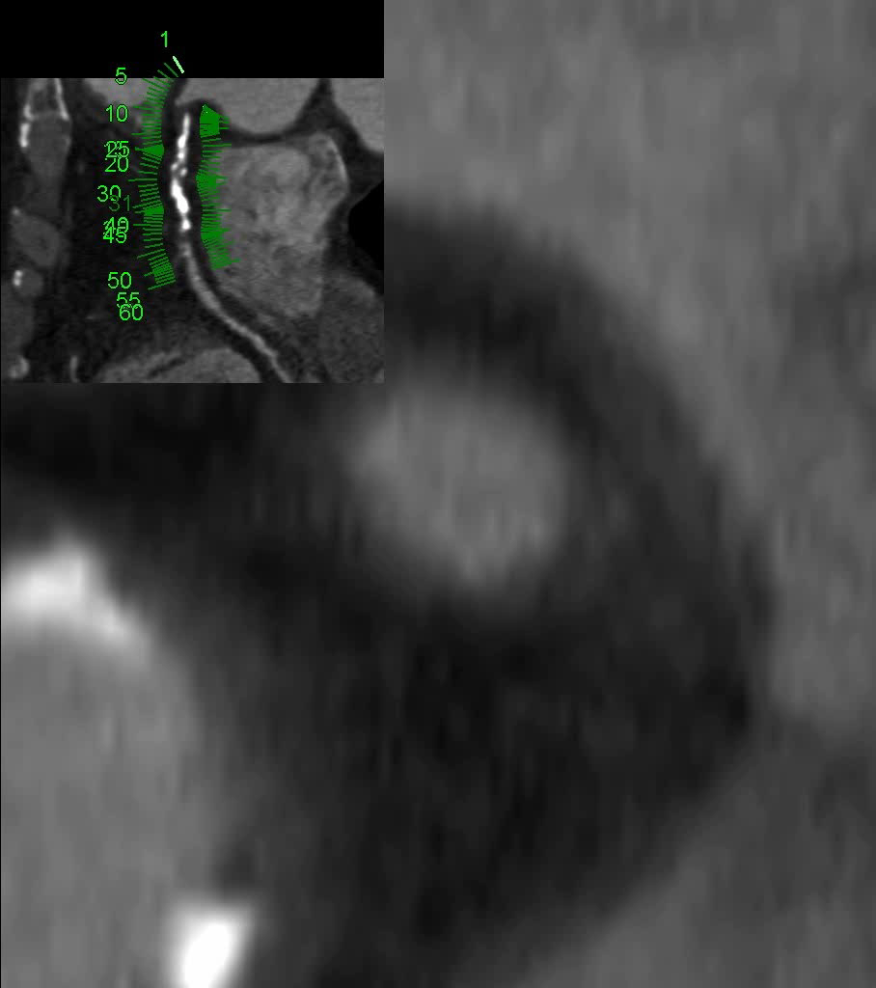
Fail to cross guidewire ≤ 30 min
E
F
G
H

Slide 15
Clinical characteristics (643 patients)
 | All | Success to cross guidewire ≤ 30 min | Fail to cross guidewire ≤ 30 min | p-value
Patient (N) | 643 | 325 | 318
Clinical risk factors
Age (year) | 62 (54 – 71) | 62 (54 – 71) | 62 (55 – 69) | 0.90
Male gender | 519 (81) | 253 (78) | 266 (84) | 0.08
Hypertension | 334 (52) | 161 (50) | 173 (54) | 0.25
Diabetes | 199 (31) | 95 (29) | 104 (33) | 0.39
Smoking | 248 (39) | 127 (39) | 121 (38) | 0.85
History of stroke | 55 (9) | 26 (8) | 29 (9) | 0.85
Prior myocardial infarction | 243 (38) | 118 (36) | 125 (39) | 0.48
Prior PCI | 138 (22) | 59 (18) | 79 (25) | 0.049
Prior bypass surgery | 22 (3) | 8 (3) | 14 (4) | 0.26
Occlusion duration ≥ 12 months or unknown | 297 (46) | 133 (41) | 164 (52) | 0.009
Laboratory and imaging tests
Hemoglobin (g/dl) | 14.0 (13.0 – 15.0) | 14.0 (13.0 – 15.0) | 14 (12.9 – 15.0) | 0.96
Creatinine (mg/dl) | 0.96 (0.82 – 1.09) | 0.93 (0.80 – 1.07) | 0.99 (0.83 – 1.10) | 0.08
Total cholesterol (mg/dl) | 157 (130 – 192) | 160 (132 – 200) | 157 (129 – 187) | 0.36
LDL cholesterol (mg/dl) | 97 (71 – 128) | 101 (74 – 131) | 92 (69 – 122) | 0.11
HDL cholesterol (mg/dl) | 42 (36 – 48) | 42 (37 – 48) | 42 (34 – 49) | 0.45
HbA1C (%) | 6.0 (5.6 – 6.9) | 5.8 (5.5 – 6.9) | 6.2 (5.8 – 6.9) | 0.07
hsCRP (mg/dl) | 0.13 (0.05 – 0.46) | 0.11 (0.05 – 0.48) | 0.15 (0.06 – 0.44) | 0.25
LV ejection fraction (%)* | 60 (55 – 66) | 60 (55 – 66) | 60 (53 – 66) | 0.74
LV ejection fraction < 40%* | 22 (5) | 11 (5) | 11 (5) | 0.99

Slide 16
Procedural characteristics (684 vessels from 643 patients)
 | All | Success to cross guidewire ≤ 30 min | Fail to cross guidewire ≤ 30 min | p-value
Vessel (N) | 684 (100) | 350 (51) | 334 (49) | -
Radial approach | 244 (36) | 155 (44) | 89 (27) | <0.001
Guiding catheter ≥ 7Fr | 393 (58) | 188 (54) | 205 (61) | 0.051
Retrograde injection | 258 (38) | 88 (26) | 170 (51) | <0.001
Retrograde advancement of wire | 85 (12) | 6 (2) | 79 (24) | <0.001
Successful revascularization of CTO | 510 (75) | 340 (97) | 170 (51) | <0.001
Simultaneous PCI of non-CTO lesion | 192 (28) | 109 (31) | 83 (25) | 0.08
Fluoroscopy time (min) | 30 (19 – 52) | 21 (13 – 32) | 48 (29 – 69) | <0.001
Procedural time (min) | 74 (48 – 112) | 55 (37 – 78) | 98 (70 – 141) | <0.001
Contrast volume (ml) | 224 (170 – 300) | 200 (160 – 270) | 250 (190 – 345) | <0.001

Slide 17
Angiographic characteristics
 | All | Success to cross guidewire ≤ 30 min | Fail to cross guidewire ≤ 30 min | p-value
Vessel (N) | 684 (100) | 350 (51) | 334 (49) | -
Location of CTO
LAD | 254 (37) | 142 (41) | 112 (34) | 0.06
LCX | 144 (21) | 87 (25) | 57 (17) | 0.015
RCA | 280 (41) | 118 (34) | 162 (49) | <0.001
Left main | 6 (1) | 3 (1) | 3 (1) | 0.99
Non-LAD* | 424 (62) | 205 (59) | 219 (66) | 0.07
De novo CTO | 657 (96) | 336 (96) | 321 (96) | 0.99
Multiple CTO | 104 (15) | 52 (15) | 52 (16) | 0.88
Reattempt of previously failed CTO PCI | 50 (7) | 11 (3) | 39 (12) | <0.001
Morphology
Blunt proximal entry | 258 (38) | 94 (27) | 164 (49) | <0.001
Calcification, visible within CTO segment | 250 (37) | 91 (26) | 159 (48) | <0.001
Bending > 45 degree | 338 (49) | 135 (39) | 203 (61) | <0.001
Severe vessel tortuosity (2 bendings > 70 degree or 1 bending > 90 degree) | 159 (23) | 50 (14) | 109 (33) | <0.001
Occlusion length ≥ 20 mm | 353 (52) | 129 (37) | 224 (67) | <0.001
Proximal branch | 487 (71) | 228 (65) | 259 (78) | <0.001
Distal branch | 408 (60) | 190 (54) | 218 (65) | 0.004
Functional occlusion | 32 (4.7) | 24 (6.9) | 8 (2.4) | 0.010
Proximal reference diameter (mm) | 2.85 (2.40 – 3.35) | 2.81 (2.37 – 3.35) | 2.88 (2.45 – 3.32) | 0.54
Distal reference diameter (mm) | 2.13 (1.70 – 2.55) | 2.12 (1.65 – 2.52) | 2.14 (1.74 – 2.67) | 0.36
Occlusion length (mm) | 16 (9 – 27) | 13 (7– 19) | 20 (13 – 31) | <0.001
Well-developed collateral (Rentrop=3 and Collateral connection=2) | 170 (25) | 67 (19) | 103 (31) | 0.001
Bridging collateral | 99 (15) | 46 (13) | 53 (16) | 0.37

Slide 18
CT characteristics (1)
 | All | Success to cross guidewire ≤ 30 min | Fail to cross guidewire ≤ 30 min | p-value
Vessel (N) | 684 (100) | 350 (51) | 334 (49) | -
Vessel proximal to CTO
Angle > 90 degree from guiding to CTO segment | 317 (46) | 121 (35) | 145 (43) | 0.022
Proximal lesion with DS ≥70% | 116 (17) | 39 (11) | 77 (23) | <0.001
Length from ostium to CTO entry (mm) | 31 (17 – 47) | 32 (20 – 47) | 27 (17 – 47) | 0.39
CTO entry and exit
Blunt proximal entry | 330 (48) | 122 (35) | 208 (62) | <0.001
Blunt distal exit | 253 (37) | 97 (28) | 156 (47) | <0.001
Proximal branch | 451 (66) | 205 (59) | 246 (74) | <0.001
Distal branch | 405 (59) | 190 (54) | 215 (64) | 0.009
Tandem lesion | 16 (2) | 7 (2) | 9 (23) | 0.73
Length from CTO exit to vessel end (mm) | 85 (63 – 110) | 89 (63 – 111) | 83 (63 – 107) | 0.40
Vessel length (mm) | 144 (124 – 161) | 142 (123 – 161) | 144 (128 – 161) | 0.28
CTO plaque
Bending > 45 degree | 243 (36) | 83 (24) | 160 (48) | <0.001
Occlusion length | 15 (8 – 24) | 11 (7 – 18) | 18 (11 – 28) | <0.001
≥ 15 mm | 343 (50) | 123 (35) | 220 (66) | <0.001
Remodeling index | 1.07 (0.93 – 1.20) | 1.08 (0.96 – 1.21) | 1.05 (0.91 – 1.20) | 0.141
Positive remodeling | 298 (44) | 160 (46) | 138 (41) | 0.25
Negative remodeling | 139 (20) | 58 (17) | 81 (24) | 0.014
Proximal reference vessel area (mm²) | 8.9 (6.5 – 11.9) | 8.5 (6.4 – 11.3) | 9.0 (6.8 – 12.3) | 0.06
Distal reference vessel area (mm²) | 5.0 (3.4 – 7.3) | 5.1 (3.5 – 7.5) | 5.0 (3.2 – 7.2) | 0.32
Maximal CTO plaque area (mm²) | 10.5 (6.7 – 14.3) | 10.7 (6.6 – 13.8) | 10.0 (6.9 – 14.8) | 0.71

Slide 19
CT characteristics (2)
 | All | Success to cross guidewire ≤ 30 min | Fail to cross guidewire ≤ 30 min | p-value
Vessel (N) | 684 (100) | 350 (51) | 334 (49) | -
Calcification of CTO plaque
Any calcification within or adjacent to CTO | 356 (52) | 154 (44) | 202 (61) | <0.001
Proximal calcification adjacent to CTO | 107 (16) | 40 (11) | 67 (20) | 0.003
Distal calcification adjacent to CTO | 113 (17) | 53 (15) | 60 (18) | 0.37
Peripheral, mild (< 180 degree or CSA < 50%) | 97 (14) | 51 (15) | 46 (14) | 0.82
Peripheral, severe (≥ 180 degree and CSA ≥ 50%) | 181 (27) | 52 (15) | 129 (39) | <0.001
Central (360 degree and CSA = 100%) | 53 (8) | 8 (2) | 45 (14) | <0.001
Visualized collateral vessel | 172 (25) | 76 (22) | 96 (29) | 0.042

Slide 20
Development of the prediction model
 | Odds ratio for success to cross guidewire ≤ 30 min (95% CI) | Standardized beta coefficient | Point
Proximal blunt entry | 0.43 (0.30 – 0.60) | 0.85 | + 1
Proximal side branch | 0.49 (0.32 – 0.73) | 0.65 | + 1
CTO segment bending > 45 degree | 0.46 (0.31 – 0.69) | 0.75 | + 1
CTO segment length ≥ 15 mm | 0.45 (0.31 – 0.66) | 0.80 | + 1
Peripheral calcification: maximal encircling ≥ 180⁰ and CSA ≥ 50% | 0.48 (0.35 – 0.66) | 0.91 | + 1
Central calcification (CSA = 100%) |  |  | + 2
Reattempt of previously failed CTO PCI | 0.24 (0.10 – 0.51) | 0.75 | + 1
CTO duration ≥ 12month or unknown | 0.28 (0.15 – 0.51) | 0.79 | + 1
Validation was tested by leave-one-out cross-validation which is an exhaustive validation that uses each sample as validation set and the remaining observations as training set and repeats it.

Slide 22
KCCT score vs time for guidewire crossing
Time to successful CTO guidewire crossing
160
140
120
100
Time to wire crossing (min)
80
60
40
20
0
0
1
2
3
4
5
6
7
8
KCCT score
N =
6 78 115 124 117 61 23 4 0

Slide 23
KCCT score vs time for crossing wire <30, <60, <90, and > 90 min
Successful CTO guidewire crossing ≤ 30 min
Final procedural success and time to cross guidewire
100%
100%
100%
100%
99%
93%
≥ 90 min
85%
83%
60 – 89 min
80%
30 – 59 min
75%
75%
71%
≤ 30 min
59%
54%
50%
42%
50%
38%
31%
25%
20%
25%
13%
7%
0%
0%
0%
0%
0
1
2
3
4
5
6
7
8
0
1
2
3
4
5
6
7
8
KCCT score
KCCT score
N =
6 78 122 145 156 108 55 13 1
N =
6 78 122 145 156 108 55 13 1

Slide 24
KCCT score for categorizing difficulty of CTO PCI
Successful guidewire crossing ≤ 30 min and procedural success according to KCCT category
100%
99%
Procedural success
KCCT score | Category | %wire crossing < 30min | %success
0 | Very easy | 100% | 100%
1 | Easy | 85% | 99%
2 | Intermediate | 80% | 93%
3 | Difficult | 59% | 83%
≥ 4 | Very difficult | 29% | 58%
100%
100%
93%
guidewire crossing ≤ 30 min
83%
85%
80%
75%
58%
59%
50%
25%
29%
0%
very easy
easy
intermediate
difficult
very difficult
KCCT score =
0
1
2
3
≥ 4
N =
6 78 122 145 333

Slide 25
 |  |  | CTO PCI success prediction scores
 |  |  | J-CTO (Morino, JACC Intv 2011) | PROGRESS-CTO (Christopoulos, JACC Intv 2016) | CL-SCORE (Alessandrino, JACC Intv 2015) | CT-RECTOR (Opolski, JACC Intv 2015) | KCCT (This manuscript)
Anatomical predictors | CTO plaque | Proximal entry | Non-tapered stump | No tapered stump or poor cap visualization | Non-tapered stump | Non-tapered stump | Non-tapered stump
 |  | Tortuosity | Bend > 45⁰ | 2 bends >70⁰ or 1 bend >90⁰ | - | Bend > 45⁰ | Bend > 45⁰
 |  | Occlusion length | ≥ 20mm | - | ≥ 20mm | - | ≥ 15mm
 |  | Side branch | - | - | - | - | Proximal side branch
 |  | Calcification | Visualized calcification | - | Visualized calcification | Calcium CSA ≥ 50% | Calcium CSA ≥ 50%, worse if CSA =100%***
 |  | Functional occlusion | - | - | - | -** | -**
 | CTO vessel location |  | - | Worse in LCX | Worse in non-LAD | - | -
 | Collateral |  | - | Non-interventional collateral | - | - | -
Clinical predictors | Previous MI |  | - | - | Previous MI | - | -
 | CTO duration |  | - | - | - | ≥ 12 mo or unknown | ≥ 12 mo or unknown
 | Reattempt |  | Reattempt | - | - | Reattempt | Reattempt
Primary endpoint |  |  | Wire cross ≤ 30 min | Procedural success | Procedural success | Wire cross ≤ 30 min | Wire cross ≤ 30 min
Number of predicting variables |  |  | 5 | 4 | 5 | 5 | 7

Slide 26
Comparison of KCCT score with prior published scoring systems
Successful CTO guidewire crossing ≤ 30 min
Final procedural success
1.0
1.0
0.8
0.8
*
*
0.6
* p<0.001
0.6
* p<0.001
Sensitivity
Sensitivity
0.4
0.4
c-statistics
c-statistics
0.2
KCCT
0.787 (0.754 – 0.820)
0.2
KCCT
0.781 (0.745 – 0.818)
CT-RECTOR
0.734 (0.698 – 0.770)
CT-RECTOR
0.717 (0.676 – 0.758)
J-CTO
0.727 (0.691 – 0.763)
J-CTO
0.681 (0.638 – 0.723)
0.0
CL-SCORE
0.702 (0.664 – 0.741)
0.0
CL-SCORE
0.669 (0.624 – 0.714)
PROGRESS-CTO
0.635 (0.600 – 0.673)
PROGRESS-CTO
0.637 (0.593 – 0.682)
1.0
0.8
0.6
0.4
0.2
0.0
1.0
0.8
0.6
0.4
0.2
0.0
Specificity
Specificity

Slide 27
Comparison of KCCT score with prior published scoring systems
Successful guidewire crossing ≤ 30 min
Cutoff | Sensitivity | Specificity | PPV | NPV
KCCT score < 4 | 71 (66 - 76) | 73 (68 – 77) | 71 (66 – 76) | 73 (68 – 77)
J-CTO score < 2 | 69 (64 – 74) | 64 (58 – 69) | 65 (59 – 69) | 68 (63 – 73)
PROGRESS-CTO score < 1 | 37 (31 - 42) | 79 (75 – 84) | 63 (56 – 70) | 57 (52 – 61)
CL-score < 3.5 | 49 (43 – 54) | 82 (78 – 86) | 72 (66 – 78) | 63 (58 – 67)
CT-RECTOR score < 3 | 65 (60 – 70) | 74 (69 – 79) | 71 (65 – 76) | 69 (64 – 74)
Final procedural success
Cutoff | Sensitivity | Specificity | PPV | NPV
KCCT score < 4 | 80 (74 - 86) | 62 (58 – 66) | 42 (37 – 48) | 90 (87 – 93)
J-CTO score < 2 | 73 (66 – 79) | 55 (50 – 59) | 35 (31 – 41) | 86 (81 – 89)
PROGRESS-CTO score < 1 | 42 (35 - 50) | 76 (72 – 80) | 38 (31 – 45) | 79 (76 – 83)
CL-score < 3.0 | 52 (44 – 59) | 73 (69 – 77) | 40 (33 – 47) | 82 (78 – 85)
CT-RECTOR score < 3 | 71 (64 – 78) | 64 (60 – 68) | 40 (35 – 46) | 87 (83 – 90)

Slide 28
Conclusion
KCCT score showed high performance for predicting guidewire crossing ≤30 min (c-statistics = 0.79) and also procedural success of CTO PCI (c-statistics = 0.78).
KCCT may enable non-invasive grading difficulty of CTO PCI.
KCCT score has a potential of improving predictive performance of prior scoring systems.

