Slide 1
10, Dec, 2016. JCR2016@Busan Session IV: New approaches to CTO How to Use Cardiac CT for CTO-PCI
Internal Medicine, Kawasaki Medical School General Medical Center
Internal Medicine 1, Kawasaki Medical School
Okayama, Japan
Masaaki Okutsu

Slide 2
Key point of CT information for PCI
Entry point of CTO
CTO route and diameter
Calcium distribution

Slide 3
Key point of CT information for PCI
Entry point of CTO
CTO route and diameter
Calcium distribution

Slide 4
CAG

Slide 5
CAG & CTA ; LAO view

Slide 6
CAG & CTA ; LAO view

Slide 7
CAG & CTA ; RAO-CRA view
calcium
RCA MB
RCA MB
RV br

Slide 8
CAG & CTA ; RAO-CRA view
calcium
RCA MB
RCA MB
RV br

Slide 9
XT-R
←Atrial
apical→

Slide 10
Conquest Pro 9

Slide 11
Antegrade GW cross & Final CAG

Slide 12
Key point of CT information for PCI
Entry point of CTO
CTO route and diameter
Calcium distribution

Slide 13
CAG

Slide 14
CAG

Slide 15
Cardiac CT

Slide 16
Comparing with CT and CAG; RAO-Cra

Slide 17
Comparing with CT and CAG; RAO-Cra

Slide 18
Route mapping

Slide 19
Route mapping

Slide 20
Comparing with CT and CAG; LAO-Cra

Slide 21
Comparing with CT and CAG; LAO-Cra

Slide 22
Route mapping

Slide 23
Route mapping

Slide 24
First wire advanced to distal true lumen
Gaia 2nd + Crusade
Beside live monitor in cath-labo

Slide 25
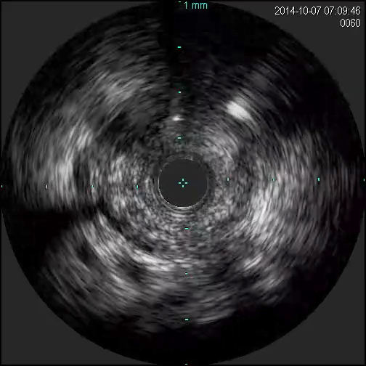
Antegrade wiring for D2
IVUS guided wiring to D2 with Gaia 2nd
Parallel wire in D2 with Gaia 2nd *2
GW to D2

Slide 26
Retrograde approach for D1
Corsair

Slide 27
Retrograde wire cross
Ultimate Bros 3
Externalization

Slide 28
Pre dilatation for D1 and mid LAD by 2.0mm balloon

Slide 29
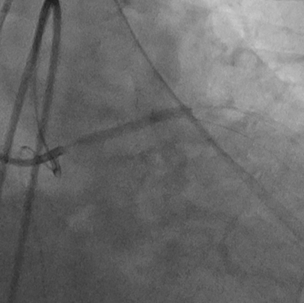
Stent implantation
T-stenting
SB:LAD#7 XienceXpedition (2.25*23mm)
MB:LAD#6-D2 ResoluteIntegrity (2.25*30)+ResoluteIntegrity (3.0*30)

Slide 30
Final CAG

Slide 31
Key point of CT information for PCI
Entry point of CTO
CTO route and diameter
Calcium distribution

Slide 32
Control CAG

Slide 33
Control CAG

Slide 34
CT
RAO-Caud
LAO-Cra

Slide 35
CT
RAO-Caud
LAO-Cra

Slide 36
CT
RAO-Caud
LAO-Cra

Slide 37
CT
RAO-Caud
RAO-Caud
LAO-Cra

Slide 38
CT
LAO-Cra
RAO-Caud
RAO-Caud
LAO-Cra

Slide 39
Route mapping

Slide 40
Route mapping

Slide 41
Route mapping

Slide 42
Route mapping

Slide 43
Route mapping

Slide 44
Route mapping

Slide 45
Wiring by calcification guidance
GW: XT-A

Slide 46
GW crossed through CTO

Slide 47
Final CAG

Slide 48
Key point of CT image during PCI
Important CT role during CTO-PCI.
Entry
Route and diameter
Calcification
What kind of CT image is required for PCI support ?
Visualize of lumen, plaque and calcium at the same time
Make same image as CAG
Make detailed road map in CAG

Slide 49
Thank you for your attention.

