Slide 1
Mitochondria as therapeutic targets for cardioprotection
Derek Hausenloy
Professor, Cardiovascular and Metabolic Disorders, Duke-National University Singapore
Senior Consultant and Clinician Scientist, National Heart Centre Singapore
10th December 2016
JOINT MEETING OF CORONARY REVASCULARIZATION, Busan, South Korea
derek.hausenloy@duke-nus.edu.sg

Slide 2
Outline
Still a need for novel cardioprotective therapies to reduce MI size and improve clinical outcomes in AMI patients.
Mitochondrial fission proteins (Drp1, MiD49/51) as targets for cardioprotection.
Mitochondrial fusion proteins (Mfn1/Mfn2 and OPA1) as targets for cardioprotection – pleiotropic effects.

Slide 3


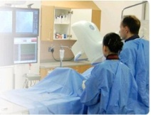
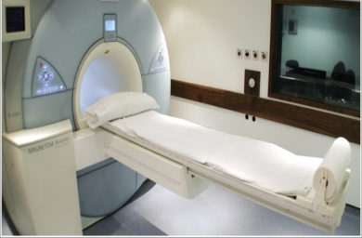
There is still a need to reduce MI size
No effective therapy for targeting reperfusion injury, reducing MI size and preventing heart failure
Anterior STEMI patients undergoing PPCI – 7% death and 25% HF at 1 year
STEMI patients with cardiogenic shock – 30% death at 1 year
Chest pain
PPCI
CMR
Acute myocardial ischemia
Reperfusion
Chest pain to PPCI time
Novel therapy

Slide 4
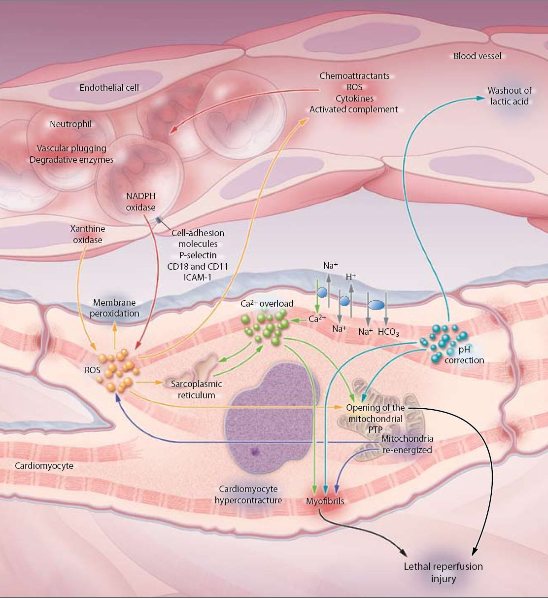
What causes myocardial reperfusion injury ?
Myocardial stunning
Reperfusion arrhythmias
Microvascular obstruction
Lethal reperfusion injury
Microvascular
obstruction
Inflammation
Endothelial
dysfunction
Ca²⁺ overload
ROS
Mitochondrial
dysfunction
Modified from Yellon & Hausenloy, NEJM 2007

Slide 5
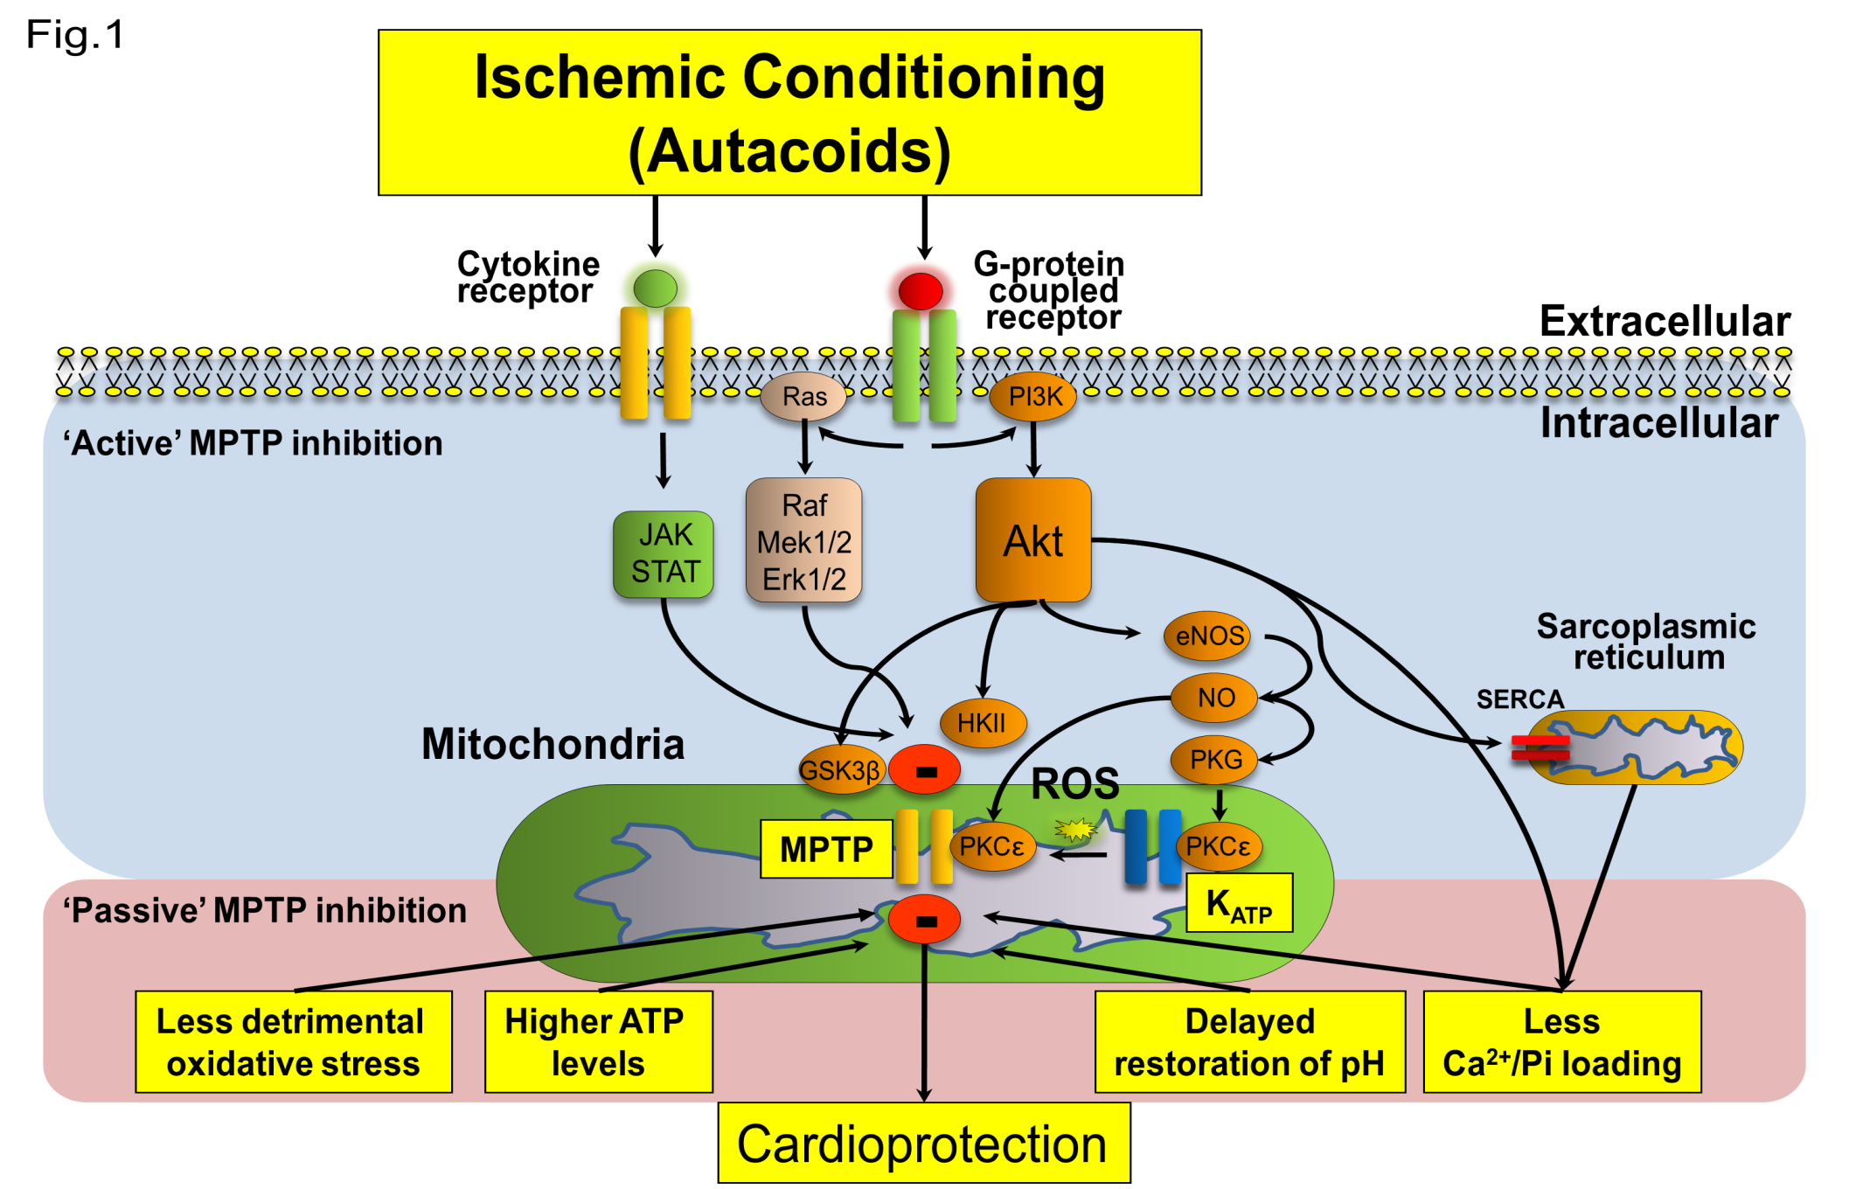
Signaling pathways of cardioprotection
Ong et al Bas Res Card 2009

Slide 6
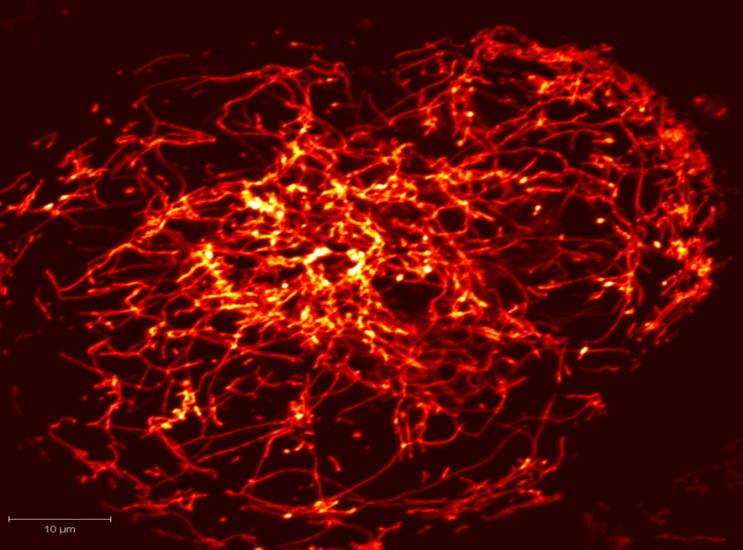
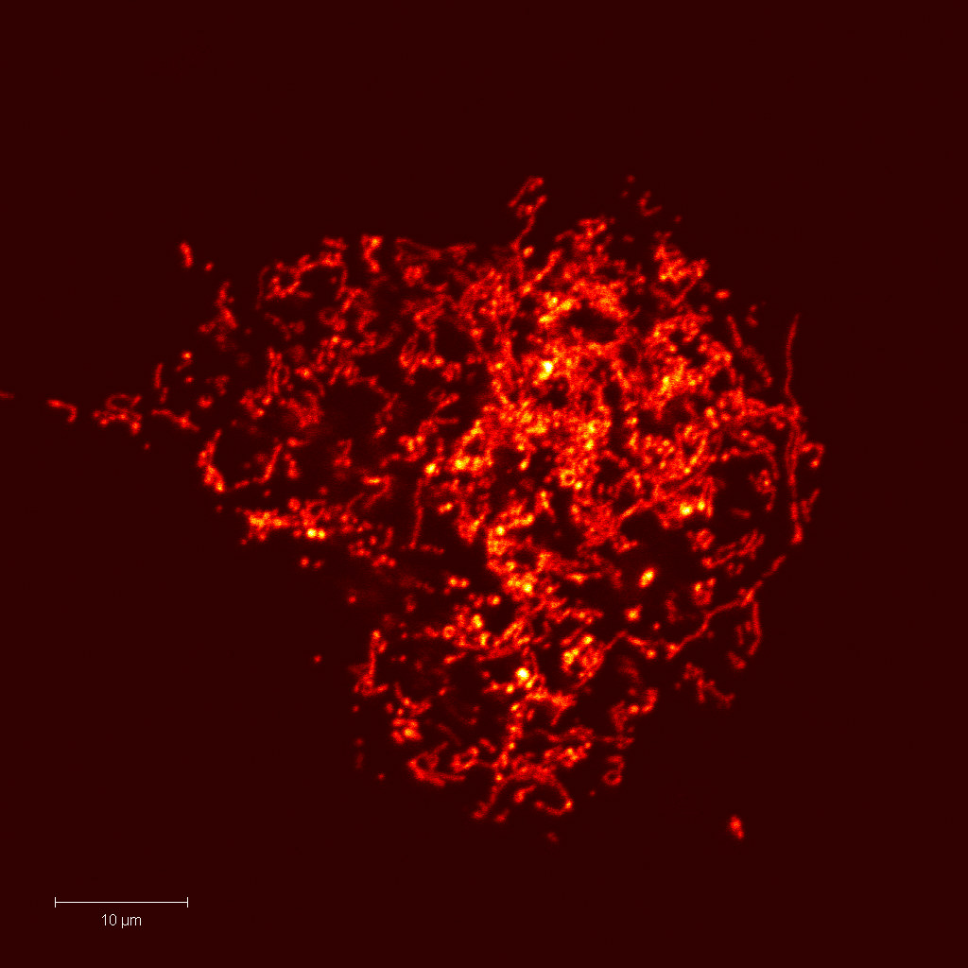
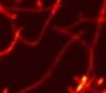

Mitochondrial fusion and fission proteins
Fusion
(Elongation)
Fission
(Fragmention)
Fusion proteins
Mfn1
Mfn2
OPA1
Fission proteins
Drp1
hFis
Mff
MiD49/51
Mitochondrial
Morphology
MPTP

Slide 7
Mitochondrial fusion and fission proteins
Hall….Hausenloy BJP 2014

Slide 8
Mitochondrial fission proteins- Drp1
Hall….Hausenloy BJP 2014

Slide 9
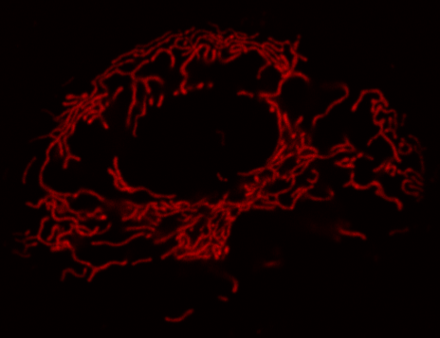
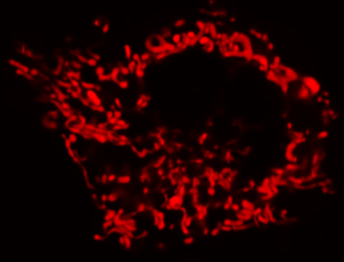
Mitochondria undergo fission with IRI
Drp1K38A
Drp1K38A
Control
Control
Ong, Lim….Hausenloy Circulation 2010

Slide 10
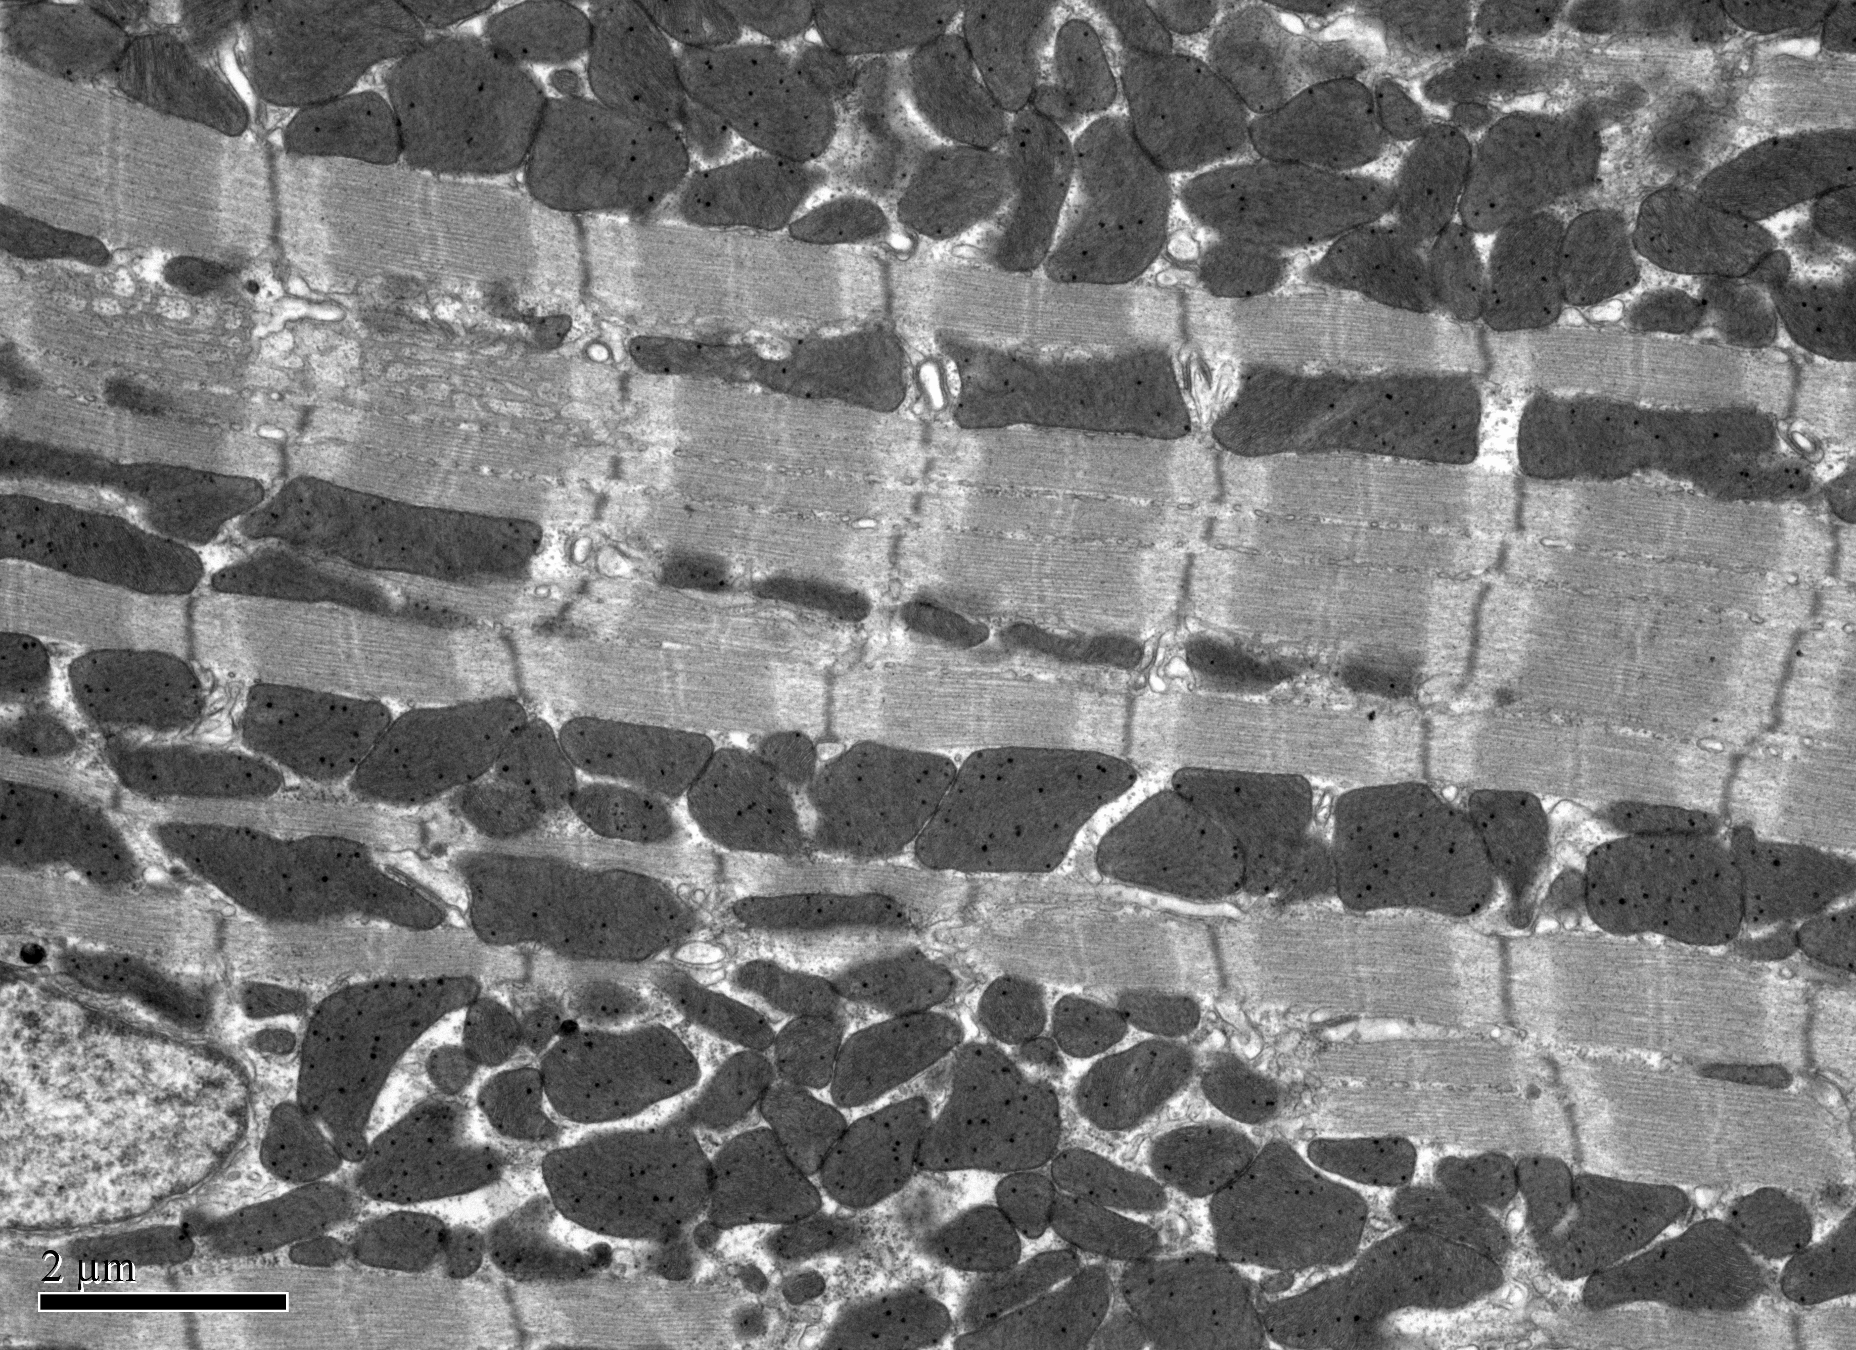
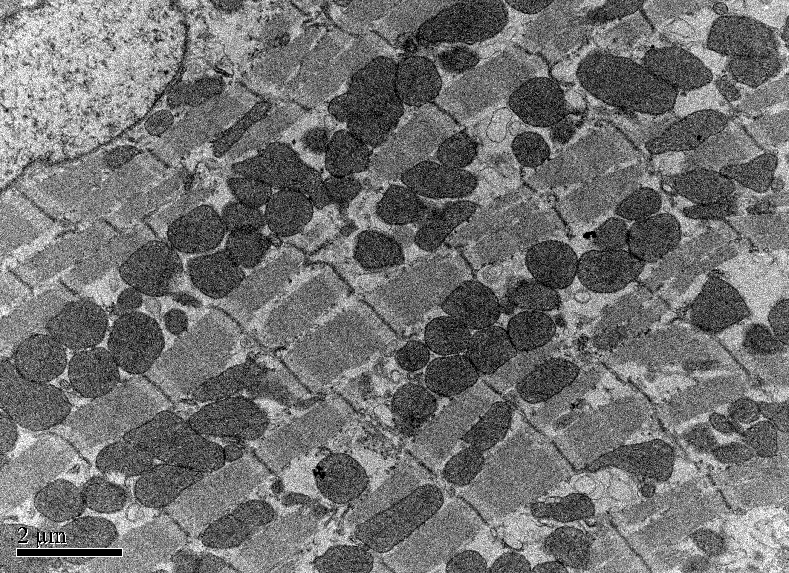
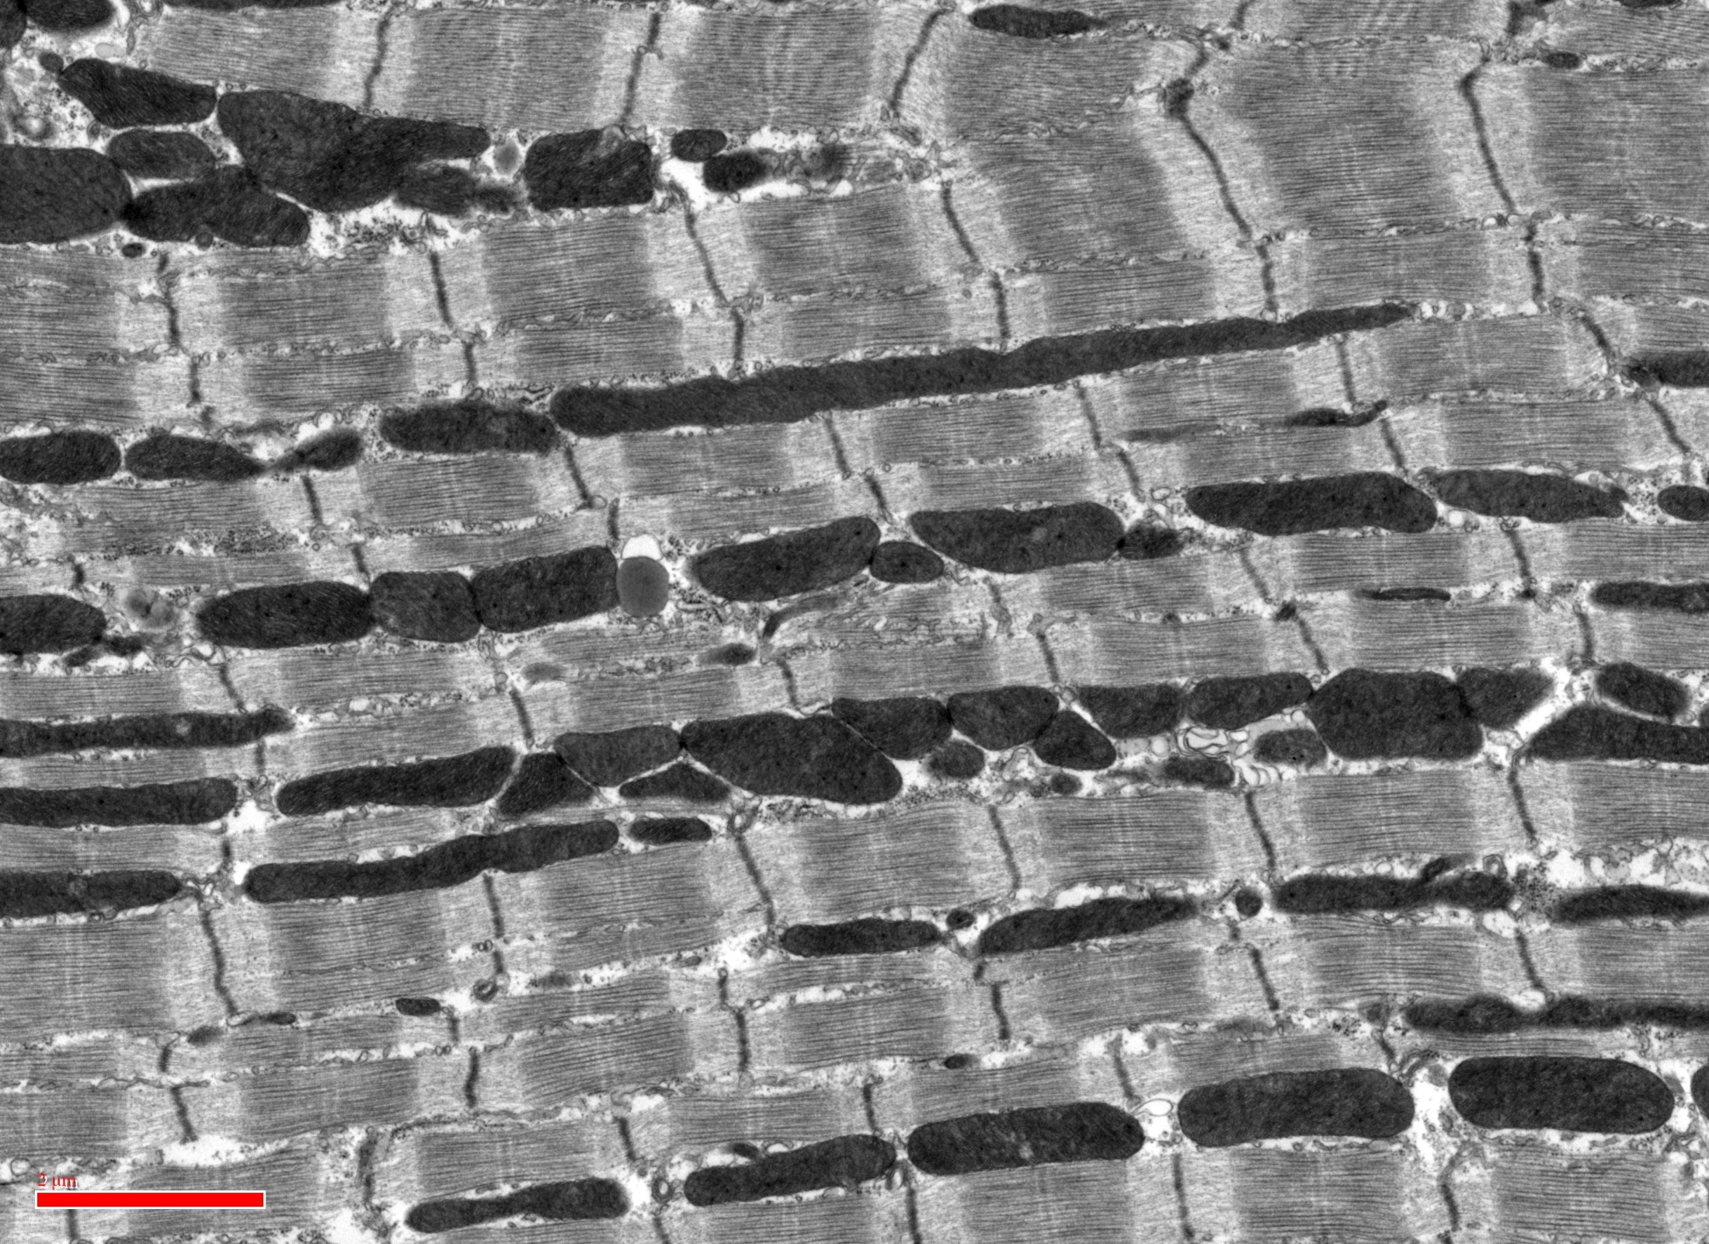
Mitochondrial morphology in the adult heart
SSM
IF
PN

Slide 11
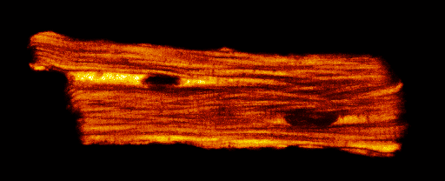
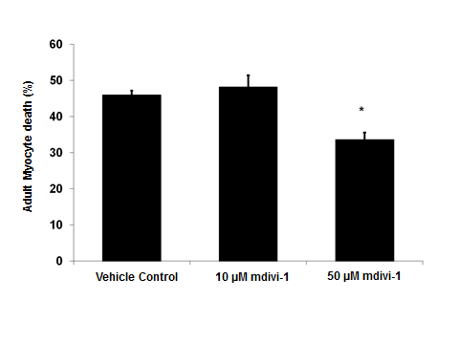
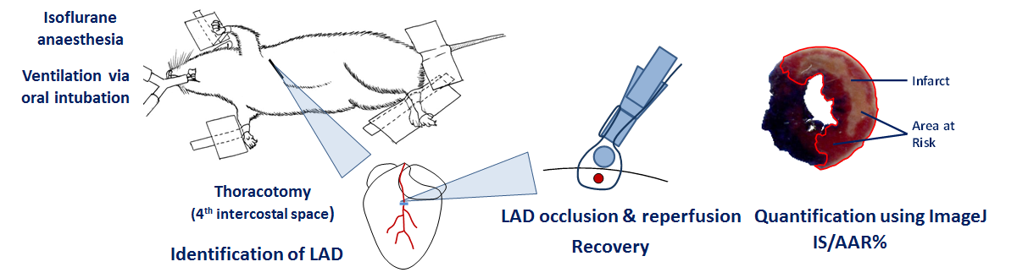
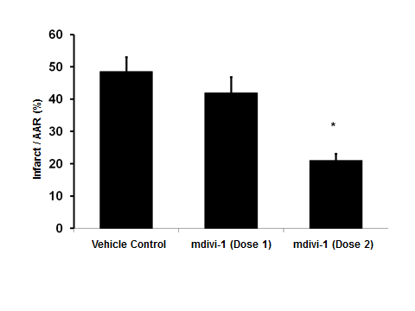
Inhibiting Drp1-fission cardioprotective
Adult cardiomyocyte model of SIRI
In vivo murine MI model
Cell viability
determined
Infarct size
determined
mdivi-1
mdivi-1
Simulated Ischemia
Reperfusion
Ischemia
Reperfusion
Ong, Lim….Hausenloy Circulation 2010

Slide 12
Improved delivery of Mdivi-1
Mdivi-1 in nanoparticles administered at the time of reperfusion reduced MI size more effectively than giving Mdivi-1 alone.
Ishikita et al JAHA 2016

Slide 13
Mitochondrial fission proteins- Drp1
Hall….Hausenloy BJP 2014

Slide 14
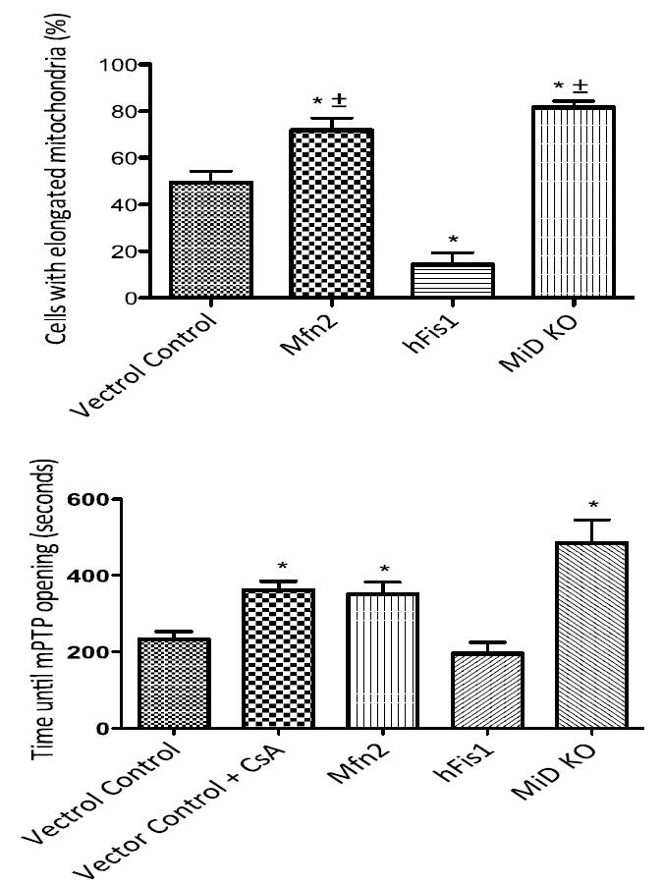
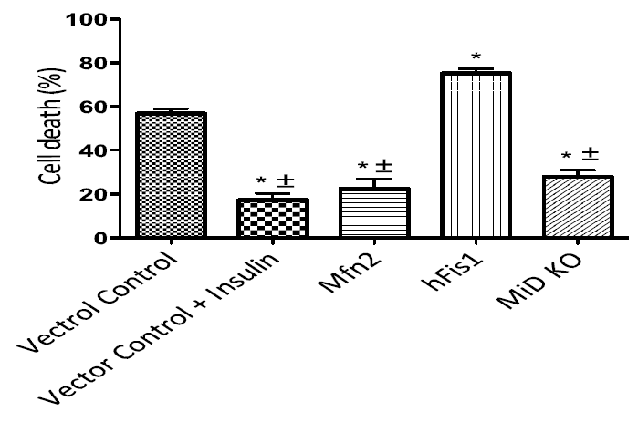
Genetic ablation of MiD49/51 is protective
Elder et al Unpublished - collaboration with Mike Ryan

Slide 15
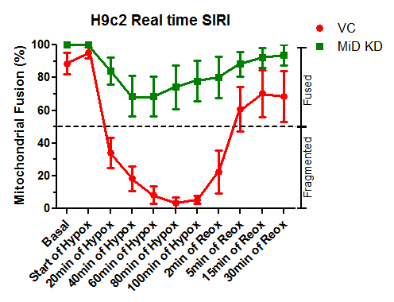
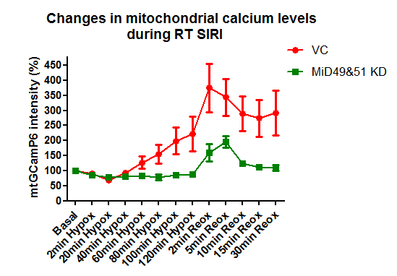
Genetic ablation of MiD49/51 reduces mitochondrial calcium overload
Now investigating effect of genetic ablation of MiD49/51 (using AAV-9-cTnT-EGFP vector) in the heart on cardioprotection
Samangouei et al Unpublished

Slide 16
Therapeutic targeting of Drp1-MiD49/51
Cytosolic part of MiD49 and MiD51 have a surface loop which binds to Drp1, which is essential for mitochondrial fission.
Molecular modelling/computational analysis has identified the most exposed amino acids as LEFHP for (MiD49) and PEYFP (for MiD51) in the Drp1 recruitment regions, providing targets for peptide inhibition.
Samangouei et al Unpublished
Loson et al Protein Science 2015

Slide 17
Mitochondrial fusion proteins- Mfn1/Mfn2
Hall….Hausenloy BJP 2014

Slide 18
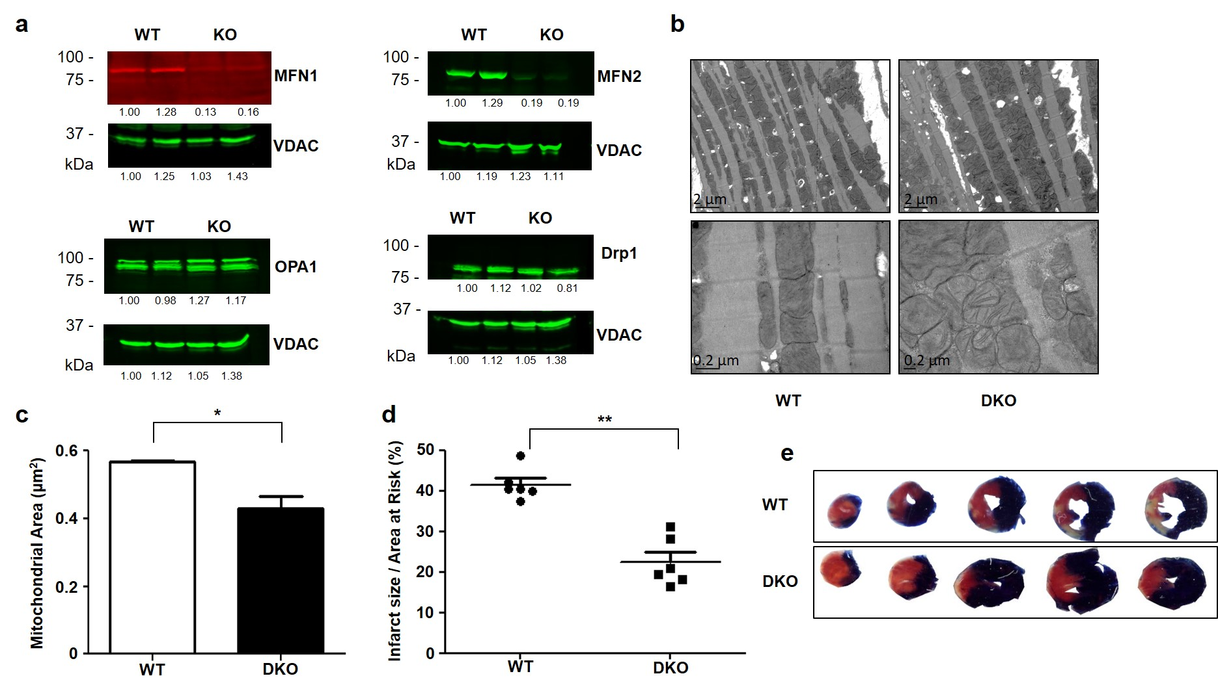
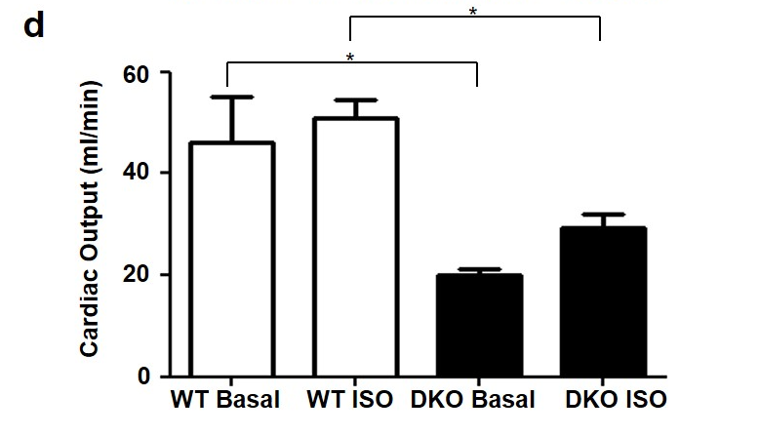
Mfn1/2 deficiency reduces MI size and affects function
Hall et al Cell Death & Dis 2016

Slide 19
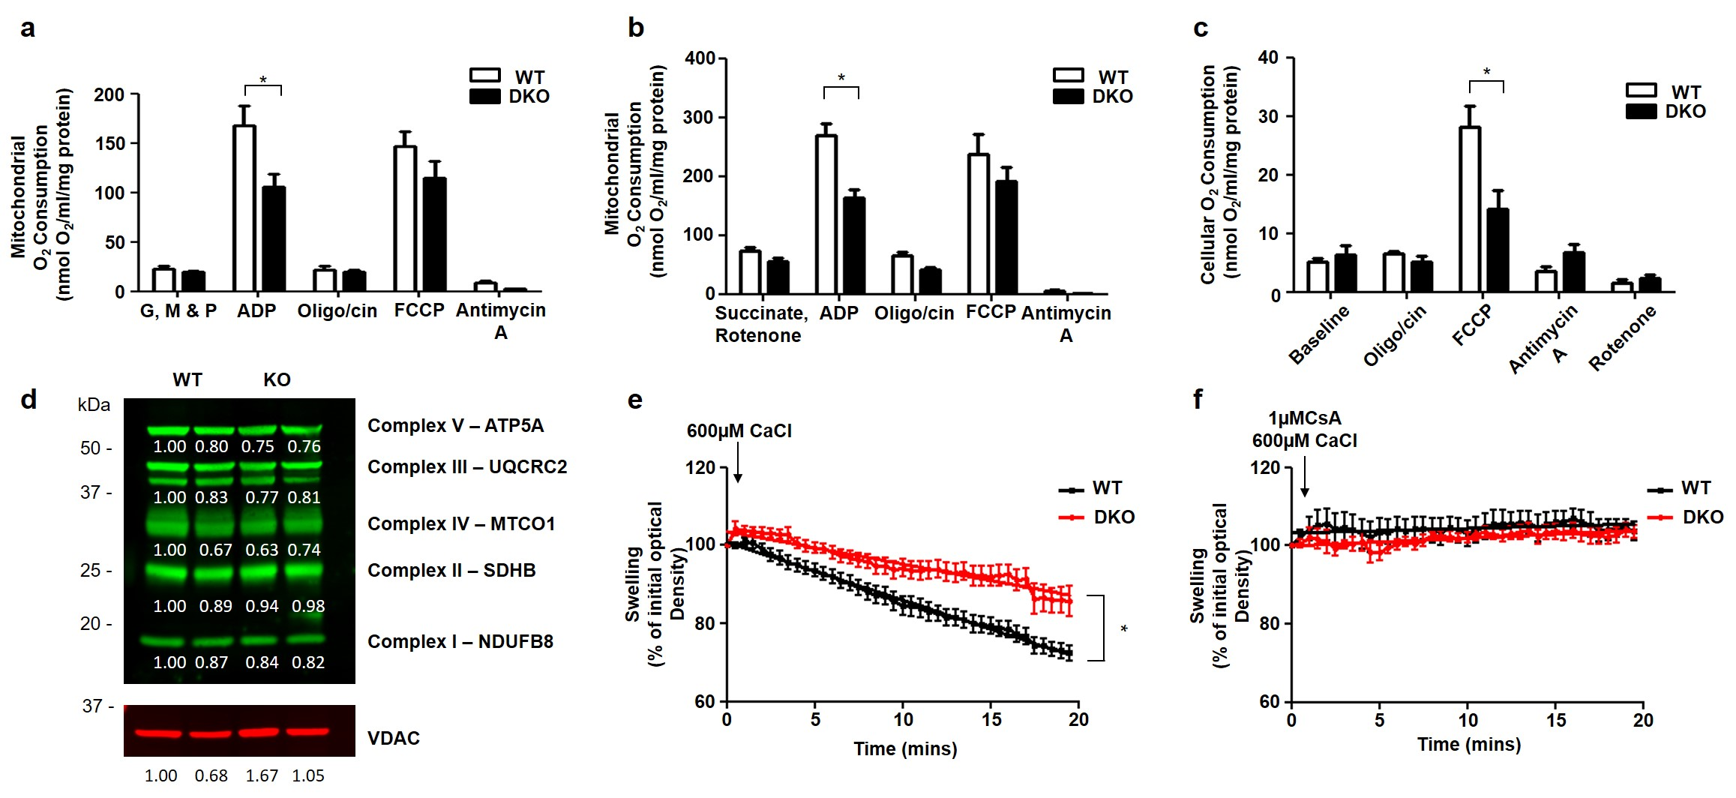
Mfn1/2 deficiency and mitochondrial function
Hall et al Cell Death & Dis 2016

Slide 20
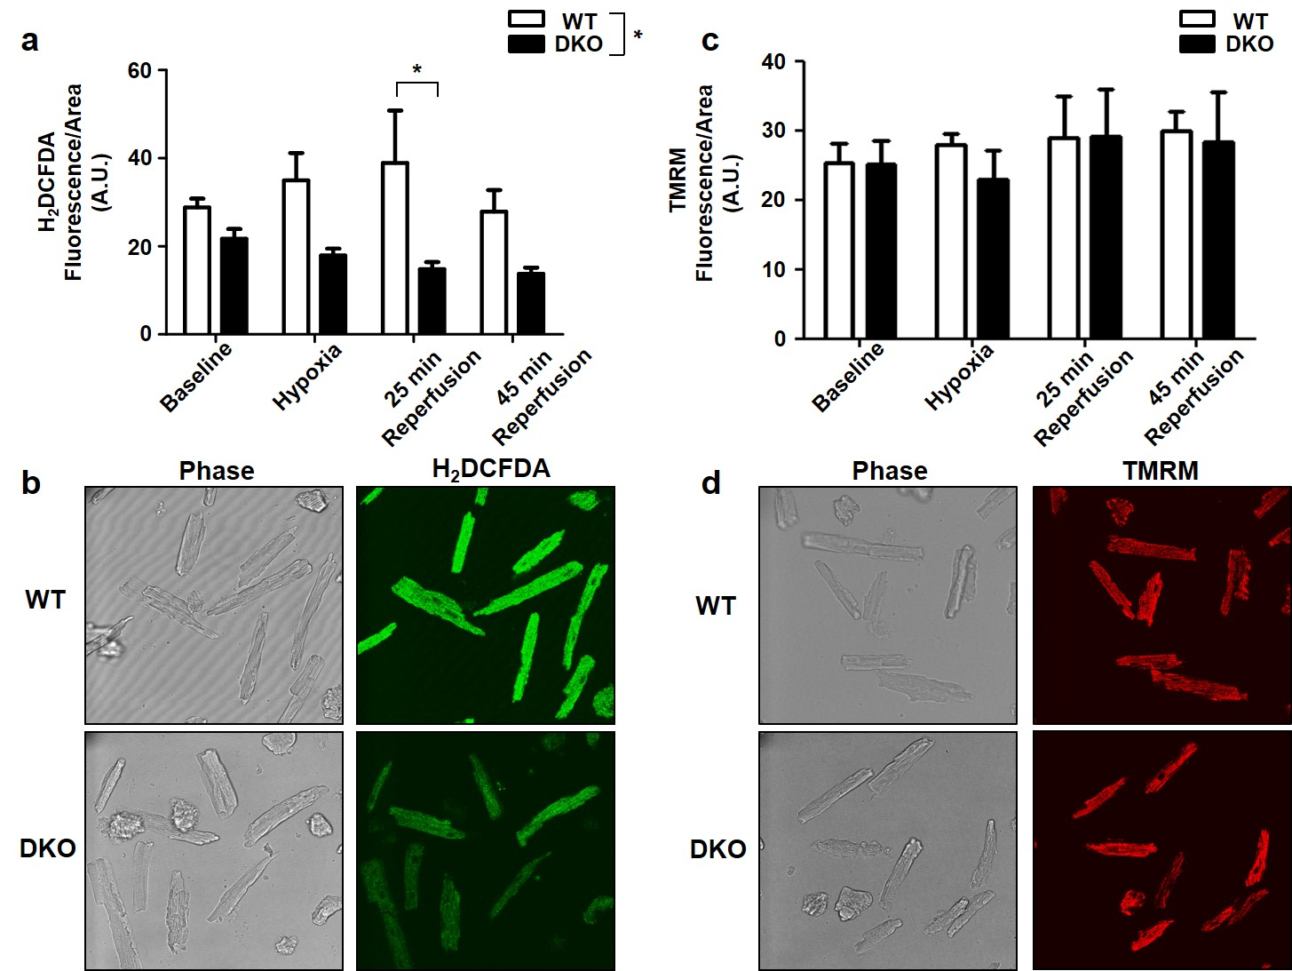
Mfn1/2 deficiency prevents ROS production
Hall et al Cell Death & Dis 2016

Slide 21
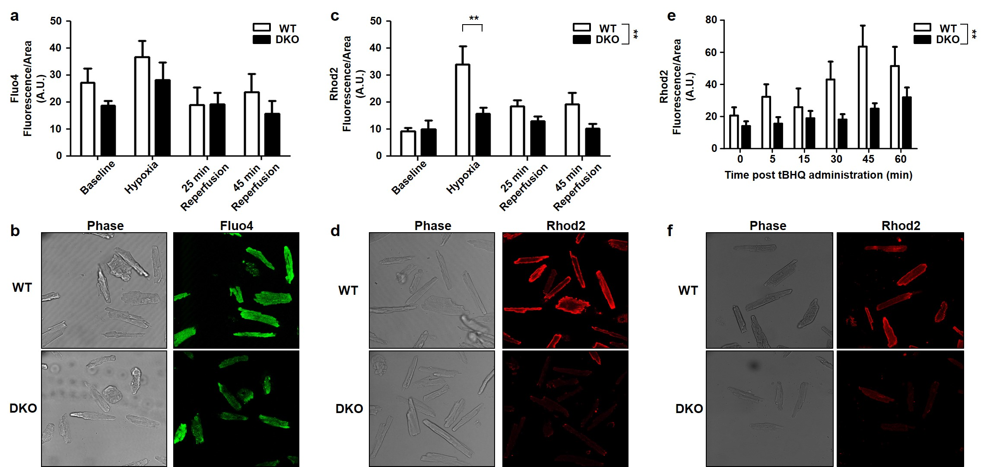
Mfn1/2 deficiency prevents mito Ca overload
Hall et al Cell Death & Dis 2016

Slide 22
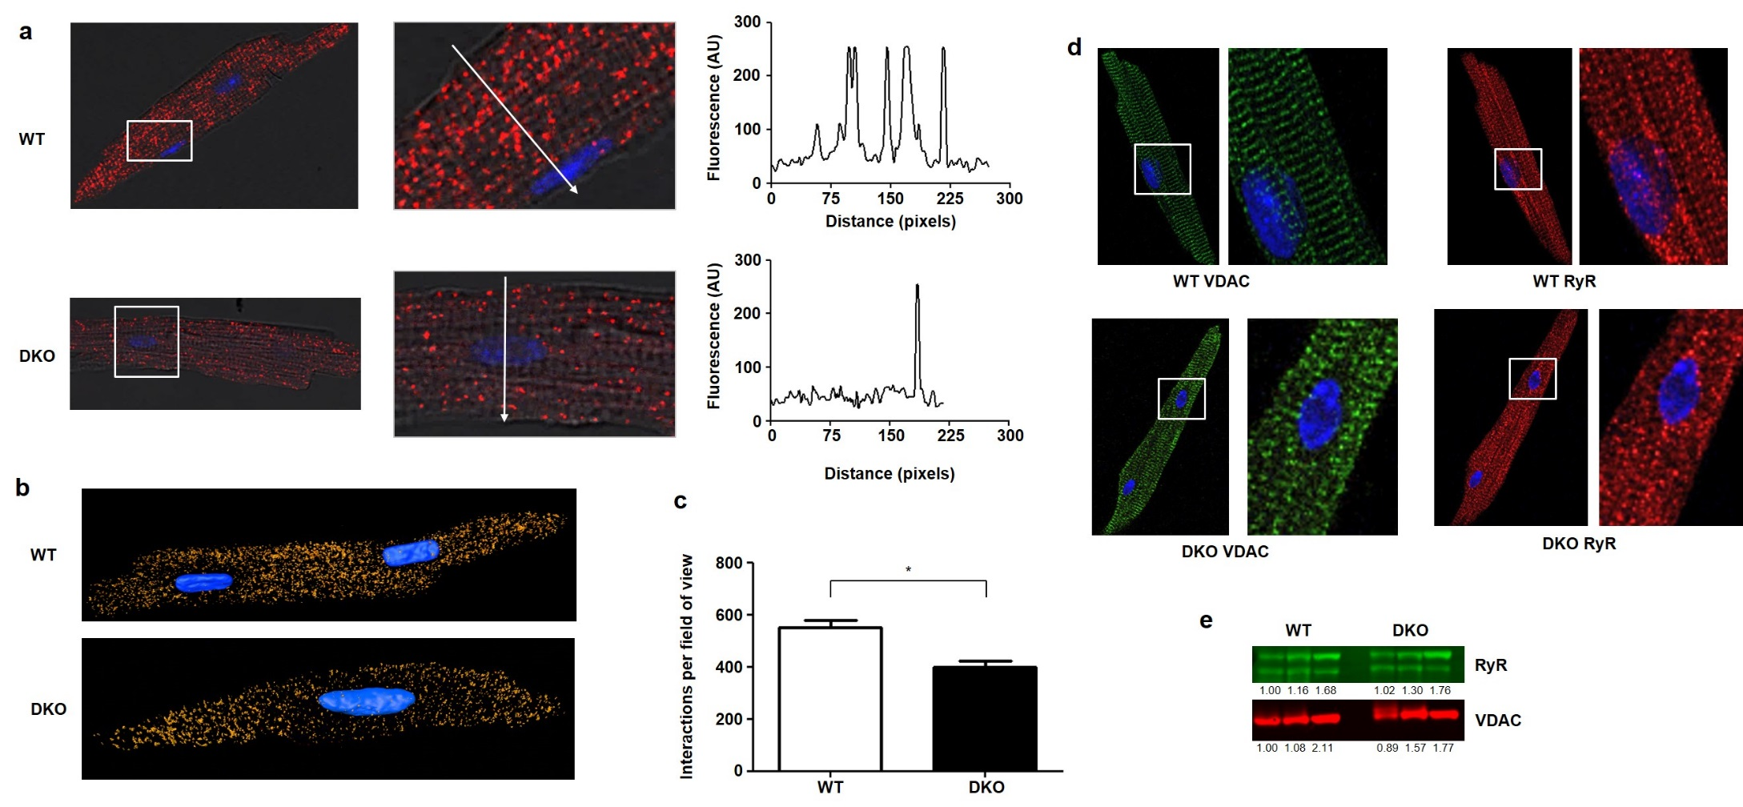
Mfn1/2 deficiency decreases mito-SR interaction
Hall et al Cell Death & Dis 2016

Slide 23
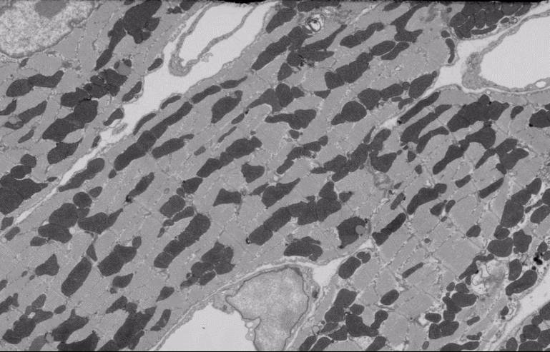
3D EM Tomography in adult heart
Kalkhoran et al unpublished

Slide 24
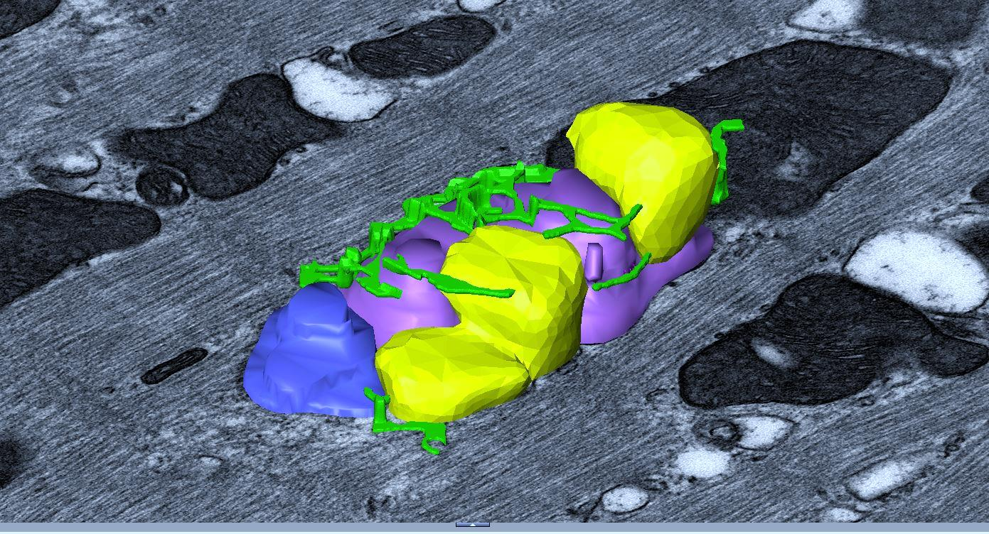
3D EM Tomography in adult heart
Kalkhoran et al unpublished

Slide 25
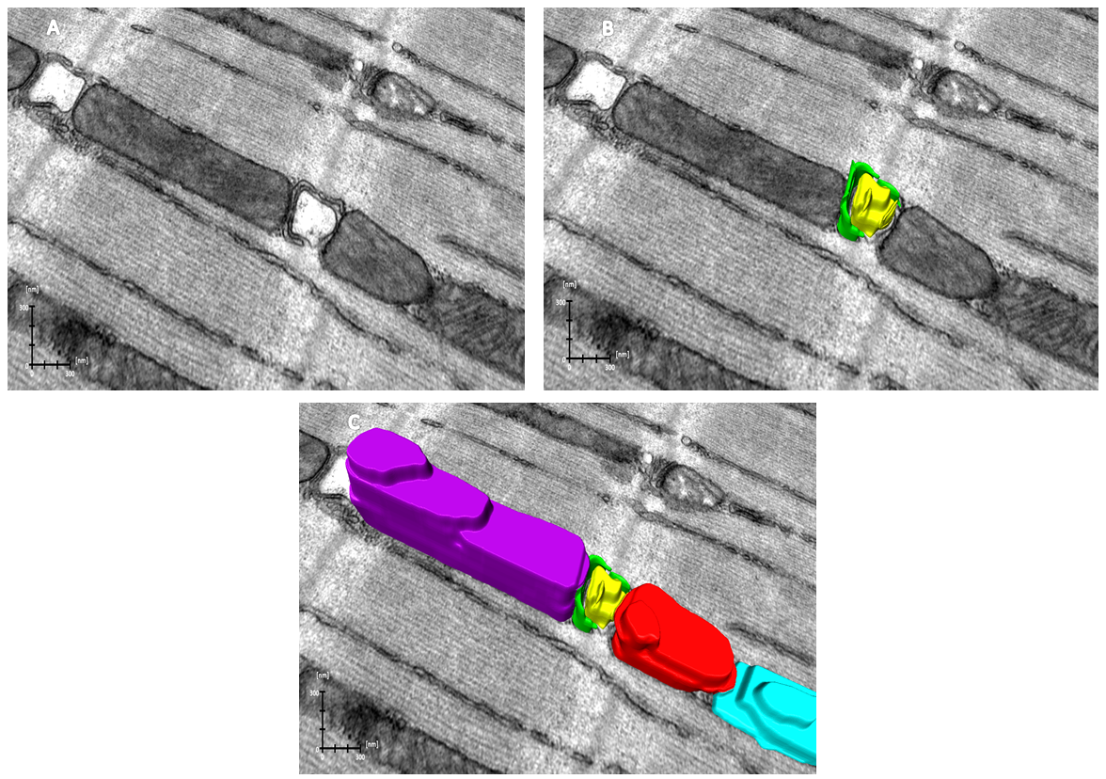
Mfn2 deficiency decreases mito-SR interaction
Postnatal heart-specific ablation of Mfn2 using Myh6-directed nuclear-localised Cre
Kalkhoran et al unpublished

Slide 26
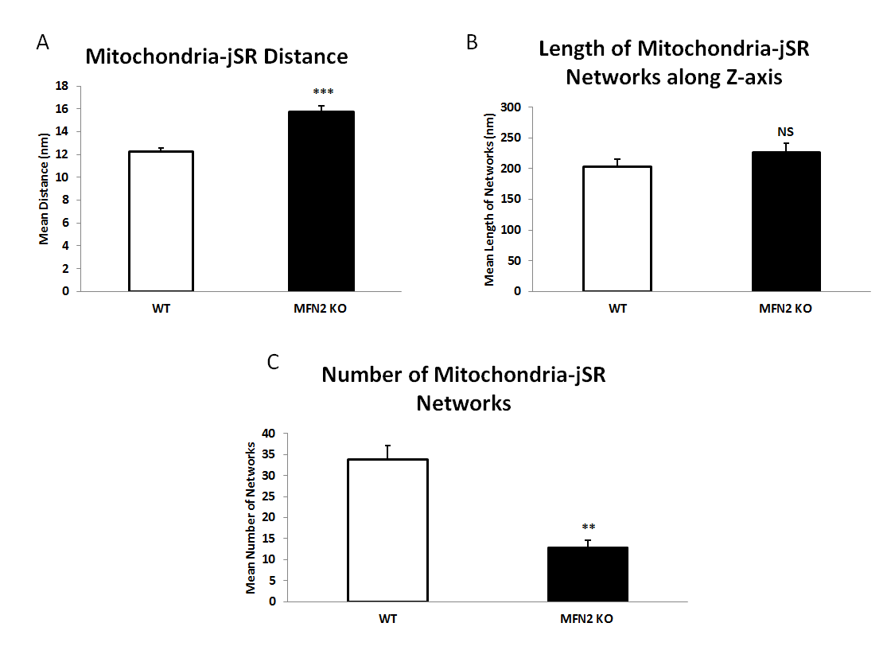
Mfn2 deficiency decreases mito-SR interaction
Kalkhoran et al unpublished

Slide 27
Mitochondrial fusion proteins- OPA1
Hall….Hausenloy BJP 2014

Slide 28
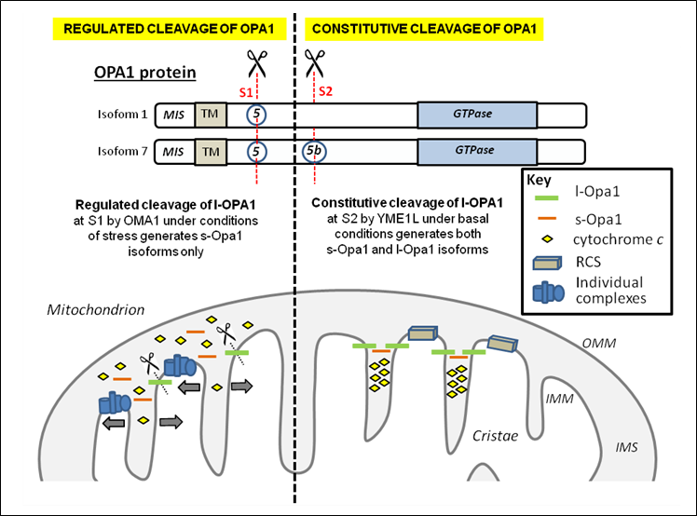
OPA1 processing complex
Burke….Hausenloy Curr Drug Targets. 2015

Slide 29
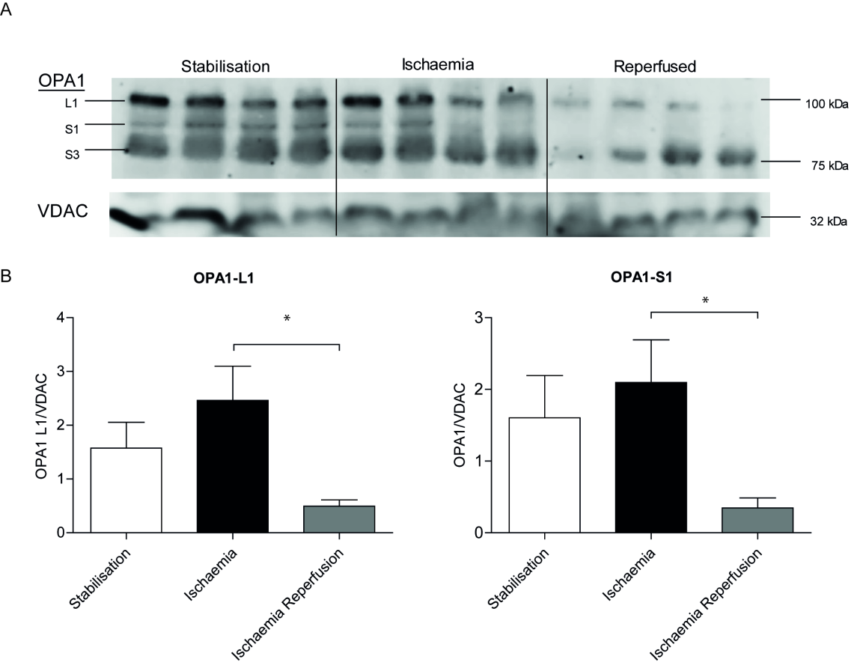
OPA1 processing in acute IRI
Burke et al Unpublished

Slide 30
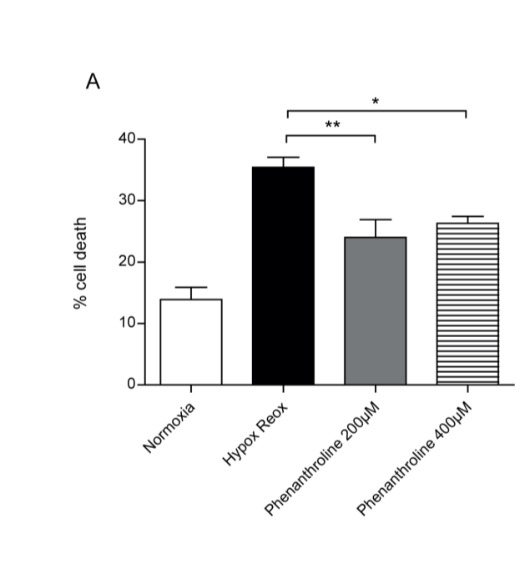
OMA1 inhibition and cardioprotection
Adult cardiomyocytes SIRI
Langendorrf heart IRI
Burke et al Unpublished

Slide 31
OMA1 inhibition and cardioprotection
Burke et al Unpublished

Slide 32
OMA1 inhibition and MPTP opening
Burke et al Unpublished

Slide 33
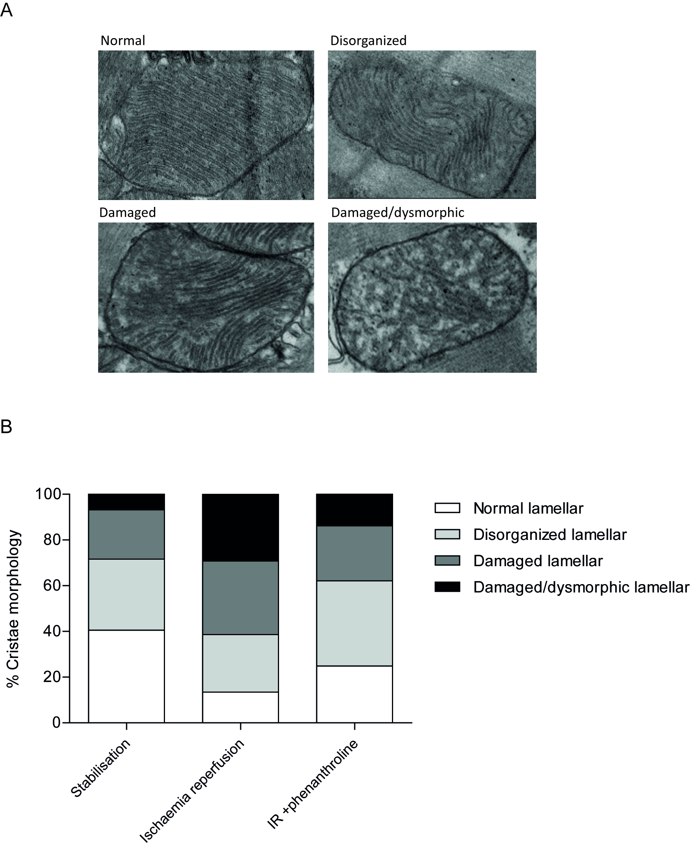
OMA1 inhibition and cardioprotection
Burke et al Unpublished

Slide 34
Mito fusion/fission proteins and cardiac disease
Condition | Observations | Potential therapeutic targets
Acute ischaemia reperfusion injury | Acutely inhibit fission proteins (heart, kidney and brain) Acutely inhibit fusion proteins | Inhibit fission proteins (mdivi-1, dynasore,P110) Inhibit fusion proteins
Cardiomyopathy Dox cardiotoxicity | Mfn1/Mfn2 and OPA1 reduction induces CM Acutely inhibit fission proteins | Activate fusion proteins. Inhibit fission proteins (mdivi-1, dynasore,P110)
LV hypertrophy | Mfn2 or OPA1 ablation induces LVH | Activate Mfn2 or OPA1
Pulmonary arterial HT | Vasculoproliferation requires fission (Drp1) | Inhibit Drp1 proteins mdivi-1, dynasore,P110.

Slide 35
Conclusions
Acute inhibition of Drp1 and MiD49/51 is cardioprotective (beware effect of chronic inhibition).
Acute inhibition of Mfn2 also cardioprotective – probably due to non-fusion effect (also beware chronic inhibition).
Acute inhibition of OMA1 is cardioprotective - mediated by preservation of myocardial OPA1 – probably due to non-fusion and fusion effects.
Pharmacological targeting of mitochondrial fusion/fission proteins may provide a novel strategy for treating cardiac disease.

Slide 36



Acknowledgements
CVMD Duke-NUS
Sang Bing Ong
Hector Carbrera Fuentes
Sauri Resendiz
Xiu Yi Kwek
Khairunnisa Binte Katwadi
The Hatter Institute, UCL
Siavash Kalkhoran
Niall Burke
Parisa Samangouei
Andrew Hall
Sean Davidson
Derek Yellon
VIMM Padova
Luca Scorrano
Washington University
Gerald Dorn
Yun Chen
Monash University
Michael Ryan
Laura Osellame
British Heart Foundation

