Slide 1
Long-term Efficacy of Drug Coated
Balloon for Superficial Femoral Artery
In-stent Restenosis
Sendai Kousei Hospital, Tokyo Kamata Hospital, Japan
Naoto Inoue M.D. FSCAI, FJCC, FAHA

Slide 2
Speaker’s name: Naoto Inoue
■I have the following potential conflicts of interest to report:
□ Research contracts
■Consulting- Kaneka, Medicon
□ Employment in industry
□ Stockholder of a healthcare company
□ Owner of a healthcare company
□ Other(s)
□ I do not have any potential conflict of interest

Slide 3
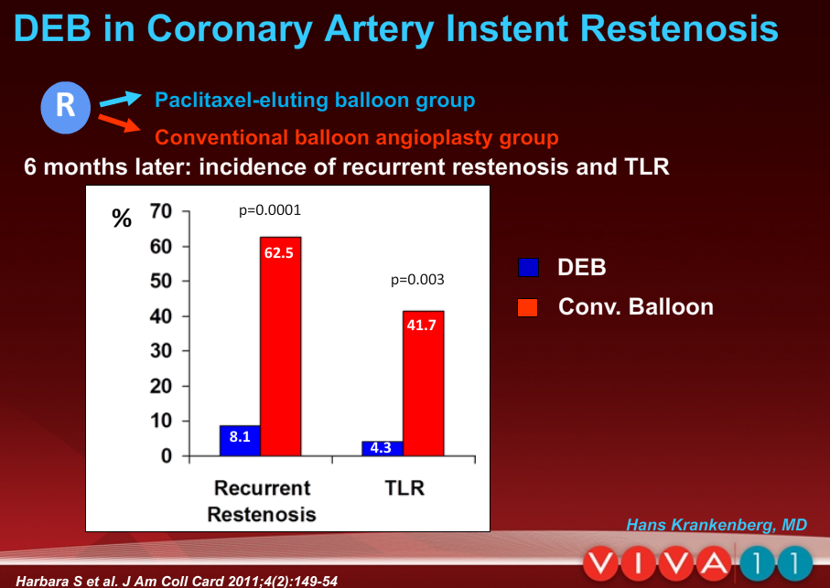

Slide 4
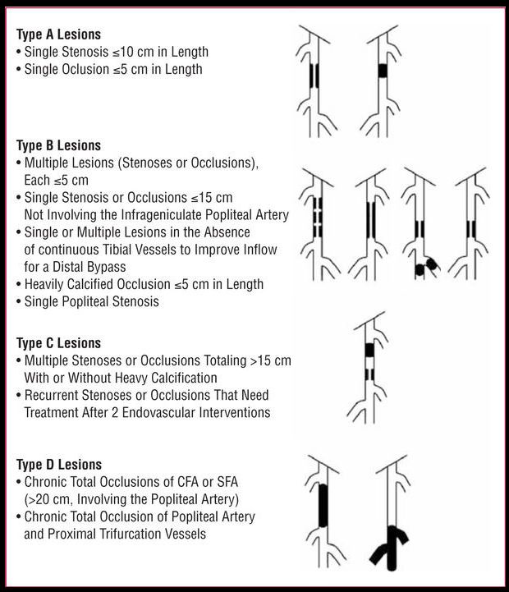
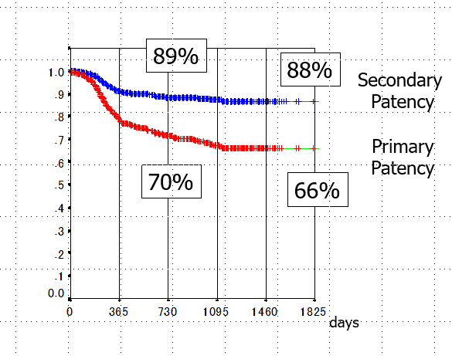
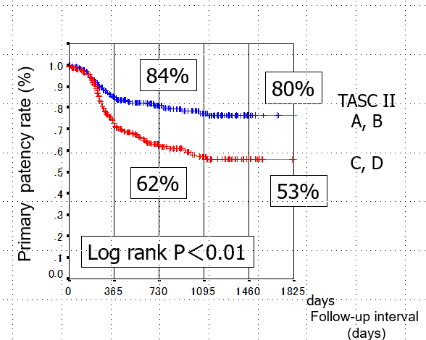
Background 1
The development of endovascular therapy (EVT) techniques and nitinol stents has improved the success rates and patency rates of superficial femoral artery (SFA) lesion. However, outcomes of TASC Ⅱ C and D group, especially of D group were even poor.
(Circulation cardiovascular Interventions. 2010; 3: 267-276)
(Circulation Journal 2011; 75: 939-944)
Classification of femoropopliteal lesions (TASC II).
Long tern results of the nitinol stents (SMART) for SFA lesions

Slide 5
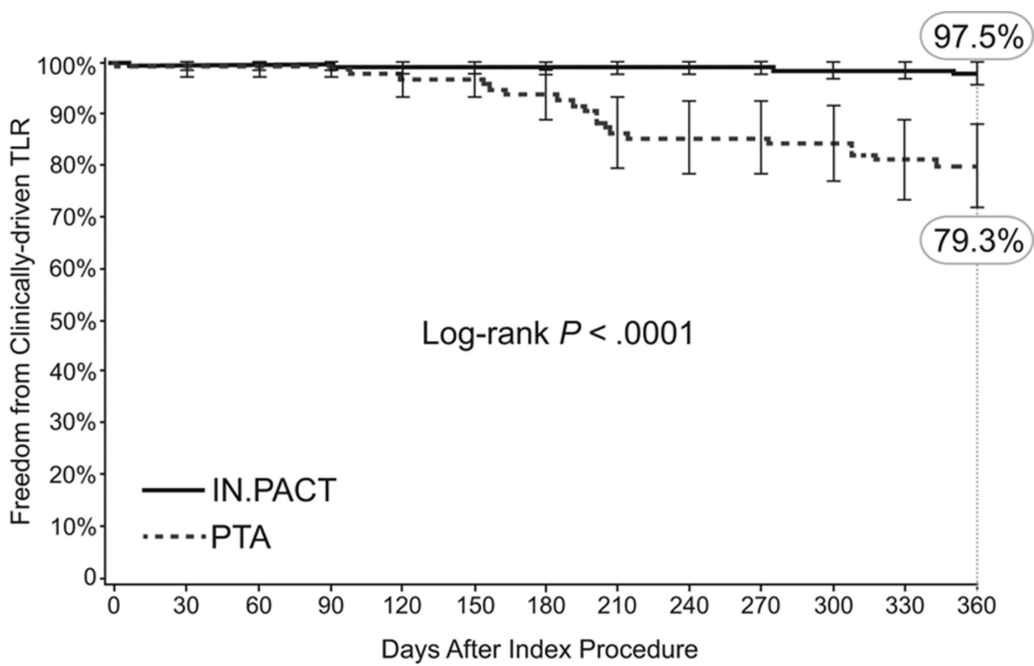
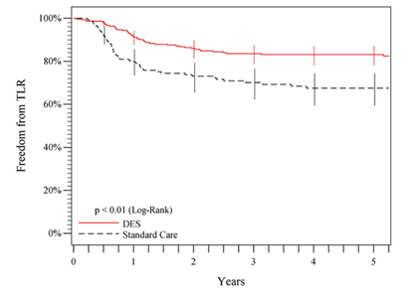
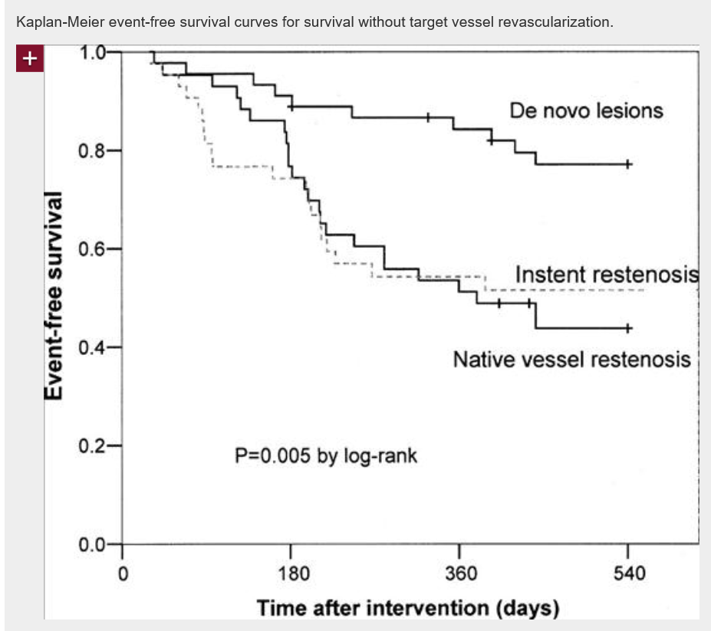
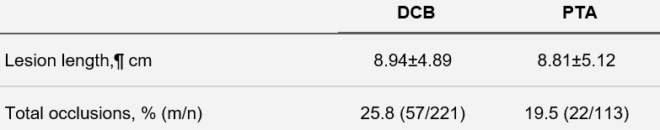
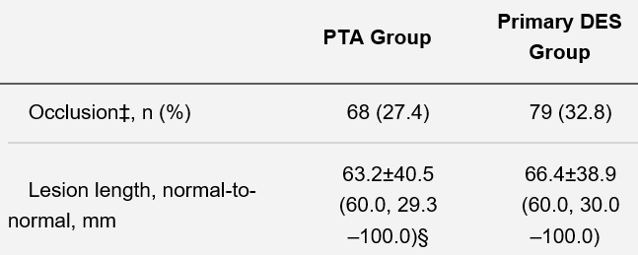

Background 2
Several studies showed encouraging results of drug coated balloons (DCB), drug eluting stent (DES) and atherectomy device using for SFA lesions.
However, those results for TASCⅡ C and D lesions were also poor or uncertain actually. There is no significant superior treatment than using STENT yet.
[DCB for SFA de-novo lesion]
[DES for SFA de-novo lesion]
[Turbo Hawk for SFA lesion]
(Circulation. 2015;131:495-502)
(JACC. 2013;62(15):1320-1327.)
(JACC. 2006; 48(8):1573-1578)

Slide 6
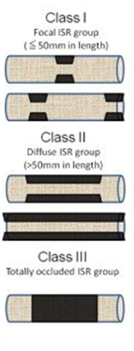
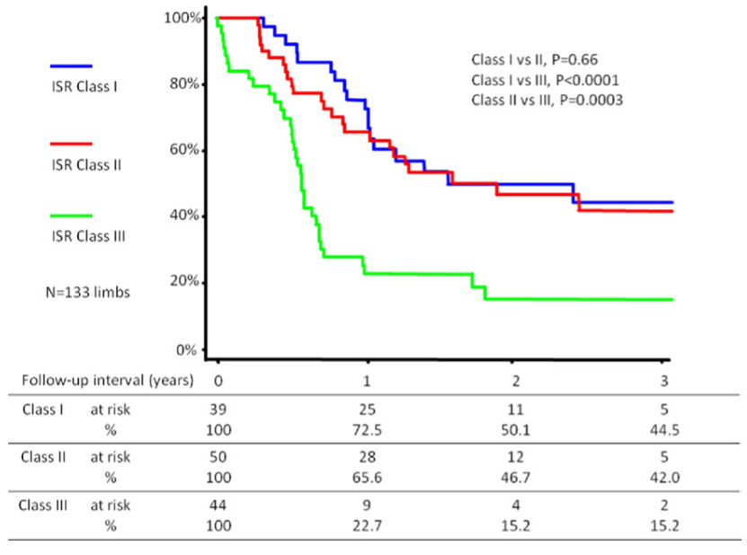
Background 3
On the other hand, occurrence of in-stent restenosis (ISR) has become a serious problem. Several studies revealed poor outcome of ISR EVT, especially for re-occlusion cases.
(JACC. 2012; 59: 16-23)
Classification of ISR
Atsushi Tosaka, et al. Classification and Clinical Impact of Restenosis After Femoropopliteal Stenting.

Slide 7
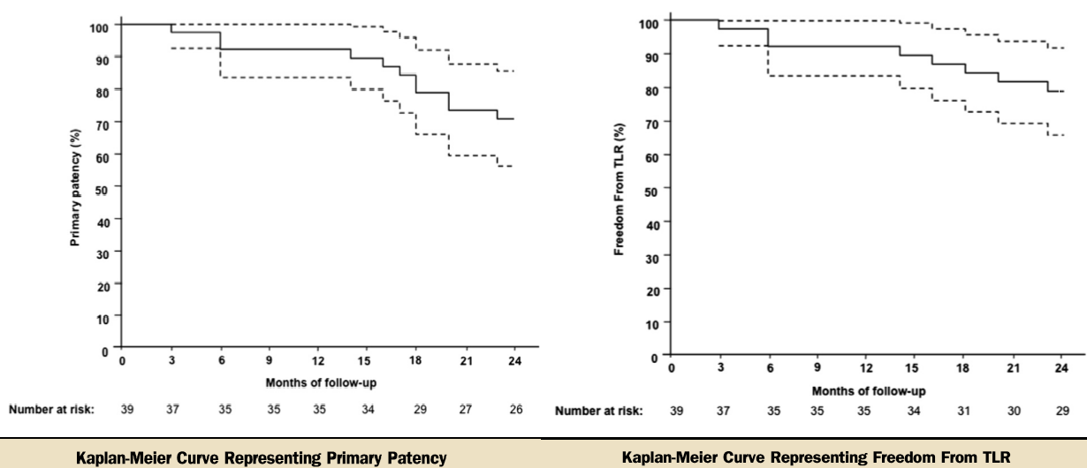
DCB for ISR
Several studies has shown encouraging results of drug coated balloons (DCB) using for SFA ISR.
(JACC 2014; 7; 411-5.)
Although, the long-term clinical efficacy remains poorly defined and there was no data in Japan.

Slide 8
DCB for ISR
This study is a retrospective, single center study.
Between Sep 2009 and May 2013, we treated 27 SFA ISR cases by using DCB (In.pact Amphirion and In.pact Pacific).
DCB is not approval in Japan, so before we use DCB, written informed consent was obtained from all patients. The study was approved by the ethics committees of the institution concerned.

Slide 9
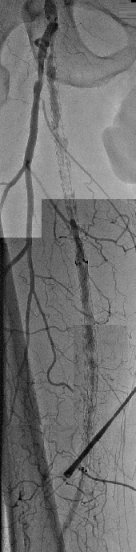
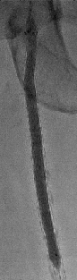
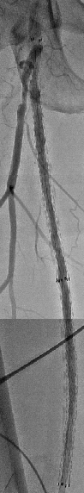
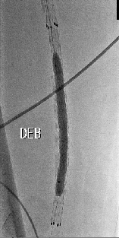
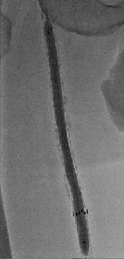
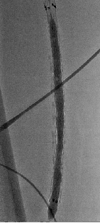
DCB for ISR
Non-DCB
DCB
All patients received aspirin (100 mg/day) indefinitely and thienopyridine.
Pre-dilation was performed by non-DCB for all lesions.
Basically, we used one DCB to one patient, for the most severe lesion.
Balloon dilation time was 60 seconds.

Slide 10
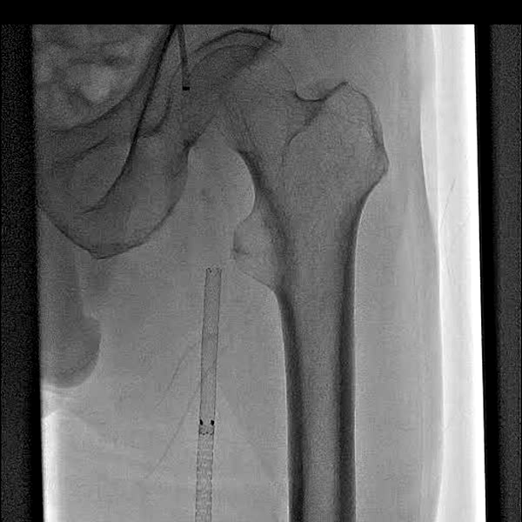
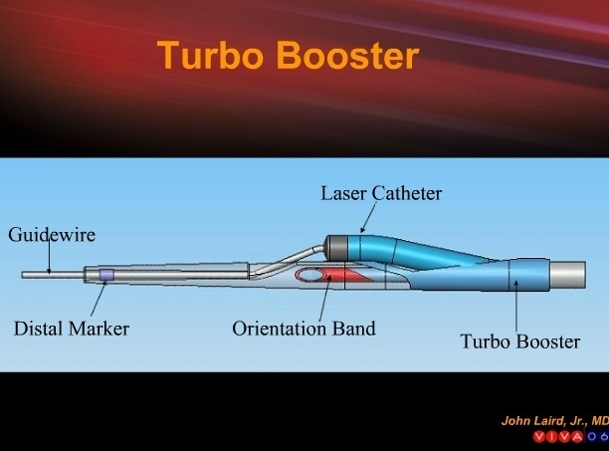
Laser atherectomy+DCB

Slide 11
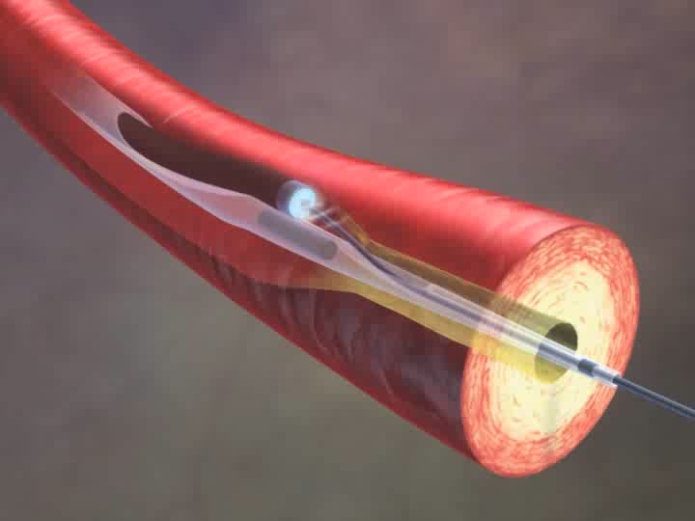

Slide 12
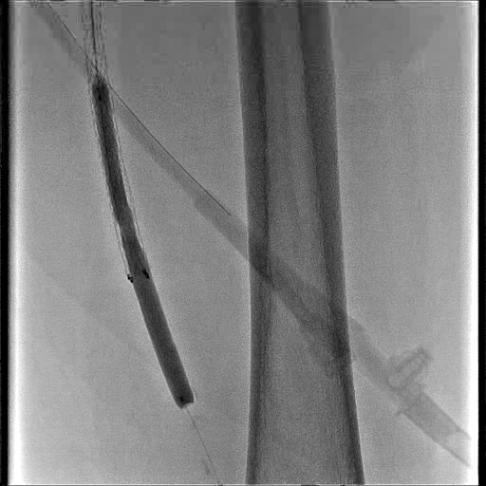
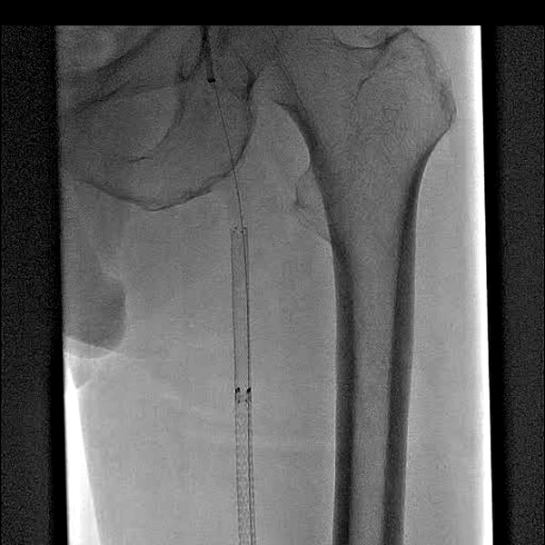
Turbo Booster for long stent occlusion
DCB

Slide 13
Methods
Patients were evaluated through baseline, hospital discharge and every 6 months until 30 months post-procedure.
Clinical follow-up was performed by clinical examination and duplex ultrasonography scan.
Primary endpoint was primary patency of DCB site.
＊Peak systolic Velocity Ratio by Duplex < 2.5
＊Angiographic restenosis < 50%

Slide 14
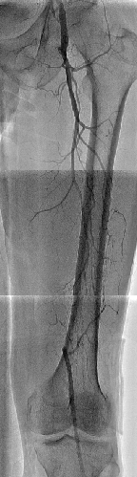
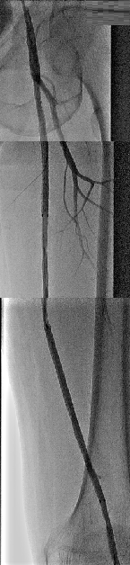
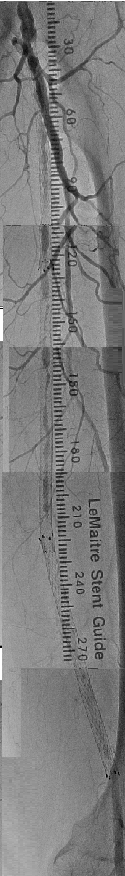
PRE Lesion Characteristics
 | Total n=27
Before primary EVT
CTO, n (%) | 25 (92.6)
TASCⅡ category A, n (%) | 0 (0)
TASCⅡ category B, n (%) | 3 (11.1)
TASCⅡ category C, n (%) | 3 (11.1)
TASCⅡ category D, n (%) | 21 (77.8)
Total STENT length, (cm) | 25.1± 6.20
Total STENT number, n | 2.37± 0.75
Pre EVT number for SFA | 1.85 ± 0.88
Notes:
ぷれ ＳＴＥＮＴ ＩＳＲの写真

Slide 15
Stent Characteristics
 | Total n=27
Kind of STENT
Luminexx, n (%) | 22 (81.5)
SMART, n (%) | 9 (33.3)
Zilver 518, n (%) | 2 (7.41)
Zilver PTX, n (%) | 1 (3.70)
Mixed STENT type use, n(%) | 5 (18.5)
STENT Diameter | 4 (14.8)
6mm only, n (%) | 18 (66.7)
6mm and 7mm, n (%) | 9 (33.3)
7mm only, n (%) | 0 (0)
 | Single STENT type use, n | Mixed STENT type use, n | P value
Total number of EVT for SFA | 1.55 ± 0.69 | 3.20 ± 1.12 | 0.007

Slide 16
ISR lesion characteristics
Lesion Characteristics
Classification of ISR
 | Total n=27
Lesion lengh, (cm) | 12.4 ± 7.28
Angiographic restenosis
75% (>50 ≤75), n (%) | 8 (29.6)
90% (>75 ≤90), n (%) | 12 (44.4)
99% (>90 ≤99), n (%) | 3 (11.1)
100%, n (%) | 4 (14.8)
Classification of ISR
Class Ⅰ, n (%) | 11 (40.7)
Class Ⅱ, n (%) | 12 (44.4)
Class Ⅲ, n (%) | 4 (14.8)
Atsushi Tosaka, et al. Classification and Clinical Impact of Restenosis
After Femoropopliteal Stenting. JACC. 2012; 59(1):16-23

Slide 17
Patient Characteristics
 | Total n=27
Age, (years) | 70.9 ± 6.1
Sex (Male), n (%) | 16 (59.3)
Body mass index, (kg/m2) | 23.5 ± 2.73
Risk factor history
Hypertension, n (%) | 26 (96.2)
Dyslipidemia, n (%) | 13 (48.1)
Diabetes, n (%) | 23 (85.2)
Smoking, n (%) | 18 (66.7)
Hemodialysis, n (%) | 3 (11.1)
History of CAD, n (%) | 17 (63.0)
History of CVD, n (%) | 5 (18.5)
Ankle Brachial Index | 0.65 ± 0.08
PAD clinical stage before EVT
Ruterford 2, n (%) | 4 (14.8)
Ruterford 3, n (%) | 22 (81.5)
Ruterford 4, n (%) | 0 (0)
Ruterford 5, n (%) | 1 (3.7)

Slide 18
Results 1
Procedure success was achieved in all cases
There were no bail-out stenting.
Two DCB was used in 6 cases.
Mean DCB length was 12.9 ± 3.75 cm.
ABI, symptom and stenosis got better at all cases.
Changes of ABI, Rutherford category and % stenosis
 | Before EVT | After EVT | P value
ABI | 0.65 ± 0.08 | 0.83 ± 0.09 | <0.001
Rutherford | 2.92 ± 0.27 | 0.59 ± 0.57 | <0.001
% stenosis | 88.0 ± 7.73 | 23.7 ± 5.81 | <0.001

Slide 19
Results 2
Two patients died during follow up.
＊1: Pneumonia after 2 months.
＊2: Lung cancer after 11 months.
No amputation, cardiac infarction and stroke occurred during follow up.
Twenty five patients could follow for 30 months.

Slide 20
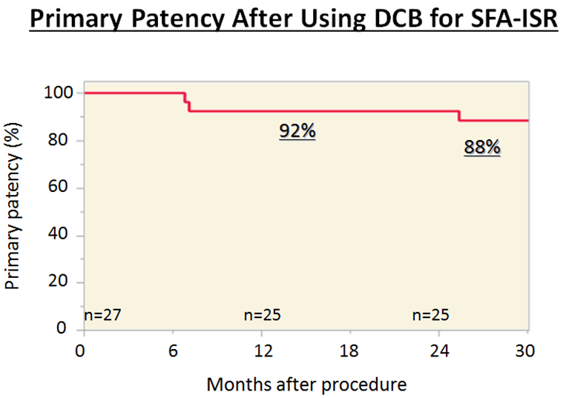


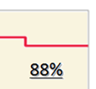

Results 3
・During 30 months follow-up, significant DCB site restenosis occurred in 3 patients.

Slide 21
Predictors for re-restenosis
Patient Characteristics
Pre Lesion Characteristics
 | No-ISR n=22 | ISR n=3 | P value
Age, (years) | 70.9 ± 1.62 | 67.0 ± 4.39 | 0.419
Sex (Male), n (%) | 13 (59.1) | 1 (33.3) | 0.399
Body mass index, (kg/m2) | 22.9 ± 0.71 | 27.4 ± 1.91 | 0.037
Risk factor history
Hypertension, n (%) | 21 (95.5) | 3 (100) | 0.609
Dyslipidemia, n (%) | 11 (50.0) | 2 (66.7) | 0.584
Diabetes, n (%) | 18 (81.8) | 3 (100) | 0.290
Smoking, n (%) | 14 (63.6) | 2 (66.7) | 0.917
Hemodialysis, n (%) | 3 (13.6) | 0 (0) | 0.365
History of CAD, n (%) | 13 (60.1) | 2 (66.7) | 0.800
History of CVD, n (%) | 3 (13.6) | 2 (66.7) | 0.055
Ankle Brachial Index | 0.66 ± 0.08 | 0.64 ±0.09 | 0.599
PAD clinical stage before EVT |  |  | 0.424
Ruterford 2, n (%) | 3 (13.6) | 1 (33.3)
Ruterford 3, n (%) | 19 (86.4) | 1 (33.3)
Ruterford 4, n (%) | 0 (0) | 0 (0)
Ruterford 5, n (%) | 0 (0) | 1 (33.3)
 | Non ISR n=22 | ISR n=3 | P value
Before primary EVT
CTO, n (%) | 20 (91.0) | 3 (100) | 0.468
TASCⅡ category |  |  | 0.412
TASCⅡ category B, n (%) | 3 (13.6) | 0 (0) | 0.365
TASCⅡ category C, n (%) | 3 (13.6) | 0 (0) | 0.365
TASCⅡ category D, n (%) | 16 (72.7) | 3 (100) | 0.183
Total STENT length, (cm) | 24.6± 1.85 | 27.0± 5.01 | 0.656
Total STENT number, n | 2.32 ± 0.20 | 2.67 ± 0.53 | 0.544
Total number of EVT for SFA | 1.91 ± 0.27 | 2.00 ± 0.72 | 0.907

Slide 22
Predictors for re-restenosis
Lesion Characteristics
 | Non-ISR n=22 | ISR n=3 | P value
Lesion lenght, (cm) | 13.9 ± 1.70 | 7.0. ±4.59 | 0.171
Angiographic restenosis |  |  | 0.301
75% (>50 ≤75), n (%) | 8 (36.4) | 0 (0)
90% (>75 ≤90), n (%) | 9 (41.0) | 2 (66.7)
99% (>90 ≤99), n (%) | 1 (4.55) | 1 (33.3)
100%, n (%) | 4 (18.2) | 0 (0)
Classification of ISR |  |  | 0.441
Class Ⅰ, n (%) | 8 (36.4) | 2 (66.7) | 0.319
Class Ⅱ, n (%) | 10 (45.5) | 1 (33.3) | 0.688
Class Ⅲ, n (%) | 4 (18.2) | 0 (0) | 0.290
 | Non ISR n=22 | ISR n=3 | P value
Kind of STENT |  |  | 0.535
Luminexx, n (%) | 17 (77.3) | 3 (100) | 0.230
SMART, n (%) | 7 (31.9) | 2 (66.7) | 0.249
Zilver 518, n (%) | 2 (9.10) | 0 (0) | 0.467
Zilver PTX, n (%) | 1 (4.55) | 0 (0) | 0.609
Mixed STENT, n(%) | 5 (18.5) | 2 (66.7) | 0.031
STENT Diameter
6mm only, n (%) | 14 (63.7) | 2 (66.7) | 0.918
6mm and 7mm, n (%) | 8 (36.3) | 1 (33.3) | 0.918
Changes of ABI, Rutherford category and % stenosis
 | Non-ISR n=22 | ISR n=3 | P value
Post ABI | 0.82 ± 0.03 | 0.92 ± 0.07 | 0.219
Post Rutherford | 0.59 ± 0.12 | 0.00 ± 0.32 | 0.102
Post % stenosis | 23.4 ± 2.31 | 25.0 ± 6.23 | 0.814
Notes:
Ｍｉｘｅｄ ＳＴＥＮＴ →複数回ＩＳＲ治療している 何回目のＩＳＲ？
ＤＣＢあてたばししょ overラップ？

Slide 23
Conclusions
During 30 months follow-up, significant DCB site restenosis occurred only in 3 patients.
Primary patency rates of DCB site were 92% at 12 and 24 months and 88% at 30 months after procedure.
In log rank analysis, BMI and mixed STENT used were significant predictors of primary patency.

Slide 24


Slide 25
Thank you !

