Slide 1
Similar but Different Hyperemic Agents in Physiologic Assessment
Joo Myung Lee, MD, MPH, PhD
Heart Vascular Stroke Institute,
Samsung Medical Center, Seoul, Republic of Korea
Notes:
15min
09:10 FFR and iFR: similarities and differences 구본권
09:25 Similar but different hyperemic agents 이주명
09:40 Post-PCI FFR measurements 도준형
09:55 Role of FFR in ACS 남창욱
Hello, I’ am Joo Myung Lee from Samsung Medical Center.
Today, I will be talking about various hyperemic agents used in invasive physiologic assessment

Slide 2
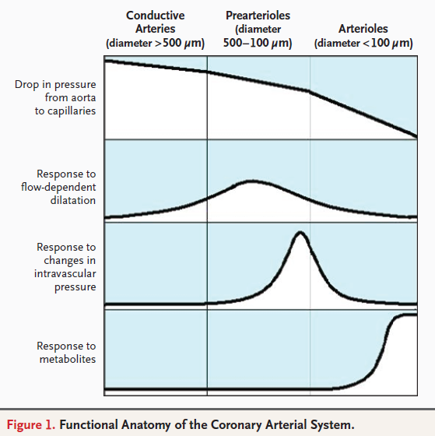
Ischemic Heart Disease
Coronary Arterial System is composed of three compartments
Any of these compartments fail to maintain sufficient O2, myocardial ischemia can occur.
Therefore, the presence of epicardial coronary stenosis is not always a “prerequisite” for the IHD.
In order to properly select treatment target, evaluating the functional significance of epicardial stenosis is important.
Crea et al. NEJM 2007
Notes:
The functional anatomy of coronary circulation consisted with 3 parts including
Conductive arteries, prearterioles and arterioles.
Among the 3 compartment, the main regulator of coronary resistance and flow is prearterioles,
Not the epicardial coronary artery.
When any of these compartments fails to maintain sufficient O2, myocardial ishcemia can occur,
Therefor, the presence of epicardial coronary stenosis is not always prerequisite for the ischemic heart disease,
Therefore, in order to properly select revascularization target, evaluating the functional significance of the epicardial stenosis
Is very important.

Slide 3
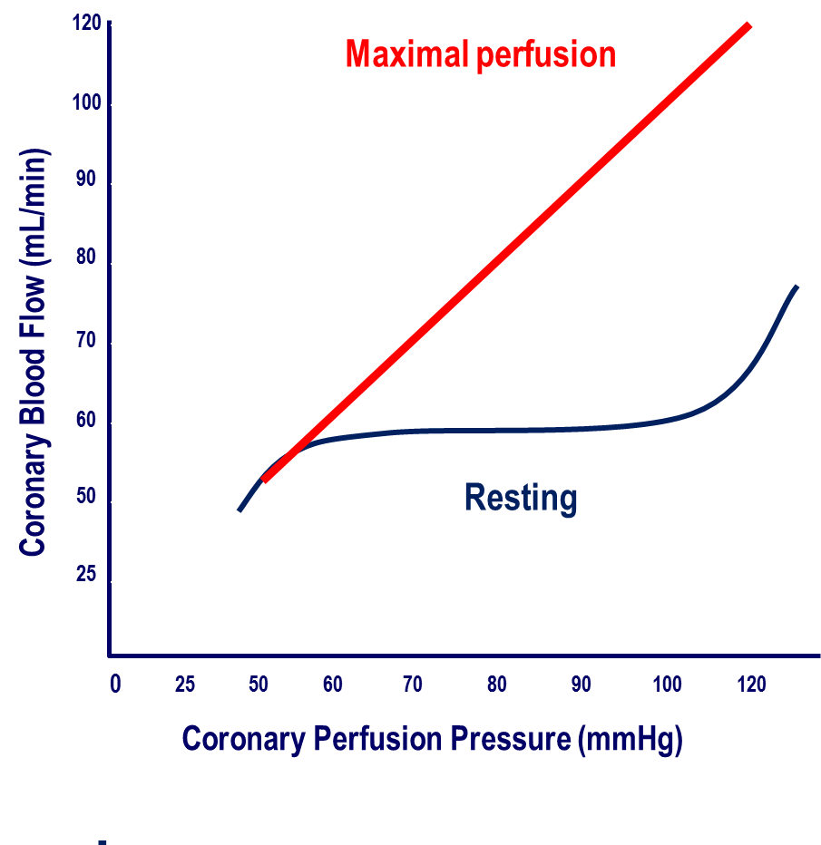
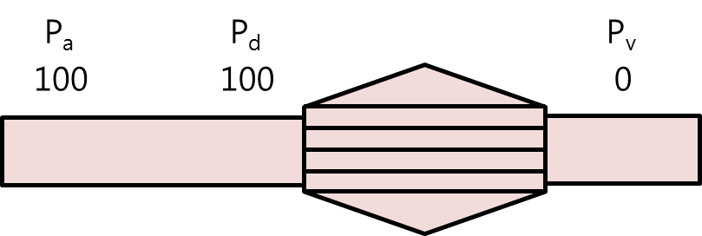
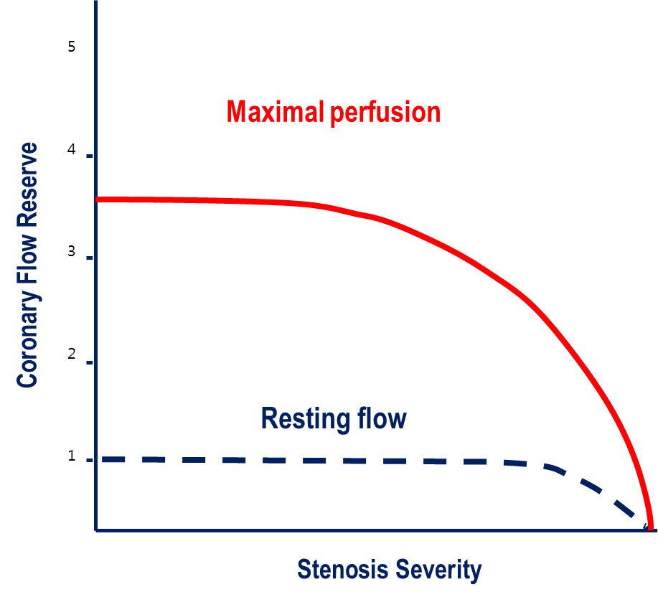
Functional Significance of Epicardial Coronary Stenosis
- Autoregulation and Concept of Maximal Perfusion -
Due to Coronary Autoregulation,
Measuring resting distal pressure cannot reflect resting coronary flow or flow velocity
In order to assess “Maximal Perfusion”, Induction of Hyperemia and Measuring Hyperemic Distal Coronary Pressure is Essential to estimate “Coronary Reserve”
Koo BK, Lee JM, IPOP Textbook of Imaging and Physiology
Notes:
In assessment of functional significance of epicardial coronary stenosis,
Understanding of coronary autoregulation and concept of maximal perfusion is essential.
This cartoon shows the changes in distal coronary pressure and blood flow,
In the resting status, coronary autoregulation mechanism maintain certain level of resting coronary flow
Within wide range of distal pressure. Therefore, in this circumstance, measuring resting distal pressure cannot reflect resting coronary
Flow or flow velocity.
The maximal perfusion means the potential ability of increasing coronary blood flow in response to exercise or pharmacologic stress
In this circumstance, the distal pressure directly correlates with coronary blood flow, therefore, In order to assess “Maximal Perfusion”, Induction of Hyperemia and Measuring Hyperemic Distal Coronary Pressure is Essential to estimate “Coronary Reserve”

Slide 4
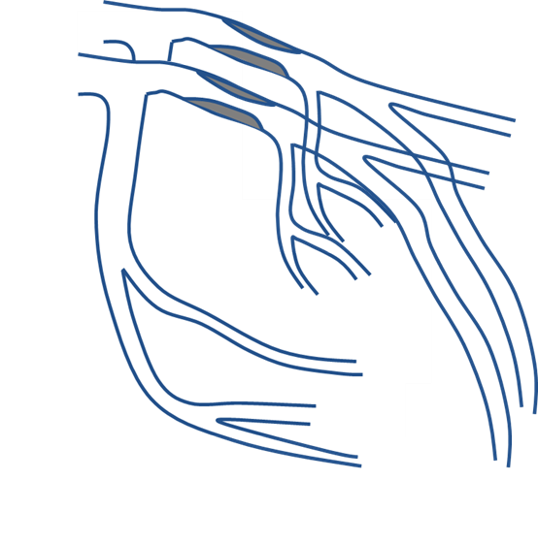
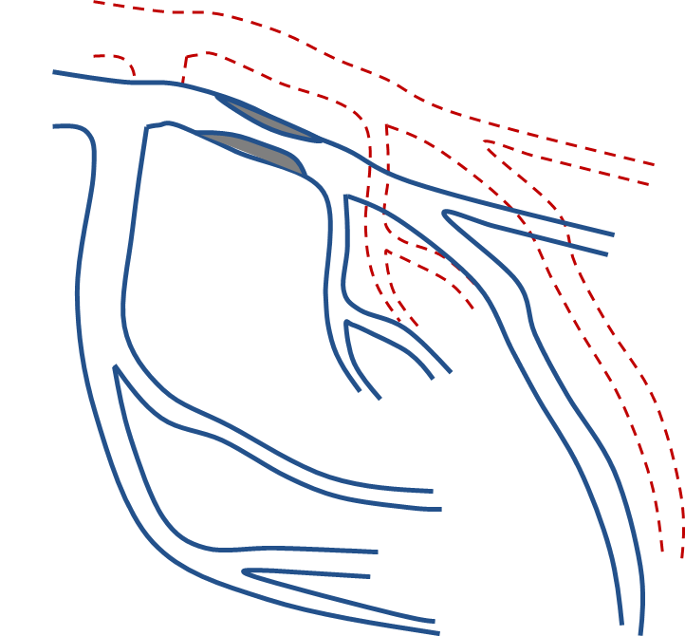
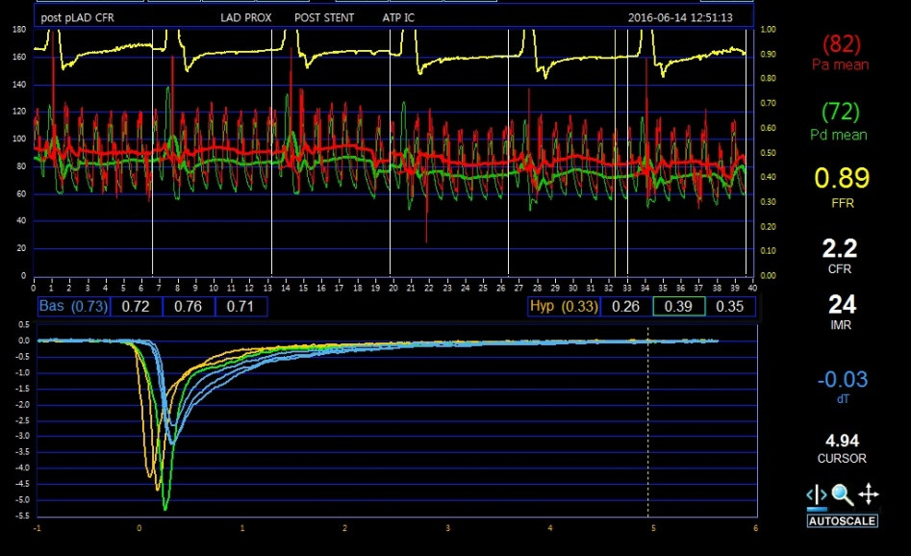
Absolute versus Fractional Flow Reserve
Absolute Flow Reserve (CFR)
Fractional Flow Reserve (FFR)
Q^{S}_{resting}
Q^{N}_{max}
Q^{S}_{max}
Q^{S}_{max}
Thermodilution Method
Koo BK, Lee JM, IPOP Textbook of Imaging and Physiology
Notes:
There are 3 kinds of coronary reserve which is absolute, relative, and fractional flow reserve.
In invasive physiologic assessment, we usually measure the absolute flow reserve and fractional flow reserve
In the target vessels.
The absolute flow reserve is ratio of hyperemic and resting coronary flow and this can be measure by
Thermodilution technique using pressure-temperature sensor wire.
The fractional flow reserve is ratio of maximal flow in presence of epicardial coronary stenosis and conceptually normal maximum flow without epicardial coronary stenosis. In practical use, this can be measured by hyperemic Pd divided by hyperemic Pa.
The fundamental rationale of both index is inducing “maximal hyperemia” to abolish coronary autoregulation and minimize microvascular resistance.

Slide 5
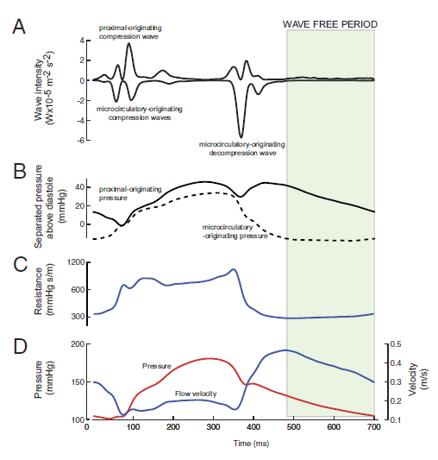
iFR, free from hyperemic agent, BUT
It is not free from “The Concept of Hyperemia and Maximal Perfusion”
iFR is also based on the concept of Pd/Pa ratio during period of “minimized microvascular resistance”
One major difference is this period of “minimized microvascular resistance” is not induced by artificial hyperemic agent.
Pd/Pa ratio during period of “NATURALLY, minimized microvascular resistance” is the “iFR”.
Sen et al. JACC 2012 (ADVISE Study)
Notes:
Recently introduced instatenous wave free ratio is measured in resting status without hyperemic agents.
Although it is free from hyperemic agent, we should consider that is not free from the concept of maximal perfusion.
Since Pd/Pa ratio during period of “NATURALLY, minimized microvascular resistance” is the “iFR”, the concept of maximal perfusion is still fundamental base of the iFR.

Slide 6
Hyperemic Agents
Drug | Administration and Dosage
Adenosine | Intravenous continuous infusion 140ug/kg/min Intracoronary bolus 40-100 ug in RCA / 80-200ug in LCA
ATP | Intravenous continuous infusion 140ug/kg/min
Nicorandil | Intracoronary bolus 2mg
Regadenosone | Intravenous slow bolus over 10 seconds of 400ug
Nitroprusside* | Intravenous continuous infusion 140 ug/kg/min Intracoronary bolus 0.6 ug/kg
Papaverine* | Intracoronary bolus 8mg in RCA / 12mg in LCA
* Not frequently used (severe hypotension / QT prolongation, ventricular tachycardia)
Koo BK, Lee JM, IPOP Textbook of Imaging and Physiology
Notes:
Although many agents have been used as hyperemic agents,
The most widely used agents are adenosine, nicorandil, and regadenosone.
Although papaverine is still used in some nations due to unavailability of adenosine, for example Singapore, it has been known to induce fatal ventricular tachycardia and this agent is not used for coronary hyperemic agent in Korea.

Slide 7
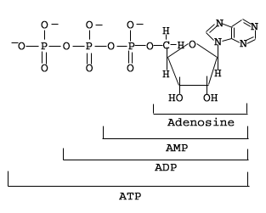
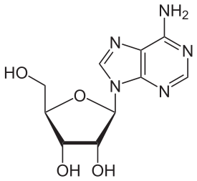
Adenosine
Current Gold Standard Agents
adenine
ribose
Uptake by RBC
ATP
ADP
AMP
5’-nucleotide
Adenosine
Inosine
Adenosine
kinase
(ADK)
Adenosine
deaminase
(ADA)
plasma clearance <30 sec
half-life <10 sec
Adenosine receptors
Notes:
Adenosine is the current gold standard agents and
It rapidly degrades after administration and has very short half life less than 10 seconds.

Slide 8
Adenosine Receptors
Receptor | Effect
A₁ | Decreased heart rate
A_{2A} | Coronary artery vasodilation; decreased dopaminergic activity in CNS; inhibition of central neuron excitation
A_{2B} | Bronchospasm
A₃ | Cardioprotective in myocardial ischemia; cardiac muscle relaxation; smooth muscle contraction; inhibition of neuronal degranulation
Adenosine acts on all adenosine receptor subtypes non-selectively.
Notes:
Among the 4 adenosine receptors, hyperemic efficacy is usually mediated via A2A receptor.
Since adenosine is nonselective agents and acts on all these receptors, side effects mediated via A1 and A2B receptors.

Slide 9
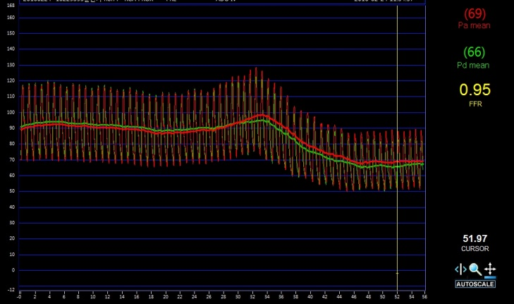
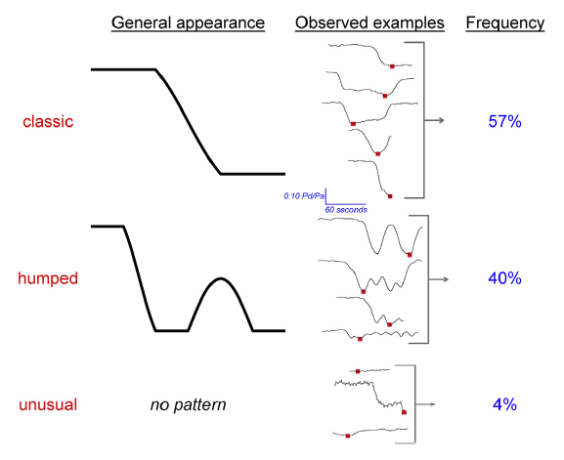
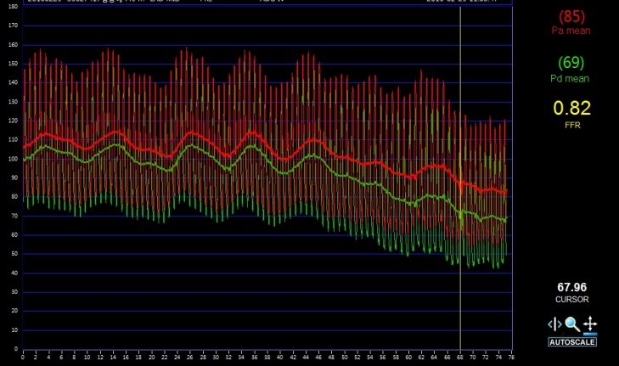
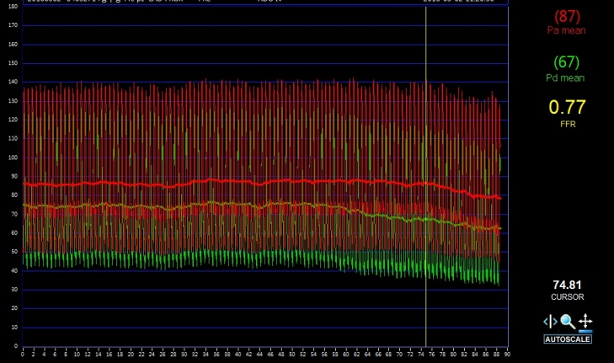
Variable Hyperemic Response
Classic
Humped
Indeterminate
VERIFY study, Berry et al. JACC 2013
Johnson et al. J Am Coll Cardiol Intv 2015
Notes:
When adenosine is continuously infused, each patient can show variable response like this.
The first one is typical hyperemic response.
The second one is humped response and Pa and Pd can show up and down response.
In the limited patient, hyperemic response can be doubtful like this.
In post-hoc analysis of VERIFY study, the incidences of these 3 patterns were reported like this.

Slide 10
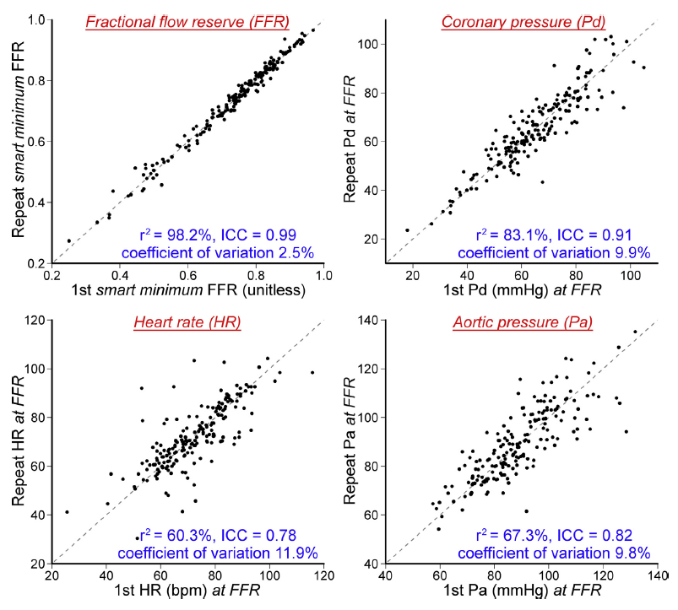
Repeatability of FFR
Lowest average of 5 consecutive cardiac cycle showed the highest repeatability, regardless of pattern of hyperemia
* FFR was calculated with Lowest average during 5 consecutive cardiac cycle
VERIFY study, Berry et al. JACC 2013
Johnson et al. J Am Coll Cardiol Intv 2015
Notes:
Although hyperemic response can be varied in each individuals,
The lowest average of 5 consecutive values showed the highest repeatability, regardless of pattern of hyperemic response.

Slide 11
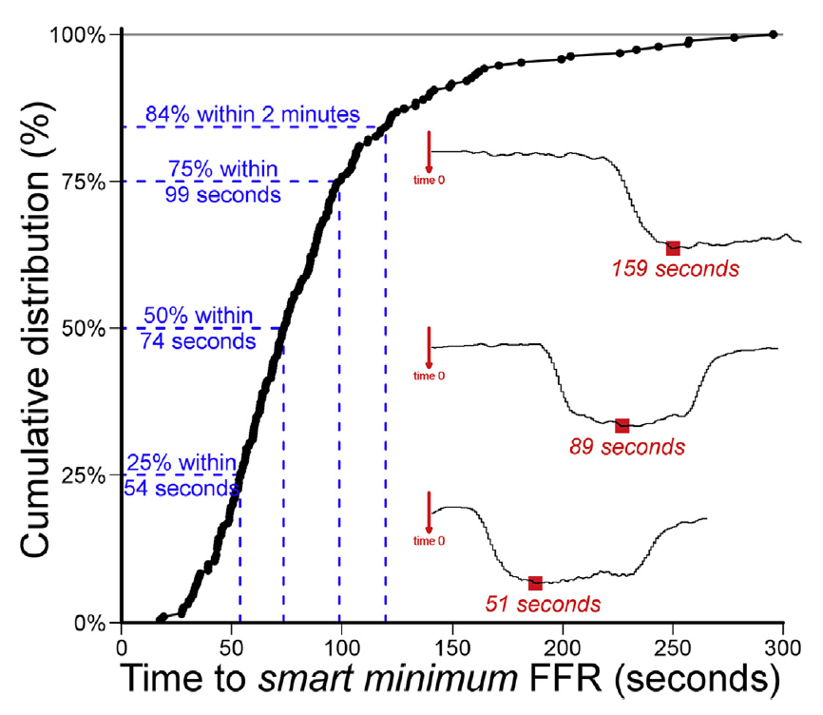
Time to Minimum FFR value (Highest Repeatability)
* FFR was calculated with Lowest average during 5 consecutive cardiac cycle
VERIFY study, Berry et al. JACC 2013
Johnson et al. J Am Coll Cardiol Intv 2015
Notes:
The same study by Nils johnson presented, over 80% of patients achieved the lowest value of FFR within 2 minutes.

Slide 12
Continuous Infusion of Adenosine
Advantage
Gold standard: largest evidences
Long maintenance of hyperemic plateau: pull-back, IMR
Disadvantage
Side effects of adenosine: AV block, chest pain, etc.
Inconvenience of continuous infusion.
Relatively high-cost (not in Korea)
Notes:
Currently, the continous infusion of adenosine is considered as gold standard method of hyperemia induction.
As the hyperemia is maintained during the infusion, this method provides sufficient time to CFR and IMR measurement and pressure pullback tracing.
However, side effect of adenosine infusion, especially nonspecific chest discomport of patient is disturbing problem.

Slide 13
Intracoronary Adenosine
Continuous infusion of adenosine 140ug/kg/min is the current gold standard.
Intracoronary Bolus administration was evaluated in several studies
Study | Test (Vasodilator) |  | Reference Method | Results |  | p-value
 | Route | Dose |  | Test | Reference
Jeremias et al. | IC bolus | 15-20 ug (RCA), 18-24 ug (LCA) | IV AD 140 ug/kg/min | 0.78 ± 0.15 | 0.78 ± 0.15 | NS
De Bruyne et al. | IC bolus | 20, 40 ug | IV AD 140 ug/kg/min | 0.62 ± 0.20 / 0.60 ± 0.19 | 0.61 ± 0.19 | NS
Koo et al. | IC bolus | 40, 80 ug | IV AD 140 ug/kg/min | 0.83 ± 0.06 | 0.79 ± 0.07 | < 0.01
 | IC infusion | 240 ug/min | IV AD 140 ug/kg/min | 0.78 ± 0.09 | 0.79 ± 0.07 | 0.40
Yoon et al. | IC bolus | 36-60 ug (RCA), 48-80 ug (LCA) | IV AD 140 ug/kg/min | 0.77 ± 0.10 | 0.80 ± 0.08 | < 0.05
Seo et al. | IC bolus | 40 ug (RCA), 80 ug (LCA) | IV AD140 ug/kg/min | 0.81 ± 0.10 | 0.80 ± 0.10 | NS
Lim et al. | IC bolus | 40 ug (RCA), 80 ug (LCA) | IV AD 140 ug/kg/min | Overall agreement = 92.9 %, Cohen’s Kappa = 0.887, p < 0.001
Adjedi J et al. | IC bolus | IC 4 to 500ug | Incremental dose and Flow measurement | 100ug in RCA, 200ug in LCA induces maximum hyperemia, assessed with Q/Qmax using Doppler-wire
Lee JM, Hwang D, BK Koo, Review of Physiologic assessment of Coronary Artery Disease 2016
Notes:
Intracoronary adenosine bolus also have been used as substitute of IV infusion method.
This table summarizes the previous evidences which explored the hyperemic efficacy of IC adneosine.

Slide 14
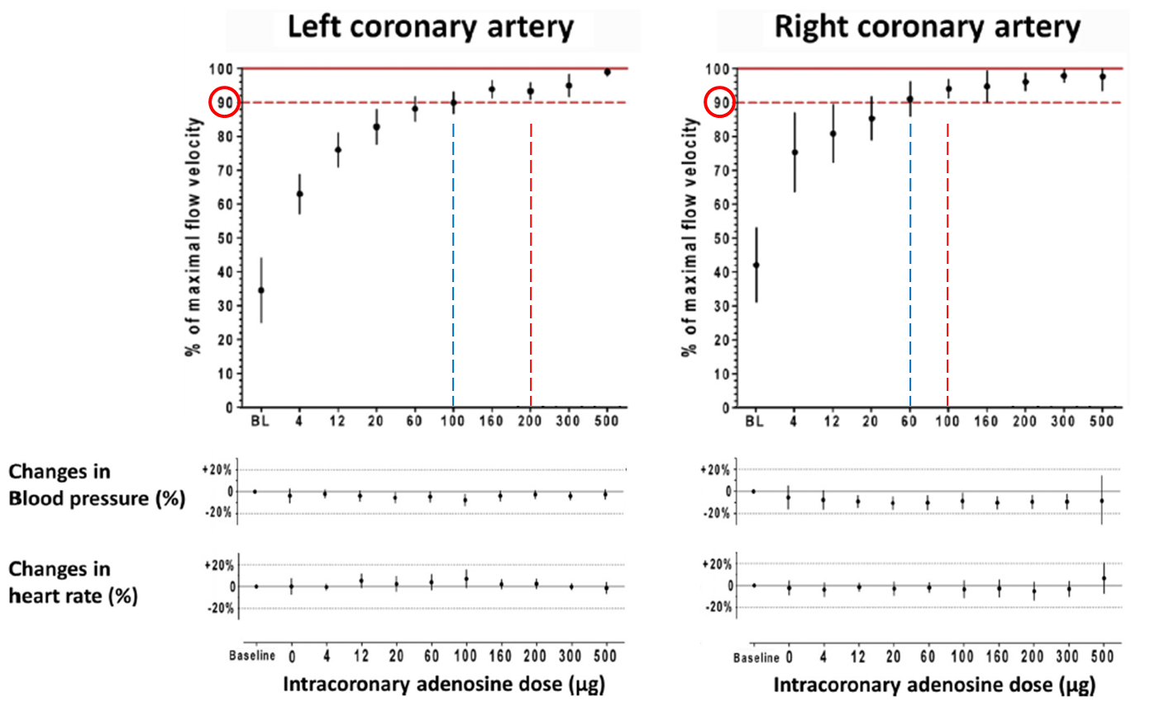
Intracoronary Adenosine
IC bolus of adenosine : 100ug for RCA, 200ug for LCA
Plateau duration : about 12 seconds for 100ug, 21 seconds for 200ug
Adjedi J et al. J Am Coll Cardiol Intv 2015
Notes:
In this study from De Bruyne group nicely demonstrated IC bolus dose of adenosine using Doppler wire measured hyperemic coronary flow velocity.
For the RCA, 100ug showed maximal hyperemic coronary flow velocity and increasing dose above 100ug has no additional effect.
For the LCA, increasing IC dose above 200ug did not showed additional increase of hyperemic coronary flow velocity
The plateau time was about 10-20 seconds.

Slide 15
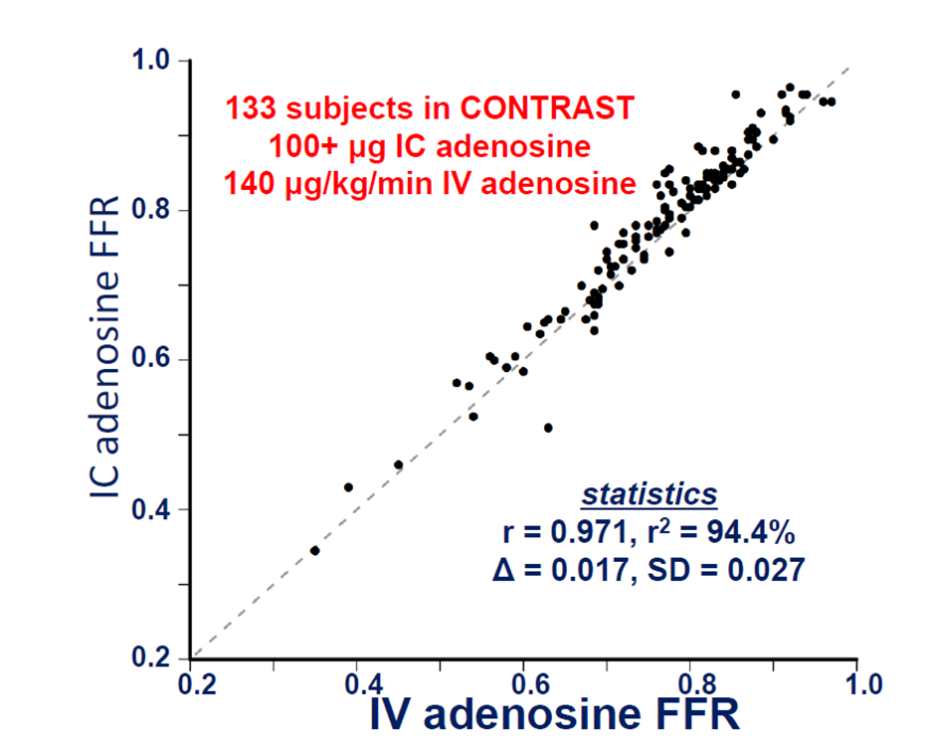
IC Adenosine vs. IV Adenosine
Contrast Study Johnson et al. JACC INT 2015
Slide from Stanford Coronary Physiology Conference 2016
Notes:
In the contrast study, which serially measured FFR using various method of adminisration,
100ug bolus of IC adenosin showed excellent agreement with IV adenosine.

Slide 16
Intracoronary Adenosine
Advantage
Faster onset of hyperemia than IV adenosine (6-8 sec)
Feasible and Convenient administration
Inexpensive
Disadvantage
Short plateau time (10-20 sec)
Similar side effects with IV adenosine
Difficult to use for evaluating ostial disease
Notes:
The advantage of IC adenosine would be
Faster onset, convenience administration, and reduced cost.
Conversely, the disadvantage of IC adenosine would be
Short plateau time, similar side effects profile with IV adenosine, and limited application for ostial disease.

Slide 17
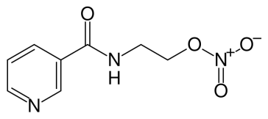
Nicorandil (Sigmart®)
Dual Mechanism of Action as Hyperemic Agents
Nicotinic ester
Nitrate-like action
Dilatation of epicardial coronary artery
ATP-sensitive K+ channel activator
Dilatation of coronary resistant arterioles
Microvascular bed
Epicardial artery
Notes:
Let’s move on to more convenient method, Nicorandil.
Nicorandil has fundamentally different action mechanism with adenosine and
It has dual-mechanism of action for both epicardial and microvascualr beds.
For the epicardial vessel, it has nitrate like dilating efficacy and for the microvascular beds,
It induced hyperemia with potassium channel opening.

Slide 18
Nicorandil (Sigmart®)
Intracoronary Bolus 2mg was evaluated in several studies
Study | Test (Vasodilator) |  | Reference Method | Results |  | p-value
 | Route | Dose |  | Test | Reference
Jang et al. | IC bolus | 2 mg | IV AD 140 ug/kg/min | 0.82 ± 0.09 | 0.82 ± 0.10 | 0.180
Lee et al. (Pooled Analysis) | IC bolus | 2 mg | IV AD 140 ug/kg/min | Overall agreement = 90.8 %, Cohen’s Kappa = 0.814, p < 0.001
Lim et al. | IC bolus | 2 mg | IV AD 140 ug/kg/min | Overall agreement = 91.2 %, Cohen’s Kappa = 0.817, p < 0.001
Lee JM, Hwang D, Koo BK, Review of Physiologic assessment of Coronary Artery Disease 2016
Notes:
The recommended dose of nicorandil is intracoronary bolus 2mg.
This table summarizes previous evidence fore nicorandil.
This study was pooled analysis of all the previous reports from Korea and Japan with largest sample size

Slide 19
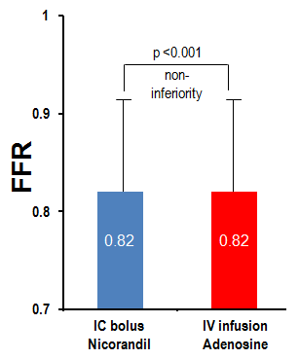
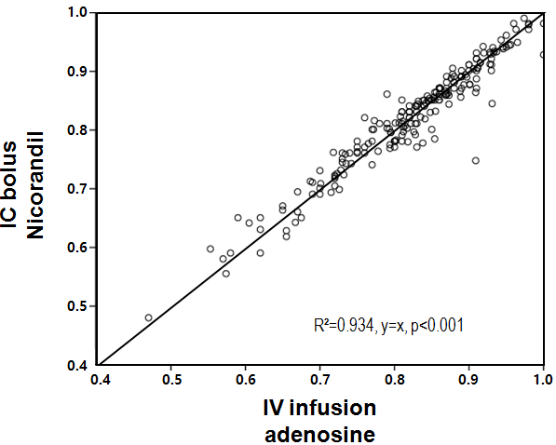
Nicorandil (Sigmart®)
210 Patients with Paired FFR measurement using
IV adenosine and IC nicorandil
Jang HJ, Koo BK et al. EHJ 2013
Notes:
In this representative study by my mentor, nicorandil FFR showed excelent agreement and correlation with IV adenosine from 210 patients

Slide 20
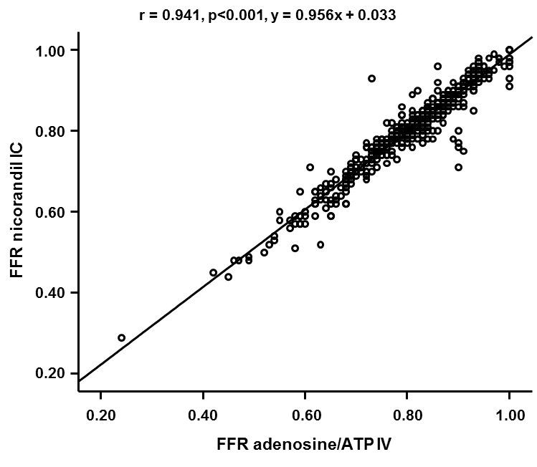
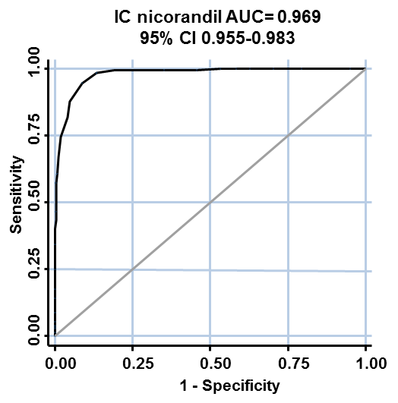
Nicorandil (Sigmart®)
- Patient-level Pooled Analysis -
429 Patients (480 Lesions) with Paired FFR measurement using
IV adenosine/ATP and IC nicorandil (6 Centers from Korea and Japan)
Lee JM, Koo BK et al. Eurointervention 2016
Notes:
In this study by our group, we pooled different studies with paired FFR measurement using IC nicorandil and IV adenosine.
The agreement and correlation between nicorandil FFR and IV adenosine was also excellent.
In affition, IC nicorandil showed faster onset of hyperemia and over 30 seconds of plateau time, which is longer than IC adneosine.

Slide 21
Nicorandil (Sigmart®)
- Protective Effect for Microvascular Function -
 | No | Design | Medication | Main findings | Target Disease
Ito et al | 60 | RCT | Nicorandil IC 2mg | Nicorandil group showed significantly lower IMR, compared with NG after primary PCI | STEMI
Kostic et al | 32 | Registry | Nicorandil IC 12mg | After IC Nicorandil administration, IMR : 14.1 → 9.9 (p<0.001) CFR (Doppler) : 2.69 → 2.92 (p<0.001) ST segment : 6.9mm → 1.6mm (p=0.004) | STEMI
Yang et al | 138 | RCT | Oral Nicorandil 10mg or 20mg | TnI elevation % : 36.2%, 20.0%, 15.2% for control, nicorandil 10mg, 20mg, respectively (p=0.0176) | ACS
Chen et al | 104 | RCT | Anisodamine 2mg Nicorandil 2mg | Group D (Anisodamine + Nicorandil) group showed significantly higher proportion of TIMI perfusion grade 3 after primary PCI (p=0.014) | STEMI (Inferior only)
Yamada et al | 52 | RCT | Nicorandil 2mg/hr CIV before PCI and after 4 days | Nicorandil group vs. NG group Max CK : 1991 vs. 2785 (p=0.03) Edema size on CMR : 17.7 vs. 21.9 (p=0.03) Infarct size on CMR : 10.3 vs. 12.7 (p=0.03) MVO : 39.2% vs. 64.7% (p=0.03) | STEMI
Yang et al (KAMIR) | 6370 | Registry | Oral Nicorandil | Patients with Nicornadil after primary PCI showed significantly lower 6-month MACE than those without nicorandil | STEMI
Outcome study
Notes:
Nicorandil also has protective effect for preventing microvascualr damage in ACS as well as SIHD.

Slide 22
Nicorandil (Sigmart®)
- Protective Effect for Microvascular Function -
Randomized controlled trial : Nicorandil (n=30) vs. Nitroglycerine (n=30) in STEMI
P=0.035
Nicorandil 2mg Intracoronary bolus
Ito et al. Cardiovasc Drugs Ther 2013
Notes:
In this study, the investigators randomly allocated STEMI patients into nitroglycerine or nicorandil administration in culprit vessel
The IC nicorandil group showed significantly decreased IMR value after nicorandil bolus than nitroglycerine

Slide 23
Nicorandil (Sigmart®)
- Protective Effect for Microvascular Function -
Randomized controlled trial : Nicornadil (n=33) vs. Control (n=29) in SA Elective PCI
P<0.05
IMR, U
Nicorandil 2mg Intracoronary bolus
Hirohata et al. EuroIntervention 2014
Notes:
Nicornail also has preventive effect to protect periprocedural microvascualr damage in elective PCI.
In this study, IC nicorandil administration before and after PCI showed significantly decreased IMR value than control

Slide 24
Nicorandil (Sigmart®)
Advantage
Feasible and Convenient administration : IC 2mg bolus
Faster induction of hyperemia
No chest discomfort, AV block, bronchospasm, hypotension
Protective effects for microvascular function (STEMI, SA)
Disadvantage
Relatively short maintenance of hyperemic plateau (32 sec)
Difficult to use for evaluating ostial disease
Notes:
In summary, Nicorandil has many advantages including
Convenient administration, faster onet, no side effect of adenosine, and protective effect for microvascular function
Although nicornadil has longer plateau time than IC adenosine, the relatively shorter plateau time than IV adenosine is limitation.

Slide 25
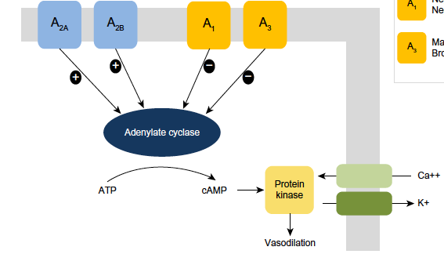
Regadenoson
- Selective A_{2A} receptor agonist -
Precursor of adenosine
IV 400ug bolus
half-life 5.2 min
Palani G, et al. Cardiol Rev 2013;21:42-8.
Notes:
Let’s move on the newer agent, Regadenosone
Regadenosone is precursor of adenosine and selctively act in A2A receptor, the main receptor for hyperemia induction.
In contrary to adenosine, it has longer half life about 5minutes.
It can be administered with IV slow bolus 400ug.

Slide 26
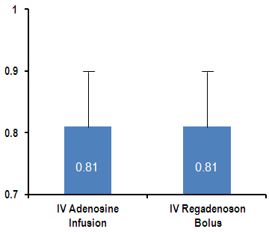
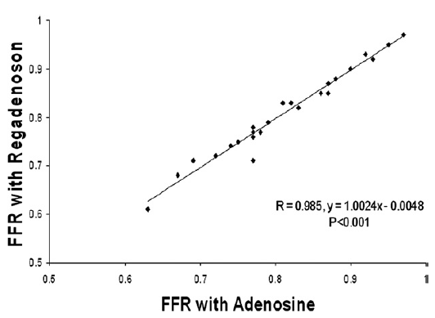
Regadenoson
25 Patients with Paired FFR measurement using
IV adenosine and IV regadenosone (400ug bolus)
Nair PK, et al. JACC Cardiovasc Interv 2011
Notes:
In this small study, Regadenoson FFR showed excellent agreement and correlation with IV adenosine FFR.

Slide 27
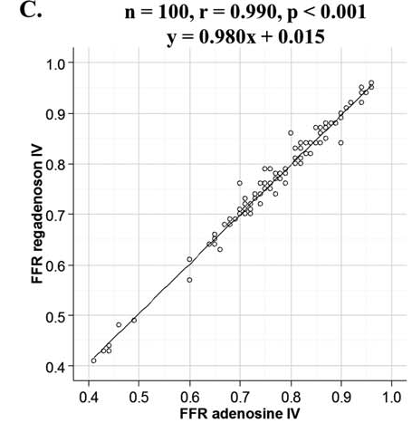
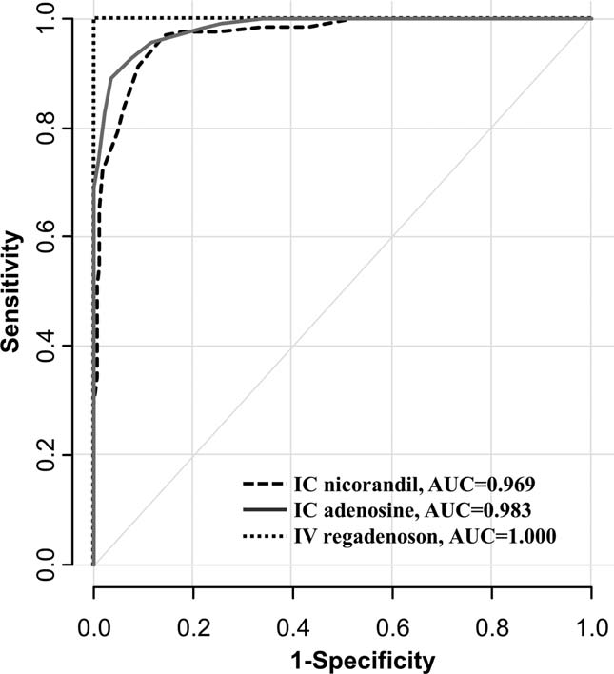
Regadenoson
100 Patients with Paired FFR measurement using
IV adenosine and IV regadenosone (400ug bolus)
Lim WH, Koo BK et al. CCI 2014
Notes:
Another pooled analysis by Dr. Koo also showed excellent agreement and correlation with IV adenosine FFR.

Slide 28
Regadenoson
Advantage
Feasible and Convenient administration : IV (slow) bolus 400ug
Faster induction of hyperemia
Sufficient maintenance of hyperemic efficacy (75sec to 9min)
Disadvantage
Similar side effects with adenosine (but Fewer)
Similar hemodynamic effects with adenosine (BP↓, HR↑)
Notes:
Although there have been limited evidence,
The most advantage of Regadenosone is convenient route of administration, IV slow bolus 400ug
It has been known to have faster onset than IV Adenosine and longer action time sufficient to perform pullback tracing and CFR/IMR measurement.
Although Regadenoson is relatively selective agent for A2A receptor,
The previous evidences presented the side effect profile and hemodynamic effect is similar with IV adenosine.

Slide 29
Summary
Hyperemia is mandatory to measure “FFR”.
Induction of hyperemia is getting more easier with new agents (nicorandil, regadenoson).
Since IC nicorandil has different action mechanism with adenosine, IC nicorandil can be used when you have any doubt about adenosine effect (non-responder) or any situation in which adenosine cannot be used (hypotension, asthma, bradycardia).
Notes:
So Ladies and Gentelman, let me summarize my presentation,
For the measurement of FFR, hyperemia is essential because it is fundamental assumption of FFR.
Induction of hyperemia is getting easier with development of newer agents.
Among the newer agents, nicorandil has different action mechanism with adenosine
IC nicorandil can be used when you have any doubt about adenosine effect (non-responder) or
any situation in which adenosine cannot be used (hypotension, asthma, bradycardia).

Slide 30
Some Points to be Considered
Hyperemia is mandatory to measure “FFR”, but it is also mandatory to assess “functional significance of epicardial stenosis?”
“FFR” is synonym with “Ischemia” ?
Diagnostic accuracy of iFR is inferior to FFR (as previously known), but what if other independent reference is used ? (for example, HSR, coronary flow capacity, PET measurement..)
When there is discordance between FFR and iFR, is this matter of “right or wrong results in one of the index”?
We will have another chance to discuss the above issues in the very near future.
Notes:
Lastly, I suggest that you consider with other point of view regarding the hyperemia issue.
Although hyperemia induction is essential for measuring FFR, but it is also mandatory to assess functional significance of epicardial stenosis?
For this question, we can consider the below issues.
As this issue beyond the purpose of current session, we will have another chance to discuss the above issues in the very near future.

Slide 31
Thank You For Your Attention !
Joo Myung Lee, MD, MPH
Heart Vascular Stroke Institute,
Samsung Medical Center, Seoul, Republic of Korea
If you have any question, don’t hesitate to e-mail me.
drone80@hanmail.net

