Slide 1
Clinical Usefulness of Post-Stenting FFR
2016. 12. 10
Joon-Hyung Doh, MD, PhD, FACC
Associate Professor, Cardiac and Vascular Center
Inje University Ilsan Paik Hospital
Goyang, Korea

Slide 2
Definition of PCI Success
Angiographic success
: <20% DS with TIMI 3 flow after stent
Procedural success
: angiographic success without in-hospital MACE
Clinical success
: procedural success with relief of symptom and sign of ischemia
2001 AHA/ACC guidelines for PCI

Slide 3
Angiographic Gain Warrant Anatomic Stent Lumen Optimization Related Better Clinical Outcome?

Slide 4
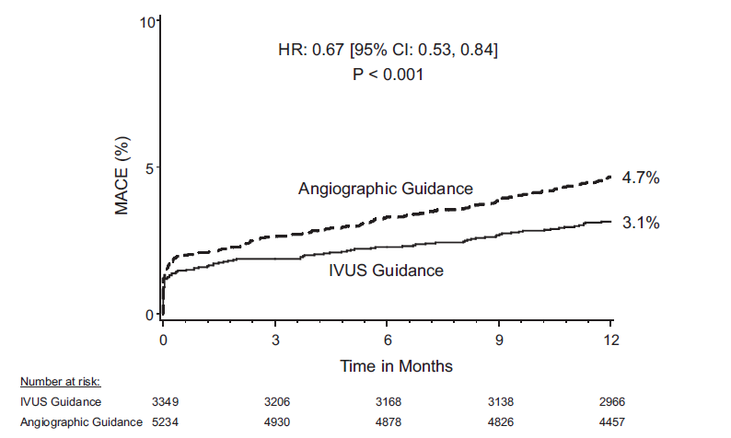
Angiographic gain is not enough! IVUS-guided stent optimization warrants better clinical outcome
ADAPT-DES study IVUS-XPL study
5.8%
4.7%
2.9%
3.1%
Witzenbichler et al, Circulation. 2014;129:463-470
Hong SJ et al, JAMA 2015. 314(20):2155-2163
Hong SJ et al, JAMA 2015. 314(20):2155-2163

Slide 5
Angiographic and IVUS Gain Warrant Optimal Physiologic Gain after Stent Implantation?

Slide 6
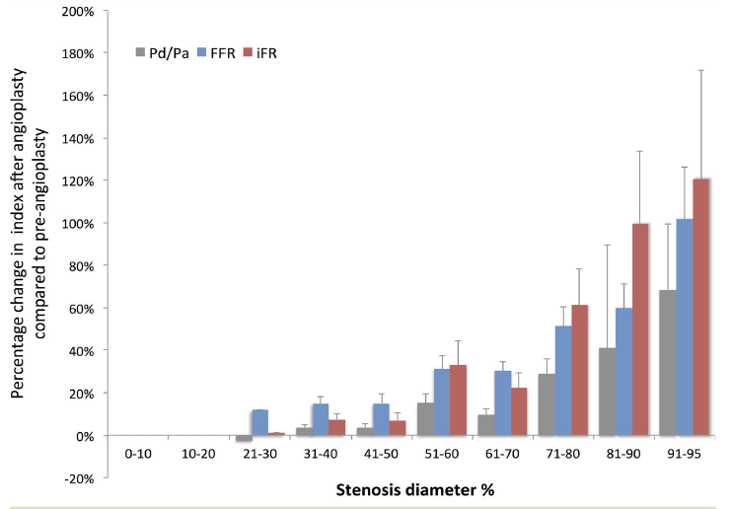
Physiologic gains of PCI
Average percent changes in Pd/Pa, iFR and FFR after PCI
Physiologic gain after PCI
Nijjer SS et al, Heart 2013;99:1740–1748

Slide 7
Do we need to assess physiologic stent optimization?

Slide 8
Correlation Between Post-stent FFR and angiographic/IVUS parameters
Hong SJ et al, JAMA 2015. 314(20):2155-2163
Doh JH et al, J Invasive Cardiol. 2015 Aug;27(8):346-51.

Slide 9
Correlation Between Post-stent FFR and angiographic/IVUS parameters
Doh JH et al, J Invasive Cardiol. 2015 Aug;27(8):346-51.

Slide 10
IVUS-guided stent optimization warrants better clinical outcome
IVUS-XPL randomized study
Met vs not-Met IVUS Criteria: minimal stent lumen CSA ≥ distal reference segment lumen CSA
Not Met IVUS criteria
Met IVUS criteria
Hong SJ et al, JAMA 2015. 314(20):2155-2163

Slide 11
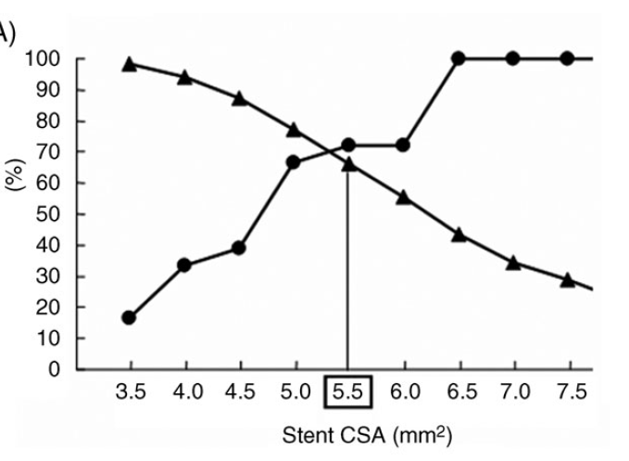
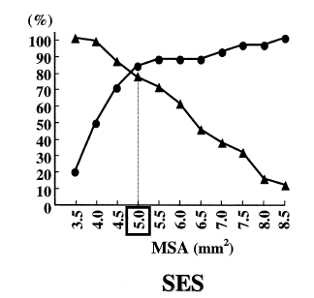
IVUS stent lumen CSA Criteria Predict Future MACE after DES
Binary restenosis and Long-term Patency after DES
5.5
5.0
Hong MK, et al. Eur Heart J, 2006:27:1305
Sonoda S et al, J Am Coll Cardiol 2004;43:1959-63

Slide 12
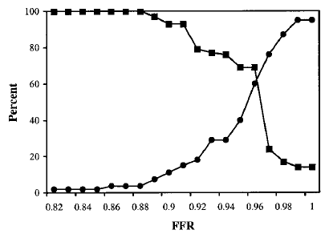
Post DES:
matched IVUS minimal stent CSA to FFR
0.89 5.4mm²
BMS
MSA: 7.0mm2
Fearon et al, Circulation. 2001;104:1917-1922.
Doh JH et al, J Invasive Cardiol. 2015 Aug;27(8):346-51.

Slide 13
Clinical Usefulness of post-stent FFR

Slide 14
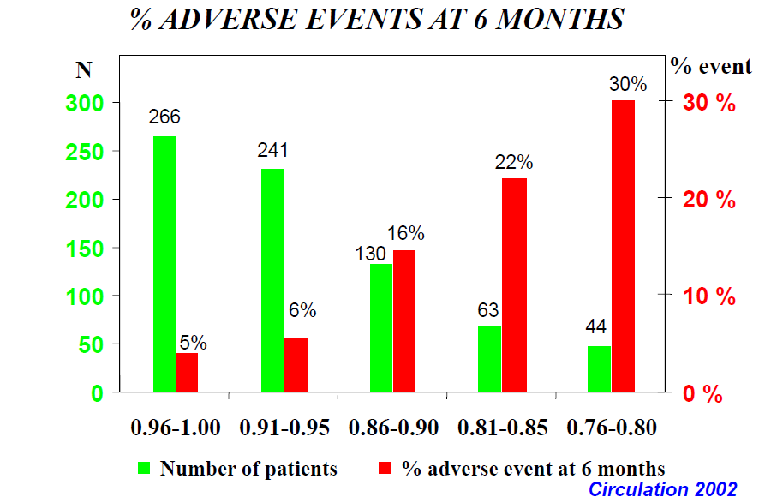
Post Stent FFR registry (n=750) in BMS

Slide 15
FFR after DES Predicts Adverse Events
(%)
P < 0.01
FFR ≤ 0.9
FFR > 0.9
Nam CW et al,A JC 2011:107(12):1783-6

Slide 16
FFR after DES Predicts Adverse Events
(%)
P < 0.01
MACE
ISR
Nam CW et al,A JC 2011:107(12):1783-6

Slide 17
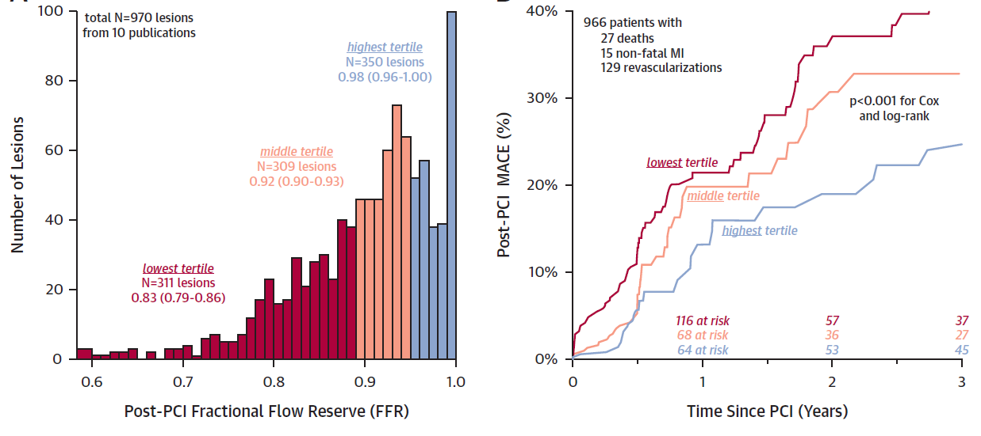
Prognostic Value of Immediate post-PCI FFR with BMS and DES
Johnson NP, JACC 2014, 1641-1654

Slide 18
High Post-DES FFR Related with Better 3 year TVF-Free Survival
Doh JH et al, J Invasive Cardiol. 2015 Aug;27(8):346-51.

Slide 19
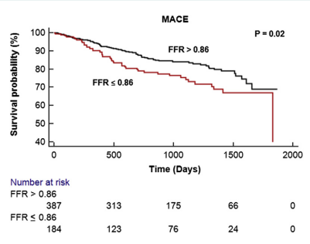
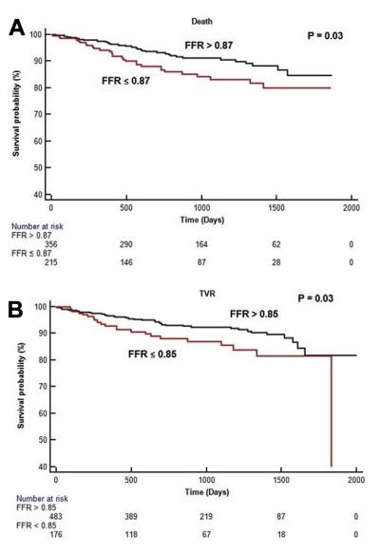
Impact of post FFR on the prognosis
death
diffuse disease
MACE free survival
574 patients (664 lesions)
FU 31± 16 months.
TVR
MVD
Agarwal et al, JACC int 2016

Slide 20
Understanding low post-stent FFR

Slide 21
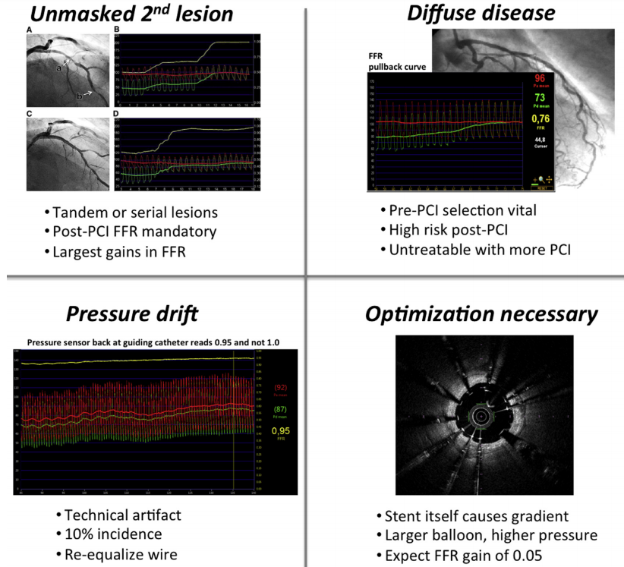
Mechanism of low FFR after PCI
Tonino et al, JACC int 2016

Slide 22
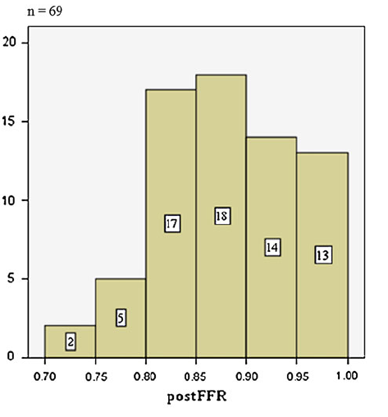
Distribution of Post-Stent FFR
Prevalence Low post-stent FFR: 25-60%
27/42(39.1%)
86/115(74.7%)
Matsuo A et al, Cardiovasc Interv and Ther 2012.
Doh JH et al, J Invasive Cardiology 2015 2015 Aug;27(8):346-51.

Slide 23
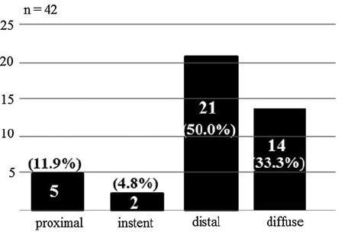
Distribution of residual pressure gradient after PCI
Matsuo A et al, Cardiovasc Interv and Ther 2012.

Slide 24
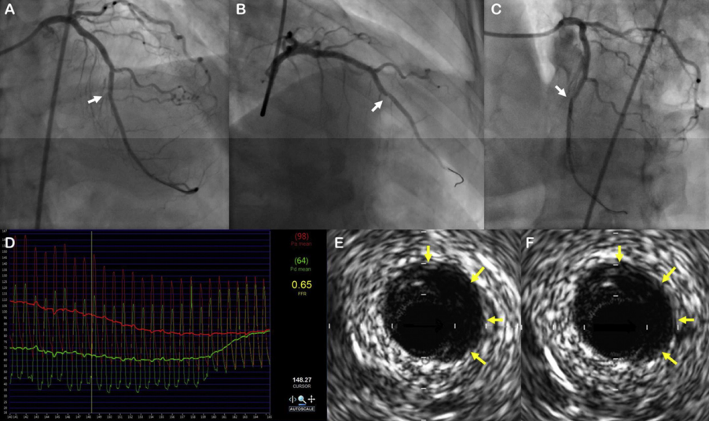
Post-stent FFR can provide information about hidden anatomic problem such as dissection
Chung JH, shin ES et al, International Journal of cardiology 185 (2015) 29–33

Slide 25
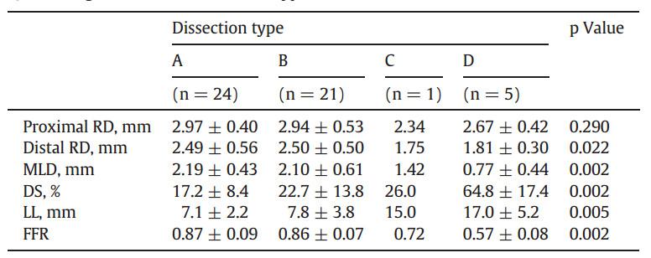
Post-stent FFR can provide information about hidden anatomic problem such as dissection
Chung JH, shin ES et al, International Journal of cardiology 185 (2015) 29–33

Slide 26
Low FFR or residual gradient after apparently successful stenting
Focal problem in- or peri-stent
Presence of diffuse disease
→FFR hyperemic pullback recording can discriminate the reason.

Slide 27
Impact of additional intervention on physiologic gain
Agarwal et al, JACC int 2016

Slide 28
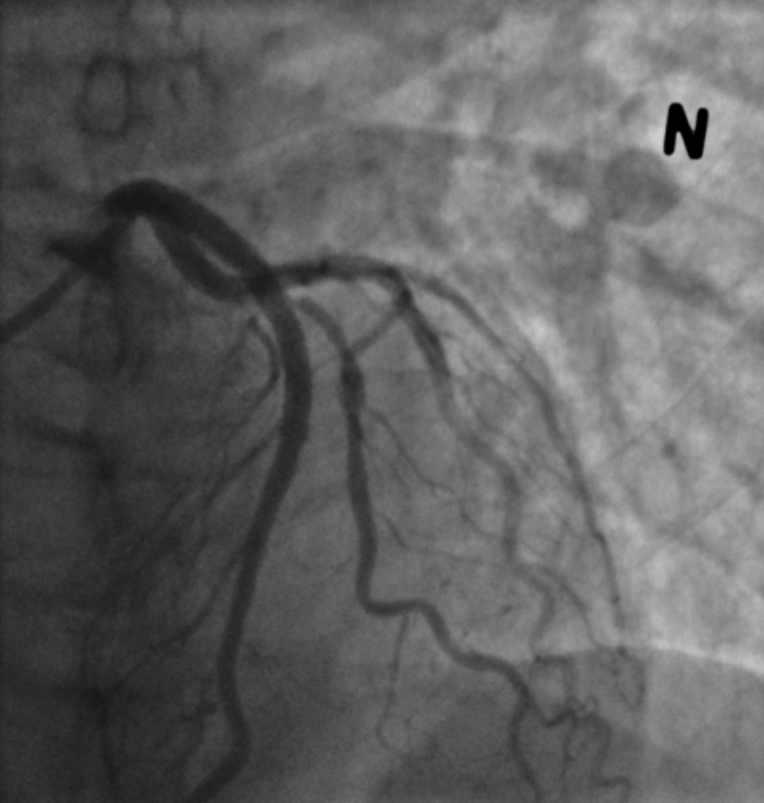
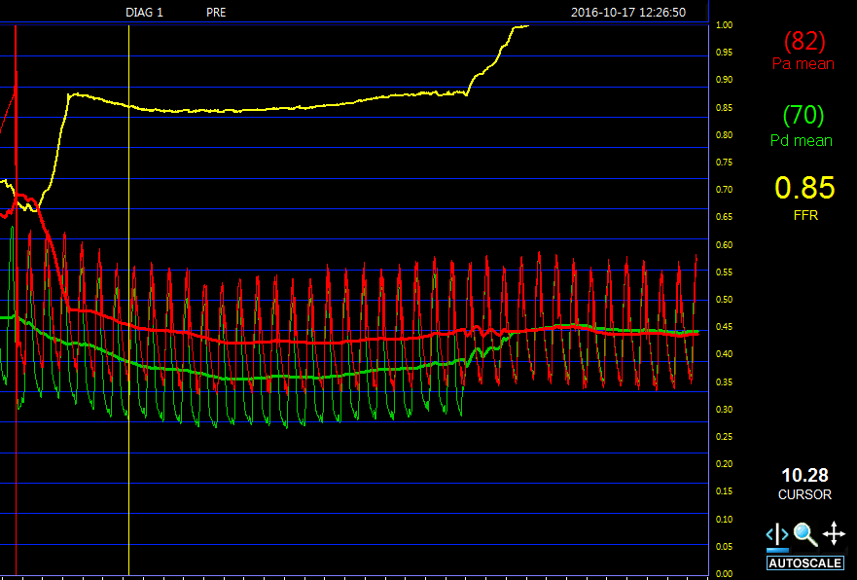
FFR for SB pullback after stenting

Slide 29
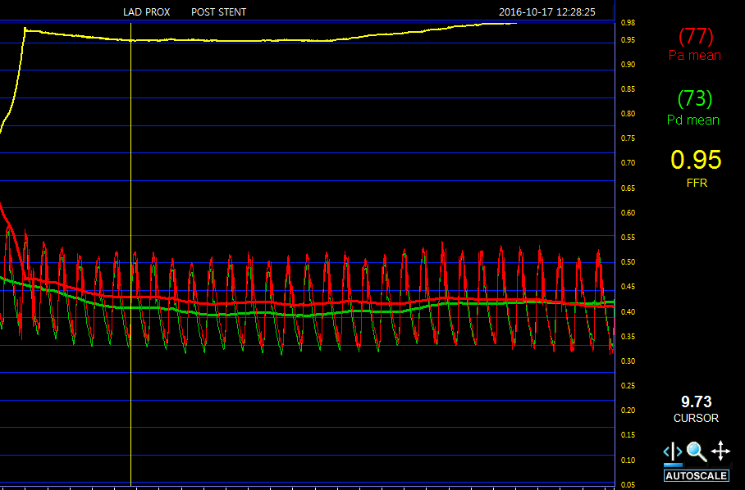
Post PCI FFR for LAD

Slide 30
Physiologic stent optimization can help our practice?

Slide 31
Summary
Pressure wire can be used as a primary guidewire before-, during-, and post PCI.
After angiographic successful stenting, hyperemic pullback FFR recording can provide very useful information on physiologic stent optimization.
In patient treated by DES, post-stent FFR ≥0.86-0.90 could offer physiologic cut-off value for prediction of TVF-free survival.
post-stent FFR ≥0.89 was relevant to IVUS MSA ≥5.4mm² in terms of physiologic and anatomic parameters of optimal stent deployment.

Slide 32
Role of post-stent FFR on physiologic stent optimization
FFR post PCI is useful to detect residual lesions or diffuse disease
FFR post PCI can prevent unnecessary repeat procedures as well as correct improper peri-stent problem.
Post-stent FFR offer prognostic value as well as pre-intervention FFR in patient treated by DES.

Slide 33
Thank you for your attention

