Slide 1
Role of FFR in ACS:
Solved & Unsolved Issues
Keimyung University Dongsan Medial Center
NAM, Chang-Wook MD, PhD

Slide 2
DISCLOSURE
Research grant: Pfizer, Medtronic, Biosensors
Consultant: Pfizer, SJM, Astrazeneca, Daiichisankyo

Slide 3

CONTENTS
01
Why Different Concept of FFR in ACS
02
FFR in Nonculprit lesion of ACS
03
FFR in Culprit lesion of ACS
04
Issues of FFR in ACS

Slide 4
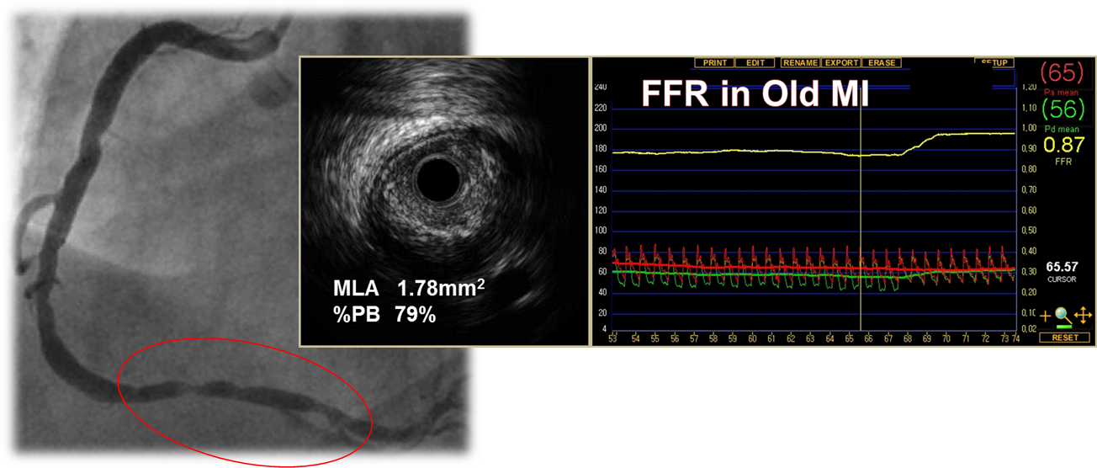
1
Why Different Concept of FFR in ACS
Indication for FFR
Clinically important coronary artery
Stable coronary artery disease
Inducible maximal hyperemia
Chronic
Stable AP
Old MI

Slide 5

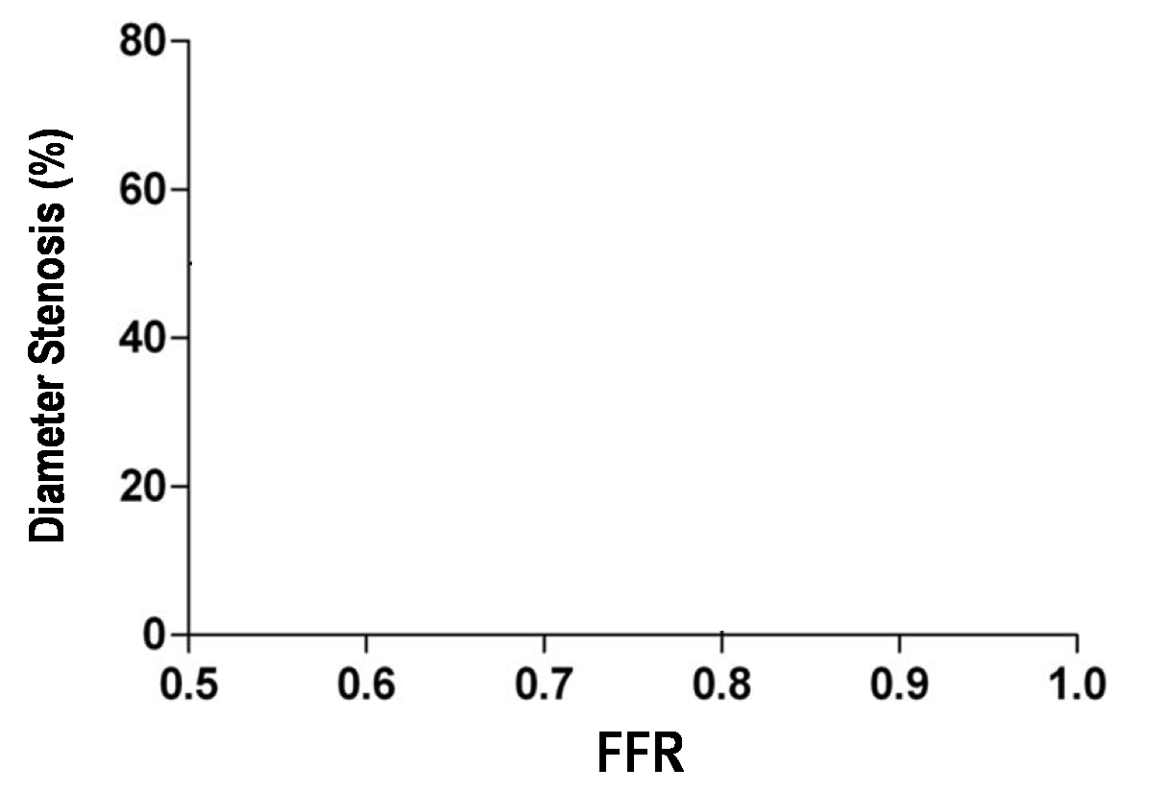
What about FFR in Acute MI?
P_{a}
P_{d}
Pressure
Wire
↓ Resistance → ↑ Flow → ↑ Pressure gradient → ↓ FFR
↑ Resistance → ↓Flow → ↓Pressure gradient → ↑ FFR
As time goes on
Courtesy to Dr Kim JH

Slide 6
2
FFR in Nonculprit lesion of ACS
Feasibility of FFR measurement in nonculprit lesion during acute stage of ACS
Evidence of FFR guided decision making in nonculprit lesion of ACS

Slide 7
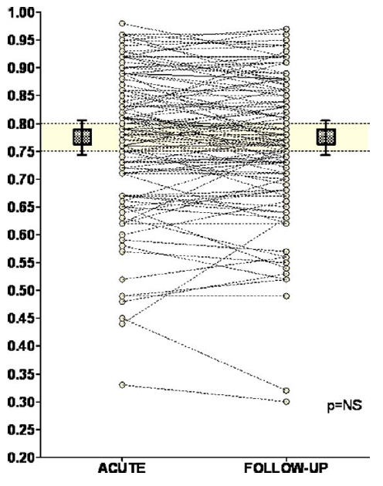
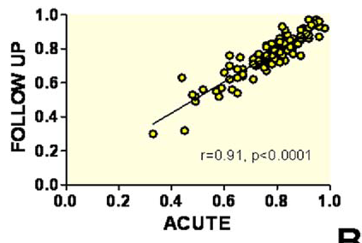
Feasibility of FFR measurement in nonculprit lesion during acute stage of ACS
101 pts(112 nonculprit lesions) undergoing PCI for AMI (75 STEMI, 26 NSTEMI) within 72 h after the onset of chest pain.
FFR obtained immediately after PCI of the nonculprit stenosis and repeated 35±4 days later.
FFR
JACC interv 2010;3:1274

Slide 8
Evidence of FFR guided decision making
in nonculprit lesion of ACS
DANAMI3-PRIMULTI :
PRImary PCI in MULTIvessel Disease
2. CompareAcute :
Comparison Between FFR Guided Revascularization
vs. Conventional Strategy in Acute STEMI Patients
with MVD
3. COMPLETE :
Complete vs Culprit-only Revascularization to Treat
Multivessel Disease After Primary PCI for STEMI

Slide 9
DANAMI3-PRIMULTI
2239 STEMI < 12 hours
2212 Successful infarct related artery PCI
627 Multivessel disease
1. >50% stenosis in non IRA
2. and > 2 mm suitable for PCI
313 IRA PCI only
314 FFR guided complete revascularisation
> 50% DS and FFR <0.80
or > 90% DS
Lancet. 2015;386:665

Slide 10
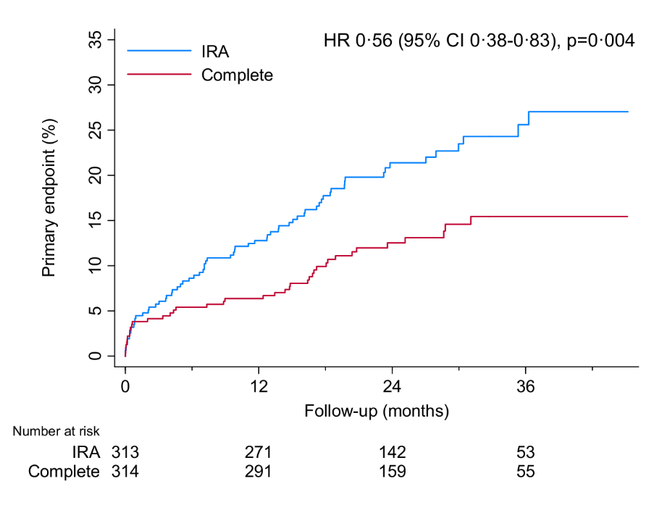
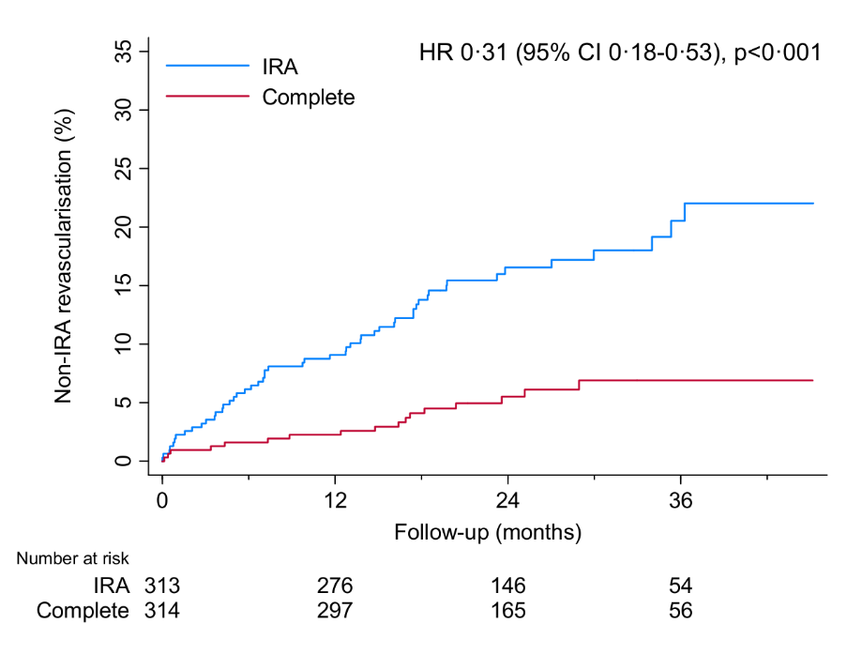
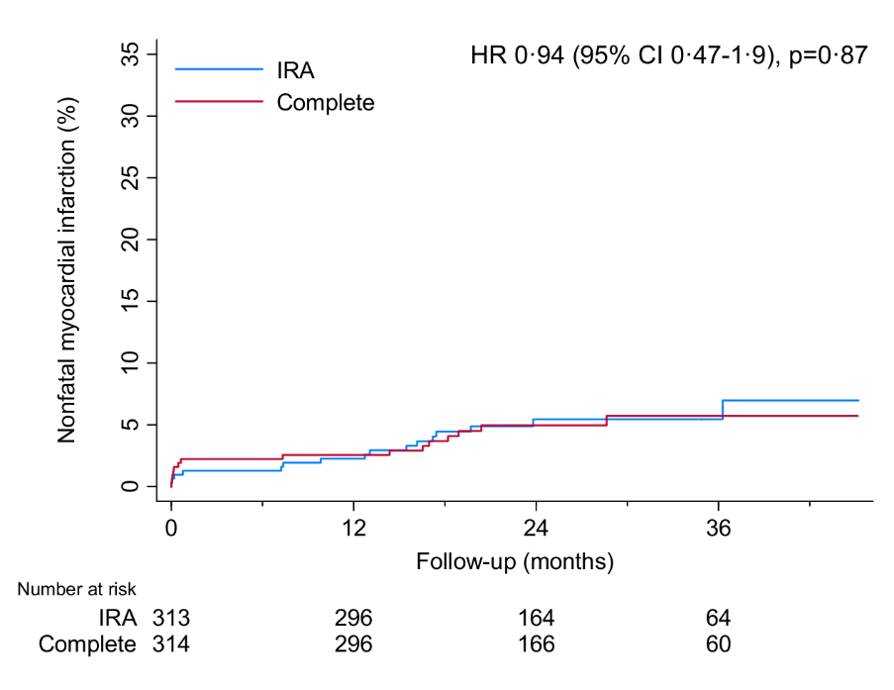
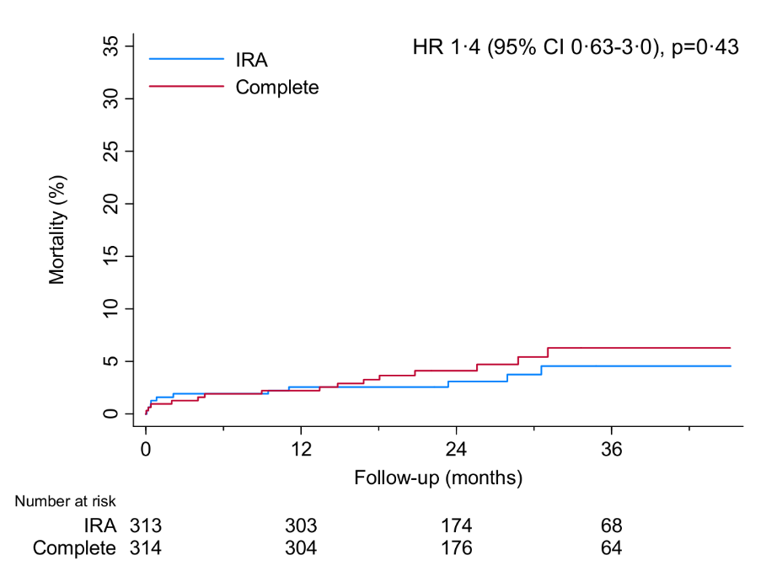
DANAMI3-PRIMULTI
Composite
Revascularisation
Non fatal MI
All cause death
Primary endpoint: Composite of all-cause mortality, nonfatal MI, and Ischemia driven revascularization of non IRA
Lancet. 2015;386:665

Slide 11
Ongoing randomized outcome trials
CompareAcute
COMPLETE
Comparison Between FFR Guided Revascularization Versus Conventional Strategy in Acute STEMI Patients With MVD
885 subjects with at least a 50% DS in a nonculprit vessel.
Nonculprit lesions randomized to standard care, or FFR-guided revascularization
1` endpoint: composite of all-cause death, MI, any revascularization, and cerebrovascular accident.
The multicenter, international COMPLETE trial
3,900 subjects with either at least a 70% DS without FFR, or 50% to 70% DS with FFR≤0.8 in a nonculprit vessel.
Nonculprit lesions randomized to staged revascularization or medical therapy
1` endpoint: CV-related death and nonfatal MI

Slide 12
3
FFR in Culprit lesion of ACS
Acute
Chronic
STEMI
Stable AP
NSTEMI
Chronic MI
Unstable angina

Slide 13
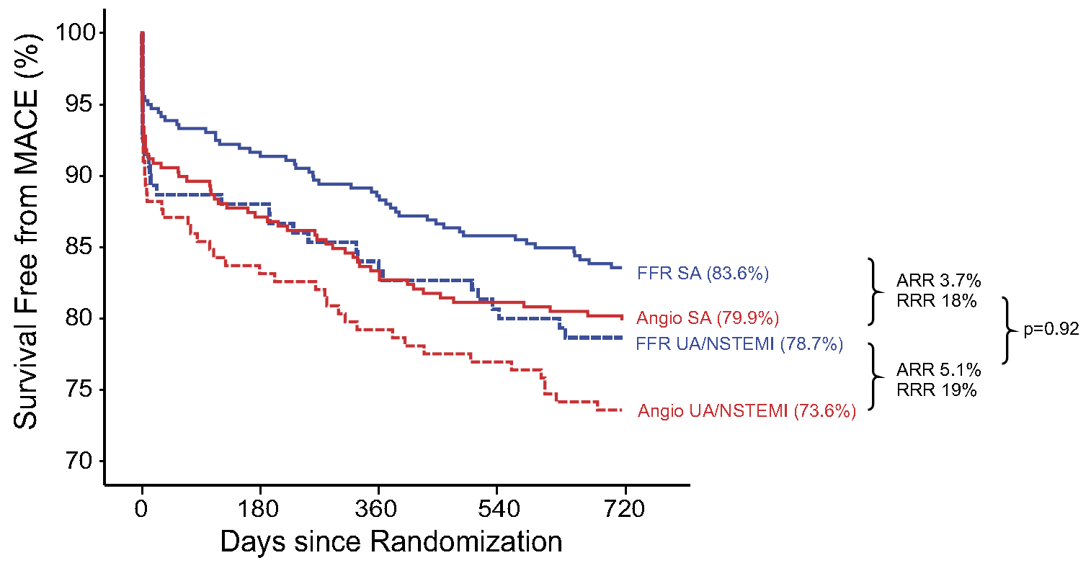
FFR in UA or NSTEMI: FAME
The benefit of using FFR to guide PCI in MVD does not differ between ACS, compared with SA
Sels JW et al. JACC interv 2011;4:1183

Slide 14
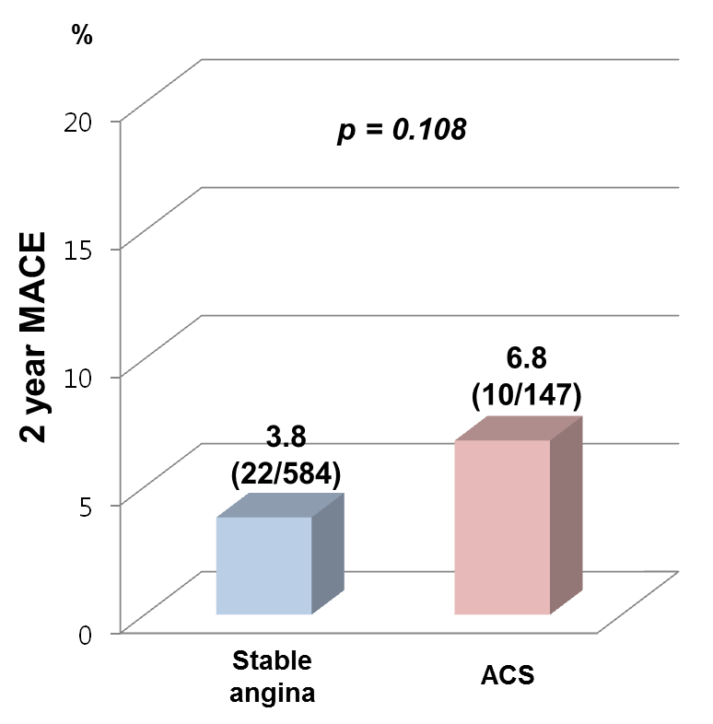
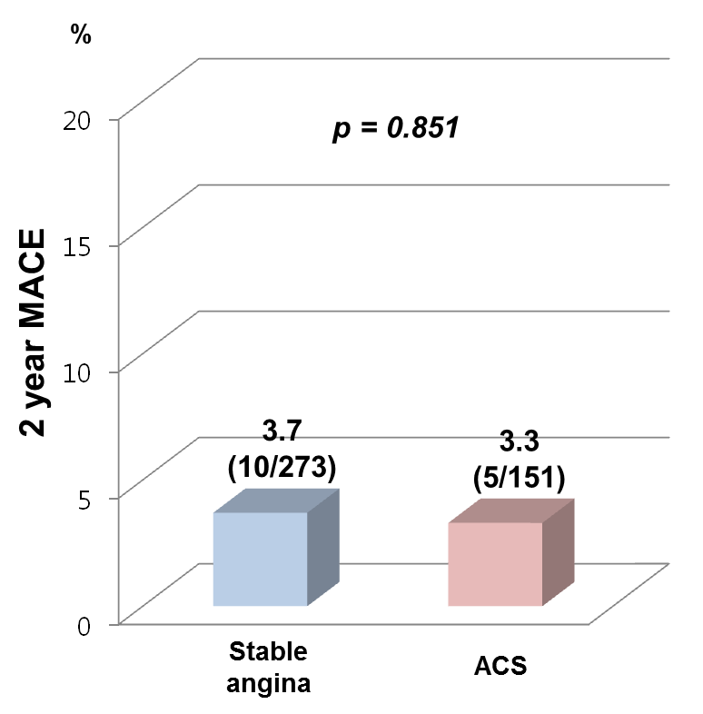
Korean FFR registry
Only FFR-guided decision made 1155 patients
FFR-guided Defer
FFR-guided PCI
Presented at 2013 KSC

Slide 15
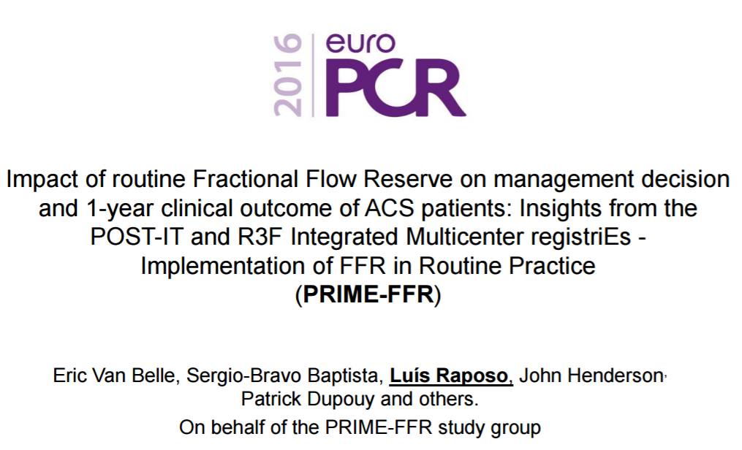
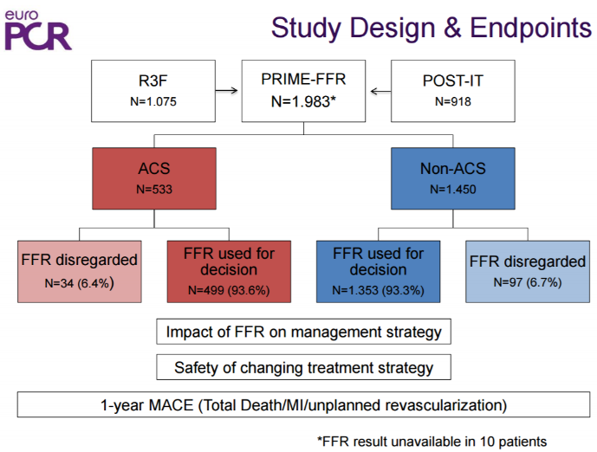
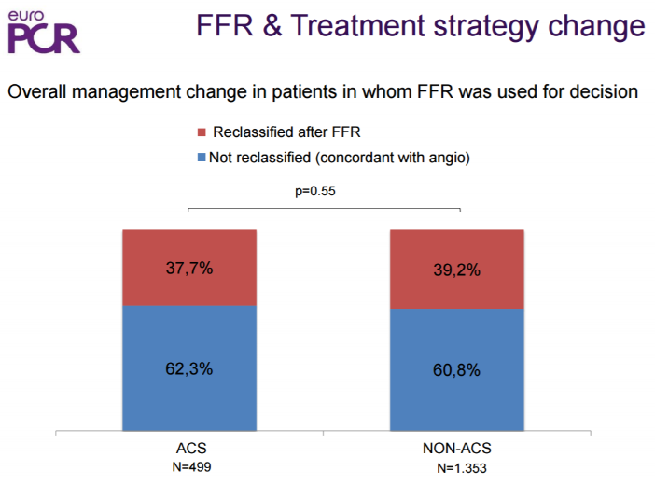

Slide 16
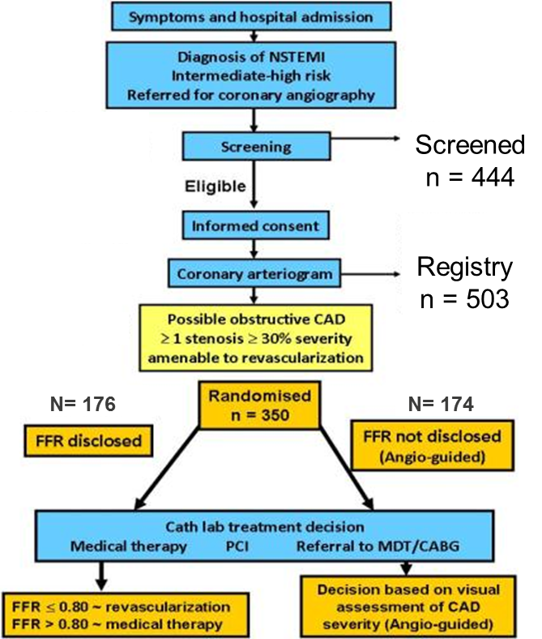
FAMOUS NSTEMI
Inclusion criteria
if urgent invasive management was planned within 72 h of the index episode of myocardial ischemia or if there was a history of recurrent ischemic symptoms within 5 days.
The angiographic inclusion criteria required at least one coronary stenosis ≥30% severity with normal coronary blood flow [TIMI grade III] in which FFR measurement might have a diagnostic value.
Exclusion criteria
the presence of ischemic symptoms that were not controlled by medical therapy, hemodynamic instability, MI with persistent ST elevation, intolerance to anti-platelet drugs, ineligible for coronary revascularization, a treatment plan for non-coronary heart surgery (e.g. valve surgery), a history of prior CABG, angiographic evidence of severe (e.g. diffuse calcification) or mild (,30% severity) coronary disease, a life expectancy ,1 year and an inability to give informed consent
Eur Heart J. 2015;36:100

Slide 17
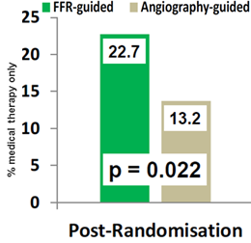
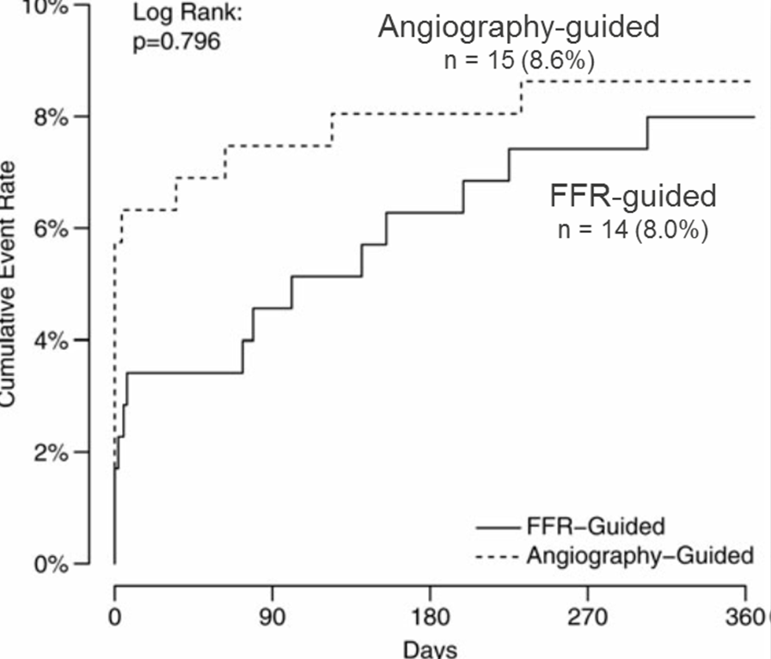
FAMOUS NSTEMI
Treatment strategy
Defer to Medical Therapy
12 months outcome
FFR changed the treatment strategy in 21.6% of patients compared to angiography alone.
FFR-guided group resulted in 9.5% absolute reduction in revascularization compared to angiography alone
Eur Heart J. 2015;36:100

Slide 18
4
Issues of FFR in ACS
P_{a}
P_{d}
Pressure
Wire
Stunning can affect not only infarct related artery but also nonculprit artery.
Early development of collateral flow
Comprehensive understanding…

Slide 19
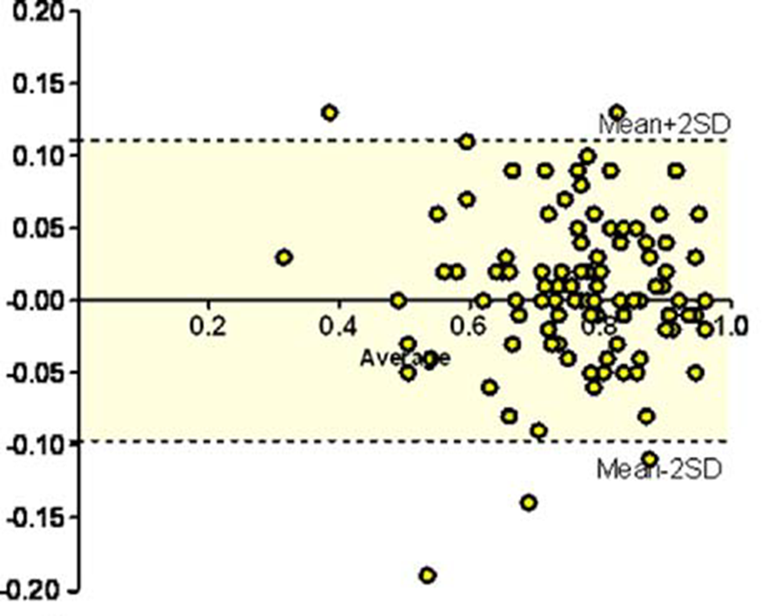
FFR in nonculprit lesion in ACS
FFR
Although there were rare cases with FFR change >0.10, not a small cases who had FFR change >0.05 were observed
JACC interv 2010;3:1274

Slide 20
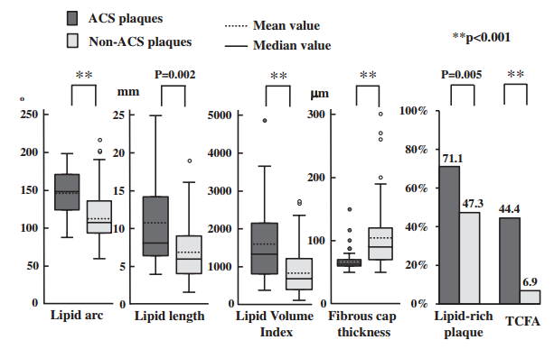
Pancoronary Plaque Vulnerability in ACS
3-vessel OCT imaging were selected from the MGH OCT Registry. 248 nonculprit plaques were found in 104 patients: 45 plaques in 17 ACS patients and 203 plaques in 87 non-ACS pts.
Circ Cardiovasc Imaging. 2012;5:433-440

Slide 21
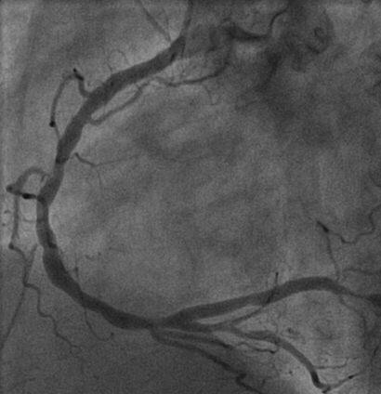
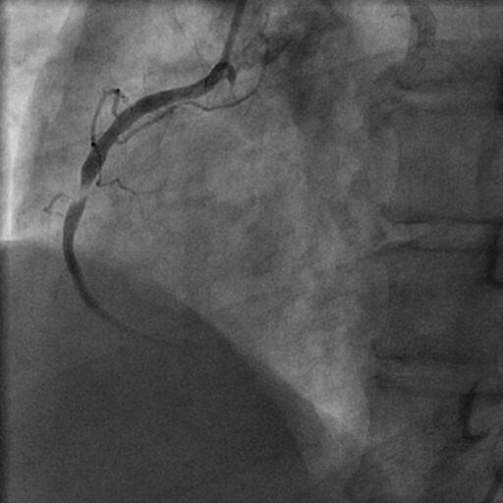
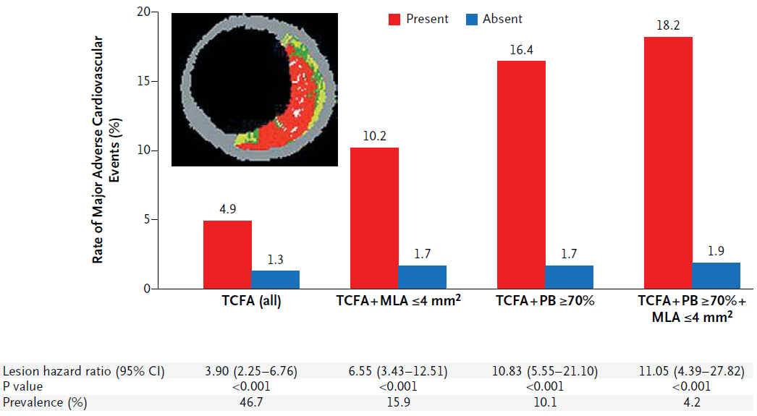
Which lesions will progress, or rupture?
Vulnerability
FFR can not show the plaque vulnerability directly…
PROSEPCT, NEJM 2011;364:226
Notes:
Intravascular ultrasound can visualize coronary lumen and artery wall
IVUS is simple to perform, and its use is associated with very low complication rates
However, IVUS might overestimate real functional significance of the coronary lesion during PCI

Slide 22
3-year Outcomes after FFR-guided Defer
Among 1294 patients and 1628 lesions in Korean FFR registry, 665 patients with 781 deferred coronary lesions were followed. MACE defined as the composites of all death, MI, and TVR
 | All participants |  |  |  |  |  |  |  | Subjects with FFR >0.8
 | Univariate analysis |  |  |  | Multivariate analysis |  |  |  | Univariate analysis |  |  |  | Multivariate analysis
 | HR | 95% CI | P |  | HR | 95% CI | P |  | HR | 95% CI | P |  | HR | 95% CI | P
Age | 1.03 | 1.00–1.06 | 0.041 |  | 1.02 | 0.99–1.05 | 0.240 |  | 1.02 | 0.99–1.06 | 0.133
Male | 1.22 | 0.69–2.15 | 0.498 |  |  |  |  |  | 1.05 | 0.55–1.98 | 0.890
Diabetes mellitus | 1.95 | 1.14–3.34 | 0.016 |  | 1.59 | 0.90–2.78 | 0.109 |  | 1.75 | 0.93–3.27 | 0.082
Dyslipidemia | 1.23 | 0.72–2.11 | 0.447 |  |  |  |  |  | 1.17 | 0.63–2.18 | 0.612
Smoking | 1.67 | 0.94–2.97 | 0.081 |  |  |  |  |  | 1.61 | 0.83–3.11 | 0.156
Previous MI | 2.35 | 1.11–4.99 | 0.026 |  | 1.09 | 0.44–2.66 | 0.856 |  | 2.56 | 1.08–6.08 | 0.034 |  | 1.20 | 0.44–3.30 | 0.725
Previous PCI | 2.13 | 1.22–3.72 | 0.008 |  | 1.76 | 0.91–3.40 | 0.094 |  | 2.64 | 1.41–4.94 | 0.002 |  | 2.37 | 1.13–5.01 | 0.023
ACS | 2.04 | 1.16–3.60 | 0.014 |  | 1.86 | 0.99–3.49 | 0.055 |  | 2.46 | 1.31–4.61 | 0.005 |  | 2.35 | 1.18–4.65 | 0.015
LVEF | 0.96 | 0.93–0.99 | 0.008 |  | 0.99 | 0.96–1.02 | 0.335 |  | 0.96 | 0.93–0.99 | 0.006 |  | 0.98 | 0.95–1.01 | 0.232
Multi-VD | 2.31 | 1.28–4.15 | 0.005 |  | 1.36 | 0.73–2.55 | 0.334 |  | 2.25 | 1.16–4.34 | 0.016 |  | 1.45 | 0.72–2.92 | 0.298
LAD | 0.51 | 0.30–0.88 | 0.015 |  | 0.56 | 0.31–1.01 | 0.052 |  | 0.45 | 0.24–0.84 | 0.012 |  | 0.57 | 0.30–1.10 | 0.095
Reference diameter | 1.03 | 0.62–1.71 | 0.923 |  |  |  |  |  | 1.26 | 0.72–2.20 | 0.424
% DS | 1.03 | 1.00–1.05 | 0.020 |  | 1.01 | 0.98–1.03 | 0.587 |  | 1.02 | 1.00–1.05 | 0.081
Lesion length>20 mm | 1.59 | 0.92–2.75 | 0.096 |  |  |  |  |  | 1.33 | 0.69–2.57 | 0.392
Previous PCI-MLD | 0.57 | 0.31–1.03 | 0.064 |  |  |  |  |  | 0.71 | 0.36–1.38 | 0.308
FFR | 0.95 | 0.92–0.98 | 0.001 |  | 0.95 | 0.92–0.99 | 0.005 |  | 0.96 | 0.90–1.02 | 0.188
JKMS 2016;31(12):1929

Slide 23
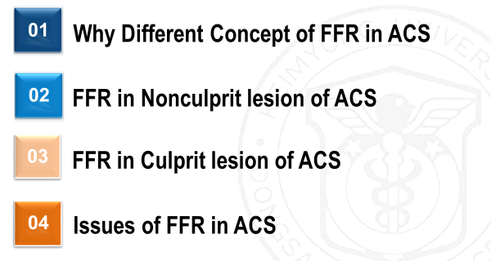
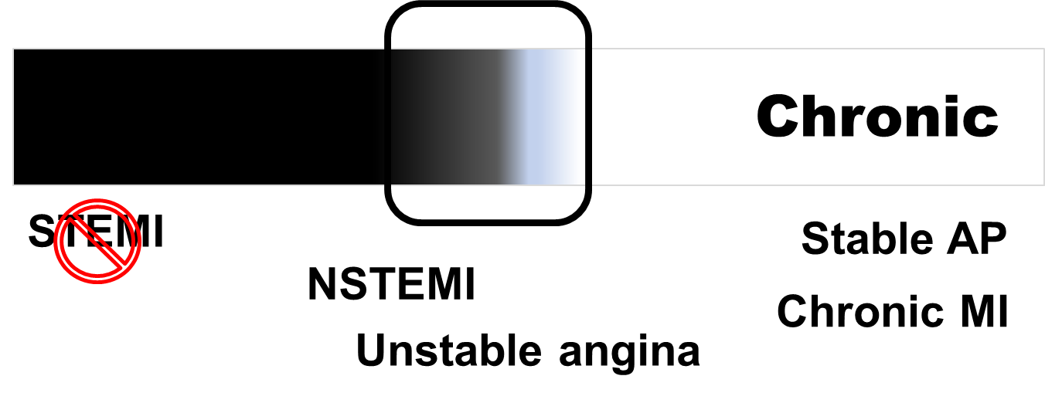
Summary
In ACS, FFR should be handled carefully and differently due to the possibility of change after acute phase.
Current data in NSTE-ACS suggested that FFR guided decision making is still reliable and valuable in daily practice.
However, large trial should be warranted to confirm this strategy.

Slide 24
FFR-Guided PCI in ACS: Solved & Unsolved Issues
Keimyung University Dongsan Medial Center
NAM, Chang-Wook MD, PhD
Thank You

