Slide 1
Macrophage-driven Expression of Interleukin 37 Protects Against Atherosclerosis
William A. Boisvert
Center for Cardiovascular Research
John A Burns School of Medicine
University of Hawaii
JCR 2016, Busan, Korea

Slide 2
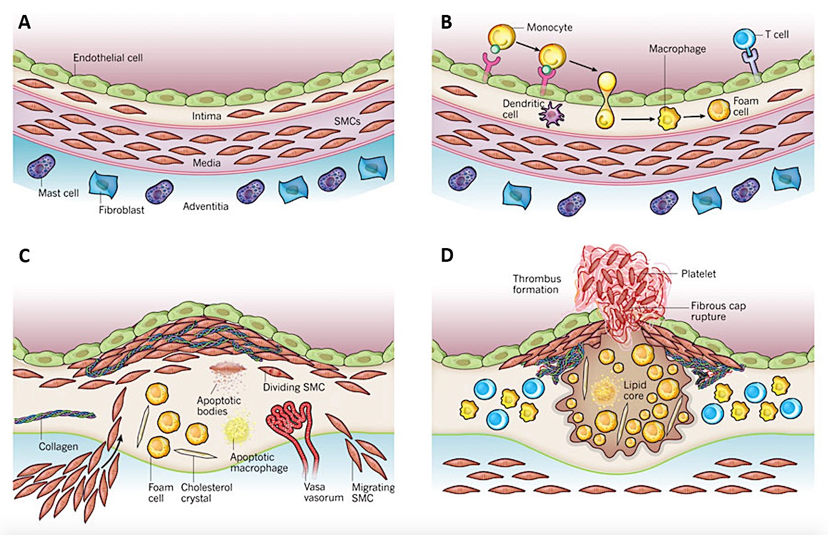
Stages of Atherosclerosis
(Adapted from Libby et al., Nature, 2011)

Slide 3
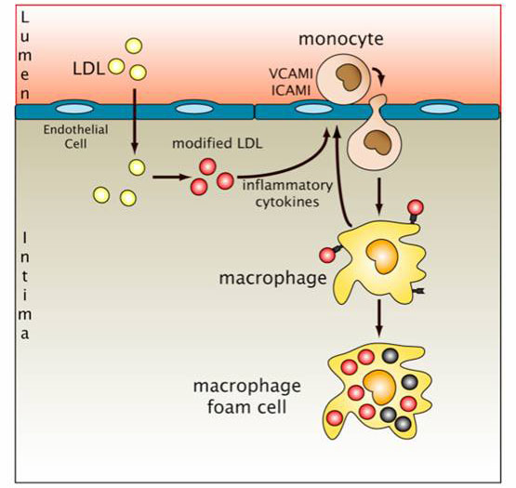
Macrophages Drive Atherogenesis
Macrophages are involved in all stages of atherosclerosis
Can account for up to 40% of the mass of the plaque.
Take up modified lipids and become foam cells
Promote inflammation and chemotaxis of immune cells
Secrete enzymes such as proteases that destabilize the plaque
(Ougrinovskaia et al., 2010)

Slide 4
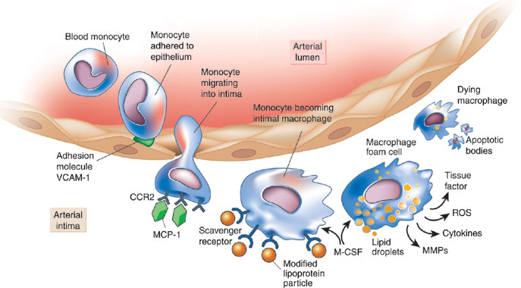
Preventing Atherosclerosis
???
???
???

Slide 5
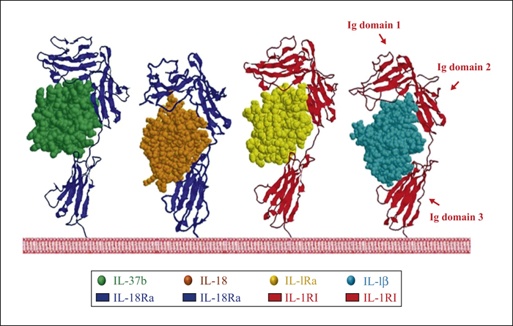
Interleukin-37
New member of the IL-1 family, 1 of 4 anti-inflammatory ligands
Found in various tissues, but especially immune cells (monocytes)
Dual function cytokine: has both intra- and extra-cellular functions
Expression associated with various inflammatory human diseases
No known mouse homolog, but active in the mouse
IL-37 transgenic mouse protected from acute inflammation
IL-37 bound to IL-18Rα
(Adapted from Borashi et al., 2011, Eur Cytokine Netw.)

Slide 6
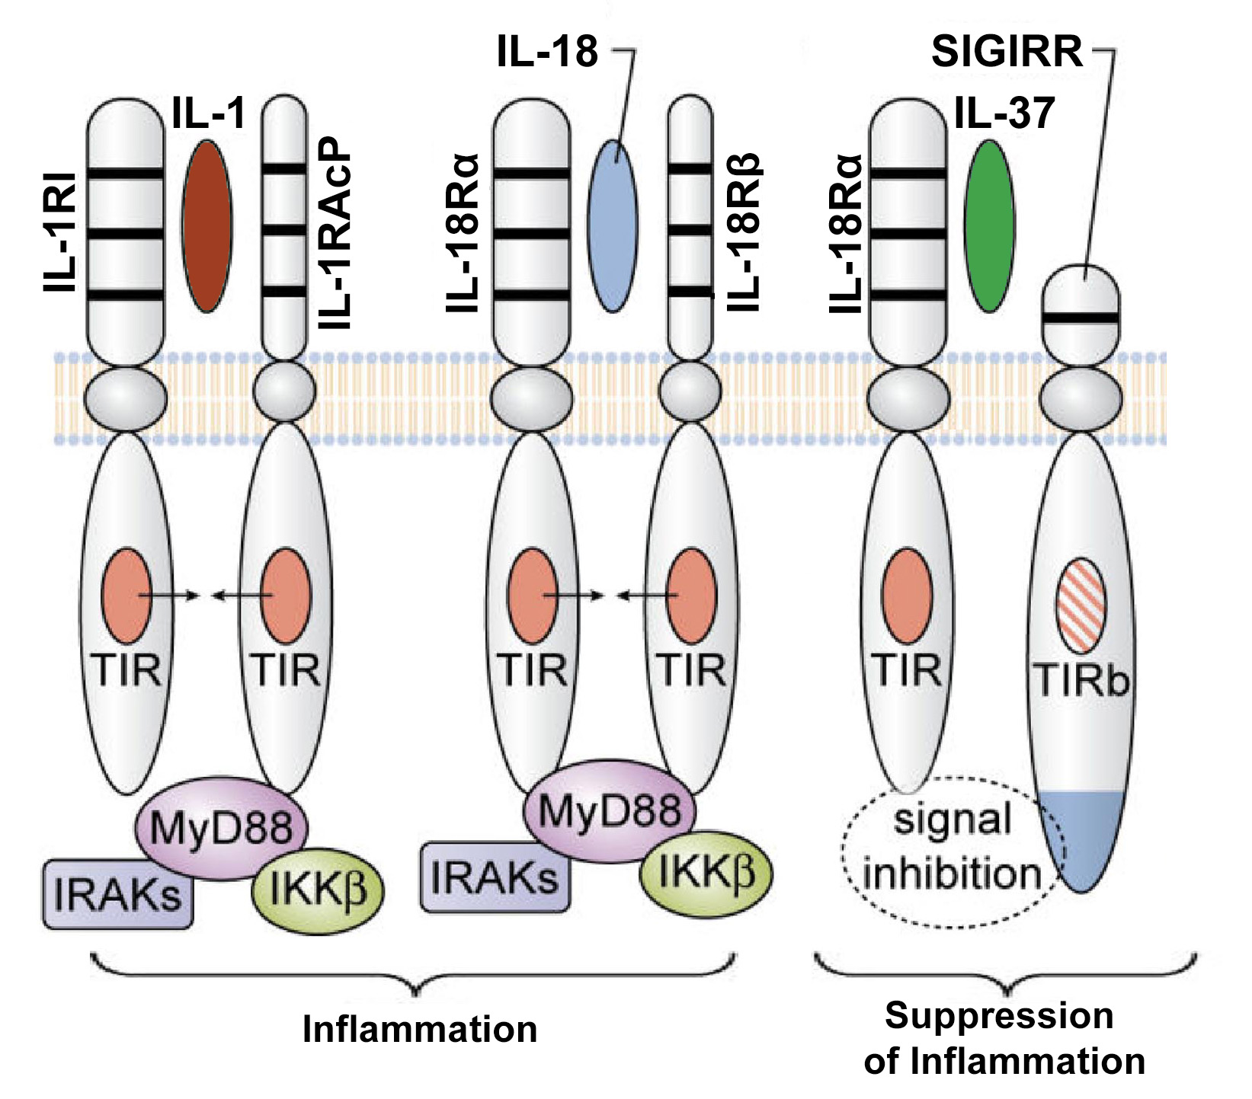
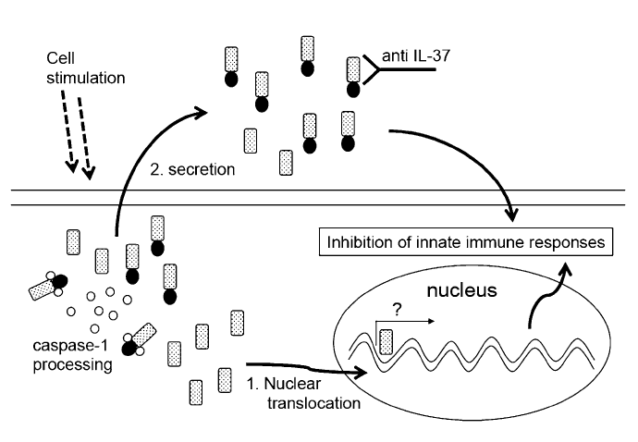
Interleukin-37
Protects against inflammation in Tg mouse model – sepsis, colitis and obesity-induced insulin-resistance.
Associated with various human inflammatory diseases – psoriasis, Lupus, RA, IBD, and HIV.
Binds to IL-18Rα and SIGIRR to induce an anti-inflammatory response.
Cleaved by Caspase1 for translocation to the nucleus to act as a transcription factor via Smad3.
TGFβ/Smad3 pathway implicated in reduced lipid uptake and resolution of inflammation, potential for IL-37 to be anti-atherogenic.
(Adapted from Dinarello, Blood, 2011)
(Bulau et al., PNAS, 2013)

Slide 7
Objectives
Express IL-37b specifically in macrophages using retroviral transduction of hematopoietic stem cells.
Determine the effects of macrophage-expressed IL-37b on inflammatory gene and protein expression, cholesterol uptake and efflux, and macrophage transmigration.
Investigate the role of macrophage-expressed IL-37b in a mouse model of atherosclerosis using bone marrow transplantation of CD68S-IL-37b transduced HSC.

Slide 8
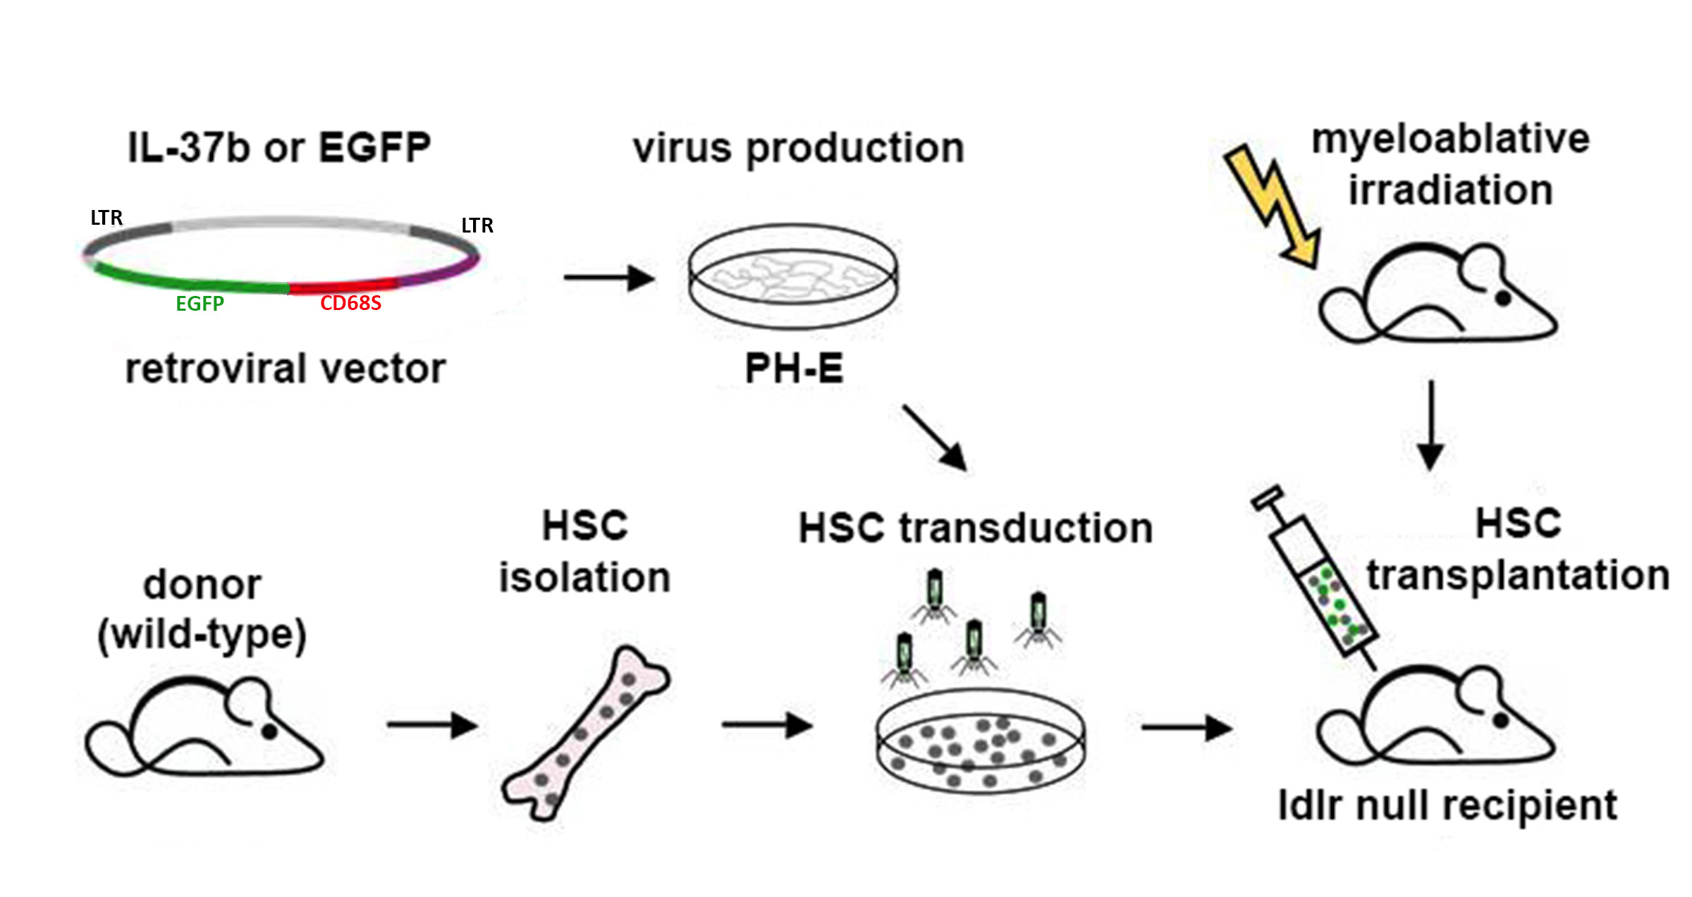
HSC Transduction and BMT
(Adapted from www.sfb684.med.uni-muenchen.de)

Slide 9
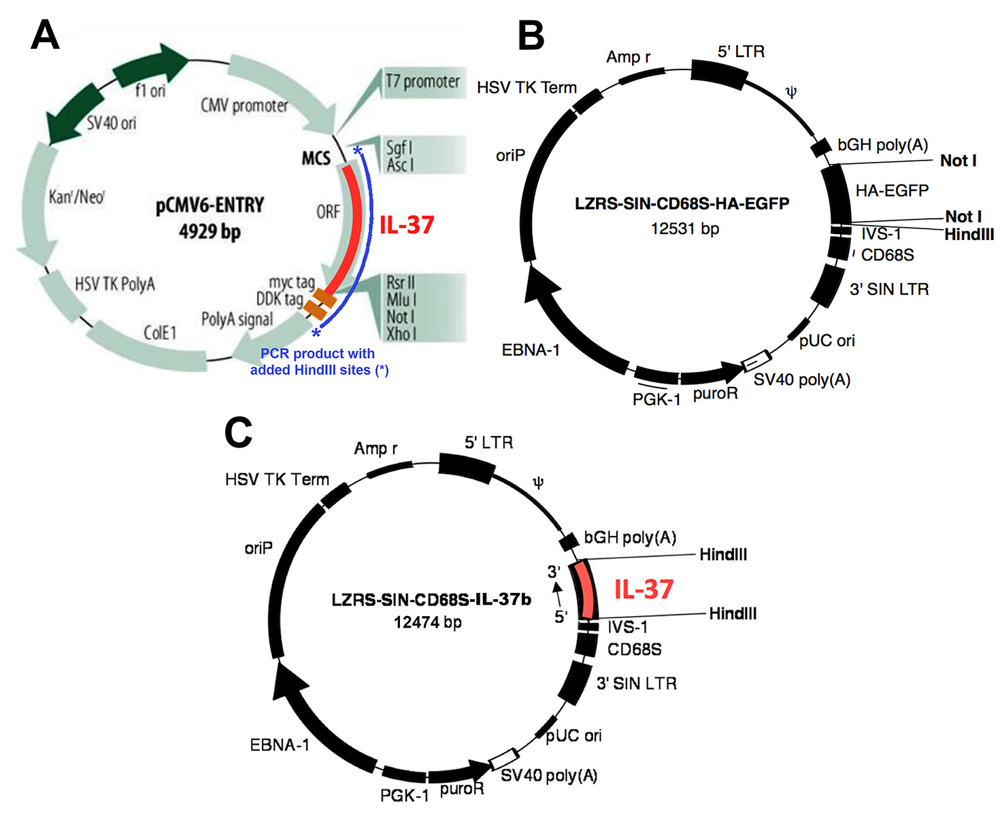
Cloning Constructs
pCMV vector used for amplifying IL-37b cDNA with myc and DDK tags. Primers designed with HindIII RE sites.
HindIII digest of PCR product used for cloning into CD68S retroviral vector.

Slide 10
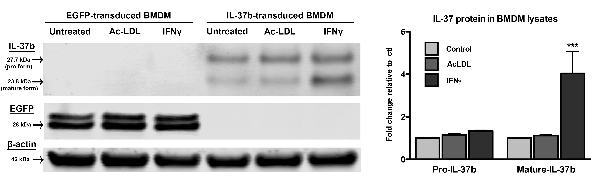
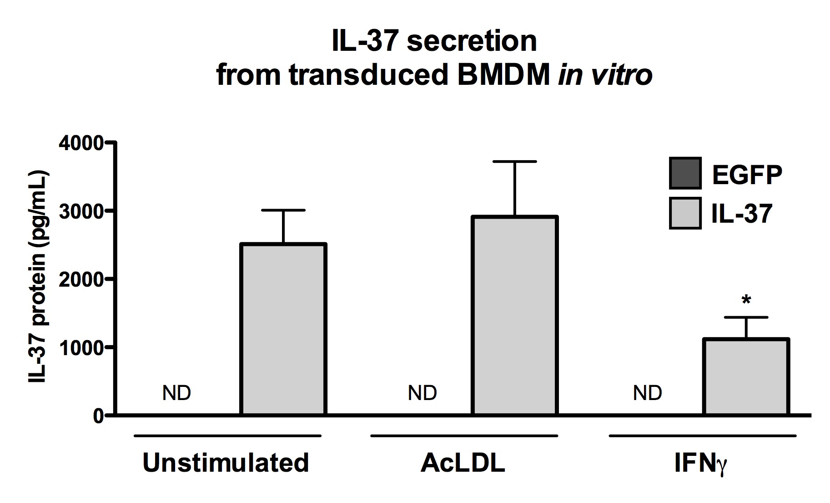
IL-37 Expression in vitro
Transduced BMDM express EGFP or IL-37 protein shown by Western blot
IFNγ treatment increased cleavage of pro-IL-37 to mature IL-37 protein
IL-37 secreted protein detected in macrophage cell culture supernatants

Slide 11
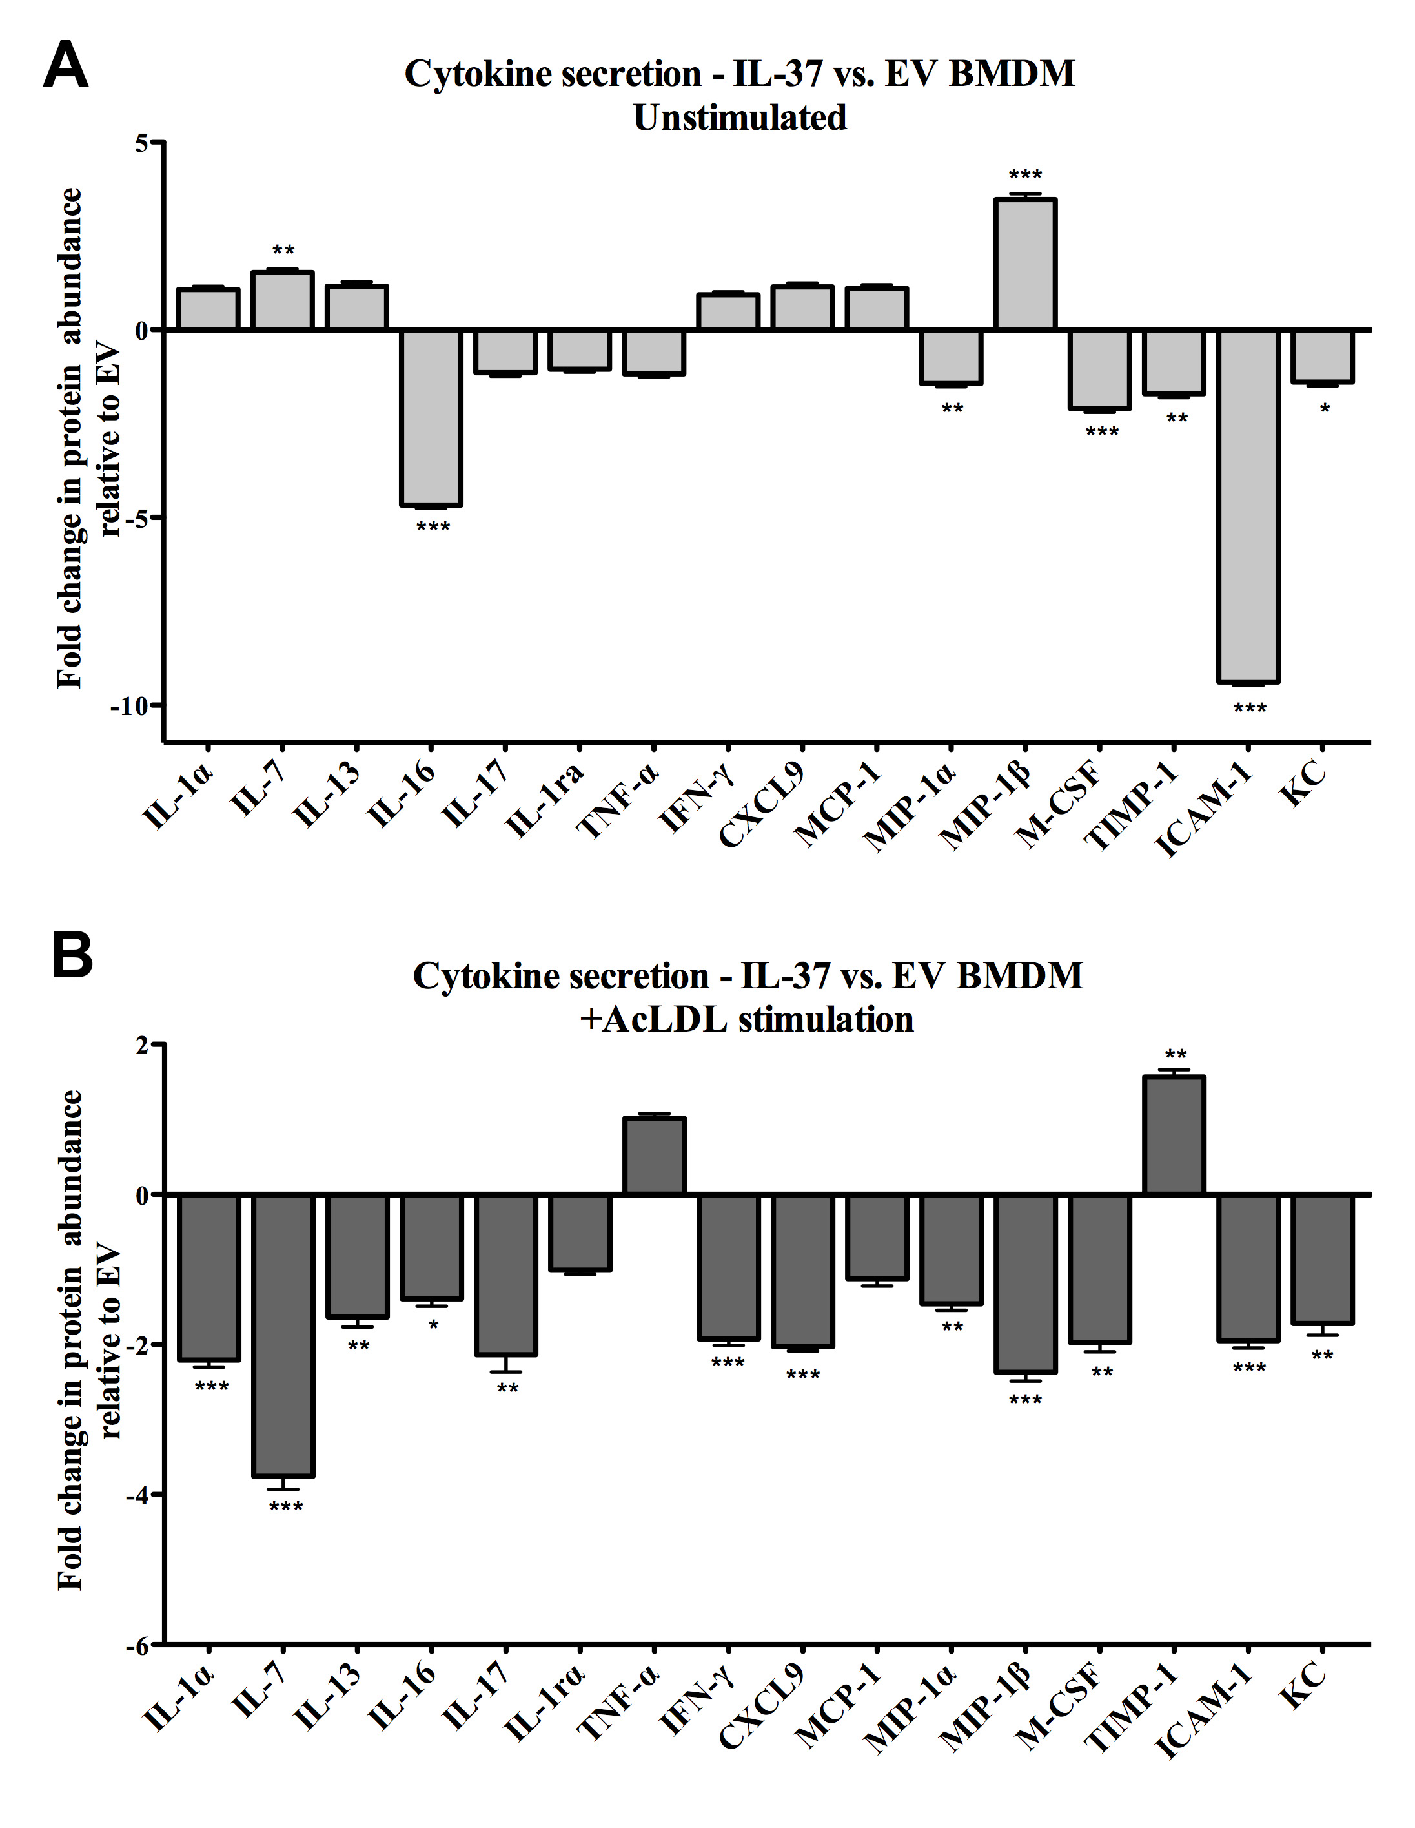
IL-37 Reduces Inflammatory Cytokine Secretion
Secreted cytokines from transduced macrophages measured by antibody array.
IL-37 expression reduces basal macrophage cytokine secretion compared to control transduced cells.

Slide 12
IL-37 Reduces Inflammatory Cytokine Secretion
Secreted cytokines from transduced macrophages measured by antibody array.
IL-37 expression reduces macrophage cytokine secretion after AcLDL treatment compared to control transduced cells.

Slide 13
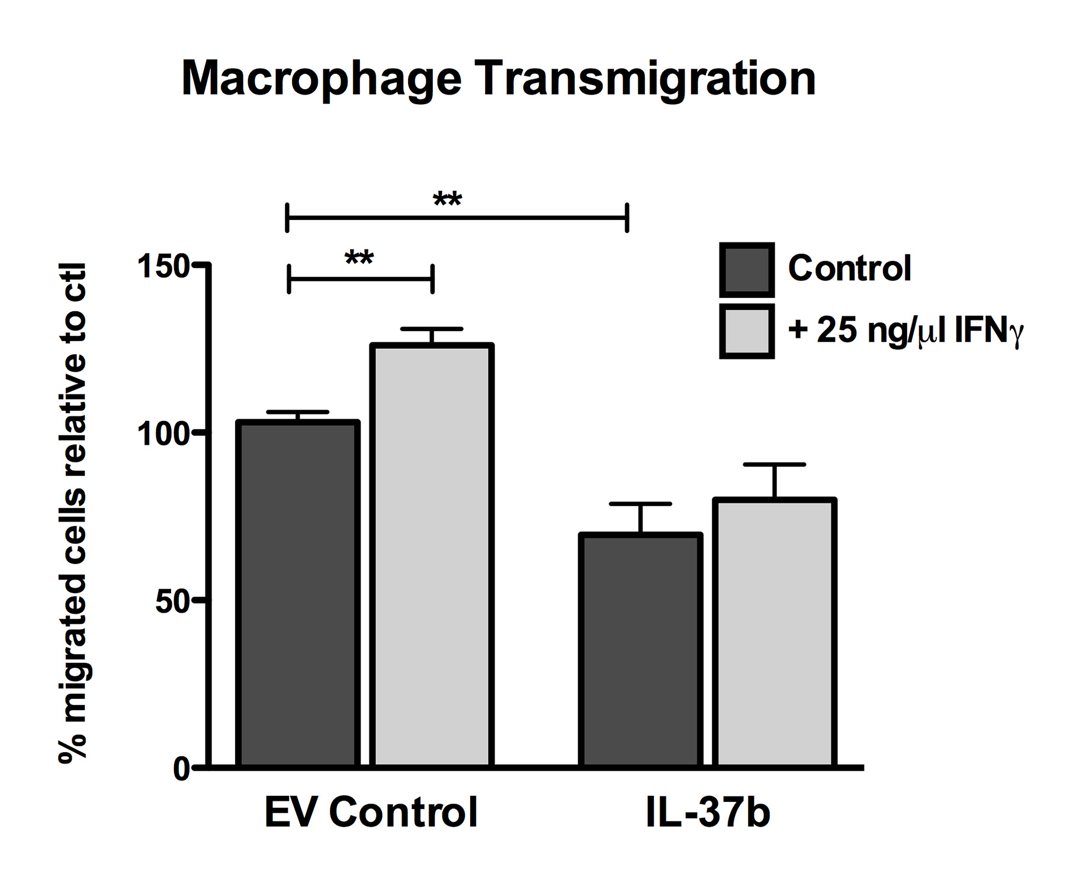
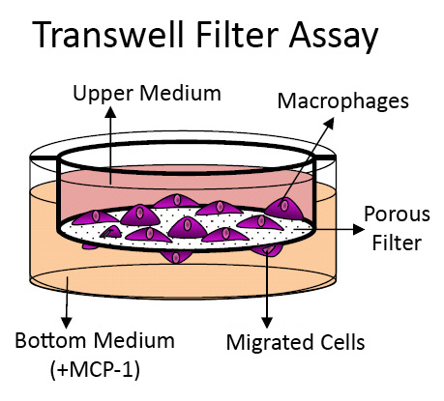
IL-37 Reduces Macrophage Transmigration
Transmigration to MCP-1 measured using transwell filter assay
Transmigration of macrophages significantly decreased by IL-37 expression
IFNγ pretreatment significantly increased migration of EGFP but not IL-37 transduced cells
(Adapted from: http://www.innoprot.com/documentos/fotos/)

Slide 14
Cholesterol homeostasis in foam cells:
cholesterol uptake and efflux pathways
modified LDL
SR-A
lipid
CD36
CE
FC
LXR/PPARγ
Foam cell
ABCA1
ABCG1
HDL
apoAI
The uptake of modified LDL leads to intracellular cholesterol deposition and foam cell formation, which is central to atherosclerotic plaque formation.
Efflux of free cholesterol protects macrophages from detrimental effects such as necrosis and apoptosis.

Slide 15
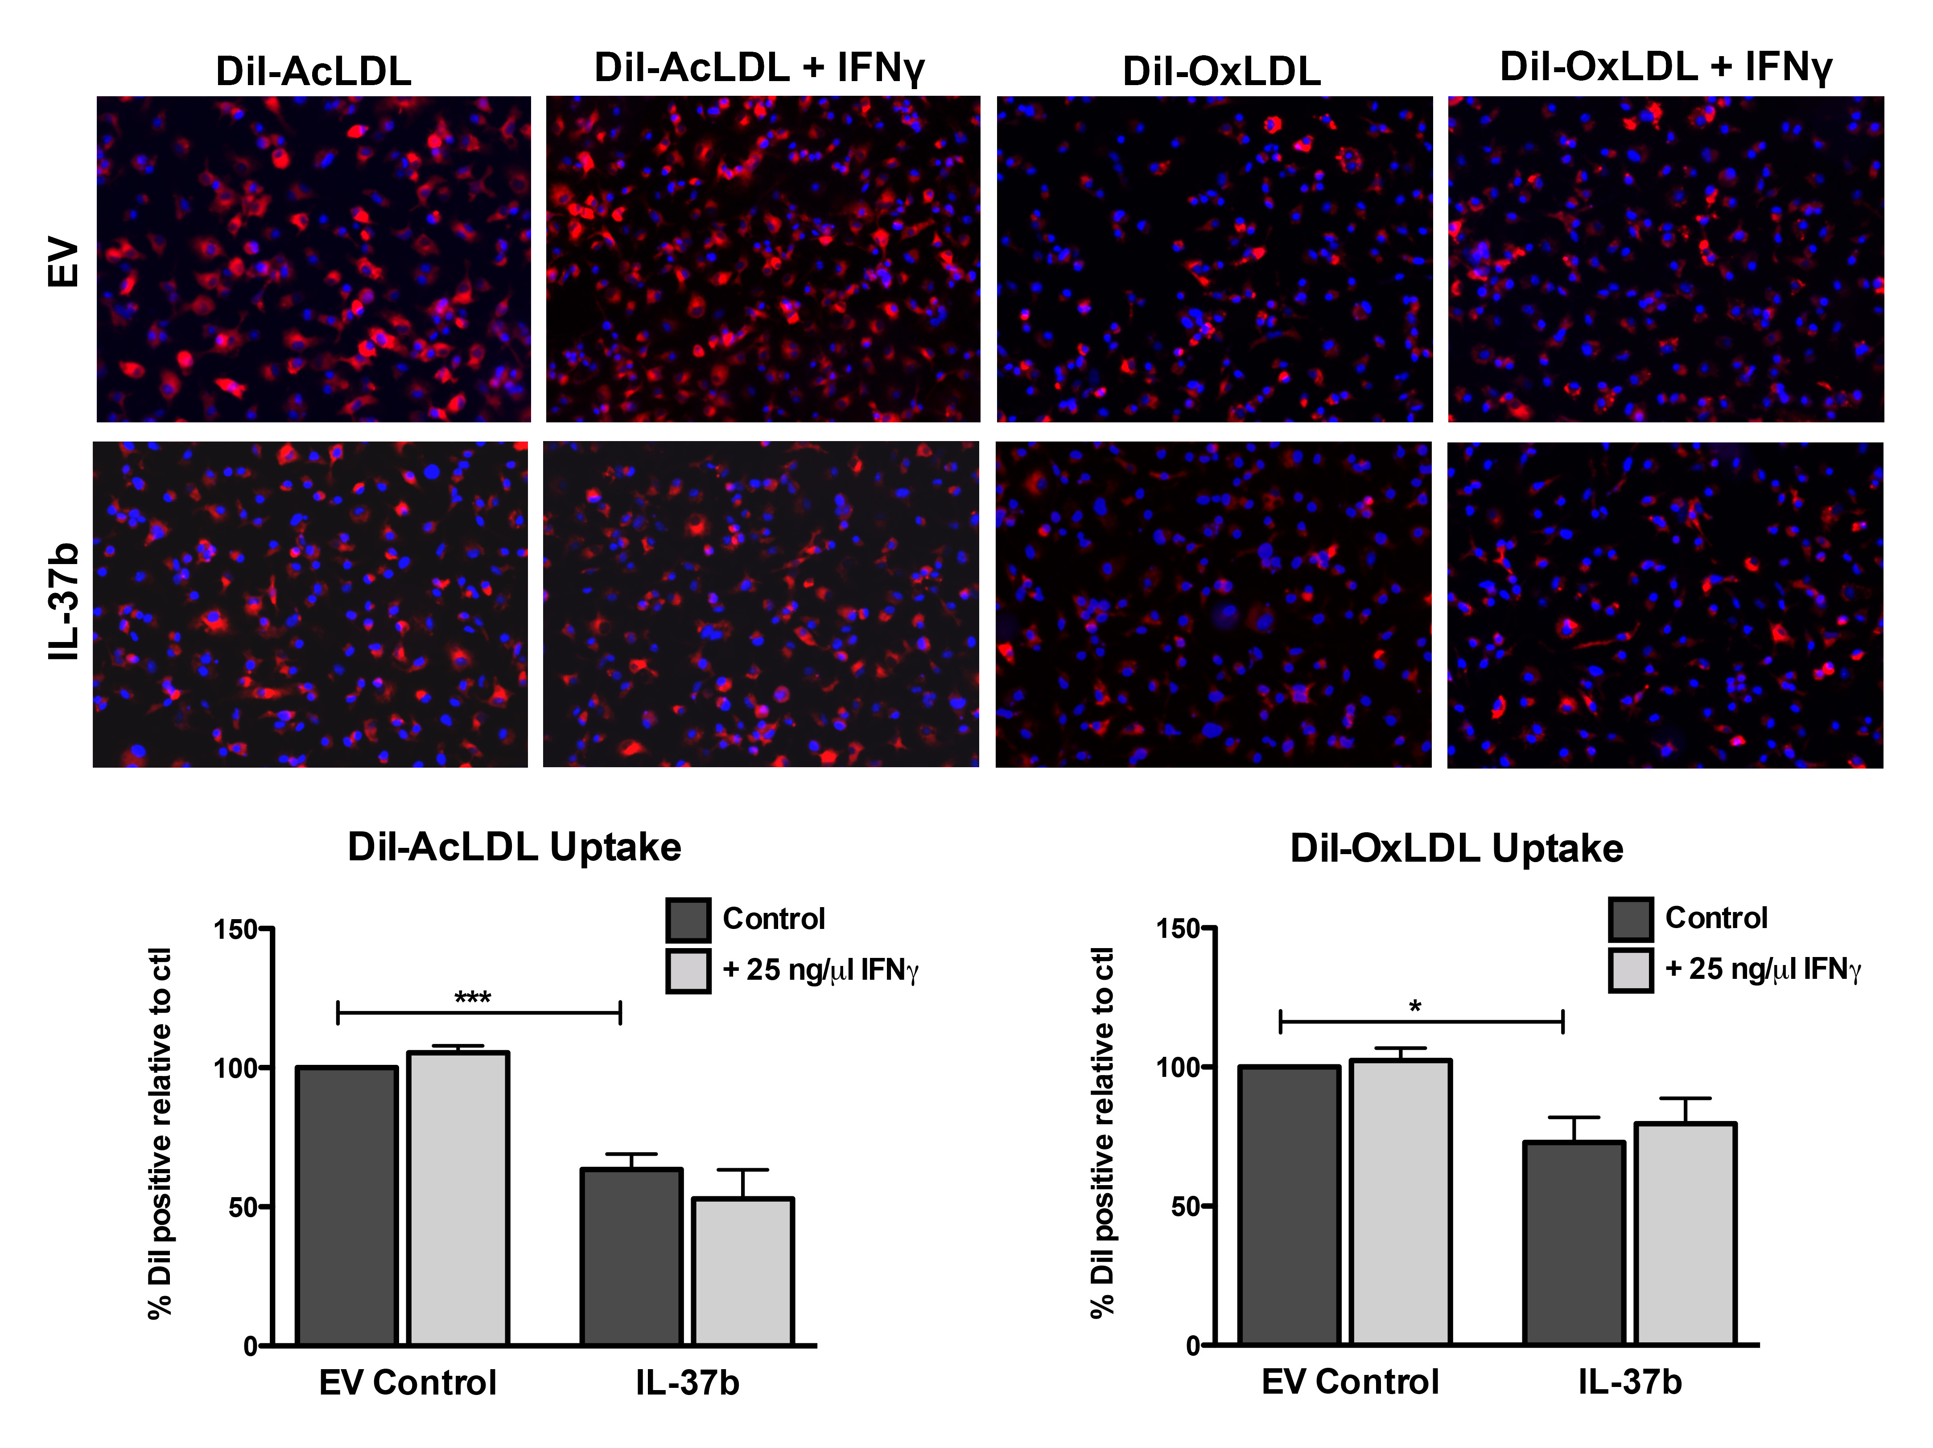
Macrophage IL-37 Expression
Reduces Cholesterol Uptake

Slide 16
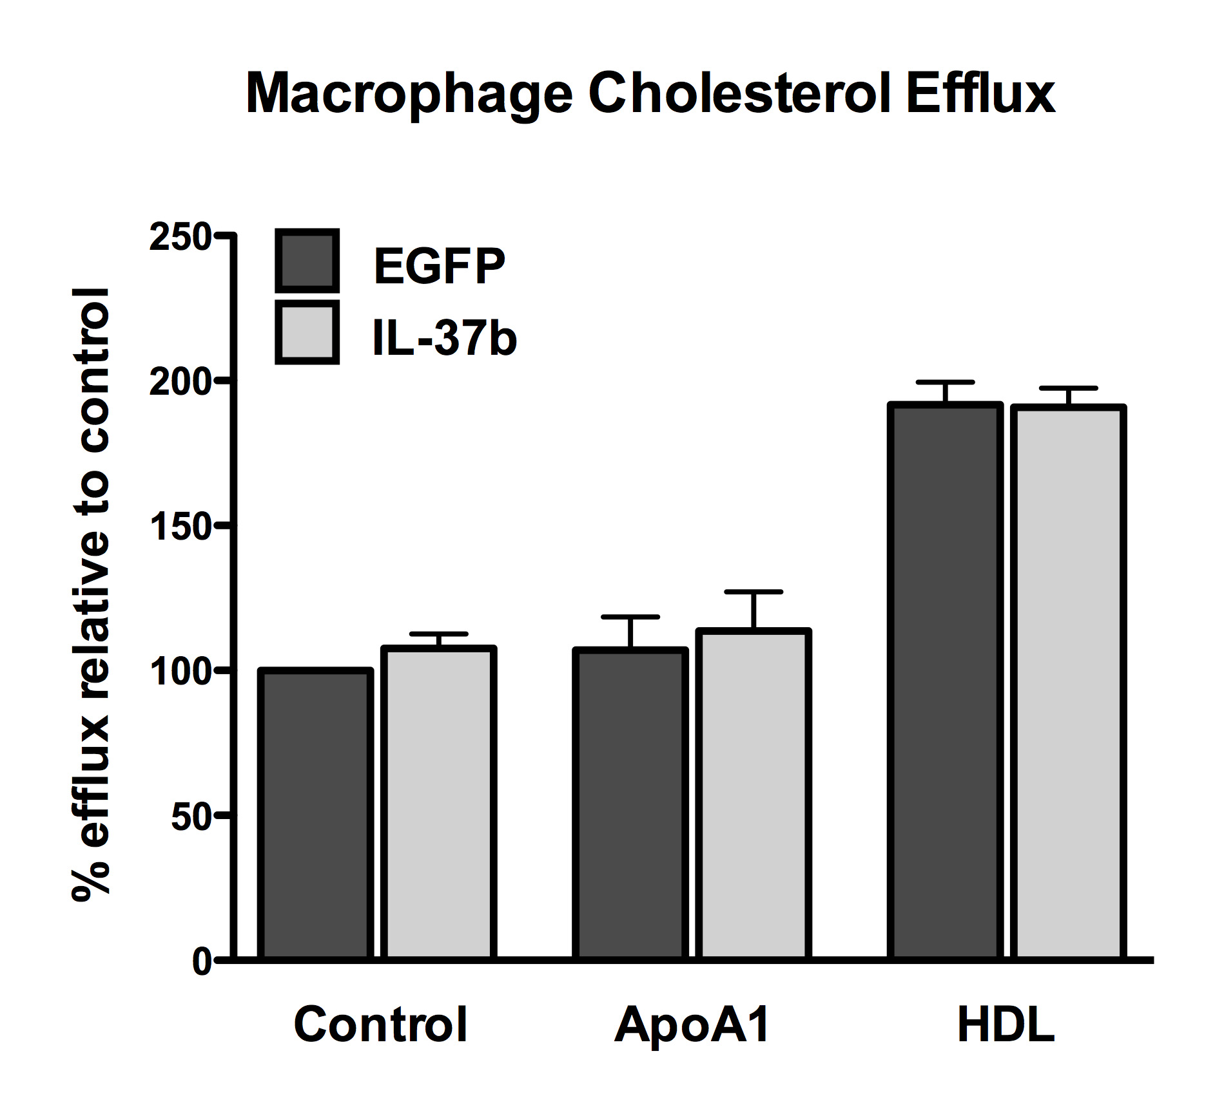
Cholesterol Efflux is Unaltered by IL-37 Expression
Cholesterol efflux to ABCA1 (ApoA1) or ABCG1 (HDL) measured using ³H-labeled cholesterol
No difference in efflux capacity observed between groups

Slide 17
In vivo BMT Study

Slide 18

Study scheme
Atherogenic diet #94059
(Harlan Teklad)
6 WK old LDLR-/-
Mice irradiated
With 1000 rad
Sacrifice
15.8% wt/wt fat
1.25% wt/wt cholesterol
WK -4
WK 0
WK 6
WK 12
BMT with
IL-37Tg or EGFP
transduced HSC
Bleed
Bleed
Bleed

Slide 19
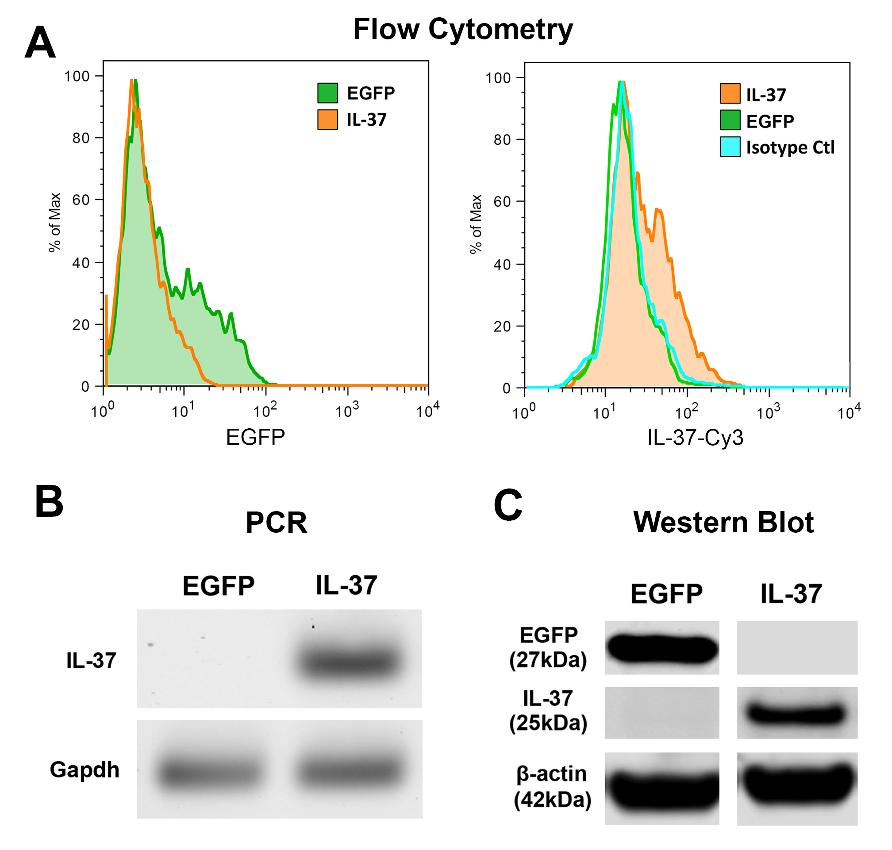
IL-37 and EGFP Expression in Transduced HSC used for BMT
Transduced HSC used for BMT differentiated to macrophages in vitro
EGFP and IL-37 protein expression detected by flow cytometry and Western blot
IL-37 transcript detected by PCR

Slide 20
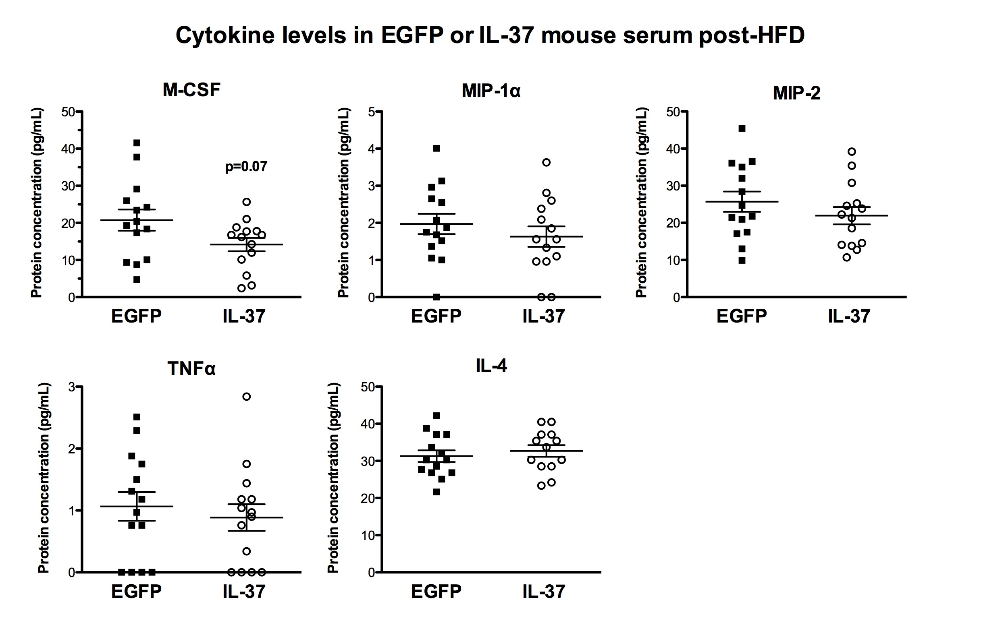
Circulating Cytokine Levels Post-HFD

Slide 21
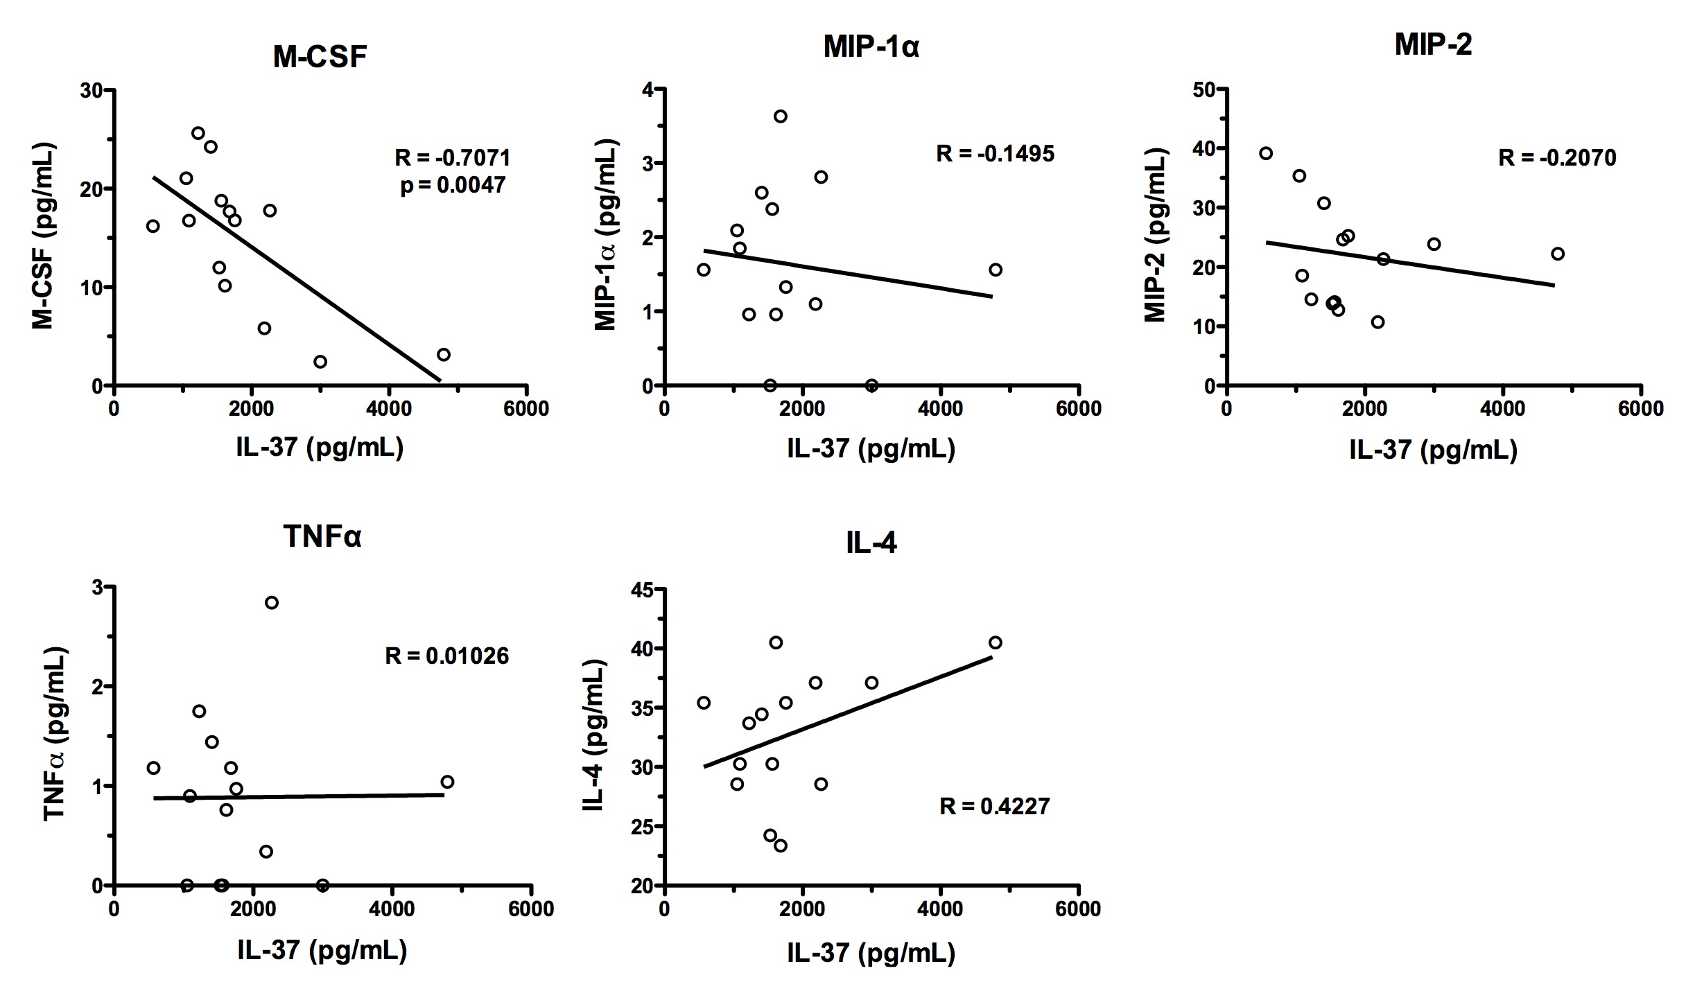
Correlation of Serum Cytokines with IL-37 Levels

Slide 22
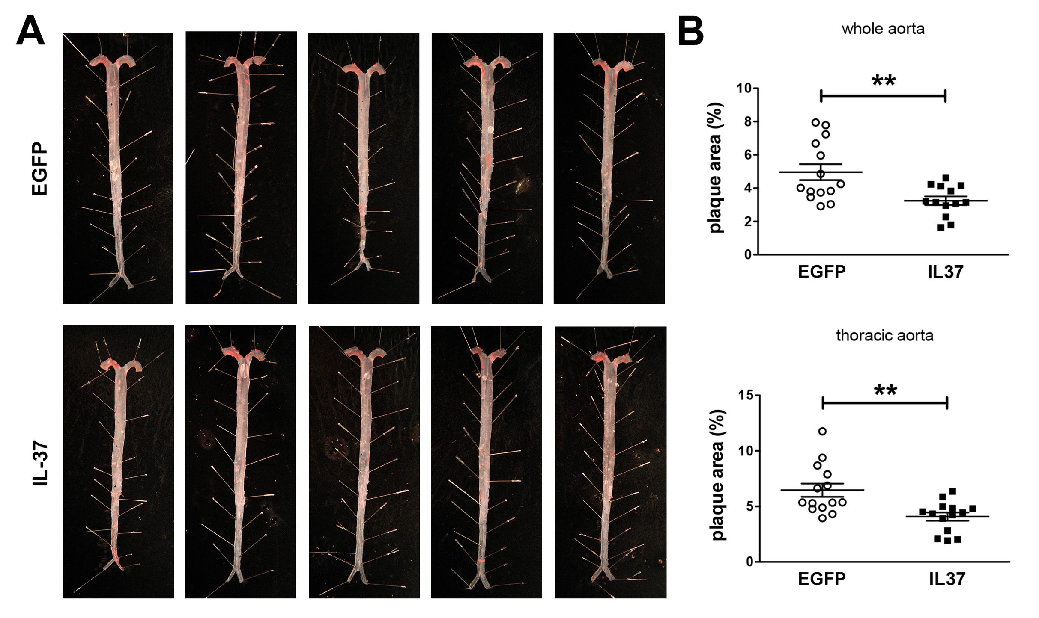
Plaque Distribution in Aorta Reduced by IL-37 Expression

Slide 23
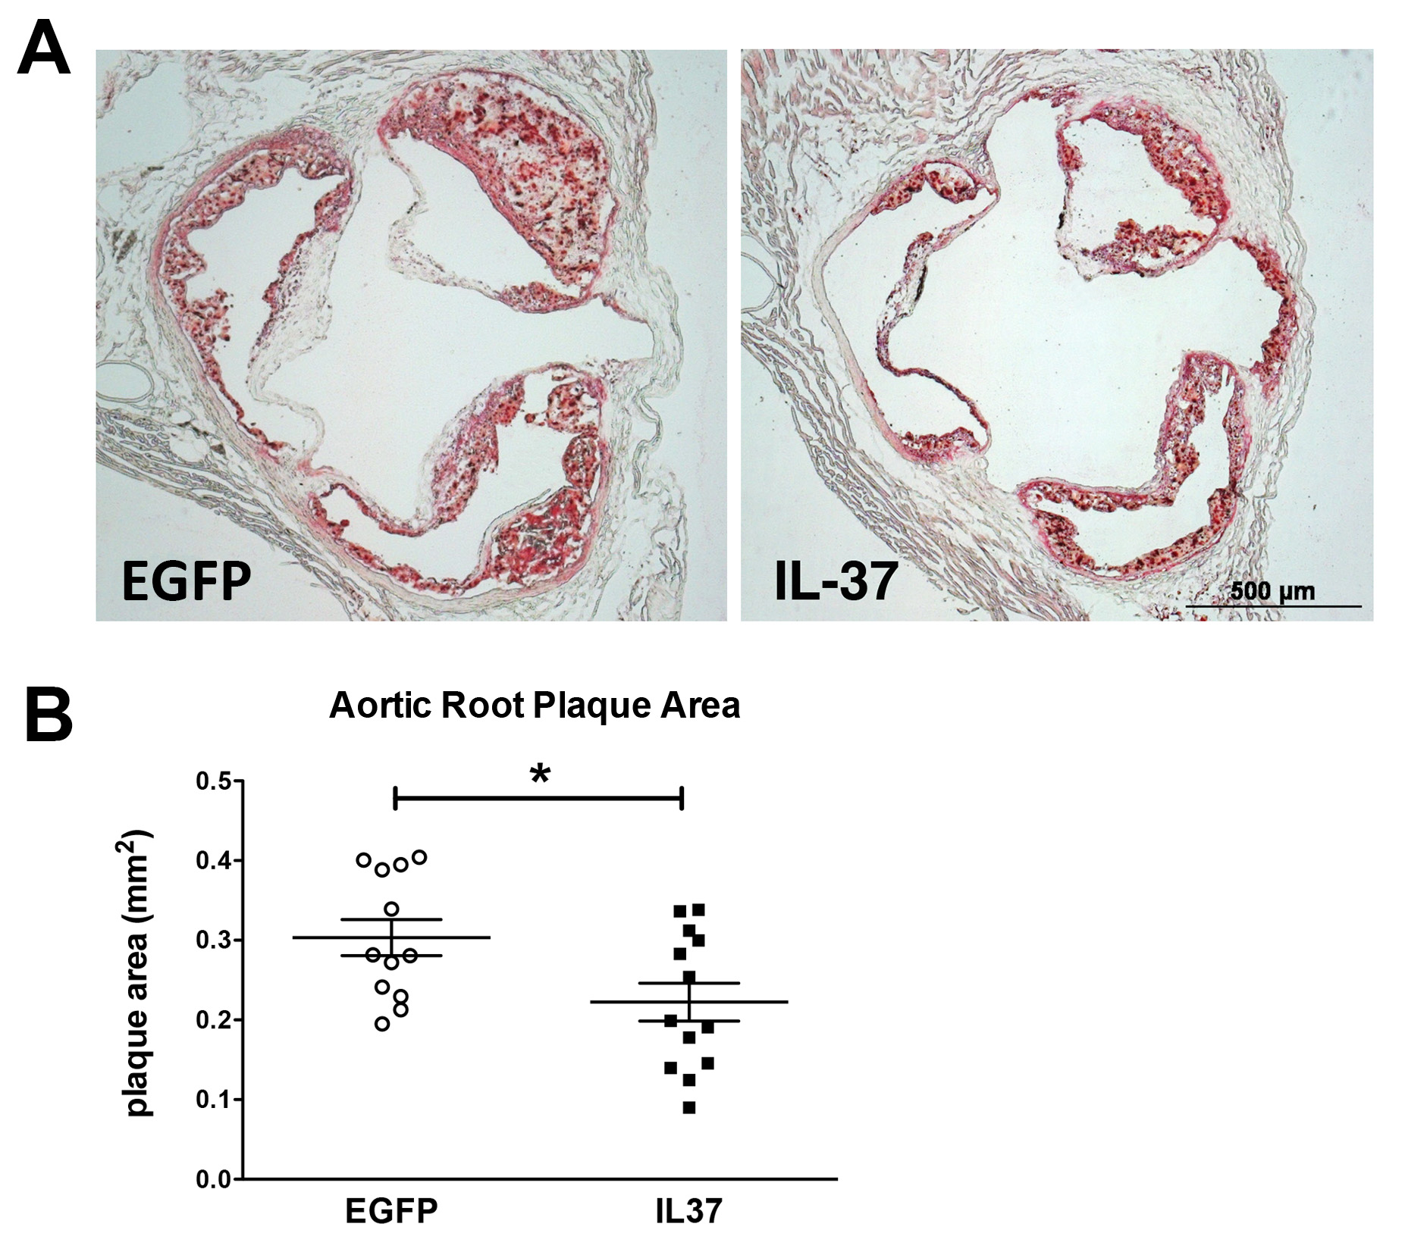
Aortic Root Plaque Area Reduced by IL-37
Aortic root heart sections stained with Oil-red-O to visualize plaque
Plaque area significantly reduced by macrophage IL-37 expression

Slide 24
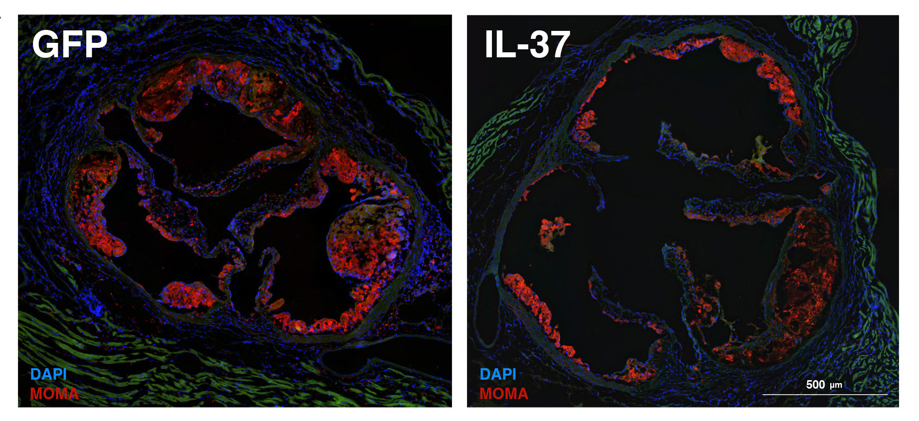
Macrophage Plaque Content Reduced by IL-37
Aortic root heart sections stained with MOMA-2 to visualize macrophages

Slide 25
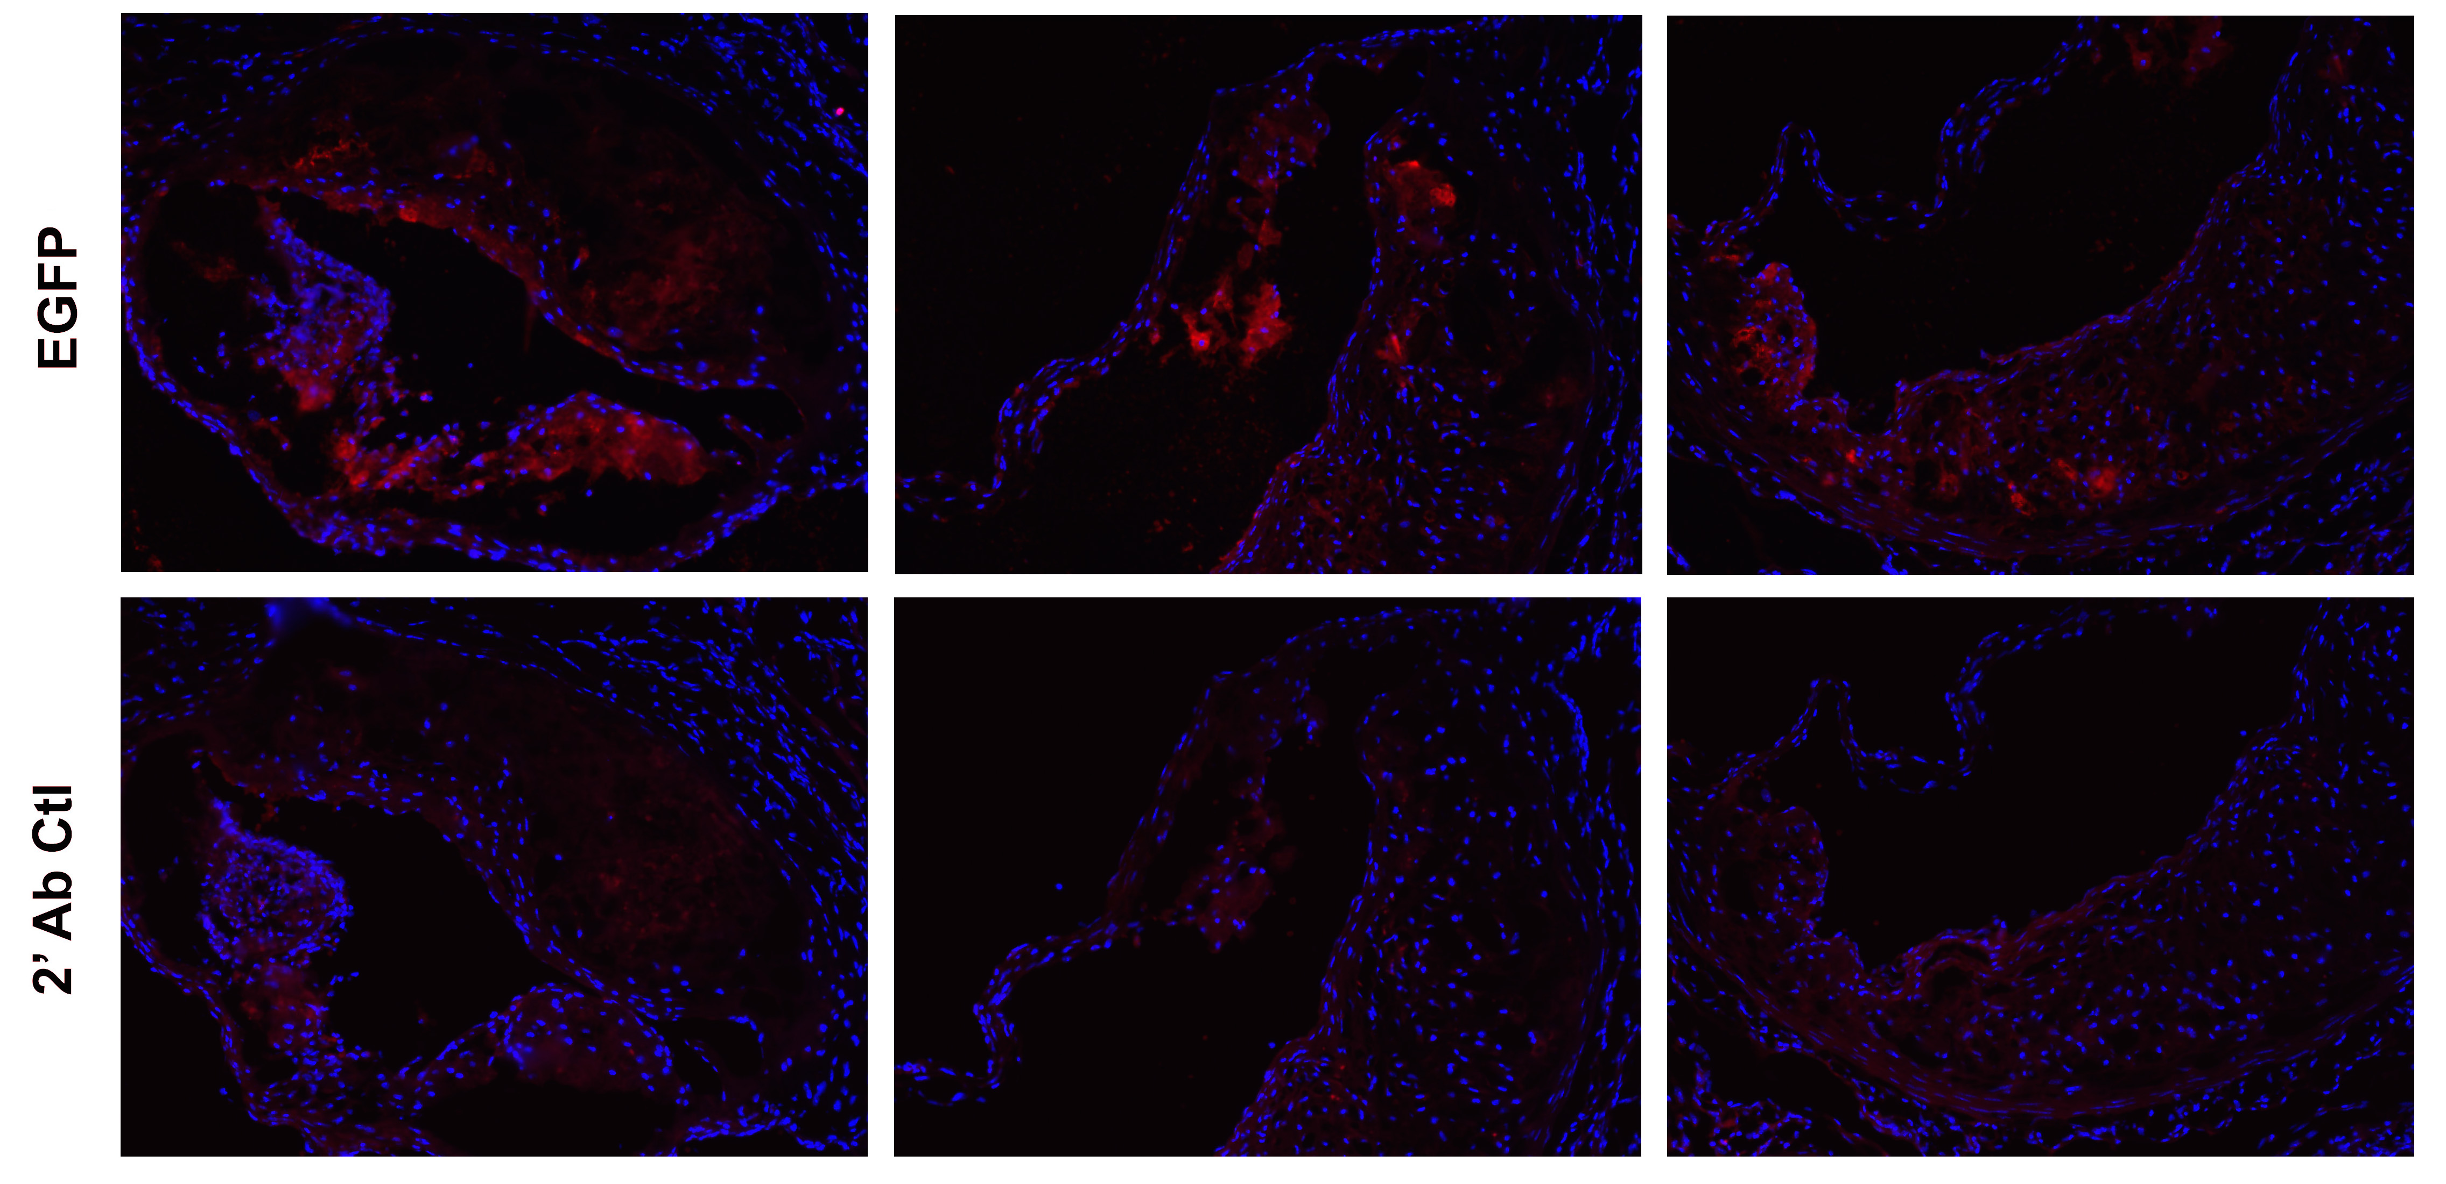
IL-37 Staining in Aortic Root Plaque
IL-37
Ctrl

Slide 26
Summary
Successful macrophage-specific retroviral gene transfer and long term expression of IL-37 led to reduced atherosclerosis.
Macrophage-specific IL-37 expression led to:
  Suppression of inflammation
  Reduction of cholesterol uptake
  Inhibition of macrophage transmigration
IL-37
IL-37
IL-37

Slide 27

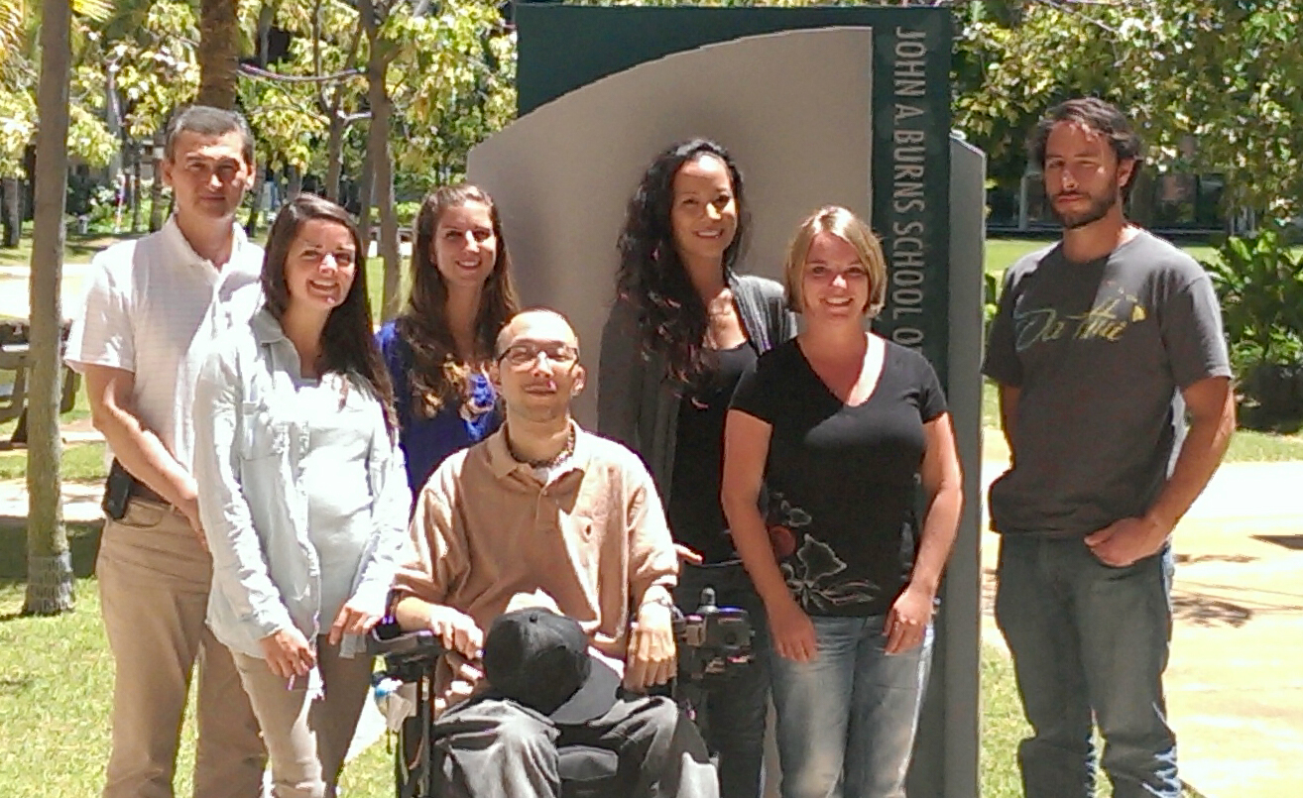

Acknowledgements
Main player:
  Sara McCurdy
Collaborator:
  Elaine Raines
    University of
    Washington
Other Lab Members:
Yvonne Baumer
Emma Toulmin
Monica Montgomery
Whitney Regan
Eric Collier

Slide 28
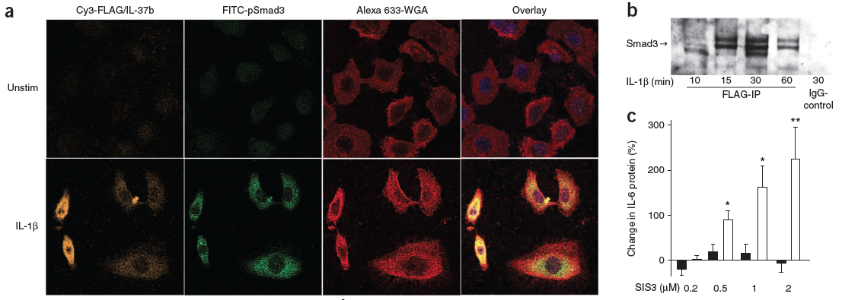
Smad3 binds IL-37 – mediating protective effects
Smad3 and IL-37 co-localization.
IL-37 pull down blotted for Smad3 shows direct binding.
Smad3 inhibitor (SIS3) causes reversal of protective effects of IL-37 against inflammation.
(Nold et al., Nature, 2010)

Slide 29
Conclusions
Macrophage-specific IL-37 expression leads to reduced inflammation and reduced cholesterol uptake in vitro, promising for preventing atherosclerosis.
BMT of IL-37-transduced HSC into atherosclerosis-prone ldlr^{-/-} mice leads to decreased plaque development, confirming its protective effects in vivo.
Systemic inflammatory gene and protein expression decreased in vivo by macrophage IL-37 expression.

Slide 30
Speculations on athero-protective mechanism of macrophage-expressed IL-37
Expression of the various macrophage cytokines observed in vitro may have been altered in vivo, difficult to measure.
Although relative macrophage plaque content was unchanged, reduced transmigration was likely a contributing factor of reduced plaque development early in the disease process.
Reduced macrophage cholesterol uptake may have also indirectly reduced inflammatory response and led to reduced foam cell formation in vivo → reduced plaque development.
EGFP staining of aortic root plaque sections was more prominent than IL-37 staining, potentially due to the reduced tendency of IL-37-expressing cells to infiltrate into the plaque.

Slide 31
Future Directions
Macrophage-specific expression of IL-37 effectively reduced inflammation – potential therapeutic value for other inflammatory diseases.
Future for atherosclerosis - investigate specific effects of IL-37 on the expression of plaque destabilizing enzymes.
Determine the contribution of intra- or extra-cellular IL-37 expression to its athero-protective mechanism.
Retroviral gene therapy still needs optimization. Targeted delivery of IL-37 to inflamed endothelium may help reduce atherosclerosis development in the future.

Slide 32
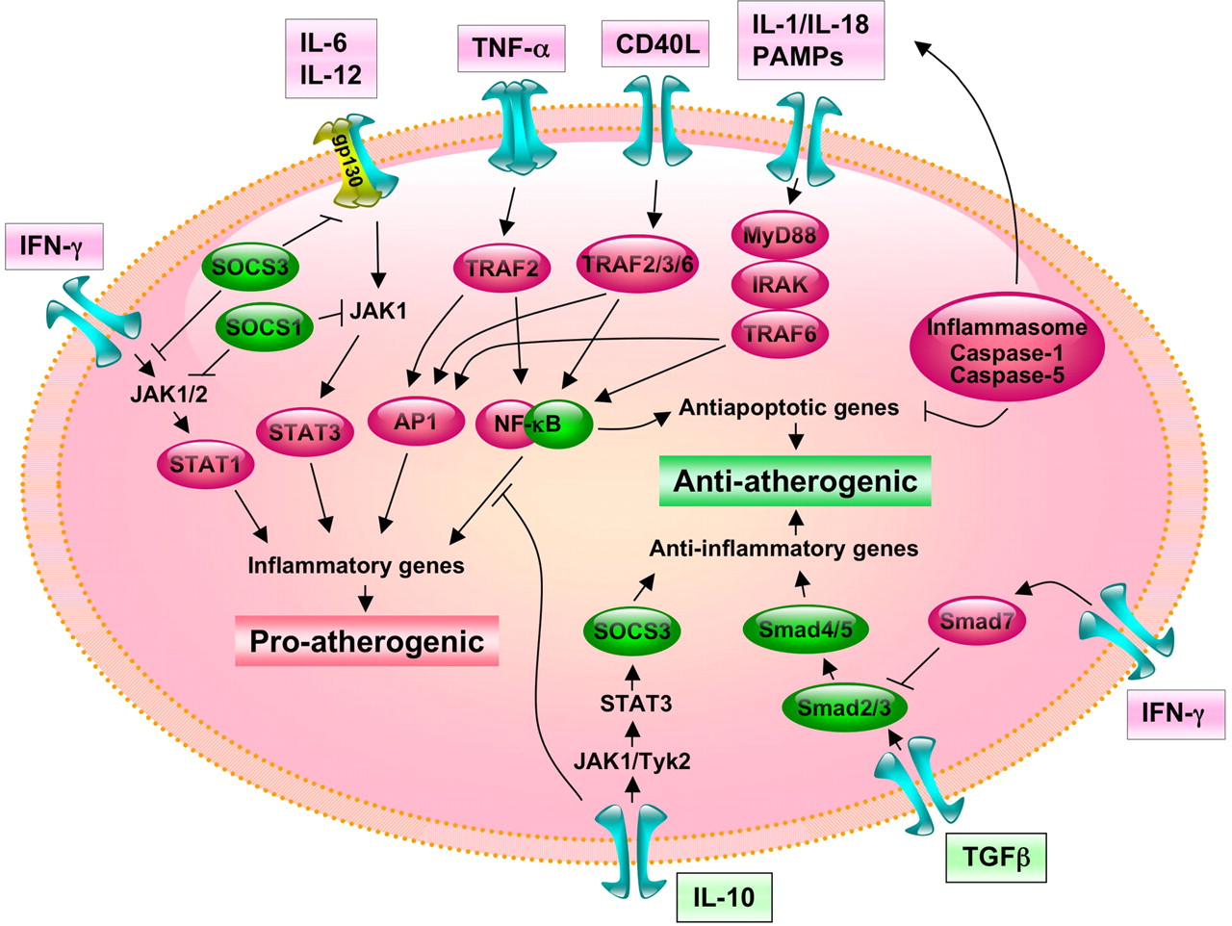
Macrophage Inflammatory Signaling
IL-37
IL-37
(Adapted from Tedgui & Mallat, Phys Rev, 2006)

Slide 33
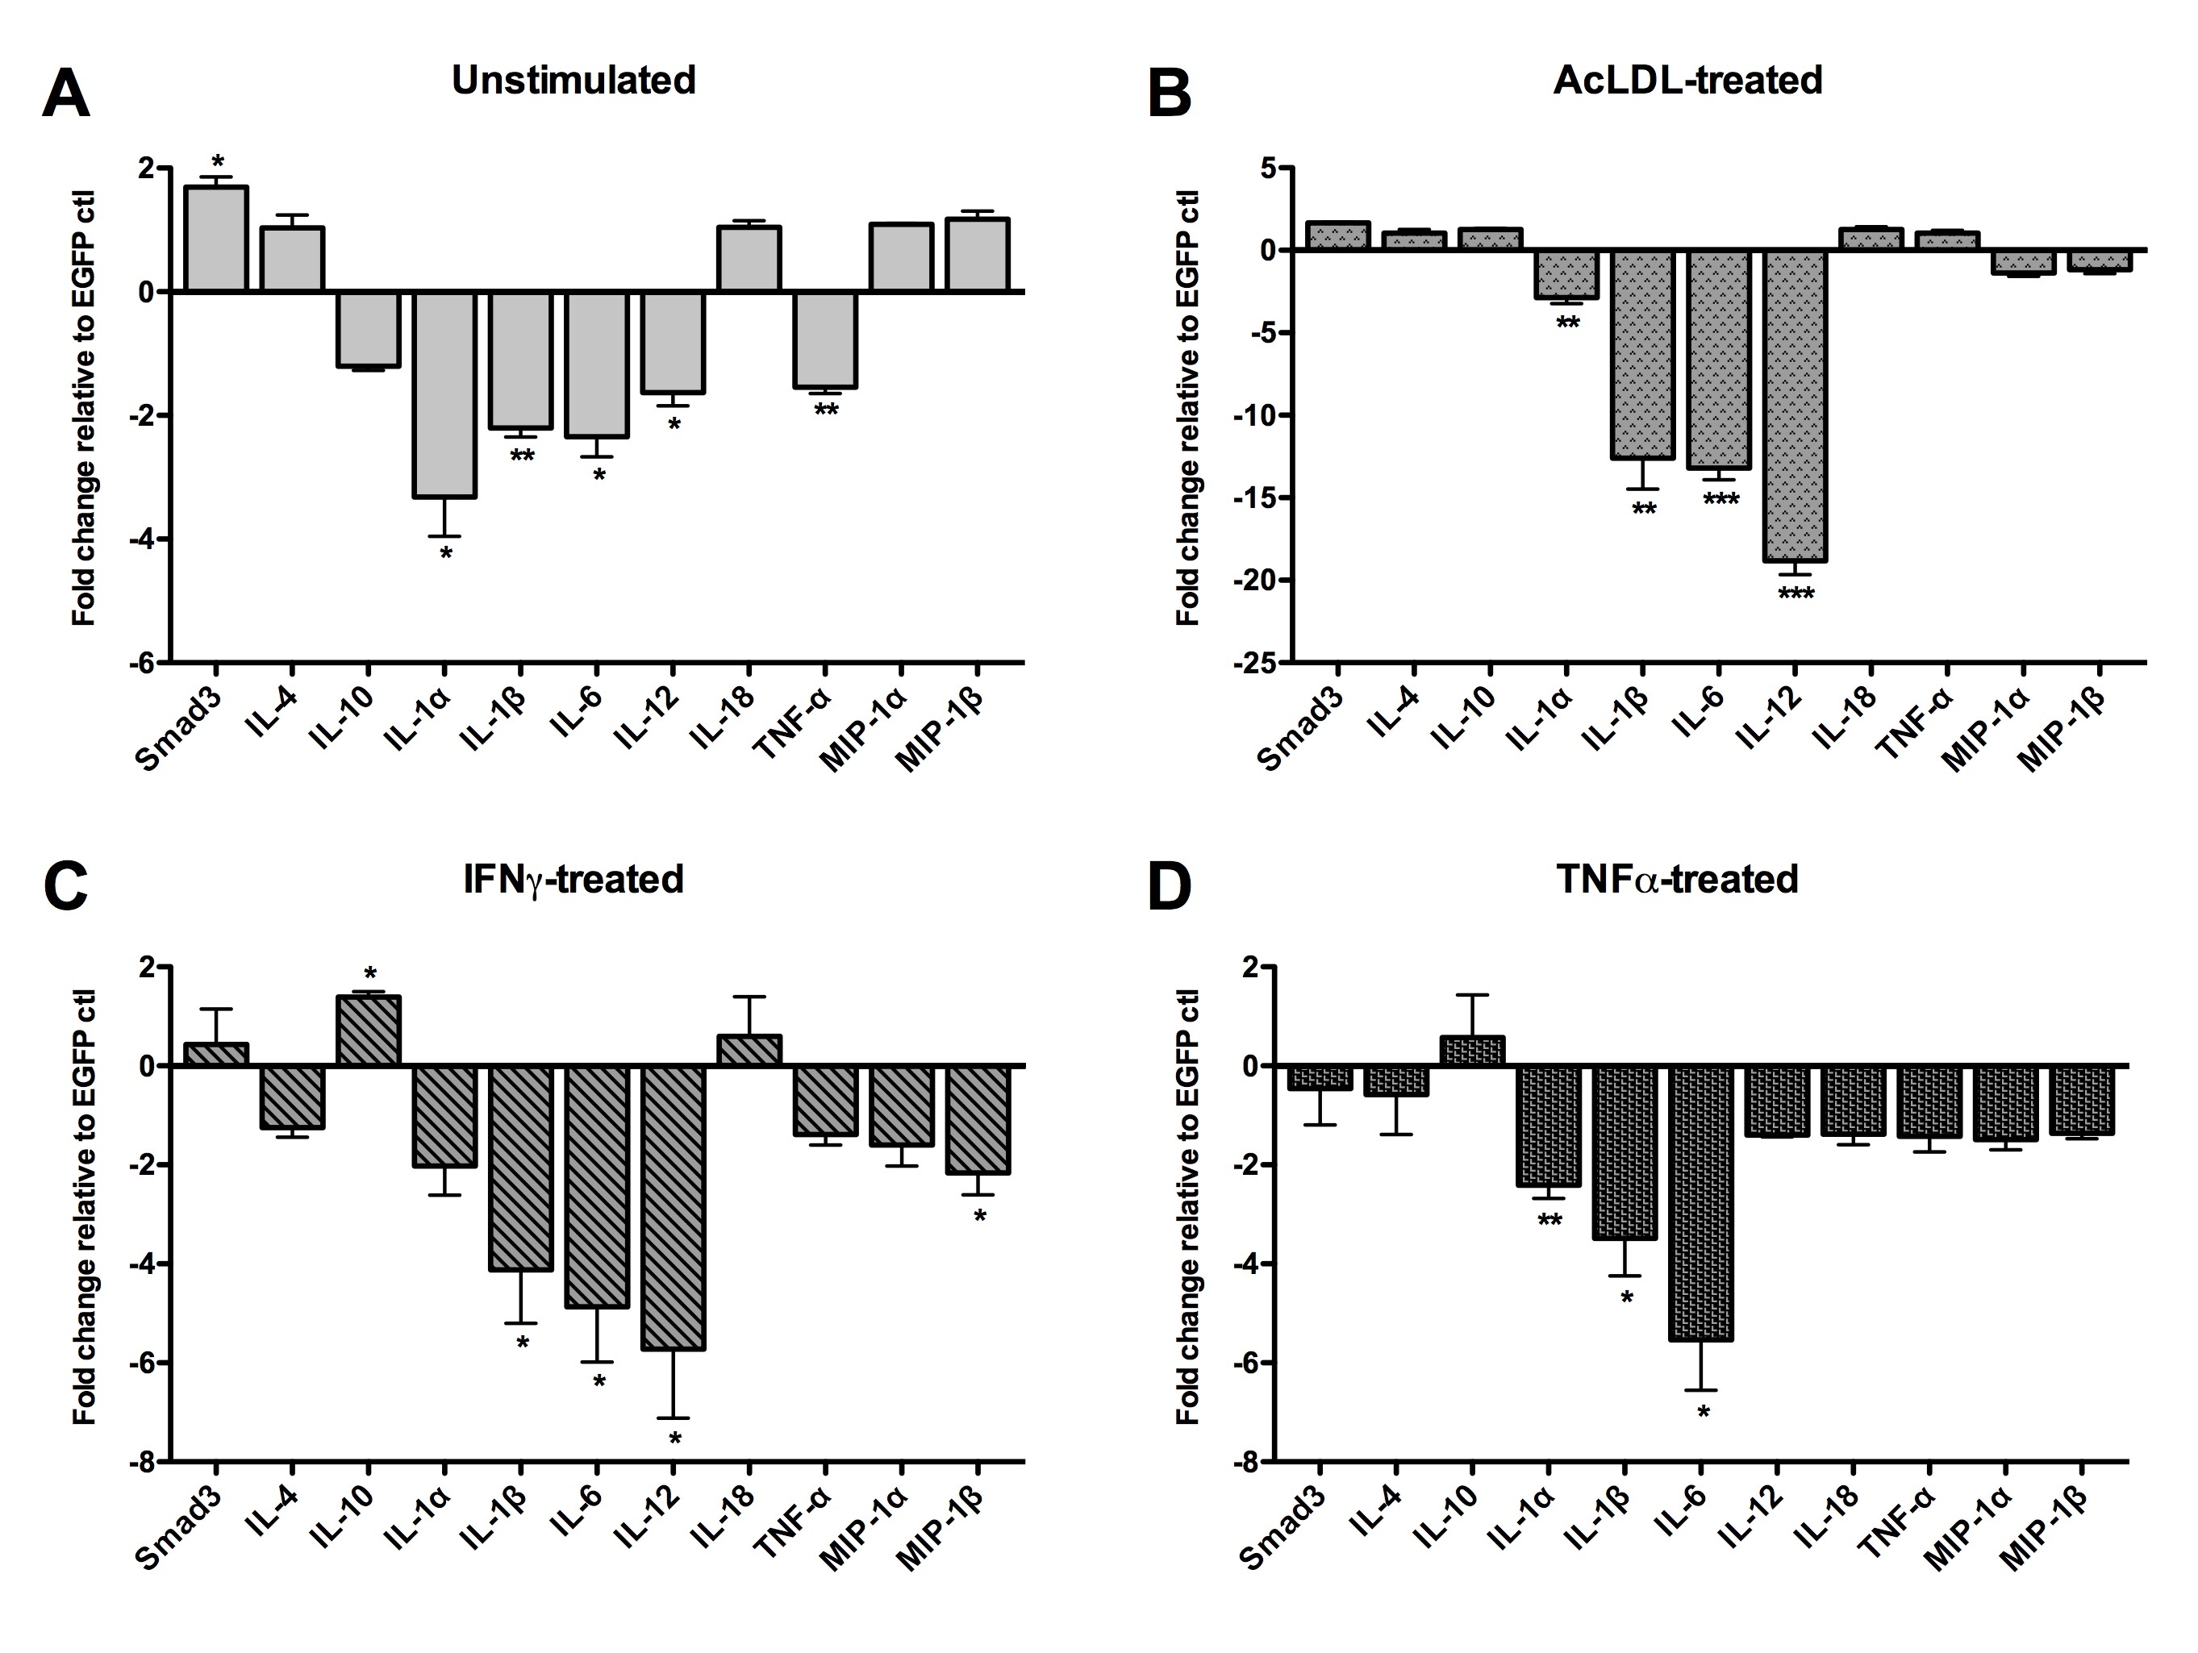
IL-37 Reduces Inflammatory Cytokine Secretion

