Slide 1
JCR 2016
Development of a Macrophage-specific Synthetic Promoter
Youngkeun Ahn, MD, PhD
(cecilyk@chonnam.ac.kr, www.reheart.or.kr)
Department of Cardiology
Cardiovascular Center
Chonnam National University Hospital
Gwangju, Korea

Slide 2
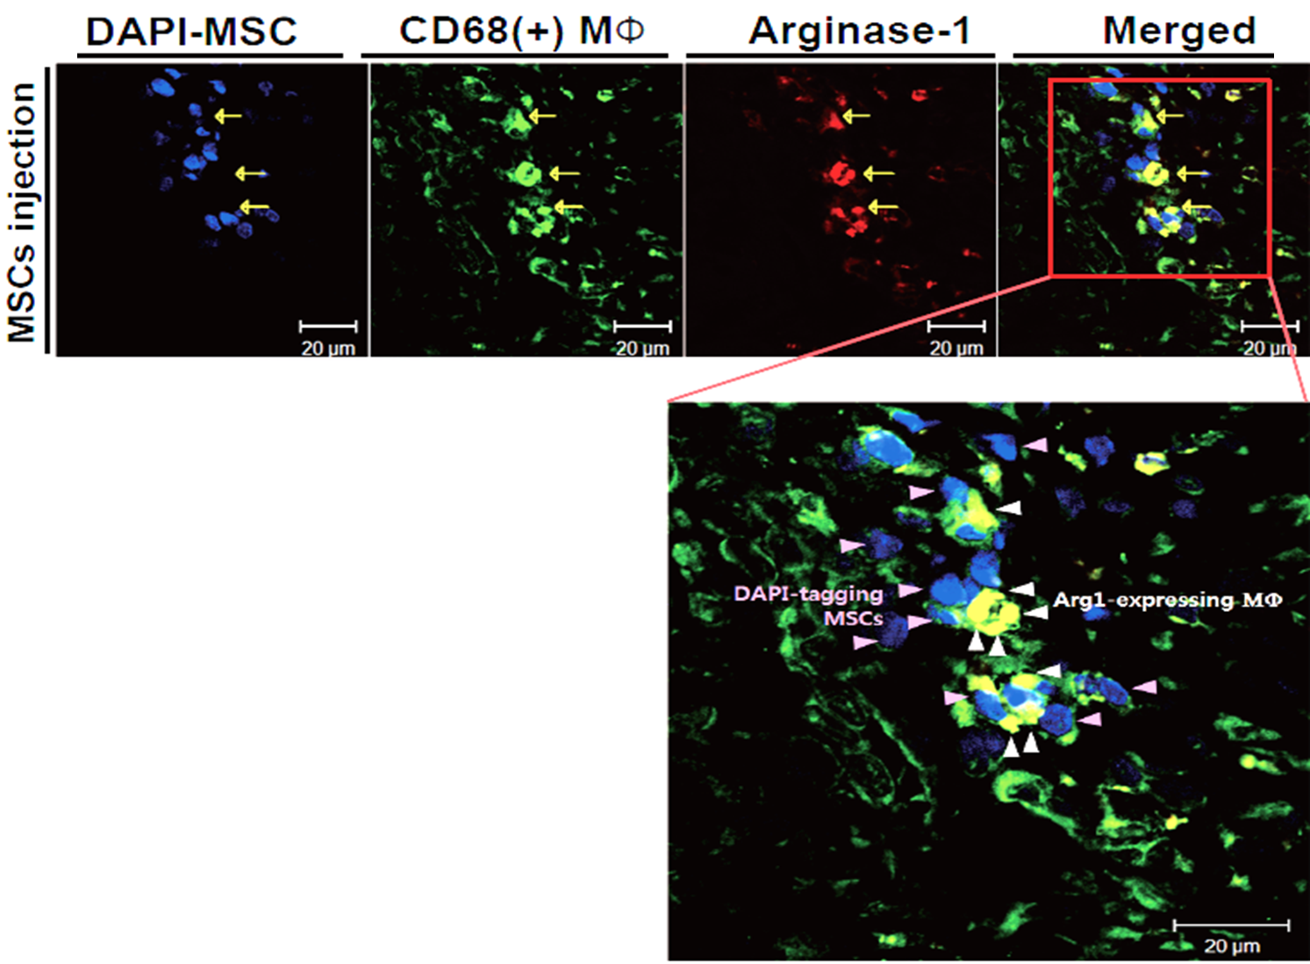
Shift of Macrophage Phenotype by Mesenchymal Stem Cells
MSC
Anti-Inflammatory
Macrophage
Pro-Inflammatory
Macrophage
Cho, Ahn et al., Exp Mol Med 2013

Slide 3
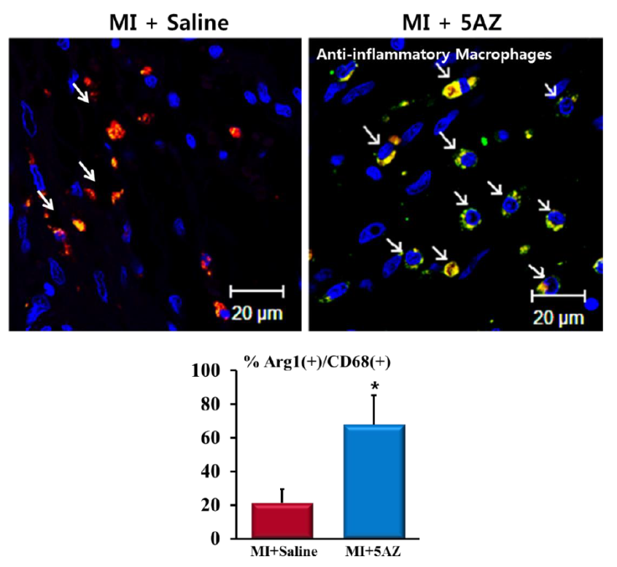
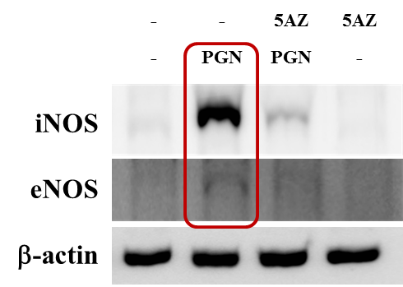
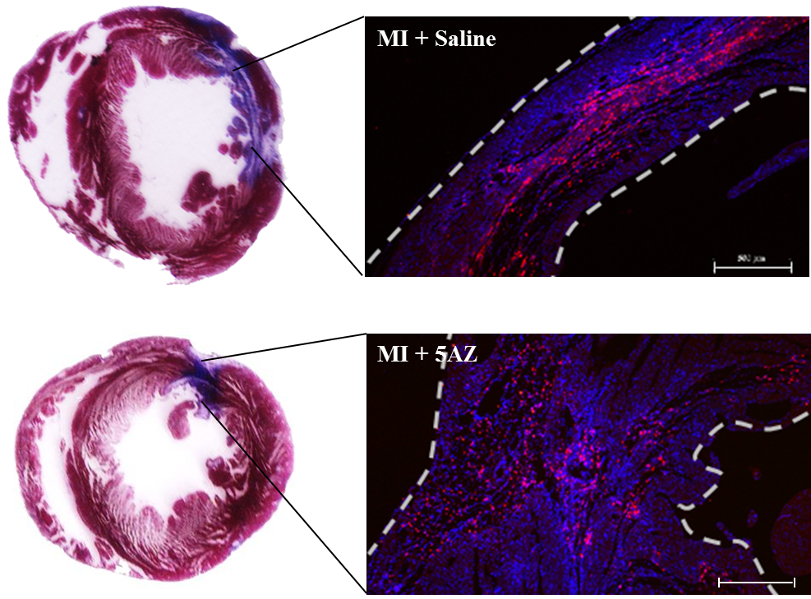
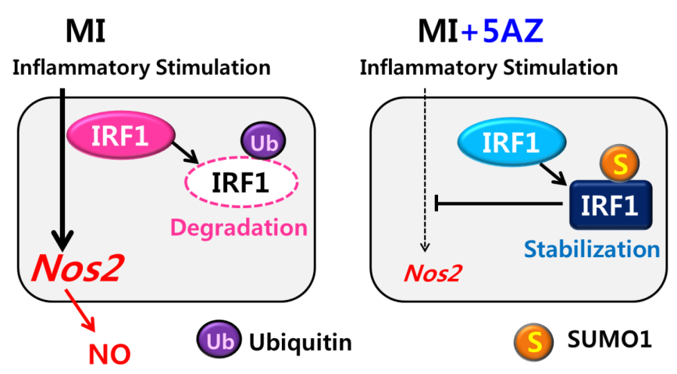
Cardioprotection by 5-Azacytidine via Macrophage Modulation
Kim, Ahn et al., J Cell Mol Med 2013
Jeong, Ahn et al., Nature Sci Rep 2015

Slide 4
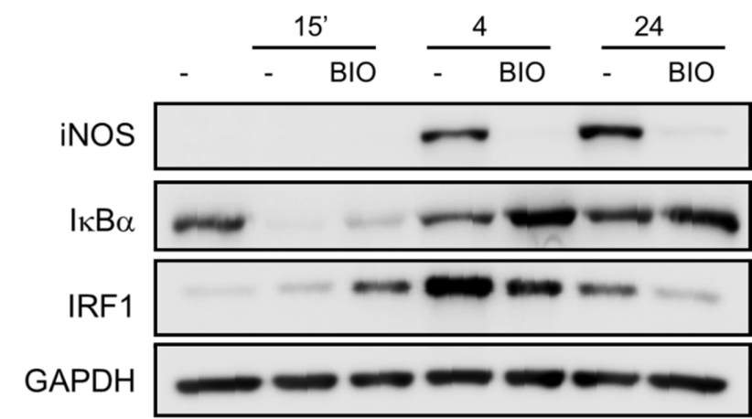
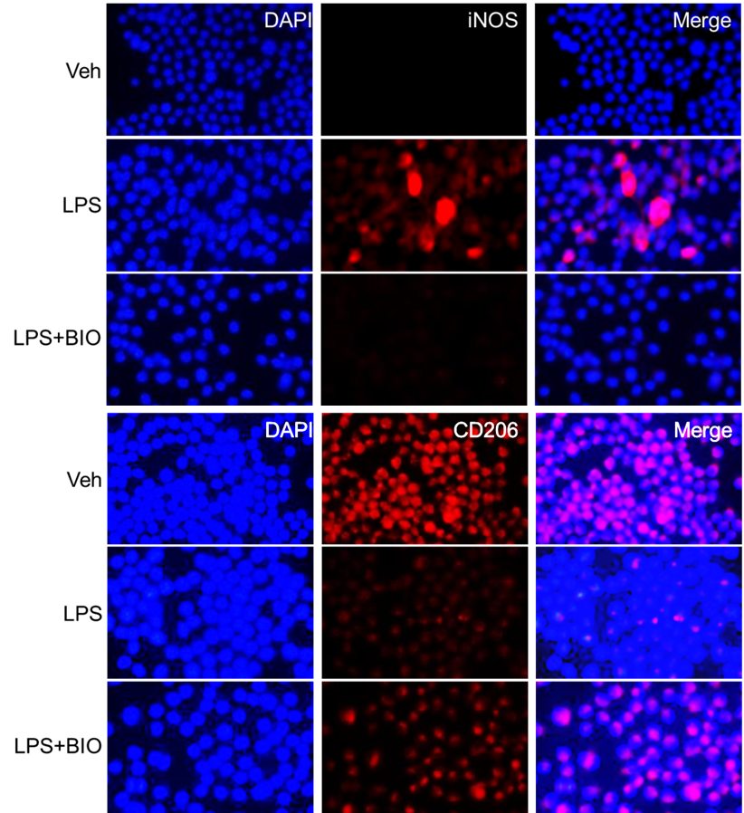
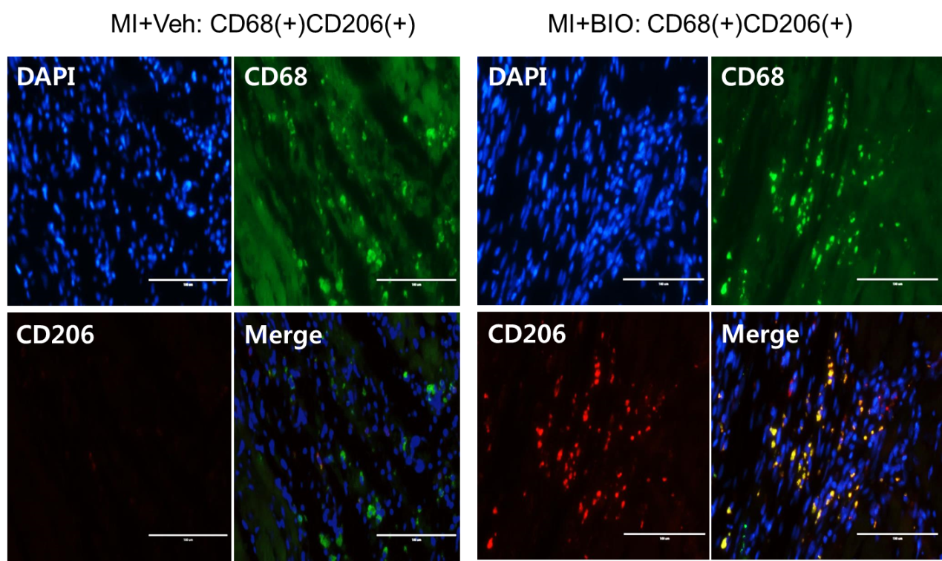
Selective Inhibition of Pro-inflammatory Macrophages by BIO
Ahn et al., Nature Sci Rep 2016

Slide 5
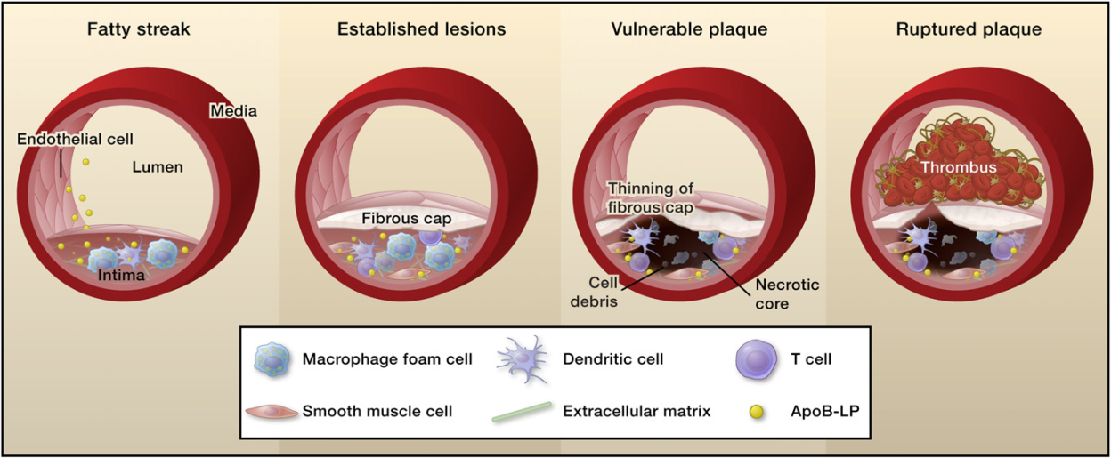
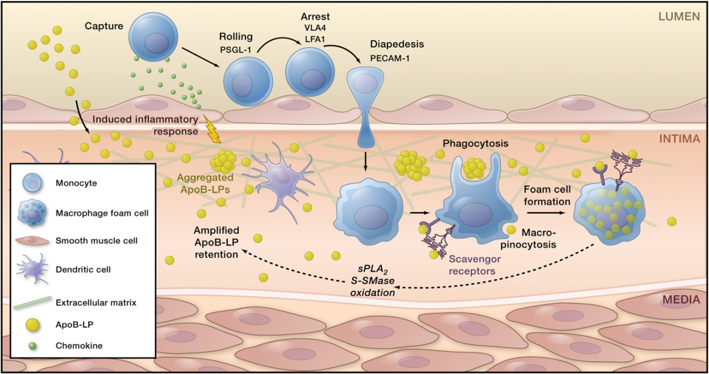
Macrophages in Atherosclerosis
Activation of Endothelial Cells
Recruitment of Monocytes
Differentiation to Macrophage
Uptake of oxidized LDL
Differentiation to Foam cells
Cell. 2011;145:341-55
Research Laboratory of Cardiovascular Regeneration
Notes:
macrophage의 foam cell 형성이 동맥경화의 주요원인으로 알려져 있음.
동맥경화 발생기전을 살펴보면,
내피세포의 활성화로 인해 분비된 cytokine이 monocyte의 유입을 촉진시키고 유입된 macrophage가 병변부위의 oxidized LDL을 흡수하여 foam cell이 됨.
Foam cell이 축적되어 동맥경화가 진행됨.

Slide 6
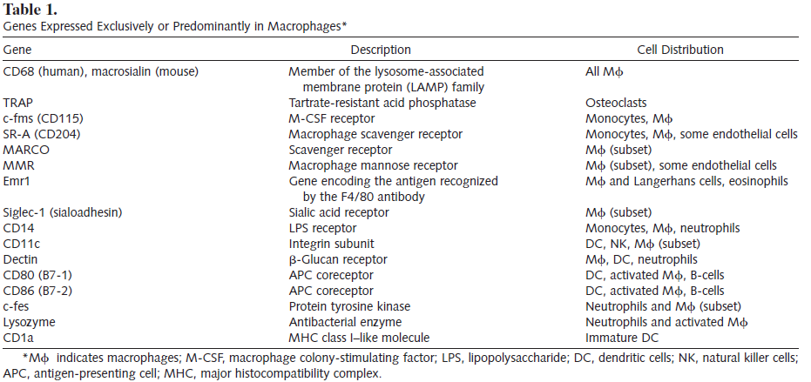
Macrophage-Specific Promoters
Int J Hematol. 2002;76:6-15
Research Laboratory of Cardiovascular Regeneration
Notes:
일찍부터 마크로파지에 특이적인 프로모터를 발굴하고자 하는 노력들이 있어왔었으며, 많은 macrophage의 receptor 프로모터들이 알려짐.

Slide 7
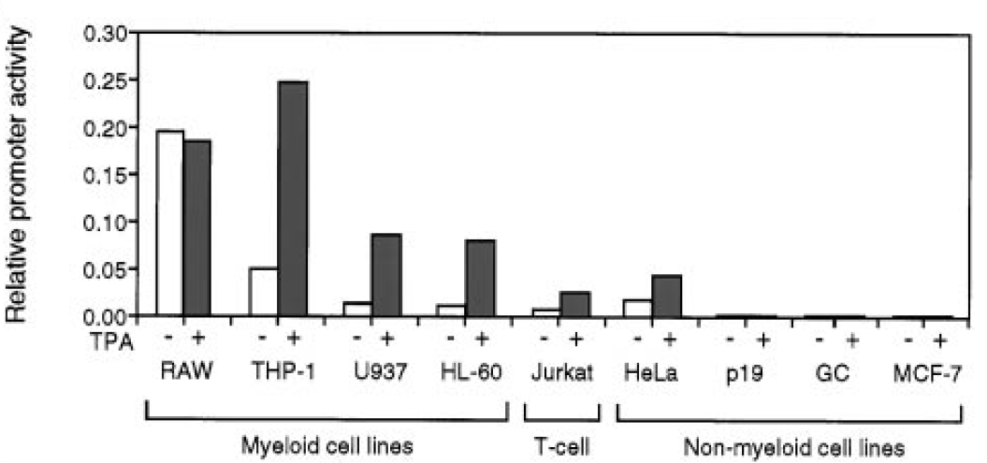
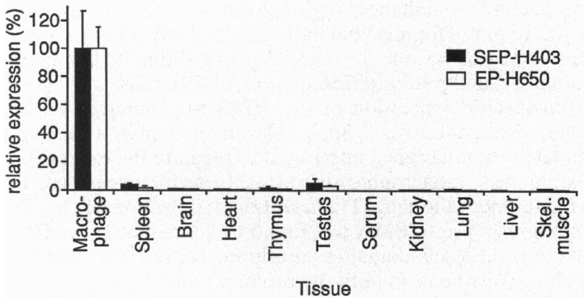
Macrophage-Specific Promoters
▪ Macrosialin (CD68) promoter
▪ SR-A promoter
J Biol Chem. 1998;273: 5389-99
PNAS. 1995;92:5391-95
Research Laboratory of Cardiovascular Regeneration
Notes:
특히 CD68 promoter와 scavenger receptor-A promoter가 대표적인 macrophage specific promoter 로 알려졌음.
The cell types used were RAW
264.7 (murine monocyte), THP-1 (monocytic leukemia), U937 (histocytic
leukemia), HL-60 (promyelocytic leukemia), Jurkat (T cells), HeLa
(cervical endothelial), P-19 (mouse embryonic carcinoma), MCSF-7
(breast adenocarcinoma), and GC-3 (anterior pituitary).
The macrosialin promoter and 7.0 kilobase pairs
of 5*-flanking information direct high levels of reporter
gene activity in monocyte/macrophage-like cells, but little
or no expression in nonmyeloid cells.
The Macrosialin Promoter Is Preferentially Expressed in Myeloid
Cells—To begin to characterize transcriptional regulatory
elements that control macrosialin expression, a 7.0-kb fragment
of the 59-flanking region of the macrosialin gene containing
the transcriptional start sites was linked to a luciferase
reporter gene and transiently transfected into myeloid and
nonmyeloid cells (Fig. 4A). The activity of the macrosialin promoter
was normalized to the activity of the b-actin promoter to
correct for different transfection efficiencies observed in the
various cell types. As shown in Fig. 4A, the macrosialin promoter
displayed a preferential activity in myeloid cell lines
versus nonmyeloid cells lines. RAW cells, which represent a
macrophage-like cell, demonstrated the highest levels of basal
promoter activity. High levels of expression were also observed
in the monocytic THP-1 cells and U937 which, represent monoblast-
like cells. The macrosialin promoter was also expressed in
HL-60 cells, which are capable of differentiating into either
monocyte, macrophage, or granulocyte-like cells in response to
vitamin D, TPA, or retinoic acid, respectively (30, 31). Jurkat
cells exhibited the lowest level of promoter activity among the
hematopoietic cell lines. Treatment of HL60, U937, and THP-1
cells with TPA to induce macrophage differentiation increased
the level of promoter activity in each of these cell lines by
3–5-fold. The results are consistent with the effect of TPA on
CD68 protein levels observed in THP-1 cells (16).
Transcription of the macrophage scavenger
receptor A gene is markedly upregulated during monocyte to
macrophage differentiation. In these studies, we demonstrate
that 291 bp of the proximal scavenger receptor promoter, in
concert with a 400-bp upstream enhancer element, is sufficient
to direct macrophage-specific expression of a human
growth hormone reporter in transgenic mice.

Slide 8
Comparisons of Macrophage-Specific Promoters
Human Gene Therapy. 2006;17:949-59
Low
Specificity
Low
Efficacy
Long
Sequences
Research Laboratory of Cardiovascular Regeneration
Notes:
그러나 이 프로모터들을 gene therapy에 활용하기 위해 각각의 활성을 비교해본 결과 그 특이성 및 효율성이 충분치 않았고, 서열 자체도 너무 길었음.
Comparison of promotor activity in myeloid cells and non-myeloid cells

Slide 9
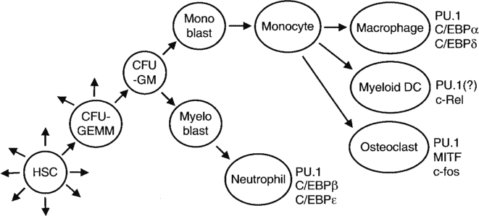
Macrophage-Specific Elements
Int J Hematol. 2002;76:6-15
Research Laboratory of Cardiovascular Regeneration
Notes:
그래서 hematopoietic stem cell lineage를 따라 macrophage로 분화하는 과정에서 가장 macrophage에서 활성을 보이는 전사인자 및 binding site에 관심을 가짐.
PU.1, C/EBP, SP1 등의 element가 hematopoietic cell로부터 macrophage로 분화할수록 활성이 높아지는 것을 발견함.

Slide 10
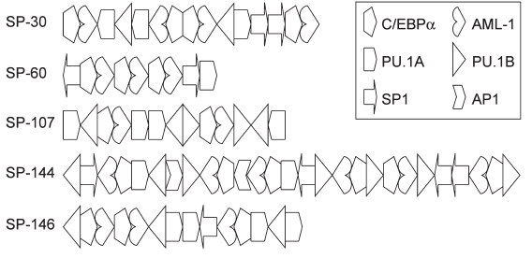
Macrophage-Specific Elements
Human Gene Therapy. 2006;17: 949-59
Research Laboratory of Cardiovascular Regeneration
Notes:
macrophage specific element들로 구성한 합성 프로모터를 제작하고자
총 6가지 element를 선정하였고 이를 랜덤으로 조합하여 최적의 구성을 확인하였음.

Slide 11
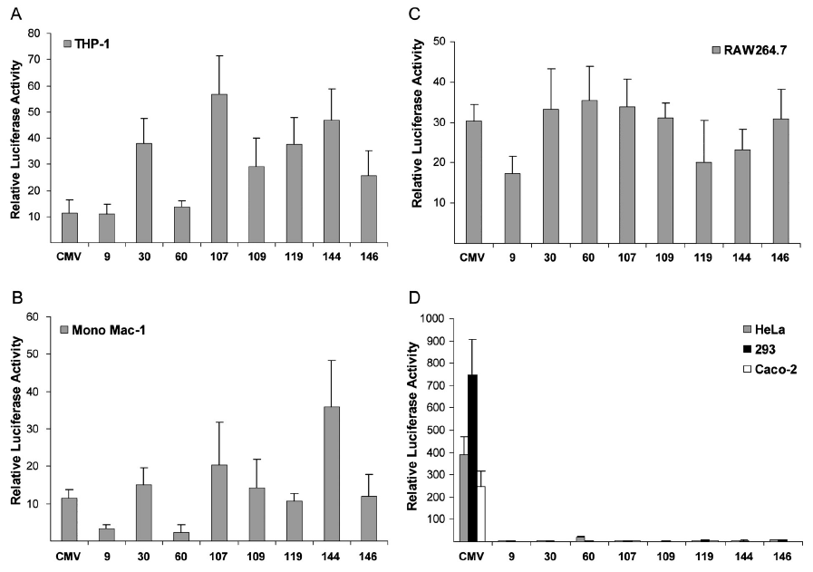
Synthetic Promoters
Human Gene Therapy. 2006;17:949-59
Research Laboratory of Cardiovascular Regeneration
Notes:
대부분의 후보들이 macrophage에 특이성을 나타내었고 이 결과에서 우리는 107과 146 두 클론에 주목하였음.
이 두 프로모터는 NCBI 에 등록이 되어있음.

Slide 12
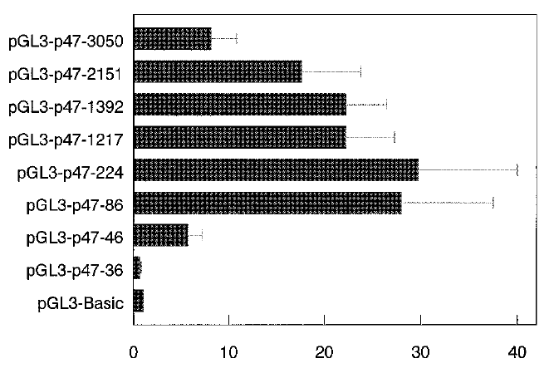
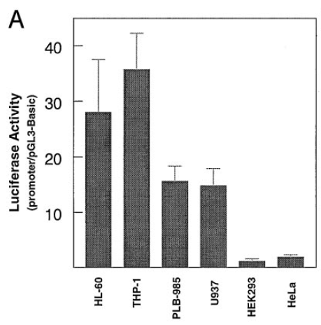
Importance of PU.1 Site in P47^{phox} Promoter
J Biol Chem 1997; 272(28):17802-9
P47^{phox} Partial Promoter
PU.1 site
-86
-46 ~ -41
+52
Transcription Initiation
Translational Initiation
Research Laboratory of Cardiovascular Regeneration
Notes:
합성 프로모터에는 전사 시작점이 없기 때문에 basal promote가 필요하였음.
P47phox promoter의 partial region이 가장 좋은 특이성 및 활성을 보였기 때문에 이를 basal promote로 사용하고자 함.

Slide 13
Construction of Synthetic Promoters
SP107
SP107-C1
SP107-C2
SP107-C3
SP146
SP146-C1
SP146-C2
SP146-C3
SP107
Luc
SP107
P47 (-86~+52)
Luc
SP107
P47 (-86~+52)
Luc
SP107
P47 (-86~+1)
Luc
SP146
Luc
SP146
P47 (-86~+52)
Luc
SP146
P47 (-86~+52)
Luc
SP146
P47 (-86~+1)
Luc
Research Laboratory of Cardiovascular Regeneration
Notes:
총 8개의 프로모터를 다음과 같이 디자인하였고
C1은 P47프로모터와 translation initiation site와 정확히 이어주도록 디자인 함.
C2는 translation initiation site 사이에 non-specific sequence를 넣어 추후 multi cloning site의 활용가능성을 보고자 함.
C3는 mRNA의 regulatory 서열을 제거하여 프로모터 활성에 어떤 영향을 주는지 확인해보고자 함.
SP107 and SP146 were inserted in front of p47phox elements containing PU.1 site

Slide 14
Promoter Activities of Synthetic Promoter
Macrophage Specificity
Research Laboratory of Cardiovascular Regeneration
Notes:
각각의 프로모터를 non-macrophage cell line인 293T, HeLa와 macrophage cell line인 RAW264.7 세포에 발현시켜 프로모터 활성을 비교함.
SP146-C1 프로모터가 non-macrophage cell line에서 낮은 발현을, macrophage cell line에서 높은 발현을 보였고 그 차이가 가장 크게 나타났음.
gene therapy에 활용하기 위해서는 특이성 뿐만 아니라 발현 능력도 좋아야 하기 때문에 발현 효율이 더 좋은 SP146-C1 프로모터가 치료벡터의 개발에 선택되었음.
Highest level of efficacy and specificity for macrophages

Slide 15
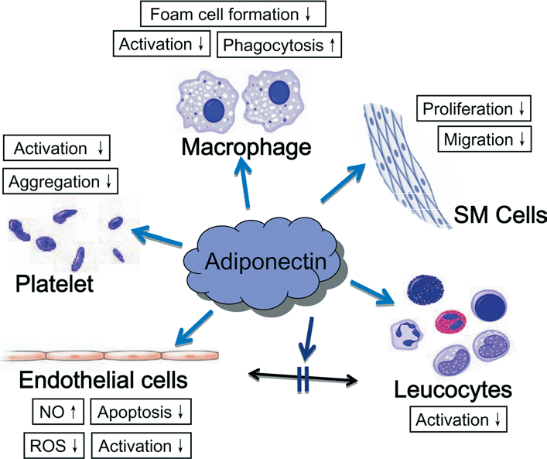
Protective Roles of Adiponectin
Clin Sci (Lond). 2008;114:361-74
Research Laboratory of Cardiovascular Regeneration
Notes:
Adiponectin is a protein hormone that modulates a number of metabolic processes, including glucose regulation and fatty acid oxidation.^{[5]}
동맥경화의 치료에 활용하기 위한 유전자로는 아디포넥틴을 선택하였음.
아디포넥틴은 anti-atherogenic, anti-diabetic, anti-inflammatory 활성 등 다양한 protective function 을 가지고 있음.

Slide 16
Constructs of Lentiviral Vectors for Adiponectin Expression
Lenti-GFP
Lenti-SP-GFP
Lenti-APN
Lenti-SP-APN
5’LTR
RRE
cPPT
CMV
GFP
PRE
3’LTR
5’LTR
RRE
cPPT
SP146
P47(-86~+52)
GFP
PRE
3’LTR
5’LTR
RRE
cPPT
CMV
Adiponectin
PRE
3’LTR
5’LTR
RRE
cPPT
SP146
P47(-86~+52)
Adiponectin
PRE
3’LTR
Kang, Ahn et al. Gene Ther 2014;21:353-62
Research Laboratory of Cardiovascular Regeneration
Notes:
질환동물모델에 적용하기 위해 다음과 같이 바이러스를 제작함.
To apply to atherosclerosis, SP146-C1-APN lentivirus was generated and its atherogenic function was verified.
APN gene combined with SP146-1 was extracted from SP-APN and was inserted into Lenti-X2 vector.

Slide 17
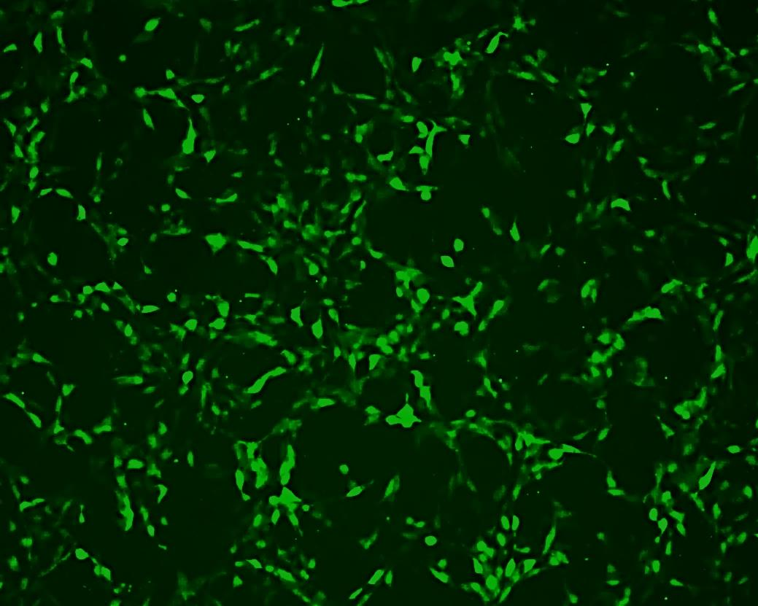
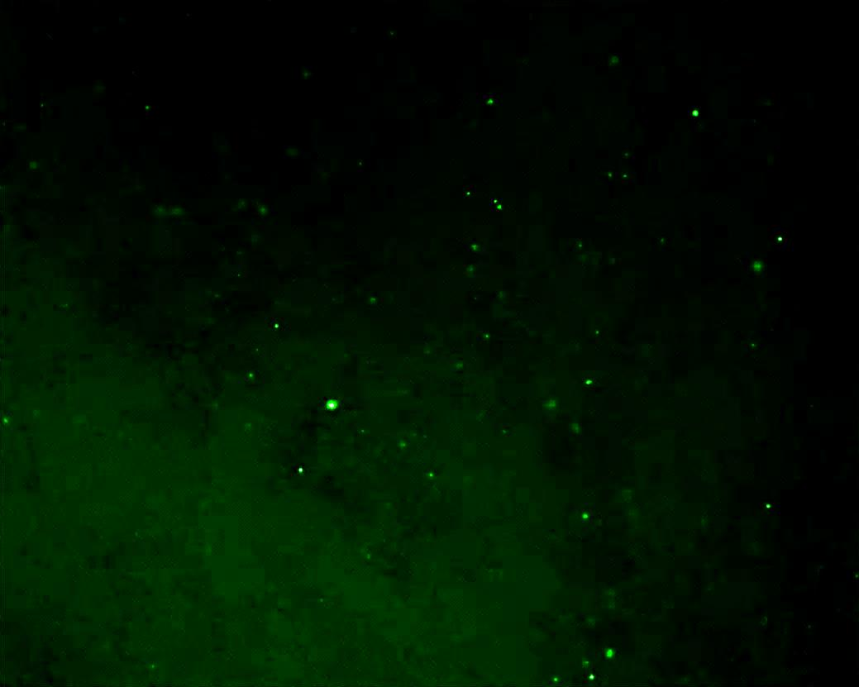
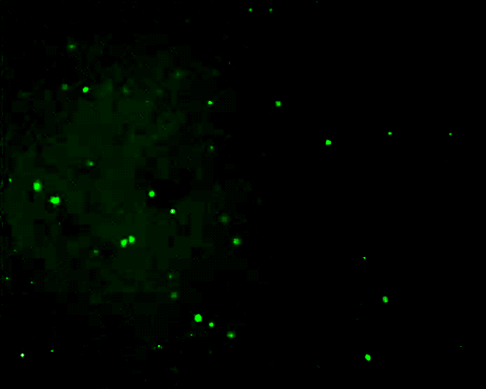
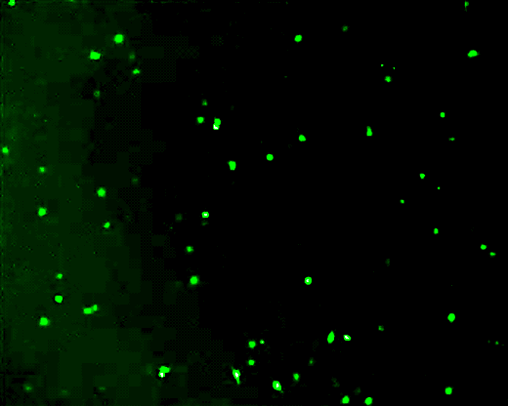
GFP expression in 293T and RAW264.7 Cells
Lenti-GFP Lenti-SP-GFP
293T
RAW
264.7
100μm
100μm
100μm
100μm
x200
Research Laboratory of Cardiovascular Regeneration
Notes:
먼저 바이러스의 세포특이성을 확인함.
293T와 RAW세포에 GFP, SP-GFP 렌티바이러스를 감염시킨 후에 GFP 발현을 형광현미경으로 확인해 보니,
SP-GFP를 감염시켰을 때 293T 세포의 GFP는 거의 나타나지 않았고 RAW세포는 잘 발현되었음.

Slide 18
GFP expression in 293T and RAW264.7 Cells
mRNA Ratio (SP-GFP/GFP)
**
Lentiviral Infection
293T RAW264.7
GFP SP-GFP GFP SP-GFP
GFP
GAPDH
293T RAW264.7
*P<0.05, *P<0.01, *P<0.001
Research Laboratory of Cardiovascular Regeneration
Notes:
PCR로 이 때 GFP mRNA 발현 수준을 검증한 결과 역시 SP-GFP감염에 의해 293T는 낮은 발현을, RAW는 높은 발현을 보였음.

Slide 19
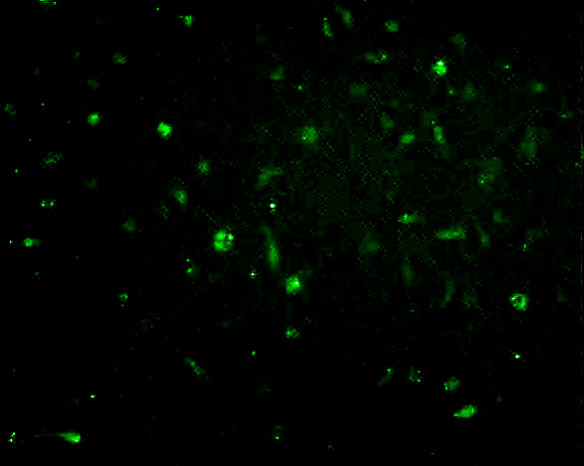
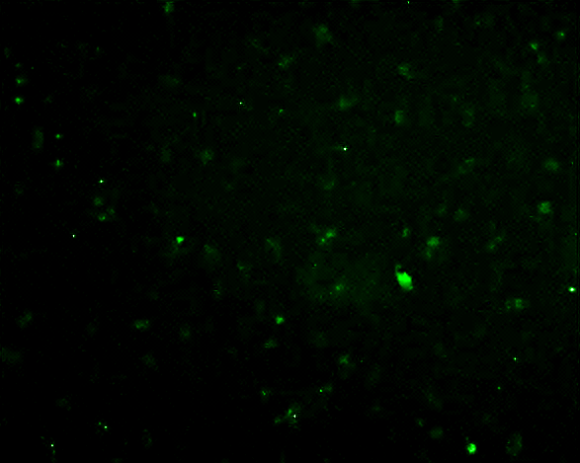
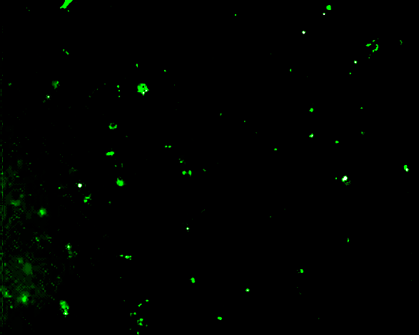
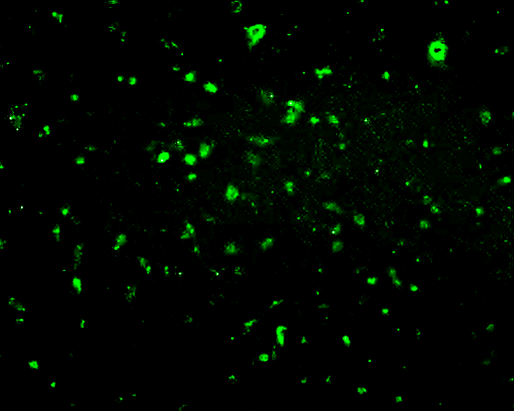
GFP expression in BM-MNC and BMDM
BM-MNC
Lenti-GFP Lenti-SP-GFP
BMDM
Lenti-GFP Lenti-SP-GFP
100μm
100μm
100μm
100μm
BM-MNC BMDM
BM-MNC BMDM
*P<0.05, *P<0.01, *P<0.001
Research Laboratory of Cardiovascular Regeneration
Notes:
바이러스의 macrophage 특이성을 primary cell에서 확인해 보고자 bone marrow에서 mononuclear 세포를 분리하여 바이러스를 처리함.
SP-GFP에 군은 GFP 발현이 낮았으나 이 세포에 MCSF를 처리하여 macrophage로 분화시켰을 때 GFP 발현이 증가되었음.
동일한 방법으로 luciferase, SP-luciferase 바이러스를 제작하여 분석한 결과 역시 macrophage로 분화되었을 때 높은 발현을 보였음.

Slide 20
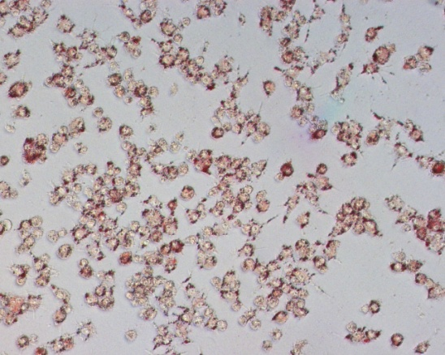
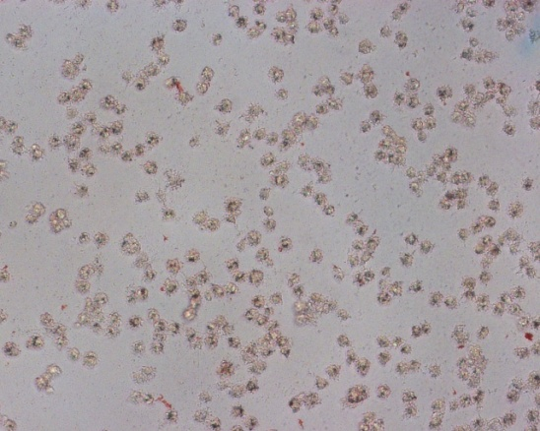
Lenti-SP-APN on Foam Cell Formation of RAW264.7
Lenti-SP-GFP+oxLDL
Lenti-SP-APN+oxLDL
100μm
100μm
Research Laboratory of Cardiovascular Regeneration
Notes:
therapeutic gene인 adiponectin 의 기능을 macrophage foam cell formation assay로 분석하였음.
adiponectin 발현에 의해 foam cell 형성이 억제된 것을 확인하였음.

Slide 21
Lenti-SP-APN on Foam Cell Formation and Adiponectin Levels
Relative Absorbance (518nm)
Adiponectin (ng/ml)
oxLDL - + +
oxLDL + +
Control
Lenti-APN
Lenti-SP-APN
*P<0.05, *P<0.01, *P<0.001
Research Laboratory of Cardiovascular Regeneration
Notes:
염색된 lipid의 흡광도를 측정한 결과 Lenti-SP-APN 군에서 확연히 감소하였음.
이때 adiponectin 농도를 측정하여 바이러스에 의해 adiponectin이 확실히 발현하였음을 검증함.

Slide 22
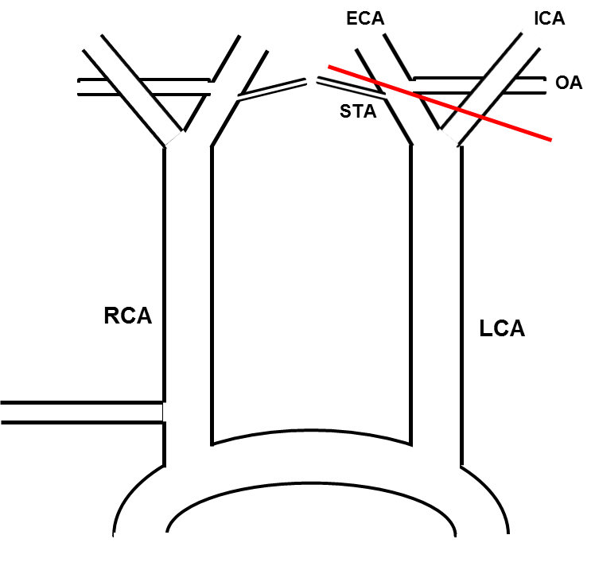
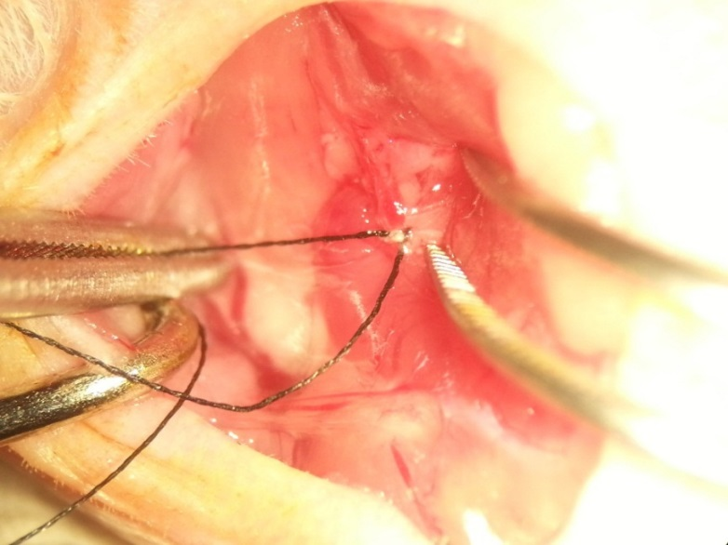
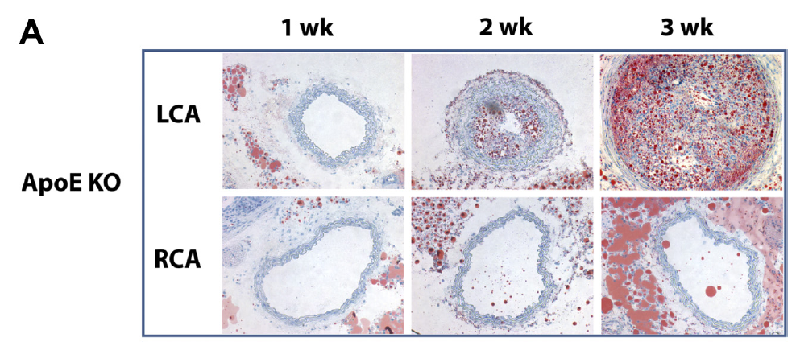
Atherosclerosis Model (Subtotal Occlusion)
Am J Physiol Heart Circ Physiol. 2009;297:H1535-43
Research Laboratory of Cardiovascular Regeneration
Notes:
SP-APN 바이러스의 효과를 확인하기 위해 동맥경화 모델을 제작함
ApoE KO 마우스에 left carotid artery의 4개 분지중 superior thyroid artery를 제외한 나머지 혈관을 결찰하는 수술을 한 뒤, cholesterol diet를 먹이면 주령에 따라 혈관내에 lipid가 축적되는 것을 볼 수 있음.

Slide 23
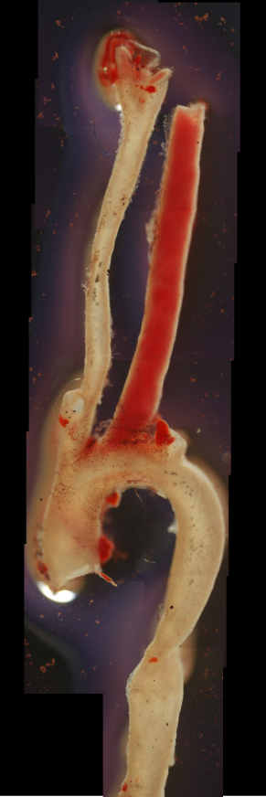
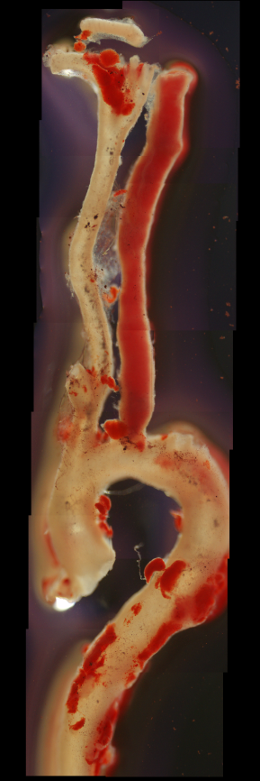
Lenti-SP-APN on Atherosclerosis Model
Lenti-GFP Lenti-APN Lenti-SP-APN
500 μm
Research Laboratory of Cardiovascular Regeneration
Notes:
2주 후 혈관에 Sudan IV staining 하여 lipid 축적을 확인함.
CMV 프로모터로 adiponectin을 발현시킨 그룹보다 macrophage specific 하게 adiponectin을 발현시켰을 때 확연히 lipid 축적이 감소함.

Slide 24
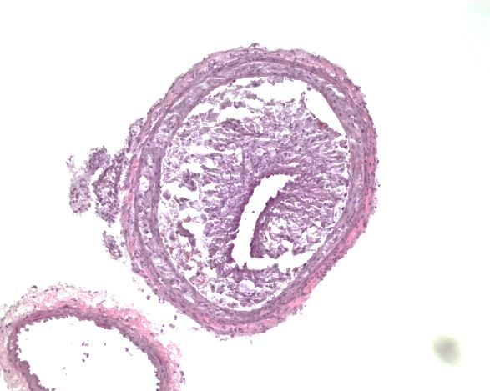
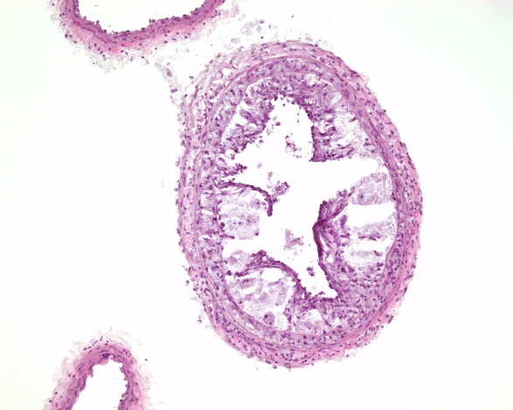
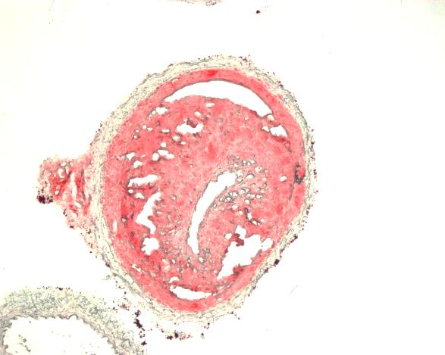
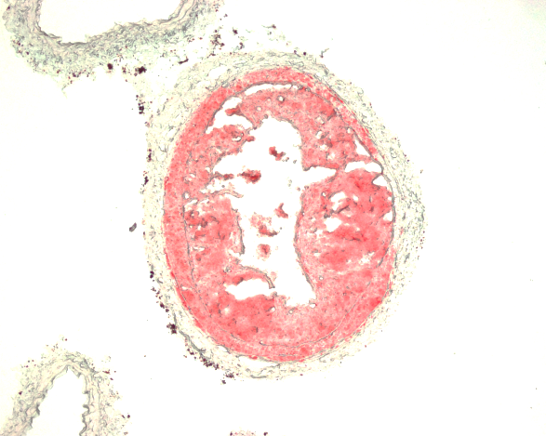
Lenti-SP-APN on Left Carotid Artery
Right Carotid
Left Carotid
Lenti-GFP
Lenti-APN
Lenti-SP-APN
H&E
100μm
100μm
100μm
100μm
Oil red O
100μm
100μm
100μm
100μm
Research Laboratory of Cardiovascular Regeneration
Notes:
혈관을 section 하여 Oil red O staining 을 한 결과에서도 역시 lipid 축적이 감소하고 혈관 remodeling도 감소하였음.

Slide 25
Lenti-SP-APN on Left Carotid Artery
Plaque Area (%)
Lenti-GFP
Lenti-APN
Lenti-SP-APN
*P<0.05, *P<0.01, *P<0.001
Research Laboratory of Cardiovascular Regeneration
Notes:
염색 결과를 가지고 plaque area를 측정했을 때에도 유의성 있는 결과를 얻음.

Slide 26
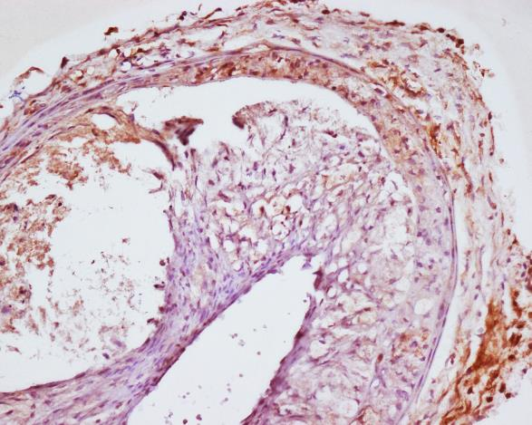
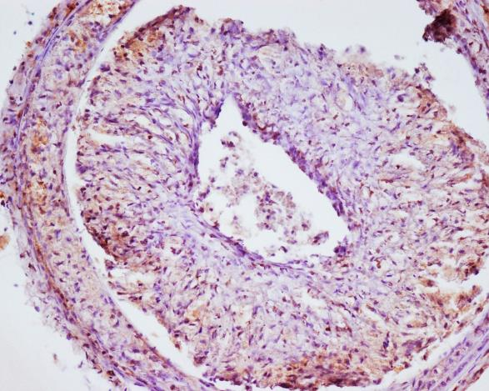
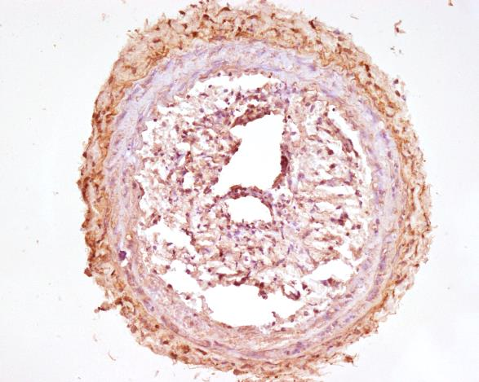
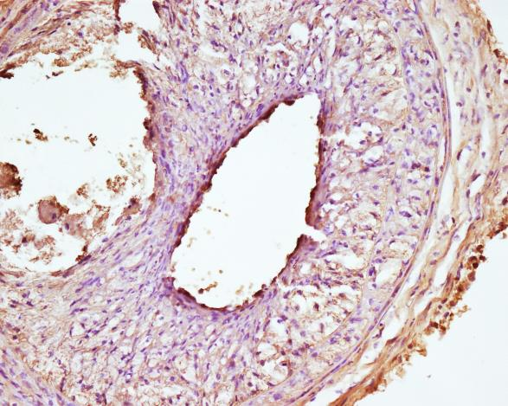
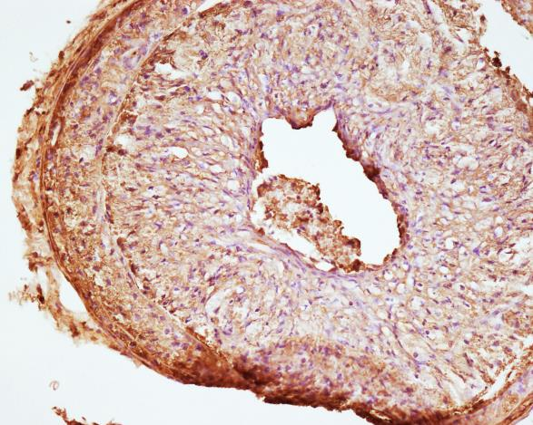
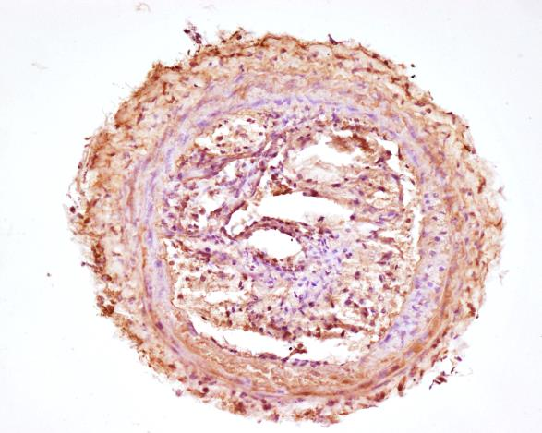
Distributions of Macrophages and Adiponectin
Lenti-GFP
Lenti-APN
Lenti-SP-APN
F4/80
100μm
100μm
100μm
Adiponectin
100μm
100μm
100μm
Research Laboratory of Cardiovascular Regeneration
Notes:
F4/80과 adiponectin 염색으로 macrophage의 위치와 adiponectin의 분포를 확인함.
병변 부위에서 macrophage가 골고루 관찰되었으며 SP-APN군에서 F4/80과 adiponectin 염색 위치가 일치하였음.

Slide 27
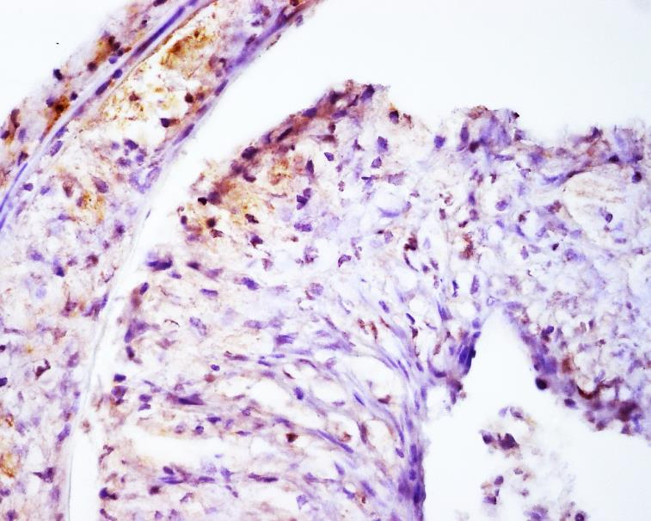
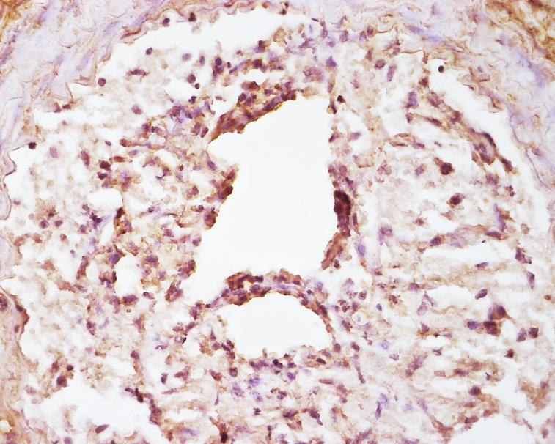
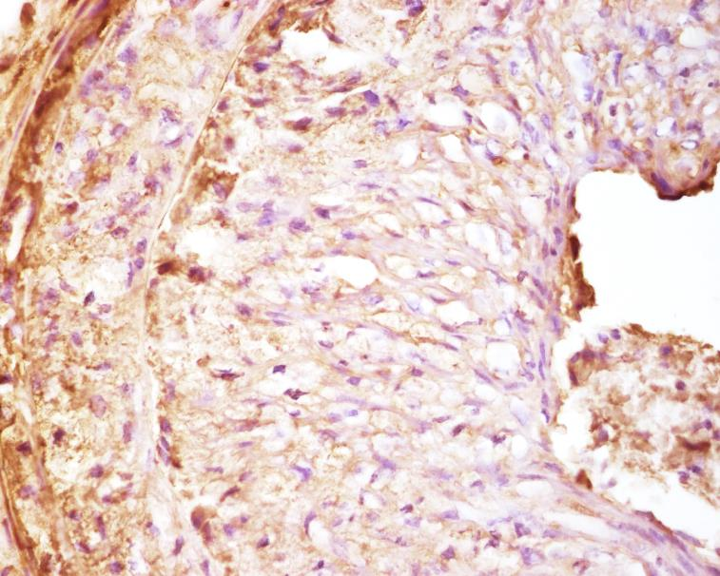
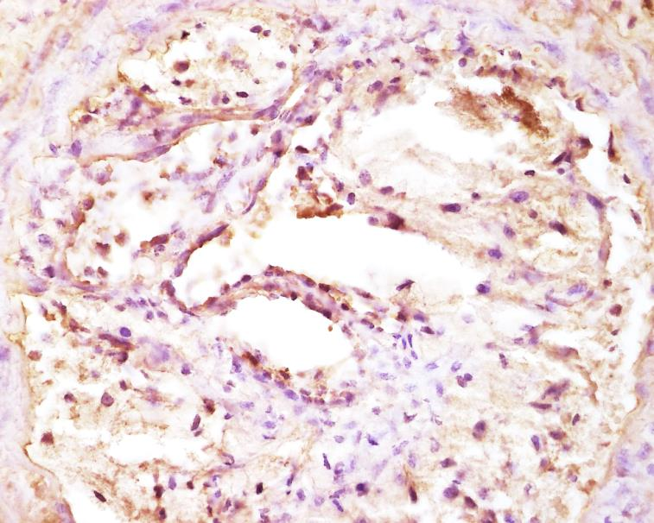
Distributions of Macrophages and Adiponectin
Lenti-APN
Lenti-SP-APN
F4/80
10μm
10μm
Adiponectin
10μm
10μm
Research Laboratory of Cardiovascular Regeneration
Notes:
F4/80과 adiponectin 염색으로 macrophage의 위치와 adiponectin의 분포를 확인함.
병변 부위에서 macrophage가 골고루 관찰되었으며 SP-APN군에서 F4/80과 adiponectin 염색 위치가 일치하였음.

Slide 28
SUMMARY
SP146-C1 was the most macrophage-specific and efficient promoter among candidates.
Accurate position of translation start site affected promoter specificity and efficiency.
Application of lentiviral SP-APN showed the macrophage-specific expression and inhibited foam cell formation.
Application of lentiviral SP-APN to atherosclerosis animal model showed that decreased lipid accumulation in atherosclerotic plaque.
Macrophage and adiponectin distributions were similar in Lenti-SP-APN. It means macrophage-specific expression of adiponectin.
Research Laboratory of Cardiovascular Regeneration

Slide 29
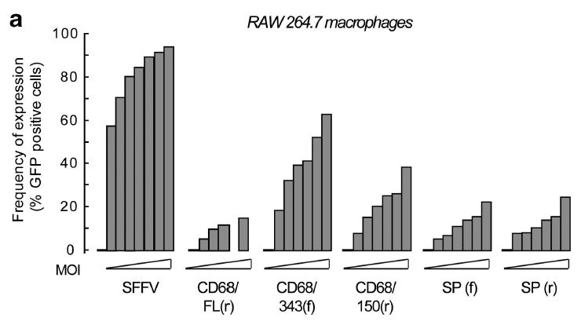
Partial Region of Human CD68 Promoter
Gene Therapy. 2012;19:1041-47
Partial region of human CD68 promoter showed increased efficacy and specificity in macrophages.
Notes:
2012년에 보고된 논문에 따르면 human CD68 프로모터를 일부만 사용했을 때, 크게 대식세포 특이성 및 효율성이 증가하였다고 보고하였음.
이에 착안하여 CD68 일부서열과 SP를 조합하여 더욱 효율적이고 강력한 대식세포 특이성 프로모터를 제작할 수 있을 것으로 예상함.
In gene therapy, tissue-specific promoters are useful tools to direct transgene expression and improve efficiency and safety.
Macrophage-specific promoters (MSPs) have previously been published using different delivery systems. In this study, we
evaluated five different MSPs fused with green fluorescent protein (GFP) to delineate the one with highest specificity using
lentiviral delivery. We compared three variants of the CD68 promoter (full length, the 343-bp proximal part and the 150-bp
proximal part) and two variants (in forward and reverse orientation) of a previously characterized synthetic promoter derived
from elements of transcription factor genes. We transduced a number of cell lines and primary cells in vitro. In addition,
hematopoietic stem cells were transduced with MSPs and transferred into lethally irradiated recipient mice. Fluorescence
activated cell sorting analysis was performed to determine the GFP expression in different cell populations both in vitro and
in vivo. We showed that MSPs can efficiently be used for lentiviral gene delivery and that the 150-bp proximal part of the CD68
promoter provides primarily macrophage-specific expression of GFP. We propose that this is the best currently available MSP to
use for directing transgene expression to macrophage populations in vivo using lentiviral vectors.

Slide 30
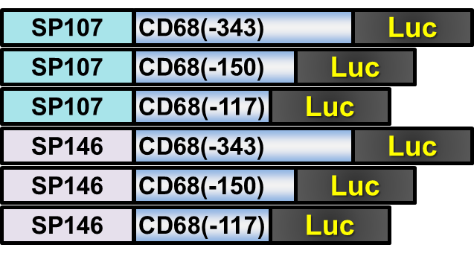
Construction of new SP candidates
Notes:
CD68 프로모터를 다음과 같이 세 길이로 나누어 각각 SP107과 SP146을 조합한 후보 프로모터를 제작하였음.

Slide 31
Promoter Activities of New Synthetic Promoters
Relative promoter activities
Relative promoter activities
RAW264.7/293T
Notes:
SP를 결합하지 않은 CD68 프로모터까지 한꺼번에 프로모터 활성을 비교하였음.
SP107-343 후보가 가장 뛰어난 대식세포 특이성을 보여주었으며, 이는 앞서 개발했던 SP146-C1에 비해서도 좀 더 개선되었음.
무엇보다 대식세포에서의 발현효율이 10배가량 향상되었음.

Slide 32
GFP Expression of New Synthetic Promoters
CMV-GFP
SPv2-GFP
293T
400μm
400μm
RAW264.7
400μm
400μm
x100
Notes:
편의상 SP107-343은 SPv2로 표현하였음. (기존에 만든 SP146-C1은 SPv1으로 표현)
SPv2-GFP 바이러스를 각각 감염시킨 결과 293T세포에서는 확연히 발현하지 않았고, RAW264.7세포에서는 안정적인 발현을 보여주었음.

Slide 33
GFP Expression of New Synthetic Promoters
293T
GFP | SPv2-GFP | GFP | SPv2-GFP | GFP | SPv2-GFP
5x10⁵ | 5x10⁵ | 2x10⁶ | 2x10⁶ | 10⁷ | 10⁷
RAW264.7
GFP | SPv2-GFP | GFP | SPv2-GFP | GFP | SPv2-GFP
5x10⁵ | 5x10⁵ | 2x10⁶ | 2x10⁶ | 10⁷ | 10⁷
GFP
GFP
β-actin
GAPDH
Fold changes
Fold changes
Notes:
바이러스를 농도별로 처리하고 PCR 및 qPCR로 분석한 결과에서도 동일한 결과를 얻었으며, RAW264.7세포에서는 CMV 프로모터보다 잘 발현하는 경향을 나타내었음.

Slide 34
Adiponectin Expression of New Synthetic Promoters
Fold changes
Fold changes
Notes:
(SP146-C1은 SPv1으로 표현)
치료 유전자로 adiponectin을 삽입한 뒤, 각각 CMV, SPv1, SPv2 adiponectin 바이러스를 제작하였음.
각각 293T 와 RAW264.7세포에 감염 후, adiponectin의 발현량을 비교하였음.
앞선 결과와 마찬가지로, SPv2-APN의 발현이 좀 더 개선된 것을 알 수 있음.

Slide 35
Atherosclerosis Model (Subtotal Occlusion)
Lenti-GFP Lenti-SPv2-APN
500 μm
Notes:
동일한 동맥경화 모델에 GFP와 SPv2-APN 바이러스를 10^8 IFU/개체 만큼 투여하고
2주 뒤에 혈관에 축적된 지질을 염색한 결과, 병변 발생이 뚜렷하게 억제된 것을 보여주었음.

Slide 36
SUMMARY
SP107-343 is more efficient macrophage-specific promoter than SP146-C1 which is previously reported by our group.
Adiponectin expression under SP107-343 successfully reduced atherosclerotic development.
Macrophage-specific expression of adiponectin will be confirmed by IHC and FACS analysis.
Novel SPs, especially when combined with lentivectors, are useful for macrophage-specific delivery of therapeutic genes.
Notes:
따라서, CD68 프로모터의 일부를 사용한 SP107-343은 기존에 제작했던 SP146-C1보다 더욱 효율적인 대식세포 특이적 프로모터임을 증명하였음.
이 프로모터에 Adiponectin을 적용했을 때, 확연히 동맥경화 발생을 억제하였음.
병변내의 바이러스의 대식세포 특이적 adiponectin의 발현은 추후 IHC와 FACS 분석을 통해 검증할 예정임.

Slide 37
Collaborators
Kook, Hyun, MD, CNUMS Darren R. Williams, PhD, GIST Kim, Hyo Soo, MD, SNUH Kim, Byung-Soo, SNU
Kwon, Sang Mo, PhD, BNU
Kim, Do Han, PhD, GIST
Oh, Goo-Taeg, PhD, EWU
Kim, Kwang Seok, MD, CNUH
Lee, Eun Ju, PhD, SNUH
Research professors,
postdoc
Kim, Yong Sook, PhD
Cho, Dong Im, PhD
Cho, Mi Young, PhD
Kang, Wan Seok, PhD
Thank you for your attention!

