Slide 1
Persistent myocardial inflammation due to intramyocardial haemorrhage in reperfused STEMI as a precursor to adverse LV remodelling
Dr Heerajnarain Bulluck
Research fellow
The Hatter Cardiovascular Institute, UCL, London, UK
National Heart Centre Singapore, Singapore
JCR 2016, Busan, South Korea

Slide 2
Contents
Background
Methods
Results
Conclusions

Slide 3
Background
Mortality has improved significantly with PPCI
Morbidity due to post-STEMI heart failure remains significant
Despite TIMI 3:
  microvascular obstruction (MVO) – 50%
  intramyocardial haemorrhage (IMH) – 40%
MVO and IMH are associated with adverse LV remodelling and worse clinical outcomes

Slide 4
IMH have been shown to result in residual myocardial iron within the MI zone and have been proposed to have cytotoxic and pro-inflammatory effects on the myocardium (Circulation Cardiovascular imaging. 2013;6(2):218-28.)
Whether changes in the ECM in the non-infarcted remote myocardium in STEMI patients reperfused by primary PPCI is linked to adverse LV remodelling remains incompletely understood
Notes:
The monoclonal antibody Mac387 stains, along with Perls stains, showed preferential
localization of newly recruited macrophages at the site of chronic iron deposition.

Slide 5

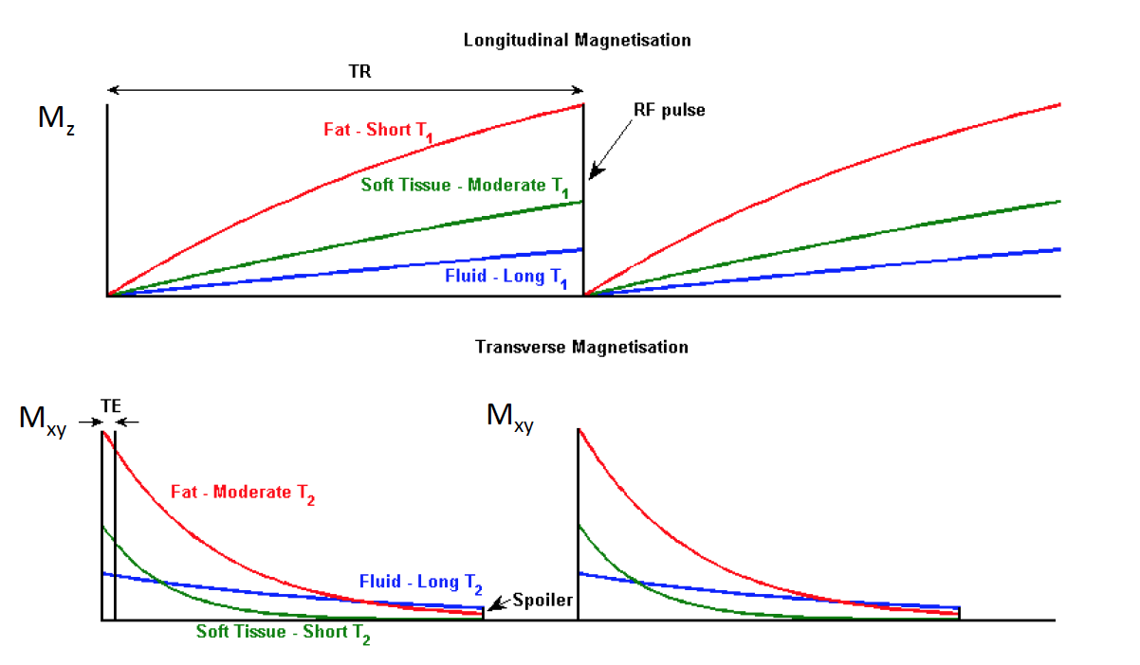
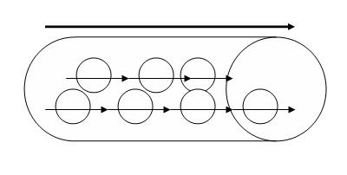
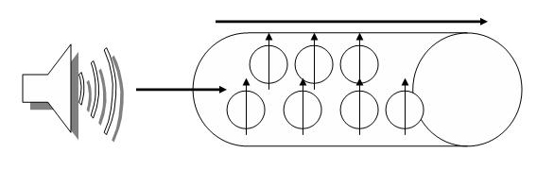
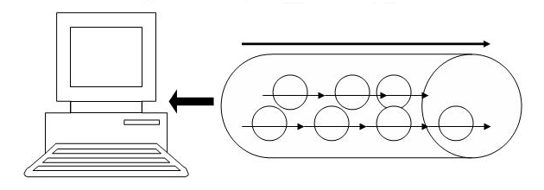
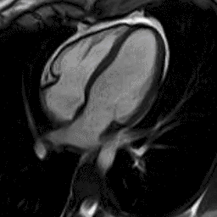
CMR basics
Excitation Pulse
T1 and T2/T2* relaxation

Slide 6
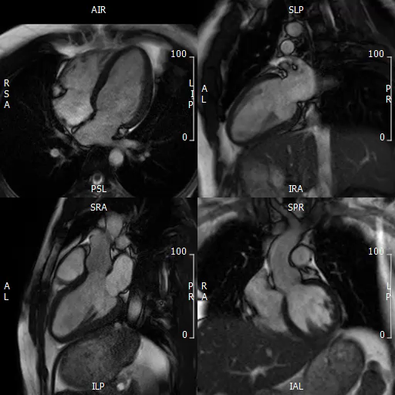
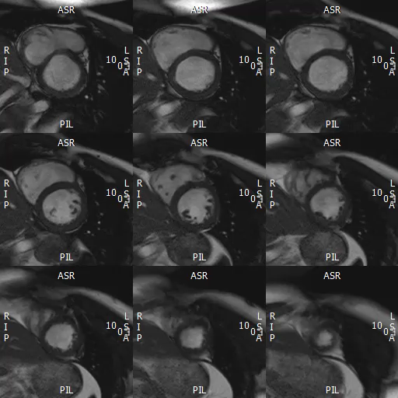
Volumes

Slide 7
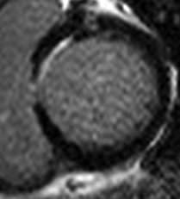
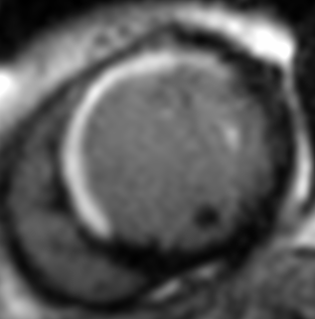
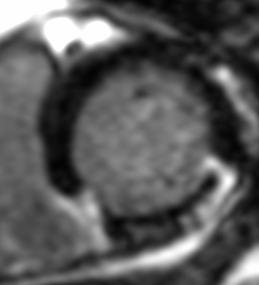
LGE
A
B
C
Small subendocardial
MI
Near transmural
MI
Transmural
MI with MVO

Slide 8

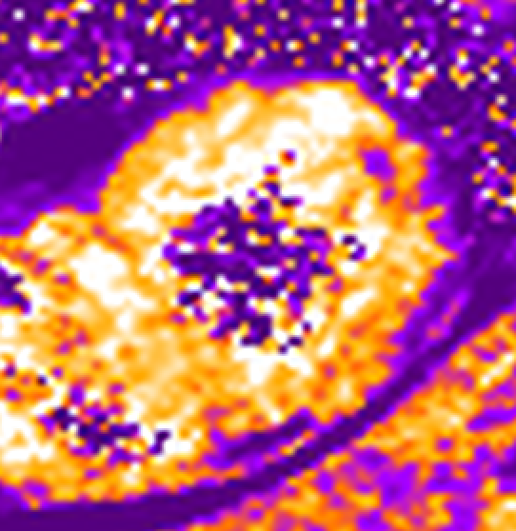
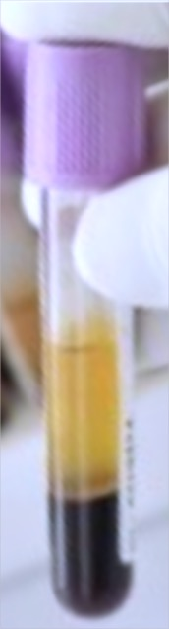
T2 map
Native T1 map
T2* map
Extracellular volume fraction
ECV_{blood}= 1 - HCT
Native T1
Post-contrast T1
ECV map

Slide 9
T1, T2, T2*, ECV
Oedema: increased T1 and T2 values
Scar: increased T1 and ECV values, normal T2
Intramyocardial haemorrhage/ residual iron: Reduced T2* values (Reduced T1, T2)

Slide 10
Salvaged myocardium
Area-at-risk
LGE
IMH
MI size
MVO
Remote myocardium

Slide 11
Hypothesis
Patients with adverse LV remodelling would more likely
  (a) have MVO/IMH on the acute scan;
  (b) have residual iron at follow-up;
  (c) have persistently high T2 around areas of residual iron that may suggest delayed infarct healing due to ongoing inflammation;
  (d) have higher ECV in the remote myocardium

Slide 12
Methods
40 reperfused STEMI patients underwent a CMR at 4±2 days and at 5±2 months post PPCI on a Siemens 1.5T scanner
Native T1 (MOLLI), T2, T2* and post contrast T1 maps (for ECV maps) were acquired
20 matched healthy volunteers served as controls
Adverse LV remodelling was defined as ≥20% increase in LV end-diastolic volume.

Slide 13
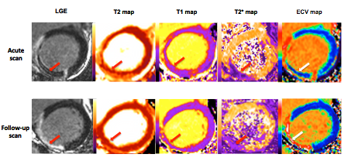

Slide 14
Results: infarct zone
MVO 65% ; IMH 54%
All patients with adverse LV remodelling (8/40, 20%) had MVO with IMH

Slide 15
87% of patients with IMH on the acute scans had residual iron and displayed higher T2 values in the surrounding infarct zone (T2: 61±4ms versus 53±4ms, P=0.001)

Slide 16
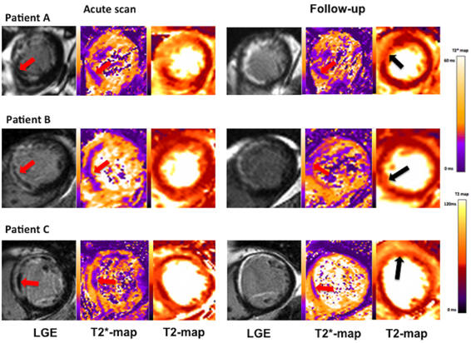

Slide 17
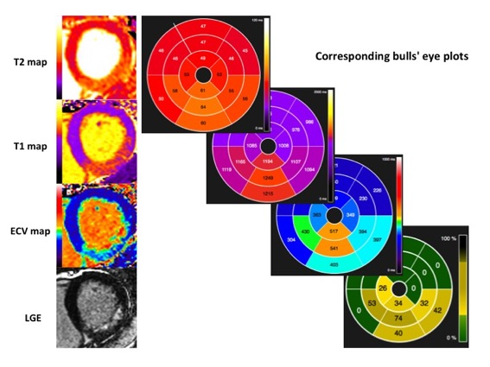
Results: remote myocardium
ECV_{Remote} was higher on the acute scan when compared to control (27.9±2.1% vs 26.4±2.1%, P=0.01), but this difference was non-significant at follow-up (27.0±2.1% vs 26.4±2.1%, P=0.30)

Slide 18
In the 8 patients with adverse LV remodelling, the ECV_{Remote} was higher on both the acute and follow-up scan when compared to those without adverse LV remodelling (acute scan: 29.5±1.4% vs. 27.4±2.0%; P=0.01; follow-up scan 28.6±1.5% vs. 26.6±2.1%; P=0.02)

Slide 19
Conclusions
The majority of patients with IMH had residual iron at follow-up, which was associated with adverse LV remodelling
Adverse LV remodelling itself was associated with delayed resolution of oedema in the MI zone that may be suggestive of ongoing inflammation
These patients also displayed expansion of the remote myocardial ECV as early as 4 days and persisted at 5 months
Patients with IMH or residual iron could be future potential targets for therapeutic interventions with anti-inflammatory agents or chelation therapy

Slide 20


Acknowledgements
The Hatter Institute, UCL, UK
Manish Ramlall
Steven White
Derek Yellon
Derek Hausenloy
UCLH/Barts Heart Centre, UK
James Moon
Anna Herrey
Charlotte Manisty
Stefania Rosmini
Amna Abdel-Gadir
Anish Bhuva
Thomas A Treibel
Steven K White
Marianna Fontana
Patricia Reant
Esther Gonzalez-Lopez
Manish Ramlall
Ashraf Hamarneh
Alex Sirker
Peter Kellman - NIH
Peter Weale - Siemens
British Heart Foundation

Slide 21
Circ Cardiovasc Imaging. 2016 Oct;9(10). pii: e004940.
Residual Myocardial Iron Following Intramyocardial Hemorrhage During the Convalescent Phase of Reperfused ST-Segment-Elevation Myocardial Infarction and Adverse Left Ventricular Remodeling.
Bulluck H, Rosmini S, Abdel-Gadir A, White SK, Bhuva AN, Treibel TA, Fontana M, Ramlall M, Hamarneh A, Sirker A, Herrey AS, Manisty C, Yellon DM, Kellman P, Moon JC, Hausenloy DJ.
J Am Heart Assoc. 2016 Jul 11;5(7). pii: e003555. doi: 10.1161/JAHA.116.003555.
Automated Extracellular Volume Fraction Mapping Provides Insights Into the Pathophysiology of Left Ventricular Remodeling Post-Reperfused ST-Elevation Myocardial Infarction.
Bulluck H, Rosmini S, Abdel-Gadir A, White SK, Bhuva AN, Treibel TA, Fontana M, Gonzalez-Lopez E, Reant P, Ramlall M, Hamarneh A, Sirker A, Herrey AS, Manisty C, Yellon DM, Kellman P, Moon JC, Hausenloy DJ.

