Slide 1
Neutrophil directly modulate fibroblasts function, promoting healing and scar formation after myocardial infarction
Heart Attack Research Team – HeART
Dr. Dr. Elisa A. Liehn
Institute for Molecular Cardiovascular Research, University Hospital Aachen
Germany
BUSAN 2016

Slide 2
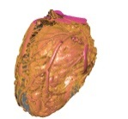
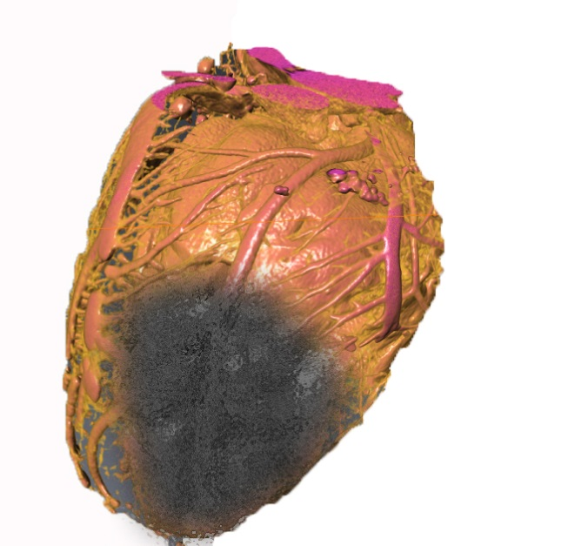
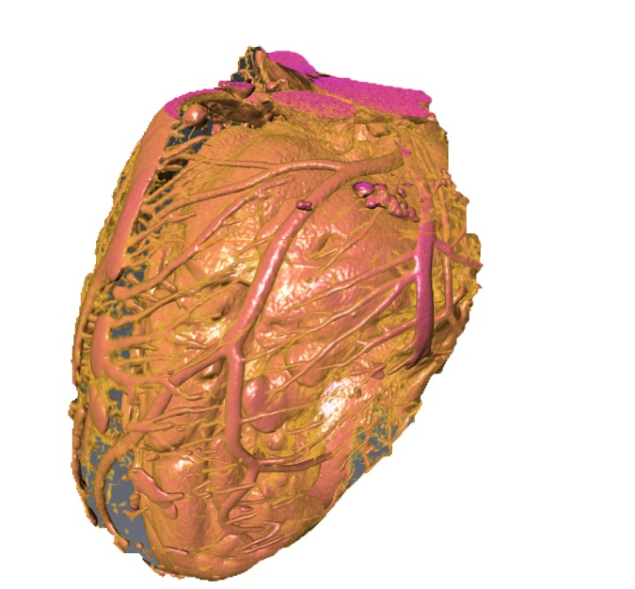
Myocardial infarction
Death of the myocardial tissue as a result of blockage of a coronary artery, usually because of atherosclerotic changes of the vessel wall, or thrombosis.

Slide 3
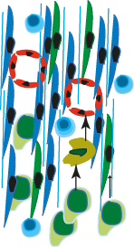
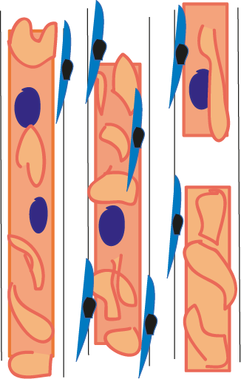
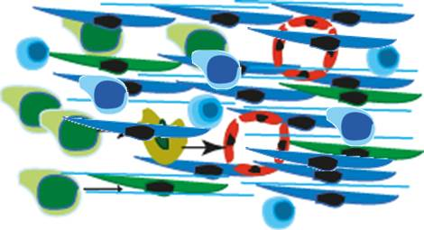
Myocardial infarction
Normal Myocardium
Inflammatory
Phase
Proliferative
Phase
Healing
Phase
TGF-ß1
0
1
2
3
4
Time course (weeks)
Liehn et al, J Am Col Cardiol, 2011
Notes:
After the acute ischemic event, the cardiomyocytes are severely affected, which induce a dramatic upregulation of all kind of cytokines and chemokines, followed by a complex inflammatory reaction. Neutrophils are comming first, followed by moncytes. Simultanously, the myofibroblasts start to proliferate and produce a provisional matrix.
A decisive moment for all these processes is represented by the induction of TGF-ß1, which stop the inflammatory reaction and permit the proliferative phase to continue and to develop the mature scar.
But that is what is happend inside the affected area. What happend in the remote area?
50 sec

Slide 4
Neutrophils
are recruited to the site of injury within minutes, and are the hallmark of acute inflammation
at the site of injury, they degranulate, releasing pro-inflammatory factors and increasing the cellular damages (neutrophil induced-injury)
release of network-like structures of DNA (Neutrophil extracellular traps - NETs), serving as a physical barrier that prevents further spread of inflammation

Slide 5
Neutrophils
reducing neutrophil infiltration preserves heart function and decreases infarction size in experimental studies
Horckmans et al. Neutrophils orchestrate post-myocardial infarction healing by polarizing macrophages towards a reparative phenotype, European heart journal, 2016
Giugliano et al, Meta-analysis of corticosteroid treatment
in acute myocardial infarction, Am J Cardiol, 2003
Silverman et al, Relation between use of anti-inflammatory agents and left ventricular free wall rupture during acute myocardial infarction, Am J Cardiol, 1987
Inflammatory cells
Neutrophil-induced injury
Inflammatory mediators
Heart function
Impaired healing
Deterioration of heart function
Cardiomyocytes survival
Infarction size
Minimizing the infarction size
Heart rupture
Notes:
Reducing the neutrophil number will…
Therefore the scientists tried to reduce the inflammatory….., and thus improving …..
However, appling anti-inflammatory strategies in clinical studies had catastrophic results, such as….
Therefore, before designing anti-inflammatory strategies, we shoud better understand the mechanismen behind the healing and scar formation

Slide 6
Notes:
And actually, we know very few about the relation between the nfallmation and scar formation or fibrosis in myocardial infarction
In a litarature research over the last 10 years, we see that this issue is poor studied. All information which we have are mostly from cancer or tumor reserach
In this scheme, the biggest the word, the more study is and the nearst the words are, the better is known the relation between them. As you see only starting with 2013 the scientific community was interested to study this relation in heart diseases.

Slide 7
Fibrosis
Inflammatory reaction
Notes:
Shortly, we know that extracellular matrix fragments …..
We also know that inflammatory reaction …..
But how exactly we do not know. Therefore we plan to study this issue in more detail.

Slide 8
Experimental Setting
PBMC
Blood
Neutrophils
Fibroblasts
Fibroblasts
Fibroblasts
+Ne
+Mo
Notes:
We isolated cardiac fibroblasts and cultured them, we also isolate neutrophils and monocytes by gradient centrifugation from mpuse blood and coincubated with the cardiac fibroblasts.

Slide 9
Experimental Setting
Normal 20% O₂
Hypoxia 2% O₂
Fibroblasts
Fibroblasts
Fibroblasts
Fibroblasts
Fibroblasts
Fibroblasts
+Ne
+Mo
+Ne
+Mo
Notes:
The study them in normal condition, as well as in hypoxic conditions.

Slide 10
unpublished
Notes:
First we were interested in extracellular matrix protein formation, because this is the main function of the fibroblasts. We see that, while hypoxia conditions perse and monocytes increase collagen synthesis, neutrophil inhibited it. These results were also confirmed by finding collagen protein by mass spectometrie analysis only in the fibroblasts incubated with mnocytes, but not in the fibroblasts coincubated with neutrophils.
Moreover, F co with Ne showed increased synthesis of fibronectic and biglycan, which are the main components of the provisional matrix, formed imediately after MI. These results are also confirmed by mass spectometrie, where we found protein expression of fibronectin and biglycan only in the fraction incubated with Ne.

Slide 11
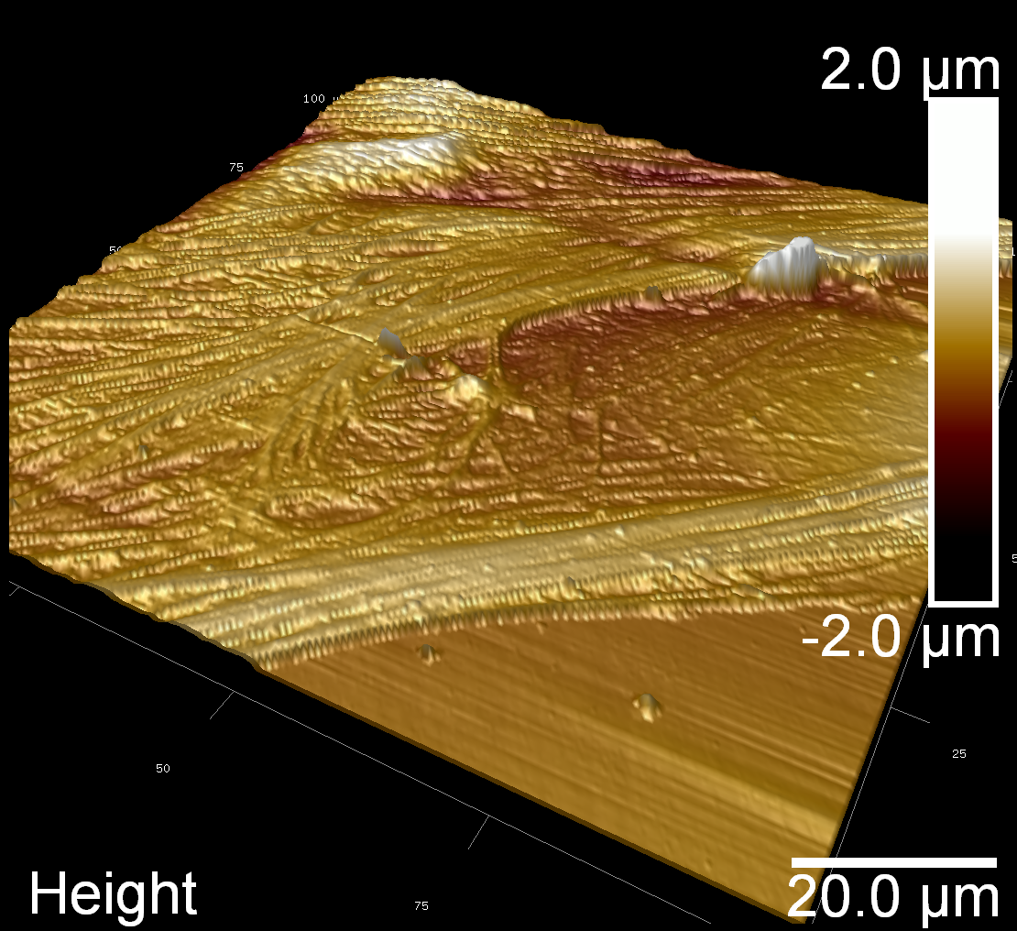
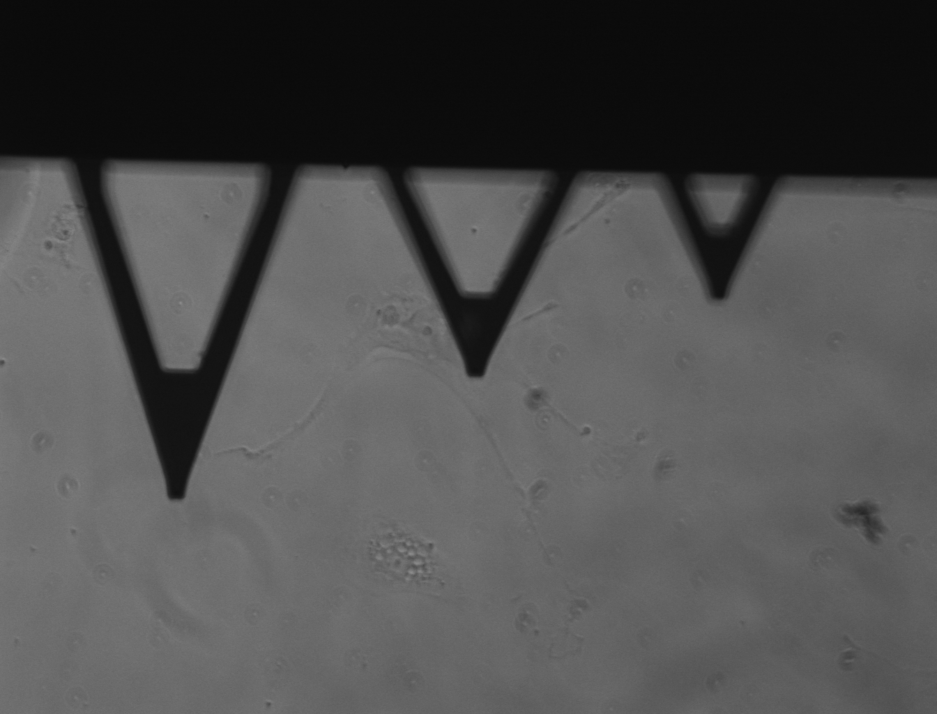
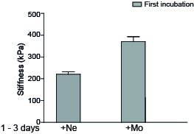
AFM
unpublished
Notes:
Another important function of fibroblasts is to determine the stiffnes of the scar. Therefore we measure the stiffness of the fibroblasts by atomic force myocroscopy. We found that while the hypoxia and monocytes increase significantly the stiffness in the fibroblasts, the neutrophil reduced it, maintaining the sifftness of the cells. But is this effect reversible? If we incubate the fibroblasts with Ne und Mo for 3 days and then change the coincubation partners, we observed that this is completely reversible. Even the fibroblasts incubated with monocytes, presented an increased stiffness, decrease their stiffness inmediatelly under the influence of neutrophils. Thus the immune cells are able to directly control the extracellular matrix foramtion and stiffness of the scar after MI.

Slide 12
Increased myofibroblasts proliferation early after myocardial infarction
unpublished
Notes:
Moreover, the fibroblasts incubated with neutrophils showed an increased proliferation, which is seen more early after MI, while the fibroblasts coincubated with Monocytes had an increased apoptosis, which is characteristic for the late phases after MI, when the monocytes predominate.

Slide 13
Increased myofibroblasts proliferation early after myocardial infarction
Increased myofibroblasts apoptosis late after myocardial infarction
unpublished

Slide 14
unpublished
Notes:
But what is more interesting, the neutrophils induce production of TGF-ß1 in fibroblasts, but only in undifferentiated fibroblasts, which are found early after MI, but not in differentiate myofibroblasts, later after MI. In mass spectometrie analysis, we found TGF-ß1 protein expression only in the fibroblasts co-incubated with Ne. In we measure the mRNA level of TGF-ß1 in vivo, we see a transient peak after 1-2 weeks, which correspond with the time of switching between the inflammtory and reparatory phase.

Slide 15
TGF-ß1 (green)
SMA (red)
unpublished
Notes:
This is also sean in immunohistology, where TGB-ß1 is seen mostly in the fibroblasts 1-2 weeks after MI, but not in later phases.

Slide 16
Myocardial infarction
Normal Myocardium
Inflammatory
Phase
Proliferative
Phase
Healing
Phase
TGF-ß1
Time course (weeks)
0
1
2
3
4
TGF-ß1
No Proliferation
Collagen synthesis
Apoptosis
Fibroblast proliferation
Provisional matrix synthesis
Myofibroblast
Liehn et al, J Am Col Cardiol, 2011
Notes:
If we conclude, Neutrophils are influencing the F to proliferate and produce provisional matrix, but also TGF-ß1. When TGF-ß1 reach a certain level, will stop the inflammation, but also induce fibroblasts differentiation in myofibroblasts, stopping ist own synthesis. At this time, monocytes predominate in infarcted area and stop the myofibroblasts proliferation, increase collagen synthesis and induce also apoptosis in fibroblasts, which is a characterisitc of later phases after MI, and determinant for maturation of the scar.
But have neutrophil a such important role in stopping inflammation? For prove this, we depleted neutrophil in mice and measure the inflammatory markers, such as TNF-alpha.

Slide 17
TGF-ß1 (green)
SMA (red)
unpublished
Notes:
While in untreated mice, TGF-ß1 is massively expressed after 1 weeks in fibroblasts, in Ne-depleted mice we bearly see TGF-ß1 expression.

Slide 18
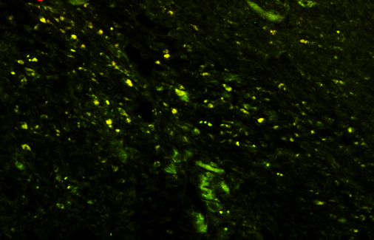
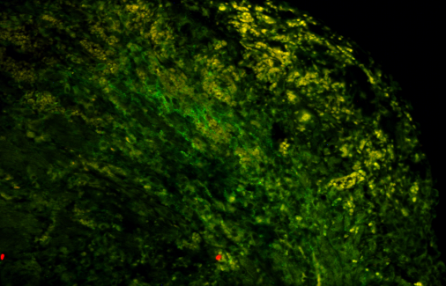
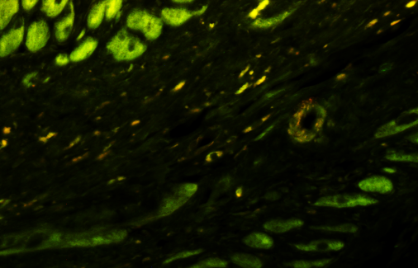
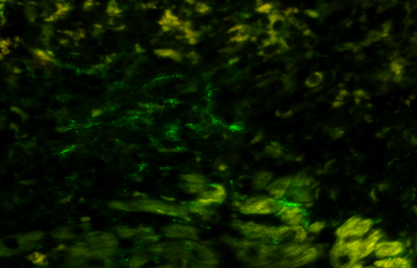
Neutrophils Depletion
1 week
2 weeks
TNF-α (green)
unpublished
Notes:
Moreover, in this Ne-depleted mice, we still have a massive TNF-a expression one week after MI, which we do not see in untreated mice. This expression persis even after 2 weeks after MI after Ne-depletion.

Slide 19
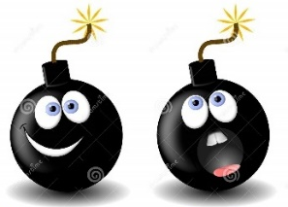
Conclusions
Neutrophils
sustain the provisional matrix formation, inhibiting the initial collagen production
sustain the proliferation and differentiation of fibroblasts
induce TGF-ß1 expression and synthesis from fibrobalsts, contributing to the limitation of pro-inflammatory phase

Slide 20
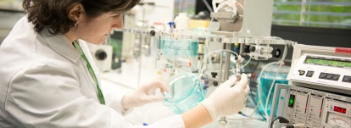
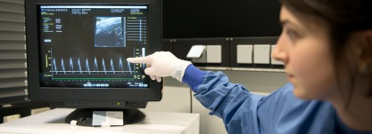
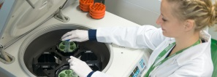
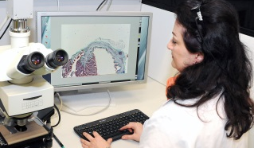
Acknowledgment
Dr. Adelina Curaj
Dr. Zhuojun Wu
Dr. Mihaela Rusu
Dr. Sakine Simsekyilmaz
Dr. Xiofang Li
Dr. Alexander Schuh
Dr. Vera Jankowski
Prof. Dr. Joachim Jankowski
Dr. Isabela Kanzler
Dr. Peter Boor
Dr. Octavian Bucur
Prof. Dr. Martin Zenke
Dr. Heidi Noels
Mareike Staudt
Roya Soltan
Leon Decker

Slide 21
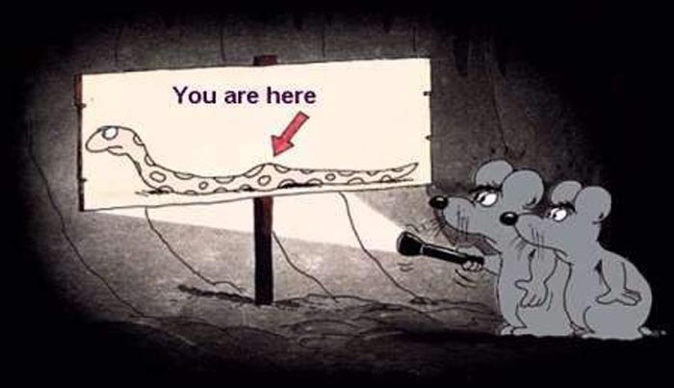
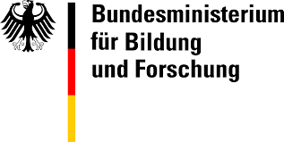
Let‘s join to find the way!
Thank you for your attention !

Slide 22
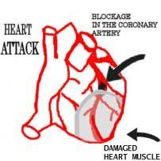
Chemokine- and
Cytokine Synthesis
Remodelling
Myocardial infarction (MI)
Leukocyte Infiltration
MI
Neutrophils
Phase I
Phase II
Weeks
1
2
3
4
reparatory
Gr-1^{low} Monocytes
Neutrophils
Proteolysis
Inflammation
inflammatory
Gr-1^{hi} Monocytes
Angiogenesis
Myofibroblast activation
CCR5
CX3CR1
CXCR4
Phagocytosis
Proteolysis
Inflammation
CCR2
CXCR2
CXCR4
CCR1
Nahrendorf et al., J Exp Med, 2007

Slide 23
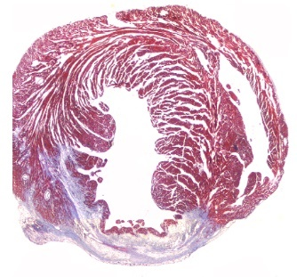
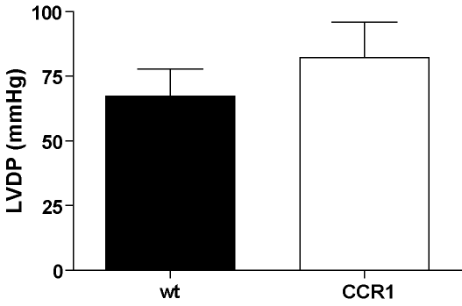
MCP1 Antagonists
MI
MI
Liehn et al, J Am Col Cardiol, 2010
Dewald et al, Circ Res, 2005
Weeks
Weeks
1
2
3
4
1
2
3
4
*
*
CCR1-/-
MI
MI
Liehn et al, J Cell Mol Med, 2008
Liehn et al, J Am Col Cardiol, 2011
Weeks
Weeks
1
2
3
4
1
2
3
4

Slide 24
Neutrophils
Monocytes
Direct contact required
Remodeling TGF-ß1, IL1ß (↑) -
Proliferation - PPARδ (↑)
Migration IL1a, IL1ß (↑) -
Diferentiation TGF-ß1 (↑) -
Inflammation IL1ß, Syndecan4 (↑) Cadherin 11 (↑)
Angiogenesis VEGFR1 (↑) -
Paracrine effects
Remodeling - AngII, NFkB (↑)
Proliferation PPARγ (↑) -
unpublished

Slide 25
