Slide 1
The Initial Experience of New Japanese DCA Device
Etsuo Tsuchikane, MD, PhD
Toyohashi Heart Center
Nagoya Heart Center
Gihu Heart Center

Slide 2
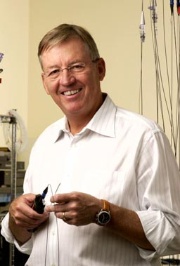
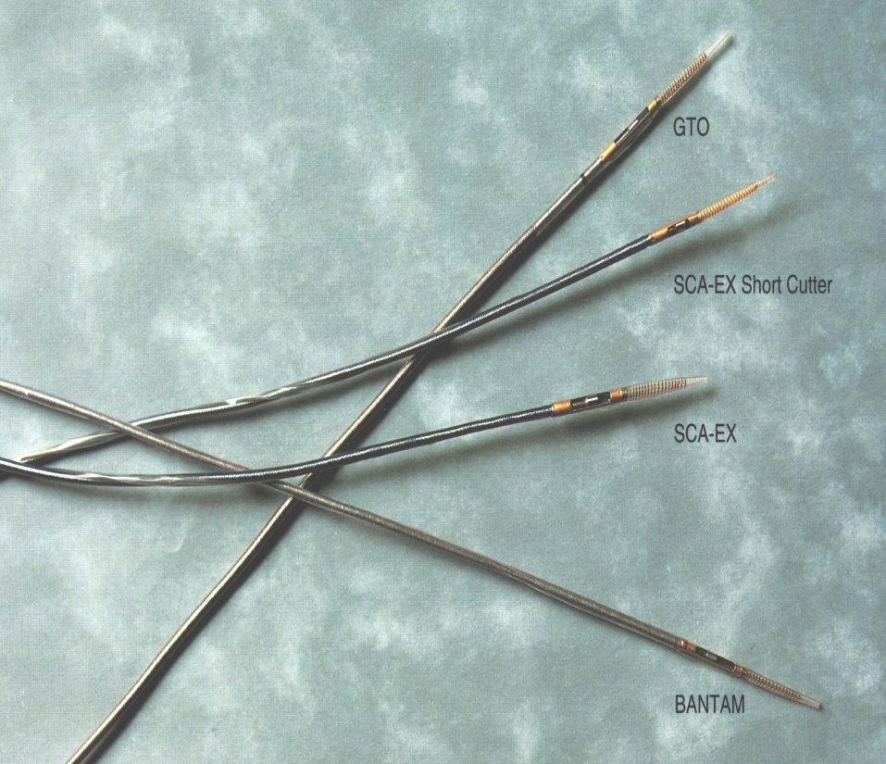
DCA Catheters
History
Designed and developed by John B. Simpson, MD
Clinical application started in 1993 in Japan
History of DCA catheter
  1992 SCA™(Abbott社)
  1995 AtheroCath GTO™(Abbott社)
  1997 AtheroCath BANTAM™(Abbott社)
  2001 FLEXI-CUT®(Abbott社)
  2003 Cypher

Slide 3
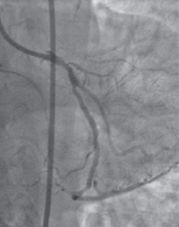
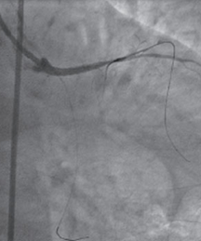
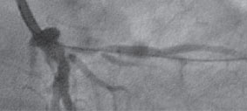
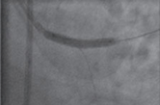
Problems of LMT bifurcation
LAD jp : CTO
LADjp: CTO
Pre
GW cross
Post
Stent implantation
Plaque shift and Carina shift

Slide 4
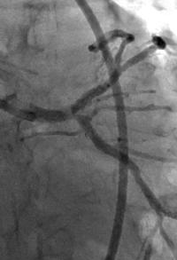
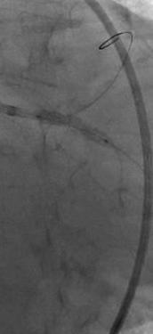
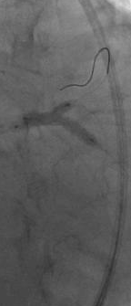
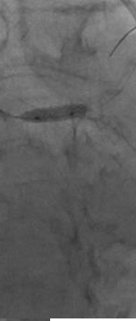
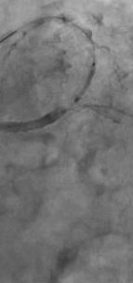
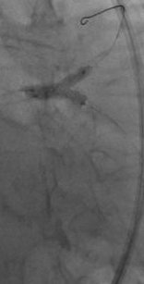
Problems of LMT bifurcation
Case: 70’s female; LMT
Complex stenting
LAD:3.5x18
LCX:3.5x15
POBA4.0x10
T-stent
SES3.0x13
LAD:3.0x13
LCX:3.5x15
SES3.5x18

Slide 5
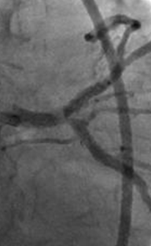
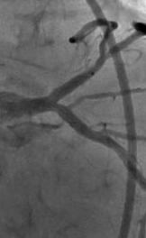
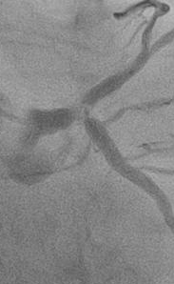
Problems of LMT bifurcation
Complex stenting did not show good outcomes.
Pre
Final
8M later

Slide 6
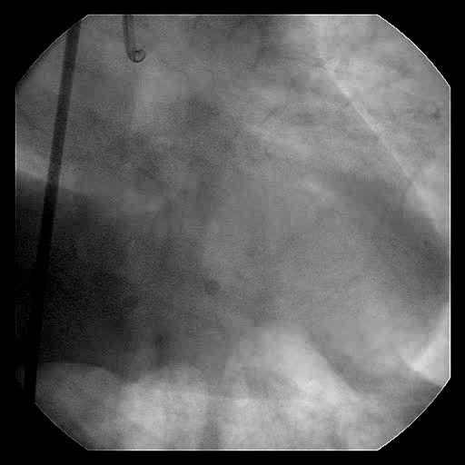
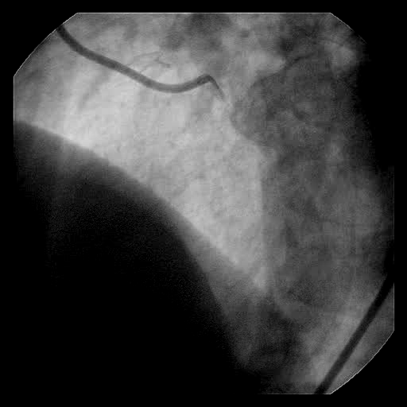
LMT Bifurcation
Type D bifurcation
Notes:
I will show you one case. This is a LMT bifurcated lesion involved with diagonal ostium stenosis.

Slide 7
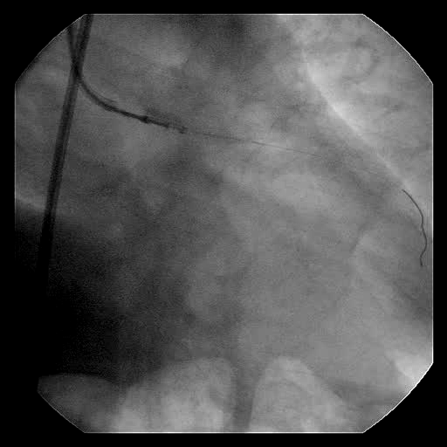
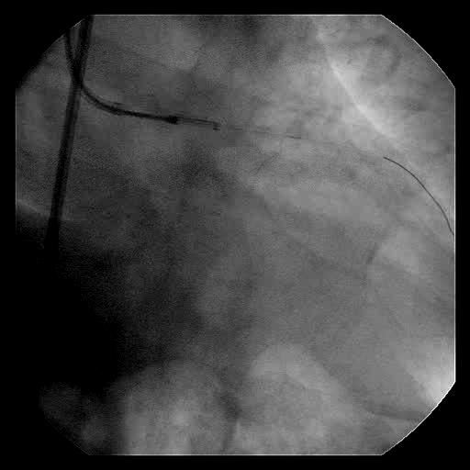
DCA for LMT~LAD
Notes:
First, the directional atherectomy was conducted for distal LMT and ostial LAD. And this is the result after DCA.

Slide 8
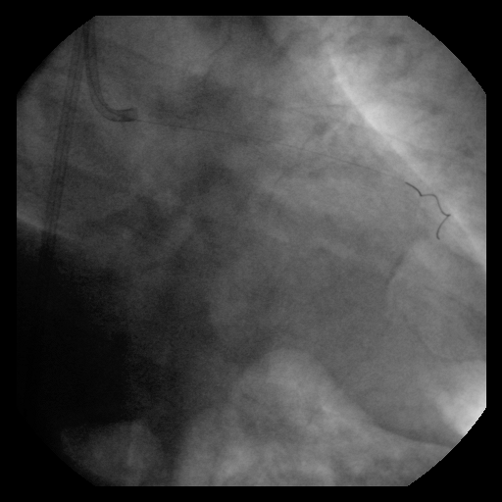
LMT Bifurcation
-LAD Post DCA-

Slide 9
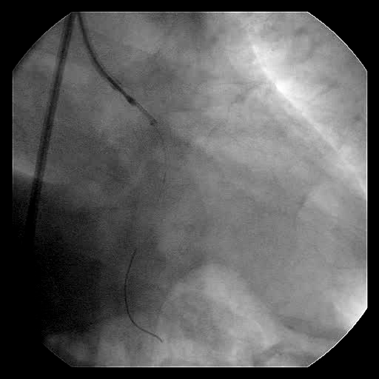
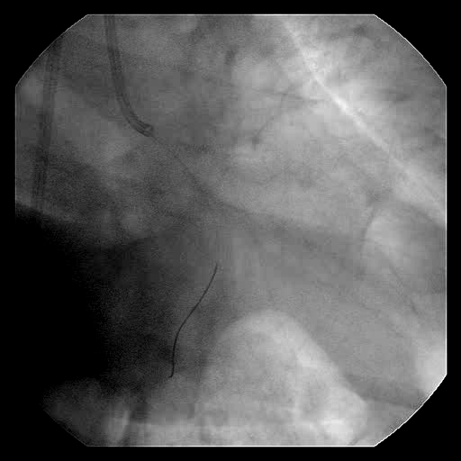
DCA for LMT~LCx
Notes:
Second, DCA was also performed for ostial circumflex artery until an optimal result was obtained as shown here.

Slide 10
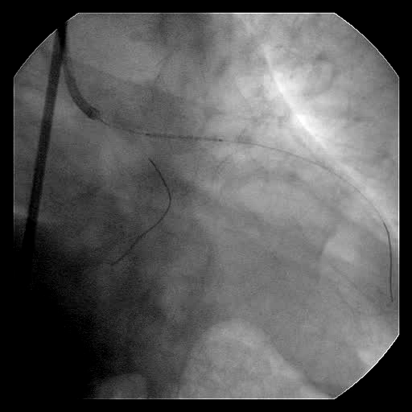
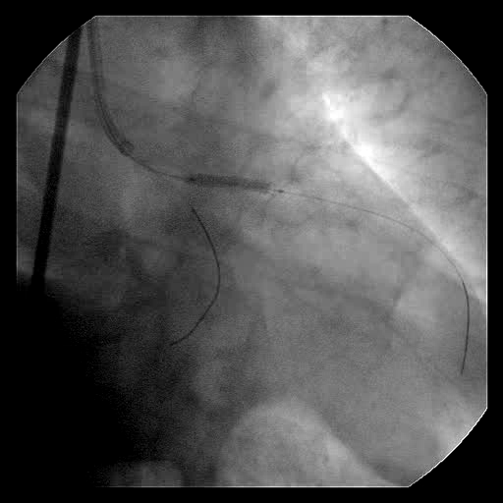
Cypher
Notes:
Then we put a drug eluting stent in proximal LAD,

Slide 11
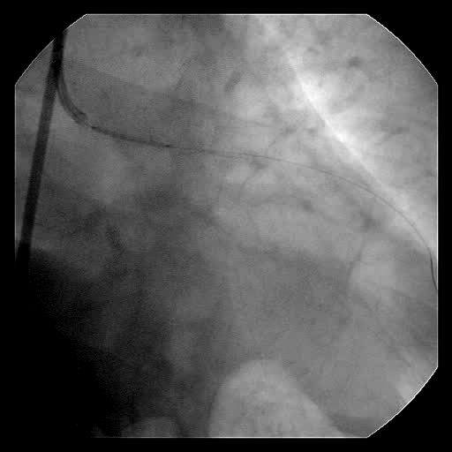
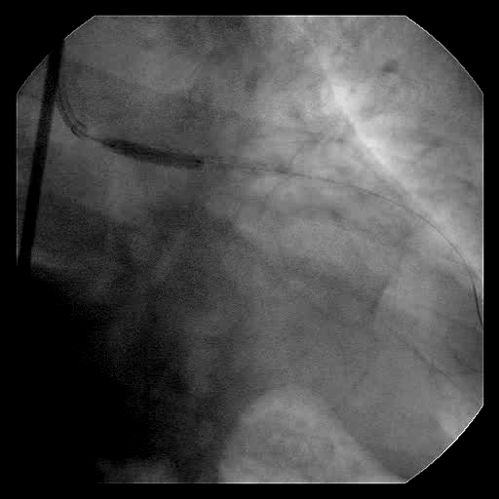
Cypher
Notes:
And in LMT and ostial LAD, as just the crossover stenting.

Slide 12
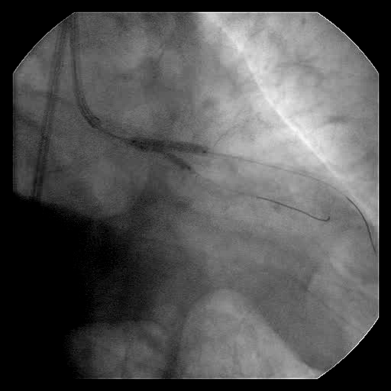
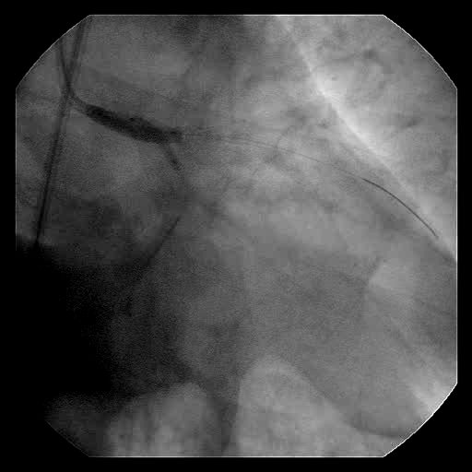
KBT
Notes:
After that, a high pressure kissing stenting was conducted for both LAD-diagonal and LMT bifurcation.

Slide 13
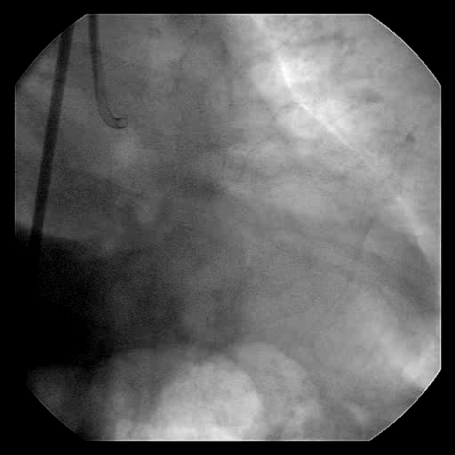
Final Angiogram
Notes:
This is final angiographic results,

Slide 14
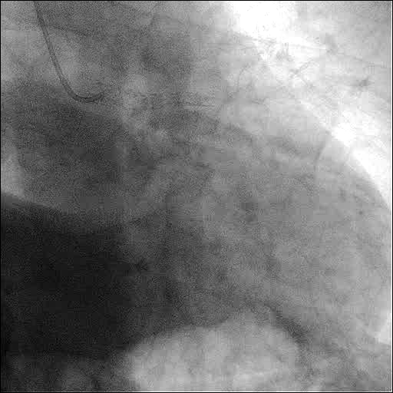
9Mo Follow-up
Notes:
And this is follow-up angiographic results. There was no restenosis.

Slide 15
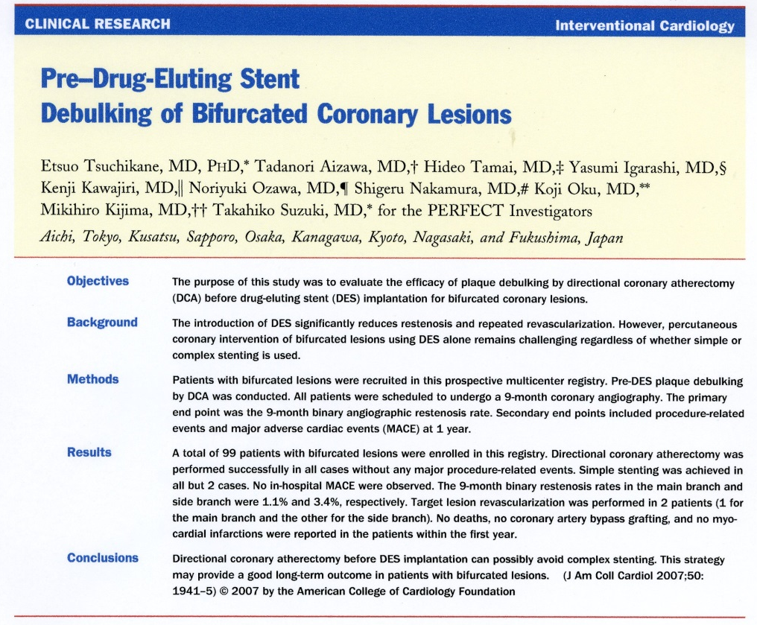
PrE Rapamycin Eluting Stent
FlExi-CuT Registry
(PERFECT Registry)

Slide 16
Study Design
Multi-center non-randomized prospective registry
DCA debulking prior to Cypher stenting
for ostial or bifurcated lesion
9-month angiographic and 1 yr clinical follow-up
17 Japanese centers

Slide 17
Endpoints
Primary endpoint
■ Angiographic restenosis (>50% DS) at 9 months
Secondary endpoint
■ MACE, TLR, TVR by 1 yr

Slide 18
Lesion Location
(n=99)
82%

Slide 19
DCA Procedural Results
(n=99)
1. FlexiCut size L/M: 98/1
2. Max. cutting pressure: 59.4 ± 34.5 psi
3. No of cut: 18.2 ± 12.3 cut
4. Vessels treated by DCA
1) Main branch alone
2) Both main and side branch
96 (97%)
3 (3%)

Slide 20
DCA Procedural Results
(n=99)
5. Complications during DCA
1) spasm
2) side branch occlusion
3) no flow
4) perforation
0%
0%
0%
0%

Slide 21
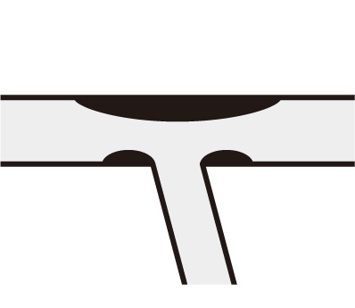
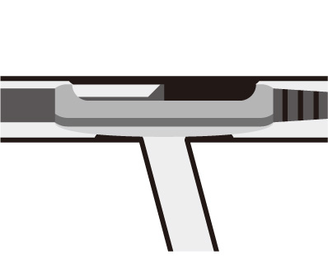
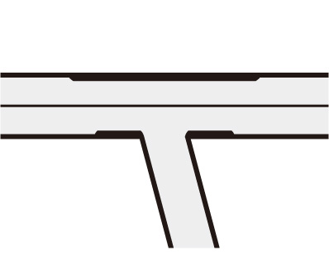
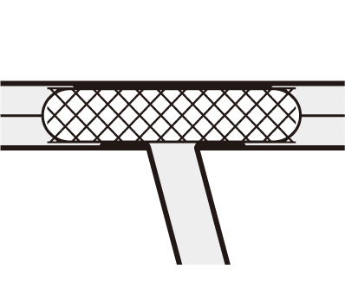
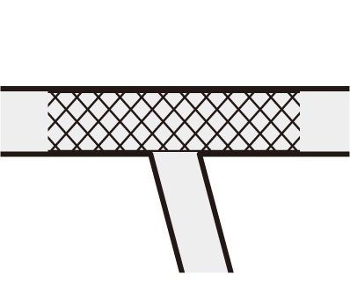
A) Crossover stenting after DCA
MB
Debulking with DCA
Post DCA
SB
Stenting to MB
Final
With/without KBT or
Ballooning to SB only

Slide 22
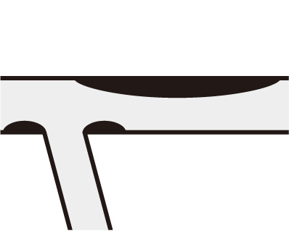
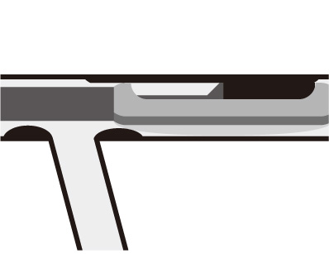
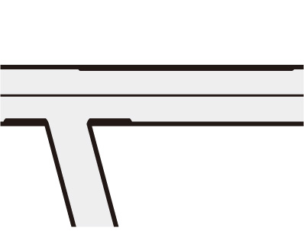
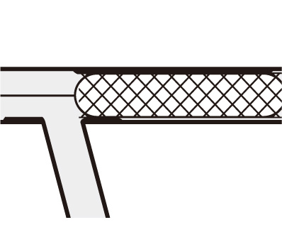
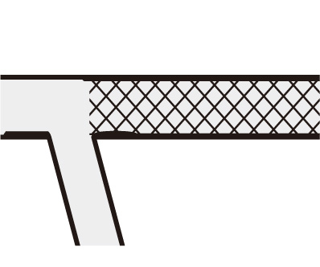
B) Non-crossover stenting after DCA
MB
Debulking with DCA
Post DCA
SB
Stenting to MB
Final

Slide 23
Stenting Procedural Results
(n=99)
1 Cr. STENT + KBT | 51 % | 50
+ Non KBT | 26 % | 26
+ SB-POBA | 6 % | 6
Non-crossover 1 STENT | 15 % | 15
Crush STENT | 0 % | 0
T STENT | 1 % | 1
Culottes STENT | 1 % | 1
82
KBT: kissing balloon techique; SB: side branch

Slide 24
In-Hospital Outcomes
(n=99)
1) Death
2) Em-CABG/TLR
3) QMI
4) Non-QMI
5) Complication at access site
0%
0%
0%
2%
0%

Slide 25
QCU Analysis (Main Branch):
Vessel area, Lumen area, Area stenosis
AS
82.3%
55.8%
46.0%

Slide 26
1yr Follow-up
Results
Fu CAG was performed in 89 pts.
And 96 pts were clinically followed up.
(90% Angiographic Fu rate. 97% Clinical Fu rate.)
No death, no CABG, no MI
TLR for the main branch in 1 patient (1.0%)
TLR for the side branch in 1 patient (1.0%)
(JACC 2007;50:1941-5 )
Notes:
And this is follow-up angiographic results. There was no restenosis.
ここの上段3行が表現がいまいちです(加藤が勝手にいじりました) 表題もプロトコールが1年クリニカルなので １Yrにしてます
1.0％になっているのは Clinicalなので分母が96だからです ほかはAngioFUのため分母が89です

Slide 27
9Mo Follow-up
QCA Results
Fu duration: 264±83 days
Binary restenosis rate
Main branch: 1.1% (1/89)
Side branch: 3.4% (3/89)
(JACC 2007;50:1941-5 )
Notes:
And this is follow-up angiographic results. There was no restenosis.

Slide 28
Follow-up Results
Binary restenosis / TLR rate
All
(%)
(n=89)
1
1
3
1
4
2
(JACC 2007;50:1941-5 )
Notes:
And this is follow-up angiographic results. There was no restenosis.

Slide 29
Follow-up Results
Binary restenosis / TLR rate
LMT Bifurcation
(%)
(n=55)
(JACC 2007;50:1941-5 )
Notes:
And this is follow-up angiographic results. There was no restenosis.

Slide 30
Summary of DCA/DES
DCA prior to DES stenting was safe and made it possible to avoid complex stenting in bifurcated lesions, which provided a better long-term outcome.
International DCA/DES registry was considered in 2008 for further evaluation.
However, .....

Slide 31

DCA Catheters
History
Designed and developed by John B. Simpson, MD
Clinical application started in 1993 in Japan
History of DCA catheter
  1992 SCA™(Abbott社)
  1995 AtheroCath GTO™(Abbott社)
  1997 AtheroCath BANTAM™(Abbott社)
  2001 FLEXI-CUT®(Abbott社)
  2003 Cypher
  2008 Production discontinued
  2015 Revival by NIPRO

Slide 32
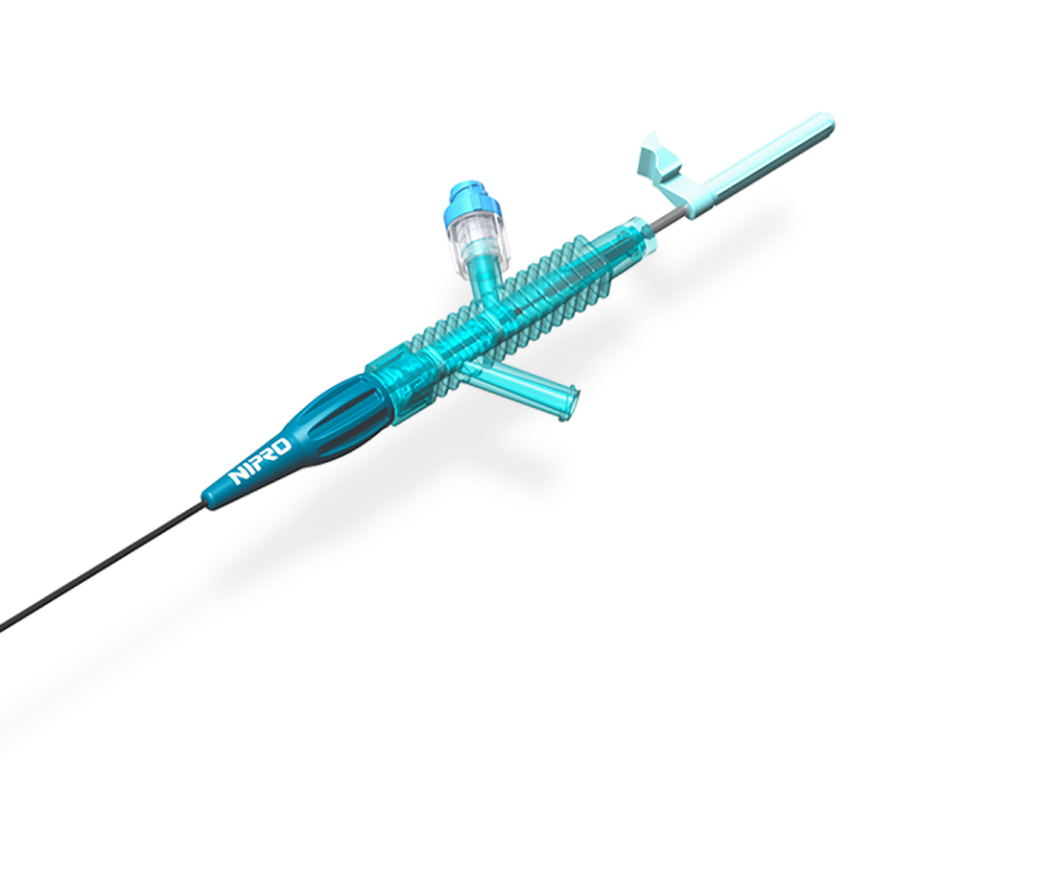
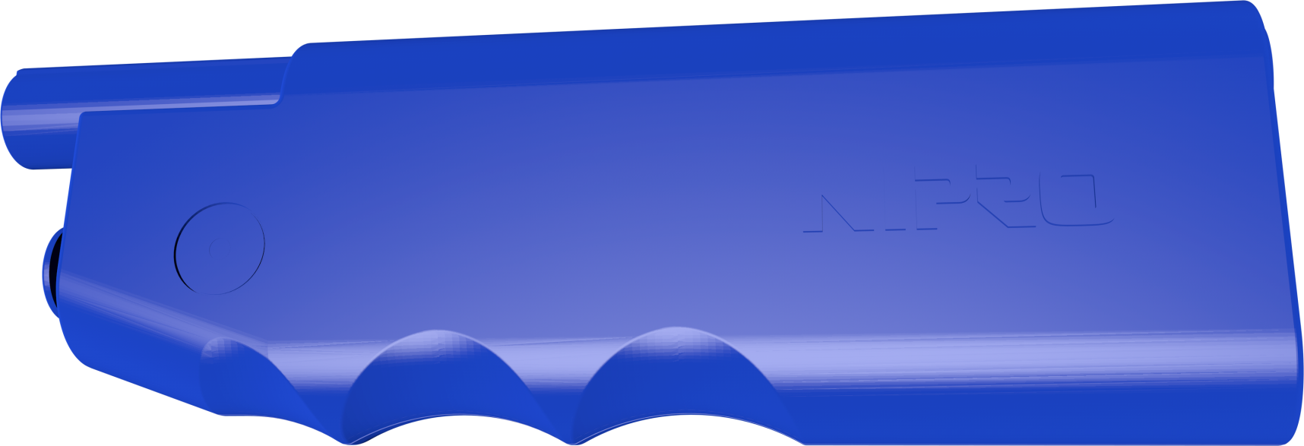
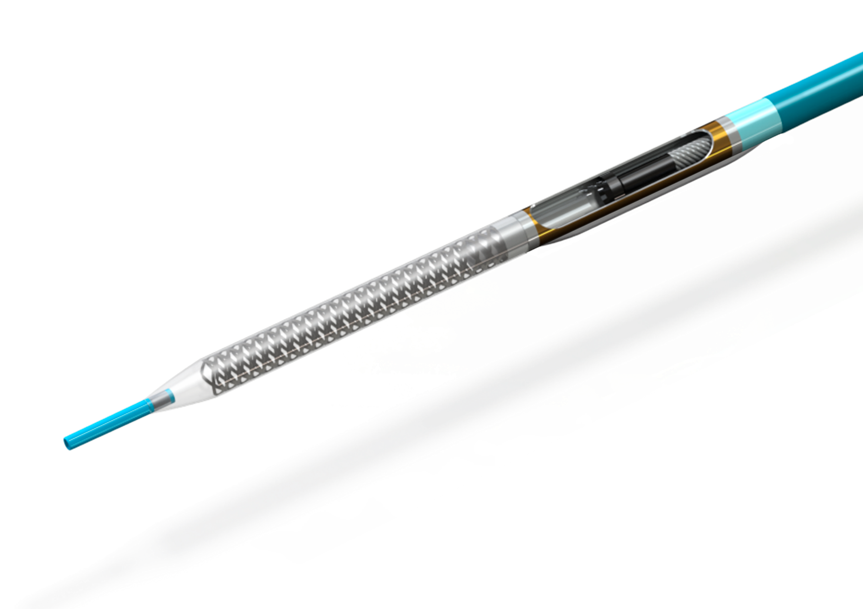
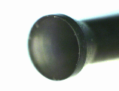
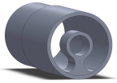
ATHEROCUT®
Overview
Proximal site
Motor Drive Unit
7Fr Guiding Catheter
Compatible
6000rpm
Distal site
Tapered nose-cone with tip
Short cutter
w/DLC
Guide-wire support

Slide 33
Product Comparison
 | ATHEROCUT® | FLEXI-CUT®
≪Material≫
Cutter | DLC; Diamond Like Carbon coating (Vickers hardness：900） | Titan coating (Vickers hardness：550）
≪Specification≫
Outer diameter | Φ1.95mm (0.077inch) | Φ2.10mm(0.083inch）
Housing length | 6mm / 9mm | 9mm
Target vessel diameter | 3.0-4.4 mm (3size) | 2.5-4.0 mm (3size)
Nosecorn capacity | 0.032mL | 0.030mL
Guiding Catheter compatibility | ≧ 7Fr ※8Fr recommend | ≧ 8Fr
MDU;rotational speed | 6,000rpm | 3,500rpm

Slide 34
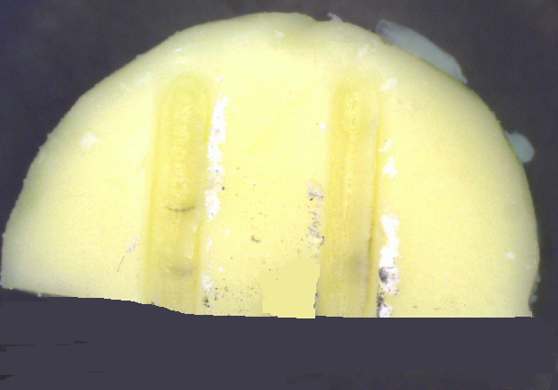
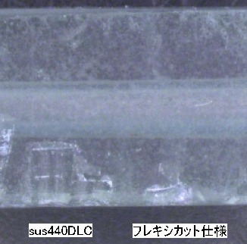
DLC Cutter
-Improved cutting efficiency-
【Functional test of cutting】
＜ATHEROCUT＞
＜FLEXI-CUT＞
＜ATHEROCUT＞
＜FLEXI-CUT＞
Soft plaque model：cheese
Hard model：fluorite
(Mohs' scale of hardness4)

Slide 35
DCA Representative Case
From CCT 2016

Slide 36
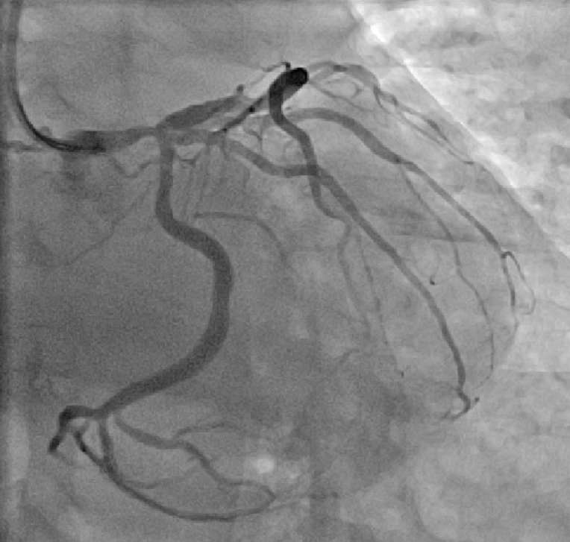
CVI Case
60’s male Target Lesion: LMT
Diagnosis: OMI,
Prior intervention :
  ’16.10.02 DCB (Diag.)
Coronary risk factor :
Hypertension,Dyslipidemia
eGFR :72.0
Syntax score : 26
Latest CAG findings:
’16.10.07 LMT 75%
LV EF:65% (UCG)

Slide 37
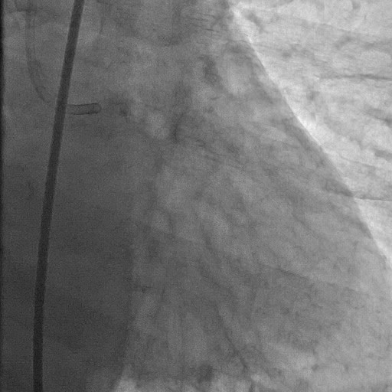

Pre Angiogram

Slide 38




IVUS
Pre LAD / LCx
LAD
LCx

Slide 39


DCA 1st session
ATHEROCUT® L
1st cut 2atm
Lower - far side

Slide 40


LAD DCA 4th session
Max.5atm

Slide 41


Post DCA

Slide 42


DCA for LCx
2 session Max. 2atm

Slide 43


Stent positioning

Slide 44




Stenting procedure
EES 4.0/18mm 10atm
4.0/15mm
3.0/15mm
KBT&HBT
6atm
SeQuent Please 3.0/20mm 6atm

Slide 45


Final Angiogram

Slide 46
Case Summary
Crossover Simple stenting
No plaque/Carina shift

Slide 47
The Initial Experience of New Japanese DCA Device
Maoto Habara, MD
Etsuo Tsuchikane, MD, PhD
Toyohashi Heart Center
Nagoya Heart Center
Gihu Heart Center
(CCI 2016 in press)

Slide 48
RESULT
Patients Characteristics
Number | 48
Male | 40 (83%)
Age, years | 66.7±10.8
Prior PCI | 17 (35.4%)
Prior CABG | 1 (2.1%)
HT | 26 (54%)
DM | 15 (31%)
HL | 32 (67%)
H/O Smoking | 16 (33%)
(CCI 2016 in press)

Slide 49
RESULT
Lesion Location
N=48
87%
(CCI 2016 in press)

Slide 50







RESULT
Lesion Location & Bifurcation type (N=48)
LMT Bifurcation | LAD Ostial | LCx Ostial | LAD/ Diagonal | LCx/OM
16 (33%) | 22 (46%) | 4 (8%) | 6 (13%) | 0 (0%)
6 (13%) | 11 (23%) | 1 (2.1%) | 0 (0%) | 2 (4.2%) | 23 (48%) | 5 (10%)
0
(CCI 2016 in press)

Slide 51
ACUTE RESULT
DCA Procedural Results (N=48)
Complication during DCA procedure
Spasm | 0%
Side branch occlusion | 0%
No flow/ Slow flow | 0%
Perforation | 0%
(CCI 2016 in press)

Slide 52
ACUTE RESULT
DCA Procedural Results (N=48)
ATHEROCUT® Size L / M | 38 / 11 *
Max. cutting pressure, atm | 5.1±2.5
Number of cuts, cuts | 15.5±8.0
Vessels treated by DCA
Main branch alone | 44 (91.7%)
Both main and side branches | 4 (8.3%)
Post DCA %PA, % | 50.1±9.3
(CCI 2016 in press)
※ 1 Left Main bifurcation (1,1,1) case :
L size for LM-LAD / M size for LM-LCx

Slide 53
ACUTE RESULT
Post DCA %PA
P=0.10
51.6±9.2%
46.6±9.3%
(CCI 2016 in press)

Slide 54
ACUTE RESULT
DCA Procedural Results (N=48)
None stent (DCA alone) | 16 | 33.3%
DCA + DCB | 5 | 10.4%
Stenting | 32 | 66.6%
① Crossover
1 stent + KBT | 9 | 18.8%
1 stent + non-KBT | 9 | 18.8%
1stent + SB-POBA | 1 | 2.1%
② Non-Crossover | 13 | 27.1%
③ Complex stenting | 0 | 0%
①
②
③
(CCI 2016 in press)

Slide 55
ACUTE RESULT
Stenting Procedural Results (N=32)
Number | 32
Delivery success | 100 (100%)
Stent size, mm | 3.38±0.43
Total length of stent, mm | 20.1±6.7
Max. inflation pressure, atm | 12.7±2.8
Number of Stent / lesion | 1.13±0.34
(CCI 2016 in press)

Slide 56
ACUTE RESULT
Procedural Results (N=48)
Device success, % | 100
Procedure success, % | 100
Amount of Contrast medium, ml | 202.4±67.0
Procedure time, min | 112.3±24.7
Fluoroscopy time, min | 40.1±10.7
(CCI 2016 in press)

Slide 57
ACUTE RESULT
In-Hospital Outcome (N=48)
Death | 0%
Em CABG / TLR | 0%
Q MI | 0%
Non-Q MI | 0%
Complication at access site | 0%
(CCI 2016 in press)

Slide 58
FOLLOW UP RESULT
(N=48)
Clinical Outcome (N=31: > 6 months)
Fu duration: 375.7 ± 148 days
MACCE | 2 (6.5%)
Cardiac death | 0 (0%)
MI | 0 (0%)
Q MI | 0 (0%)
Non-Q MI | 0 (0%)
TVR | 2 (6.5%)
TLR
By PCI | 1 (3.3%)
By CABG | 0 (0%)
Follow up angiography | 19 (61.3%)
Follow up cardiac CT | 1 (3.3%)
Angiographic follow up (N=20: >6 months)
Fu duration: 190.2 ± 86.3 days
Restenosis | 1 (5.0%)
TLR | 1 (5.0%)
(CCI 2016 in press)

Slide 59






Representative Case
DCA + Stent
Pre
DCA
max10atm 21cuts
%PA 55.6
EES 3.0*15 mm
Post POBA 3.5mm
Final
F.U
(CCI 2016 in press)

Slide 60







Representative Case
DCA + DCB
Pre
Final
F.U
DCA for LAD
max4atm 2cuts
DCA for HL
Max10atm 13cuts
DCA for LCX
Max1atm 2cuts
DCB 4.0*20 mm
DCB 3.0*20 mm
(CCI 2016 in press)

Slide 61







Representative Case
40y.o TLR
Pre
Final
F.U
max5atm 17cuts
%PA 41.0%
TLR
DCB 4.0*20 mm
TLR Final
MAX5atm 20cuts
%PA 45%
(CCI 2016 in press)

Slide 62
SUMMARY
There were no complication during the DCA procedures.
No in-hospital MACE was observed.
DCA could avoid complex stenting in all cases.
In clinical follow up (n=31), TVR rate was 6.5% and TLR rate was 3.3%.
In angiographic follow up (n=20), restenosis rate and TLR rate including both for main and side branches were both 5.0%.
(CCI 2016 in press)

Slide 63
CONCLUSION
DCA can possibly avoid complex stenting.
Thus, DCA may provide
a good long-term outcome
in patients with major bifurcated lesions.

