Slide 1

"Impact of Procedural Technique on long term adverse outcomes in recent absorb trials“
Manish Narang
Sr. Medical Advisor-APJ, Abbott Vascular
HAVING NOTHING
CAN MEAN EVERYTHING

Slide 2
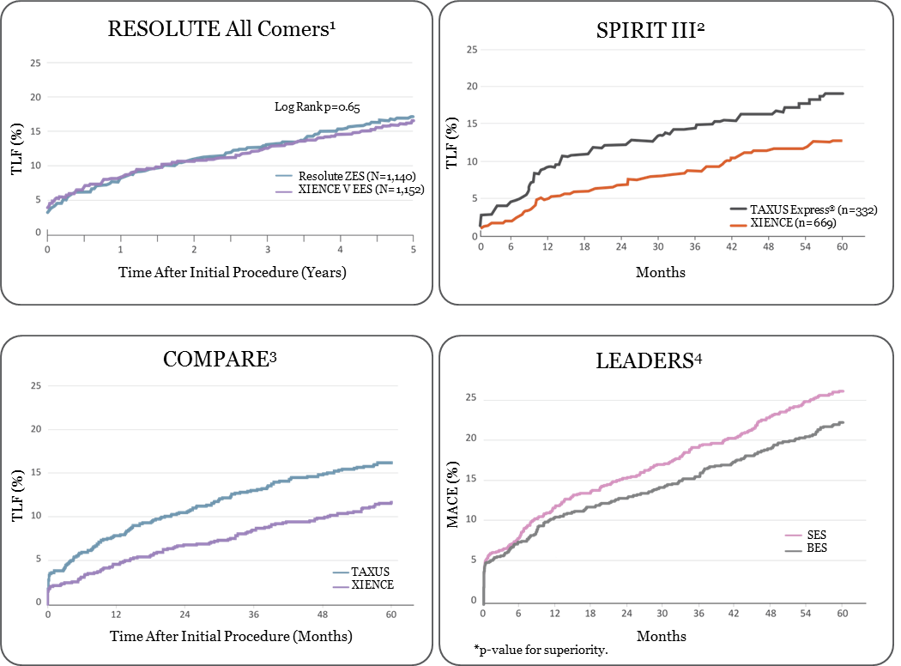
Why do we need a bioresorbable scaffold?
LONG-TERM COMPLICATIONS OF PERMANENT STENTS
Absorb Clinical Results
Ongoing Annual Accrual of Events with Permanent Stents
¹Windecker S. RESOLUTE All Comers 5-Year. EuroPCR 2014. / ²Gada H et al. SPIRIT III 5-year. JACC Cardiovasc Interv. 2013;6:1263-1266. / ³Smits P.C. et al. COMPARE 5-Year. J AM Coll Cardiol Cardiovasc Interv. 2015; *: 1157-1165. / ⁴Serruys PW. LEADERS 5-Year. TCT 2012.
Notes:
All DES studies have shown a steady annual accrual of adverse events. The presence of a permanent foreign body in the vessel may be contributing to these ongoing events.
A fully bioresorbable scaffold may reduce these very late events by leaving the vessel free of any foreign body, and by allowing the vessel to regain its natural vessel function.

Slide 3
Overview of Absorb Clinical Program
Absorb clinical results
HAVING NOTHING
CAN MEAN EVERYTHING

Slide 4

ABSORB: Extensive Clinical Program
Absorb Clinical Results
More than 150,000 patients treated¹
30,000+ patients studied^{2, 3}
Available in more than
100 countries worldwide
12 RCTs³
20 Registries²
¹Sales data through May 2016, 1.2 units/patient, Data on file at Abbott Vascular. ²ABSORB First, ABSORB Extend, Gabi–R, REPARA, UK registry, IT-Disappears, France ABSORB, FEAST.RU, RAI Registry, SMART REWARD, ABSORB Australia, BVS EXPAND, ASSURE, PABLOS, Absorb CTO, Prague – 19, GHOST Ferrarotto, POLAR ACS, GHOST EU. Cohort B. ³AIDA, EVERBIO, ABSORB II, ABSORB III, ABSORB IV, ABSORB Japan, ABSORB China, COMPARE Absorb, Trofi II, Prospect II, ISAR Absorb, PREVENT.

Slide 5
ABSORB: Extensive Clinical Program
Real World and Complex Patient Populations
Absorb Clinical Results
ALL-COMERS
COMPLEX POPULATIONS
GABI-R
Design: All-comers registry
N=~5000
1˚: Safety & efficacy
AIDA
Design: RCT vs. XIENCE
N=~1850
1˚: 2-year TVF
POLAR-ACS
Design: ACS registry
N=94
1˚: Safety, clinical device, procedure, success & in-hospital MACE
ABSORB CTO
Feasibility: CTO
N=35
1˚: Safety & performance
FEAST Russia Registry
Design: All-comers registry
N=2500
1˚: 1-year MACE, TVF, Revascularization, ST, Peri-procedural MI, Angina
FRANCE ABSORB
Feasibility: De novo lesions
N=~2000
1˚: 1-year MACE
ISAR ABSORB MI
Design: Non-inferiority vs. EES
N=260
1˚: % diameter stenosis at 6-8 months
PABLOS
Feasibility: Bifurcations
N=30
1˚: Device, procedural, main & side branches
ABSORB FIRST
Design: Prospective, multi-center, global registry
N= ~1800
1˚: ST, CD, MI, revascularization, MACE, TLF, & TVF
REPARA
Design: All-comers registry
N=~1500
1˚: 1-year MACE
PRAGUE 19
Design: STEMI (STEMI Killip I/II)
N=79
1˚: Clinical outcomes
IT-DISAPPEARS
Design: MVD and Long Lesion Registry
N=~1000
1˚: Safety & efficacy
GHOSTGHOST EU
Design: All-comers registry
N=continuous enrollment
1˚: TVF
BVS EXPAND*
Design: All-comers registry
N=~300
1˚: 1-year MACE
TROFI II
Design: STEMI vs. XIENCE
N=190
1˚: 6-months,
neo-intimal healing score
COMPARE ABSORB
Design: High risk for ISR
N=~2100
1˚:TLF
EVERBIO II
Design: Non-inferiority
RCT EES vs. BES vs. BVS
N=~240
1˚: Late lumen loss at 9 months
Kuwait Registry
Design: All-comers registry
N=200
1˚: Safety & efficacy
BVS STEMI First
Design: STEMI
N=151
1˚: Safety & performance
PROSPECT ABSORB
Design: RCT BVS vs. OMT in unstable asymptomatic pts
N=900
1˚: 2-Yr IVUS MLA
UUKKUK REGISTRY
Design: Prospective, single-arm, multi center, observational registry
N= 1005
1˚: RDS < 50% at procedure conclusion, MACE
ASSURE
Design: All-comers registry
N=180
1˚: Safety & efficacy
UNDERDOGS
Design: Long Lesions/Overlap
N=314
DOCE at 1 Year
Retrospective Multicentric/MICAT Registry
Design: All-comers registry
N=1305
1˚: Safety & efficacy
RAI Registryistry
Design: All-comers registry
N=1505
1˚: Safety & efficacy
ABSORB COHORT B
Design: Allocated (non-randomized)
N=101
1˚: Safety & performance
SIMPLE TO MODERATELY COMPLEX POPULATIONS
ADDITIONAL LARGE RCTs
ABSORB II
Design: Randomized 2:1 Absorb BVS:XIENCE
N=501
1˚: Vasomotion & lumen diameter
after the index procedure & at 3 years
ABSORB EXTEND
Design: Prospective, single-arm, open-label
clinical study
N=812
1˚: ID-MACE
ABSORB CHINA
Design: RCT. N= ~440
1˚: In-segment late loss at 1 year
ABSORB III
Design: RCT. N= ~2250
1˚: TLF at 1 year
ABSORB JAPAN
Design: RCT. N= ~400
1˚: TLF at 1 year
ABSORB IV
Design: RCT. N= ~3000
1˚: Angina within 1 year
*Excludes STEMI patients. ACS, acute coronary syndrome; MVD, multi-vessel disease; CTO, chronic total occlusion; MI, myocardial infarction RCT, randomized controlled trial; OMT, optimal medical therapy; EES, everolimus-eluting stents; BVS, bioresorbable vascular scaffold; STEMI, ST-segment–elevation myocardial infarction; MACE, major adverse cardiac events; ID-MACE, ischemia-driven major adverse cardiac events; TLF, target lesion failure; IVUS MLA, intravascular ultrasound minimal lumen area; TVF, target vessel failure; LAD, left anterior descending; FIM, first-in-man.

Slide 6
Absorb II study structure
Objective | Evaluate Absorb vs. XIENCE for performance
Design | Randomized 2:1 Controlled Absorb BVS vs. XIENCE, in 501 patients, in 46 sites in Europe & New Zealand
Absorb
XIENCE
Clinical
Follow-Up (Months)
1
6
12
24
36
48
60
QoL follow-up
Angio, IVUS follow-up
MSCT follow-up (Absorb arm only*)
TCT 2016
Co-primary Endpoints | Vasomotion at 3 years (superiority) Minimum Lumen Diameter (MLD) at 3 years (non-inferiority, reflex to superiority)
Major Secondary Endpoint | Change in mean lumen area from post-procedure to 3-years by IVUS (superiority test)
Secondary Endpoints | Standard clinical endpoints (MACE, TVF, TLF, Cardiac Death, MI, TLR) Quality of life (QOL) especially recurring angina Device and procedural success
*Non-German sites only.

Slide 7

Co-primary endpoint: in-device vasomotion in ABSORB II
Cumulative frequency distribution curves of vasomotion at 3 years
CHANGE IN MEAN LUMEN DIAMETER
Absorb | n=258 | 0.047±0.109 mm
XIENCE | n=130 | 0.056±0.117 mm
Cumulative frequency
P_{superiority} = 0.49
Vasomotion (mm)
ABSORB MISSED THIS PRIMARY ENDPOINT
Absorb vasomotion is consistent with results in COHORT B and ABSORB Japan @ 2 years*
XIENCE unexpectedly showed vasomotion, contrary to historical data
*Vasomotion assessed by change in Mean Lumen Diameter between pre-and post-nitrate at 3 years by QCA (superiority)
Serruys P.W., et al. ABSORB II 3-Year, TCT 2016.

Slide 8
Co-primary endpoint: angiographic late luminal loss
Cumulative frequency distribution curves of late luminal loss at 3 years
Acute ScT
Subacute ScT
Late ScT
Very Late ScT
Cumulative frequency
XIENCE | n=151 | 0.250±0.250 mm
Absorb | n=298 | 0.371±0.449 mm
P _{non-inferiority} = 0.78
Late luminal loss (in-stent/scaffold) (mm)
Serruys P.W., et al. ABSORB II 3-Year, TCT 2016.

Slide 9
INTRAVASCULAR ULTRASOUND RESULTS
 | Absorb 247 lesions | XIENCE 136 lesions | p value
Mean lumen area
Pre-procedure (mm²) | 4·81 | 5·02 | 0·1568
Post-procedure (mm²) | 6·05 | 6·81 | <0·0001
Follow-up (mm²) | 6·12 | 6·66 | 0·003
=
<
<
Major secondary endpoint
Mean Change in mean lumen area from postprocedure to 3 years (mm²) | + 0·07 | - 0·15 | 0·02
>
Minimal lumen area
Pre-procedure (mm²) | 2·01 | 2·11 | 0·2714
Post-procedure (mm²) | 4·88 | 5·72 | <0·0001
Acute gain (mm²) | 2·89 | 3·64 | <0·0001
Follow-up (mm²) | 4·32 | 5·38 | <0·0001
=
<
<
<
Serruys P.W., et al. ABSORB II 3-Year, TCT 2016.

Slide 10
ABSORB II
Three Year Clinical Results
Absorb Clinical Results
24.2
20.9
P = 0.04
17.4
Hierarchical Event Rates %
10.8
P = 0.04
P = 0.049
10.5
7.7
P = 0.01
6.5
5.0
P = 0.03
3.7
3.1
3.1
2.8
2.5
1.9
1.2
1.9
0.9
0.0
ABSORB II clinical results @ 3 years
  Compared to XIENCE, Absorb showed a numerically lower rate of POCE, and higher rates of DOCE/TLF,
  MI and ST, which could have been reduced by using proper PSP
  The very late thrombosis events in ABSORB II, as in ABSORB Japan, were related to sub-optimal implantation techniques of the scaffolds that are NOT used today (trial enrolled pre-PSP)
Study is not powered to detect small differences in clinical endpoints.
Chevalier, B., ABSORB II 3-Year, TCT 2016.
Notes:
The results favored XIENCE in nearly all of the components of the composite endpoints.
The higher event rates for Absorb were mainly driven by target vessel MI and TLR. Scaffold thrombosis contributed to both the MI and TLR rates.
The very late thrombosis events in ABSORB II, as in ABSORB Japan, were related to malapposition of the scaffolds due to implantation techniques that are not used today. Remember, this trial enrolled patients prior to the recent PSP implantation guidance.

Slide 11
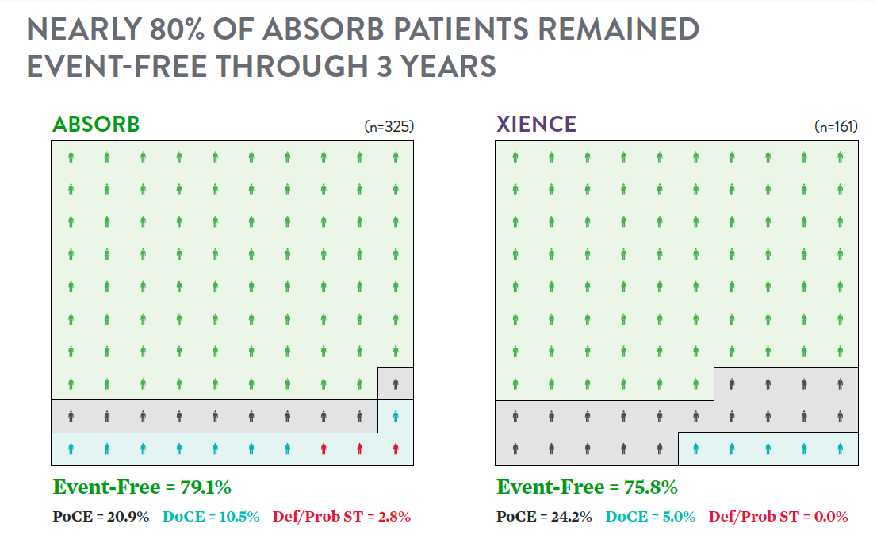
Absorb II
Three years clinical outcomes in perspective
Absorb Clinical Results
Study is not powered to detect small differences in clinical endpoints.
Hierarchical analysis derived from Chevalier, B., ABSORB II 3-Year, TCT 2016.
Notes:
ABSORB II has shown that Absorb has comparable short and long term results to XIENCE, when the scaffold is implanted properly.
Absorb did have a higher rate of device-oriented events, however, these could have been further reduced with proper implantation technique.

Slide 12
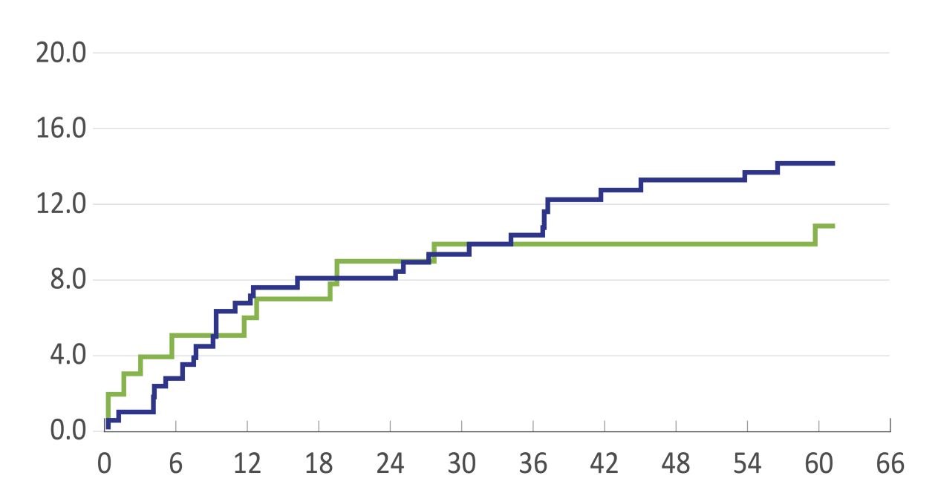
Adverse event rates for absorb in absorb ii are in line with previous studies
ABSORB Cohort B
and SPIRIT Studies¹
Out to
3 years
Out to
5 years
ABSORB II 3-Year MACE²:
● Absorb = 11.7%
Absorb
XIENCE V
14.3%
∆3.3%
11.0%
In Cohort B, after 3 years, KM curve of complications showed a flatter trajectory
MACE %
(Cardiac Death, MI or ID-TLR)
Time Post-Index Procedure (Months)
Descriptive comparison of XIENCE V (3.0 x 18 mm subgroup from SPIRIT FIRST, SPIRIT II, and SPIRIT III. n=227) and
Absorb (3.0 x 18 mm scaffolds in ABSORB Cohort B1 + B2. n=101).
Kaplan-Meier estimates of cumulative major adverse cardiac events (Cardiac death, MI or ID-TLR) of the ABSORB Cohort B at 3 and 5 years (green, n=101) and the
227 patients who received a single 3.0 × 18 mm metallic everolimus-eluting stent in the SPIRIT I, II and III trials (purple).
1. Serruys PW et al. ABSORB Cohort B 5-Year. TCT 2015. / 2. Chevalier, B., ABSORB II 3-Year, TCT 2016.
Notes:
Nevertheless, the event rates for Absorb are actually in line with what has been seen in previous studies.
It could be that 3 years is the peak for events and we may see a plateau going forward, as was seen in Cohort B.

Slide 13
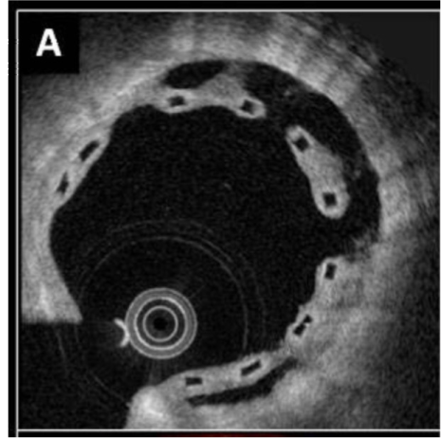
Malapposition leading to VLST
“How does malapposition lead to very late thrombosis?”
Malapposed struts have the potential for increasing thrombosis risk due to flow disturbances; this same phenomenon is true of contemporary DES.
Blood will tend to pool behind the malapposed struts, leading to fibrin deposition and platelet aggregation. At later time points when the structural integrity of the device is lost, this thrombogenic milieu can collapse into the lumen and occlude the vessel.
Thrombosis related to malapposition can be mitigated by addressing the malapposition with proper implantation technique.

Slide 14
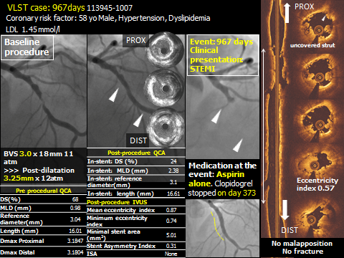
Malapposition leading to VLST
Example VLST case – ABSORB II
Malapposition
Underexpansion
(residual stenosis>20%)
Malapposition
Incorrect!

Slide 15
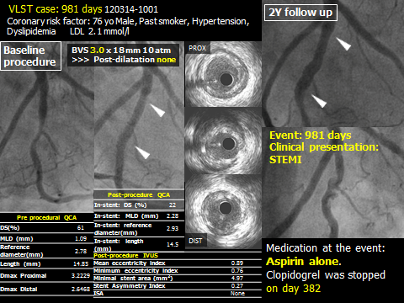
Malapposition leading to VLST
Example VLST case – ABSORB II
No high pressure post-dilatation
Malapposition
Underexpansion
(residual stenosis>20%)
Malapposition

Slide 16
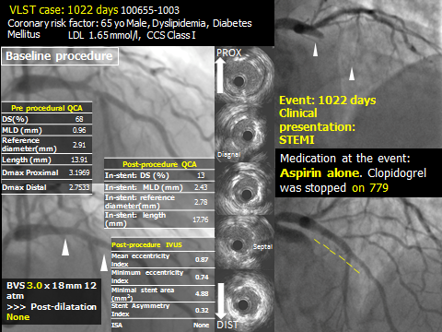
Malapposition leading to VLST
Example VLST case – ABSORB II
Malapposition
Underexpansion
(residual stenosis>15%)
No high pressure post-dilatation

Slide 17
Absorb china study structure
Objective | China Approval Trial
Design | Prospective, open label, randomized 1:1, non-inferiority, multicenter, Absorb BVS vs. XIENCE, in 448 patients, up to 25 China sites, follow-up out to 5 years
Absorb
XIENCE
Clinical
Follow-Up (Months)
1
6
12
24
36
48
60
QCA
TCT 2016
Primary Endpoints | In-segment late loss at 12 months, non-inferiority to XIENCE V (n~440)

Slide 18
ABSORB China
One Year Primary Endpoint (1-Year In-Segment LL)
Absorb Clinical Results
PTE Population
ITT Population
100%
100%
90%
90%
80%
80%
70%
Absorb BVS:
0.19 ± 0.03 (n=212)
XIENCE V:
0.13 ± 0.03 (n=208)
P_{NI} = 0.01
70%
Absorb BVS:
0.18 ± 0.03 (n=221)
XIENCE V:
0.13 ± 0.03 (n=213)
P_{NI} = 0.01
60%
60%
Cumulative Percent of Lesions
Cumulative Percent of Lesions
50%
50%
40%
40%
30%
30%
20%
20%
10%
10%
0%
0%
-1.5
-1
-0.5
0
0.5
1
1.5
2
2.5
3
3.5
-1.5
-1
-0.5
0
0.5
1
1.5
2
2.5
3
3.5
In-Segment Late Loss (mm)
In-Segment Late Loss (mm)
Summary results are adjusted using generalized estimating equations for cases in which 2 lesions were present in a single patient and presented as least square mean ± standard error.
PTE Population | Absorb BVS (N=200) | XIENCE V (N=195) | NI P-value
Per-Subject Analysis | 0.19 | 0.13 | 0.01
Gao R., TCT 2015

Slide 19

ABSORB CHINA at 2 years: Absorb continues to show COMPARABLE clinical results to xience
Absorb Clinical Results
At 1 year, primary endpoint was successfully met
(angiographic in-segment late loss)
Event Rate %
Gao, R., ABSORB China 2-Year, TCT 2016.
P = NS for all endpoints.
Study is not powered to detect small differences in clinical endpoints.
Notes:
The components of both the patient-oriented composite endpoint and the device-oriented composite endpoint were all comparably low in both arms.

Slide 20
ABSORB CHINA at 2 years: Absorb continues to show COMPARABLE clinical results to xience
Absorb Clinical Results
Absorb (N=241)
XIENCE (N=239)
 |  |  |  |  |  |  |  |  | 
 |  |  |  |  |  |  |  |  | 
 |  |  |  |  |  |  |  |  | 
 |  |  |  |  |  |  |  |  | 
 |  |  |  |  |  |  |  |  | 
 |  |  |  |  |  |  |  |  | 
 |  |  |  |  |  |  |  |  | 
 |  |  |  |  |  |  |  |  | 
 |  |  |  |  |  |  |  |  | 
 |  |  |  |  |  |  |  |  | 
 |  |  |  |  |  |  |  |  | 
 |  |  |  |  |  |  |  |  | 
 |  |  |  |  |  |  |  |  | 
 |  |  |  |  |  |  |  |  | 
 |  |  |  |  |  |  |  |  | 
 |  |  |  |  |  |  |  |  | 
 |  |  |  |  |  |  |  |  | 
 |  |  |  |  |  |  |  |  | 
 |  |  |  |  |  |  |  |  | 
 |  |  |  |  |  |  |  |  | 
Event Free = 89.9%
Event Free = 88.6%
PoCE= 10.1%
PoCE= 11.4%
DoCE= 4.2%
DoCE= 4.6%
Def/Prob ST = 0.8%
Def/Prob ST = 0.0%
Derived from Gao, R., ABSORB China 2-Year, TCT 2016.
Study is not powered to detect small differences in low frequency events.
Notes:
The clinical outcomes at 2 years demonstrate that Absorb continues to show comparable clinical results to XIENCE, with very low event rates in both arms.

Slide 21
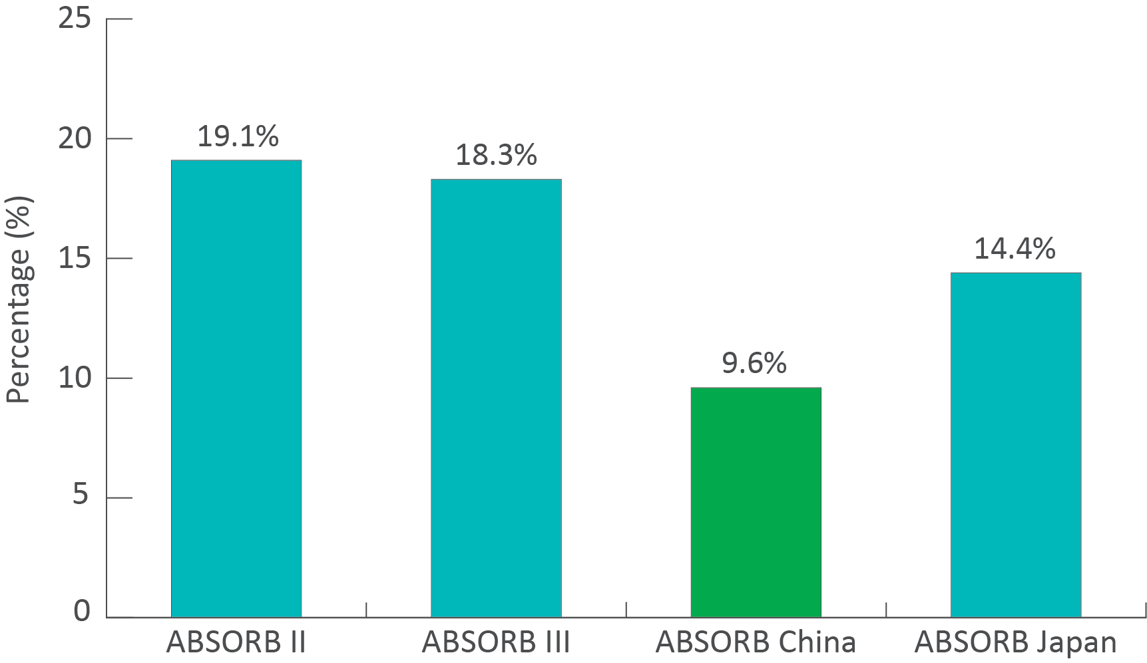
DATA supports need for proper implantation technique to ensure good clinical outcomes
Absorb Clinical Results
Absorb China included lowest percentage of small vessels.
Proper vessel sizing & avoiding very small vessels are critical components of PSP.
% Lesions with RVD < 2.25 mm
Gao, R., ABSORB China 2-Year, TCT 2016.
Study is not powered to detect small differences in clinical endpoints.
Notes:
Interestingly, ABSORB China enrolled the lowest percentage of very small vessels across all of the ABSORB randomized trials, which may be one reason the results are so good.
You may recall that an analysis of ABSORB III 12-month data showed an increased risk for scaffold thrombosis in very small vessels, prompting our guidance to avoid implanting Absorb in vessels with an RVS less than 2.5 mm by visual estimation (less than 2.25 mm by QCA).

Slide 22
DATA supports need for proper implantation technique to ensure good clinical outcomes
Absorb Clinical Results
Absorb China vs. Absorb Japan vs. Absorb III (ITT Population)
Difference between visual assessment and QCA for RVD*
Absorb China (N=480) (L=503) | Absorb Japan (N=400) (L=412) | Absorb III (N=2,008) (L=2,098) | P-value
0.25 ± 0.31 (501) | 0.33 ± 0.33 (411) | --- | 0.0001
0.25 ± 0.31 (501) | --- | 0.33 ± 0.36 (2,088) | <0.0001
*Difference = Visual Assessment – QCA
Absorb China Performed the Best in Vessel Sizing – A Critical Component of PSP
Gao, R., ABSORB China 2-Year, TCT 2016.
Study is not powered to detect small differences in clinical endpoints.
Notes:
Investigators in ABSORB China were also very accurate with their vessel sizing. Proper sizing is one of the key elements of PSP.

Slide 23
DATA supports need for proper implantation technique to ensure good clinical outcomes
Absorb Clinical Results
PSP Analysis for TLF and ST
 |  | Complete PSP* | No PSP
TLF | 0-1 Year | 0% (0/32) | 3.9% (8/205)
 | 1-2 Years | 0% (0/32) | 1.5% (3/204)
ST | 0-1 Year | 0% (0/32) | 0.5% (1/205)
 | 1-2 Years | 0% (0/32) | 0.5% (1/204)
This is a post-hoc analysis for hypothesis-generating only.
*PSP analysis (all lesions must satisfy all the criteria below) based on As-treated population:
  Pre-dilatation
  Sizing (vessel): 2.25mm ≤ QCA RVD ≤ 3.5 mm
  Post-dilatation:
    Pressure > 16 atm
    Balloon diameter: scaffold diameter > 1:1 and balloon diameter ≤ scaffold diameter + 0.5mm
Gao, R., ABSORB China 2-Year, TCT 2016.
Study is not powered to detect small differences in clinical endpoints.
Notes:
A post-hoc, hypothesis-generating PSP analysis once again illustrates the positive impact of proper implantation technique for reducing the incidence of TLF and ST.

Slide 24
SUMMARY – ABSORB CHINA
ABSORB China achieved a better vessel sizing as demonstrated by the smallest difference between visual assessment and QCA and the lowest percentage of small vessel treatment among the ABSORB RCTs.
Procedural compliance of PSP is important of good clinical outcomes of ABSORB BVS.
  ABSORB CHINA shows highly comparable clinical results to XIENCE, and had the lowest percent of very small vessels (RVD<2.25 mm) enrolled across all the RCTs. Both ABSORB-II and ABSORB-China were powered for imaging-based primary endpoints, and underpowered for clinical assessments.
Gao, R., ABSORB China 2-Year, TCT 2016.

Slide 25
PSP ANALYSIS
Absorb clinical results
HAVING NOTHING
CAN MEAN EVERYTHING

Slide 26
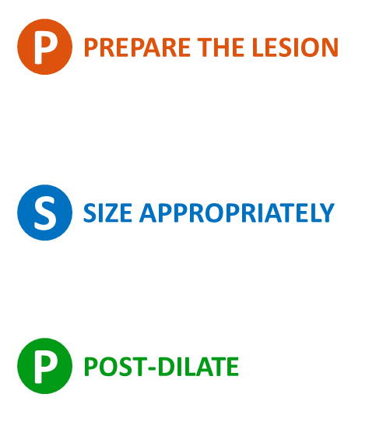
OBJECTIVES
P
S
P
Comparable results to best in class DES can be achieved with optimal implantation technique
OBJECTIVE
Prepare lesion to receive scaffold
Facilitate delivery
Enable full expansion of pre-dilatation balloon to facilitate full scaffold expansion
OBJECTIVE
Accurately size the vessel
Select appropriate scaffold for “best fit”
OBJECTIVE
Achieve <10% final residual stenosis
Ensure full strut apposition
PRESCRIBE DAPT
Consider current ACC/AHA and ESC DAPT guidelines: Aspirin (minimum 81 mg PO QD), Clopidogrel (minimum 300 mg load at procedure and 75 mg PO QD)
As with any DES procedure, patients should be selected who will be able to comply with DAPT for the duration prescribed by their physician; the Absorb GT1 Instructions For Use (IFU) recommends a minimum of 6 months DAPT
Wright, RS, et al., Circulation. 2011; 123: 2022-2060. / Wijns, W, et al., European Heart Journal. 2010; 31: 2501-2555. / Levine, GN, et al., Circulation. 2011; 124: 2574-2651. / Steg, PG, et al., European Heart Journal. 2012; 33: 2569-2619. / O’Gara, PT, et al., Circulation. 2013; 127: 529-555.
26
Notes:
Recently, we simplified our implantation guidance to the three-letter acronym PSP. The objectives of PSP are outlined here.
The goal of PSP is to help ensure full scaffold expansion and strut apposition, which are critical for good outcomes.

Slide 27
ABSORB achieves COMPARABLE RESULTS TO BEST IN CLASS DES WHEN IMPLANTED PROPERLY (psp)
Optimal implantation technique substantially reduces adverse events, now confirmed in GHOST-EU analysis
1-Year GHOST-EU Data Analysis: Complete PSP versus Incomplete PSP
7.4
Event Rate %
P=0.037
P=0.095
2.3
1.5
0.0
Brugaletta, S., GHOST-EU PSP Analysis, TCT 2016.

Slide 28
ABSORB achieves COMPARABLE SHORT AND LONG TERM RESULTS TO BEST-IN-CLASS DES WHEN IMPLANTED PROPERLY (psp)
Absorb Clinical Results
Optimal implantation technique substantially reduces adverse events,
now confirmed in analysis of ABSORB trials
1-3-Year ABSORB Data Analysis: PSP versus No PSP
 |  | No PSP | PSP
0-1Y | Absorb Extend, Absorb II, Absorb Japan, Absorb China, Absorb III | N=2549 | N=297
1-2Y | Absorb Extend, Absorb II, Absorb Japan, Absorb China | N=1405 | N=199
1-3Y | Absorb II | N=307 | N=23
Rizik, D., ABSORB PSP Analysis, TCT 2016.
Notes:
Dr.Rizik presented a similar analysis of data from the ABSORB trials, also comparing those patients implanted using PSP to those implanted without adherence to PSP. Once again, the results are impressive, showing a substantial reduction in events when PSP is followed.
All of these data represent a growing body of evidence pointing to the importance of proper implantation technique for achieving excellent clinical outcomes that are comparable to best in class DES.

Slide 29
Impact of Individual Components of PSP
Absorb Clinical Results
ST
Sizing Appears to Optimize 1-year ST
Post-Dilatation Appears to Optimize Later ST
Time | PSP Component | Yes PSP | No PSP | P-value
0-1 Year | 2.25mm ≤ QCA RVD ≤ 3.5mm | 0.8% (18/2235) | 2.6% (15/585) | 0.001
 | Post-dilatation | 1.2% (23/1885) | 1.3% (12/954) | 0.93
 | Post-dilatation + >16atm | 1.0% (7/701) | 1.3% (28/2122) | 0.51
 | Post-dilatation + >16atm + >1:1 | 0.8% (3/360) | 1.3% (32/2456) | 0.46
1-2 Years | 2.25mm ≤ QCA RVD ≤ 3.5mm | 0.9% (11/1269) | 0.0% (0/303) | 0.14
 | Post-dilatation | 0.6% (6/1080) | 1.0% (5/505) | 0.34
 | Post-dilatation + >16atm | 0.5% (2/423) | 0.8% (9/1160) | 0.52
 | Post-dilatation + >16atm + >1:1 | 0.0% (0/229) | 0.8% (11/1344) | 0.38
1-3 Years | 2.25mm ≤ QCA RVD ≤ 3.5mm | 2.5% (6/240) | 0.0% (0/75) | 0.34
 | Post-dilatation | 1.6% (3/189) | 2.4% (3/126) | 0.62
 | Post-dilatation + >16atm | 0.0% (0/49) | 2.3% (6/265) | 0.60
 | Post-dilatation + >16atm + >1:1 | 0.0% (0/26) | 2.1% (6/289) | >0.99
Ellis, S., ABSORB Trials PSP Analysis, TCT 2016
Notes:
Important learnings that are starting to emerge is that proper vessel sizing, and in particular avoiding implanting Absorb in very small vessels, appears to minimize ST rates in the first year. Post-dilatation appears to play an important role in late and very late outcomes, by helping ensure full expansion and apposition of the scaffold.

Slide 30
Impact of Individual Components of PSP
Absorb Clinical Results
TLF
Sizing Appears to Optimize 1-year TLF
Post-Dilatation Appears to Optimize Later TLF
Time | PSP Component | Yes PSP | No PSP | P-value
0-1 Year | 2.25mm ≤ QCA RVD ≤ 3.5mm | 5.3% (120/2250) | 5.8% (56/959) | 0.001
 | Post-dilatation | 6.3% (119/1899) | 5.8% (56/959) | 0.65
 | Post-dilatation + >16atm | 6.5% (46/705) | 6.0% (129/2137) | 0.64
 | Post-dilatation + >16atm + >1:1 | 5.8% (21/362) | 6.2% (153/2473) | 0.78
1-2 Years | 2.25mm ≤ QCA RVD ≤ 3.5mm | 3.0% (38/1272) | 2.6% (8/304) | 0.74
 | Post-dilatation | 2.9% (31/1081) | 3.0% (15/508) | 0.92
 | Post-dilatation + >16atm | 2.1% (9/423) | 3.2% (37/1164) | 0.27
 | Post-dilatation + >16atm + >1:1 | 0.9% (2/229) | 3.3% (44/1348) | 0.06
1-3 Years | 2.25mm ≤ QCA RVD ≤ 3.5mm | 7.0% (17/243) | 5.3% (4/75) | 0.61
 | Post-dilatation | 5.8% (11/189) | 7.8% (10/129) | 0.50
 | Post-dilatation + >16atm | 4.1% (2/49) | 7.1% (19/268) | 0.44
 | Post-dilatation + >16atm + >1:1 | 0.0% (0/26) | 7.2% (21/292) | 0.24
Ellis, S., ABSORB Trials PSP Analysis, TCT 2016
Notes:
The same trends seen in the scaffold thrombosis data are also seen here in the analysis looking at TLF.
Proper sizing and high pressure post-dilatation with a non-compliant balloon that is slightly larger than the nominal scaffold size are critical elements of PSP that are imperative for achieving good clinical outcomes.

Slide 31
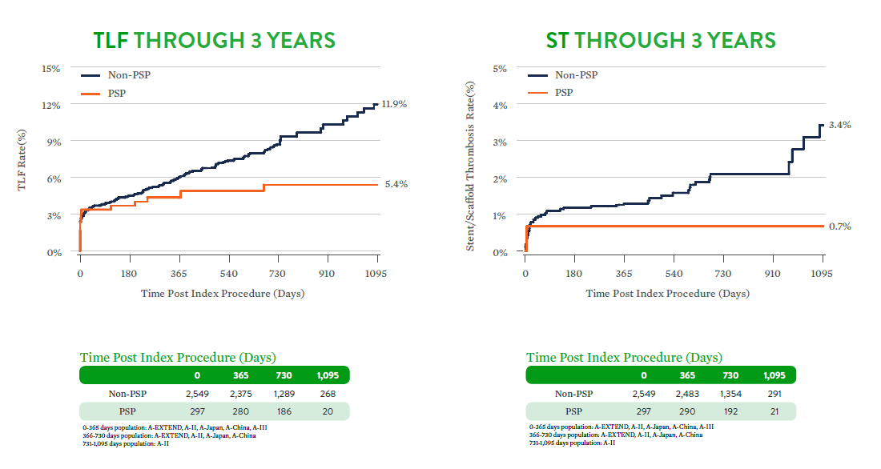
Impact of PSP on TLF and ST Rates
Absorb Clinical Results
Adapted from Ellis, S., ABSORB Trials PSP Analysis, TCT 2016
Notes:
The same trends seen in the scaffold thrombosis data are also seen here in the analysis looking at TLF.
Proper sizing and high pressure post-dilatation with a non-compliant balloon that is slightly larger than the nominal scaffold size are critical elements of PSP that are imperative for achieving good clinical outcomes.

Slide 32
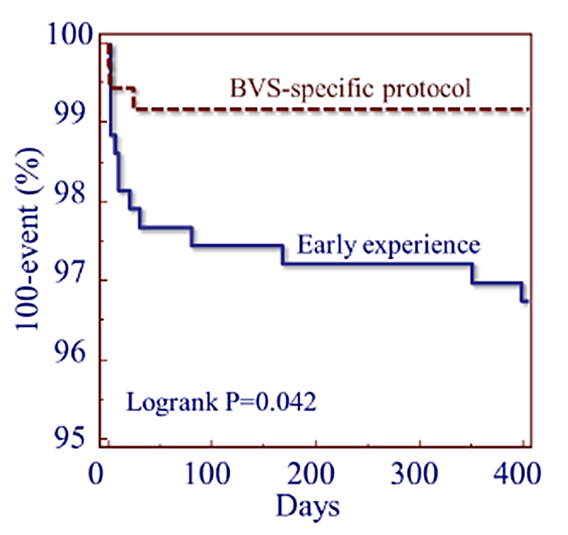
Learning Curve
A BVS-specific implantation strategy can improve outcomes
Absorb Clinical Results
P
PREPARE THE LESION
S
SIZE APPROPRIATELY
P
POST-DILATE
2011
2012
2013
2014
2015
2016
Enrollment & Follow-up
1Y
4 Cities
International Registry
N ~ 1,300
Nitrates
P
Pre-dilate
Sizing with balloon (1:1:1)
2 angiographic planes
S
Low threshold for intravascular imaging
Implant following IFU
NC post-dilation (+0.5mm)
P
Do not accept:
MLD<2.5/2.9mm
MLA <4.9/6.6mm ²
Adapted from Gori, T., EuroPCR 2015

Slide 33
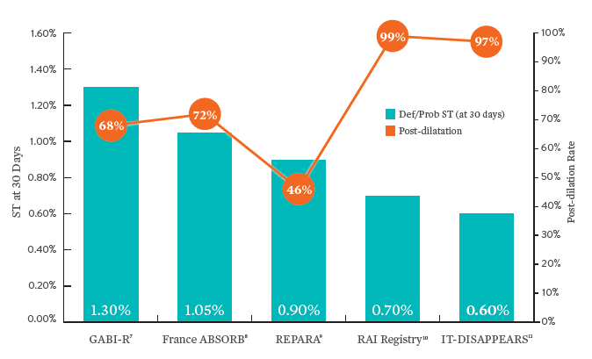
ABSORB achieves COMPARABLE SHORT AND LONG TERM RESULTS TO BEST IN CLASS DES WHEN IMPLANTED PROPERLY
Optimal implantation technique substantially reduces adverse events, confirmed in large real-world registries
1
2
3
4
5
1. Hamm, C. GABI-R, EuroPCR 2016. / 2. Koning, R., France ABSORB Registry, EuroPCR 2016. / 3. Hernandez, F., REPARA, EuroPCR 2016. / 4. Cortese, B. RAI, EuroPCR 2016. / 5. Petronio, A.S., IT-DISAPPEARS, EuroPCR 2016.

Slide 34
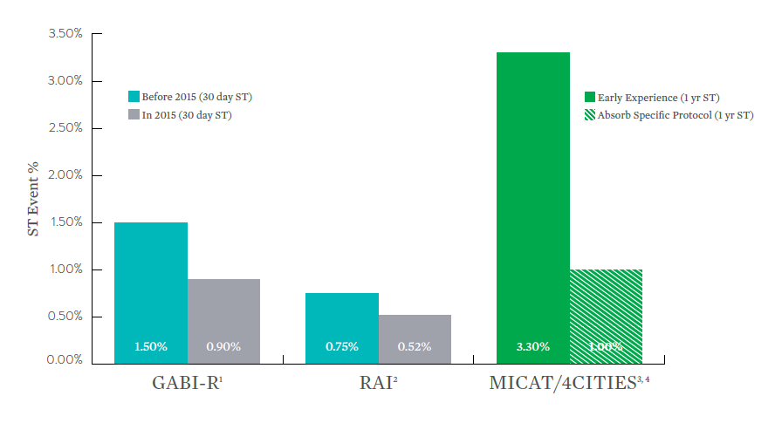
ABSORB achieves COMPARABLE SHORT AND LONG TERM RESULTS TO BEST IN CLASS DES WHEN IMPLANTED PROPERLY
Improvement over time due to patient/lesion selection and improved technique
¹Hamm, C. GABI-R, EuroPCR 2016. / ²Cortese, B. RAI, EuroPCR 2016. / ³Puricell, S., et al. Bioresorbable Coronary Scaffold Thrombosis, J Am Coll Cardiol. 2016;67:921–31. / ⁴Gori, T. 4 Cities Registry, EuroPCR 2015.

Slide 35
UNDEREXPANSION, MALAPPOSITION AND RESIDUAL STENOSIS ARE IMPORTANT CONTRIBUTORS TO EARLY AND LATE EVENTS FOR ABSORB AND ARE MITIGATED BY PSP
Early ST | Very late ST
Frequent finding: Underexpansion Often in small vessels (e.g. ABSORB III) | Frequent finding: Malapposition and Post-PCI Residual Stenosis Often in mid-large vessels
Mitigation: RVD > 2.50 mm and PSP In particular proper sizing to ensure full expansion of the device in an appropriately sized vessel | Mitigation: PSP In particular high pressure post-dilatation with properly sized non compliant balloon (>1:1) to ensure full wall apposition and achieve <10% residual stenosis
Example: 2.5 mm device in 2.0 mm RVD
Example: 3.0 mm device in 3.25 mm RVD
without high pressure post-dilatation
Notes:
Our current understanding of the factors contributing to early and late events is summarized here.
Early scaffold thrombosis is often the result of underexpansion of the scaffold, particularly in small vessels. These events can be mitigated by avoiding the implantation of Absorb in very small vessels, and by following PSP to ensure full expansion of the device in an appropriately sized vessel.
Very late scaffold thrombosis is typically the result of underexpansion and malapposition, often in larger vessels . Most of the patients with very late thrombosis are found to have a post-PCI residual stenosis greater than 10%, and many are also found to have malapposition on imaging. PSP can mitigate these issues. High pressure post-dilatation with a properly sized non-compliant balloon will help ensure complete apposition and achieve a post-PCI residual stenosis less than 10%.

Slide 36
THANK YOU

