Slide 1
New flatform and the 2nd generation BRS
Jang-Whan Bae
Chungbuk National University, School of Medicine
Chungbuk National University Hospital,
Chungbuk Regional Cardiovascular Disease Center, Cheongju, Korea
The BRS session, JCR 2016. Dec. 10, 2016.

Slide 2
Possible advantages of BRS
Nothing of metal left behind
No more vessel irritation or chronic vessel wall inflammation
Recover natural and physiologic vessel contour and vasomotion
  ? Easier reintervention in future
  ? Potentiality of reduction very long-term potent antiplatelet agent
  ? Easier work-up with non-invasive imaging (CT/MRA) without blooming artifact
Notes:
Insuline IV injection에도 혈당에는 큰 변화가 없고 맥박에도 큰 변화가 없이 혈압의 강하가 재현됨.

Slide 3
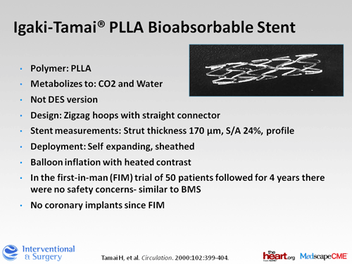
Essential materials of BRS
Igaki Tamai stent: the first use for coronary in 1998
Notes:
Insuline IV injection에도 혈당에는 큰 변화가 없고 맥박에도 큰 변화가 없이 혈압의 강하가 재현됨.

Slide 4
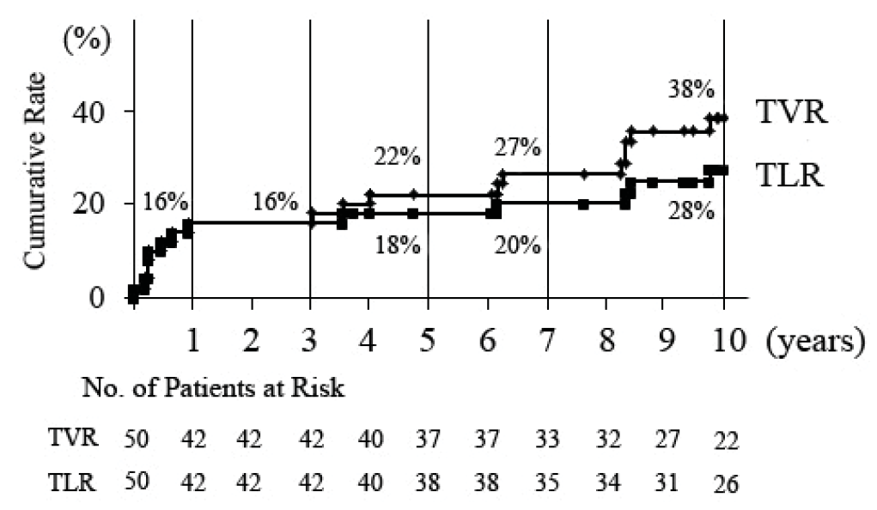
Essential materials of BRS
Igaki Tamai stent; MACE of 10 years
Nishio S. Circulation. 2012;125:2343.
Notes:
Insuline IV injection에도 혈당에는 큰 변화가 없고 맥박에도 큰 변화가 없이 혈압의 강하가 재현됨.

Slide 5
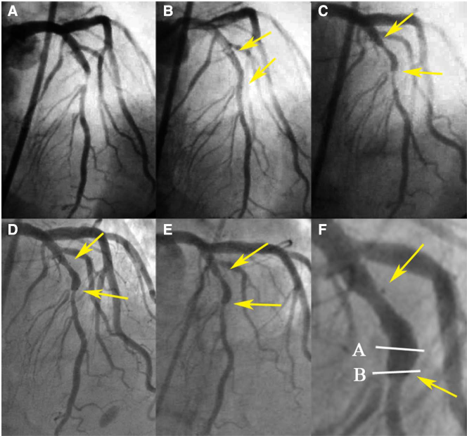
Essential materials of BRS
Igaki Tamai stent; tissue analysis of 10 years
1999.11.
1999.11.
2000. 5.
2001.11.
2005.11.
Nishio S. Circulation. 2014;129:534.
Notes:
Insuline IV injection에도 혈당에는 큰 변화가 없고 맥박에도 큰 변화가 없이 혈압의 강하가 재현됨.

Slide 6
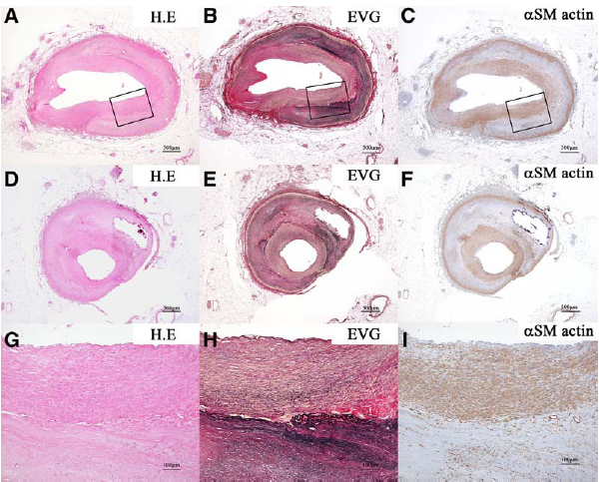
Essential materials of BRS
Igaki Tamai stent; tissue analysis of 10 years
Nishio S. Circulation. 2014;129:534.
Notes:
Disappeared PLLA scaffold
No inflammatory cell, FB reaction, thrombus, no neoatherosclerosis
EVG: connective tissue
SM: VSMC로 잘 cover

Slide 7
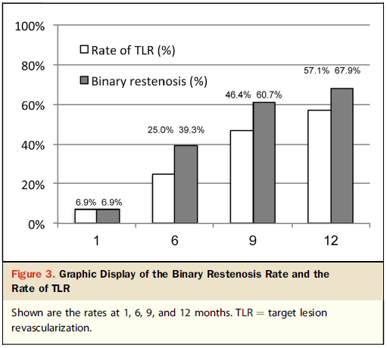
Essential materials of BRS
Igaki Tamai stent; new indication for SFA stenosis (GAIA study)
Werner M. J Am Coll Cardiol Intv. 2014;7:305.

Slide 8
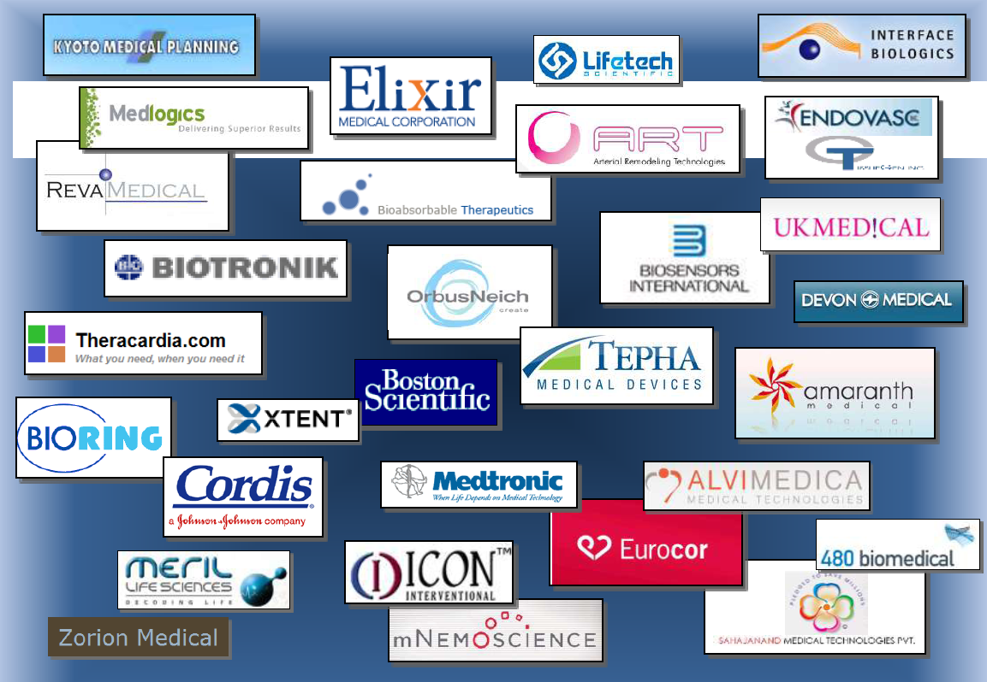
So many kinds of BRS

Slide 9
So many kinds of BRS
CE marked
Abbort Vascular Absorb
Elixir DESolve
Biotronik Magmaris
Meril MeRes100

Slide 10
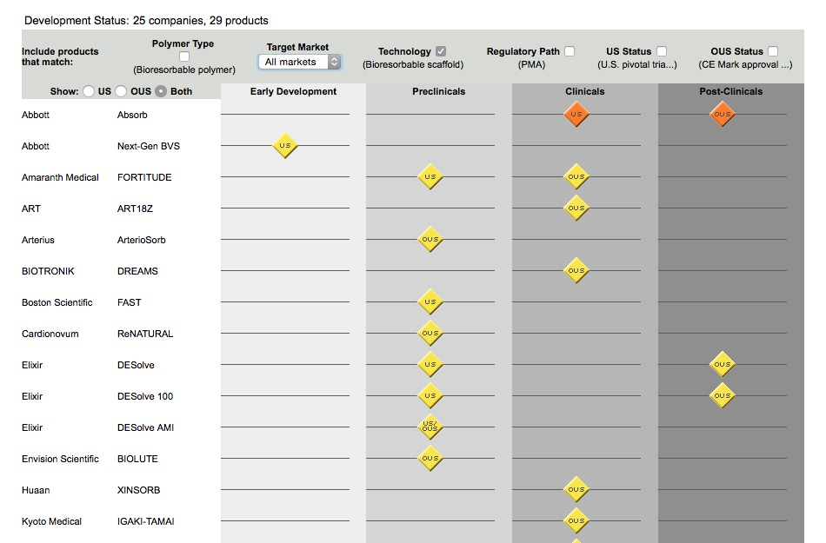
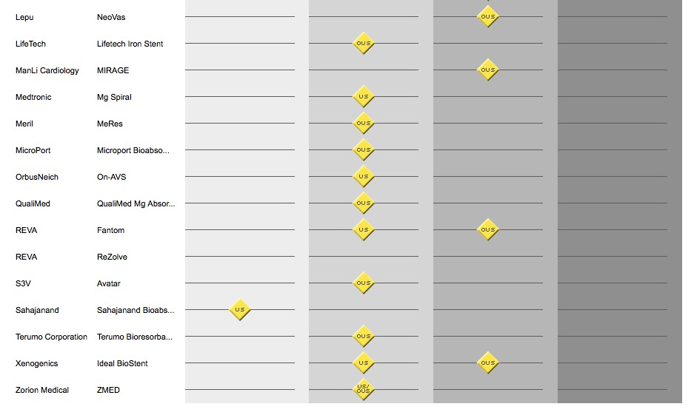
So many kinds of BRS
Abbort Vascular ABSORB
Elixir DESOLVE
Biotronik MAGMARIS
Meril MERES

Slide 11
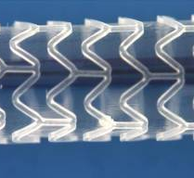
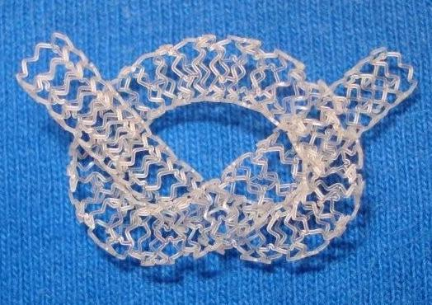
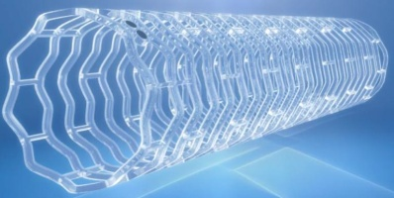
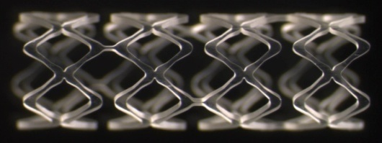
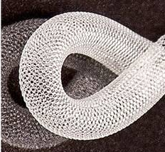
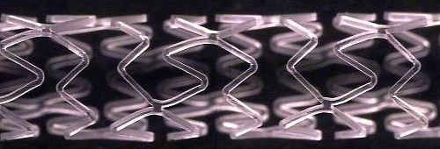
Essential materials of BRS
Aliphatic polymer
 | PRODUCT DEVELOPMENT PROGRAMS
LEADING COMPOUND: Poly (lactic acid) = PLLA and copolymers DEGRADATION END PRODUCTS: Lactic and glycolic acid (metabolites) | ABBOTT“ABSORB”” PLLA Everolimus | AMARANTH “FORTITUDE” Layered PLLA No drug
 | ELIXIR “DESolve” PLLA Myolimus/ Novolimus | ART “ART18AZ” R+D PLLA No drug
 | 480 BIOMEDICAL “STANZA” Peripheral, self- expandable PLLA | ORBUS CD34 EPC-capturing, sirolimus- eluting
 | MERIL “MeRes” PLA, Merilimus-eluting | HUAAN BIOTECH “XINSORB” PLA, PCL, PGA, Sirolimus-eluting
Gabriel Maluenda, TCT 2013

Slide 12
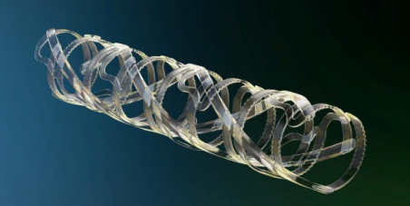
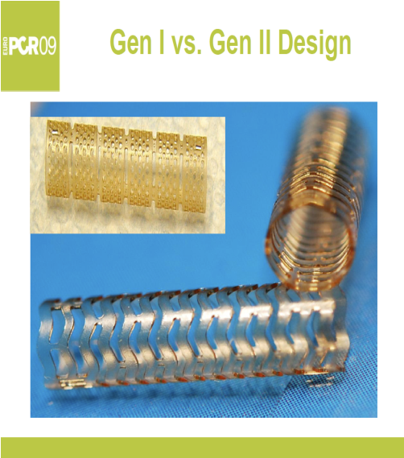
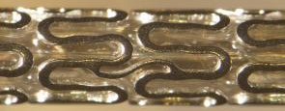
Essential materials of BRS
Other polymer
MATERIAL GROUP | LEADING COMPOUNDS/ DEGRADATION END PRODUCTS | COMPANY | PRODUCT
Polycarbonates | Aminoacids (e.g. tyrosine)/ Chemicals, metabolites, and oligomers | REVA MEDICAL | ReZolve 2 Slide-and-lock, Sirolimus eluting BVS
Poly-anhydrides | Salicylic acid and Adipic acid/ Chemicals | BTI | NONE – program not active
Metals | Magnesium/ Salts and ions (hydroxyapatite) | BIOTRONIK | Biosolve Magnesium BVS, paclitaxel eluting (sirolimus expending)
“Hybrid” | Magnesium and PLGA/ Salts, ions, metabolites | ZORION MEDICAL | Fades BVS No drug
Gabriel Maluenda, TCT 2013
Notes:
Insuline IV injection에도 혈당에는 큰 변화가 없고 맥박에도 큰 변화가 없이 혈압의 강하가 재현됨.

Slide 13
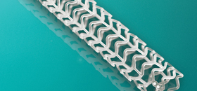
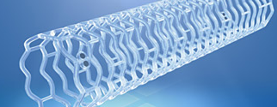
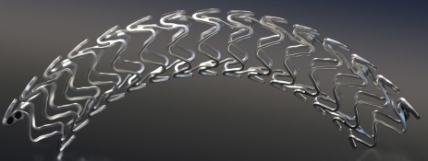
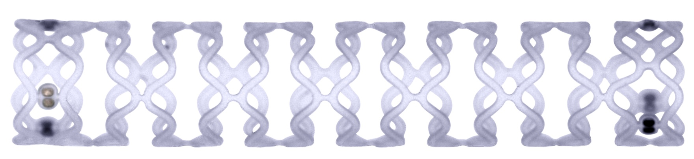
Essential materials of BRS
4 brands of BRS
Product | Company | Scaffold material | Eluting drug
Absorb | Abbott | PLLA | Everolimus
DeSolve | Elixir | PLLA | Myolimus/Novolimus
Magmaris | Biotronik | Magnesium | Sirolimus
MeRes | Meril | PLLA+PLGA | Sirolimus

Slide 14
Absrob from Abbott Vascular

Slide 15
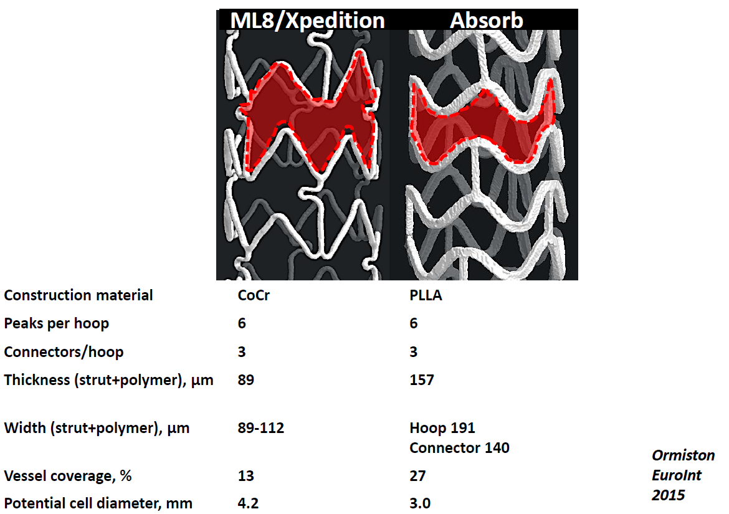
Strut design and thickness
Thicker and wider
Cypher | 140 μm
Taxus | 97 μm
Xience | 89 μm
Endeavor | 90 μm
Promus | 81 μm
ORSIRO | 60 μm
Courtesy of Pf. John Ormiston
Notes:
Especially in 1-30 days after implantation

Slide 16
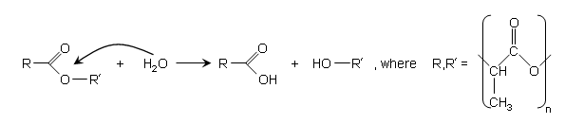
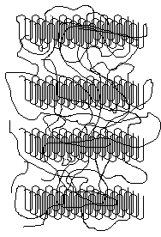
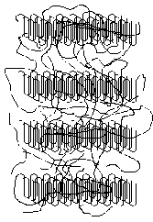
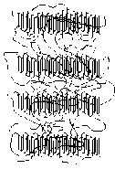
Loss of radial support at 6 months
Hydrolysis hinders radial support
Hydrolysis occurs via random chain scission of the ester bond


•
•
⊗
⊗
•
•
⊗
⊗
•
•
•
•
Tie chains
⊗
•
⊗
⊗
⊗
⊗
Hydrolysis randomly cleaves amorphous tie chains, leading to a decrease in molecular weight without altering radial strength
•
•
•
•
⊗
⊗
⊗
⊗



When enough tie chains are broken, the device begins losing radial strength



Support




Molecular Weight
⊗
⊗
⊗
⊗
Mass Loss
⊗
⊗
1
3
6
12
18
24 Mos

Slide 17
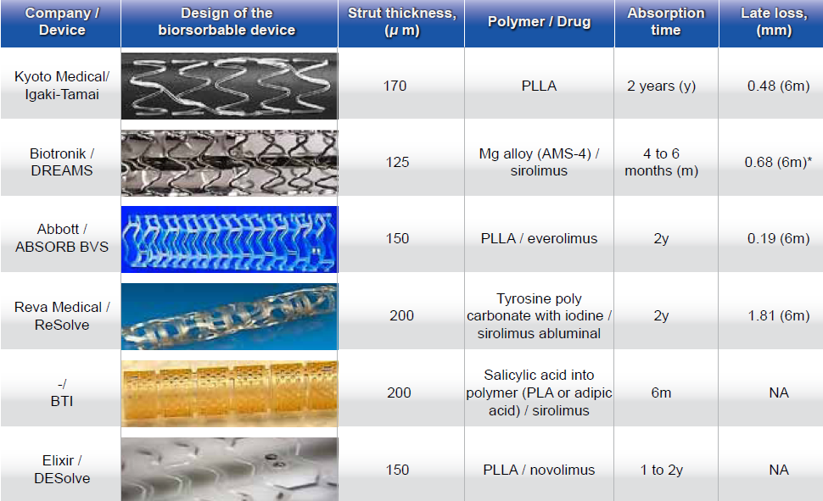
Strut thickness of BVS
Thicker and wider
Gogas BD. Hellenic J Cardiol. 2012;53:301.
Notes:
Especially in 1-30 days after implantation

Slide 18
Strut thickness of BVS
Thicker and wider
Notes:
Especially in 1-30 days after implantation

Slide 19
ABSORB; history of clinical trials

Slide 20
ABSORB-III
1 year data of Absorb (1,322 Absorb vs 686 Xience in SA & UA)
 | Absorb (%) | Xience (%) | P-value
TLF | 7.8 | 6.1 | 0.16
cardiac death | 0.6 | 0.1 | 0.29
TV MI | 6.0 | 4.6 | 0.18
Ischemic driven TLR | 3.0 | 2.5 | 0.50
Device thrombosis | 1.5 | 0.7 | 0.13
acute (< 1day) | 0.2 | 0.6 | 0.19
subacute (< 1 month) | 0.9 | 0.1 | 0.04
late | 0.5 | 0 | 0.10
N Engl J Med. 2015;373:1905.

Slide 21
ABSORB-II
3 year data of Absorb (355 Absorb vs 166 Xience)
 | Absorb | Xience | P-value
Vasomotor reactivity | 0.047±0.109 mm | 0.056±0.117 mm | P_{superiority}=0.49
Late luminal loss | 0.38±0.45 mm | 0.25±0.25 mm | P_{non-inferiority}=0.78
Minimal lumen area | 4.32±1.48 mm² | 5.38±1.51 mm² | <0.0001
Device oriented composite endpoint | 10% | 5% | HR 2.17 [95% CI 1.01-4.70]
Target vessel MI | 6% | 1% | 0.0108
Lancet. 2016;388:2479.

Slide 22
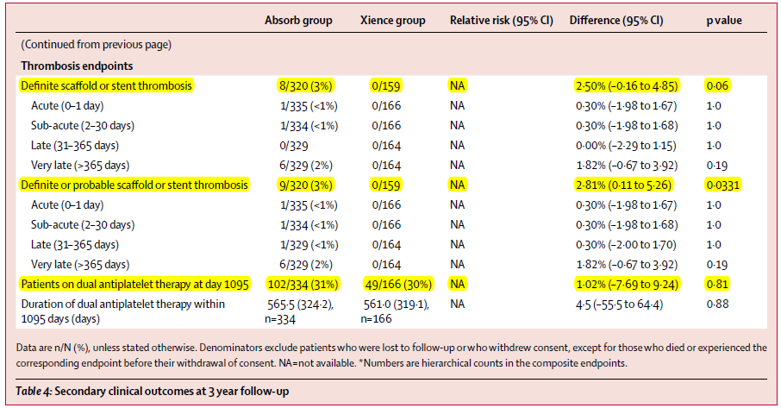
ABSORB-II
3 year data of Absorb (355 Absorb vs 166 Xience)
  Scaffold thrombosis and DAPT use
Lancet. 2016;388:2479.

Slide 23
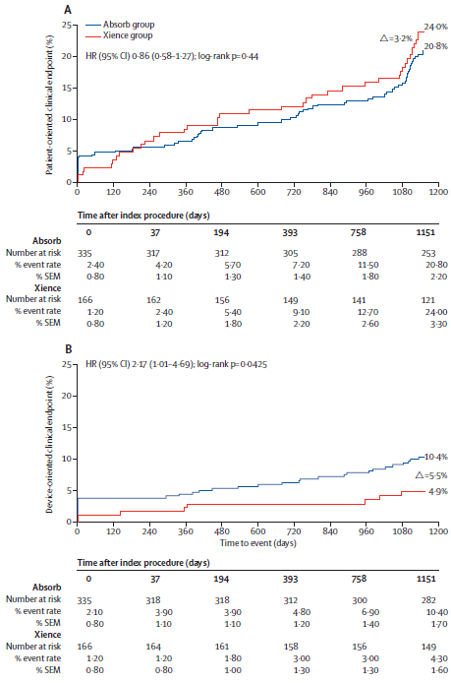
ABSORB-II
3 year data of Absorb (355 Absorb vs 166 Xience)
  Patient and device oriented clinical outcome
Lancet. 2016;388:2479.

Slide 24
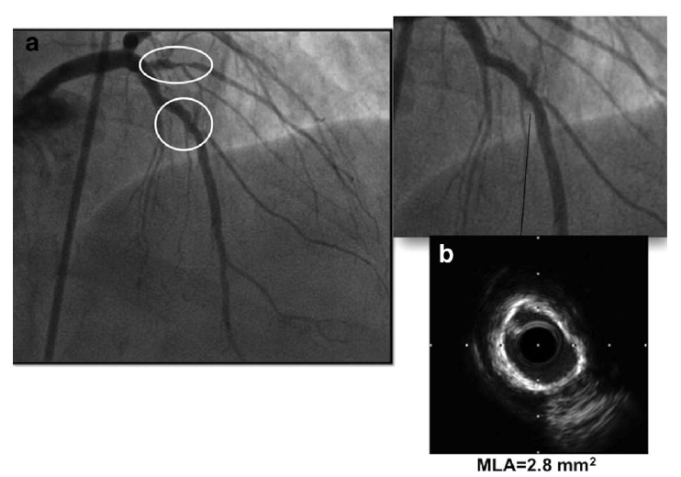
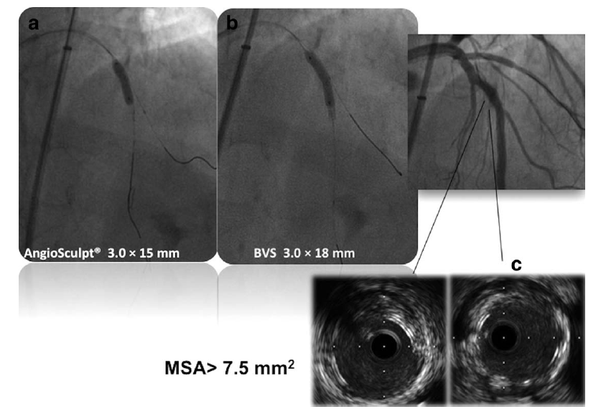
BRS in Calcified lesion
Lesion preparation, lesion preparation, lesion preparation !
Catheter Cardiovasc Interv. 2014;84:48.
Notes:
Colombo group showed series of case for using BVS in calcified lesion

Slide 25
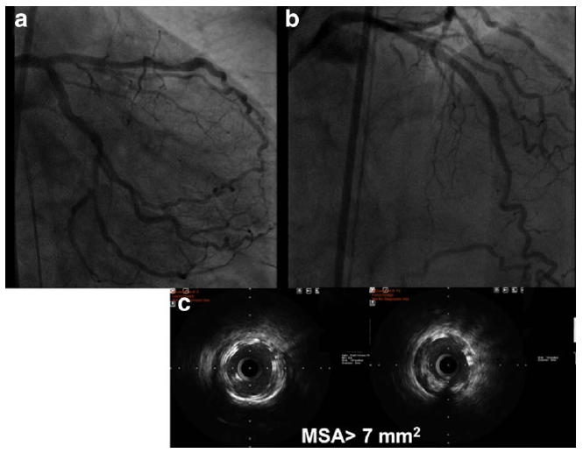
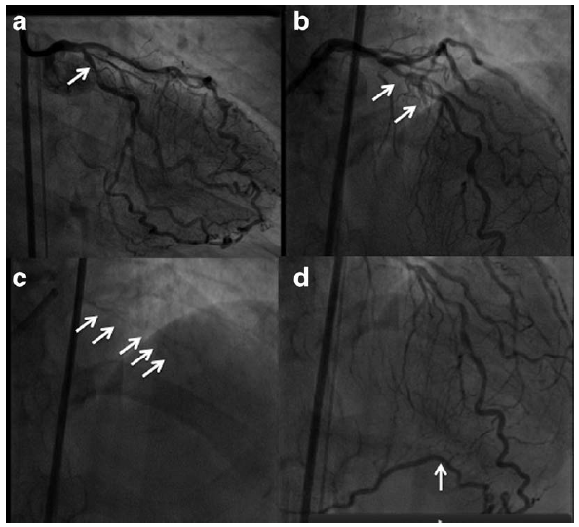
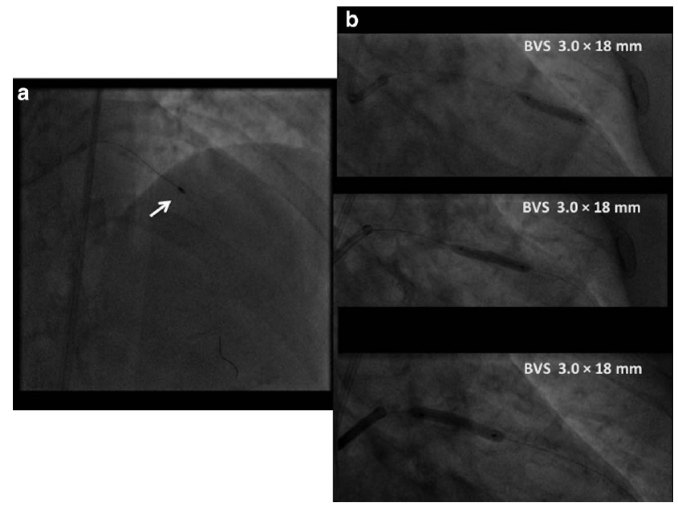
BRS in Calcified lesion
Lesion preparation, lesion preparation, lesion preparation !
Catheter Cardiovasc Interv. 2014;84:48.

Slide 26
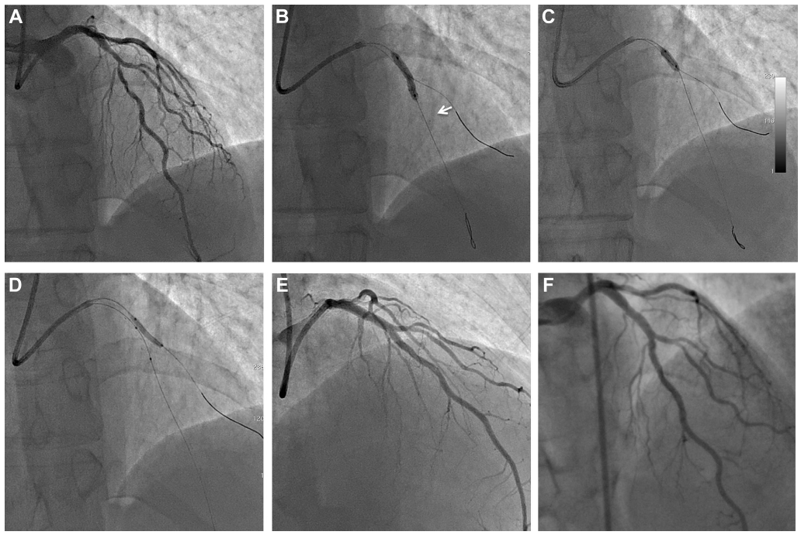
POT and FKB in bifurcation lesion with BVS
LAD/D1 bifurcation lesion
BVS 2.5X18 mm+ 3.0X18 mm
POT NC 3.5X8 mm
FKB 3.0X15 mm NC+2.5X15 mm NC (8 atm)
NC 2.5X15 mm for D1 (12 atm)
Canadian J Cardilol. 2014;30:1461.
Notes:
Drs in gran canaria in Spain

Slide 27
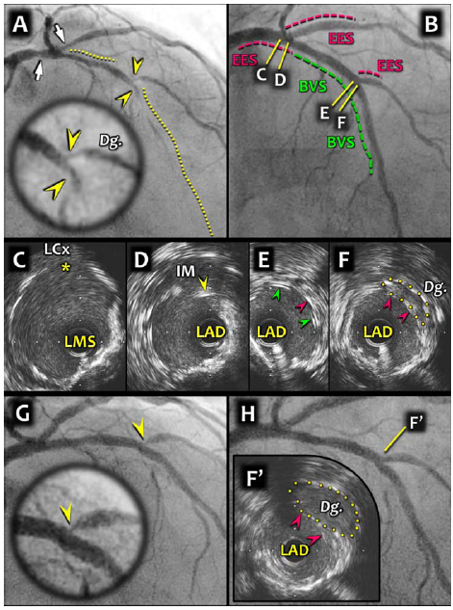
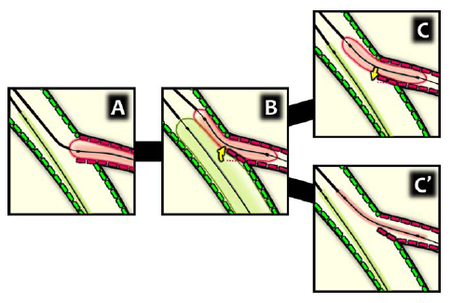
Tentative plan for bifurcation lesion
Initially one stenting
  SB compromise: careful KB angioplasty
  Still SB compromise: T stent with small protrusion (metallic stent in SB)
Catheter Cardiovasc Interv. 2015;86:682.
Notes:
Colombo lab’s plan for bifurcation lesion
MB는 BVS를 하고 (deflation하고) SB에 DES를 넣고, B) KBAP를 하고 C)MB deflation하고 나서 SB을 deflation해야한다.
C’은 잘 못 된 예로 함께 deflation을 하면 SB의 edge가 좋지 않게 된다.

Slide 28
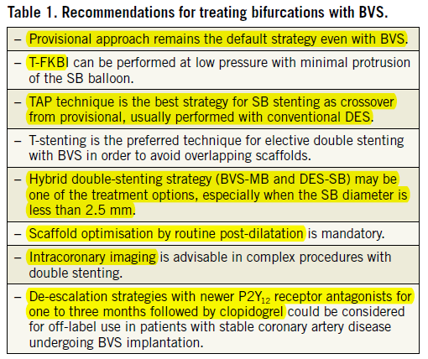
Tentative plan for bifurcation lesion
Lessons from GHOST-EU registry
  Bifurcation procedure: 25%
EuroIntervention. 2015;11:V170.

Slide 29
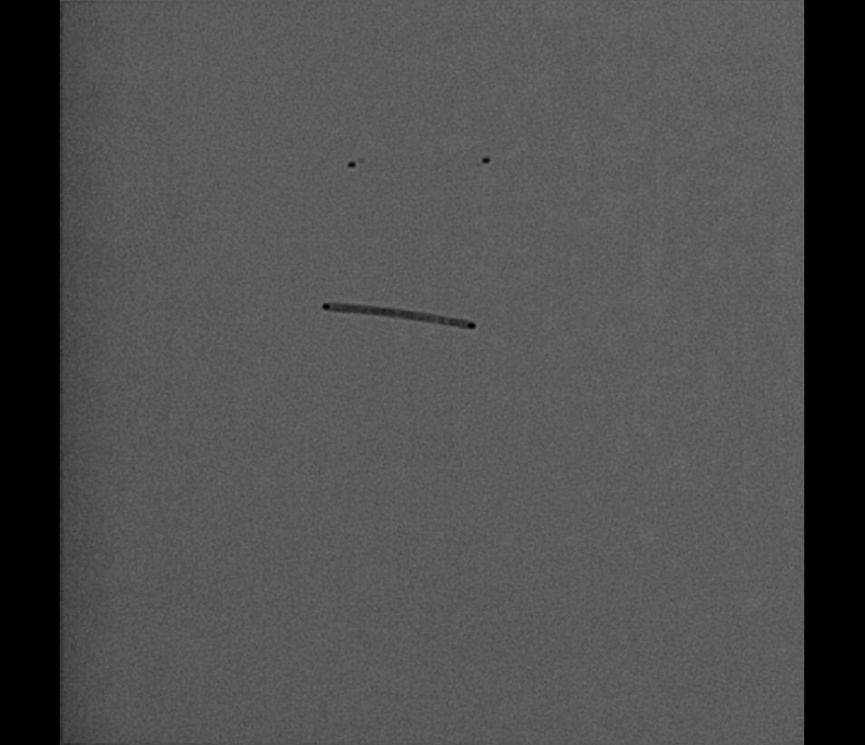
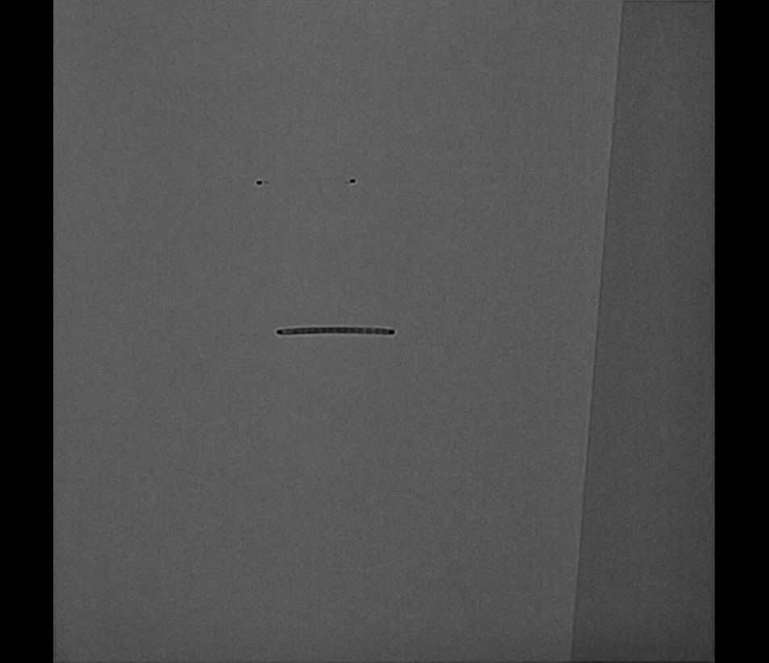
Bench or mischief ?
Radiopacity
  After removal of balloon, you will loose stent position in calcified lesion.
Notes:
Side branch balloon proximal marker must be positioned at SB exit site or little bit more into MB with less than 10 atm

Slide 30
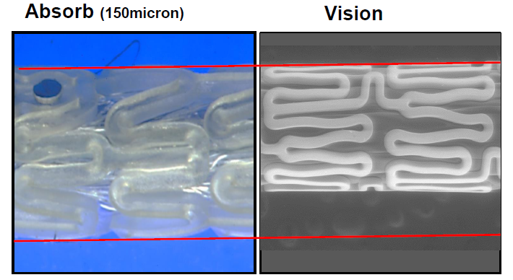
Crossing profile
Larger then metallic stent
1.43 mm
1.14 mm
Courtesy of Pf. John Ormiston
Notes:
Side branch balloon proximal marker must be positioned at SB exit site or little bit more into MB with less than 10 atm

Slide 31
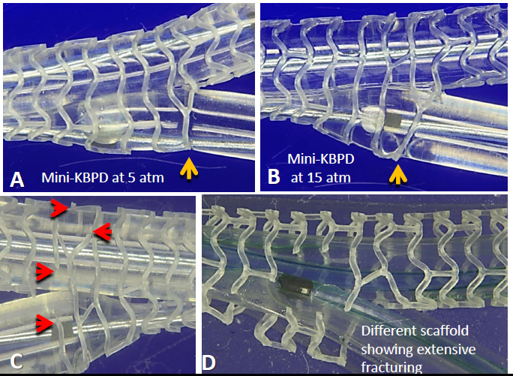
Don’t even think about full length KB dilation
Mini-KB dilation with two 3.0 mm NC balloons in 3.0 mm BVS
Courtesy of Pf. John Ormiston
Notes:
Side branch balloon proximal marker must be positioned at SB exit site or little bit more into MB with less than 10 atm

Slide 32
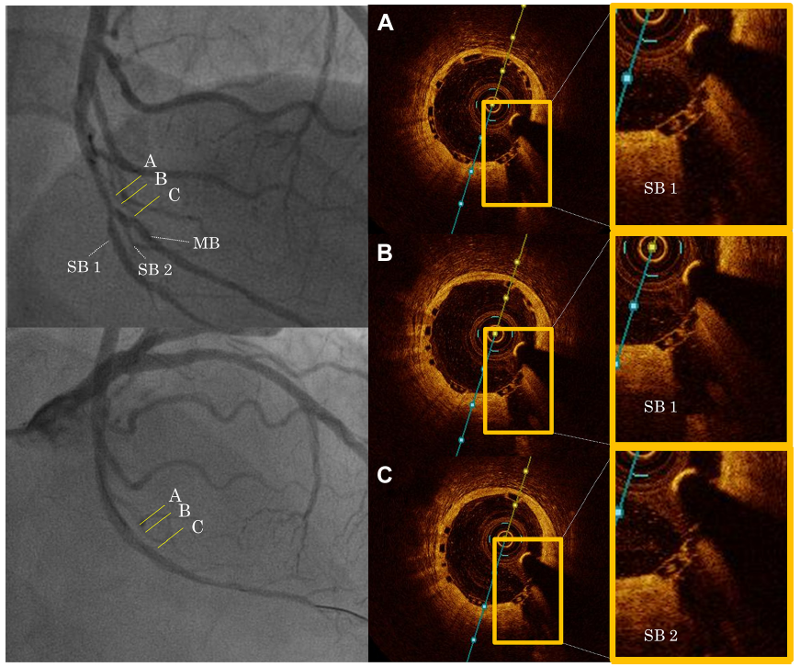
Side branch occlusion in BVS
Thick BVS strut occluded side branch of distal LCx.
JACC Cardiovasc Interv. 2015;8:116.
Notes:
Colombo lab – SBO due to thickened strut, not plaque shift

Slide 33
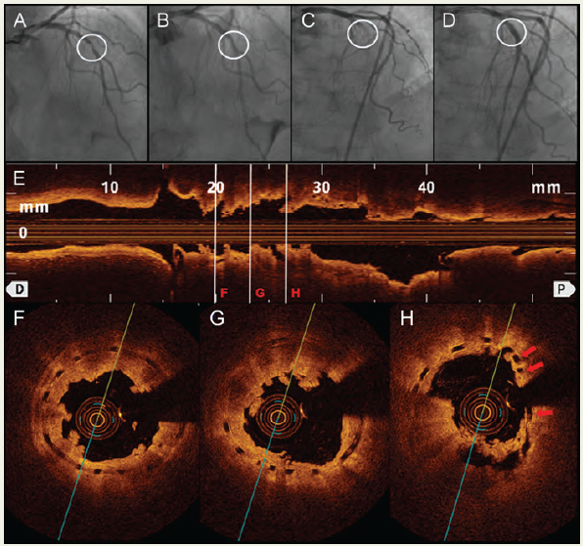
Acute scaffold thrombosis
The 1st acute scaffold thrombosis in ACS
  Associated with strut malapposition even after 12 atm inflation
  Treated with TA, Biolimus eluting stent implantation and NC ballooning
Eur Heart J. 2013;34:2046.
Notes:
D. Residual thrombus, uncovered BVS strut
E. In short axis – underexpansion
F. In short axis – uncovered BVS strut 결국 DES를 삽입함.

Slide 34
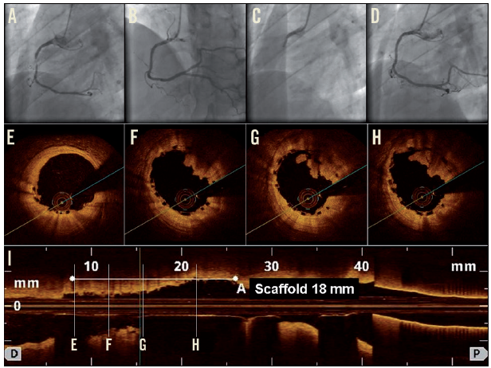
Acute scaffold thrombosis
The 1st acute scaffold thrombosis in STEMI (3.0X18 ABSORB)
  No mechanical abnormality in OCT after TA
  Treated with TA, abciximab, and balloon dilation (3.25 mm NC balloon – 20 atm)
Fernandez-Rodriquez D. EuroIntervention 2014;10:600.
Notes:
No scaffold edge dissection, strut fracture, or malapposition

Slide 35
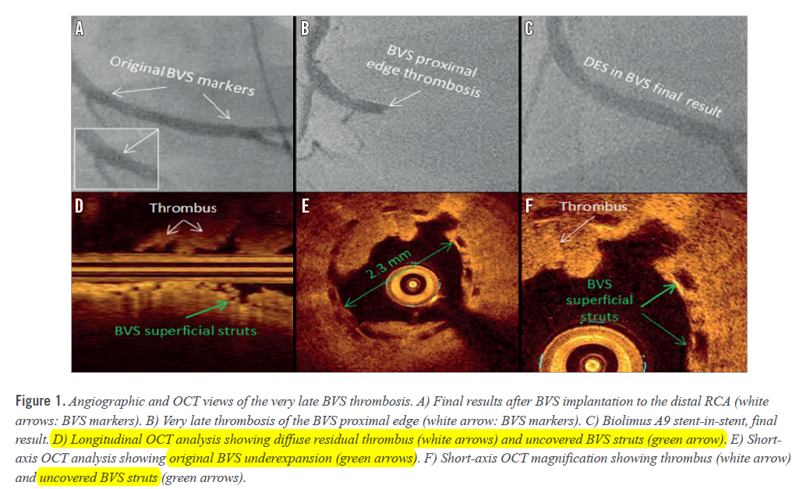
Very late stent thrombosis
VLST (565 days) after 3.5X12 mm BVS implantation
  Index lesion: acute thrombotic occlusive lesion
  DAPT for 1 year, aspirin 100 mg qd there after
EuroIntervention. 2015;11:e1.
Notes:
D. Residual thrombus, uncovered BVS strut
E. In short axis – underexpansion
F. In short axis – uncovered BVS strut 결국 DES를 삽입함.

Slide 36
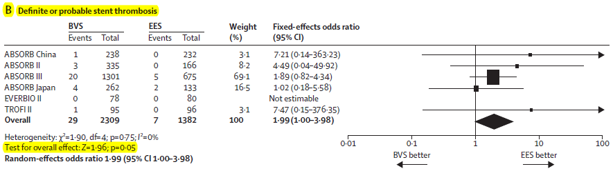
Definite and probable thrombosis
Higher thrombosis rate compared to EES
Lancet. 2015;Nov 16, Epub ahead of print
Notes:
Especially in 1-30 days after implantation

Slide 37
Definite and probable thrombosis
 |  |  |  | TCT 2015
 |  |  | ABSORB Meta-analysis² | ABSORB III³ | ABSORB CHINA⁴ | ABSORB JAPAN⁵ | ABSORB II⁶
Presenter |  |  | G. Stone | D. Kereiakes | R. Gao | T. Kimura | B. Chevalier
Data presented on… |  |  | 3,389 patients | 2,008 patients | 480 patients | 400 patients | 501 patients
…with FU to… |  |  | @ 1 year | @ 1 year | @ 1 year | @ 1 year | @ 2 years
Cl inical Resul ts | All Death |  | 0.8% | 1.1% | 0.0% | 0.8% | 1.2%
 | Cardiac Death |  | 0.4% | 0.6% | 0.0% | 0.0% | 0.6%
 | All MI |  | 5.7% | 6.9% | 2.1% | 3.4% | 5.8%
 | QMI |  |  | 0.8% | 0.8% | 1.1% | 1.5%
 | NQMI |  |  | 6.1% | 1.3% | 2.3% | 4.3%
 | All Revascularization |  | 7.9% | 9.1% | 6.7% | 7.9% | 5.8%
 | TLR |  | 2.7% | 3.0% | 2.5% | 2.6% | 2.7%
 | TVR |  | 4.3% |  |  | 4.9% | 1.5%
 | MACE |  |  |  |  |  | 7.6%
 | TLF |  | 6.6% | 7.8% | 3.4% | 4.2% | 7.0%
 | TVF |  |  |  | 4.2% | 6.0% | 8.5%
 | DEF/Prob ST (ARC) |  | 1.3% | 1.5% | 0.4% | 1.5% | 1.5%
 | Acute (<1day) |  |  |  |  | 0.0%
 | Subacute (1-30 d) |  |  |  |  | 1.1%
 | Late (31d-365d) |  | 0.4% | 0.46% | 0.0% | 0.4% | 0.3%
 | POCE (DMR) |  | 11.9% |  |  |  | 11.6%
Notes:
About 1.5% definitive and probable ST about 1-2 years

Slide 38
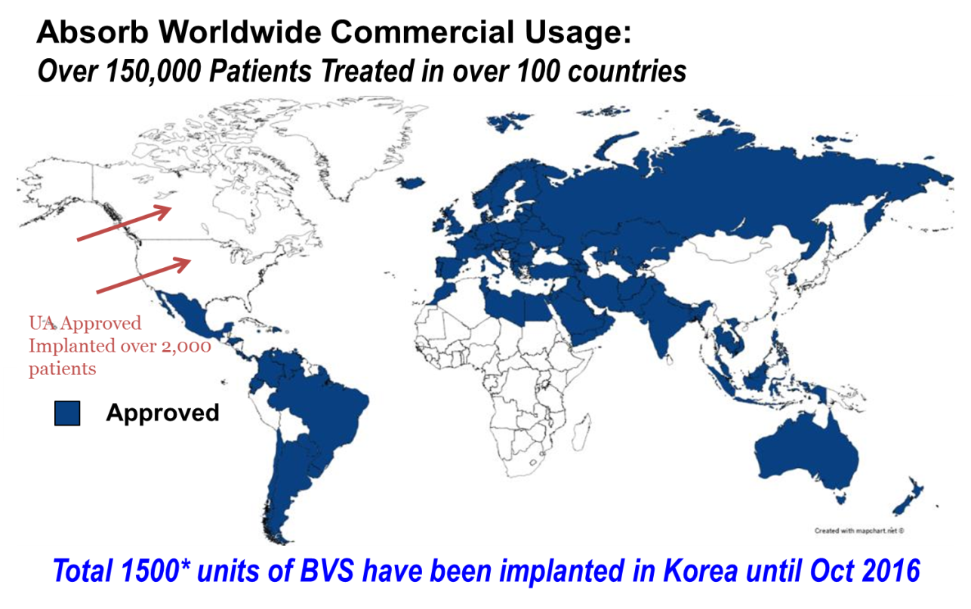
Absorb thrombosis in Korea
1,500 unit of Absorb in Korea until Oct. 2016
  7 cases of scaffold thrombosis (0.47%)
7 cases of Absorb thrombosis
7/1500, 0.47%
Courtesy of Pf. CW Nam in Keimyeong University
Notes:
Especially in 1-30 days after implantation

Slide 39
Absorb thrombosis in Korea
 | Case 1 | Case 2 | Case 3 | Case 4 | Case 5 | Case 6 | Case 7
Sex/Age | M/54 | M/45 | M/67 | M/87 | F/75 | F/68 | M/58
Diagnosis | UA | NSTEMI | NSTEMI | STEMI | UA | UA | NSTEMI
Location | mid LAD | prox LAD | mid LAD | mid LAD | p LAD | p-m LAD | m LAD
BVS | 3.5×28 mm | 2.5×18 mm | 2.5×28 mm | 3.0×18 mm | 3.0×18 mm | 3.5×28 mm | 3.5×28 mm
Image guidance | IVUS | IVUS | OCT | OCT | OCT | Unknown | Unknown
Post-dilatation | Done | Done | Done | Not done | Done | Done | Done
Days post-procedure | 12 days | 14 days | 20 days | 8 days | 7 days | About 5 hours | 13 days
DAPT | Aspirin, Clopidogrel D/C for 3 days | Aspirin, Ticagrelor D/C for 2 days | Aspirin, Ticagrelor D/C for 3 days | Aspirin, Clopidogrel | Aspirin, Clopidogrel | Aspirin, Clopidogrel | Aspirin, Ticagrelor D/C for 3 days
Possible mechanism | DAPT D/C | DAPT D/C Under-expansion | DAPT D/C Under-expansion | Under-expansion? | Under-expansion? | Jailed Diagonal Br | DAPT D/C
Final outcome | Recovered | Recovered | Recovered | Recovered | Recovered | Recovered | Recovered
Courtesy of Pf. CW Nam in Kemyeong University
Notes:
All ACS case, 6 subacute ST,
DAPT discontonuation, possible underexapnsion malapposition

Slide 40
Useless luxury ? New trend of PCI?
Technologies are definitely evolving !

Slide 41
Magmaris from Biotronik

Slide 42
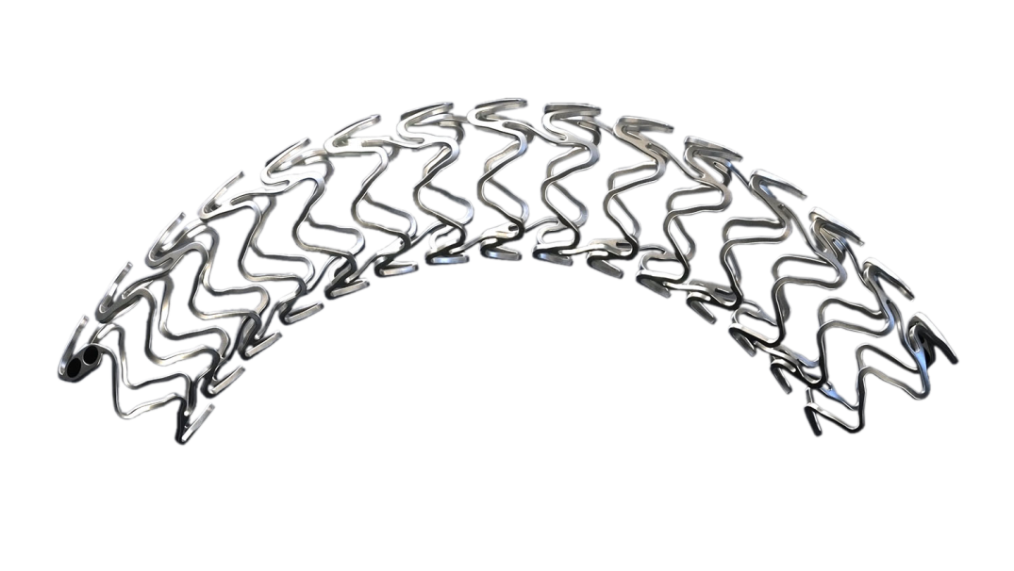
Magmaris from Biotronik
Sirolimus eluting resorbable coronary magnesium scaffold system
  ~95% of Magnesium will be resorbed @ 12 months.
Scaffold | Scaffold material | Proprietary Magnesium alloy
 | Strut thickness/width | 150/150 μm
 | Maximum expandable diameter | Nominal Diameter +0.6 mm
 | Markers | Two Tantalum markers at each end
 | Coating - drug | BIOlute resorbable Poly-L-Lactide (PLLA) eluting a limus drug
 | Scaffold design | Open cell, 2 links, 6 Crowns, 150X150 μm
Delivery System | Catheter type | Rapid exchange
 | Recommended guide catheter | 6F
 | Crossing profile | 1.5 mm
 | Guide wire diameter | 0.014”
 | Nominal pressure [NP] | 10 atm
 | Rated burst pressure [RBP] | 16 atm
 | Balloon | Single step inflation for 15-30 sec

Slide 43
Magmaris from Biotronik
Reabsorption profile

Slide 44
Magmaris from Biotronik
OCT imaging in BIOSOLVE-II
  ~95% of Magnesium will be resorbed @ 12 months.
Post-Implantation
6 month
12 month
Immediately after implantation, struts are well apposed to the vessel wall.
While the Magnesium resorption process continues, endothelialization progresses.
At 12 months after implantation, the Magnesium resorption is almost completed.

Slide 45



Clinical trials of Magmaris
3 studies with 232 patients
  No definite or probable scaffold thrombosis in Magmaris @ 36 Mos.
Clinical trial
Outcome
Trials | Patient number | Available FUP [m]
 | 63 | 84
 | 46 | 36
 | 123 | 12
Total | 232
No definite or probable scaffold thrombosis was observed with Magmaris.
Previous generations showed no scaffold thrombosis up to 36 months.
 | PROGRESS n=63 | BIOSOLVE-I n=46 | BIOSOLVE-II n=123
 | 12 month | 36 month | 12 month
TLF [%] | 23.8 | 6.8 | 3.4
Scaffold Thrombosis Definite or probable | 0.0 | 0.0 | 0.0

Slide 46
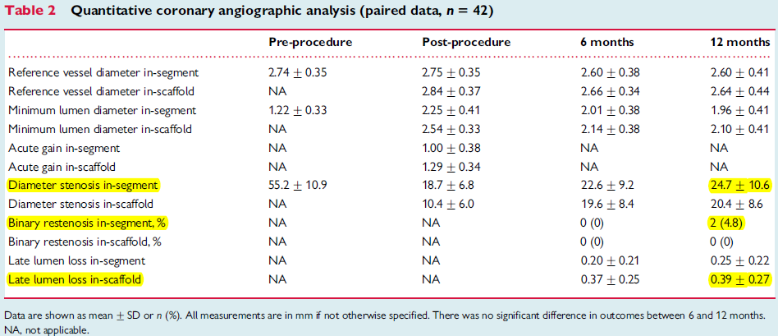
The first-in-man BIOSOLVE-II
1 year data of DREAMS 2G (123 de novo lesions in 123 patients)
  Target lesion failure: 3.4% @ 1year (1 death, 2 TVMI, 2 TLR)
  Scaffold thrombosis: none
Lancet. 2016;388:2479.

Slide 47


The first-in-man BIOSOLVE-II
1 year data of DREAMS 2G (123 de novo lesions in 123 patients)
  Vasomotion @ 12 months (N=13)
81% (13/16) demonstrate
≥ 3% vasomotion after
Ach or Nitro
Lancet. 2016;388:2479.
Ach = Acetylcholine Nitro = Nitroglycerine

Slide 48
The first-in-man BIOSOLVE-II
6 months data of DREAMS 2G
  Target lesion failure: 3.4% @ 1year (1 death, 2 TVMI, 2 TLR)
  Scaffold thrombosis: none
 | n=120 | % | 95% CI
TLF¹ | 4 | 3.3 | 1.3-8.3
Cardiac Death | 1² | 0.8 | 0.0-4.6
Target Vessel MI | 1 | 0.8 | 0.0-4.6
Clinically driven TLR | 2 | 1.7 | 0.2-5.9
CABG | 0 | 0.0 | 0.0-3.1
Scaffold Thrombosis Definite or probable | 0 | 0.0 | 0.0-3.1
Lancet. 2016;388:2479.

Slide 49
From PROGRESS to BIOSOLVE-II
Clinical data @ 6 months (PROGRESS @ 4 months)
 | PROGRESS n=63 | BIOSOLVE-I n=46 | BIOSOLVE-II n=123
TLF¹ (%) | 23.8 | 4.3 | 3.3
Cardiac Death (%) | 0.0 | 0.0 | 0.8
Target Vessel MI (%) | 0.0 | 0.0 | 0.8
Clinically driven TLR (%) | 23.8 | 4.3 | 1.7
CABG | 0.0 | 0.0 | 0.0
Scaffold Thrombosis Definite or probable | 0.0 | 0.0 | 0.0
Composite of cardiac death, target vessel myocardial infarction, clinically driven target lesion revascularization and CABG
Lancet. 2016;388:2479. Lancet. 2007;369:9576. Lancet. 2013;381:9869.

Slide 50
MeRes100 from Meril

Slide 51





MeRes100 from Meril
Sirolimus eluting bioresorbable vascular scaffold
Hybrid Cell Design
100 μm
Drug coat of PDLLA + Sirolimus 1.25 μgm/mm²
Closed Cell
OpenCell
Scaffold backbone PLLA
Couplets of tri-axial RO markers at either end
Optimal side branch access
Size Matrix – 63 SKUs
Diameters – 2.50, 2.75, 3.00, 3.25, 3.50, 4.00, 4.50 mm
Lengths – 8, 13, 16, 19, 24, 29, 32, 37, 40 mm

Slide 52



MeRes100 from Meril
Sirolimus eluting bioresorbable vascular scaffold
  Degradation profile
Degradation begins from a high molecular weight and the entire scaffold is consumed over a period of 2years.

Slide 53


MeRes100 from Meril
Inflammation status on coronary artery wall in porcine
Absorb
MeRes100
Both devices show strut-associated fibrin deposition, which is less in MeRes100 (mean score= 0.00±0.00), compared to Absorb (mean score= 0.20±0.28).
Inflammation was slightly higher in Absorb (mean score= 0.40±0.57) compared to MeRes100 (mean score= 0.15±0.10).

Slide 54
MeRes-1 FIM
108 single-vessel, de novo coronary lesions (16 sites in India)
  Inclusion
    Maximum 2 lesions in native coronary arteries (1 lesion/vessel)
    RD: 2.75~3.50 mm, LL ≤ 20 mm, DS 50~99%, TIMI 1,2,3
    Type A lesion
    SA, UA, SI
  DAPT for 1year
  Clinical endpoints
    Ischemia driven MACE @ 180 days for marketing approval

Slide 55
MeRes-1 FIM
108 single-vessel, de novo coronary lesions (16 sites in India)
  Clinical outcomes @ 6 months
Primary Endpoint MACE, n (%) | In-Hospital N = 108 (100%) | 1-month N = 108 (100%) | 6-months N = 108 (100%)
MACE | 0 (0%) | 0 (0%) | 0 (0%)
Cardiac Death | 0 (0%) | 0 (0%) | 0 (0%)
Myocardial Infarction@ | 0 (0%) | 0 (0%) | 0 (0%)
Ischemia-driven TLR | 0 (0%) | 0 (0%) | 0 (0%)
Ischemia-driven TVR | 0 (0%) | 0 (0%) | 0 (0%)
Scaffold Thrombosis$ | 0 (0%) | 0 (0%) | 0 (0%)
Non-cardiac death | 0 (0%) | 0 (0%) | 1# (0.9%)
# Death due to aminophylline induced anaphylactic shock.

Slide 56
MeRes-1 FIM
108 single-vessel, de novo coronary lesions (16 sites in India)
  QCA
Angiographic Analysis (QCA) | Baseline N = 41 | Post-procedure N = 41 | 6-months N = 41
Lesion length (mm) | 20.23 ± 7.94 | - | -
In-segment RVD (mm) | 3.07 ± 0.39 | 3.03 ± 0.41 | 2.94 ± 0.38
In-scaffold RVD (mm) | - | 3.14 ± 0.38 | 3.06 ± 0.39
In-segment MLD (mm) | 0.95 ± 0.38 | 2.67 ± 0.38 | 2.53 ± 0.40
In-scaffold MLD (mm) | - | 2.82 ± 0.32 | 2.67 ± 0.40
In-segment acute gain (mm) | - | 1.71 ± 0.50 | -
In-scaffold acute gain (mm) | - | 1.86 ± 0.42 | -
In-segment DS (%) | 68.75 ± 11.9 | 11.66 ± 8.1 | 13.87 ± 9.6
In-scaffold DS (%) | - | 10.02 ± 6.5 | 12.68 ± 8.5

Slide 57
MeRes-1 FIM
Late lumen loss @ 6 months

Slide 58
MeRes100 from Meril
Future directions
  FIM data: promising
  MeRes-1 Extended (n=64)
    Currently recruiting in Europe, Asia, South Africa and South America
  Randomized pivotal trial against the 2nd genration DES (EES)
    Planned for 2017

Slide 59
DESolve from Elixir

Slide 60

DESolve from Elixir
Novolimus eluting bioresorbable coronary scaffold system
  Scaffold will be resorbed @ 12 months.
  System crossing profile: 1.3 mm
  Strut: DESolve 150 μm, DESolve Cx 120 μm
  Flow dynamics

Slide 61

DESolve from Elixir
Novolimus eluting bioresorbable coronary scaffold system
Int J Cardiol. 2016;227:127

Slide 62

DESolve from Elixir
Self-correction property
Int J Cardiol. 2016;227:127

Slide 63

DESolve Nx clinical trial
126 patients with single de novo coronary lesions

Slide 64

DESolve Nx clinical trial
DESolve NX serial CAG

Slide 65

DESolve Nx clinical trial
Serial QCA

Slide 66

DESolve Nx clinical trial
Serial cumulative MACE
JACC Cardiovasc Interv. 2016;9:565.

Slide 67

DESolve Cx clinical trial
50 patients with single de novo coronary lesions

Slide 68
Conclusion
BRS is evolving.
  Thinner strut
    But still thicker than 100 μm
  Easy implantation
    Single step inflation
  Modification of resorbable duration
    New material
    Mixture of PLLA+PLGA
  Improving performance
    < 1 % scaffold thrombosis
    < 5% of TLR in 1-2 years
  Strut design improvement
    Easy side branch access and wider side branch lumen
    Self –correction function by post-implantation dilation

Slide 69
MeRes100 from Meril
Inflammation on coronary artery wall
Absorb
MeRes100
Both devices show strut-associated fibrin deposition, which is less in MeRes100 (mean score= 0.00±0.00), compared to Absorb (mean score= 0.20±0.28).
Inflammation was slightly higher in Absorb (mean score= 0.40±0.57) compared to MeRes100 (mean score= 0.15±0.10).

Slide 70
MeRes-1 FIM
108 single-vessel, de novo coronary lesions (16 sites in India)
  Inclusion
    Maximum 2 lesions in native coronary arteries (1 lesion/vessel)
    RD: 2.75~3.50 mm, LL ≤ 20 mm, DS 50~99%, TIMI 1,2,3
    Type A lesion
    SA, UA, SI
  DAPT for 1year
  Clinical endpoints
    Ischemia driven MACE @ 180 days for marketing approval

Slide 71
MeRes-1 FIM
108 single-vessel, de novo coronary lesions (16 sites in India)
  Clinical outcomes @ 6 months
Primary Endpoint MACE, n (%) | In-Hospital N = 108 (100%) | 1-month N = 108 (100%) | 6-months N = 108 (100%)
MACE | 0 (0%) | 0 (0%) | 0 (0%)
Cardiac Death | 0 (0%) | 0 (0%) | 0 (0%)
Myocardial Infarction@ | 0 (0%) | 0 (0%) | 0 (0%)
Ischemia-driven TLR | 0 (0%) | 0 (0%) | 0 (0%)
Ischemia-driven TVR | 0 (0%) | 0 (0%) | 0 (0%)
Scaffold Thrombosis$ | 0 (0%) | 0 (0%) | 0 (0%)
Non-cardiac death | 0 (0%) | 0 (0%) | 1# (0.9%)
# Death due to aminophylline induced anaphylactic shock.

Slide 72
MeRes-1 FIM
108 single-vessel, de novo coronary lesions (16 sites in India)
  QCA
Angiographic Analysis (QCA) | Baseline N = 41 | Post-procedure N = 41 | 6-months N = 41
Lesion length (mm) | 20.23 ± 7.94 | - | -
In-segment RVD (mm) | 3.07 ± 0.39 | 3.03 ± 0.41 | 2.94 ± 0.38
In-scaffold RVD (mm) | - | 3.14 ± 0.38 | 3.06 ± 0.39
In-segment MLD (mm) | 0.95 ± 0.38 | 2.67 ± 0.38 | 2.53 ± 0.40
In-scaffold MLD (mm) | - | 2.82 ± 0.32 | 2.67 ± 0.40
In-segment acute gain (mm) | - | 1.71 ± 0.50 | -
In-scaffold acute gain (mm) | - | 1.86 ± 0.42 | -
In-segment DS (%) | 68.75 ± 11.9 | 11.66 ± 8.1 | 13.87 ± 9.6
In-scaffold DS (%) | - | 10.02 ± 6.5 | 12.68 ± 8.5

Slide 73
MeRes-1 FIM
Late lumen loss @ 6 months

Slide 74
MeRes100 from Meril
Future directions
  FIM data: promising
  MeRes-1 Extended (n=64)
    Currently recruiting in Europe, Asia, South Africa and South America
  Randomized pivotal trial against the 2nd genration DES (EES)
    Planned for 2017

Slide 75

My disclosure
I do not have any financial disclosure on current topic.
I don’t have any intention to slander BVS.
Notes:
Insuline IV injection에도 혈당에는 큰 변화가 없고 맥박에도 큰 변화가 없이 혈압의 강하가 재현됨.

Slide 76
So many things on BVS
Discovered truth
Unveiled truth
Unreasonable optimism
Irrational pessimism
They came from ignorance of it.
If we knew the limitations of BVS, we would overcome it.
Notes:
Insuline IV injection에도 혈당에는 큰 변화가 없고 맥박에도 큰 변화가 없이 혈압의 강하가 재현됨.

Slide 77
So many curiosities and questions …
Material characteristics
Stent thrombosis
for special lesions
  Calcified lesion
  Bifurcation lesion
Cautions for use in real situations
Notes:
Insuline IV injection에도 혈당에는 큰 변화가 없고 맥박에도 큰 변화가 없이 혈압의 강하가 재현됨.

Slide 78
So many curiosities and questions …
Material characteristics
Stent thrombosis
for special lesions
  Calcified lesion
  Bifurcation lesion
Cautions for use in real situations
Notes:
Insuline IV injection에도 혈당에는 큰 변화가 없고 맥박에도 큰 변화가 없이 혈압의 강하가 재현됨.

Slide 79
Radial strength
Lesser radial strength
  Radial strength by assessing pressure
  atmos required to reduce cross-sectional area by 25%
 | Xpedition | ABSORB | P-value
Area reduction by 25% | 1.6±0.1 atm | 1.4±0.2 atm | 0.02
Courtesy of Pf. John Ormiston
Notes:
Especially in 1-30 days after implantation

Slide 80

Is BVS Brittle?
Acute radial strength
Agrawal CM. Biomaterials 1992;13:176.

Slide 81

Post-dilation safety without fracture
Main branch diameter and % scaffold with fracture
  3.0 mm scaffolds and 3.0 mm balloon
Courtesy of Pf. John Ormiston
Notes:
Manufacturer’s recommendation: no more than 0.5 mm overexpansion
Remember this number for maximal dilation of proximal optimization and full KBAP

Slide 82

Side branch dilation
It makes contralateral side distortion similar to metal stents
Courtesy of Pf. John Ormiston

Slide 83

Side branch dilation
3.0 mm NC balloon for SB dilation in 3.0 mm devices
Courtesy of Pf. John Ormiston
Notes:
No more than 10 atm with 3.0 mm NC balloon for side branch dilation

Slide 84

Mini-KB of 3.0 mm NC balloon
Never dilated more than 5 atm in mini-KB angioplasty in 3.0 mm BVS
Courtesy of Pf. John Ormiston
Notes:
Side branch balloon proximal marker must be positioned at SB exit site or little bit more into MB with less than 10 atm

Slide 85







Bench or mischief ?
In the air
In the water
2 atm
7 atm
Notes:
About 1.5% definitive and probable ST about 1-2 years

Slide 86


Bench or mischief ?
Bending
Elongation
Notes:
About 1.5% definitive and probable ST about 1-2 years

Slide 87
So many curiosities and questions …
Material characteristics
Stent thrombosis
for special lesions
  Calcified lesion
  Left main
  Bifurcation lesion
Cautions for use in real situations
Notes:
Insuline IV injection에도 혈당에는 큰 변화가 없고 맥박에도 큰 변화가 없이 혈압의 강하가 재현됨.

Slide 88

Definite and probable thrombosis in ACS and SA
EuroIntervention. 2014;Sep 10, Epub ahead of print

Slide 89
Definite and probable thrombosis
Notes:
About 1.5% definitive and probable ST about 1-2 years

Slide 90



Definite thrombosis in GHOST-EU
1,189 pts in 10 European centers (Nov. 2011~ Jan. 2014)
D Capodanno. EuroIntervention 2015;10:1144.
Notes:
Circumstance of unrestricting use of BVS in Europe

Slide 91

Early scaffold thrombosis
Undersizing and underexpansion
Early Scaffold thrombosis
- scaffold undersizing
- scaffold underexpansion
Cuculi F. Circ Cardiovasc Interv. 2015;8:e002518.
Notes:
Single center OCT exploit of Tommaso Gori Switzerland

Slide 92

Very Late scaffold thrombosis
PSLIA (peristrut low intensity area) and strut discontinuity
Late Scaffold thrombosis
Peristrut low intensity are
- neovessle formation
- scaffold rupture
- delayed healing
Cuculi F. Circ Cardiovasc Interv. 2015;8:e002518.
Notes:
Tissue: large amount of PLT and red cell rare inflammatory cells scarce eosinophil
결국 Late ScT: BVS resoprtion, peristrut light intensity, neovessels and scaffold rupture : delayed healing is late VLST 의 원인이된다.

Slide 93

Tentative treatment plan for scaffold thrombosis
Fernandez-Rodriquez D. EuroIntervention 2014;10:600.

Slide 94
So many curiosities and questions …
Material characteristics
Stent thrombosis
for special lesions
  Calcified lesion
  Bifurcation lesion
Cautions for use in real situations
Notes:
Insuline IV injection에도 혈당에는 큰 변화가 없고 맥박에도 큰 변화가 없이 혈압의 강하가 재현됨.

Slide 95
So many curiosities and questions …
Material characteristics
Stent thrombosis
for special lesions
  Calcified lesion
  Bifurcation lesion
Cautions for use in real situations
Notes:
Insuline IV injection에도 혈당에는 큰 변화가 없고 맥박에도 큰 변화가 없이 혈압의 강하가 재현됨.

Slide 96


BVS rupture after SB dilation
2.5 mm side branch ballooning
  Prolonged BVS sized ballooning
Am J Cardiol. 2015;116:1045.
Notes:
Drs in gran canaria in Spain

Slide 97

BVS rupture after SB dilation
2.5 mm side branch ballooning
  Prolonged BVS sized ballooning
Am J Cardiol. 2015;116:1045.
Notes:
Drs in gran canaria in Spain

Slide 98
So many curiosities and questions …
Material characteristics
Stent thrombosis
for special lesions
  Calcified lesion
  Left main
  Bifurcation lesion
Cautions for use in real situations
Notes:
Insuline IV injection에도 혈당에는 큰 변화가 없고 맥박에도 큰 변화가 없이 혈압의 강하가 재현됨.

Slide 99


Early outcome bwn BVS and EES in real world
BVS (n=92), EES (n=1,296)
  PSM: BVS (92 pts, 137 lesion) vs EES (92 pts, 124 lesion)
Catheter Cardiovasc Interv. 2015;85:E10.
Notes:
Colombo group 201501

Slide 100

Early outcome bwn BVS and EES in real world
BVS (n=92), EES (n=1,296)
  PSM: BVS (92 pts, 137 lesion) vs EES (92 pts, 124 lesion)
Catheter Cardiovasc Interv. 2015;85:E10.
Notes:
Colombo group 201501

Slide 101




Hybrid therapy of BVS and DES
Know the advantage and characteristics of BVS and DES
JACC Cardiovasc Interv. 2015;8:1518.
Notes:
BVS 2.5X28 + 3.0X28 + 3.0X28 mm
Finally D1 take off LAD에 DES를 삽입함. We can use freely LAD/D1 FKBT without fear of scaffold fracture related to KB.
I don’t think we should hanging just one type of metal or scaffold.

Slide 102
Introduction of postprandial hypotension (PPH)
Definition of PPH
  Fall in systolic BP of > 20 mmHg, or a decrease to < 90 mmHg when the preprandial BP is > 100 mmHg, within 2 hours of a meal.
Postprandial BP response
  Diastolic BP change: unremarkable
  Nadir of the BP reduction
    Evident at about 45 (30~60) minutes postprandially in most individuals
    Maximum BP drop occurs within the first 15 minutes in autonomic failure
Prevalence of PPH
  Healthy older subjects, inmates of residential care : 25~38%
  Hospitalized geriatric patients: 20~91%
  Type 2 diabetes: ~40%
  Parkinson disease: 40~100%
Ann Intern Med. 1995;122:286, Am J Hypertens 1998;11:1358, J Hypertens 1995;13:1291

Slide 103
Conclusion
So many points to be improving.
Technology of BVS is evolving.
We will get more user friendly and reliable device of it very soon.

