Slide 1


Coronary Microvascular Disease (MVD) and Clinical Prognosis in Deferred Lesions
Joo Myung Lee, MD, MPH, PhD
Heart Vascular Stroke Institute,
Samsung Medical Center, Seoul, Republic of Korea
Notes:
Sep.26(Mon) 11:00-12:30 Rm. HARMONY II
How Can We Evaluate Coronary Atherosclerosis and Predict Future Event?
Chairpersons:탁승제, 구본권
Panel:도준형, 이현종, 임홍석
15분, 30장
Hello Ladies and Gentleman, I am Joo Myung Lee from Samsung Medical Center.
Today, I will be taking about the clinical outcome of microvascular disease in patients with deferred epicardial coronary stenosis.

Slide 2
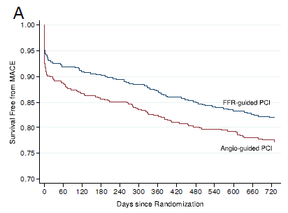
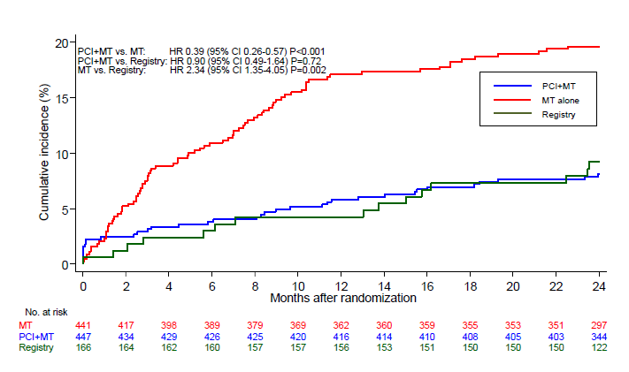
Introduction
FFR-guided PCI - Better than Angio-guided PCI or Medical therapy
FAME 1
FAME 2
Pijls, et al. JACC 2010
De Bruyne et al. NEJM 2014
Notes:
As you well know, the previous FAME trials showed significant benefit of FFR-guided strategycompared with angiography guidance only or medical treatment.

Slide 3
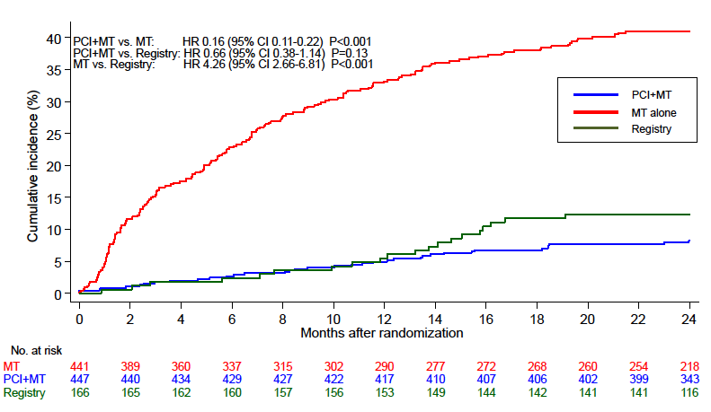
Introduction
FFR > 0.80 did not mean no ischemia
9.0% of patients with FFR>0.80 (registry arm in FAME II)
experienced all-cause death, MI, and urgent revasc.
FAME II, De Bruyne et al, NEJM 2014
Notes:
However, when you look more closely to FAME 2 data,
About 9.0% of patients with high FFR and deferred revascularization experienced
All cause mortality, MI and urgent revascularization, despite functionally insignifcant epicardial coronary stenosis.

Slide 4
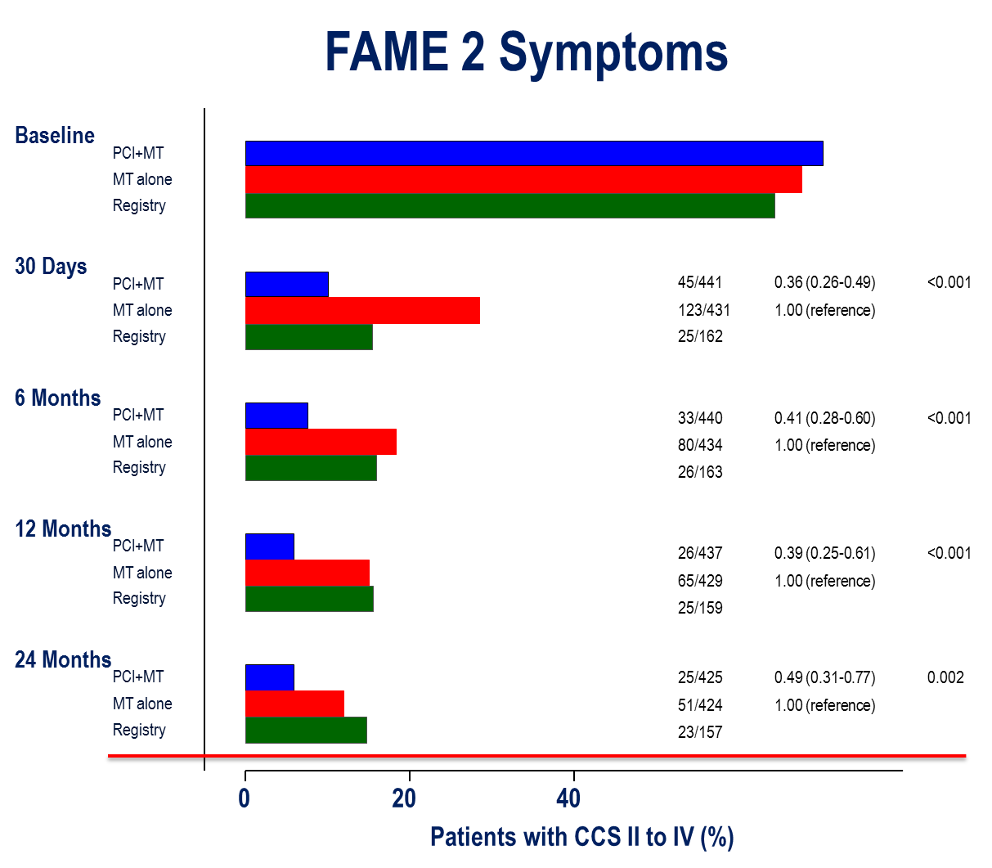
Introduction
14.6% of patients with FFR>0.80 (registry arm in FAME II)
showed persistent CCS II-IV angina at 2-years
De Bruyne et al. NEJM 2014
Notes:
Furthermore, about 15% of patient with high FFR showed persistent CCS class II to IV angina at 2 years

Slide 5
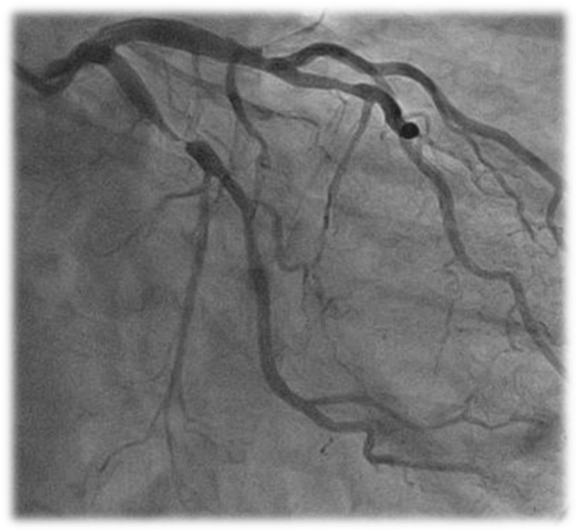
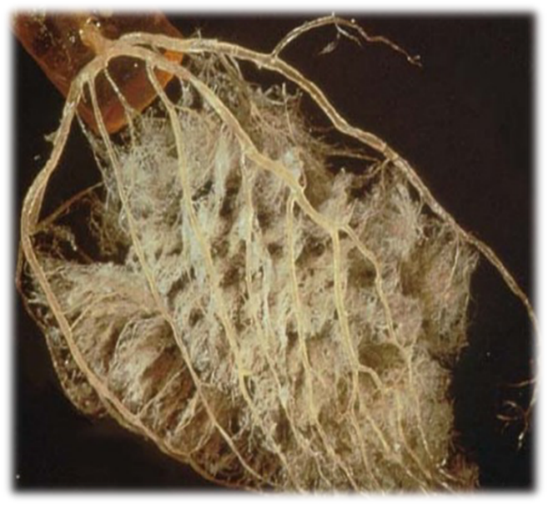
Potential Causes of Cardiac Events/ Chest Pain in Deferred Patients
Progression of atherosclerosis
Pain or event due to non-atherosclerotic coronary disease
Vulnerability
Hidden disease, diffuse atherosclerosis
Microvascular disease
<5% of the total coronary tree
Courtesy to My Mentor, Prof. Koo BK
Notes:
What is the potential cause of cardiac events or persistent angina in deferred patient?
Although there are several potential causes, I will focus on the role of microvascular disease.
As substantial amount of coronary circulation eventually depends on the microvascular function.

Slide 6
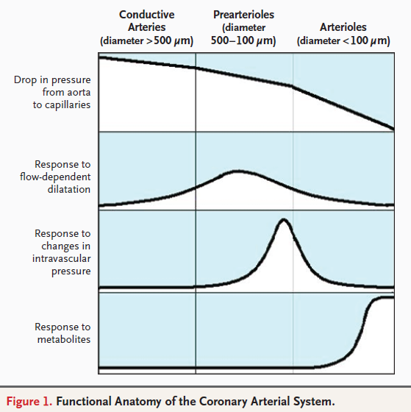
Ischemic Heart Disease
Coronary Arterial System is composed of three compartments
Any of these compartments fail to maintain sufficient O2, myocardial ischemia can occur.
Therefore, the presence of epicardial coronary stenosis is not always a “prerequisite” for the IHD.
Crea et al. NEJM 2007
Notes:
As coronary circulation composed with 3 major compartment and
Major controller of coronary resistance and flow is microcirculatory beds.
When any of these compartment fails to meet sufficient O2, myocardial ischemia can occur.
Therefore, the presence of epicardial coronary stenosis is not always prerequisite of ischemic heart disease.

Slide 7
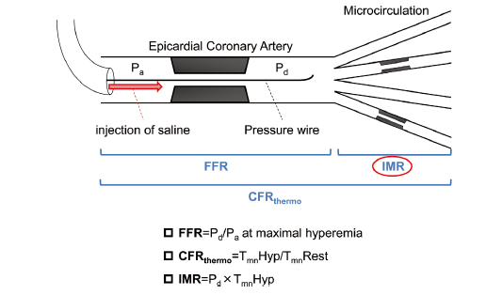
Associated, but Completely Different
3 Physiologic Index
Kobayashi et al. CJ 2014
Notes:
In order to evaluate epicardial to microcirculatory function,
We can measure 3 different indices, which are FFR, CFR, and IMR

Slide 8
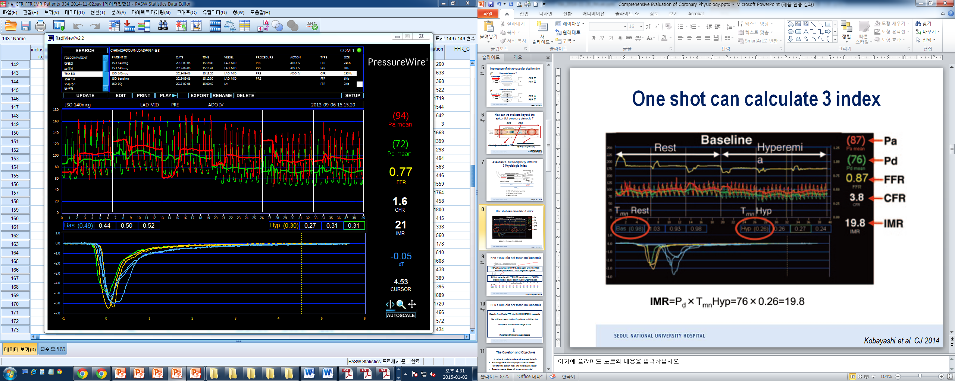
3 different index can be calculated at one interrogation
Resting
Hyperemia
Pd
Pa
FFR
CFR
IMR
FFR = h_Pd / h_Pa = 72/94 = 0.77
CFR = r_Tmn / h_Tmn = 0.49/0.30 = 1.6
IMR = h_Pd x h_Tmn = 72 x 0.30 = 21.6
Notes:
These 3 different indices can be easily measures with one interrogation of pressure-temperature wire using thermodilution technique.

Slide 9
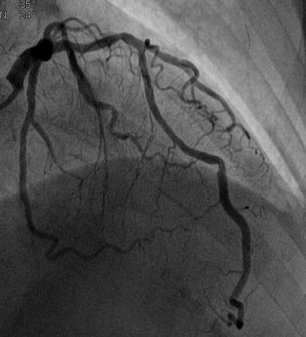
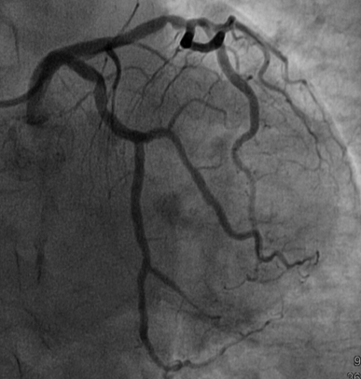
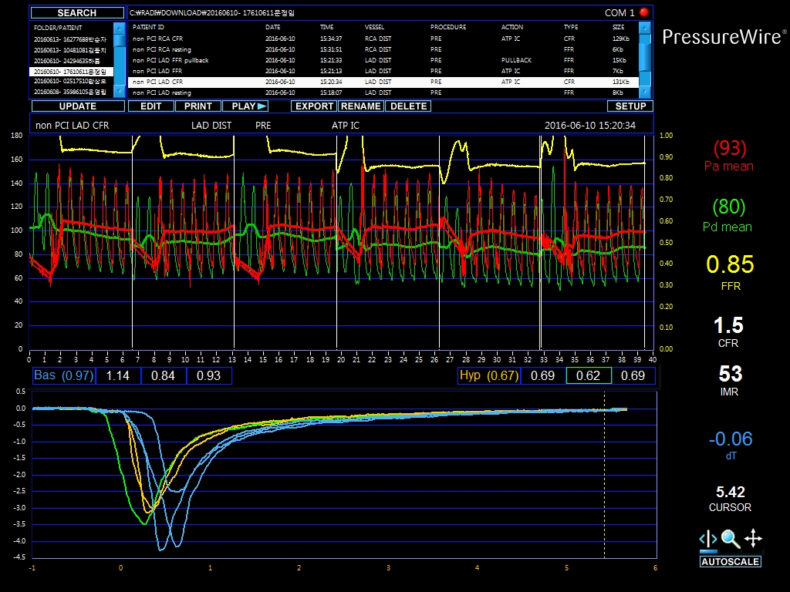
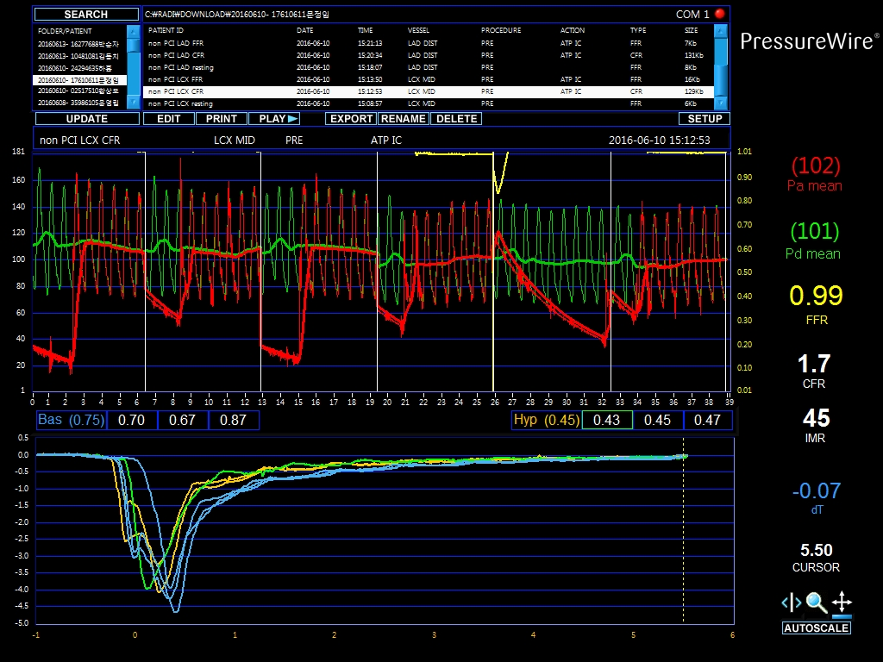
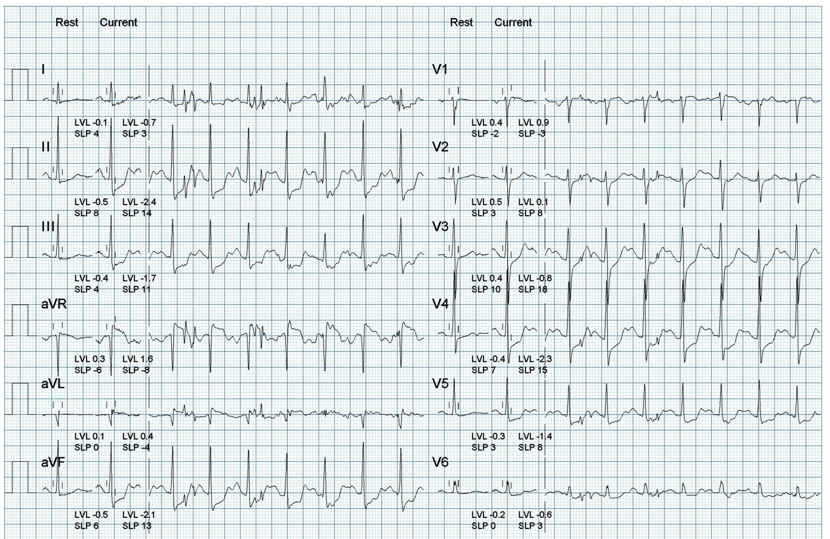
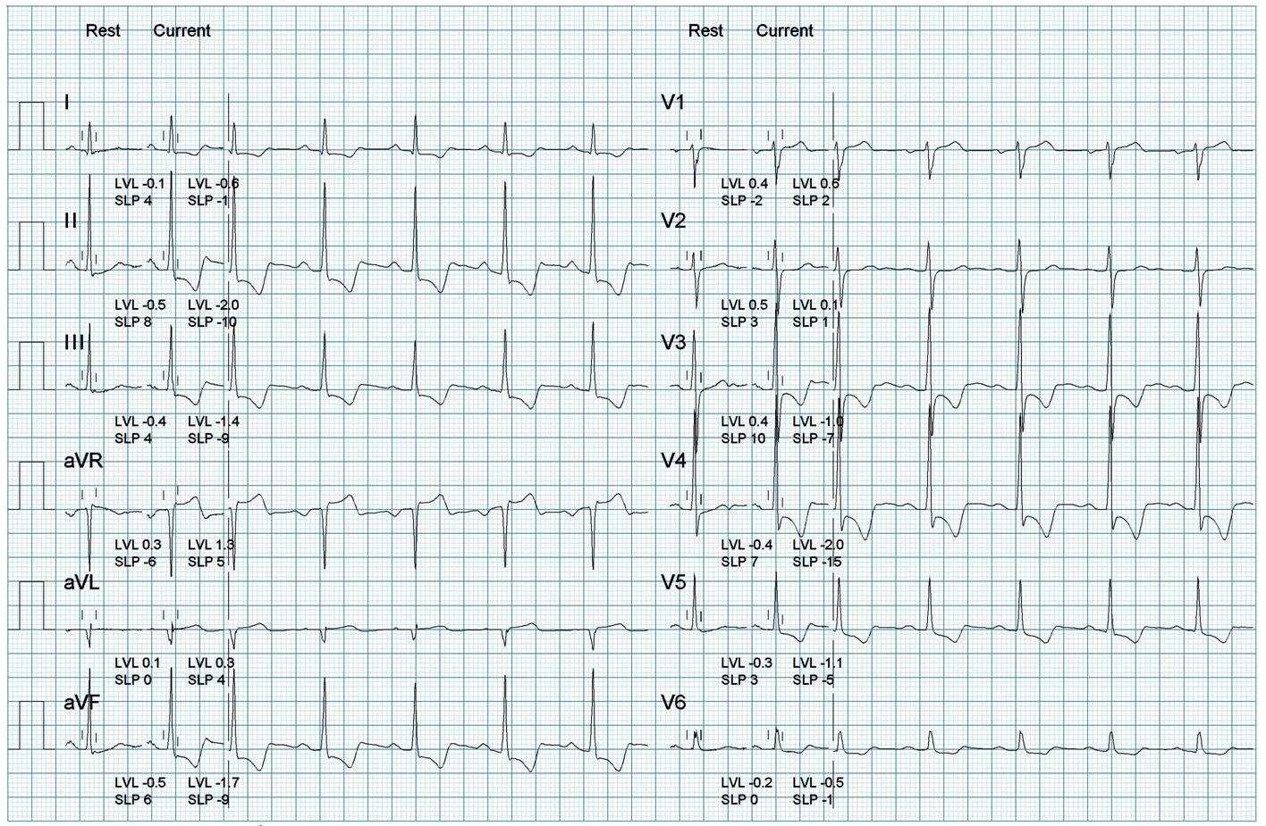
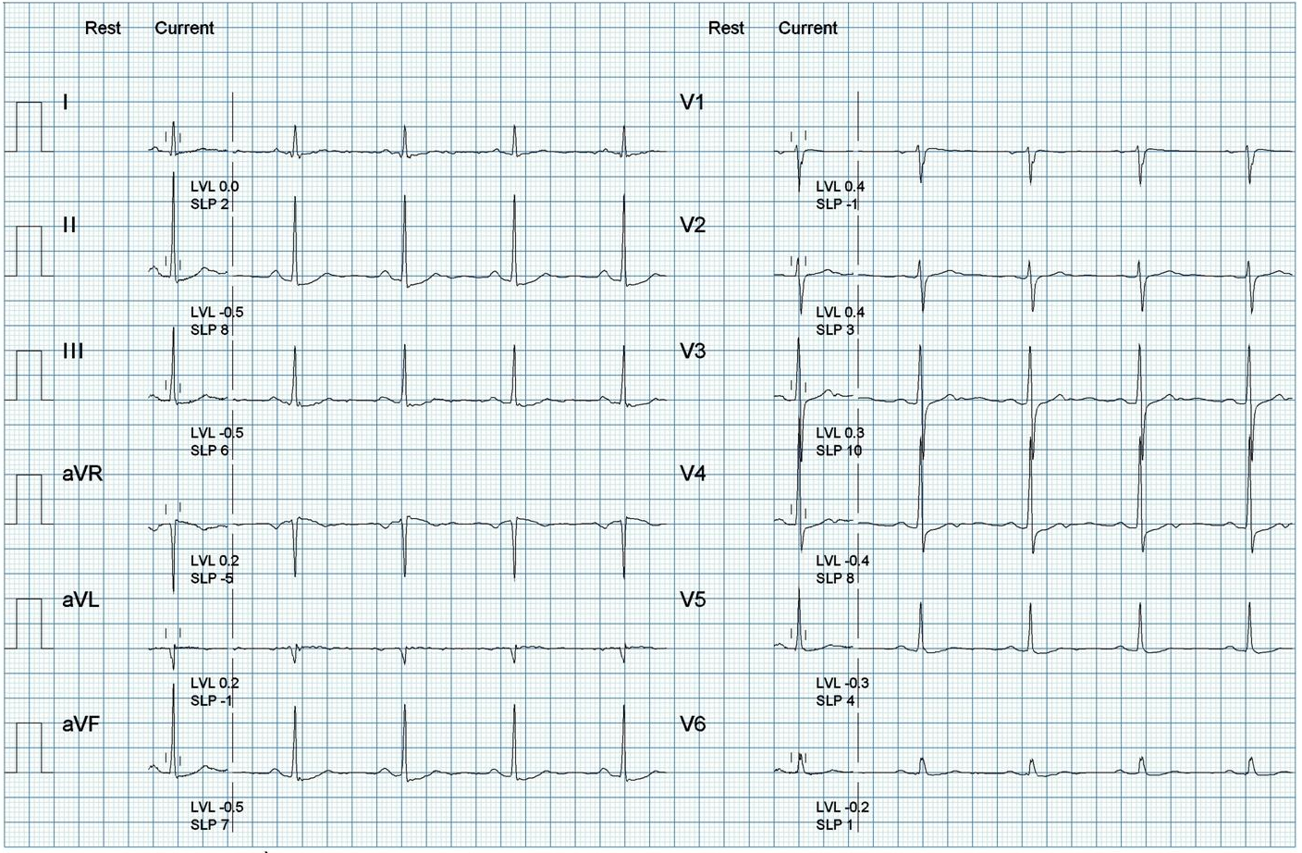
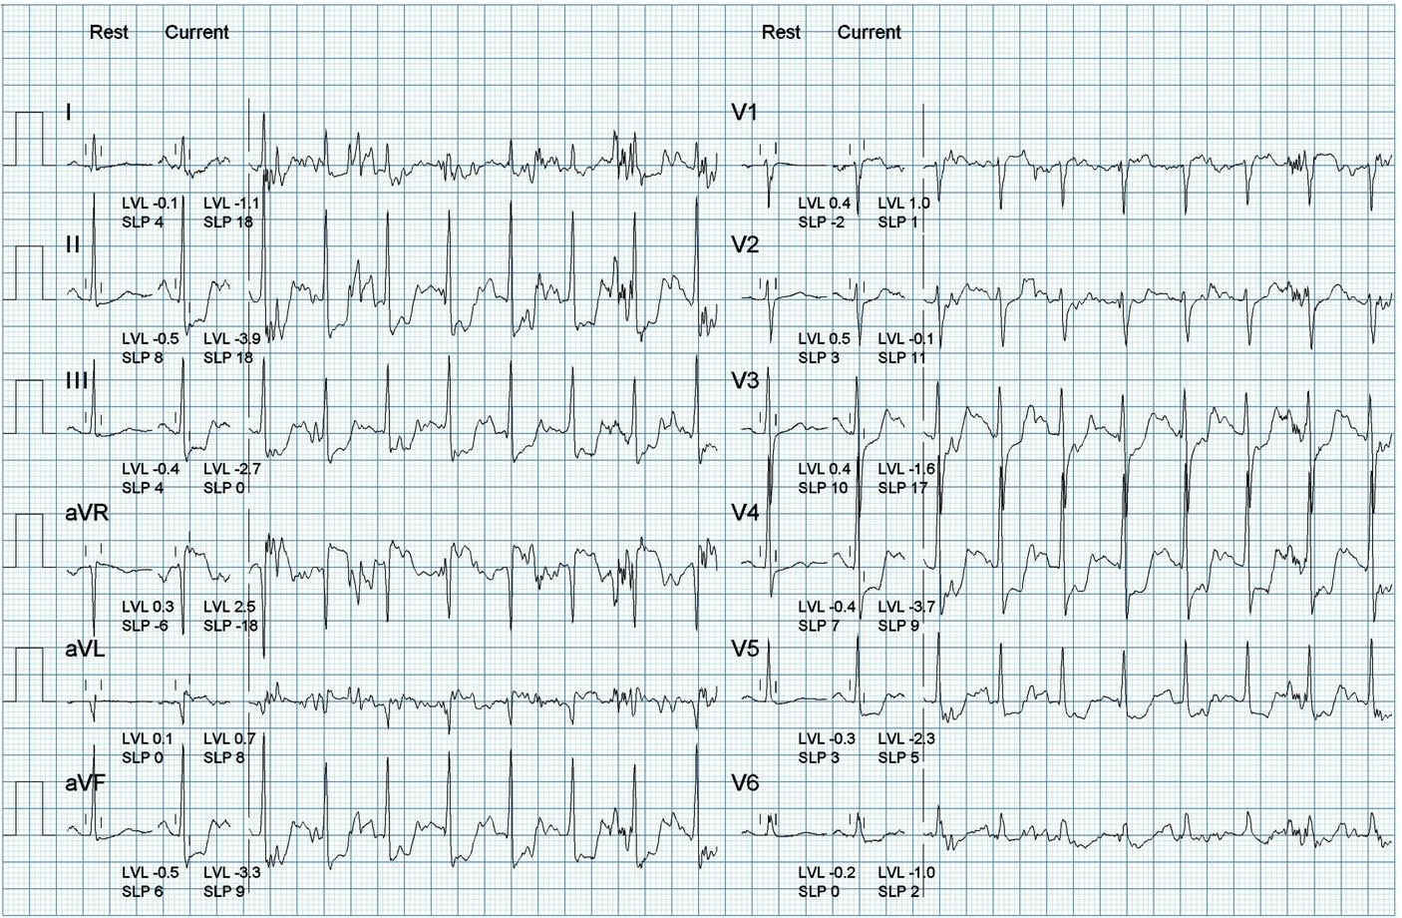
Typical Angina, TMT (+)
Resting ECG
Stage 3
Stage 4
Recovery 3-min
LAD FFR 0.85
CFR 1.5
IMR 53
LCX FFR 0.99
CFR 1.7
IMR 45
Diagnosis of Micro-Vascular Disease
Exercise Duration : 9 min 58 sec, 12.8 METS
Chest pain during Stage 3 and 4
Horizontal ST depression in II, III, aVF, V3, V4, V5
Duke score : -5 (moderate risk)
Notes:
Like this patient with typical angina and positive TMT,
Some patient with definite angina and non-invasive evidence of myocardial ischemia
Did not show any functionally significant epicardial stenosis.
Despite functionally insignificant epicardial stenosis,
this patient showed depressed CFR and elevated IMR, suggesting the possibility of microvascular disease.

Slide 10
Unsolved Issues for Microvascular Disease
    [Primary Microvascular disease]
    Distribution and Abnormal value of IMR values in non-MI patients
    Whether Macro- and Micro- disease has independent disease process?
    Predictors of High IMR and Low FFR
    Clinical Prognosis of Patients with Microvascular disease
    Gender will affect the clinical outcomes of Microvascular Disease?
    Mechanism of Clinical Events in Patients with Microvascular disease
    Effective Treatment of Microvascular Disease
    [Secondary Microvascular Damage after AMI or Procedure-related]
    Is it “Regional Problem” or “Globalization will be occurred?”
    Non-Culprit stenosis evaluation with FFR
    How can we reduce MV damage after successful revascularization
Notes:
In contrary to epicardial coronary disease, we still don’t know many thing about microvascualr disease.
When we specifically focus of primary microvascular disease,
These issues from diagnostic criteria to treatment have not been clarified yet.

Slide 11
Primary Microvascular Disease
International IMR registry
- 1,096 patients with 1,452 coronary arteries -
To explore clinical relevance of microvascular assessment using IMR in addition to the current FFR guided strategy in non-MI patients
    [Primary Microvascular disease]
    Distribution and Abnormal value of IMR values in non-MI patients
    Whether Macro- and Micro- disease has independent disease process?
    Predictors of High IMR and Low FFR
    Clinical Prognosis of Patients with Microvascular disease
    Gender will affect the clinical outcomes of Microvascular Disease?
    Mechanism of Clinical Events in Patients with Microvascular disease
    Effective Treatment of Microvascular Disease
Lee JM , Koo BK et al. Circ Intervention 2015
Notes:
To explore our curiosity for primary microvascular disease,
Our group have focused on the issue of microvascular disease.
Using the international IMR registry data of over 1 thousand patient with 15 hundred coronary arteries,
We evaluated the first 3 questions.

Slide 12
International IMR registry
- 1,096 patients with 1,452 coronary arteries -
Patients who underwent elective measurement of both FFR and IMR
FFR measurement was as clinically-indicated
IMR measurement was for research purpose or as operator’s discretion
From 8 centers in 5 countries
South Korea, United Kingdom, Spain, USA and Australia
1,096 patients with 1,452 coronary arteries
Exclusion Criteria
  Acute myocardial infarction (within 72 hours) with Cardiac enzyme ↑
  Hemodynamic instability
  LV dysfunction (EF<30%)
  Culprit vessel of acute coronary syndrome
Lee JM , Koo BK et al. Circ Intervention 2015
Notes:
The international IMR registry was multinational and multicenter registry of patients
Who underwent simultaneous measure of FFR and IMR.
In order to exclude the possibility of secondary microvascular damage from AMI,
Those patients with AMI was excluded.

Slide 13
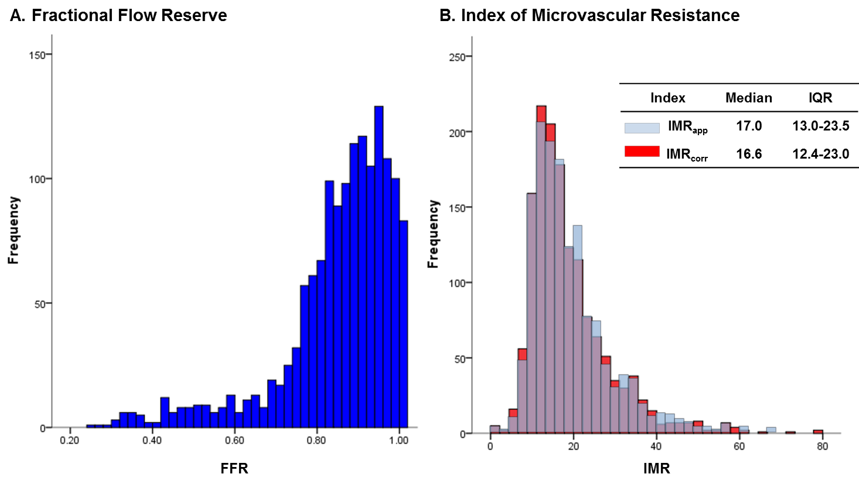
Distribution of FFR and IMR in 1,452 Lesions
International IMR registry
An IMR≤25 is considered normal in non-MI population
Lee JM , Koo BK et al. Circ Intervention 2015
Notes:
When we look the distribution of IMR in over 15 hundreds vessels,
75th percentile value of IMR is close to 25.
Considering with the previous results from normal volunteer study and our largest population data,
IMR less than 25 can be considered normal in non MI population.

Slide 14
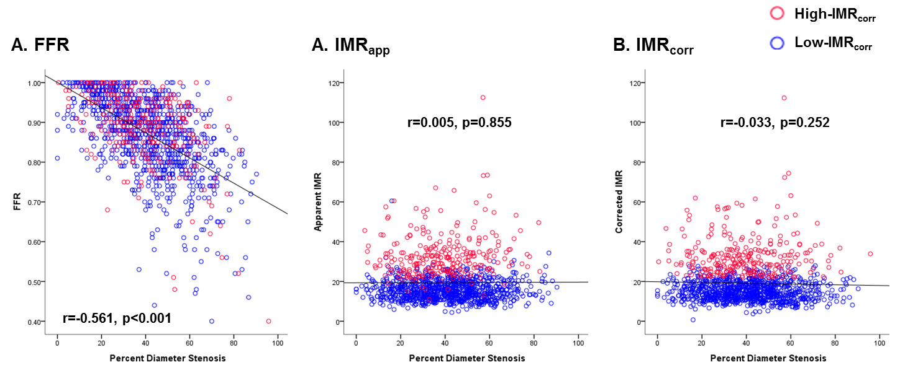
Association between Angio, FFR, IMR in 1,452 Lesions
International IMR registry
FFR showed significant correlation with angiographic %DS
IMR did not show any correlation with angiographic %DS
Lee JM , Koo BK et al. Circ Intervention 2015
Notes:
When evaluating the association with epicardial coronary stenosis severity.
FFR showed significant correlation with diameter stenosis of epicardial disease,
However, IMR did not showed any correlation with diameter stenosis.

Slide 15
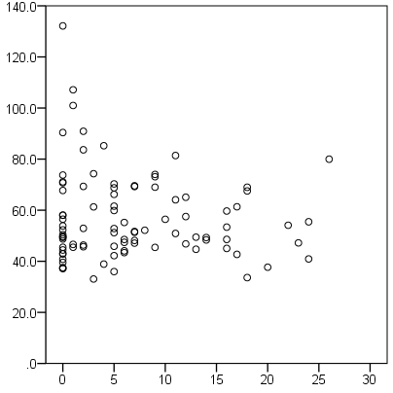
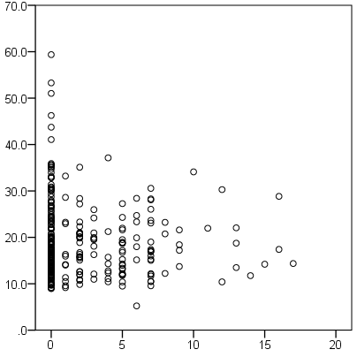
Correlations between SYNTAX Score and IMR
3-vessel FFR/IMR measure subgroups
A. SYNTAX score (Patient)
B. Vessel-specific SYNTAX score
93 patients
ρ=-0.002, p=0.99
279 vessels
ρ=-0.06, p=0.36
Global IMR
IMR
SYNTAX score
Vessel specific SYNTAX score
Kobayashi Y, Fearon WF, Lee JM, Koo BK et al. Unpublished data
Notes:
When evaluating the association between the marker of atherosclerotic burden in epicardial coronary artery, the SYNTAX score and IMR values, There was no association between severity of macrovascular disease and IMR value.

Slide 16
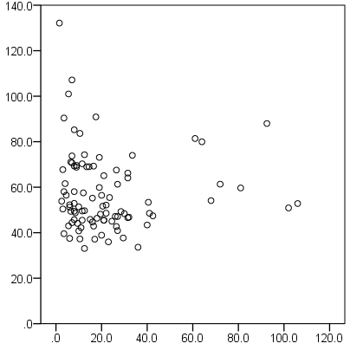
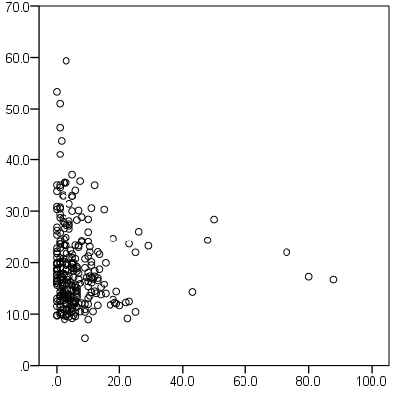
Correlations between Gensini Score and IMR
3-vessel FFR/IMR measure subgroups
A. Gensini score (Patient)
B. Vessel-specific Gensini score
93 patients
ρ=-0.13, p=0.22
279 vessels
ρ=-0.13, p=0.03
Global IMR
IMR
Gensini score
Vessel specific Gensini score
Kobayashi Y, Fearon WF, Lee JM, Koo BK et al. Unpublished data
Notes:
The lack of association between macrovascular disease severity and IMR value was similarly observed when using Gensini score

Slide 17
Different Independent Predictor for High-IMR or Low-FFR
International IMR registry
Independent Predictor for High-IMR or Low-FFR in Target Vessels
High-IMR (≥75th percentile) |  |  |  | Low-FFR (≤0.80)
 | OR | 95% CI | P value |  | OR | 95% CI | P value
Previous MI | 2.16 | 1.24-3.74 | 0.006 | LAD | 5.92 | 3.73-9.41 | <0.001
RCA | 2.09 | 1.54-2.84 | <0.001 | %DS ≥50% | 5.84 | 3.98-8.56 | <0.001
Female | 1.67 | 1.18-2.38 | 0.004 | Male | 2.25 | 1.38-3.66 | 0.001
Obesity | 1.8 | 1.31-2.49 | <0.001 | Age | 1.02 | 1.00-1.04 | 0.046
Completely different predictors between High-IMR and Low-FFR
Lee JM , Koo BK et al. Circ Intervention 2015
Notes:
Furthermore, when we explored the independent predictors for Low FFR or High IMR
The predictors were totally different between macro- and microvascular disease.
It is interesting that obesity and female gender, and previous MI were independently associated with high IMR
All the previous results imply the potentillay independent disease process between macro- and microvascular disease.

Slide 18
Summary
The results from the International IMR registry suggests that Macro- and micro-vascular diseases seems to possess “independent disease process” with “different predictors for its development”, although complex interaction could be presented.
Female gender was independent predictor for high-IMR. As with previous studies, microvascular disease may more prevalent in female disease (However, this should be more clarified with other study).

Slide 19
Korean Registry for
Comprehensive Physiologic Evaluation
- 313 patients with 663 coronary arteries -
To evaluate the prognostic implications of abnormal CFR and IMR in high-FFR patients.
    [Primary Microvascular disease]
    Distribution and Abnormal value of IMR values in non-MI patients
    Whether Macro- and Micro- disease has independent disease process?
    Predictors of High IMR and Low FFR
    Clinical Prognosis of Patients with Microvascular disease
    Gender will affect the clinical outcomes of Microvascular Disease?
    Mechanism of Clinical Events in Patients with Microvascular disease
    Effective Treatment of Microvascular Disease
Notes:
Let’s move on to clinical outcome study.
In order to clarify the No 4 question regarding clinical outcome of patients with microvascular disease,
Korean 4 centers registry with comprehensive physiologic evaluation was analyzed.

Slide 20
Korean Registry for
Comprehensive Physiologic Evaluation
- 313 patients with 663 coronary arteries -
Patients who underwent comprehensive physiologic evaluation (FFr, CFR, IMR)
FFR measurement was as clinically-indicated
CFR, IMR measurement was for research purpose or as operator’s discretion
313 patients with 663 coronary arteries
Clinical outcomes : Median duration of 658 (503.8-1139.3) days.
Exclusion Criteria
  Acute myocardial infarction (within 72 hours) with Cardiac enzyme ↑
  Hemodynamic instability
  LV dysfunction (EF<30%)
  Culprit vessel of acute coronary syndrome
Lee JM , Koo BK et al. JACC 2016
Notes:
The population of Korean registry for comprehensive physiologic evaluation was
About 300 patients with 600 vessels.
Comprehensive physiologic evaluation with simultaneous measurement of FFR, CFR, IMR was performed in non-MI population
Among these patients, clinical outcomes about 2-years follow-up was compared.

Slide 21
Clinical Characteristics
General characteristics
Age, years | 61.2 ± 9.7
Male | 206 (65.8%)
Clinical Presentations
Stable angina | 152 (48.6%)
Unstable angina | 49 (15.7%)
Atypical chest pain | 69 (22.0%)
Silent ischemia | 43 (13.7%)
Cardiovascular Risk Factors
Hypertension | 189 (60.4%)
Diabetes mellitus | 90 (28.8%)
Hypercholesterolemia | 195 (62.3%)
Current smoker | 50 (16.0%)
Obesity (BMI>25) | 135 (43.1%)
Family history | 50 (16.0%)
Previous MI | 12 (3.8%)
Previous PCI | 86 (27.5%)
Multivessel disease | 141 (45.0%)
SYNTAX score | 7.0 (0.0-14.5)
Gensini score | 17.0 (8.5-33.0)
Lee JM , Koo BK et al. JACC 2016
Notes:
The demographic and risk factor profiles are well reflecting real-world population of ischemic heart disease.
About half of patient showed multivessel disease, and
Mean SYNTAX score was 7 and Gensini score was about 17 points.

Slide 22
Lesional Characteristics
Lesional Characteristics
Measured vessel location
Left anterior descending artery | 378 (57.0%)
Left circumflex artery | 137 (20.7%)
Right coronary artery | 148 (22.3%)
Quantitative coronary angiography
Reference diameter, mm | 2.99 ± 0.61
Minimum lumen diameter, mm | 1.78 ± 0.68
Diameter stenosis, % | 41.0 ± 17.2
Lesion length, mm | 11.8 ± 7.9
Coronary physiological parameters
FFR | 0.85 ± 0.93
CFR | 2.81 ± 1.02
IMR, U | 16.0 (12.5-22.4)
IMR_{corr}, U | 15.7 (12.0-21.6)
Lee JM , Koo BK et al. JACC 2016
Notes:
The included lesions were mainly intermediate degree of stenosis
And mean FFR of total lesions were 0.85
Mean CFR was 2.81
Since 75th percentile value of calculated IMR was about 22, therefore IMR equal or greater than 23 were defined as High-IMR.

Slide 23
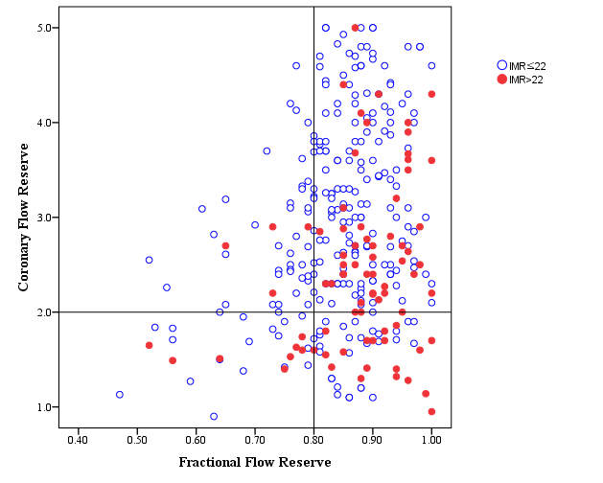
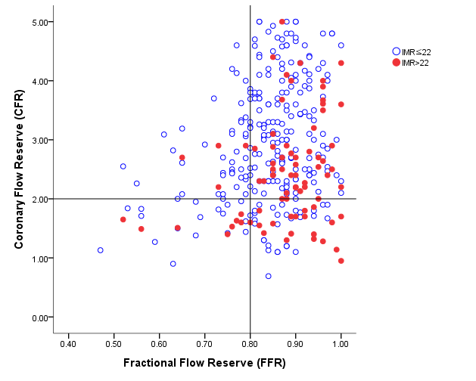
Distribution of patients according to FFR and CFR
Normal IMR < 23U
High IMR ≥ 23U
Angiographic % DS: 36.8% (32.4-38.2)
FFR 0.91 (0.90-0.91)
CFR 2.88 (2.78-2.97)
IMR 20.2U (19.3-21.1)
Lee JM , Koo BK et al. JACC 2016
23
Notes:
Among the 4 quadrants according to CFR and FFR,
This study focused on patients with high FFR, namely functionally insignificant epicardial coronary stenosis.
Among these patients, mean %DS was about 37%, FFR 0.91, CFR 2.9, and IMR was about 20.

Slide 24
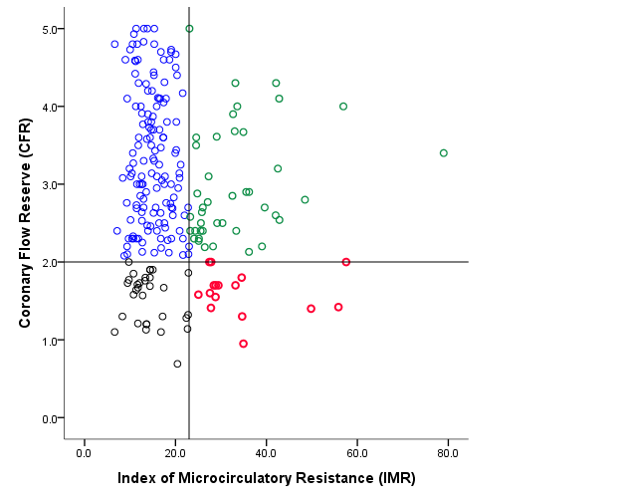
Distribution of High-FFR patients
according to CFR and IMR
A (61%)
Concordant Normal
B (18%)
Discordant
High resistance with preserved reserve
Using only 2 index (FFR and CFR) can not completely stratify high-FFR patients.
C (14%)
Discordant
Normal resistance with low reserve
D (7%)
Concordant Abnormal
Overt microvascular disease
Lee JM , Koo BK et al. JACC 2016
24
Notes:
Among the high FFR patients, the distribution of CFR and IMR was plotted.
Since these population showed functionally insignificant epicardial disease,
These 4 groups can be classified like this.
Among the 4 groups. The Group A reperesents normal microvascualr function, and
Group D represents overt microvascualr disease since those had depressed CFR and high IMR.

Slide 25
Comparison of Clinical, Angiographic Findings
Among 4 Group of High-FFR population
 | Group A (CFR>2 and IMR<23U) | Group B (CFR>2 and IMR≥23U) | Group C (CFR≤2 and IMR<23U) | Group D (CFR≤2 and IMR≥23U) | p value
Age, years | 60.2 ± 9.9 | 63.9 ± 7.1 | 65.6 ± 9.7 | 62.6 ± 9.9 | 0.017
Male | 90 (63.8%) | 22 (52.4%) | 18 (58.1%) | 10 (62.5%) | 0.591
BMI, kg/m² | 24.3 ± 2.9 | 25.4 ± 3.1 | 24.6 ± 2.5 | 25.2 ± 3.3 | 0.161
Hypertension | 78 (55.3%) | 27 (64.3%) | 18 (58.1%) | 10 (62.5%) | 0.747
Diabetes mellitus | 44 (31.2%) | 10 (23.8%) | 8 (25.8%) | 5 (31.3%) | 0.784
Hypercholesterolemia | 88 (62.4%) | 23 (54.8%) | 17 (54.8%) | 7 (43.8%) | 0.434
Current smoker | 25 (17.7%) | 6 (14.3%) | 3 (9.7%) | 2 (12.5%) | 0.687
Family history | 23 (16.3%) | 7 (16.7%) | 3 (9.7%) | 1 (6.3%) | 0.548
Previous MI | 6 (4.3%) | 2 (4.8%) | 0 (0.0%) | 0 (0.0%) | 0.541
Previous PCI | 40 (28.4%) | 7 (16.7%) | 9 (29.0%) | 2 (12.5%) | 0.263
Multivessel disease | 57 (40.4%) | 12 (28.6%) | 14 (45.2%) | 3 (18.8%) | 0.163
Gensini score | 12.0 (6.5-25.5) | 11.3 (5.0-18.8) | 20.5 (9.0-37.0) | 9.3 (4.8-19.5) | 0.114
Angiographic characteristics
Reference diameter | 3.02 (2.95-3.09) | 3.18 (3.03-3.34)§ | 2.91 (2.80-3.01)‡ | 3.12 (2.92-3.32) | 0.017
Diameter stenosis, % | 36.8 (34.9-38.6) | 36.4 (33.4-39.4) | 38.7 (35.6-41.9) | 33.2 (28.3-38.1) | 0.343
Lesion length, mm | 10.9 (10.1-11.8) | 10.7 (9.4-12.4) | 10.9 (9.4-12.4) | 10.4 (8.6-12.2) | 0.961
We can not discriminate High-FFR patient/lesions
Using any clinical or angiographic findings “OR”
Using only 2 physiologic index (FFR, CFR)
Those patients can be only discriminated
by multiple physiologic criteria (FFR, CFR, IMR).
Notes:
When comparing clinical and lesional profiles, these 4 gorups cannot be discriminated using conventional risk factors.
Those patients can be only discriminated
by multiple physiologic criteria (FFR, CFR, IMR).

Slide 26
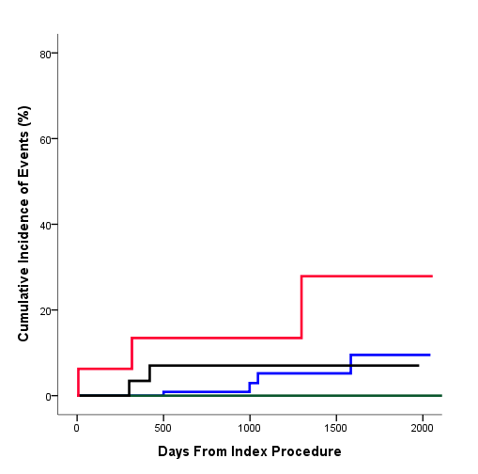
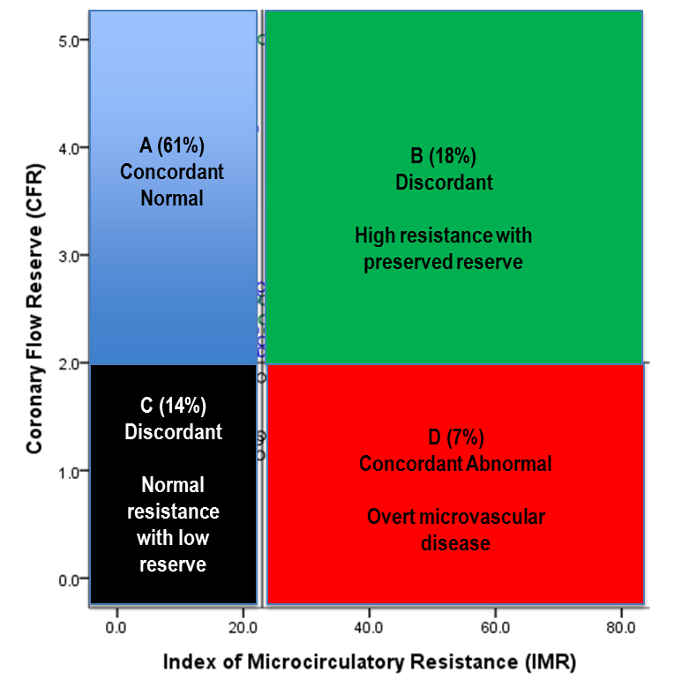
Comparison of Clinical Outcomes
Among 4 Group of High-FFR population
Group | CFR | IMR | Hazard Ratio (95% CI) | P value
A | High | Low | 1.000 (Reference) | NA
B | High | High | NA | NA
C | Low | Low | 2.116 (0.386-11.589) | 0.388
D | Low | High | 5.623 (1.234-25.620) | 0.026
Breslow P for overall comparison = 0.002
Overt Microvascular Disease
D
A
C
B
POCO, Patient-oriented Composite Outcomes
➔ a Composite of any Death, any MI, and any Revascularization
Lee JM , Koo BK et al. JACC 2016
Notes:
During 2 years of follow-up, only Group D with overt microvascular disease showed
Significantly higher rates of POCO, mainly driven by higher ischemia-driven revascularization for epicardial disease.

Slide 27
Independent Predictors of POCO
Among High-FFR population
Clinical/Angiographic Variables Only
Model with Physiologic Index
Model 1 | HR | 95% CI | P
Multivessel disease | 3.254 | 1.082-9.787 | 0.033
Diabetes mellitus | 2.828 | 1.088-7.349 | 0.033
Model 2 | HR | 95% CI | P
Low-CFR and high-IMR | 4.914 | 1.541-15.66 | 0.007
Multivessel disease | 3.639 | 1.238-10.669 | 0.019
Diabetes mellitus | 2.714 | 1.050-7.016 | 0.039
Improved discriminant function (Model2)
Relative IDI: 0.467, p=0.037
Category-free NRI: 0.648, p=0.007
Lee JM , Koo BK et al. JACC 2016
Notes:
In addition, Incorporating Comprehensive Physiologic Classification
Significantly Improves Discriminant function of the risk-prediction model

Slide 28
Summary
Macro- and micro-vascular diseases seems to possess “independent disease process” with “different predictors for its development”, although complex interaction could be presented.
Female gender was independent predictor for high-IMR.
Among the high-FFR patients (functionally insignificant macrovascular disease), about 7.0% of patient showed overt microvascular disease (low-CFR and high-IMR).
Presence of overt microvascular disease was associated with poor prognosis in high FFR population.
Comprehensive physiologic evaluation is essential to stratify those patients with overt microvascular disease.
Notes:
So ladies and gentelman, let me summarize the previous results,
In addition to the results from the International IMR registry,
Korean registry of Comprehensive physiologic evaluation revealed that
Among the high-FFR patients (functionally insignificant macrovascular disease), about 7.0% of patient showed overt microvascular disease (low-CFR and high-IMR).
Presence of overt microvascular disease was associated with poor prognosis in high FFR population.
Comprehensive physiologic evaluation is essential to stratify those patients with overt microvascular disease.

Slide 29
Unsolved Issues for Microvascular Disease
    [Primary Microvascular disease]
    Distribution and Abnormal value of IMR values in non-MI patients
    Whether Macro- and Micro- disease has independent disease process?
    Predictors of High IMR and Low FFR
    Clinical Prognosis of Patients with Microvascular disease
    Gender will affect the clinical outcomes of Microvascular Disease?
    Mechanism of Clinical Events in Patients with Microvascular disease
    Effective Treatment of Microvascular Disease
    [Secondary Microvascular Damage after AMI or Procedure-related]
    Is it “Regional Problem” or “Globalization will be occurred?”
    Non-Culprit stenosis evaluation with FFR
    How can we reduce MV damage after successful revascularization
Notes:
Although the female gender was independently associated with high IMR,
The current available data could not present differential prognosis of patient with overt microvascular disease, according to gender.
Furthermore, although patients with overt microvascular disease showed significantly worse clinical outcomes,
The underlying mechanism of clinical events in overt microvascular disease is still unclear.
Lastly, there have been limited evidence for effective treatment modality for microvascular disease.

Slide 30
IMPACT-FFR Registry
Objectives / Primary Hypothesis
[1] To compare the risk of atherosclerotic lesion progression and subsequent patient-oriented composite outcomes (all-cause mortality, any MI, or any Ischemia-driven repeat revascularization) between deferred lesions with or without over microvascular disease, defined as physiological classification
[2] To explore independent predictors of atherosclerotic lesion progression in deferred lesions based on fractional flow reserve-guided strategy and treated by contemporary medical treatment
IMaging and Physiologic Predictors of Atherosclerotic Progression in Deferred Lesions with Contemporary Medical Treatment based on Fractional Flow Reserve-guided Strategy (IMPACT-FFR registry)
Bon-Kwon Koo, Joo-Yong Hahn, Eun-Seok Shin, Chang-Wook Nam, Joon-Hyung Doh, Joo Myung Lee
Notes:
In order to clarify the remaining issues for microvascular disease,
Our collaborating group is now preparing multicenter registry for comprehensive imaging and physiologic database.
The main purpose of IMPACT-FFR registry are
No1. To compare the risk of atherosclerotic lesion progression and subsequent patient-oriented composite outcomes (all-cause mortality, any MI, or any Ischemia-driven repeat revascularization) between deferred lesions with or without over microvascular disease
No2. To explore independent predictors of atherosclerotic lesion progression in deferred lesions based on fractional flow reserve-guided strategy and treated by contemporary medical treatment

Slide 31
IMPACT-FFR Registry
1,400 Patients who are deferred revascularization due to FFR>0.80
Inclusion Criteria
Subject must be ≥ 18 years
Patients suspected with ischemic heart disease
Patients with intermediate degree of stenosis (30-70% stenosis by visual estimation) with fractional flow reserve of >0.80
OO centers in Korea
Exclusion Criteria
End-staged renal disease on hemodialysis
Acute hepatic injury
Cardiogenic shock
Non-cardiac co-morbid with life expectancy <2 year
Unable to perform invasive imaging study or physiologic assessment
Index Evaluation with Imaging and Physiologic Assessment
Index coronary angiography (visual 30-70% stenosis with FFR >0.80)
Comprehensive physiologic evaluation (FFR, CFR, IMR)
Comprehensive intravascular imaging (IVUS, OCT)
Invasive Imaging and Physiologic F/U (12-Month)
Coronary angiography
Comprehensive physiologic evaluation (FFR, CFR, IMR)
Comprehensive intravascular imaging (IVUS, OCT)
Non-Invasive Imaging F/U (12- or 24-Month)
Coronary CT angiography
(In Subgroup of Patients with Available Index CCTA)
Clinical F/U (1, 6, 12, 24, 36, 60-Month)
Primary Endpoint
Patient-oriented composite outcome at 24-Month F/U
(a Composite of all-cause mortality, any MI, any ischemia-driven repeat revascularization)
Secondary Endpoints
Clinical Endpoints
  Major adverse cardiovascular events All-cause death, cardiac death, Any nonfatal MI, target/non-target-vessel nonfatal MI
  Any repeat revascularization, target/non-target-vessel repeat revascularization (ischemia-driven or all)
  Stroke (ischemic and hemorrhagic)
  Seattle Angina Questionnaires
  1, 6, 12, 24, 36, and 60-month after index procedure
Imaging and Physiologic Endpoints
Change in normalized total atheroma volume (TAV) of target lesion
Change in TAVi: TAVifollow-up – TAVibaseline
Change in fibrous cap thickness by OCT
Change in Plaque burden, remodeling index at MLA site
Change in physiologic index (FFR, CFR, and IMR)
Change in total plaque volume and adverse plaque characteristics in coronary CT angiography 12- or 24-month after index procedure
Notes:
The Estimated Sample size is about 14 hundred,
At index procedure, comprehensive imaging and physiologic evaluation will be performed in deferred lesion, based on FFR.
Then, Invasive imaging follow-up or non-invasive CCTA follow-up will be performed at 1 or 2 years later.
These comprehensive data of imaging and physiologic index along with clinical outcomes will be analyzed at 2-year.
The IMPACT-FFR registry will also clarify the gender issue for microvascular disease.

Slide 32

Conclusion
My mentor always says that “We should be more physiologic than FFR..”
Lesion Geometry
Vulnerability
Resting Pd/Pa
CFR
Wedge Pressure/ CFI
FFR
IMR
External Force
iFR
Although we cannot see the forest with just one tree,
But, If we are trying to see as many trees as possible,
Finally we will be able to see the forest.
Notes:
Lastly, I would like to conclude with my montor’s phrase.
My mentor always says that we should be more physiologic than FFR.
Although we cannot see the forest with just one tree,
But, If we are trying to see as many trees as possible,
Finally we will be able to see the forest.

Slide 33
Thank You For Your Attention !
Joo Myung Lee, MD, MPH
Heart Vascular Stroke Institute,
Samsung Medical Center, Seoul, Republic of Korea
If you have any question, don’t hesitate to e-mail me.
drone80@hanmail.net

