Slide 1
How to overcome heavily calcified femoropopliteal lesions
Sendai Kousei Hospital, Tokyo Kamata Hospital, Japan
Naoto Inoue M.D. FJCC, FSCAI, FAHA

Slide 2
Speaker’s name: Naoto Inoue
■I have the following potential conflicts of interest to report:
□ Research contracts ■Consulting- Kaneka, Medicon
□ Employment in industry
□ Stockholder of a healthcare company
□ Owner of a healthcare company
□ Other(s)
□ I do not have any potential conflict of interest

Slide 3
Heavily Calcification of Femo-Pop lesion
Patient characteristics:
DM
CKD including Hemodialysis
Lesion characteristics:
Diffuse disease
CTO

Slide 4
Key points for the calcified lesion
No.1 Penetration for the calcified lesion especially
in CTO
No.2 Treatment after the successful wire recanalization

Slide 5
Key points for the calcified lesion
No.1 Penetration for the calcified lesion especially
in CTO
No.2 Treatment after the successful wire recanalization

Slide 6
CTO recanalization for heavily calcification
Antegrade approach preferred vs Cross-over
Wire manipulation, pushability
Super stiff wire
Bilateral approach
Subintimal technique
Crosser device, Wingman etc.

Slide 7
CTO recanalization for heavily calcification
Antegrade approach preferred vs Cross-over
Wire manipulation, pushability
Super stiff wire
Bilateral approach
Subintimal technique
Crosser device, Wingman etc.

Slide 8
CTO recanalization for heavily calcification
Antegrade approach preferred
Wire manipulation, pushability
Super stiff wire
Bilateral approach
Subintimal technique
Crosser device, Wingman etc.

Slide 9
Super stiff wire
0.014, 0018 size
Treasure, Astato
Chevalier series
True finder 45g, 60g
Jupiter Max 100g

Slide 10
CTO recanalization for heavily calcification
Antegrade approach preferred
Wire manipulation, pushability
Super stiff wire
Bilateral approach
Subintimal technique
Crosser device, Wingman etc.

Slide 11
Subintimal technique

Slide 12
Subintimal technique and CART

Slide 13
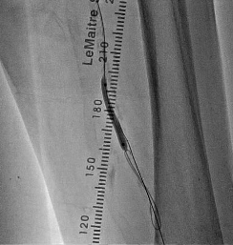
Subintimal technique and CART
Stent underexpansion
Subintimal tracking

Slide 14
CTO recanalization for heavily calcification
Antegrade approach preferred
Wire manipulation, pushability
Super stiff wire
Bilateral approach
Subintimal technique
Crosser device, Wingman etc.

Slide 15
Wingman CatheterTM
WingmanTM (ReFlow Medical, Inc., San Clemente, US) is an over the wire and extendable tip crossing catheter with a round metallic blade.
Notes:
WingmanTM (ReFlow Medical, Inc, San Clemente, US) is an over the wire and extendable tip crossing catheter with a round metallic blade.
We can manipulate the blade with the hand operating portion, put our or in the catheter tip.
After penetrating the solid point in CTO, wire is going. In the next solid point, wingman penetrates it and wire is going.
Repeating this procedure, we can cross the long segment CTO.
The direction of Wingman can be controlled by the guidewire.
(This blade can be put out or in the catheter tip by being manipulated with the hand operating portion. )

Slide 16
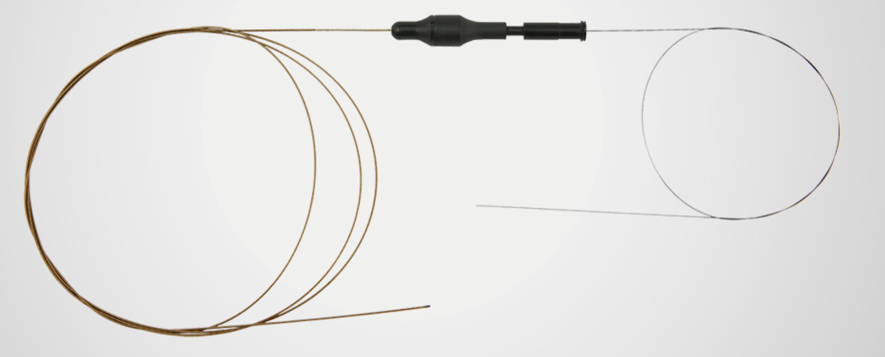
Wingman CatheterTM
Spec of the device
a single-use 0.014- or 0.035-inch guidewire-compatible catheter.
Non-electric and manual device.
Allows treatment of SFA, illiac and below-the-knee lesions.
Notes:
Wingman is 0.014 or 0.035 inch guidewire-compatible catheter. Non-electric and manual device. We can use for all segments of a limb artery.
This device was submitted by FDA in August 2013 and it was approved by the institutional review board at Sendai Kousei Hospital.

Slide 17
Case Presentation
A 64-year-old gentleman, with the history of HTN, DM and former smoking presented to our hospital due to Rutherford class-Ⅲ intermittent claudication, whose left ABI was 0.59.
LAO 30
Notes:
I would like to present the case, treated by Wingman.
A 64-year-old gentleman presented to our hospital due to Rutherford class-Ⅲ intermittent claudication, whose left ABI was 0.59.
Angiography revealed a long-segment CTO in left SFA.

Slide 18
Wingman CatheterTM
A short 6 Fr sheath was placed antegradely via the left common femoral artery. We considered that the antegrade approach was suitable for controlling a crossing catheter.
Wingman 35TM was introduced into the proximal cap with 0.018-inch TreasureTM wire.
Notes:
A short 6 Fr sheath was placed antegradely via the left common artery. At first, Wingman 35TM was introduced into the proximal cap with 0.018” TreasureTM wire.

Slide 19
Wingman CatheterTM
A metallic blade can be put out or in the catheter tip by being manipulated with the hand operating portion. WingmanTM is following the guidewire and penetrating intimal occlusion.
Notes:
A metallic blade can be put out or in the catheter tip. Wingman penetrated intimal occlusion and followed the guidewire.

Slide 20
Successful Crossing
When TreasureTM could not proceed, WingmanTM preceded the wire and penetrated the solid point of CTO. Repeating this procedure, successful crossing was achieved in 8 minutes.
Notes:
When TreasureTM could not proceed, WingmanTM preceded the wire and penetrated the solid point of CTO. Repeating this procedure, successful crossing was achieved in 8 minutes.

Slide 21
WingmanTM in a heavy calcified lesion
A 77-year-old lady with ESRD due to diabetes underwent EVT for heavy calcified occlusion in SFA.
Notes:
I would like to present one more case with heavy calcified SFA.
A 77-year-old lady with ESRD due to diabetes underwent EVT for heavy calcified occlusion in SFA.

Slide 22
WingmanTM in a heavy calcified lesion
A 77-year-old lady with ESRD due to diabetes underwent EVT for heavy calcified occlusion in SFA. WingmanTM could penetrate ahead, even if stiff wires or knuckle wire didn’t proceed.
Not Crossing
Penetrate ↔️ Wiring
Notes:
When the stiff wires or knuckle wire didn’t proceed the lesion, WingmanTM could penetrate ahead,

Slide 23
WingmanTM in a heavy calcified lesion
A 77-year-old lady with ESRD due to diabetes underwent EVT for heavy calcified occlusion in SFA. WingmanTM could penetrate ahead, even if stiff wires or knuckle wire didn’t proceed.
Penetrate ↔️ Wiring
Notes:
At the mid portion of SFA, wire could not pass again, so we repeated Wingman penetration and wiring.
This slide shows that Wingman tip is turning around.
This is 0.014 Wingman, so we can not see well, but the blade is turning around sufficiently.

Slide 24
WingmanTM in a heavy calcified lesion
A 77-year-old lady with ESRD due to diabetes underwent EVT for heavy calcified occlusion in SFA. WingmanTM could penetrate ahead, even if stiff wires or knuckle wire didn’t proceed.
Bidirectional wiring
CART → Crossing
Notes:
Repeating Wingman and wiring, we succeeded in making the wire reaching subintimal space in the distal re-entry point.
We performed bidirectional wiring, CART, and then we achieved wire crossing.

Slide 25
Key points for the calcified lesion
No.1 Penetration for the calcified lesion especially
in CTO
No.2 Treatment after the successful wire recanalization

Slide 26
Focal force angioplasty

Slide 27
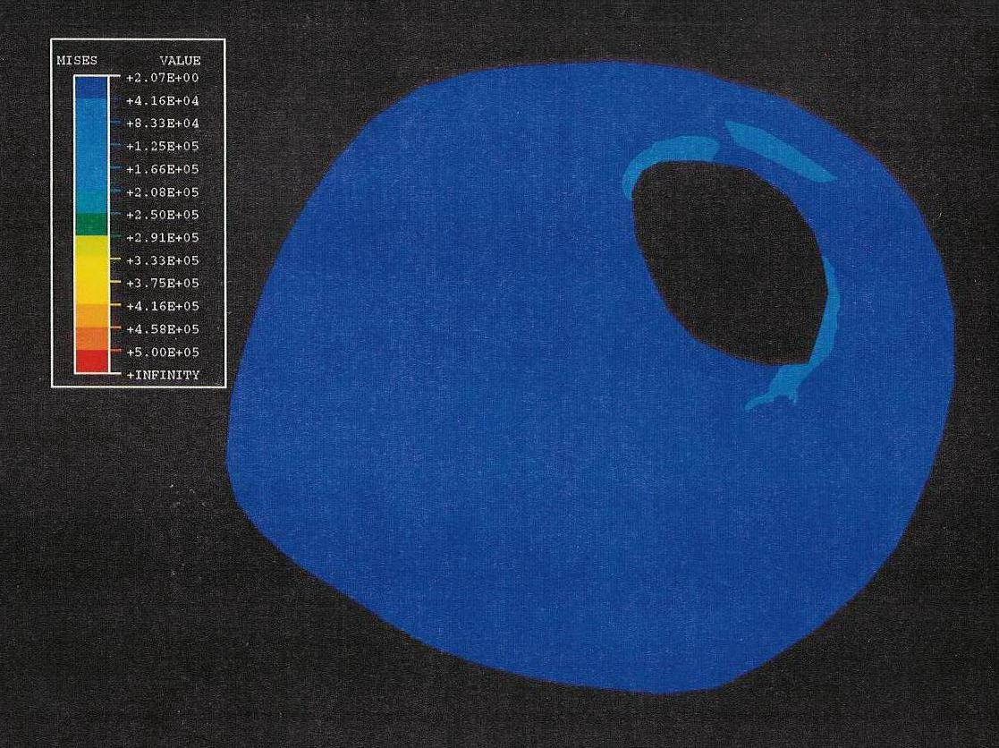
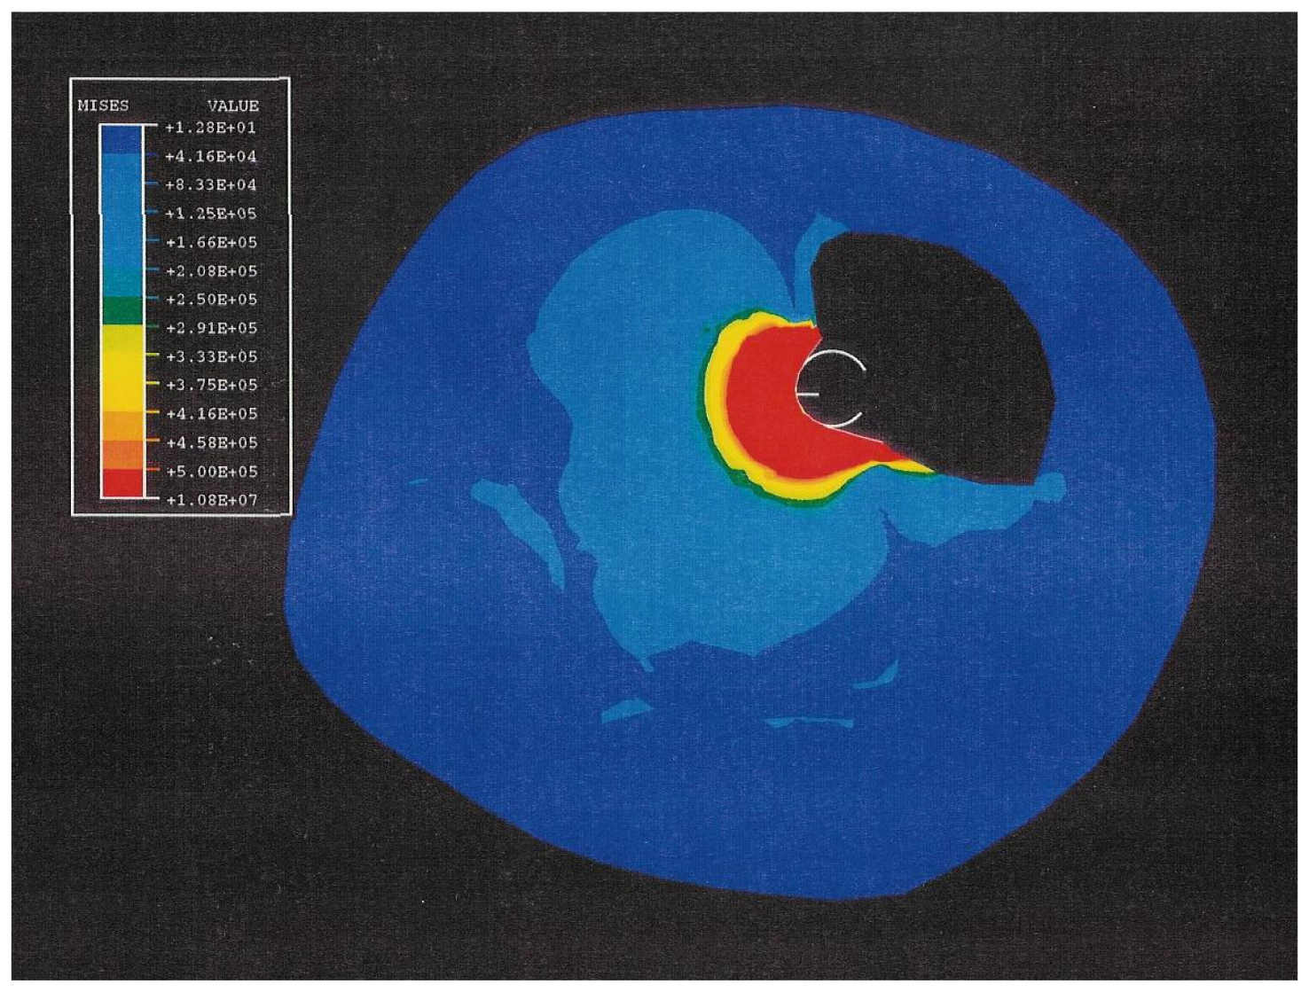
Stress Concentration
P
1atm Dilatation
～2atm
～100atm

Slide 28
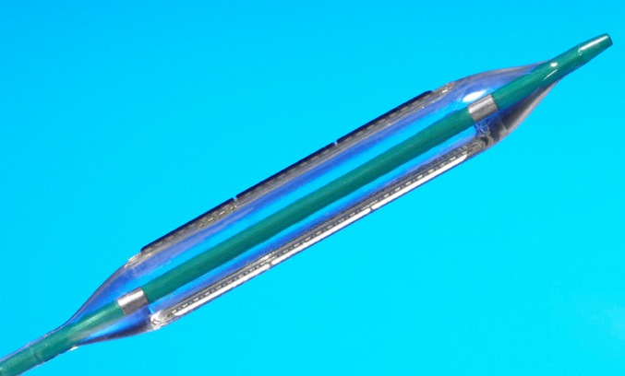
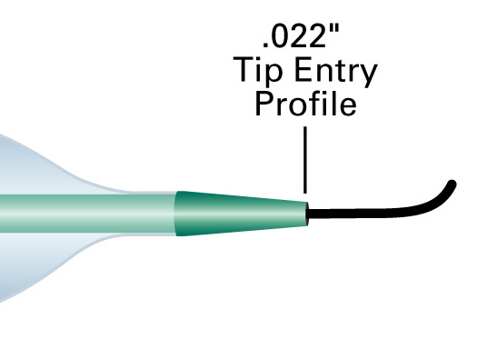
Peripheral Cutting BalloonTM Flextome™ Balloon
New Nylon balloon material:
Softer & more flexible than PET
Nominal: 6atm
RBP: 12 atm
Tip flexibility:
ability of tip to flex and follow the guidewire is a major contributing factor for crossing lesions on a bend
Photo taken by Boston Scientific

Slide 29
AngioSculpt^{R} Scoring balloon

Slide 30
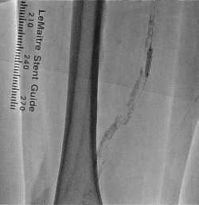
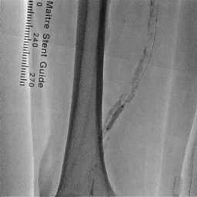
AngioSculpt^{R} Scoring balloon
Angiosulpt 4.0mm
24 atm

Slide 31
AngioSculpt^{R} Scoring balloon

Slide 32
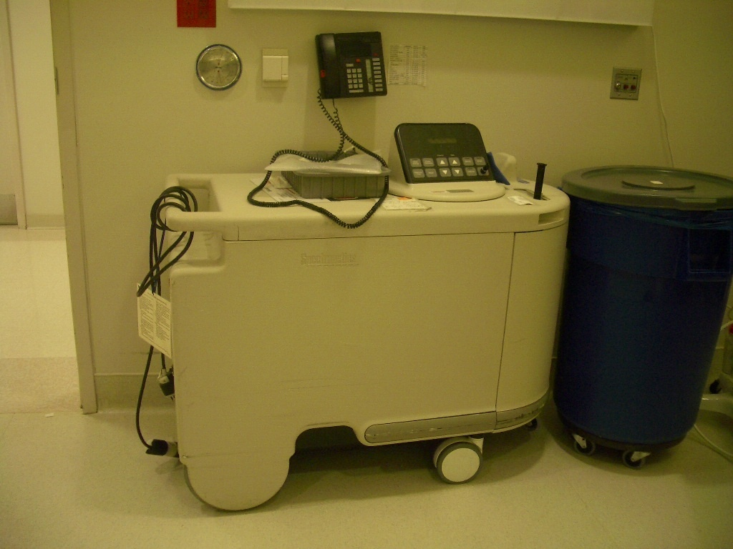
Excimer Laser

Slide 33
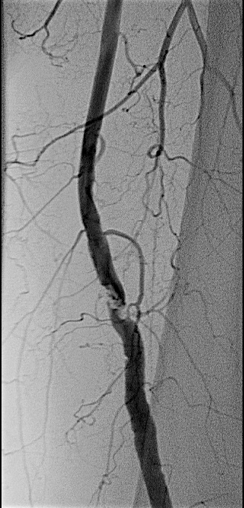
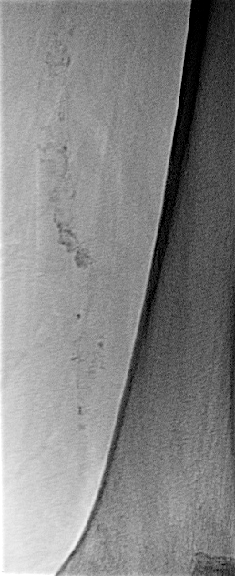
Lesion Calcification
High grade calcification lesion

Slide 34
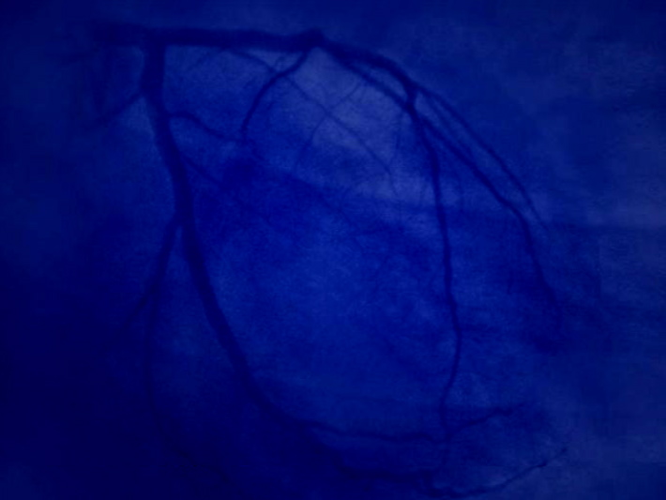
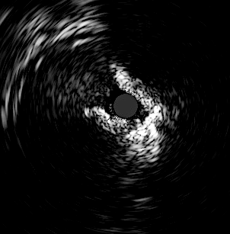
IVUS
Arcs of Calcium

Slide 35
Increased Lumen with fragmentation of
the calcium rendering the vessel more compliant

Slide 36
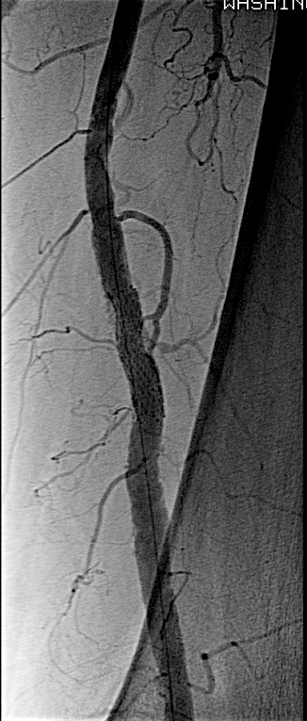
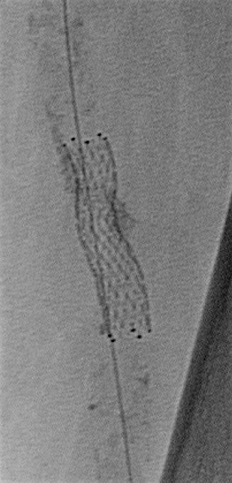
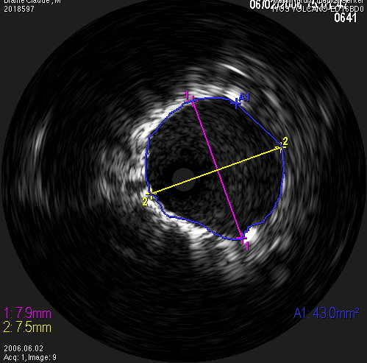
Well expanded stent

Slide 37
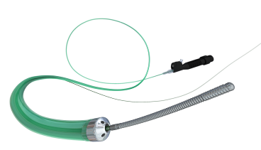
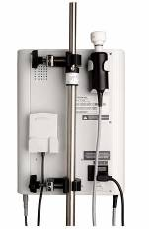
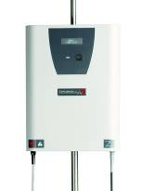
The “CROSSER”
Uses High Frequency
Ultrasound Energy to
Cross CTO’s
20.000cycle/sec

Slide 38
Crosser device
Notes:
Plaster board

Slide 39
Crosser device
Notes:
Plaster board

Slide 40
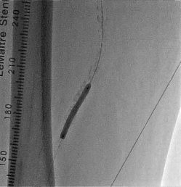
Crosser device
Good response to balloon dilatation

Slide 41
Rotablator

Slide 42
Diamondback

Slide 43
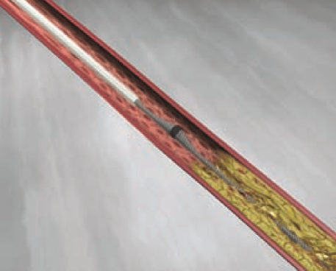
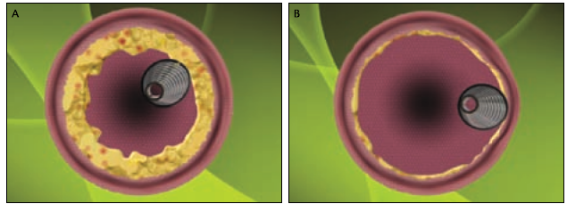
x1.75
Notes:
Swing motion

Slide 44
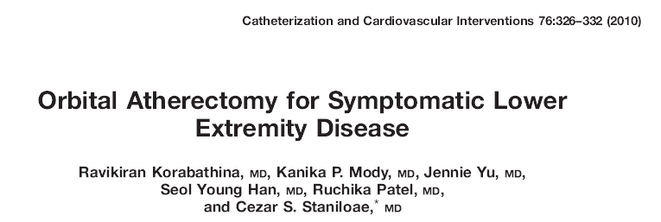
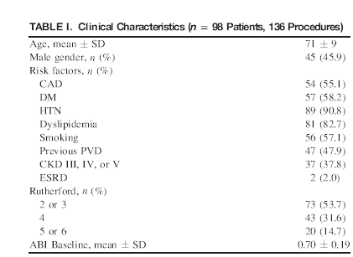

Slide 46
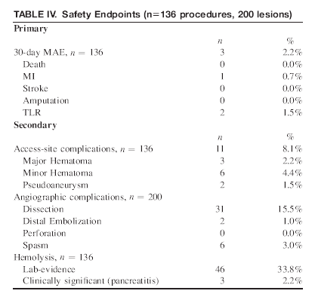

Slide 47
Diamondback
Courtesy by Dr. Dave

Slide 48
Conclusion
Optimization of calcified Fem-pop is really difficult.
There are many techniques for the recanalization of
calcified CTO (Stiff wire, Subintimal technique,
Bilateral approach, Wingman etc.)
Fully expansion of balloon catheter is difficult.
Some roles of new devices (Such as Laser, Crosser,
Scoring balloon, Diamondback etc.)

Slide 50
Thank you!

