Slide 1

Joint Meeting of Coronary Revascularization
2016
PLASMA DABIGATRAN, RIVAROXABAN AND APIXABAN
LEVELS IN PATIENTS WITH NON-VALVULAR
ATRIAL FIBRILLATION: A SINGLE CENTRE STUDY
(NMRR-16-1867-32865)
Lim MSH^{1,2}, Tiong LL^{1,2}, Tan SSN^{1,2}, Ku MY^{1,2}, Charles S⁴, Ong TK³, Fong AYY^{2,3}
¹ Department of Pharmacy, Sarawak Heart Centre, Kota Samarahan, Malaysia
² Clinical Research Centre, Sarawak General Hospital, Kuching, Malaysia
³Department of Cardiology, Sarawak Heart Centre, Kota Samarahan, Malaysia
⁴Clinical Research Malaysia
Notes:
1

Slide 2
Warfarin: Mechanism of Action
Vitamin K epoxide
WARFARIN
Vitamin K reduced
Inactive factors II,
VII, IX, and X
Proteins S and C
Active factors II,
VII, IX, and X
Proteins S and C
Problem:
Has no effect on previously formed thrombus
Narrow therapeutic range
Greatly affected by vitamin k diet, ie. Green leafy vegetables

Slide 3
New Anticoagulants
ORAL
PARENTERAL
TF/VIIa
TFPI (tifacogin)
TTP889
X
IX
IXa
APC (drotrecogin alfa)
sTM (ART-123)
Rivaroxaban (2011)
Apixaban (2012)
LY517717
YM150
DU-176b
Betrixaban
TAK 442
VIIIa
Va
Xa
AT
Fondaparinux
Idraparinux
II
DX-9065a
Dabigatran (2010)
IIa
Fibrinogen
Fibrin
Adapted from Weitz & Bates, J Thromb Haemost 2007
Notes:
There are many targets for novel anticoagulants in the coagulation pathway:
Tissue factor pathway inhibitor (TFPI) bound to Factor Xa inactivates the tissue factor (TF)–Factor VIIa complex, preventing initiation of coagulation
Activated protein C (APC) degrades Factors Va and VIIIa, and thrombomodulin (soluble; sTM) converts thrombin (Factor IIa) from a procoagulant to a potent activator of protein C
Fondaparinux and idraparinux indirectly inhibit Factor Xa, requiring antithrombin (AT) as a cofactor
Direct (AT-independent) inhibitors of Factor Xa include rivaroxaban (BAY 59­7939), LY517717, YM150 and DU-176b (all orally available), and DX-9065a (intravenous)
Oral, direct thrombin inhibitors include ximelagatran (now withdrawn) and dabigatran
Weitz JI & Bates SM. New anticoagulants. J Thromb Haemost 2005;3:1843–1853

Slide 4
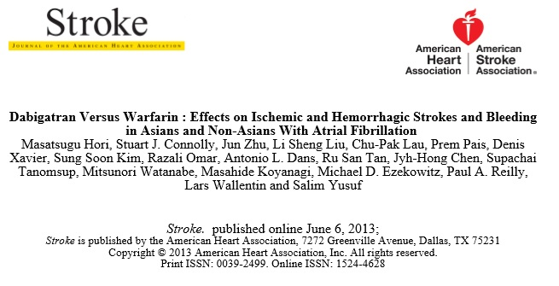
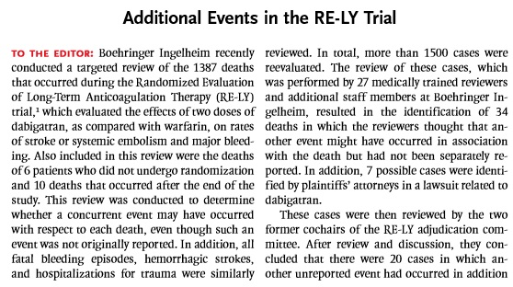
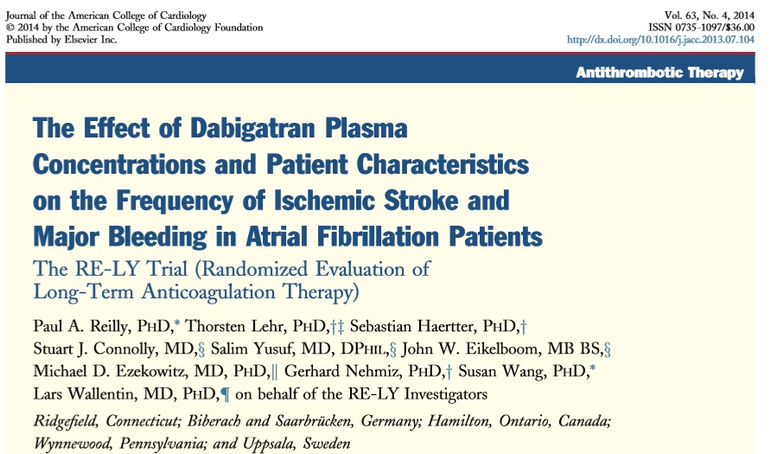
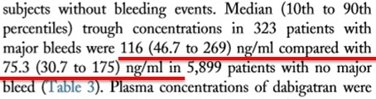
Dabigatran Etexilate
MAJOR BLEEDING

Slide 5
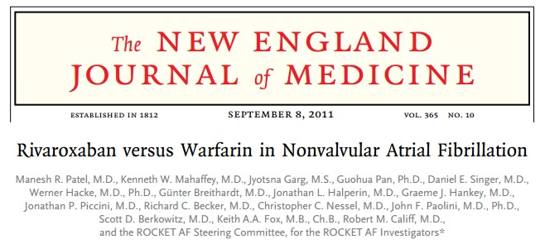
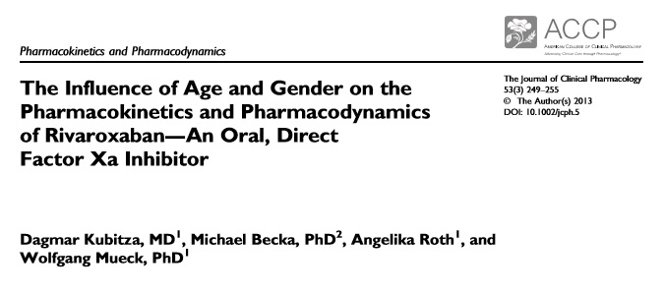
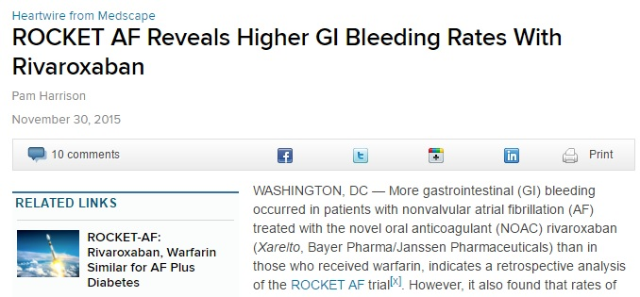

Rivaroxaban

Slide 6
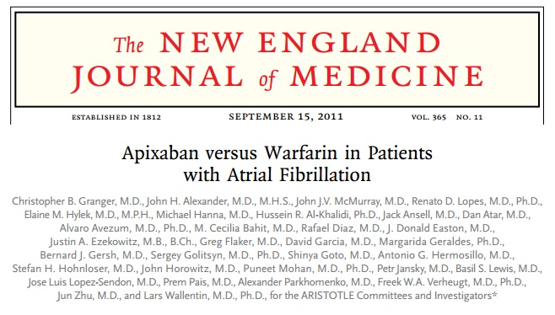
Apixaban

Slide 7
Objective
To characterise the plasma levels of Dabigatran, Rivaroxaban and Apixaban (NOACs) in patients with NVAF taking either drug for > 4 days
  To assess the median trough plasma Dabigatran, Rivaroxaban and Apixaban level in our population
  To study the association of this plasma Dabigatran, Rivaroxaban and Apixaban level with patient-specific factors such as gender, age and other co-morbidities

Slide 8
Materials and Methods
SINGLE CENTRE RECRUITMENT
Sarawak Heart Centre
(Kota Samarahan)
78 PATIENTS
(51 Patients on Dabigatran twice daily, 22 Patients on Rivaroxaban once daily and 5 Patients on Apixaban twice daily for at >4 days)
Liquid Chromatography Tandem Mass Spectrometry (LC-MS/MS)
Trough Dabigatran and Rivaroxaban levels
(blood drawn prior to morning dose)
2. Triplicate samples

Slide 9
Results
39.91ng/ml
63.75ng/ml
Trough Range:
10.23ng/ml to 330.55ng/ml
41.24ng/ml
43.4ng/ml
43.83ng/ml

Slide 10
Results
Trough Range:
0.83ng/ml to 205.12ng/ml
38.47ng/ml
42.13ng/ml
57.42ng/ml
40.30ng/ml

Slide 11
Results
24.31ng/ml
25.36ng/ml
24.31ng/ml
3.24ng/ml

Slide 12
Demographic Data
Variable | Dabigatran Etexilate | Rivaroxaban | Apixaban | Overall
Age(yr)* | 68.90(11.71) | 63.32(13.51) | 77.60(7.13) | 67.88(12.42)
Genderᵟ Male Female | 34(66.7%) 17(33.3%) | 17(77.3%) 5(22.7%) | 2(40.0%) 3(60.0%) | 53(67.9%) 25(32.1%)
AFᵟ Paroxysmal Persistent Permanent | 17(33.3%) 5(9.8%) 29(56.9%) | 3(13.6%) 3(13.6%) 16(72.7%) | 2(40.0%) 1(20.0%) 2(40.0%) | 22(28.2%) 9(11.5%) 47(60.3%)
Weight, kg* | 63.75(15.3) | 78.37(23.78) | 61.93(22.90) | 67.97(19.39)
CrCl, ml/min*ᵝ | 63.13(25.72) | 78.93(34.7) | 35.62(9.88) | 65.49(29.04)
CHA₂DS₂-VASc* | 3.92(1.35) | 3.36(1.36) | 4.20(1.30) | 3.78(1.36)
HAS-BLED* | 1.51(0.67) | 1.09(0.68) | 1.40(0.55) | 1.38(0.69)
Plasma level (ng/ml) | 43.83(44.12) | 40.3(75.88) | 24.31(42.90) | -
Plasma level (nomalised) (ng/ml/mg) | 0.34(0.41) | 2.14(4.45) | 9.72(17.49) | -
*All data presented as Mean(SD) with 95% Confidence Interval ᵟAll data presented as percentage
ᵝData inclusive of 52 patients

Slide 13
Risk Factors affecting trough levels of Dabigatran
(Total n=51)
Risk Factors | Plasma level (ng/ml/mg) | P Value | Risk factors | Plasma level (ng/ml/mg) | P Value
Age (yrs) |  |  | CAD
<65 (n=13) ≥65 (n=38) | 0.23(0.17,0.36) 0.40(0.27,0.68) | 0.023ᵟ | Yes(n=9) No(n=42) | 0.23(0.15,0.50) 0.39(0.24,0.63) | 0.165
Gender |  |  | CrClᵝ
Male (n=33) Female (n=18) | 0.33(0.22,0.52) 0.50(0.21,0.69) | 0.296 | <50ml/min ≥50ml/min | 0.64(0.39,1.14) 0.29(0.22,0.45) | 0.026
Hypertension |  |  | Prior Stroke
Yes(n=45) No(n=6) | 0.38(0.22,0.65) 0.29(0.21,0.59) | 0.658 | Yes (n=26) No (n=25) | 0.33(0.16,0.65) 0.40(0.23,0.61) | 0.498
Diabetes Mellitus |  |  | Prior Bleeding
Yes(n=11) No(n=40) | 0.57(0.13,1.18) 0.34(0.22,0.58) | 0.410 | Yes (n=6) No (n=45) | 0.31(0.15,0.74) 0.38(0.22,0.61) | 0.765
*All data presented as Median(IQR) using non-parametric t-test (Mann-Whitney) ᵟp-value significant at <0.05
ᵝData inclusive of 52 patients

Slide 14
Dabigatran Subgroup Analysis (n=51)
110mg vs 150mg
Variable | DE 110mg (n=29) | DE 150mg (n=22) | Total (n=51) | P Value
Genderᵟ Male Female | 15(45.5%) 14(77.8%) | 18(54.5%) 4(22.2%) | 33(100%) 18(100%) | 0.026
Prior Stroke Yes No | 11(42.3%) 18(72.0%) | 15(57.7%) 7(28.0%) | 26(100%) 25(100%) | 0.032
Prior Bleeding Yes No | 3(50%) 26(57.8%) | 3(50%) 19(42.2%) | 6(100%) 45(100%) | 0.718
Age(SD) | 72.14(11.7) | 64.64(10.5) | 68.90(11.7) | 0.022
CrCl(SD) ᵝ | 52.54(15.4) | 81.63(30.5) | 63.34(26.1) | 0.002
Normalised level (ng/ml/mg)* | 0.47(0.28,0.74) | 0.27(0.16,0.41) | 0.34(0.22,0.63) | 0.010
*All data presented as Median(IQR) using non-parametric t-test (Mann-Whitney) ᵟChi-Square tests of p-value significant at <0.05
ᵝData inclusive of 35 patients

Slide 15
Risk Factors affecting trough levels of Rivaroxaban
(Total n=22)
Risk Factors | Plasma level (ng/ml/mg) | P Value | Risk factors | Plasma level (ng/ml/mg) | P Value
Age (yrs) |  |  | CAD
<65 (n=10) ≥65 (n=12) | 2.02(0.43,3.58) 2.58(0.81,5.44) | 0.283ᵟ | Yes(n=5) No(n=17) | 1.52(0.55,4.18) 2.18(0.77,5.23) | 0.543
Gender |  |  | CrClᵝ
Male (n=17) Female (n=5) | 2.18(0.77,4.85) 2.11(0.56,5.23) | 0.880 | <50ml/min ≥50ml/min | 3.83(2.18,-) 3.08(0.74,5.35) | 0.641
Hypertension |  |  | Prior Stroke
Yes(n=16) No(n=6) | 2.54(0.75,5.31) 1.53(0.59,3.84) | 0.641 | Yes (n=8) No (n=14) | 3.21(1.62,6.04) 1.53(0.48,3.78) | 0.145
Diabetes Mellitus
Yes(n=10) No(n=12) | 2.58(1.34,5.17) 1.49(0.52,5.09) | 0.628
*All data presented as Median(IQR) using non-parametric t-test (Mann-Whitney) ᵟp-value significant at <0.05
ᵝData inclusive of 13 patients

Slide 16
Conclusions
Wide range of Dabigatran, Rivaroxaban and Apixaban levels in our cohort
Median trough plasma Dabigatran is 43.83ng/ml, Rivaroxaban is 40.30ng/ml while for Apixaban is 24.31ng/ml in our cohort
Prospective studies utilizing these median levels in association to stroke and bleeding end-points with larger sample size are warranted
LIMITATIONS: Retrospective, Single Centre experience study with small sample size

Slide 17

Thank You

Slide 18
DISCLAIMER
This work involved the drug level of Dabigatran (Pradaxa) by Boehringer Ingelheim and Rivaroxaban (Xarelto) by Bayer. However, none of this work was funded by either company.

