Slide 1

The Plasma Concentrations of Atorvastatin and its Active Metabolites in Relation to the Dose in Stable Coronary Artery Disease Patients at a Tertiary Referral Center
JOINT MEETING OF CORONARY REVASCULARIZATION 2016
TIONG LEE LEN
SENIOR RESEARCH PHARMACIST
CLINICAL RESEARCH CENTER, SARAWAK GENERAL HOSPITAL
Notes:
1
A very good morning, ladies and gentlemen. I am Lee Len, a pharmacist from Clinical Research Center, Sarawak General Hospital. This morning I’d like to share on the findings with regards to “TITLE”

Slide 2
INTRODUCTION
Dyslipidemia – well established modifiable risk factor for cardiovascular diseases.
Reducing low density lipoprotein cholesterol (LDL-C) markedly reduced the incidences of coronary artery disease (CAD).
  ↓ LDL-C by 1%, ↓ CAD risk by 1%
HMG-CoA reductase inhibitors (statins) – mainstay in lipid lowering therapy.
Notes:
Dyslipidemia is a well established risk factor for cardiovascular diseases that are modifiable by dietary restrictions and pharmacotherapy. It has been proven that reducing LDL cholesterol markedly reduced the incidences of coronary artery diseases, by which a 1% reduction in LDL cholesterol results in reduction of coronary artery disease at the same magnitude. HMG-CoA reductase inhibitors, or more commonly known as statins have been the mainstay pharmacotherapy prescribed for lipid lowering in coronary artery disease patients.

Slide 3
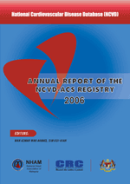
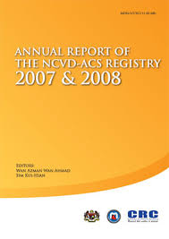
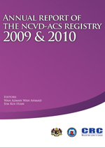
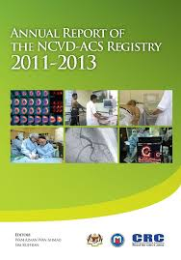
IN MALAYSIA
Notes:
In Malaysia, we have the National Cardiovascuclar Disease Database-Acute Coronary Syndrome Registry that collects data on ACS patients admitted to public and private hospitals all across Malaysia.

Slide 4
NCVD-ACS
From the National Cardiovascular Disease Database – Acute Coronary Syndrome Registry (2011-2013) annual report:
  approximately 37.4% of patients with ACS had history of hyperlipidemia.
  more than 90% of ACS patients were prescribed with statins.
Notes:
From the NCVD-ACS Registry 2011-2013 annual report, it was found that approximately 37.4% of the patients admitted for ACS had a prior history of hyperlipidaemia and more than 90% of these patients were prescribed with statins.

Slide 5
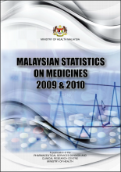
MSOM
Atorvastatin (AT) is widely used for secondary prevention of CAD.
Notes:
We also have the Malaysian Statistics on Medicines report which was compiled from the national medicine used survey that was conducted annually. From this report, it was found that atorvastatin is widely prescribed for secondary prevention of coronary artery disease.

Slide 6
ATORVASTATIN
Mainly metabolized by CYP3A4:
  2 active metabolites: 2-hydroxy-atorvastatin (2-OH-AT) and 4-hydroxy-atorvastatin (4-OH-AT).
  3 inactive lactone metabolites.
70% of the HMG-CoA reductase inhibitory activity is attributed by the active metabolites.
Notes:
Atorvastatin is a HMG-CoA reductase inhibitors that has been proven in clinical trials such as ASCOT and TNT that it effectively reduces LDL cholesterol and therefore, reducing coronary related events. It is mainly metabolized by the cytochrome 3A4 system to 2 active metabolites, namely 2-OH-AT and 4-OH-AT. It is also metabolized to 3 inactive lactone metabolites by the same enzyme system. Approximately 70% of the HMG-CoA reductase inhibitory activity is attributed by the active metabolites. Therefore, we also took into account the plasma levels of both the active metabolites in this study.

Slide 7
OBJECTIVE
To assess the association of plasma concentrations of AT and its active metabolites (2-OH-AT and 4-OH-AT) to AT doses in stable CAD patients.

Slide 8
METHODOLOGY (1)
Clinical notes from patients with stable CAD attending the outpatient clinic, Sarawak Heart Center from 1 March to 31 May 2016 were screened for:
  those established on AT therapy for at least 1 month.
  had their plasma concentrations of AT, 2-OH-AT and 4-OH-AT measured with fasting lipid profile (FLP).

Slide 9
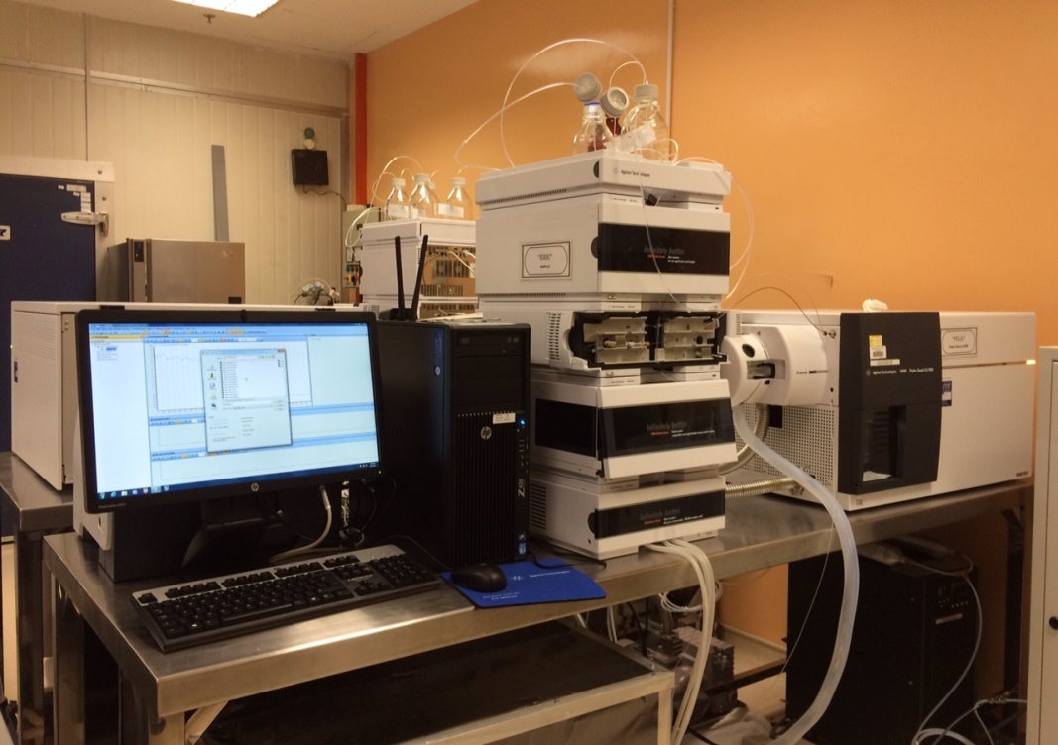
METHODOLOGY (2)
LC-MS/MS
Notes:
The plasma level of atorvastatin and its active metabolites were measured by liquid chromatography tandem mass spectrometry and the lowest limit of quantification was predefined at 0.5ng/mL.

Slide 10
RESULTS
From 410 cases screened, 223 (54.4%) were included in the study.

Slide 11
BASELINE CHARACTERISTICS
Characteristics |  | Mean ± SD or Number (%)
Age (years) |  | 60.87 ± 10.63
Male |  | 193 (86.5)
Race | Malay | 57 (25.6)
 | Chinese | 132 (59.2)
 | Iban | 9 (4.0)
 | Bidayuh | 18 (8.1)
Body mass index (kg/m²) |  | 26.83 ± 4.31
Cardiovascular risk factors | Hypertension | 164 (73.5)
 | Dyslipidemia | 149 (66.8)
 | Diabetes Mellitus | 94 (42.2)
 | Smoking Status | 31 (13.9)
Lipid Profile (mmol/L) | Total Cholesterol | 4.27 ± 1.27
 | LDL | 2.36 ± 1.02
 | HDL | 1.13 ± 0.28
 | Triglycerides | 1.71 ± 1.32

Slide 12
MEAN PLASMA CONCENTRATIONS
 | Plasma Concentrations, Mean ± SD (ng/mL) | Dose-adjusted plasma concentrations, Mean ± SD (ng/mL)
AT | 3.09 ± 3.04 | 0.09 ± 0.08
2-OH-AT | 5.40 ± 4.68 | 0.15 ± 0.12
4-OH-AT | 1.85 ± 2.46 | 0.05 ± 0.07

Slide 13
DOSE vs PLASMA CONCENTRATIONS
(all p< 0.002; respectively)
Dose (mg) | AT Plasma Concentrations, Mean ± SD (ng/mL) | 2-OH-AT Plasma Concentrations, Mean ± SD (ng/mL) | 4-OH-AT Plasma Concentrations, Mean ± SD (ng/mL)
10 | 0.70 ± 0.28 | 1.85 ± 1.37 | 0.40 ± 0.29
20 | 1.33 ± 1.76 | 2.27 ± 1.92 | 0.90 ± 1.65
40 | 2.62 ± 3.10 | 4.76 ± 5.09 | 1.61 ± 2.42
60 | 4.53 ± 6.95 | 3.80 ± 4.21 | 0.92 ± 1.06
80 | 0.28 ± 0.62 | 0.64 ± 1.28 | 0.29 ± 0.43

Slide 14
LDL vs DOSE-ADJUSTED PLASMA CONCENTRATIONS (1)
 | Dose adjusted plasma concentrations for LDL < 2.6 mmol/L, Mean ± SD (ng/mL) | Dose adjusted plasma concentrations for LDL ≥ 2.6 mmol/L, Mean ± SD (ng/mL) | P value
AT | 0.09 ± 0.09 | 0.07 ± 0.05 | 0.22
2-OH-AT | 0.16 ± 0.12 | 0.13 ± 0.09 | 0.16
4-OH-AT | 0.06 ± 0.08 | 0.04 ± 0.05 | 0.24

Slide 15
LDL vs DOSE-ADJUSTED PLASMA CONCENTRATIONS (2)
77.0% of the patients achieved LDL target of less than 2.6 mmol/L.
Mean LDL levels were higher in approximately 25% of the patients with plasma concentrations of AT and its metabolites below the LLOQ (p<0.01).

Slide 16
DISCUSSION
↑ dose of AT, ↑ plasma concentrations of AT and its metabolites, ↓ LDL level.
However, limited at very high dose of AT
  Genetic predisposition (PCSK9)
  Compliance issues
  Drug interactions
Notes:
As the dose of atorvastatin increases, the plasma level of atorvastatin and its metabolites increases as well with a corresponding decline in the LDL level. However, this finding is limited at high dose of atorvastatin or 60mg and above which might explained by different genetic predisposition of the patients. It might also be attributed to drug compliance issue as well as any concurrently interacting medications that were taken by the patients which might affect their plasma levels through interaction at the cytochrome metabolizing systems.

Slide 17
LIMITATIONS
Single centre experience.
Observational and retrospective study design in a clinical practice setting:
  No assessment of compliance done.
  Only single point of plasma concentration captured – no peak concentration.
  Timing to blood sampling.
  Brand of AT.
Notes:
The limitation includes this is a single center study and it is observational and retrospective in nature. Due to the study design, a lot of parameters are not within our control. For instance, no assessment of drug compliance was done. There was only a single point of plasma concentrations captured, with no peak concentration data. The timing of blood sampling and the brand of atorvastatin used might be different.

Slide 18
CONCLUSION
In stable CAD patients established on AT therapy, increasing doses up to 60mg were associated with higher plasma concentrations of AT and its active metabolites.
Future studies are warranted to explore other factors, namely compliance and genetic predisposition that might explain the current finding and their association to plasma concentrations of AT and its active metabolites.

Slide 19

THANK YOU

