Slide 1




Micro-vascular Obstruction
Department Academic Cardiology
National Institute for Health Research, Leicester Cardiovascular Biomedical Research Unit
What is it?
How important is it ?
Current status of therapeutic interventions
Tony Gershlick
Professor Interventional Cardiology
University Hospitals of Leicester UK

Slide 2
“Microvascular Obstruction” (MVO)
What is it ?
Abnormal tissue perfusion and/or distal coronary blood flow despite normal patency of the infarct-related artery (IRA)
Can result in persistent myocardial injury and necrosis despite angiographically successful P-PCI
Angiographically ranges from true “no-reflow” to impairment of distal vessel micro-angiographic flow (“slow-flow”) to CMR detected MVO
Notes:
The long-term detrimental effect of no-reflow has been documented to include increased risk for cardiac death, CHF, malignant arrhythmias and decrease in ejection fraction.

Slide 3
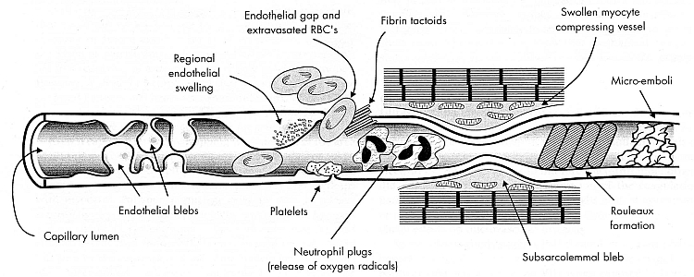
Pathophysiology of MVO
The mechanism of the development of MVO is multi-factorial, but predominantly
            distal embolization
            vaso-active substances
            microvascular ischemia-reperfusion injury.
Notes:
The mechanism of the development of MVO is multi-factorial, but predominantly it occurs due to distal embolization and microvascular ischaemia-reperfusion injury. After plaque rupture and intracoronary thrombus formation, ischemia causes ultrastructural damage to myocytes and the coronary microcirculation soon after coronary occlusion (13). Once epicardial reperfusion occurs and blood flow to the infarct zone is restored, reperfusion injury caused by neutrophil infiltration, generation of oxygen free radicals and activation of the complement system and adhesion molecules may further damage the microcirculation (11,14-15). Damaged myocytes and arterioles are thought to hinder microvascular flow by increasing distal vascular resistance, stimulating arteriolar spasm and causing endothelial dysfunction. In addition, platelet microemboli are thought to be “showered” downstream of the microcirculation after plaque rupture, causing microvascular obstruction that further limits tissue perfusion once the epicardial infarct vessel is recanalized

Slide 4
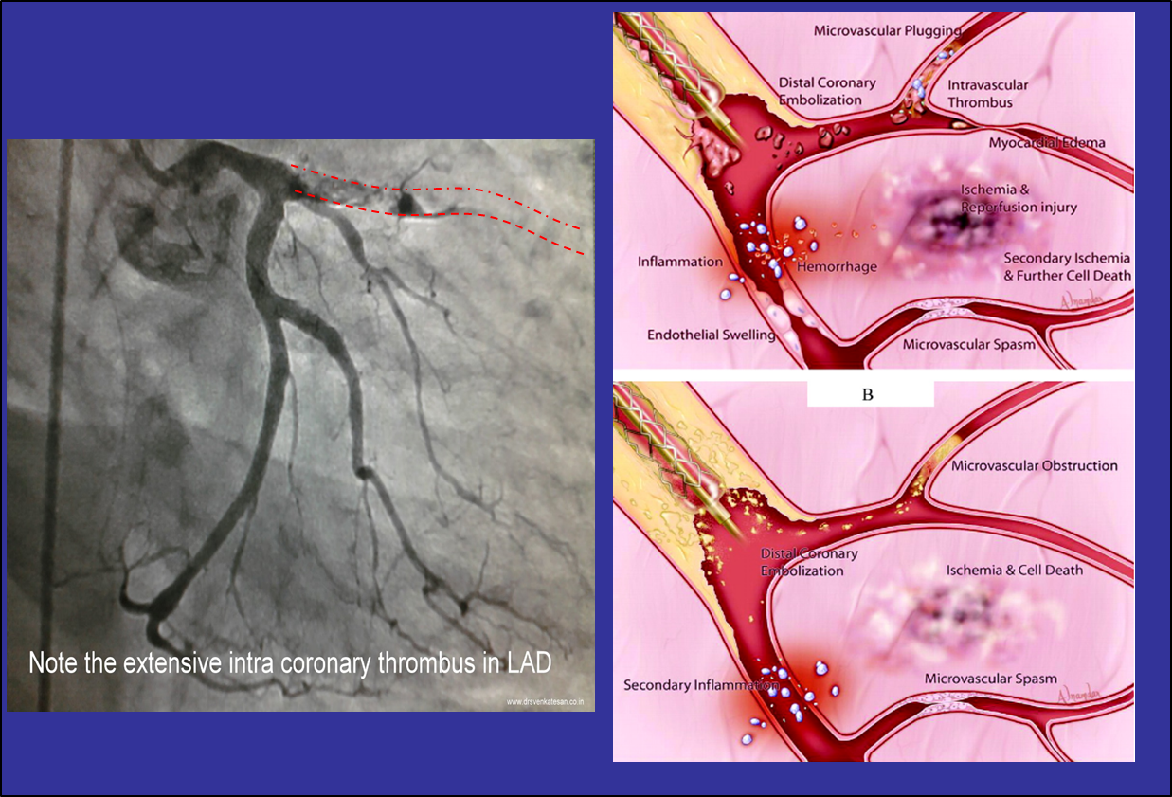

Slide 5
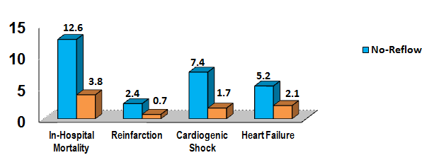
In-hospital clinical outcomes
P<0.0001 for each outcome
Incidence (%)
Adjusted Odds Ratio for Mortality= 2.21, 95% CI 1.97-2.47, p<0.001
American College of Cardiology National Cardiovascular Data Registry (ACC NCDR)

Slide 6
< No-reflow “Microvascular Obstruction” (MVO)
Why is it important?
“silent” MVO occurs in 40 to 60% in STEMI despite “optimal reperfusion” with primary angioplasty
Not so obvious as “no-reflow”
MVO is associated with MACE rate of > 30% at 1 month and 60% at 12 months.
May contribute to infarct expansion, adverse left ventricular (LV) remodeling and adverse clinical outcomes, independent of infarct size
Notes:
The long-term detrimental effect of no-reflow has been documented to include increased risk for cardiac death, CHF, malignant arrhythmias and decrease in ejection fraction.

Slide 7

Corrected TIMI Frame count
The number of cineframes required for dye to reach standardized distal landmarks is counted.
Markers of myocardial perfusion
There are two methods of directly measuring myocardial perfusion
TIIMI Myocardial Perfusion Grade (TMPG)
TMPG is an index that defines not only the intensity of blushing but also focuses on the rate of clearance of contrast opacity.
TMPG adds information to corrected TIMI frame count.
Myocardial blush grade (MBG)
The MBG is an index that defines the intensity of contrast opacity of the infarcted area compared to the contralateral or ipsilateral N-IRA
Both have been shown to be multivariate and independent predictors of mortality in STEMI, and independent of age, TIMI epicardial flow.
Patients with TIMI Grade 3 epicardial flow and TMPG 0 flow have a 7x mortality risk.

Slide 8
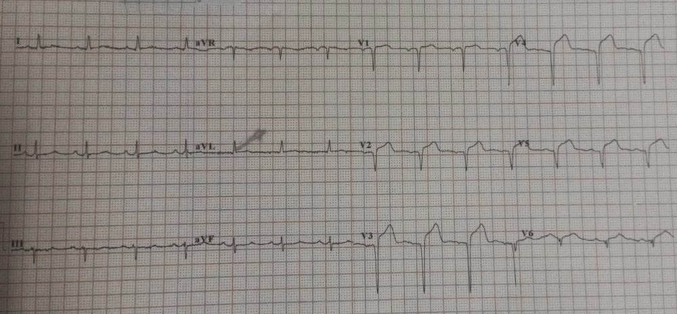
ST-segment resolution: STR defined as the percent reduction in the sumSTE obtained on admission and each time point following P-PCI. Complete STR was considered for a reduction of ≥70%

Slide 9
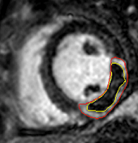
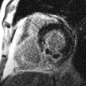
MVO on CMR
MVO on CMR
Areas of hypointensity inside infarct on LGE (‘late MVO, L-MVO’)
Increases over first 48h then slowly decreases
Strong predictor of outcome
signal hypointensity within area of infarction on late gadolinium enhancement
Notes:
L-MVO: dynamic, increases to 48hr then reduces after 1 week
Nijveldt 2008, Wu 1998 and now Eitel 2010 main studies showing L-MVO IP for cinical outcomes post STEMI

Slide 10
Can we prevent / mitigate MVO?

Slide 11
Adenosine
  potent vasodilator
  additional benefits due to its pleiotropic effects
  anti-inflammatory action
  ability to block the neutrophil-mediated processes that promote MVO
  reduction of reperfusion injury seen with intracoronary (IC) adenosine in canine infarct models

Slide 12
Intracoronary Adenosine as adjunct to P-PCI
RCT: STEMI pts with TIMI flow 0/I
IC Adenosine (n=80) 120 mcg as fast bolus followed by 2 mg given in 33 ml of saline over 2 min as slow bolus vs same volume saline (n=80)
End Point | Saline (n=80) | Adenosine (n=80) | P-value
STR>70% (n, %) | 41 (51%) | 57 (71%) | 0.009
Angiographic MVO (n, %) | 24 (30%) | 14 (18%) | 0.06
MACE (n, %) | 16 (20%) | 8 (10%) | 0.08
Niccoli et al. JACC Cardio Int 2013

Slide 13
limitations in addition to the mixed reperfusion strategy cohort:
Adenosine was administered by intravenous (IV) infusion after the PCI
infarct size was measured relatively late after presentation in only 11% of patients and by technetium-99m sestamibi single-photon emission computed tomography (SPECT), which may underestimate infarct size compared to CMR,
(3) no measure of myocardial salvage was obtained.
Overall, AMISTAD-II appears not to be applicable in the modern PPCI era.

Slide 14
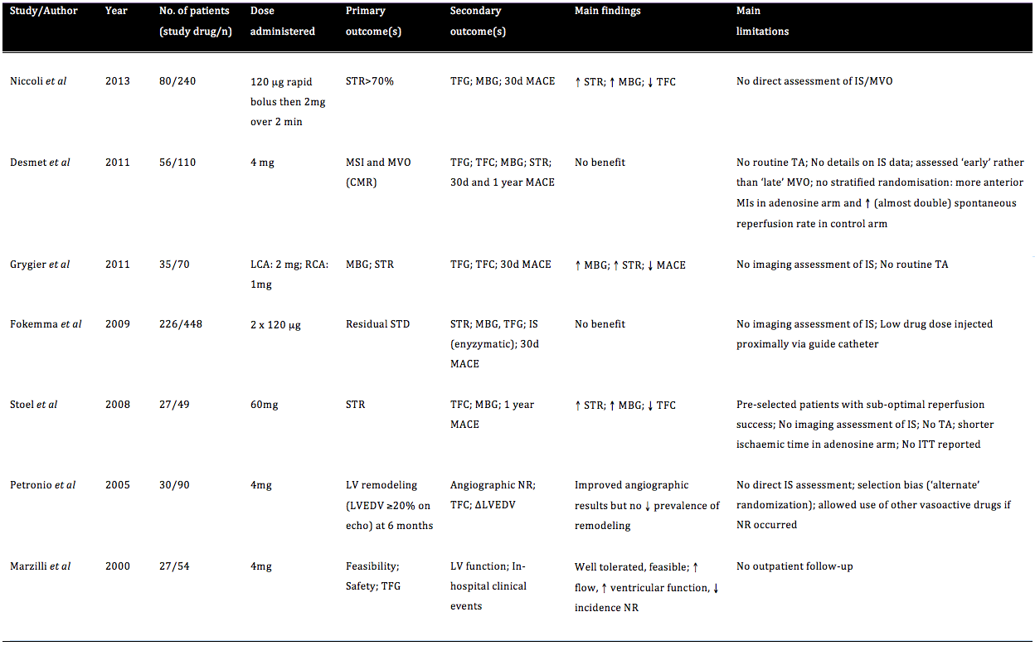
Intracoronary Adenosine as adjunct to P-PCI: Summary of RCTs
      Inclusion criteria
      Trial type
      Dose
      End point
      Measure of MVO
TRIALS DIFFER
Nazir et al. Trials 2014

Slide 15
Sodium NitroPrusside
a direct nitric oxide (NO) donor that requires no intracellular metabolism, utilizes NO’s multiple vascular functions
Effect : -
vasodilatation of arterioles,
inhibition of platelet adhesion
anti-inflammatory activity, which effectively reduce no-reflow in animal reperfusion-injury models.
SNP like adenosine has, in some trials, demonstrated favourable improvement in electrocardiographic (ECG) and angiographic markers of microvascular perfusion, as well as improvements in short-term MACE

Slide 16
Effect of SNP on no-reflow in a prospective, controlled clinical trial:
Angiographic and ECG 1ry end Points
RCT 98 STEMI pts TIMI flow I/II.
  IC SNP (60 µg) via perfusion catheter (multi- function probing catheter, Boston Scientific Corporation,Boston, MA) or saline distally in the IRA.
1 ary EP
End Point | Placebo (pt=50) | SNP (pt=48) | P-value
CTFC, mean ± SD | 20.3 ± 21.3 | 20.8 ± 18.6 | 0.78
TIMI III (%) | 81.4 | 86.4 | 0.59
Complete STR at 1h (%) | 61.2 | 61.7 | 0.96
Complete STR at 24h (%) | 67.3 | 68.9 | 0.87
Amit et al. Am Heart J 2006

Slide 17
Effect of SNP on no-reflow in a prospective, controlled clinical trial: Clinical outcomes at 6 month
End Point | Placebo (pt=50) n,% | SNP (pt=48) n,% | P-value
Death | 3 (6.0) | 2 (4.2) | 0.68
MI | 4 (8.0) | 0 (0) | 0.05
TVR | 6 (12.0) | 1 (2.0) | 0.05
Composite of death, MI or TVR | 10 (20) | 3 (6.3) | 0.04
Any acute cardiac admission | 10 (20) | 5 (10.4) | 0.19
Amit et al. Am Heart J 2006

Slide 18
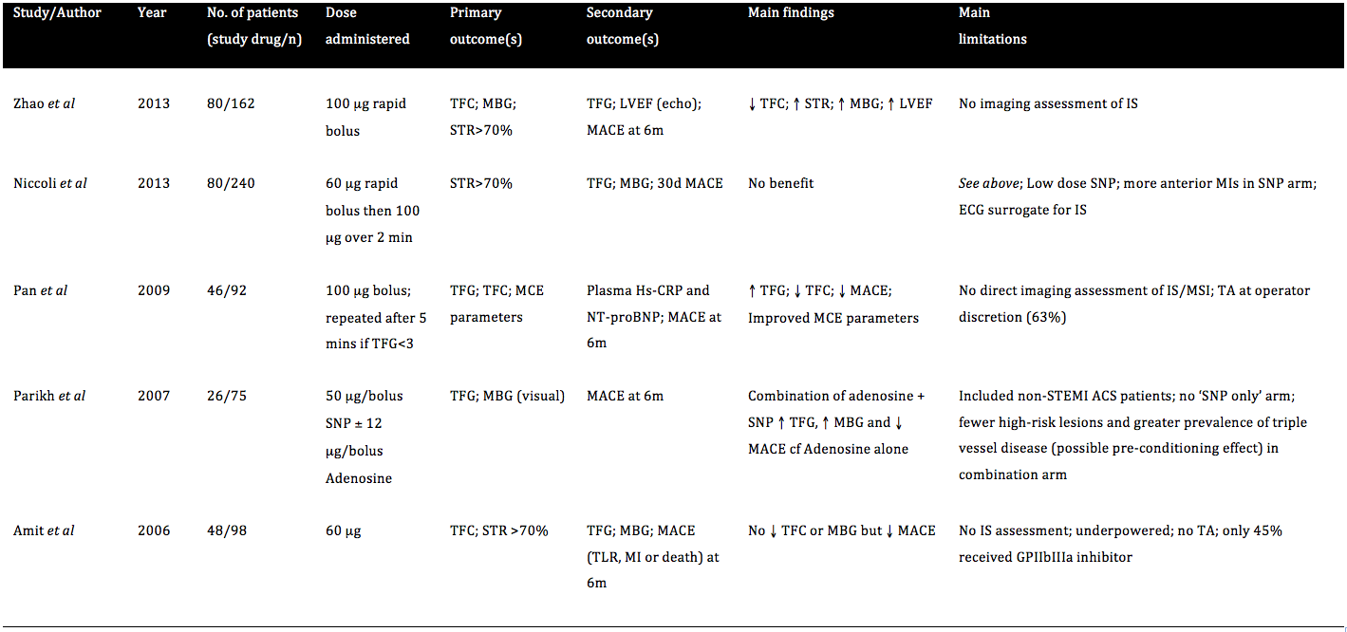
Intracoronary SNP as adjunct to P-PCI: Summary of RCTs
      Inclusion criteria
      Trial type
      Dose
      End point
      Measure of MVO
TRIALS DIFFER
Nazir et al. Trials 2014

Slide 19
Limitations of current evidence
  Small trials
  Conflicting results
  Sub-optimal drug dosages/delivery
  Inadequate anti-platelet cover
  Surrogate end-points
  Lack of sensitive imaging modality to detect MVO

Slide 20
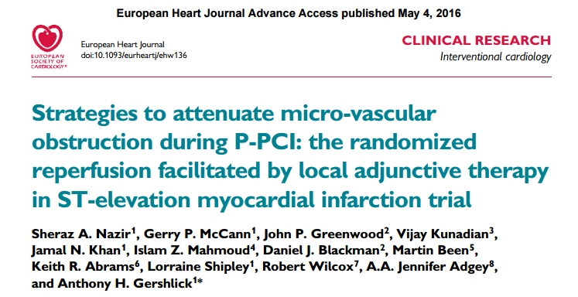
The REFLO-STEMI Study
National Institute for Health Research, Leicester Cardiovascular Biomedical Research Unit
Department Academic Cardiology

Slide 21

300 pts with STEMI –> P-PCI
Single vessel occlusion at angiography
PCI with bivalirudin
Thrombus aspiration
.
R
Control
Adenosine 1mg via MC then 1mg (RCA) or 2mg (LAD) via Guide
SNP
250 µg via MC then 250 µg via Guide
Primary endpoint: Infarct size on CMR at <120 hrs
2º endpoints: TIMI flow, blush, ST-resolution,
MACE (30 & 180d)

Slide 22
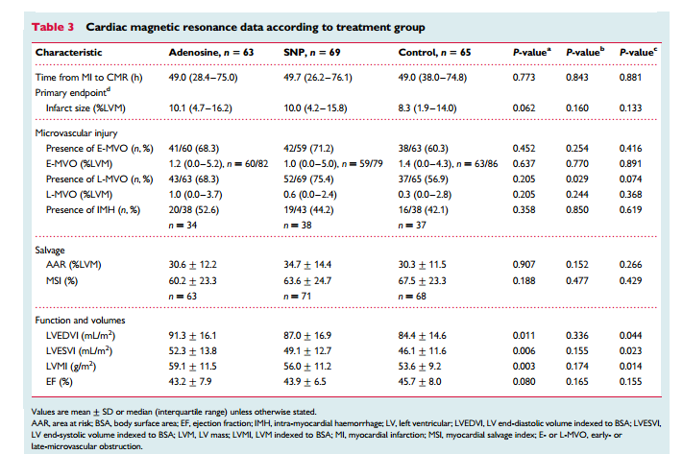
Main CMR Results
Neither agent had any impact on CMR measures of MVO

Slide 23
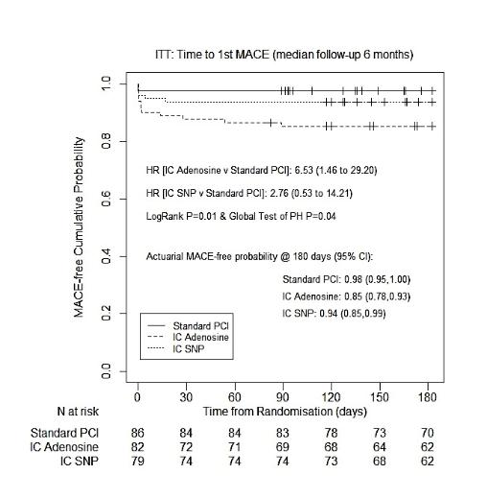
Clinical Outcome

Slide 24
Summary of results
IC adenosine and SNP did not reduce infarct size nor MVO during PPCI for STEMI.
High-dose adenosine appeared to be associated with adverse clinical outcomes, increased infarct size and reduced EF compared with control.
Data suggest that neither agent is effective for sub-clinical no-reflow and should not be used routinely in the setting of PPCI to prevent reperfusion injury.

Slide 25
Other studies …
CIRCUS trial cyclosporin
  MITOCARE study results: Eur Heart J
  NIAMI study results: Eur Heart J

Slide 26
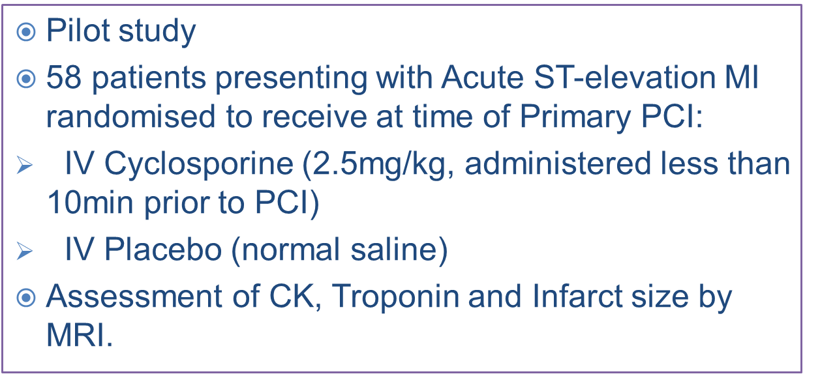
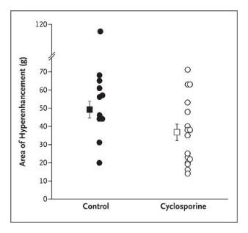
Cyclosporine A

Slide 27
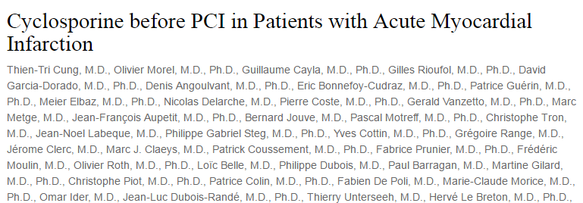
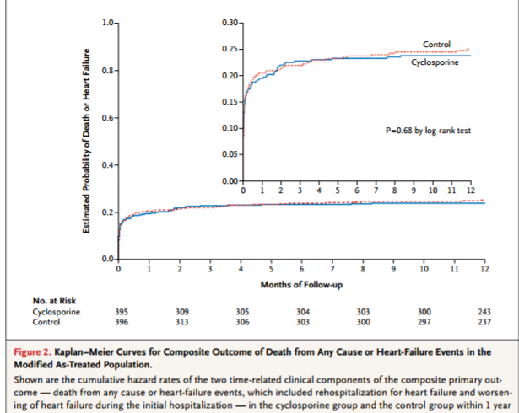
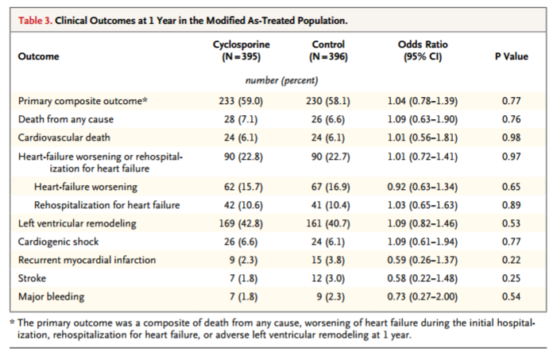

Slide 28
MITOCARE STUDY
Multicenter, randomized, double-blind, placebo controlled study to assess safety and efficacy of
TRO40303 for reduction of reperfusion injury in STEMI patients undergoing primary PCI
Mechanism: mitochondrial permeability transition pore
TRO40303 has shown to inhibit the opening of this transition pore.
Rationale: TRO40303 has been shown to reduce infarct size by 50% in rat and mouse models
LVEF at 24h and 1 month in these models.
It has also shown protective effects on human isolated cells.

Slide 29
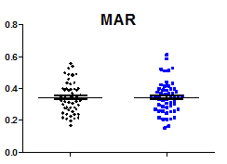
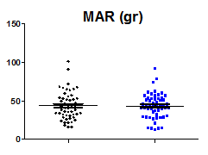
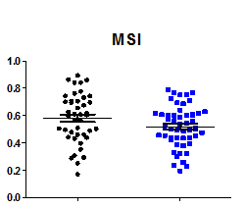
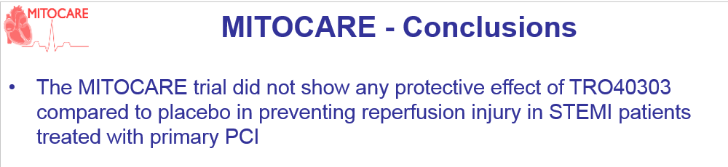
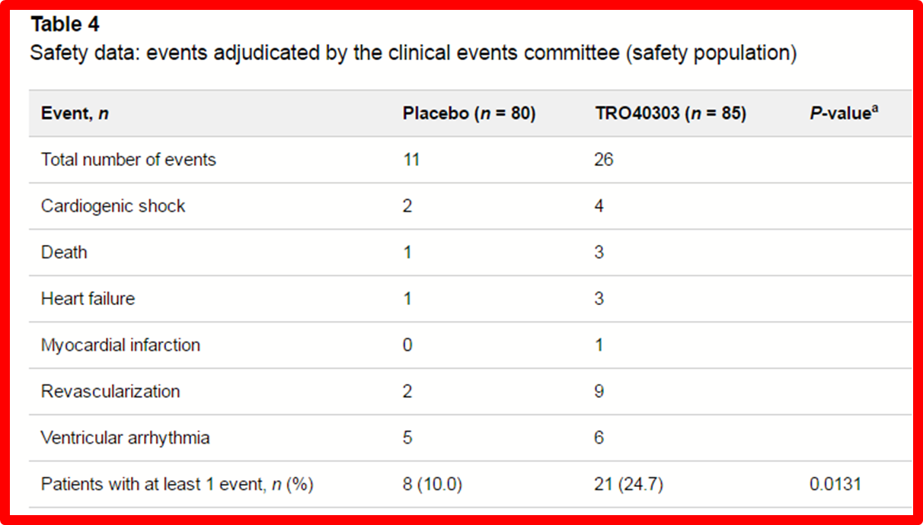
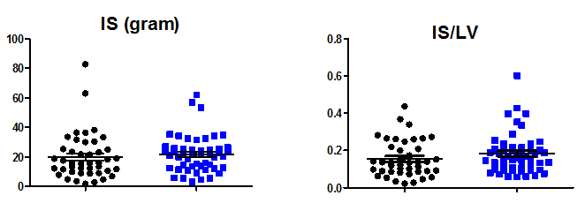
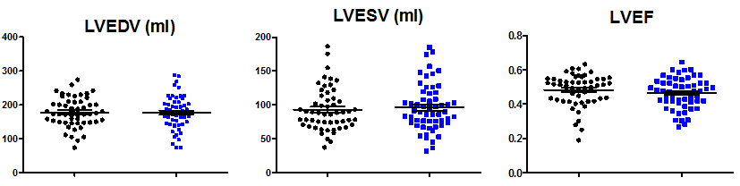
MRI Endpoints

Slide 30
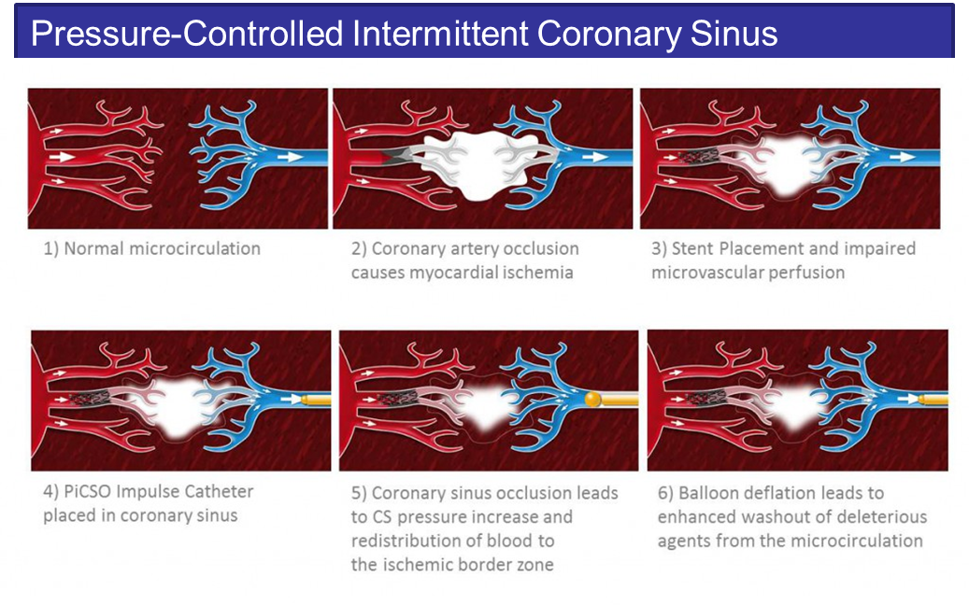

Slide 31
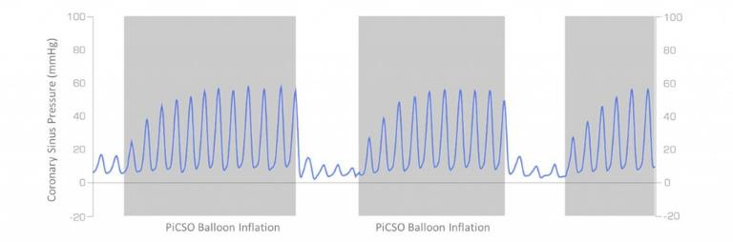
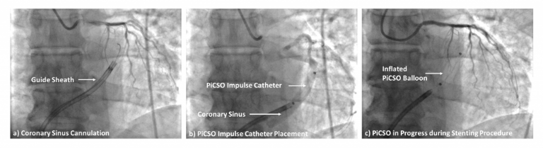
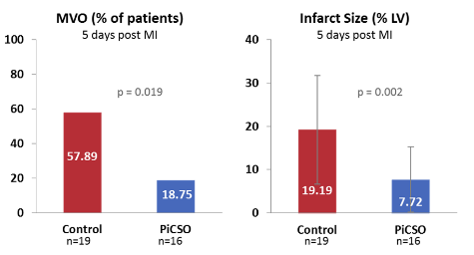

Slide 32

A Randomised, Double Blind, Placebo-controlled, Parallel Group Trial of 2 doses of Low-dose Adjunctive alTeplase During prIMary PC versus placebo
slow infusion administration after reperfusion with aspiration thrombectomy ± angioplasty but before stenting during primary PCI.
T-TIME TRIAL
Primary PCI
Intra coronary TPA versus control
CMR end point
Primary Outcome Measures:
The amount of MVO (% of Left Ventricular (LV) mass) disclosed by late (10 - 15 min) gadolinium contrast enhancement MRI 2 days post-MI.
Amount of MVO (% of LV mass) disclosed by late (10 - 15 min) gadolinium contrast enhancement MRI 2 days post-MI.

Slide 33
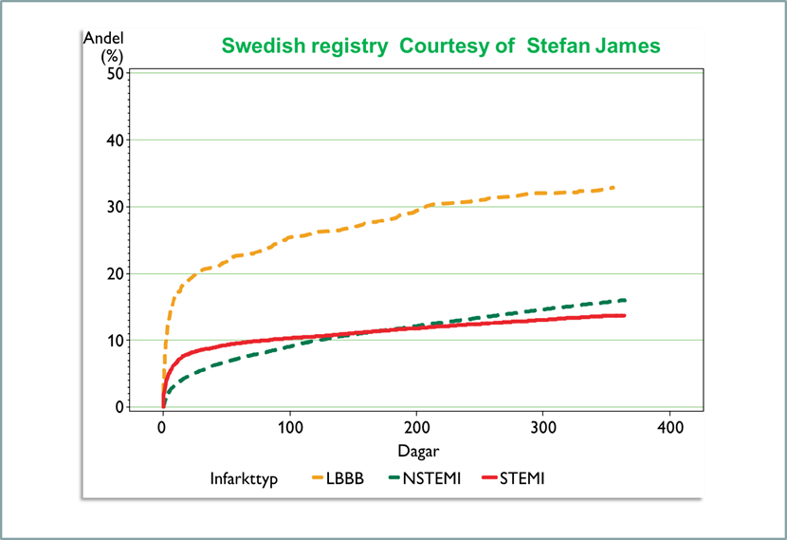
Just because we havn’t found a solution it does not mean that MVO is not important – merely that is is complex
Combination of local embolic physical, vaso-active and local inflammatory responses
This is an important and potentially fruitful area of research that should translate in patient mortality benefit

Slide 35
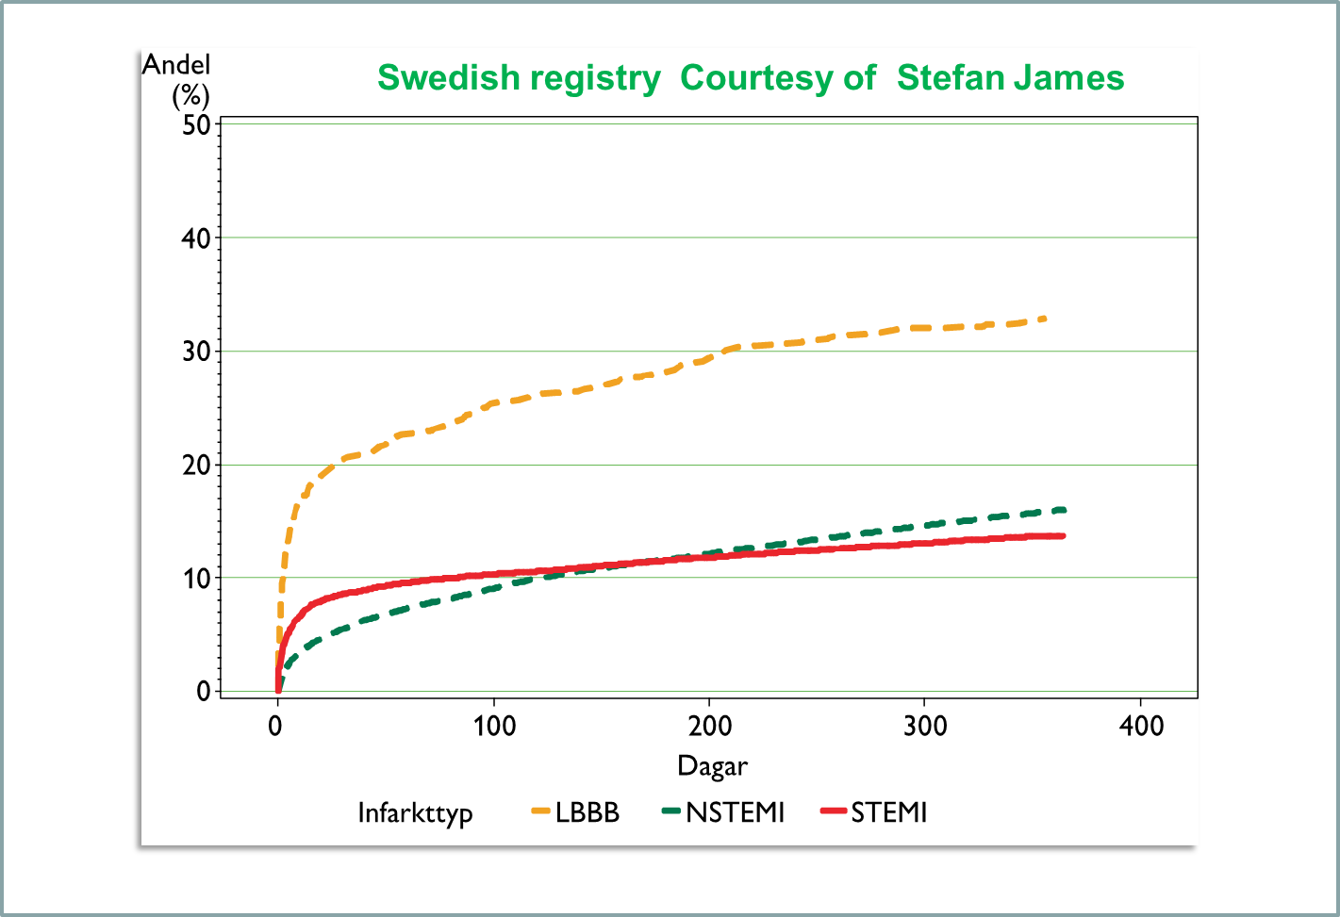
Just because we havn’t found a solution it does not mean that MVO is not important – merely that is is complex
Combination of local embolic physical, vaso-active and local inflammatory responses
This is an important and potentially fruitful area of research that should translate in patient mortality benefit

Slide 36
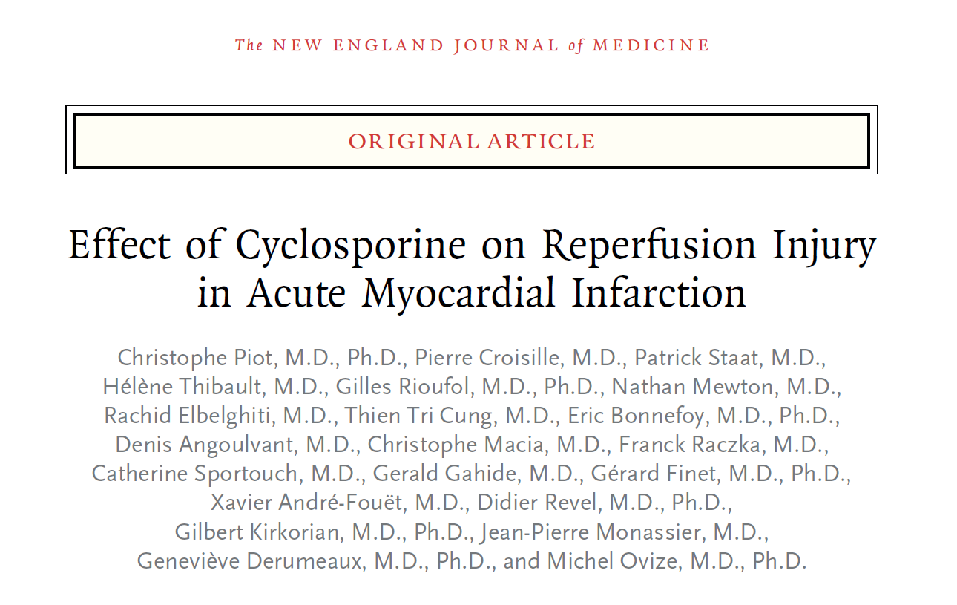

Slide 37
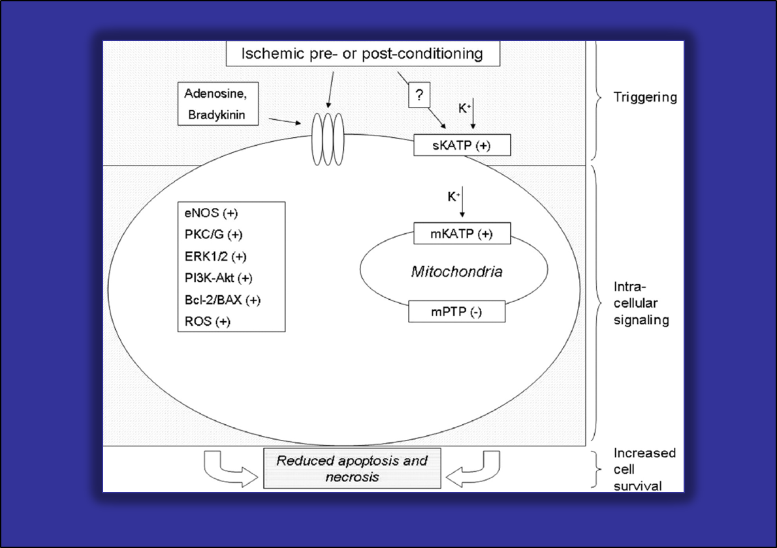

Slide 38
Ischaemia-Reperfusion Injury
MPTP
Cyclosporine A
Potent inhibitor of the mitochondrial permeability transition pore
Oxidative Stress
Potential Therapeutic targets
following Acute STEMI
Inflammation
Intracellular Ca²⁺ Overload
Restoration of Physiological pH
Hausenloy D & Yellon D, J Clin Invest 2013; 123(1): 92-100

Slide 39
Lecture Overview
Micro-vascular obstruction
MVO – What is it?
MVO – Why is it important?
Management strategies - Evidence to date
Trials & Studies
REFLO-STEMI Trial – Results
Other studies / strategies
Can we prevent/limit MVO ?

Slide 40
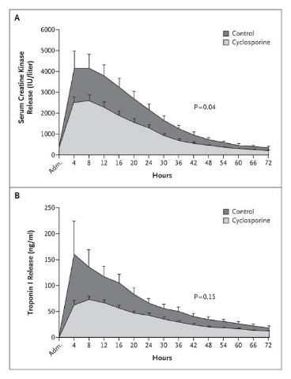
AUC for creatinine kinase release following reperfusion was
Significantly reduced with cyclosporine compared to placebo:
Median AUC Cyclosporine = 138,053 (IQR=114,008 – 283,461)
Median AUC Placebo = 247,930 (IQR=145,639 – 404,349)
P for difference = 0.04.
AUC for troponin release following reperfusion was not
Significantly reduced with cyclosporine compared to placebo:
Median AUC Cyclosporine = 112,321 (IQR=48,680 – 153,956)
Median AUC Placebo = 129,320 (IQR=65,019 – 224,116)
P for difference = 0.15.
Piot C et al. NEJM 2008; 359: 473-481

Slide 41
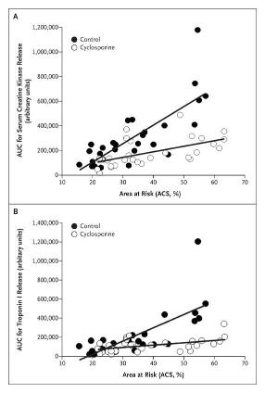

For any given area at risk, cyclosporine administration was associated with a reduction in the resulting infarct size as measured by creatine kinase release. This difference was significant by analysis of covariance (P=0.006).
There was also a significant correlation between the AUC for troponin I release and the area at risk in the control group (r²=0.54), as shown in Panel B. Data points for the cyclosporine group (r²=0.26) lie below the regression line for the control group.
These data indicate that, for any given area at risk, cyclosporine administration was associated with a reduction in the resulting infarct size as measured by troponin I release. This difference was confirmed to be significant by analysis of covariance (P=0.002).

Slide 42
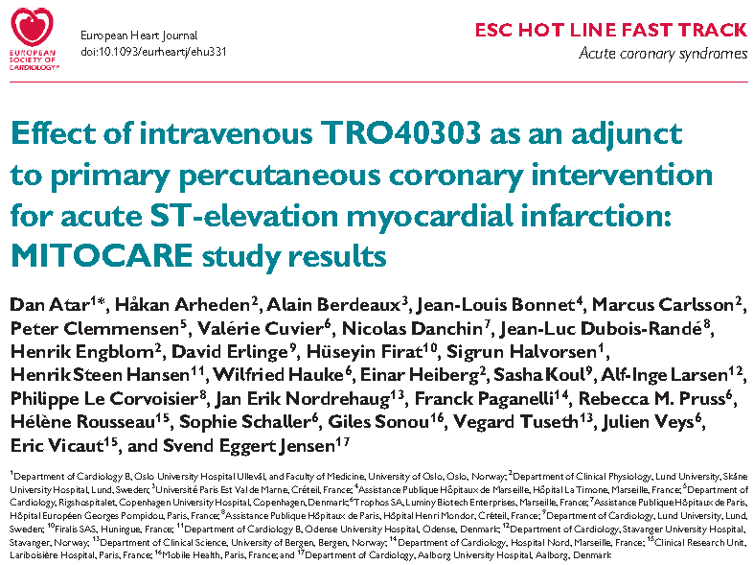

Slide 43
Piot et al, 2008
No adverse events (LFT, U&E) detected with cyclosporine administration
Data support Cyclosporine effect in reduction of IS through action on MPTP in preventing ischaemia-reperfusion injury.

Slide 44
Cyclosporine-A
Cyclophilin D
Inhibits MPTP
Reduces effect of ischaemia-reperfusion injury on myocardium
Cyclosporine-A
Binding sites
Cyclophilin A
Inhibits calcium-activated calcineurin
Calcineurin-dependent pathway is important in non-infarcted
remodelling
- Thus, may have an impact on post-MI LV remodelling

Slide 45
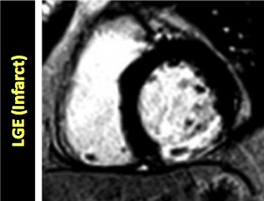
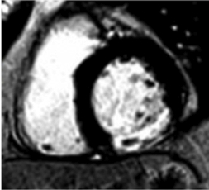
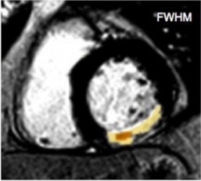
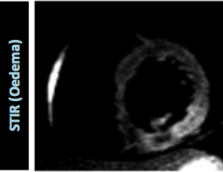
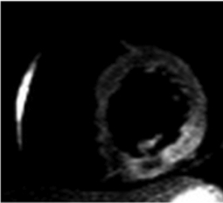
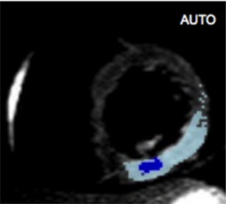
Quantitative Imaging with MRI after STEMI
Allows calculation of heart attack size and salvage index (% saved by Rx)

Slide 46
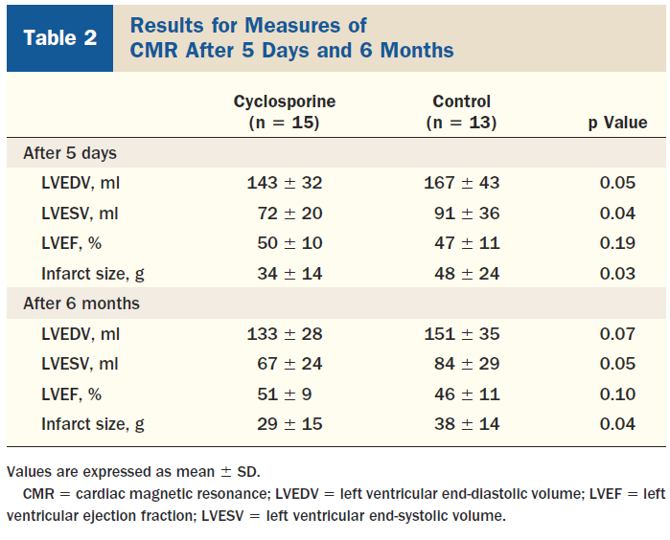
Cyclosporine-A
6 month follow-up of original cohort with repeat MRI scans
Persistent reduction in Infarct Size with the cyclosporine group at 6 months.
Reduction in LVEDV and LVESV at 6 months in cyclosporine group
Mewton N et al. JACC 2010; 55(12): 1200-1205

Slide 47
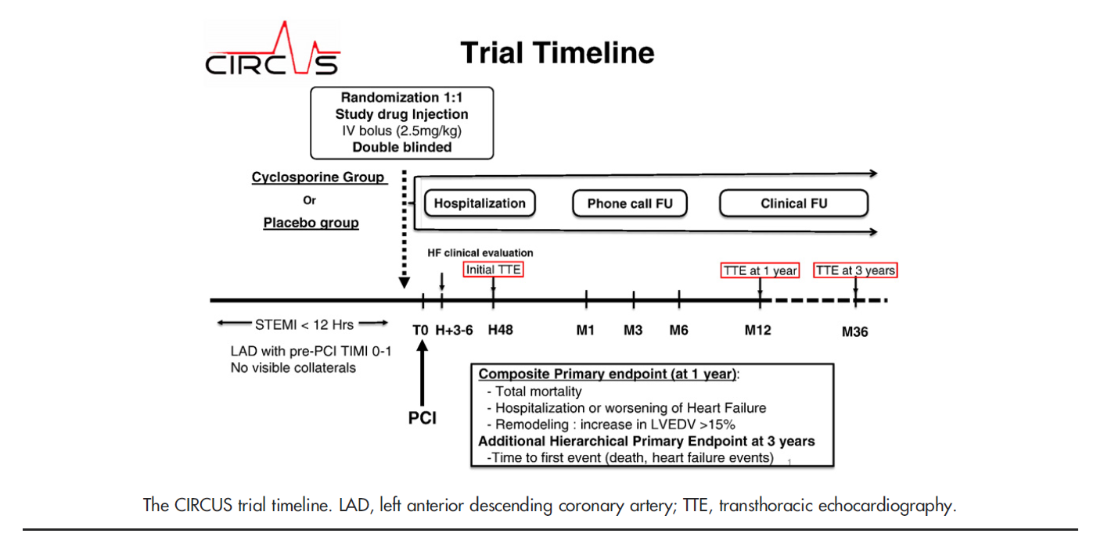
CIRCUS Trial
Mewton N et al. Am Heart J 2015; 169(6): 758-766.

Slide 48
MitoSNO
MitoSNO: Mitochondrial targeted S-nitrosothiol
Reversible S-nitrosation of Cys39 on the ND3 subunit of Mitochondrial Complex I
Inhibits rapid reactivation of Mitochondrial complex I during reperfusion
This results in reduced mitochondrial ROS production during reperfusion
Mitochondrial released ROS
Opening of Mitochondrial Permeability Transmembrane Pore (MPTP)
IR injury
Mitochondrial matrix Ca²⁺ overload

Slide 49
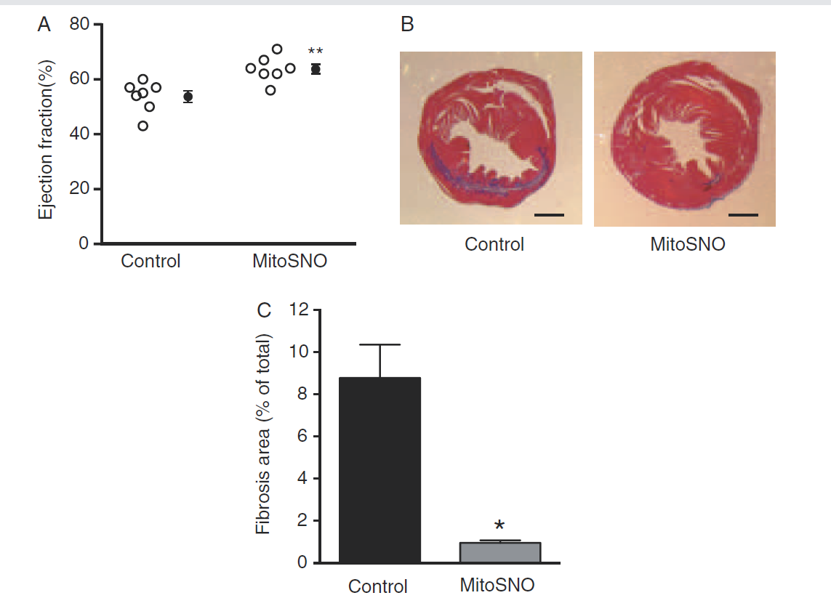
28-days post Treatment
Methner C et al. Eur J Heart Failure 2014; 16: 712-717
Improved LVEF in MiroSNO treated group compared to control sustained to 28 days (A)
Significant decrease in collagen content in the MitoSNO-treated hearts compared to controls using Masson Trichome staining (B, C); indicating reduced tissue fibrotic remodelling at 28 days.
Acute administration of MitoSNO upon reperfusion in a mouse ischaemia-reperfusion model prevents acute heart damage secondary to ROS-mediated reperfusion injury, and this has sustained long-term benefits in post-MI LVEF and remodelling.

Slide 50
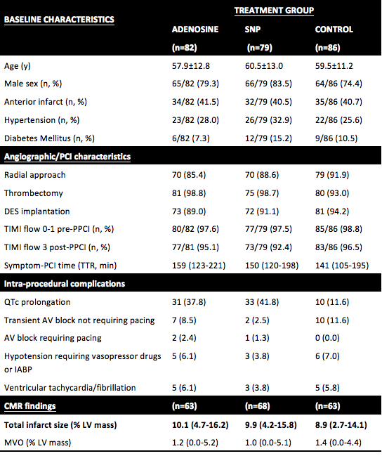


REFLO-STEMI Trial – Intracoronary Adenosine and Sodium Nitroprusside versus control for the attenuation of Infarct size and Microvascular obstruction
Nazir SA¹, Khan JN¹, Mahmoud IZ², Greenwood JP³, Blackman DJ³, Kunadian V⁴, Been M⁵, Abrams KR⁶, Shipley L¹, Wilcox R⁷, Adgey AAJ⁸, McCann GP¹, Gershlick AH¹
¹Department of Cardiovascular Sciences, University of Leicester and the NIHR Leicester Cardiovascular Biomedical Research Unit, Glenfield Hospital, Leicester, UK.
²Department of Cardiovascular Imaging, Division of Imaging Sciences & Biomedical Engineering, Rayne Institute, BHF Excellence Centre, St Thomas’ Hospital, King’s College London, UK.
³Multidisciplinary Cardiovascular Research Centre, Leeds Institute of Genetics, Health and Therapeutics, University of Leeds, Leeds, UK.
⁴ Institute of Cellular Medicine, Faculty of Medical Sciences, Newcastle University and Cardiothoracic Centre, Freeman Hospital, Newcastle upon Tyne Hospitals NHS Foundation Trust, Newcastle upon Tyne, UK.
⁵Department of Cardiology, University Hospitals Coventry and Warwickshire NHS Trust, Coventry, UK.
⁶Centre for Biostatistics & Genetic Epidemiology, Department of Health Sciences, School of Medicine, University of Leicester, Leicester, UK.
⁷Faculty of Medicine & Health Sciences, Queen’s Medical Centre, Nottingham, UK.
⁸Heart Centre, Royal Victoria Hospital, Belfast, Northern Ireland, UK.

Slide 51
Table 1: Baseline, angiographic and CMR results in the interventional (PPCI with adjunctive intra-coronary adenosine or SNP) and control (Standard PPCI) arms
Conclusions
Adjunctive intracoronary adenosine and SNP during PPCI do not significantly reduce IS or MVO measured by CMRI.
However, our negative results do not imply that Adenosine and SNP are ineffective in reversing no-reflow if it occurs during PPCI.

Slide 52

THANK YOU
AH Gershlick MB BS BSc FRCP
Professor of Interventional Cardiology
University of Leicester & University Hospitals of Leicester NHS Trust

Slide 53
ST-elevation myocardial infarction (STEMI)
>100,000 STEMIs/year in UK
  Primary-PCI (P-PCI) – first line
Timely reperfusion limits extent of myocardial injury (final infarct size)
Improved survival in P-PCI era but ? outcomes now plateaued

Slide 54
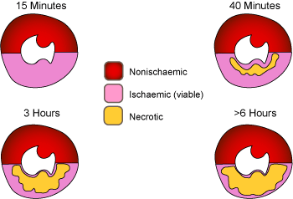
Ischaemic cascade &
Wavefront phenomenon
Relaxation abnormality
Wall motion abnormality (19 secs)
ECG ST-segment change (30 secs)
CHEST PAIN (39 secs)
Source: http://www.nottingham.ac.uk/nursing/practice/resources/cardiology/images/wavefront.gif

Slide 55
“Micro-vascular Obstruction” What is the Phenomenon?
MVO may occur during P-PCI to various degrees that range from the true no-reflow phenomenon to impairment of distal vessel micro-angiographic flow.
MVO occurs in 38.5 to 57.5% of patients with STEMI despite optimal reperfusion with primary angioplasty.
MVO is associated with MACE rate of > 30% at 1 month and 60% at 12 months.
The mechanism of the development of MVO is multi-factorial, but predominantly it occurs due to distal embolization and microvascular ischemia-reperfusion injury.
Currently there is no consensus on the optimal strategy to limit MVO during P-PCI.

Slide 56
Short-term Mortality
In the GUSTO-IIb trial, the correlations between early mortality (i.e. within 30 days) and the final TIMI flow grades as follows:
  Grade 0, 21.4% mortality;
  Grade 1, 14.3% mortality;
  Grade 2, 19.9% mortality;
  Grade 3, 1.6% mortality.
N Engl J Med, 1997
P<0.001

Slide 57
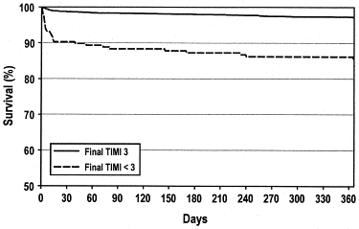
One-year adjusted survival using the Cox proportional hazards model among patients undergoing P–PCI with final TIMI <3 flow compared with those with final TIMI 3 flow: p < 0.0001 for the difference in adjusted survival.
Mehta et al, J Am Coll Cardiol. 2003
One-year Survival
Notes:
Mehta et al evaluated 3,362 patients with ST elevation myocardial infarction enrolled in various Primary Angioplasty in Myocardial Infarction trials, who underwent primary PCI.
The purpose of this study was to determine the clinical and angiographic correlates and
outcomes of patients with suboptimal coronary flow after primary PCI.

Slide 58
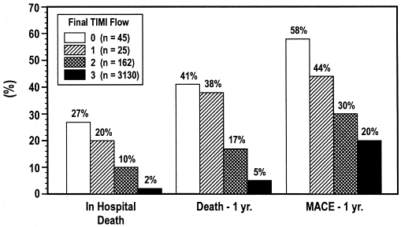
Relationship of final TIMI flow grades after primary PCI with in-hospital and one-year mortality and major adverse cardiovascular events (MACE): P <0.0001 for all three outcomes.
Mehta et al, J Am Coll Cardiol. 2003
In-hospital and One-year Mortality

Slide 59
Intracoronary Adenosine as adjunct to P-PCI
RCT: 54 STEMI pts with TIMI flow 0-II randomised to IC adenosine (4 mg in 2 mL saline) or saline (2 mL ).
2ry End Point | Saline (pt=27) | Adenosine (pt=27) | P-value
Death, n (%) | 5 (18%) | 0 (0%) | 0.02
In-hospital CHF | 5 (18%) | 2 (7%) | NS
Recurrent ischemia | 2 (7%) | 3 (11%) | NS
Nonfatal AMI | 1 (4%) | 0 (0%) | NS
Composite | 13 (48%) | 5 (18%) | 0.03
1ry End Points:
IC adenosine or saline tolerated with no side effects.
No-reflow was diagnosed in 1 pt in the adenosine group and 7 pts in the saline group (P, 0.02)
Marzilli et al. Circulation 2000

Slide 60
Intracoronary Adenosine as adjunct to P-PCI
RCT: 448 STEMI pts with TIMI flow 0-III randomised to IC adenosine (2 x 120 mcg in 20 mL 0.9% NaCl) or 20 mL 0.9% NaCl.
End Point | Saline | Adenosine | P-value
STR>70% (n, %) | 128/193 (66%) | 129/189 (68%) | NS
MBG Grade 3 (n, %) | 77/218 (35%) | 64/224 (29%) | NS
MACE (n, %) | 14/226 (6%) | 10/222 (5%) | NS
Fokkema et al. Circ Cardiovasc Interv 2009

Slide 61
The REFLO-STEMI trial comparing intracoronary adenosine, sodium nitroprusside and standard therapy for the attenuation of infarct size and microvascular obstruction during primary percutaneous coronary intervention: study protocol for a randomised controlled trial
.
Nazir SA, Khan JN, Mahmoud IZ, Greenwood JP, Blackman DJ, Kunadian V, Been M, Abrams KR, Wilcox R, Adgey AA, McCann GP, Gershlick AH.
Trials. 2014 Sep 25;15:371. doi: 10.1186/1745-6215-15-371.

Slide 62
Effect of SNP on no-reflow in a prospective, controlled clinical trial: Clinical outcomes at 6 month
End Point | Placebo (pt=50) n,% | SNP (pt=48) n,% | P-value
Death | 3 (6.0) | 2 (4.2) | 0.68
MI | 4 (8.0) | 0 (0) | 0.05
TVR | 6 (12.0) | 1 (2.0) | 0.05
Composite of death, MI or TVR | 10 (20) | 3 (6.3) | 0.04
Any acute cardiac admission | 10 (20) | 5 (10.4) | 0.19
Amit et al. Am Heart J 2006

Slide 63
The randomized and placebo-controlled Acute Myocardial infarction STudy of ADenosine (AMISTAD)-II trial sought to determine the benefit of adenosine in 2118 patients presenting within 12h of onset of anterior STEMI treated with thrombolysis (60%) or PPCI (40%).59 IS and adverse clinical events were reduced in a sub-group who received a higher (70 g/kg/min) dose of adenosine and in those reperfused within 3h of symptom onset. This trial, although the largest to date, has a number of limitations in addition to the mixed reperfusion strategy cohort: (1) Adenosine was administered by intravenous (IV) infusion after the PCI, (2) infarct size was measured relatively late after presentation in only 11% of patients and by technetium-99m sestamibi single-photon emission computed tomography (SPECT), which may underestimate infarct size compared to CMR, and (3) no measure of myocardial salvage was obtained. Overall, AMISTAD-II appears not to be applicable in the modern PPCI era.

Slide 64
Intracoronary Adenosine and SNP for Prevention of MVO during P-PCI
Aim: to determine if adjunctive pharmaco-therapy can prevent MVO and reduce infarct size detected by CMR.
Study hypothesis: Intracoronary adenosine or SNP delivered via micro-catheter following thrombus aspiration in P-PCI reduces MVO parameters * and infarct size as measured with CMR, compared with standard P-PCI treatment post thrombus aspiration.
Research design: Multi-centre, prospective, randomized, controlled, open label, pilot clinical trial with blinded end-point analysis of primary outcome measures.

Slide 65
Sample Size
80% power
Two-tailed, alpha = 0.05
Detect 5% absolute difference in IS
Assuming an expected IS of 20% with a SD +/-10%
Allowance for dropouts (20%) before CMR
Target: 240 patients (80 per group)

Slide 66
Inclusion criteria
≥ 18 years age
Informed ASSENT (verbal consent) prior to angiography.
STEMI ≤ 6 hrs of symptom onset, requiring reperfusion by P-PCI.
Single-vessel coronary artery disease
QTc <450ms (on ECG) prior to randomisation
TIMI flow 0/I at angiography

Slide 67
Exclusion criteria
Systolic Blood Pressure <90mmHg at baseline/Cardiogenic Shock
Previous Q wave MI
Culprit vessel not able to be identified, or identified in a by-pass graft
Stent thrombosis
Left Main disease
Known severe asthma
Known stage 4 or 5 chronic kidney disease eGFR <30ml/min
Pregnancy
CI to P-PCI, CMR, study drugs

Slide 68
Primary outcome measure
      CMR measured infarct size (%LV mass) at 48-72 hours post procedure.
      MVO and infarct size measured on CMR are closely inter-related and are both important predictors of prognosis.

Slide 69
Secondary outcome measures
CMR incidence & extent of MVO (%LV mass) at 48-72 hours
CMR measured myocardial salvage index, haemorrhage, LV EF and volumes in the acute stage.
Angiographic markers of MVO (cTFC, MBG)
Incidence of angiographic slow/no-reflow after P-PCI
Overall MACE and its components at 6 months (death, recurrent MI, TLR, severe heart failure, and CVE).

Slide 70
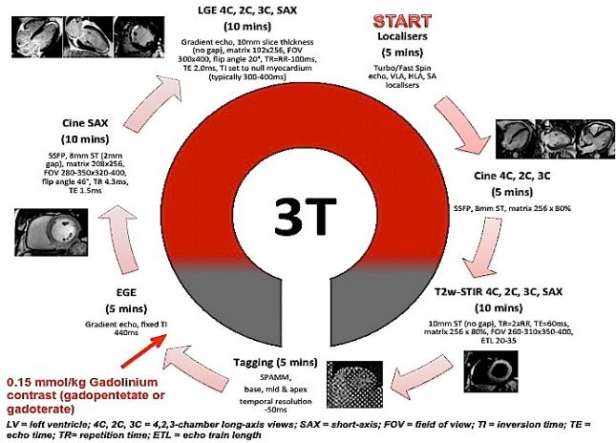
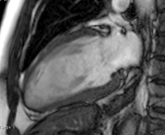
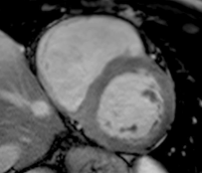
CMR protocol

Slide 71

REFLO-STEMI Trial: CONSORT

Slide 72
Limitations
Open-label - ? influenced management of patients. However, primary outcome assessed on blinded CMR scans.
Relatively small sample size.
IC bolus dosing ? Insufficient to sustain adequate drug levels in microvascular bed (⬇T½ adenosine) ? Infusion superior
One might still consider low-dose (50-100mcg) adenosine, as is common in clinical practice, to reverse established slow-flow or no-reflow when it is encountered.

Slide 73
Can we prevent MVO ?

Slide 74

Cyclosporine-A
6 month follow-up of original cohort with repeat MRI scans
Persistent reduction in Infarct Size with the cyclosporine group at 6 months.
Reduction in LVEDV and LVESV at 6 months in cyclosporine group.
No difference in LV wall thickness at 6 months in non-infarcted myocardium.
Data shows sustained improved LV function with no evidence of adverse remodelling in cyclosporine group.

Slide 75
MitoSNO
Mitochondrial released ROS
Opening of Mitochondrial Permeability Transmembrane Pore (MPTP)
IR injury
Mitochondrial matrix Ca²⁺ overload

Slide 76

Aim of study to determine whether acute & transient action of MitoSNO during reperfusion of the ischaemic heart would protect against chronic damage leading to heart failure
Mouse in-vivo LAD occlusion model for ischaemia-reperfusion. 30 min of LAD ischaemia.
MitoSNO administered 5 mins before reperfusion as bolus and continued as infusion for 20 min.
Methner C et al. Eur J Heart Failure 2014; 16: 712-717

Slide 77

24h post-treatment
Reduction in Infarct size on histology
Using 2,3,5-TTC staining of myocardium (A,B)
Lower Troponin release at 24h post-infarct
In the MitoSNO group (C)
Reduction in Infarct size by LGE assessment on MRI and less LVSD in MitoSNO group (D, E)
Methner C et al. Eur J Heart Failure 2014; 16: 712-717

Slide 78
STEMI for Primary PCI
ASSENT for
CVLPRIT and MVO
Angiogram
SVD
MVO
Wire & Aspirate
Flush thrombectomy catheter
Adenosine via thrombectomy cath 1 mg RCA
1 mg IRA LCA (LAD or Cx)
SNP via thrombectomy cath 250 microg
Control
nil
PCI DES
Adenosine via GUIDE cath
1 mg RCA 2 mg LCA
SNP -via GUIDE cath 250 microg
Control
nil

Slide 79
Acknowledgements
Research Fellow
  Dr. Sheraz Nazir
Co-Investigators
  Prof. G. McCann, Prof. K. Abrams, Prof. J. Greenwood, Dr. D. Blackman, Dr, V. Kunadian, Dr. M. Been
Leicester Cardiac Research Nurse Team
  Lorraine Shipley, Emma Parker, Gemma Turland, Emma Nanda, Carla Moorley, Joanne Hughes, , Sue MackNess, Sarah Mellor
  Teams at recruiting centres (Cath Lab, Medical, Nursing & Research)
  TSC Members (Chair: Prof. R. Wilcox)
  DSMB Members (Chair: Prof. J. Adgey)
  Clinical Trials Unit, Leicester
  NIHR-MRC

Slide 80
TIMI Blush Grade
Myocardial blush grades are defined as follows:
no myocardial blush or contrast density;
minimal myocardial blush or contrast density;
moderate myocardial blush or contrast density but less than that obtained during angiography of a contralateral or ipsilateral non-infarct -related coronary artery
normal myocardial blush or contrast density, comparable with that obtained during angiography of a contralateral or ipsilateral non-infarct-related coronary artery.
When myocardial blush persisted ("staining"), this phenomenon suggested leakage of the contrast medium into the extravascular space (13), and was graded 0

Slide 81
The REFLO-STEMI trial comparing intracoronary adenosine, sodium nitroprusside and standard therapy for the attenuation of infarct size and microvascular obstruction during primary percutaneous coronary intervention: study protocol for a randomised controlled trial
.
Nazir SA, Khan JN, Mahmoud IZ, Greenwood JP, Blackman DJ, Kunadian V, Been M, Abrams KR, Wilcox R, Adgey AA, McCann GP, Gershlick AH.
Trials. 2014 Sep 25;15:371. doi: 10.1186/1745-6215-15-371.

Slide 82




Study Results: Co-primary Endpoint
Mean +/- SEM. Analysis of AUC by ANCOVA. N = 163
MitoCare – HEALTH-F2-2010-261034

Slide 83



Conclusion This study in STEMI patients treated with contemporary mechanical revascularization principles did not show any effect of TRO40303 in limiting reperfusion injury of the ischaemic myocardium.

