Slide 1

Singapore’s Experience in Primary PCI in the Last Ten Years
Dr Heerajnarain Bulluck on behalf of Mark Y. Chan
Associate Professor Yong Loo-Lin SoM, NUS
Senior Consultant, Department of Cardiology, NUHCS
Li-Ling Tan¹, Huili Zheng², Khuan-Yew Chow², Lau Yee How³, Joshua Loh¹, Terrance Chua⁴, Huay-Cheem Tan¹, David Foo⁵, Hean-Yee Ong⁶, Khim-Leng Tong⁷, A. Mark Richards¹, Mark Y. Chan¹
Cardiac Department, National University Heart Centre, National University Hospital, Singapore¹
National Registry of Diseases Office, Health Promotion Board, Singapore²
Singapore Cardiac Databank⁴
National Heart Centre, Singapore³
Tan Tock Seng Hospital, Singapore⁴
Khoo Teck Puat Hospital, Singapore⁵
Changi General Hospital, Singapore⁶

Slide 2
Authors’ Disclosures
No disclosures

Slide 3
Management of ST-elevation Myocardial Infarction (STEMI)^{1,2}
Rapid recognition
Early revascularization
PCI-capable hospital
Non-PCI-capable hospital
Primary PCI
Pharmacoinvasive strategy
Thromboylsis → Early transfer for PCI
¹ ACCF/AHA (2013) Guideline for Management of ST-Elevation Myocardial infarction
² ESC (2012) Guidelines for the management of acute myocardial infarction in patients presenting with ST-segment elevation

Slide 4
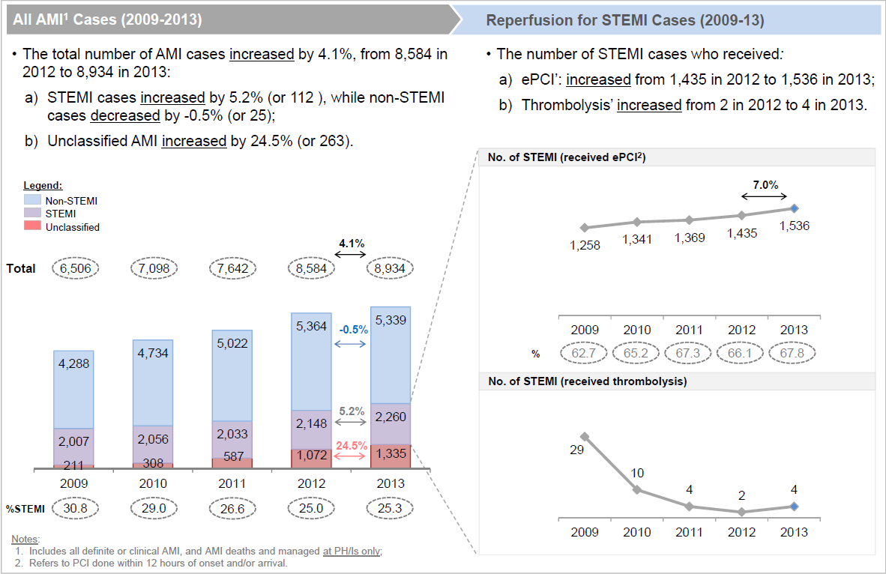
What happens if you have a STEMI in Singapore?
No of STEMI receiving primary PCI
No of STEMI receiving thrombolysis
Singapore Myocardial Infarct Registry, National Registry of Diseases Office

Slide 5

Map of Singapore
5.61 million people
13 miles
Land area: 278 miles²
26 miles

Slide 6




5 Public Hospitals with 24-hr primary PCI service
13 miles
26 miles

Slide 7
Association between D2B time, S2B time & mortality
Guidelines set a target door-to-balloon (D2B) time < 90min^{1,2}
Early studies showed that shorter D2B time reduces mortality ^{3,4}
³ Cannon et al. JAMA. 2000;283:2941-2947
⁴ Gibson et al. Am Heart J. 2008;156:1035-1044

Slide 8
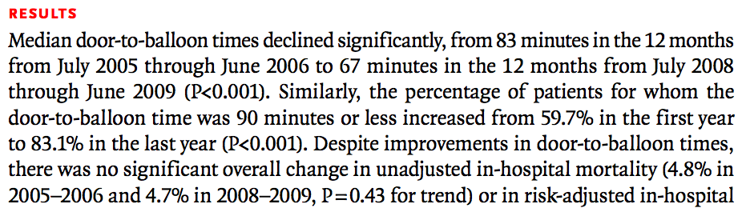
Association between D2B time, S2B time & mortality
Guidelines set a target door-to-balloon (D2B) time < 90min^{1,2}
Early studies showed that shorter D2B time reduces mortality ^{3,4}
  But subsequent studies showed conflicting evidence
Menees et al. N Engl J Med 2013

Slide 9
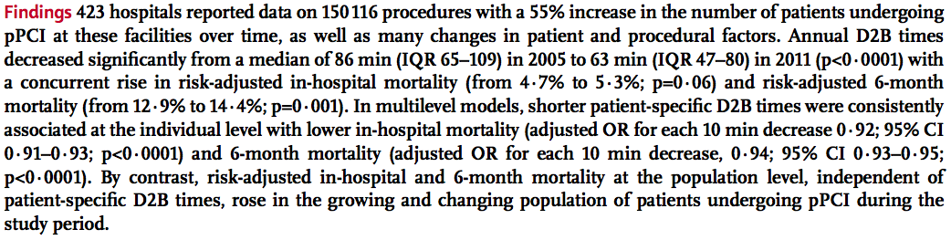
Association between D2B time, S2B time & mortality
Guidelines set a target door-to-balloon (D2B) time < 90min^{1,2}
Early studies showed that shorter D2B time reduces mortality ^{3,4}
  But subsequent studies showed conflicting evidence
Nallamothu et al. Lancet 2015
Shorter patient-specific times were consistently associated with lower inhospital mortality at the individual-patient level

Slide 10
Association between D2B time, S2B time & mortality
Correlation between symptom-to-balloon (S2B) time & mortality?
  S2B time = total ischemic time
  But evidence is inconsistent ^{3,5,6}
³ Cannon et al. JAMA. 2000;283:2941-2947
⁴ Gibson et al. Am Heart J. 2008;156:1035-1044
⁵ Brodie et al. J Am Coll Cardiol.1998;32:1312-1319
⁶ Giuseppe De Luca et al. J Am Coll Cardiol. 2003;42:991-7

Slide 11
Aims
Among STEMI patients undergoing primary PCI in Singapore, what is the relationship between
    D2B time & all-cause inhospital mortality
    S2B & all-cause inhospital mortality

Slide 12
Methods
Observational, retrospective study from 1 Jan 2007 to 31 Dec 2013
Data sources
  Singapore Myocardial Infarct Registry (SMIR)
  National registry with data from all unselected patients presenting with AMI to local hospitals
  Data obtained from
      MediClaims database
      Hospital inpatient discharge summary
      Death Registry
      Screening of abnormal troponins from hospital laboratories
  Trained research personnel to review each case
  Singapore Cardiac Data Bank (SCDB)
  All patients undergoing PCI in Singapore

Slide 13
Methods
Inclusion criteria
  STEMI patients who underwent primary PCI at public hospitals
  Singapore citizens or Permanent Residents
Exclusion criteria
  D2B time > 3 hours
  Patients who have been transferred from another facility
  Inpatients
  Patients presented to private hospitals
Requirement for consent and ethics approval was waived

Slide 14
Patient demographics
Year | Total (n=7597) | 2007 (n=742) | 2008 (n=829) | 2009 (n=1120) | 2010 (n=1115) | 2011 (n=1182) | 2012 (n=1252) | 2013 (n=1357) | P value
Mean age (year) | 58.2 | 57.4 | 57.9 | 58.0 | 57.9 | 58.1 | 58.6 | 58.8 | 0.075
Male (%) | 86.2 | 86.4 | 84.8 | 85.8 | 87.3 | 87.5 | 85.9 | 85.8 | 0.610
Ethnicity (%) - Chinese - Malay - Indian Others | 62.1 20.1 16.1 1.8 | 63.6 16.0 17.3 2.3 | 61.3 21.1 16.4 1.2 | 61.9 19.6 16.8 1.7 | 64.0 19.7 14.7 1.6 | 62.6 19.5 16.6 1.4 | 61.4 21.3 15.0 2.2 | 60.4 21.5 16.3 1.9 | 0.459

Slide 15
Clinical history
Year | Total (n=7597) | 2007 (n=742) | 2008 (n=829) | 2009 (n=1120) | 2010 (n=1115) | 2011 (n=1182) | 2012 (n=1252) | 2013 (n=1357) | P value
Hyperten-sion (%) | 51.5 | 50.5 | 52.5 | 50.5 | 49.1 | 52.5 | 51.0 | 53.7 | 0.332
Diabetes (%) | 27.0 | 28.0 | 28.1 | 25.9 | 27.3 | 27.4 | 26.7 | 26.4 | 0.912
Smoking (%) | 63.7 | 61.4 | 63.7 | 63.6 | 63.6 | 64.6 | 62.8 | 65.4 | 0.652
Dyslipide-mia (%) | 44.3 | 41.5 | 41.6 | 42.7 | 42.7 | 46.0 | 47.1 | 46.1 | 0.025

Slide 16
Correlating D2B time, S2B time with inhospital mortality…

Slide 17
Temporal trend: D2B time and mortality
Median D2B time
(P<0.001)
Median D2B time (min)
Mortality (%)
Inhospital mortality
(P=0.593)
Year

Slide 18
Temporal trend: S2B time and mortality
Median S2B time
(P<0.001)
Median S2B time (min)
Mortality (%)
Inhospital mortality
(P=0.593)
Year

Slide 19

No change in inhospital mortality
despite temporal reduction in D2B & S2B times
BUT…
What if we analyze the results differently?
Patient-level instead of temporal trend
Correlation between D2B and mortality

Slide 20
Mortality according to D2B time
Mortality (%)
D2B time (min)
No of patients
(n)
n=136
n=2896
n=2276
n=1139
n=438
n=212

Slide 21
Mortality according to S2B time
Mortality (%)
S2B time (min)
No of patients
(n)
n=29
n=1320
n=1856
n=1265
n=758
n=504
n=1865

Slide 22
At the patient-specific level…
D2B time
Every 10 min decrease
10.5% reduction
in inhospital mortality
(95% CI 6.2-16.1%)
S2B time
Every 60 min decrease
0.6% reduction
in inhospital mortality
(95% CI 0.0-1.8%)

Slide 23
Conclusion
D2B time is more strongly associated with inhospital mortality than S2B time
D2B time still remains as an important performance indicator
  Highly quantifiable
  Highly objective

Slide 24

Thank you!

