Slide 1
Detecting Microvascular Obstruction in STEMI Patients at the Time of PPCI
Dr Heerajnarain Bulluck
Research fellow
The Hatter Cardiovascular Institute, UCL, London, UK
National Heart Centre Singapore, Singapore
JCR 2016, Busan, South Korea

Slide 2
Contents
Background
Methods
Results
Conclusions

Slide 3
Background
Mortality due to STEMI is in decline but morbidity and mortality due to post-MI heart failure is on the rise
Partly attributed to reperfusion injury:
  No reflow/microvascular obstruction
  MVO➔adverse LV remodelling➔heart failure
New therapies required to prevent MVO

Slide 4

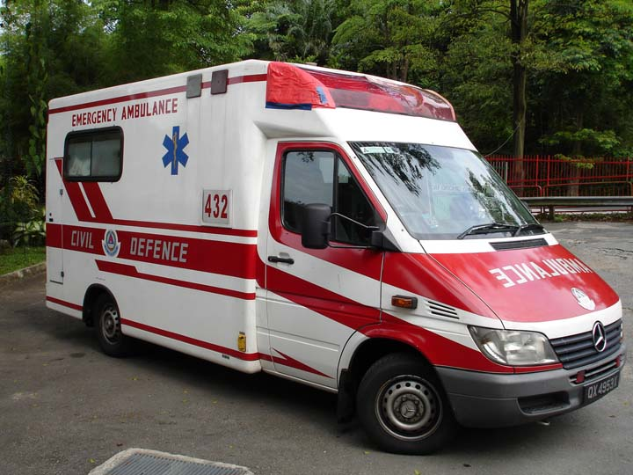
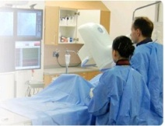
STEMI
Chest pain
PPCI
Cardiac MRI (first week)
Acute myocardial ischaemia
Reperfusion

Slide 5
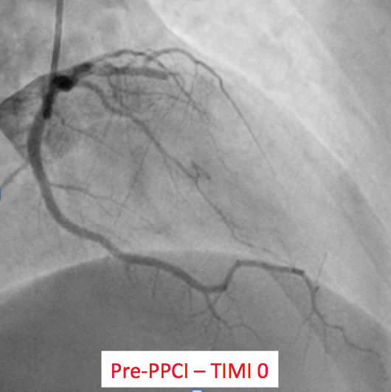
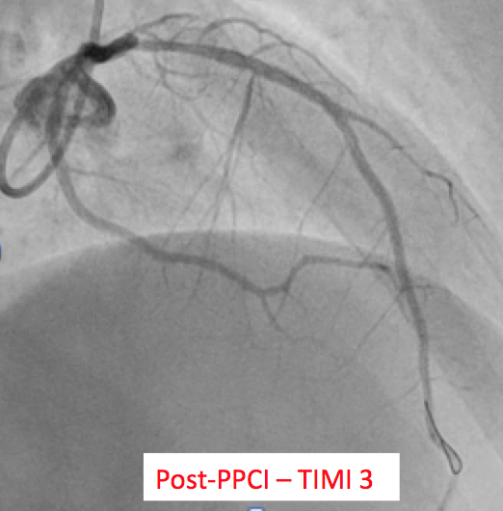
Acute STEMI

Slide 6
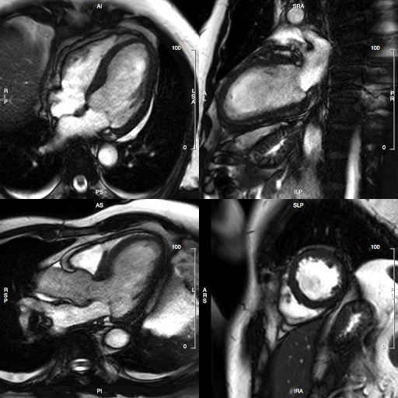
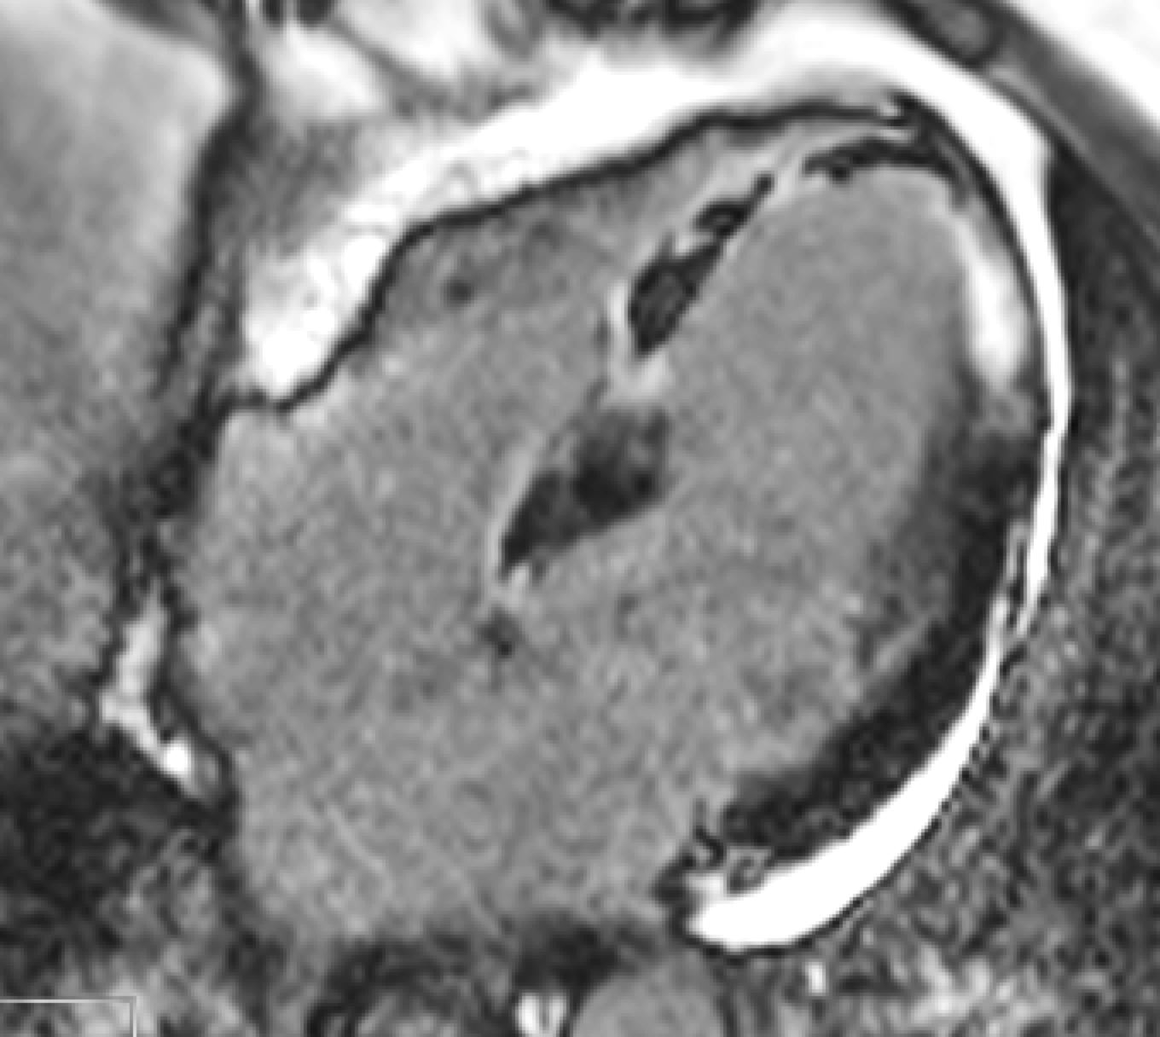
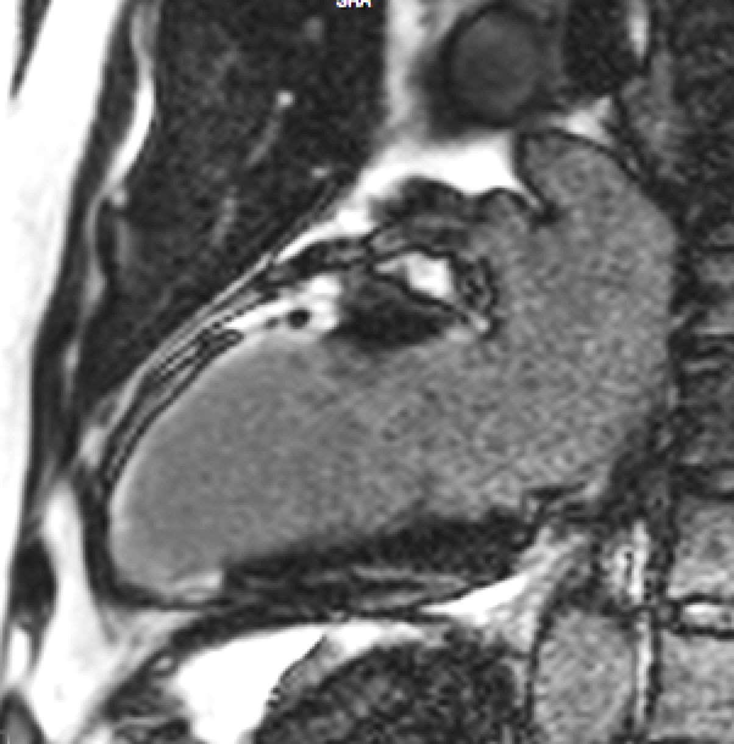
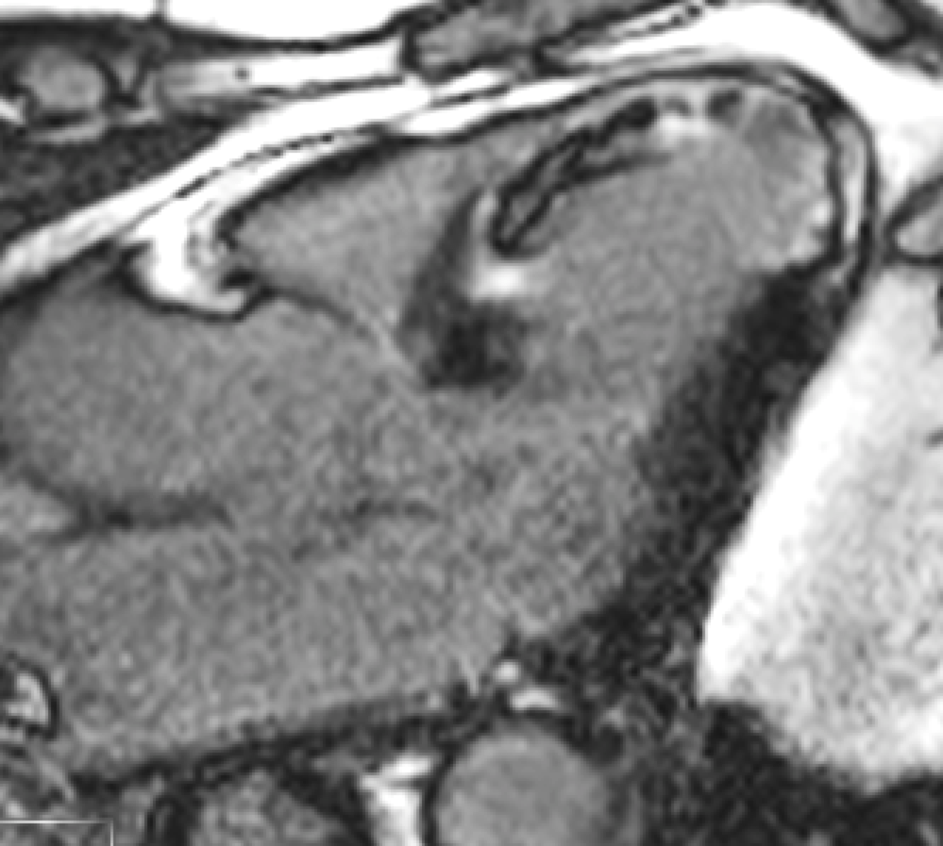
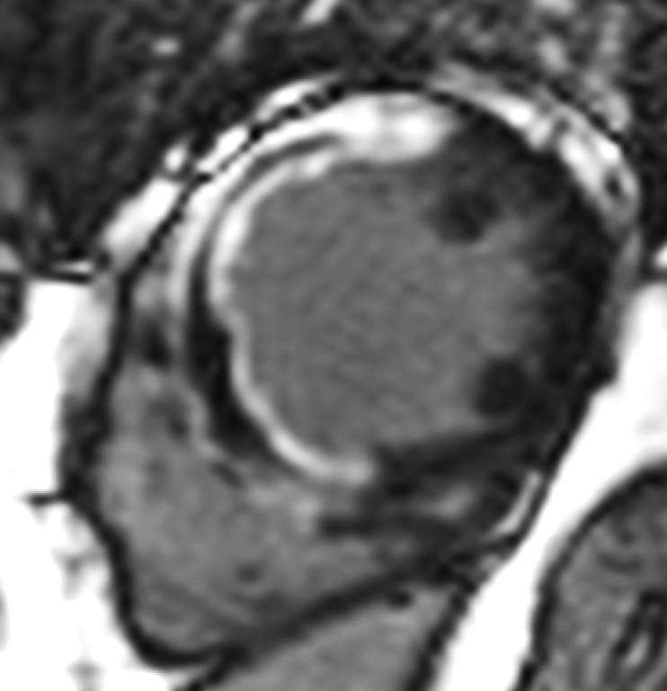
Acute anterior STEMI

Slide 7
Onset of STEMI
Bulluck et al, Heart 2015 Jul;101(13):1067-77
100
Reperfusion
via PPCI or
thrombolysis
Loss of viable myocardium due to
Ischaemia – Reperfusion Injury,
a target for cardioprotection
MYOCARDIAL SALVAGE (% of LV)
Expected
myocardial
salvage
Actual
myocardial
salvage
No salvage
without
reperfusion
0
0
TIME (Hours)
12

Slide 8
Ischemia – Reperfusion Injury (IRI)
Lethal myocardial
reperfusion injury
Myocardial
stunning
Reperfusion
arrhythmias
Coronary no reflow
or microvascular obstruction
Due to the opening of the MPTP and irreversible cardiomyocyte
hypercontracture from:
Ca⁺ overload
Oxidative stress
Rapid restoration in intracellular pH
Transient and self-limiting
Self-terminating or is usually easily treated
As a result of:
External compression of capillaries
Release of vasoactive substances
Extravasation of RBC
Neutrophil plugging
Embolization of plaques and thrombi
In-situ thrombi formation
Reversible
Irreversible

Slide 9
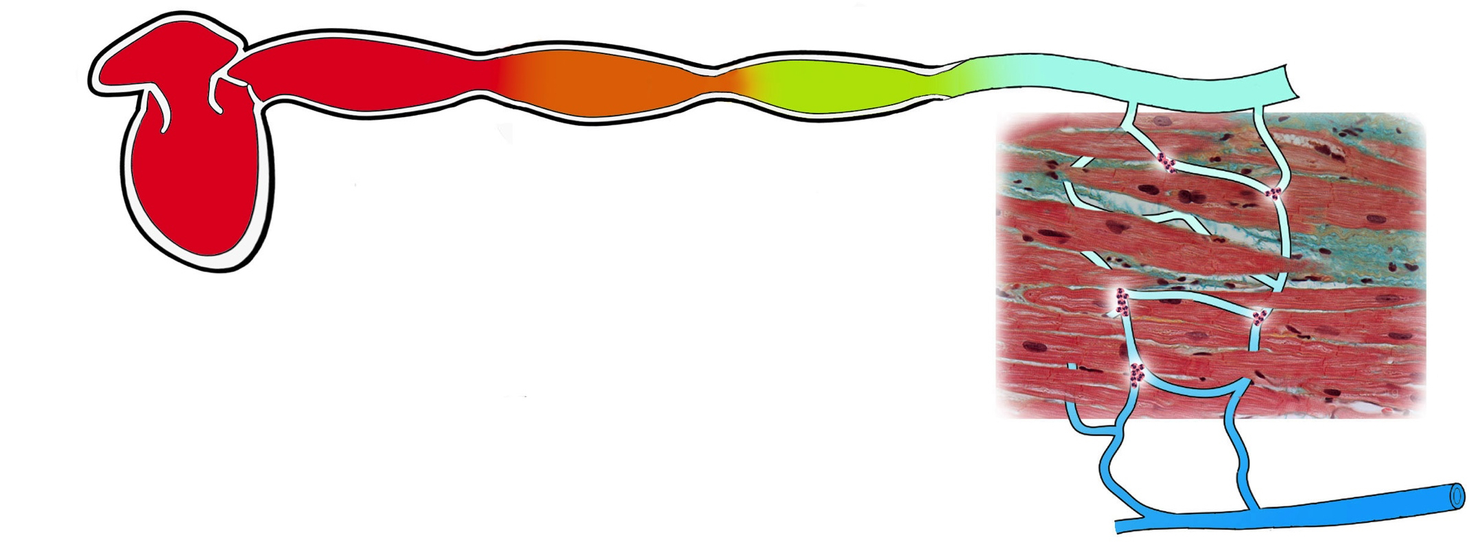
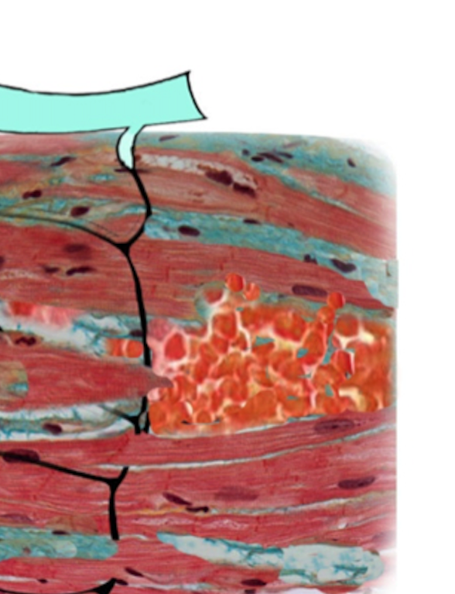
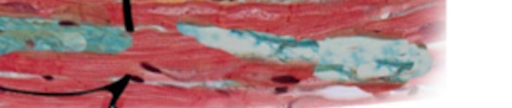
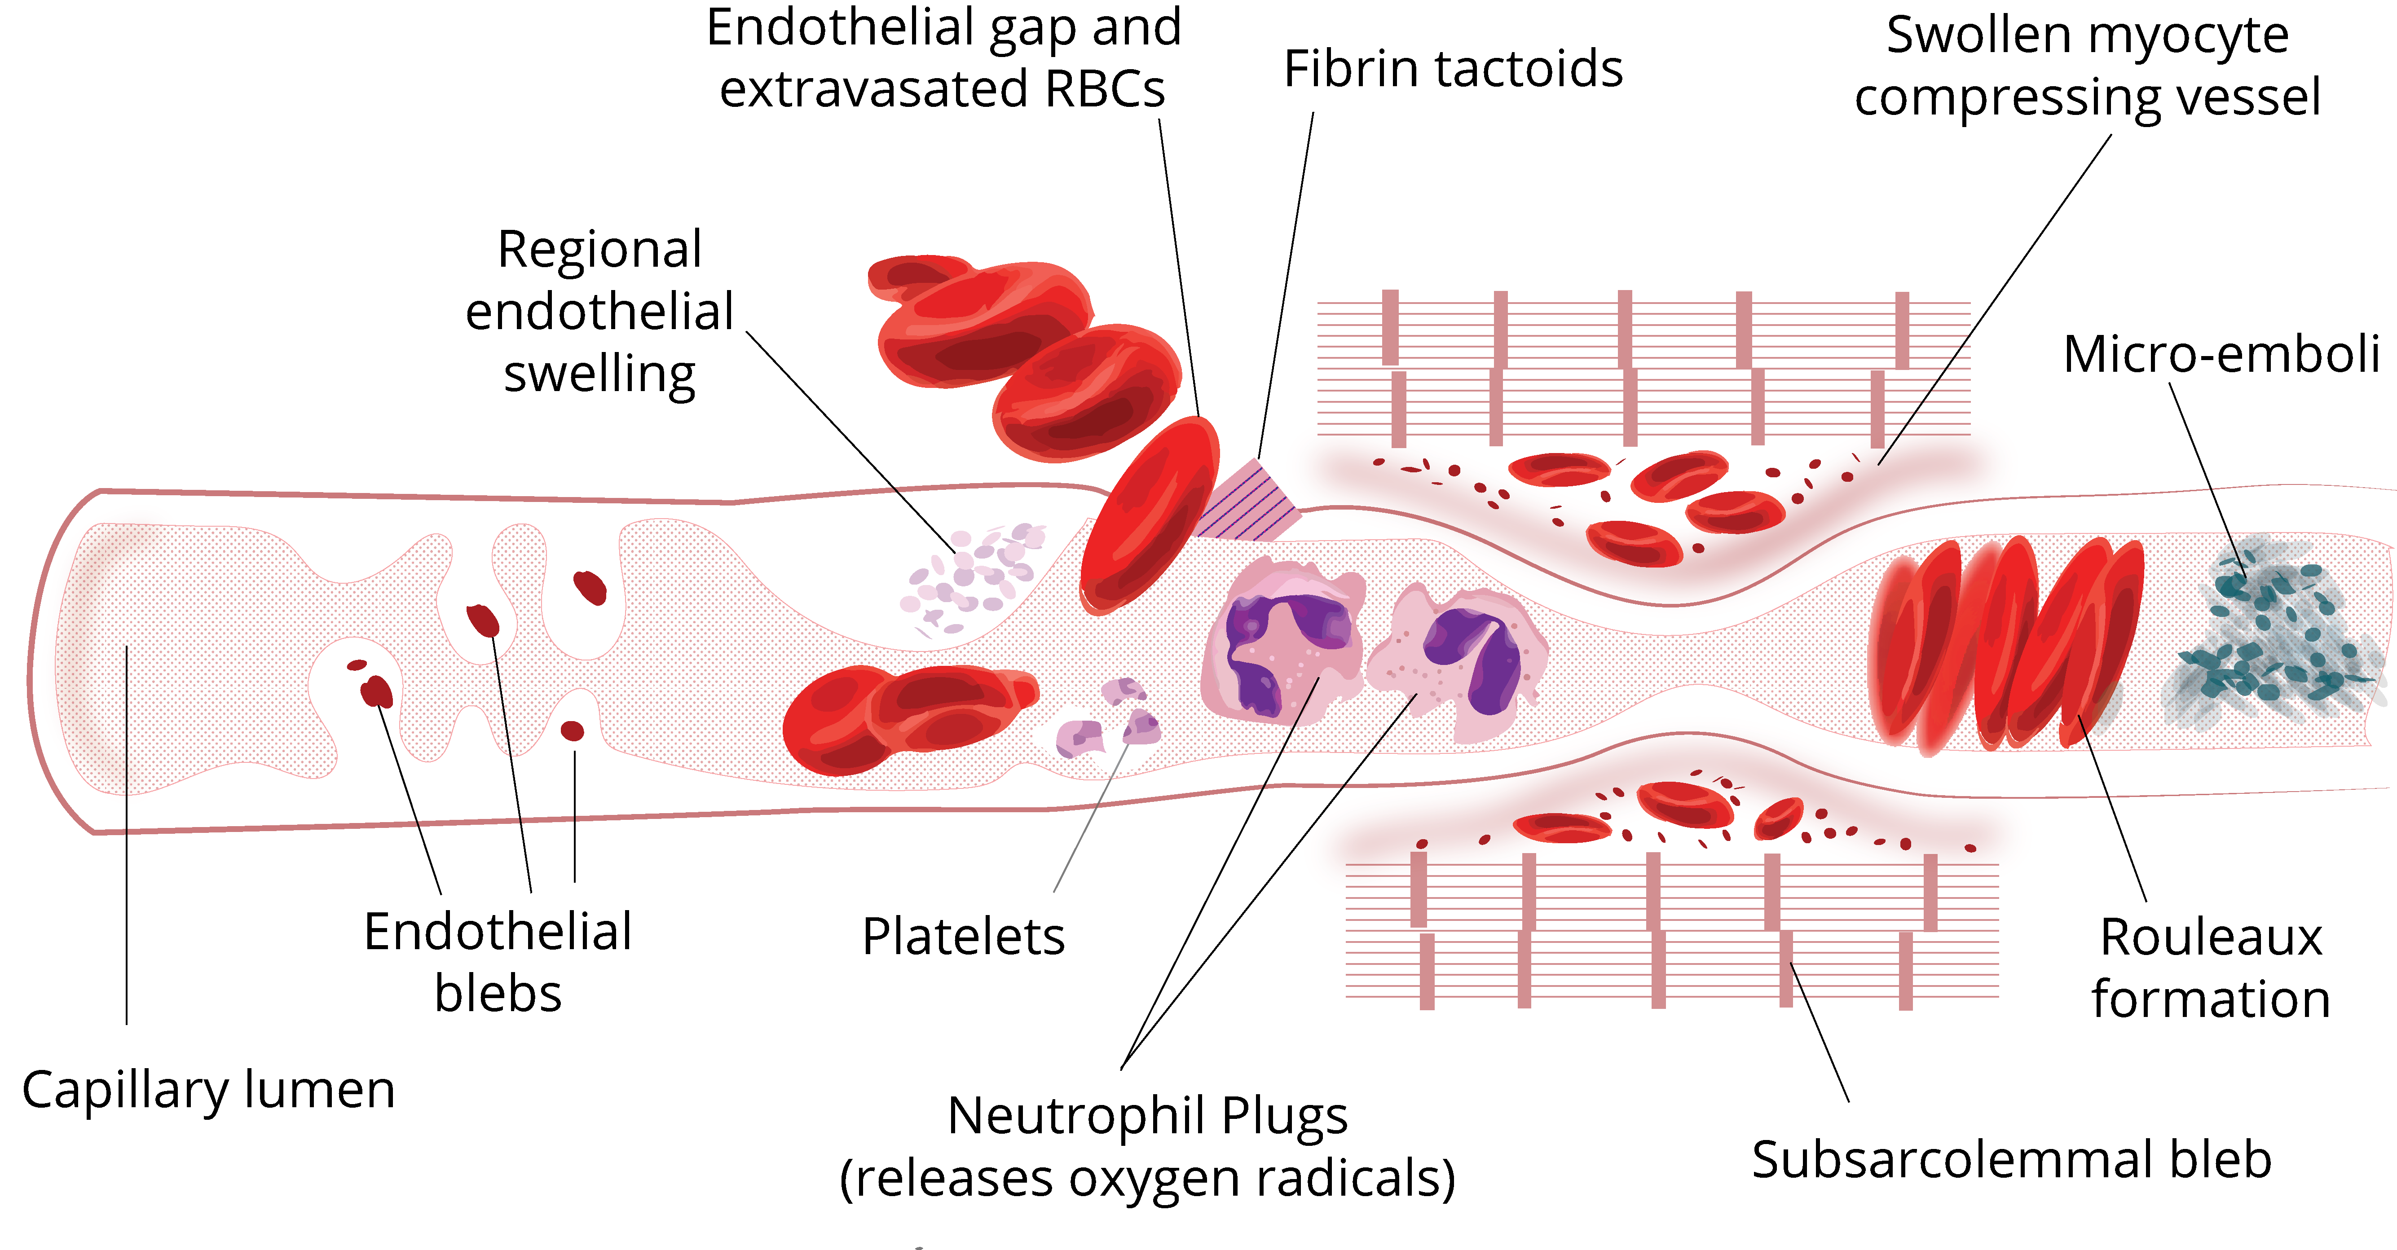
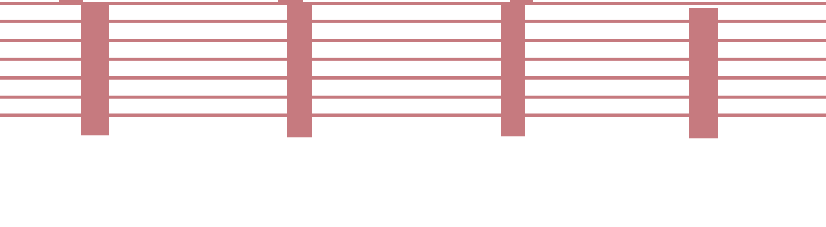
Patent epicardial coronaries
Heart
Microcirculation
Extravasated RBCs
Fibrin
Extrinsic compression by swollen cardiomyocytes
Endothelial swelling
Micro-thrombi
Coronary veins
Platelet
aggregation
Rouleaux formation
Endothelial blebs
Capillary
Neutrophil plugging

Slide 10
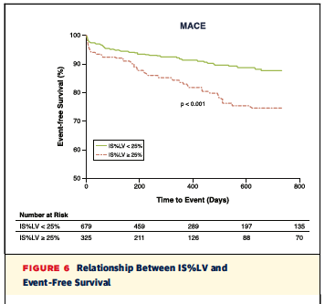
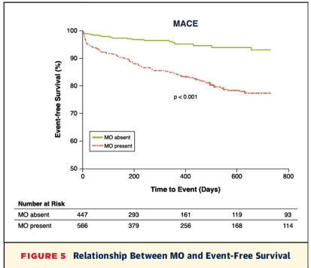
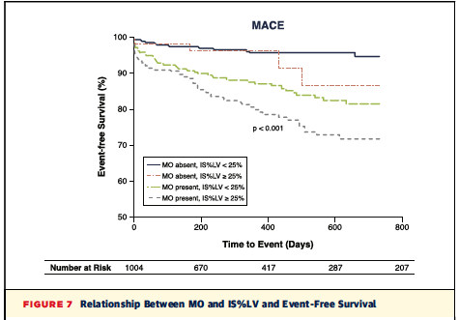
Van Kranenberg et al. JACC Cardiovasc Imaging. 2014 Sep;7(9):930-9

Slide 11
Assessing the microvascular circulation
TIMI flow grade
MBG/ TMPG
ST-segment resolution
Contrast-enhanced echocardiography
CMR
Cardiac CT
Invasive measure of microvascular resistance: index of microvascular resistance (IMR)

Slide 12
IMR – Mean Transit Time

Slide 13
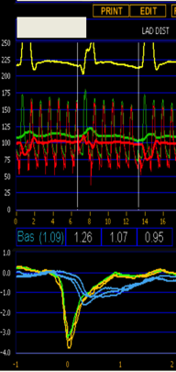
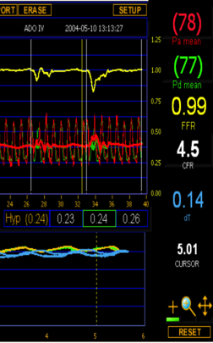
IMR
IMR= Pd x Tmn at hyperaemia

Slide 14
Background
Studies have assessed the relationship between IMR and MVO by CMR
But results not consistent
Underpowered

Slide 15
Aim
To conduct a meta-analysis to investigate the role of IMR in detecting the presence of MVO at the time of PPCI in reperfused STEMI patients.

Slide 16
Methods
We searched MEDLINE and EMBASE databases up to June 2016
The inclusion criteria were those studies undertaking both IMR at the end of PPCI in STEMI patients and performing CMR to detect MVO
We only included studies reporting the mean IMR in patients with and without MVO

Slide 17
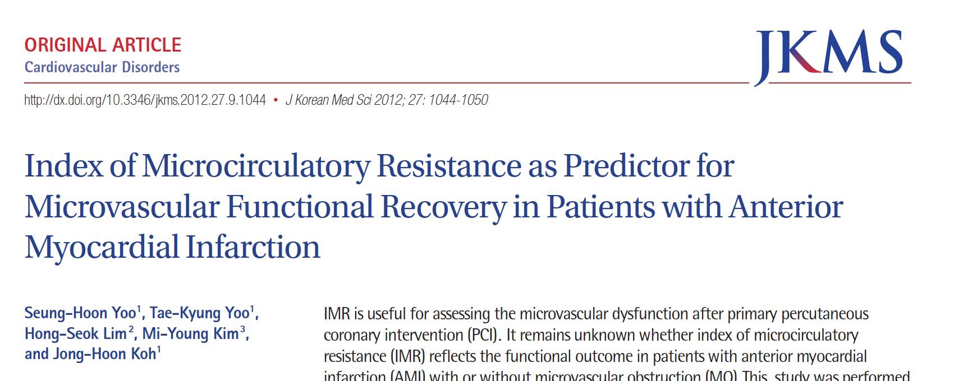
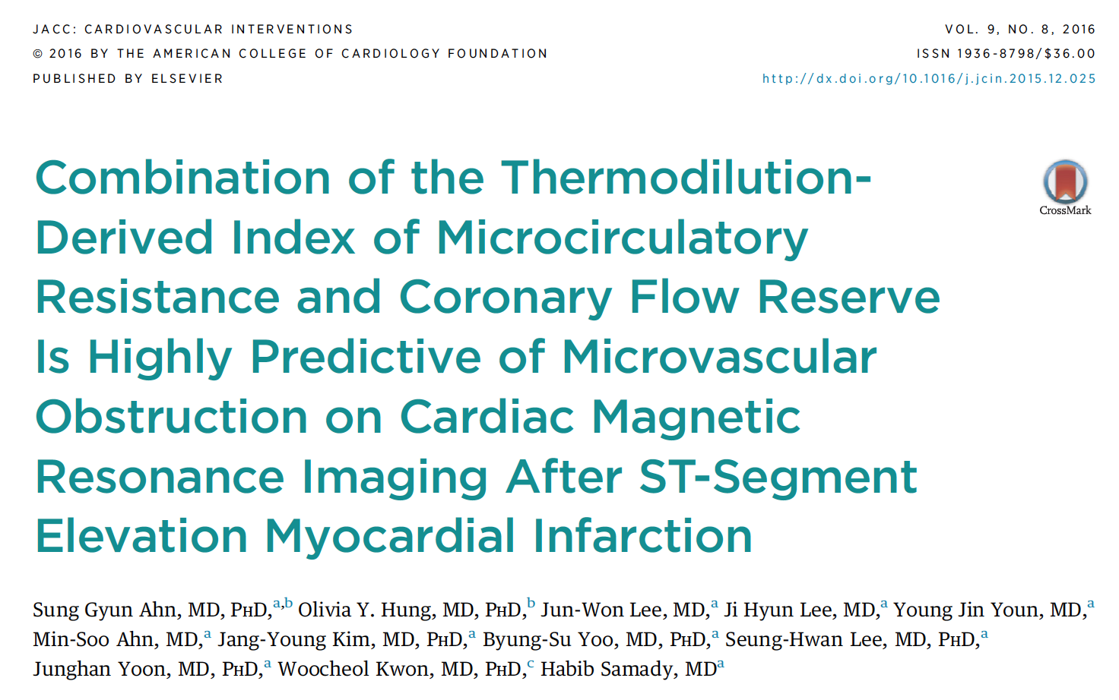
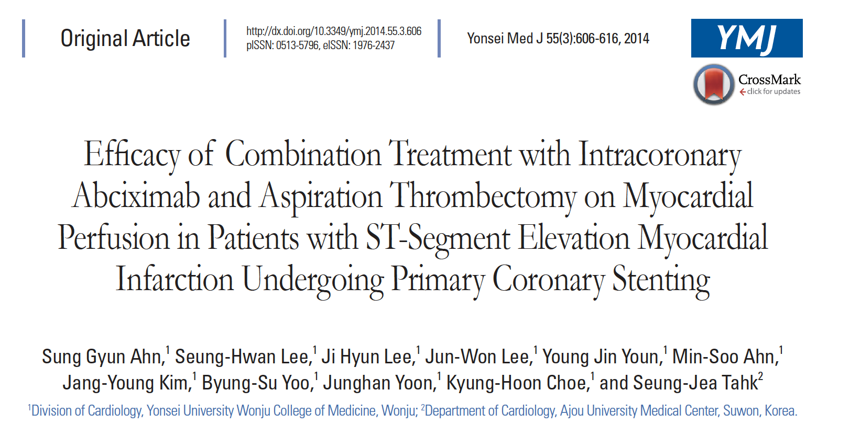
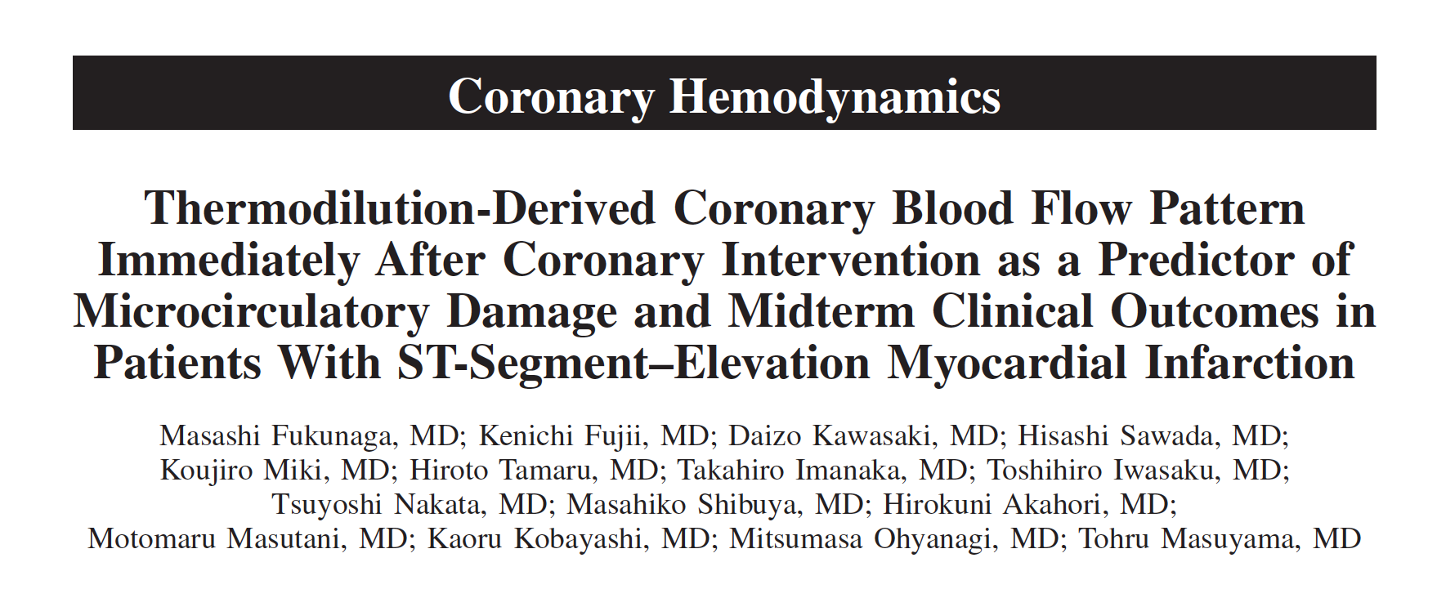
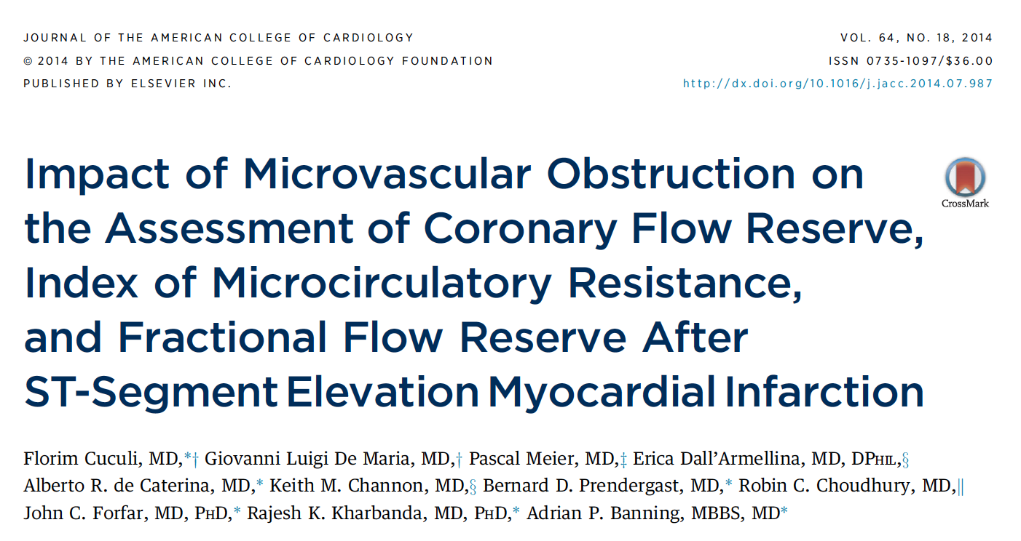
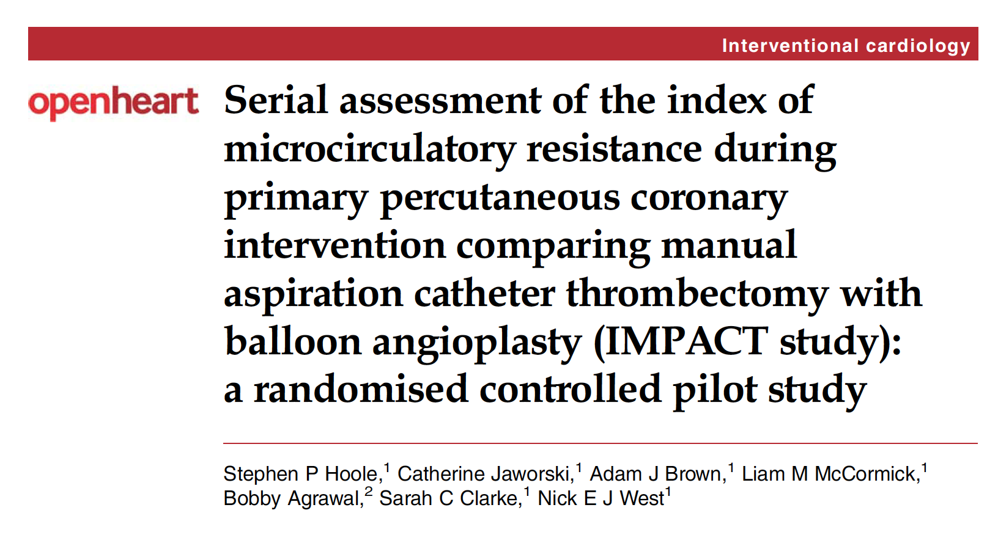

Slide 18
Results
Six studies were included in the meta-analysis, comprising a total of 288 patients
MVO data by CMR was available for 246 patients
MVO was present in 130/246 (53%) patients

Slide 19
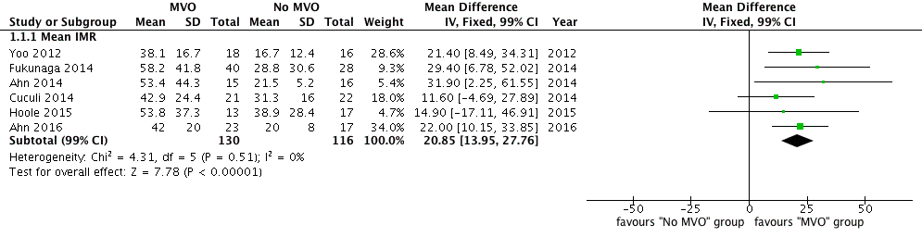
Results
The weighted mean IMR of the whole cohort was 38.6 (99%CI 33.5-43.6)U.
The weighted mean IMR in the 130 patients with MVO was 49.1 (99%CI 41.4-56.8)U and 26.7(99%CI 21.6-32.0)U(P<0.0001; heterogeneity; I²=0%) in 116 patients without MVO

Slide 20
Patients with a weighted mean IMR <32U (upper limit of the 99%CI in the group without MVO) were far less likely to have MVO, whereas those with a weighted mean IMR >41U (lower limit of the 99%CI in the group with MVO) were much more likely to have MVO
Fearon et al (Circulation. 2013 Jun 18;127(24):2436-41.): median IMR value of >40U was an independent predictor of death in 253 STEMI patients (hazard ratio 4.3, P 0.02) after a median follow-up of 2.8 years
Carrick et al (Circulation. 2016 Dec 6;134(23):1833-1847.): also showed that an IMR >40U was a multivariable associate of adverse LV remodeling by CMR at 6 months, and was a better predictor of all-cause death or heart failure than the duration of ischemia, ST-segment resolution, TMPG and CFR after a median follow-up of 845 days.

Slide 21
Conclusions
This study suggest that patients with a weighted mean IMR <32U were far less likely to have MVO, whereas patients with a weighted mean IMR >41U were much more likely to have MVO
We would propose that when investigating a novel intervention for preventing MVO, selecting patients with an IMR>41U may help identify those most likely to benefit from the treatment

Slide 22
JACC Cardiovasc Interv. 2016 Oct 24;9(20):2172-2174. doi: 10.1016/j.jcin.2016.08.018.
Index of Microvascular Resistance and Microvascular Obstruction in Patients With Acute Myocardial Infarction.
Bulluck H, Foin N, Cabrera-Fuentes HA, Yeo KK, Wong AS, Fam JM, Wong PE, Tan JW, Low AF, Hausenloy DJ.

