Slide 1
Establishing a research network of cardiac MRI centers to investigate cardioprotection in STEMI patients
Derek Hausenloy
Professor, Cardiovascular and Metabolic Disorders, Duke-National University Singapore
Senior Consultant and Clinician Scientist, National Heart Centre Singapore
10th December 2016
JOINT MEETING OF CORONARY REVASCULARIZATION, Busan, South Korea
derek.hausenloy@duke-nus.edu.sg

Slide 2
Background
Ischemic heart disease and the heart failure which results are the leading causes of death and disability inAsia.
Despite PPCI, the mortality and morbidity of reperfused STEMI patients remain significant with 7% death and 25% heart failure at one year.
Novel therapies are needed to reduce myocardial infarct (MI) size, preserve left ventricular (LV) systolic function and preventing the onset of heart failure.

Slide 3
Cardiac MRI in STEMI
To assess the cardioprotective efficacy of any new therapy for reducing MI size, it is necessary to measure the area-at-risk (AAR) to enable myocardial salvage (a more sensitive measure of cardioprotection) to be estimated.
Cardiac MRI in the first week following STEMI can provide info on:
LV/RV size and function
Myocardial infarct size and myocardial salvage (AAR-MI)
Myocardial oedema/inflammation
Microvascular obstruction/Intramyocardial haemorrhage
Interstitial volume in remote myocardium

Slide 4
Multicentre Research Network of Cardiac MRI/PPCI Centres
A research network of PPCI centres able to perform cardiac MRI in first week can allow multicentre testing of novel cardioprotective therapies for reducing MI size.
Multicentre testing more robust than single centre
Increase in patient pool (esp if selected population)
Cardiac MRI can provide info on surrogate endpoints for cardioprotection – MI size, myocardial salvage, MVO, IMH, LV size and function (reduced sample size).
Need to standardise cardiac MRI protocols and/or scanners (esp T1/T2 maps) across sites.
Needs centralised and standardised Core Lab Analysis of cardiac MRI sites.
Can answer new research questions.

Slide 5

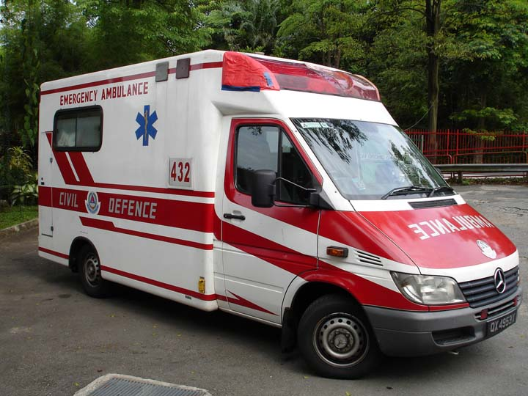
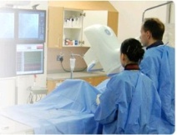
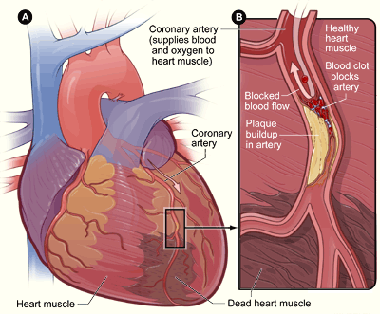
Cardiac MRI in the acute STEMI patient
Chest pain
PPCI
Cardiac MRI (first week)
Acute myocardial ischaemia
Reperfusion

Slide 6
Measuring myocardial infarct size
Delayed washout of gadolinium contrast can delineate MI – strong predictor of remodelling, heart failure and survival
White et al JACC Cardiovasc Imaging 2015

Slide 7
Dectection of myocardial oedema/inflammation
Myocardial oedema detected by T2-MRI can be used to delineate area-at-risk of MI (reversible myocardial injury)
White et al JACC Cardiovasc Imaging 2015

Slide 8
Detection of microvascular obstruction
Failure to perfuse myocardium due to damaged coronary microvasculature (60%) – strong predictor of remodelling, heart failure and survival
White et al JACC Cardiovasc Imaging 2015

Slide 9
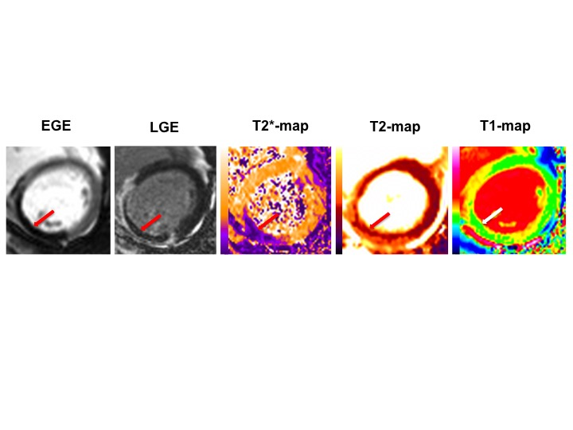
Dectection of intramyocardial haemorrhage
In patients with MVO, severe microvasculature damage can cause extravasation into myocardium (50%) - strong predictor of remodelling, heart failure and survival
Bulluck et al Radiology 2016 In Press

Slide 10
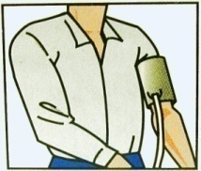
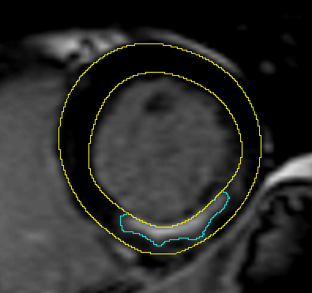
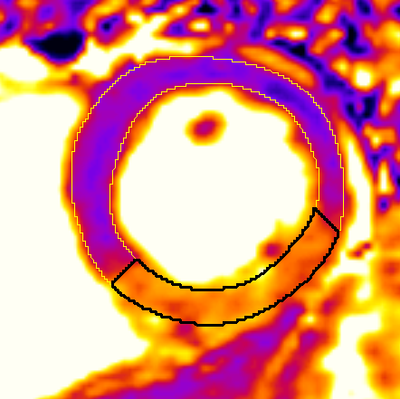
Cardiac MRI in cardioprotection
Cardiac MRI can assess efficacy of therapies for reducing MI size
120
0
White et al JACC Cardiovasc Imaging 2015

Slide 11
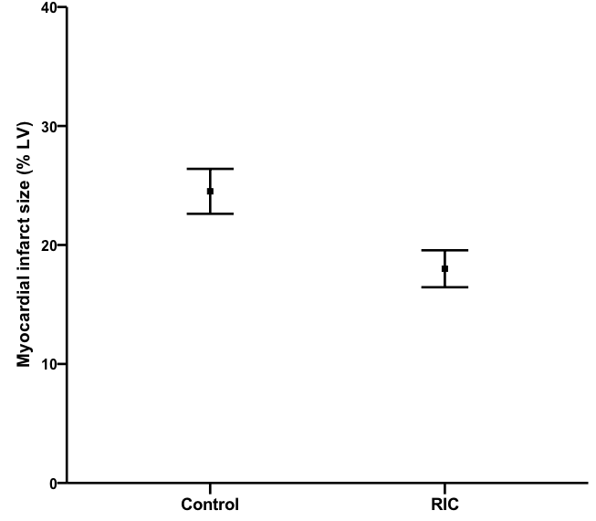
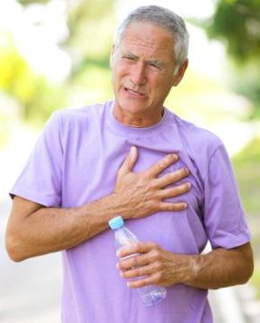
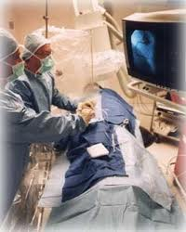
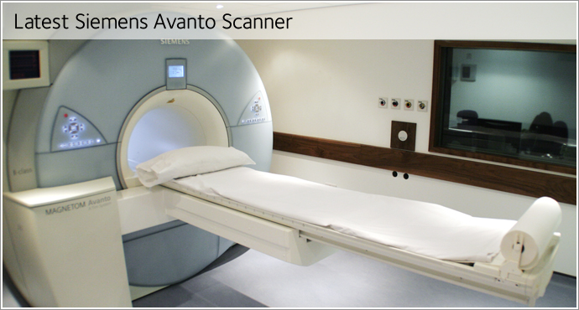
Remote ischemic conditioning
MI size (%LV)
4 cycles of brief IR applied to upper arm.
83 STEMI patients:
RIC- 4x5 min cuff inflation
Control- 40 min deflated cuff
RIC reduced MI size by 27%.
*
White et al JACC Cardiovasc Imaging 2015

Slide 12


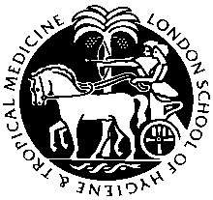
CONDI2/ERIC-PPCI trial
  European multicentre trial (UK, Denmark, Spain, Serbia)
  4300 STEMI patients undergoing PPCI
Randomisation/allocation
  RIC: 4 x 5 min cuff
  Inflation 200mmHg/deflation
  Sham RIC: 4 x 5 min simulated
  Inflations/deflations
Primary outcome
Cardiac death and Hospitalisation for Heart Failure at 12 mths
2500 patients recruited so far (250 patient MRI substudy)
British Heart Foundation

Slide 13
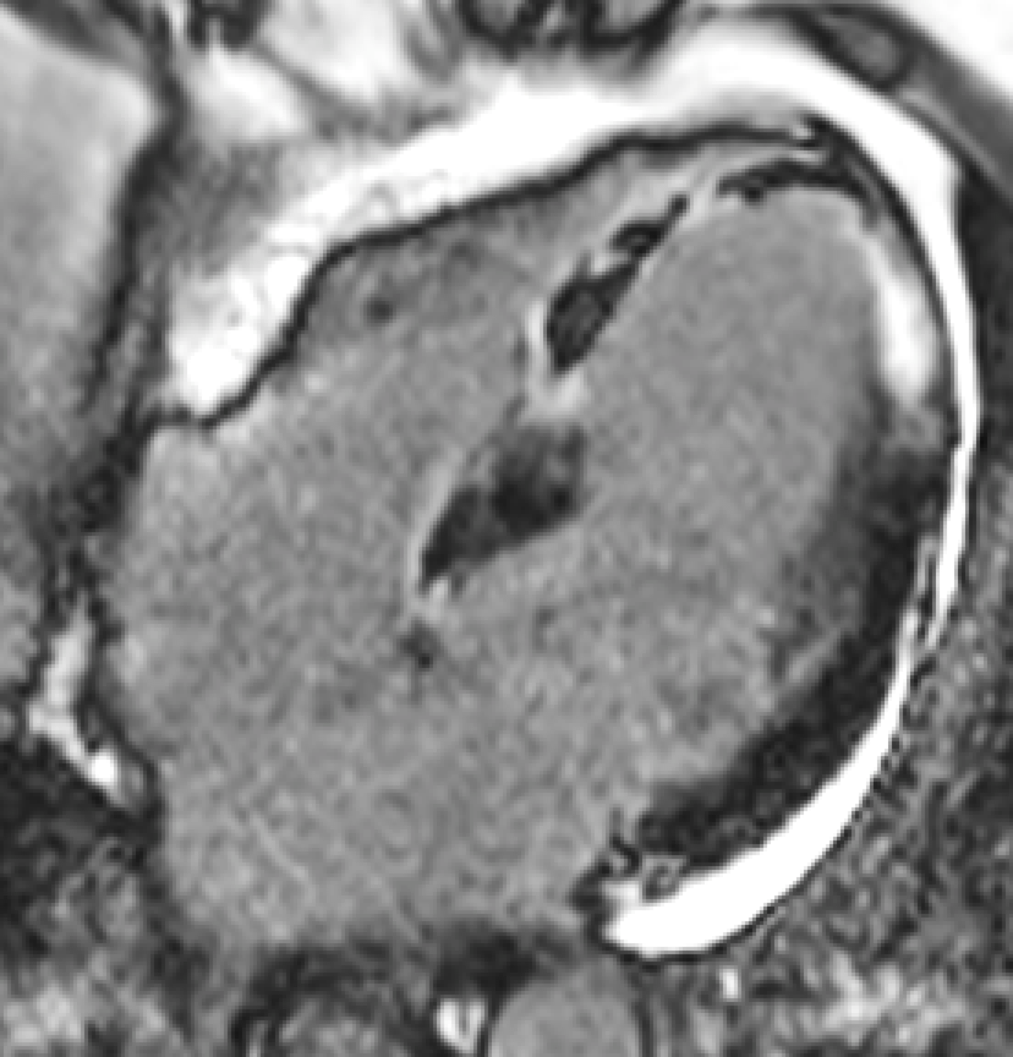
Platelet Inhibition to Target Reperfusion Injury:
PITRI trial
Oral P2Y₁₂ inhibitors do not offer maximum platelet inhibition at the time of PPCI in STEMI patients.
Cangrelor (IV platelet P2Y₁₂ inhibitor) prior to PPCI may have dual benefits:
(1) maximum platelet inhibition at PPCI to prevent MVO
(2) direct decrease cardiomyocyte death to reduce MI size.
  210 STEMI patients undergoing PPCI
  (NHCS, NUHS, TTSH)
Randomisation/allocation
  IV Cangrelor infusion
  (initiated prior to PPCI)
  IV Normal Saline infusion
  (initiated prior to PPCI)
Primary outcome
Myocardial infarct size on CMR at 6 months
(LGE mass % of LV)

Slide 14
Conclusions
Novel therapies are required to reduce MI size and prevent heart failure in reperfused STEMI patients.
Cardiac MRI can assess the cardioprotective efficacy of novel therapies for reducing MI size and preventing heart failure (MI size, myocardial salvage, LV remodelling) in multicentre clinical cardioprotection trials.
Multi-centre research network of cardiac MRI centres will allow assessment of novel cardioprotective therapies in reperfused STEMI patients – surrogate endpoints, increased access to sample size, core lab analysis, answer new research questions.

Slide 15


Acknowledgements
The Hatter Institute, UCL, UK
Heerajnarain Bulluck
Manish Ramlall
Steven White
Derek Yellon
UCLH/Barts Heart Centre, UK
James Moon
Anna Herrey
Charlotte Manisty
UCLH Nuclear Cardiology, UK
Ashley Groves
Leon Menezes
Simon Wan
Celia O’Meara
CIRC, Singapore
John Totman
Stephanie Marchesseau Le Prado
Mary Stephenson
Fatima Al Nasirallah
NHCS MRI unit, Singapore
All MRI staff
Stuart Cook
Tan Ru San
Calvin Chin
Narayan Lath
Adrian Shoen Low Choon Seng
Tang Hak Chiaw
Zhang Shuo
NCIS, Singapore
Lee Soo Chin
British Heart Foundation

