Slide 1
The SwedeHeart registry
- lessons from Uppsala
Jang-Whan Bae
Chungbuk National University, School of Medicine
Chungbuk National University Hospital,
Chungbuk Regional Cardiovascular Disease Center, Cheongju, Korea
The session of “Heart-Brain Networks”, JCR 2016. Dec. 10, 2016.

Slide 2
My disclosure
I do not have any disclosure on current topic.
I do not have any conflict of interest on current topic.

Slide 3
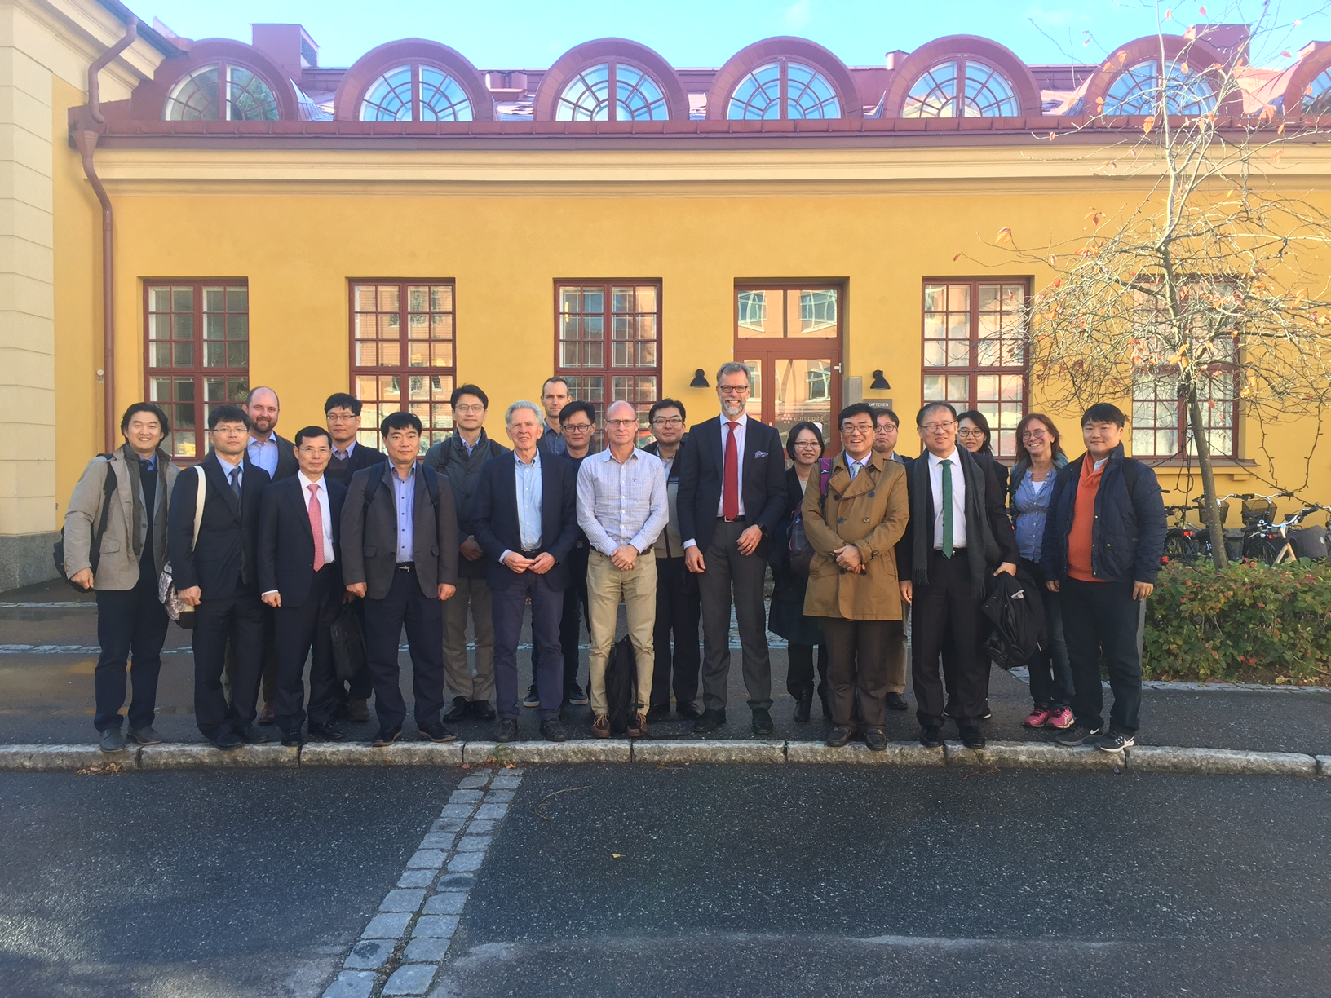
K-RCCVC to benchmark the SwedeHeart

Slide 4
The Swedish National Quality Registries

Slide 5
ROK and Sweden
General information in ROK and Sweden.
ROK |  | Sweden
100,201 Km² | Geographic area | 444,964 Km²
51,515,399 (‘15) | Population | 9,753,627 (‘15)
505.1/Km² | Population density | 20/Km²
$ 1,377,873.11 Million | GDP | $492,618.07 Million (‘15)
$ 27,221.5 | GDP/capita | $50,272.9 (‘15)
7.4% (‘14) | Healthcare expenditure/GDP | 11.9% (‘14)
http://data.worldbank.org/indicator/NY.GDP.PCAP.CD

Slide 6
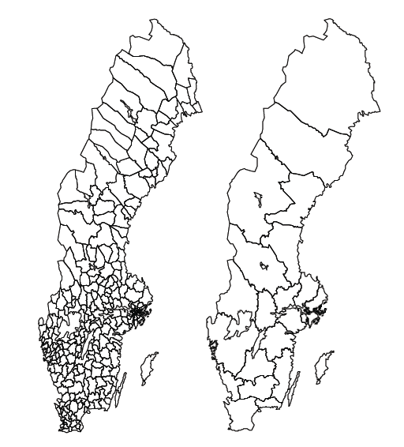
Swedish Health Care
Decentralization
  Municipalities and country councils/regions are responsible for much of public services
  Strong local self-government
  State-county-municipality
Right to taxes on incomes and charge users for their services
Financing of services
  70%; Taxes, > 15% State grants
290 municipalities
  Population between 2,400 and 912,000 inhabitants
21 county councils/regions
  Population between 127,000 and 2,198,000 inhabitants

Slide 7
Nationwide registries in Sweden
Nationwide registries in Sweden
  96 certified registries, total 108 registries
    35 Million Euros (43.365 Billion KRW) for 96 certified registries
  From SwedeHeart, cancer to Hip joint replacement, Cataract registry
Conditions
  Consent
    Usually verbal consent is enough
    written consent for specific medical research
  Related acts
    Swedish patients data act
    National board regulations SOSFS 2008;14
    The personal data act, legislation on Biobanking
    New EU data protection law
  Direct liking to related national registries
    Often performed
    National quality registries and health registries such as;
      Birth, death, twin, drug registries

Slide 8
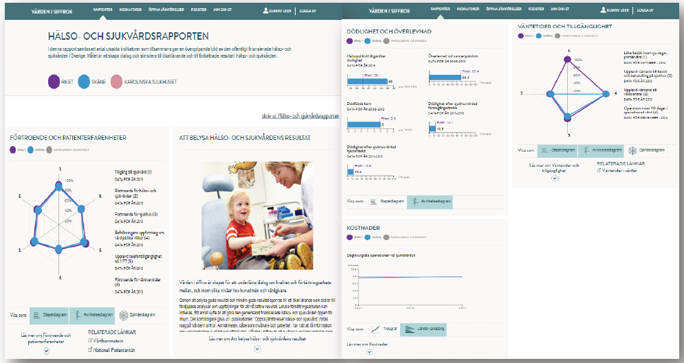
Nationwide registries in Sweden
Tools for online reports

Slide 9
Nationwide registries in Sweden
Office of national quality registries
  Funding and follow up
  IT-service tools and projects
    Basically in-house and open source program
    Link to OCS/EMR, practically merged
  Development projects for registries
    Quality, patients involvement
  Education
    Web, conferences, meetings
  Industry collaboration support
  International collaboration support

Slide 10
Nationwide registries in Sweden
Swedish philosophy; why and for what ?
  Why
    Safety and follow-up
    Patient outcome
    Clinical research
    Health economics
    Risk factors, prevalence, incidence
    Method development
  What
    Development of guidelines
    International and local comparisons in healthcare-benchmarking
    Industry follow-up of new drugs/devices
    Epidemiological studies
    Feasibility studies
    Real world studies
      Medical effect and cost
    Answering questions from health authorities

Slide 11
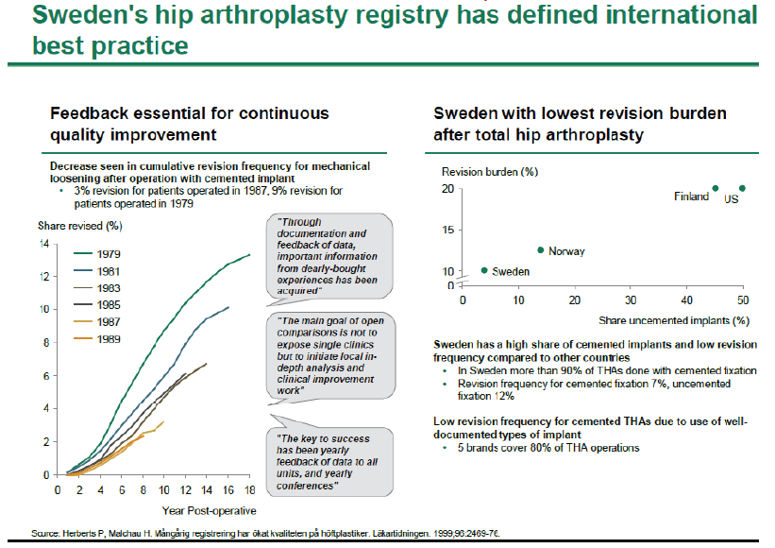
Nationwide registries in Sweden
The best possible care for the patient
  The new drug/devices – hip athroplasty registry

Slide 12
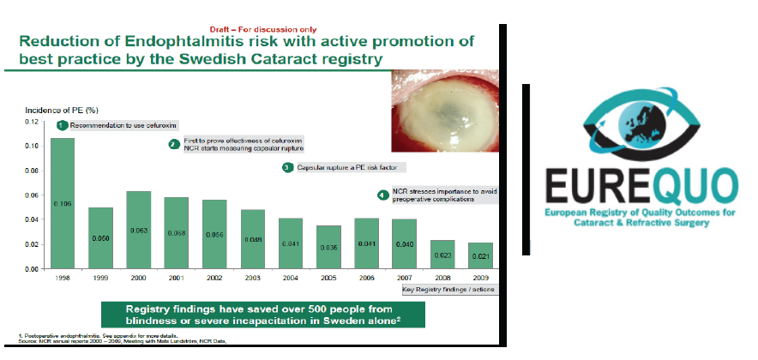
Nationwide registries in Sweden
The best possible care for the patient
  Improvement of working procedures – cataract registry

Slide 13
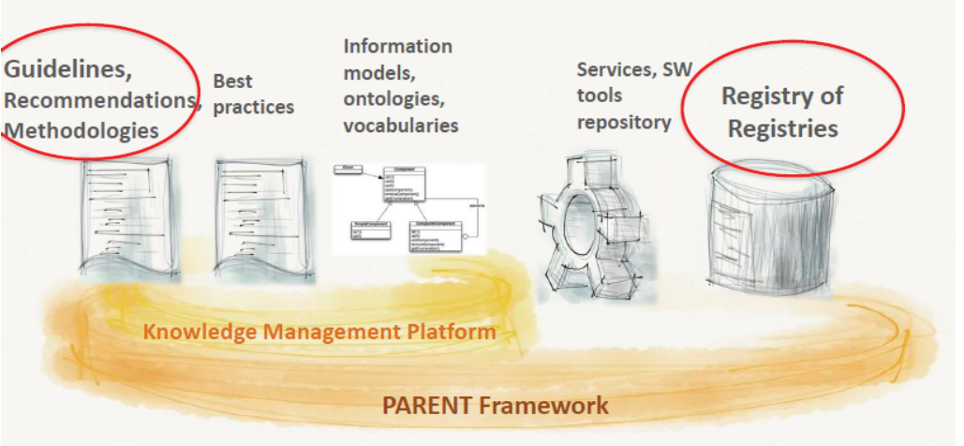
Nationwide registries in Sweden
PARENT framework: the tools

Slide 14
The SwedeHeart Registries

Slide 15
SwedeHeart – History
From the early 1980s – Lars Wallentin in Uppsala Univ.
  Some cardiologists in Uppsala
    “Do our ACS patients who treated in our CCU well after discharge?”
  Bottom-up procedure
    Started with papers, then used one Mac.
    Small grants → company sponsored
  Government needed data for CV disease.
    Number one killer in Sweden
    RIKS-HIA data: well matched in Sweden Statistics.
    Government started funding for the SwedeHeart.
  Government helps but, not governs makers of registries.
    Uppsala operates whole procedures of the SwedeHeart.

Slide 16
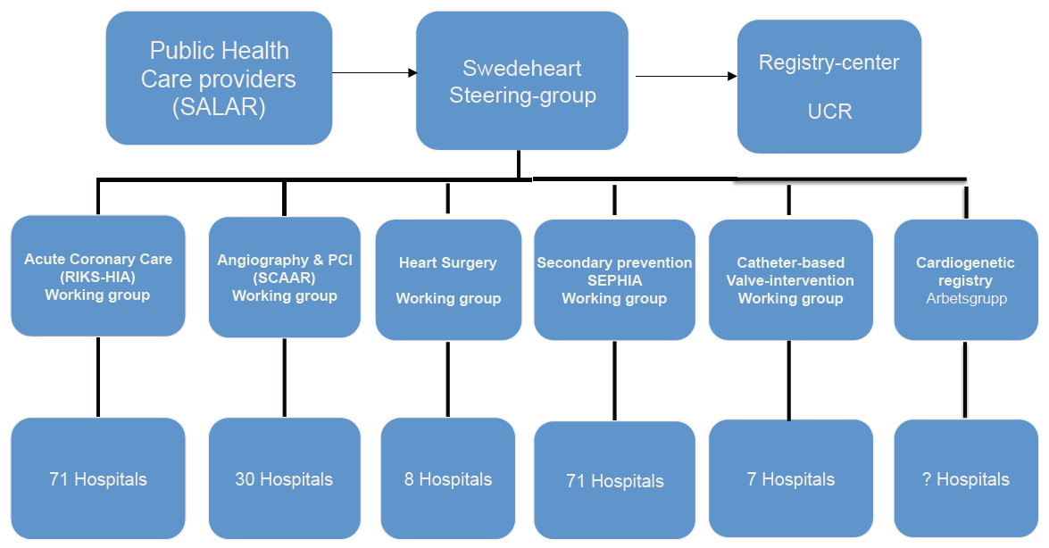
SwedeHeart – organizations

Slide 17
SwedeHeart – organizations
Number of cases yearly: 80,000
  RIKS-HIA
    20,000 AMI
    10,000 UA
    25,000 other causes to symptoms
  SCAAR
    40,000 CAG or PCI
  Heart surgery registry
    7,000 heart surgery
  SEPHIA
    7,000 secondary prevention
  TAVI
    500 catheter based valve intervention
> 500 variables
  Baseline data, process- and outcome measures
  Monitoring
    95~95% agreement between patients records and registry

Slide 18
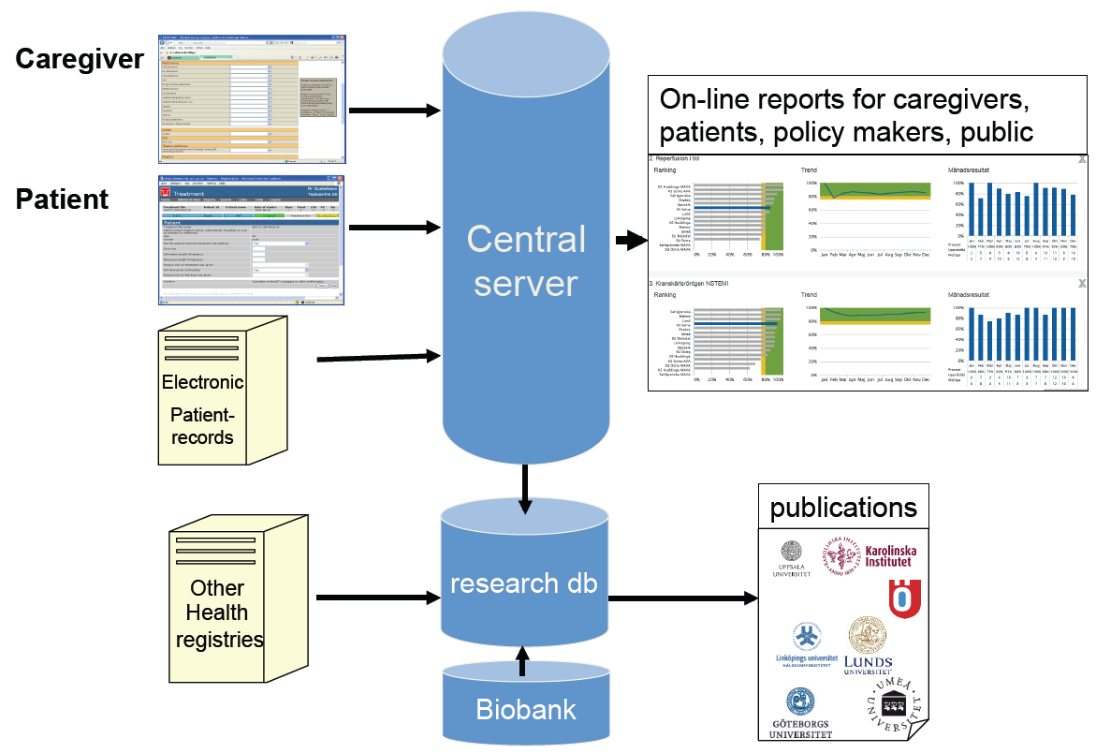
SwedeHeart – organizations

Slide 19
Recording variables
Patients with symptoms suggestive of ACS (RIKS-HIA)
  Patient demographics
  Admission logistics
  Risk factors
  Past medical history
  Medical treatment before admission
  Electrocardiographic changes, biochemical markers
  Other clinical features and investigations
  Medical treatment in hospital, interventions
  Hospital outcome
  Discharge diagnosis
  Discharge medications

Slide 20
Recording variables
Patients with symptoms suggestive of ACS (RIKS-HIA)
  Recorded by discharge and after 6-10 weeks
  PROM (patient reported outcome measures)
    The Somatic Health Complaints Questionnaire (SHCQ)
    Minimal Insomnia Symptom Scale (MISS)
    Physical activity according to Grimby scale
    Cardiac Self Efficacy Scale (CSES)
  PREM (Patient Reported Experiences Measures)
    Patients’ views on their care

Slide 21
The SwedeHeart is merged with;
Registries at the National Board of Health and Welfare
  The national registry of cause of death
  The national patient register (all ICD codes, all admission since 1987)
  The Swedish prescribing drug register (all dispensed drugs since 2005)
Statistics Sweden (SCB)
  Marital status, country of birth, income, educational level
The Swedish Social Insurance Agency (sick leave)
Other National Quality Registries (about 100 at present)

Slide 22
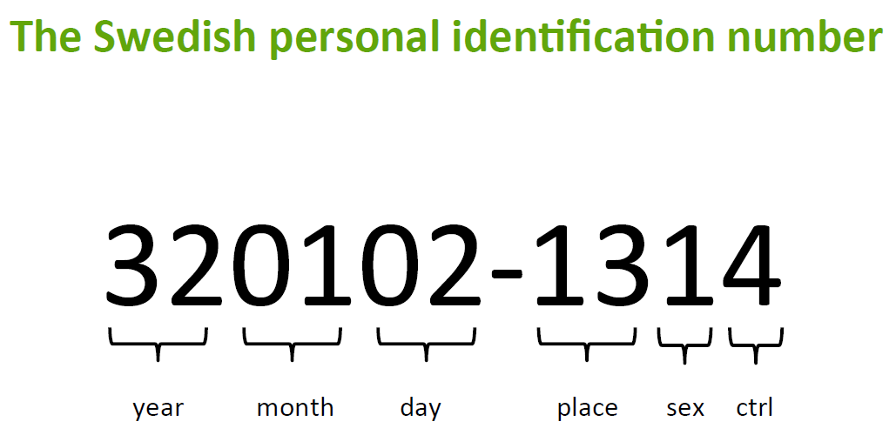
The SwedeHeart starts with …
The Swedish personal identification number …

Slide 23
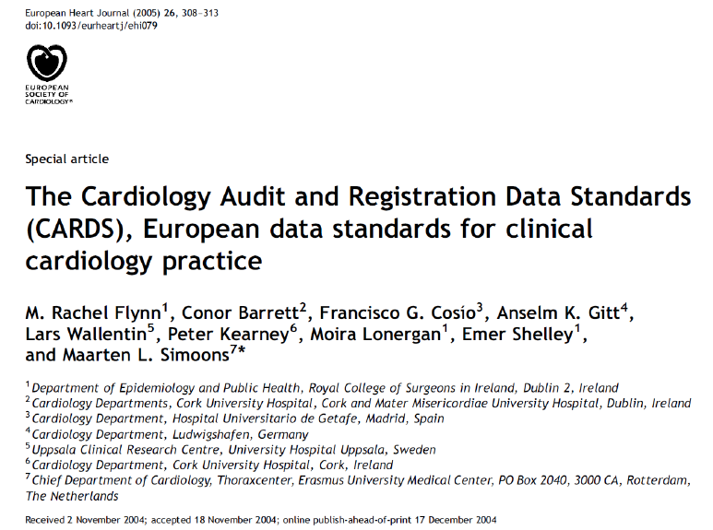
The SwedeHeart starts with …
CARDS (the Cardiology Audit and Registration Data Standards)

Slide 24
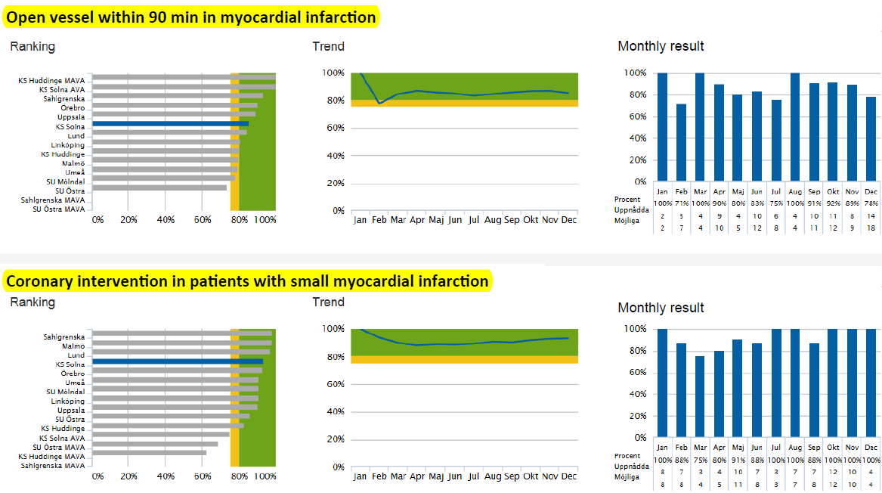
The SwedeHeart; Quality at a glance
On-line reports for each institution, not for each clinician

Slide 25

The SwedeHeart; Annual reports
Open for public, media and health policy makers
http://www.ucr.uu.se/swedeheart

Slide 26
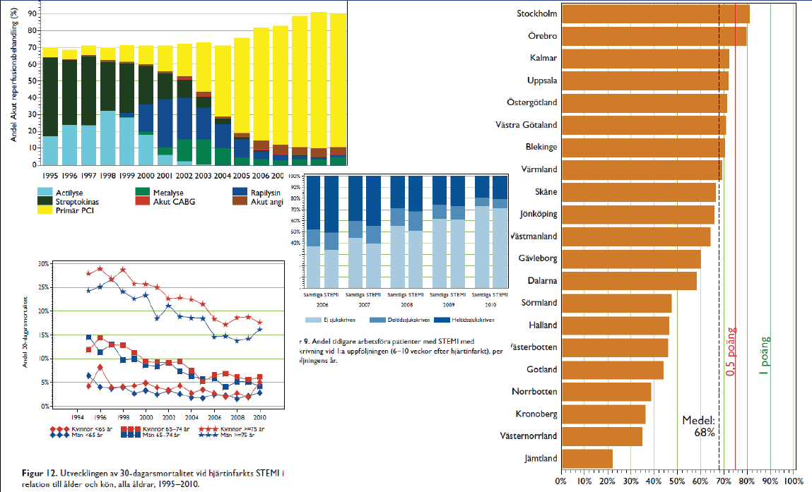
The SwedeHeart; Annual reports
From demographics to clinical outcomes
http://www.ucr.uu.se/swedeheart

Slide 27
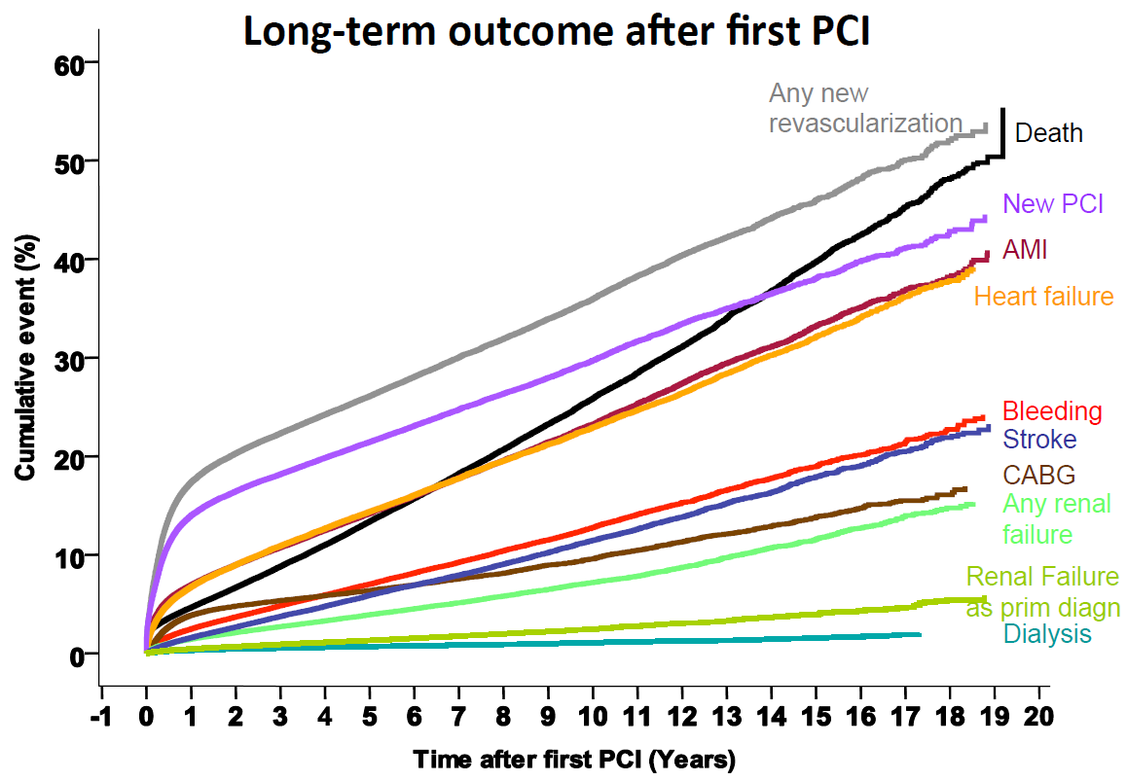
The SwedeHeart; Annual reports
Pride with long-term clinical data in Sweden

Slide 28
Annual report of the SwedeHeart
The RIKS-HIA Quality Index
http://www.ucr.uu.se/swedeheart/arsrapport-2015

Slide 29
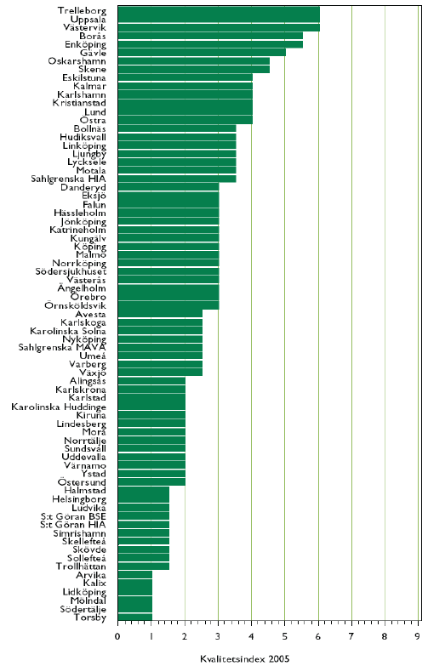
Annual report of the SwedeHeart
The RIKS-HIAs Quality Index
2005
2011
2015
http://www.ucr.uu.se/swedeheart/arsrapport-2015

Slide 30
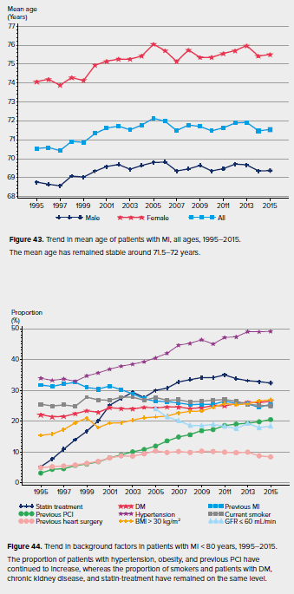
Annual report of the SwedeHeart
The RIKS-HIA
Trend in mean age with MI
Trend in background factors in patients with MI
http://www.ucr.uu.se/swedeheart/arsrapport-2015

Slide 31
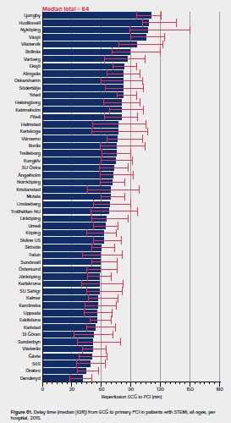
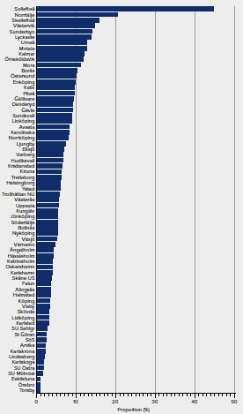
Annual report of the SwedeHeart
The RIKS-HIA
ECG to primary PCI
Rate of IV beta blocker in AMI
http://www.ucr.uu.se/swedeheart/arsrapport-2015

Slide 32
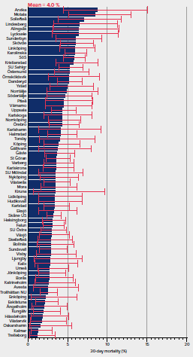
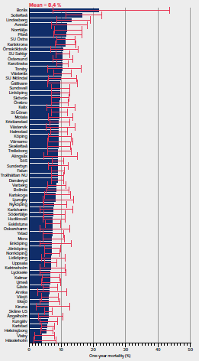
Annual report of the SwedeHeart
The RIKS-HIA
30 day mortality per hospital
1 year mortality per hospital
http://www.ucr.uu.se/swedeheart/arsrapport-2015

Slide 33
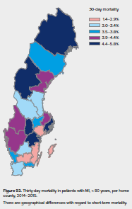
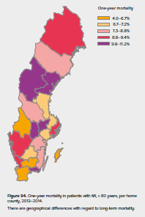
Annual report of the SwedeHeart
The RIKS-HIA
1Mo mortality per county
1 year mortality per county
http://www.ucr.uu.se/swedeheart/arsrapport-2015

Slide 34
Admit the difference of outcome …
Clinical outcome differences are real and exist.
  Difference of geography (island), long-distance transfer, insufficient medical resources
    e.g. Gotland
Media control
  Media likes to make provocative headlines.
    e.g. Our state (or municipality is the worst area of AMI care in nation.)
Incentive-disincentive system
  Induce competition, but data will be fabricated.
  We will lose the opportunities to improve our quality of care.
  Goal is in improvement for our citizens, not in numbers or indices.
Find the reasons in poor quality institutions and areas.
  Listen the voices of healthcare providers, analyze the data.
  Make funds and rules to improve those institutions and areas.

Slide 35
The SCAAR

Slide 36
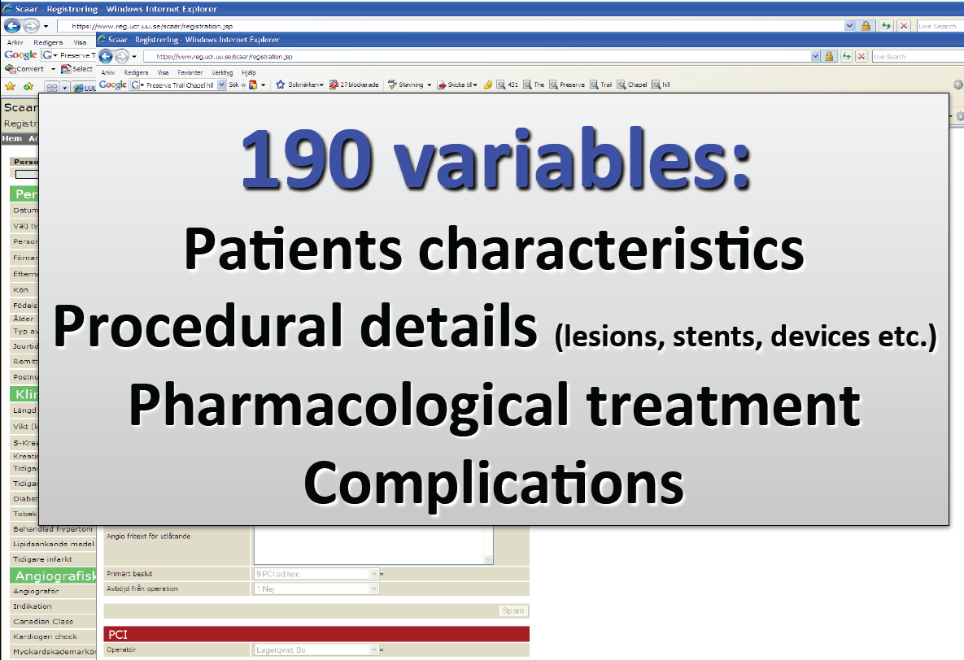
Data entry on-line by the operator
190 variables

Slide 37
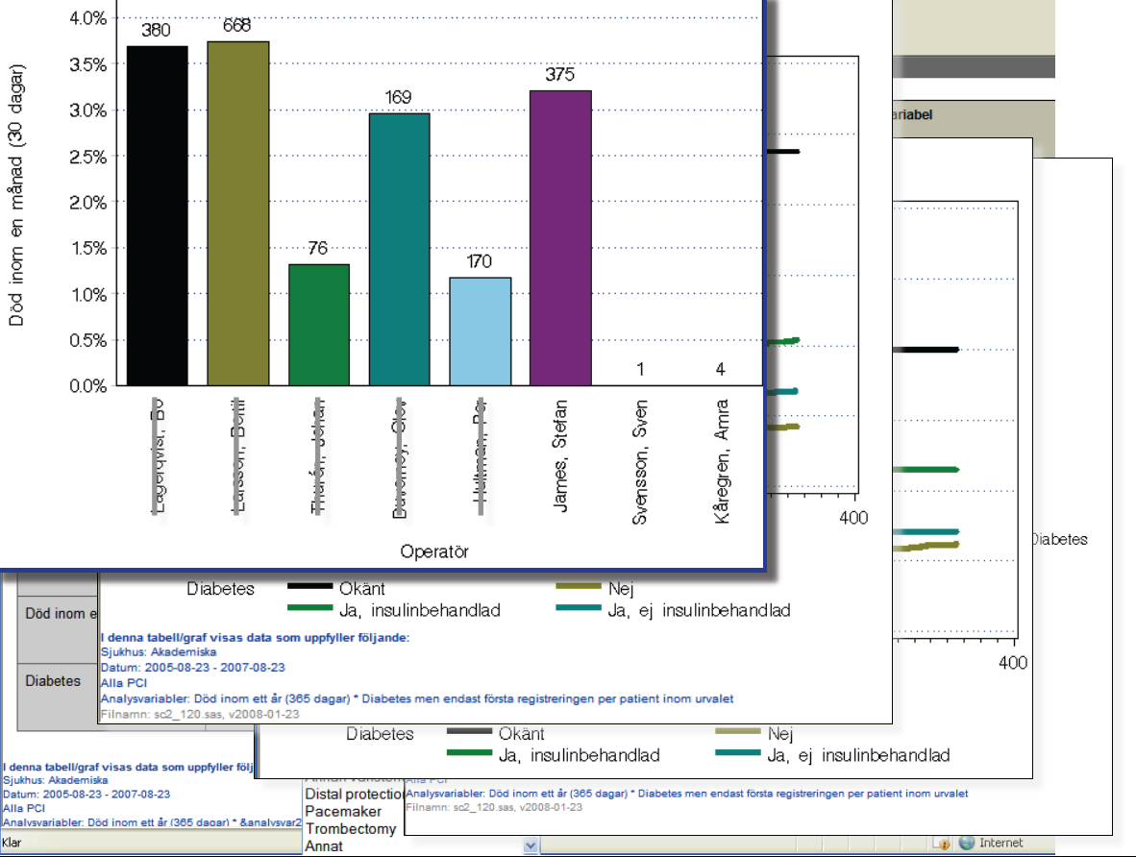
Real-time measurement for quality
On-line reports

Slide 38
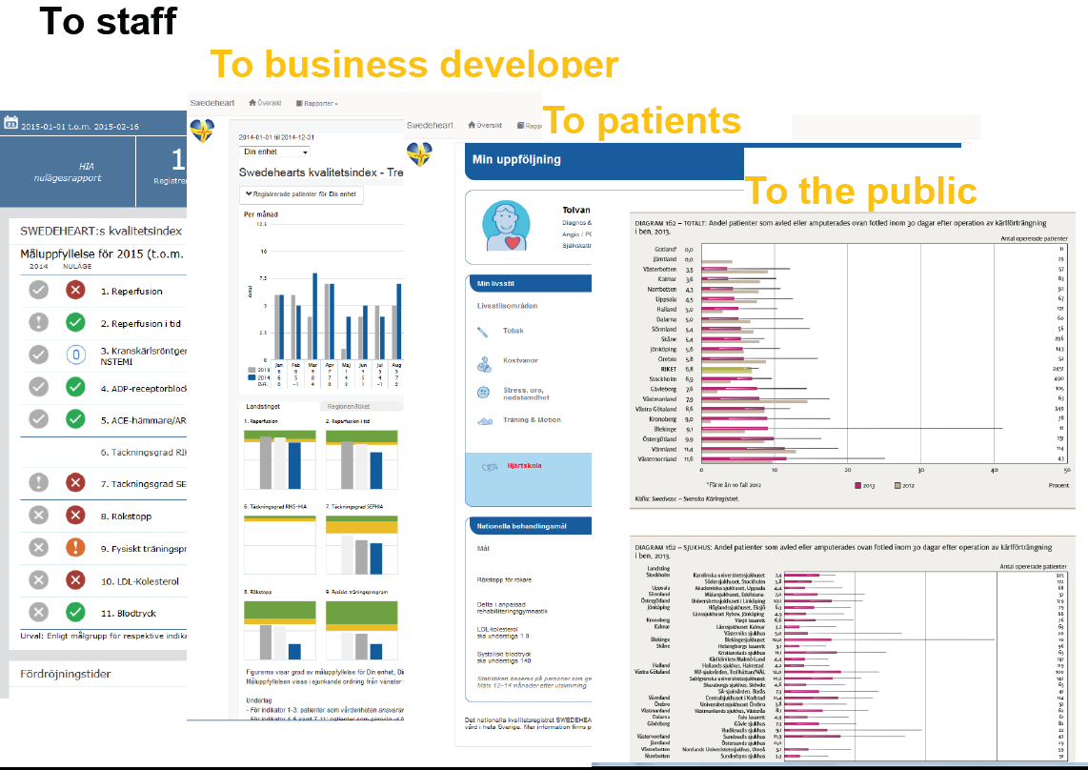
Feedback for multi-teams
Feedback

Slide 39
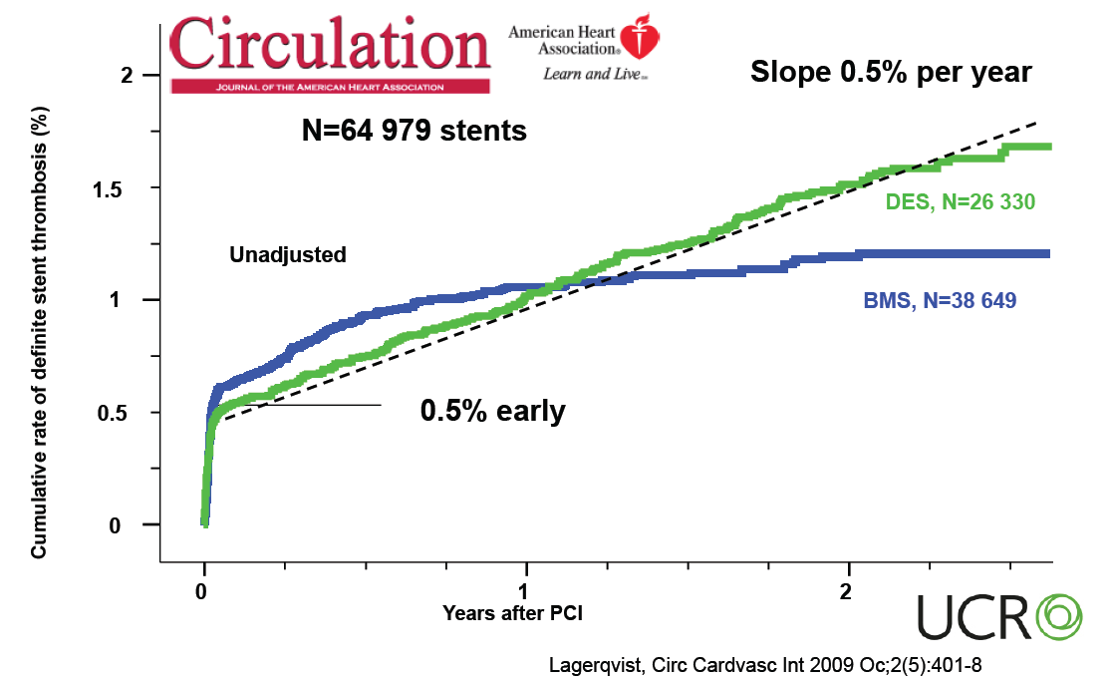
Scientific achievement
DES ST never asleep ..

Slide 40
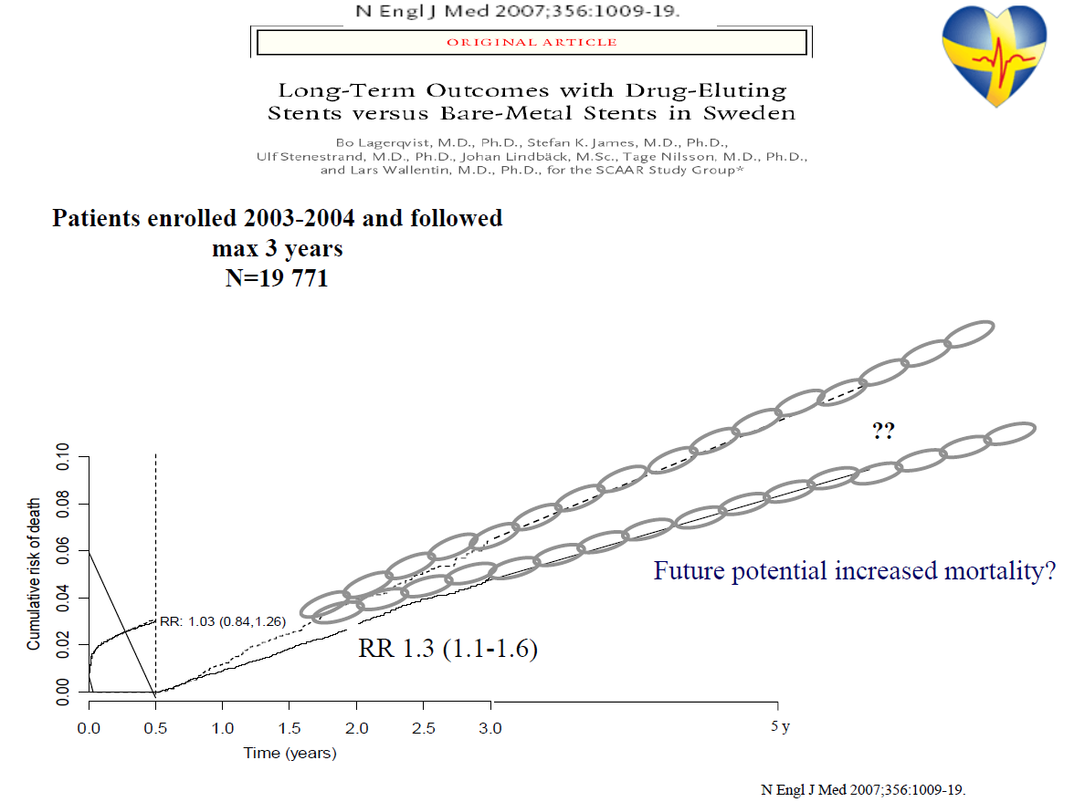
Scientific achievement
DES will kill you ..

Slide 41
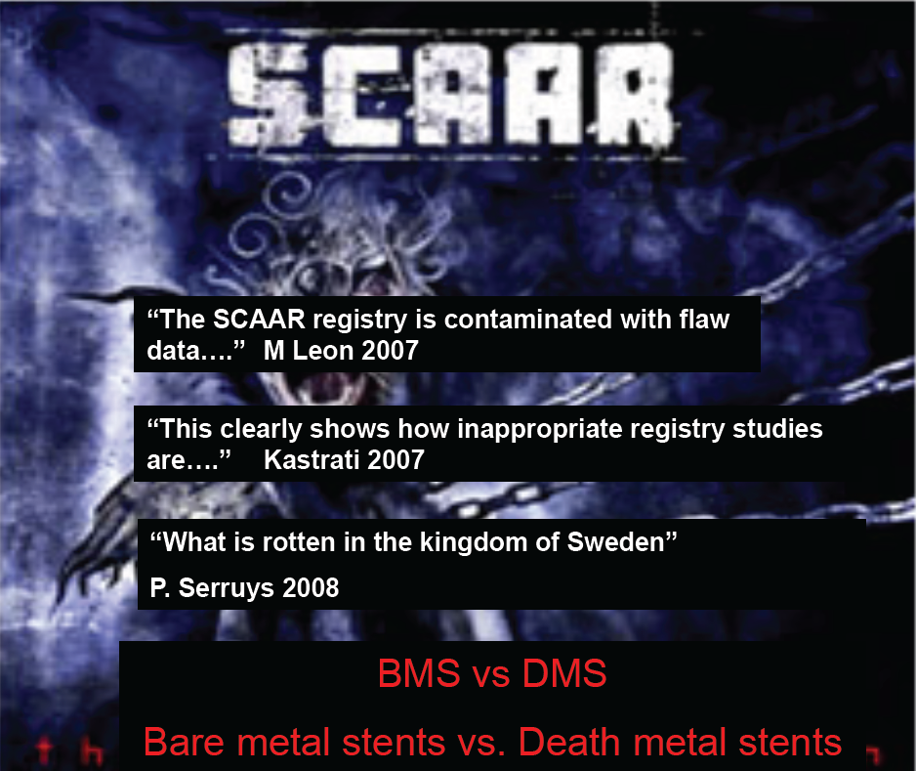
Scientific achievement
The SCAAR Scare

Slide 42
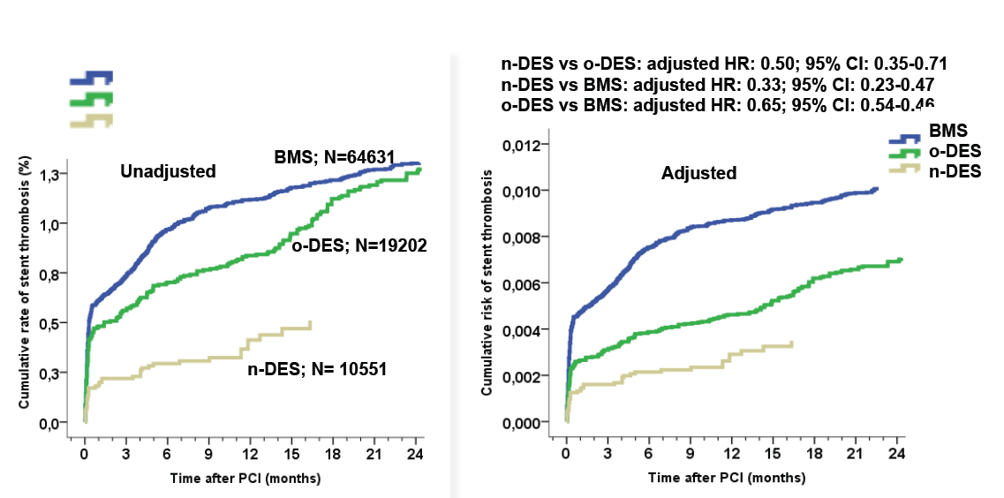
Scientific achievement
Newer generation DES … the new hope (ST @ 2 years)

Slide 43
Prospective registry-based RCT
; a new concept for clinical research

Slide 44
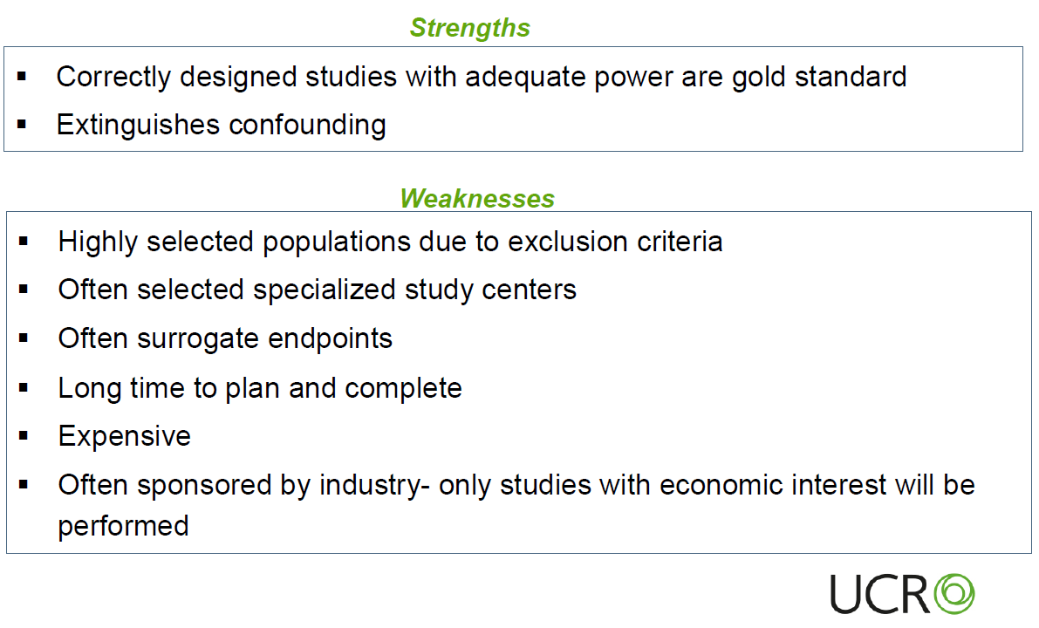
RCT .. Is not holy grail.
RCT …

Slide 45
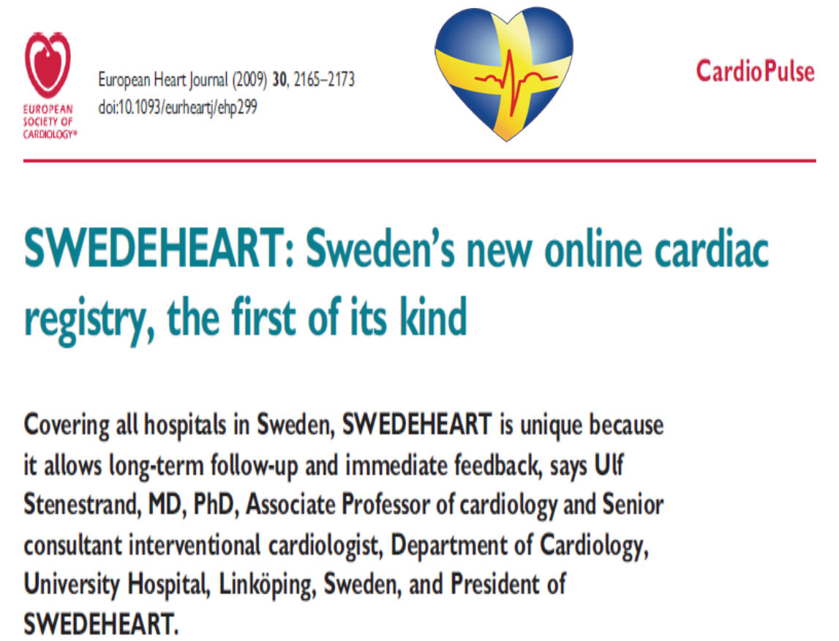
New trials of the SwedeHeart

Slide 46
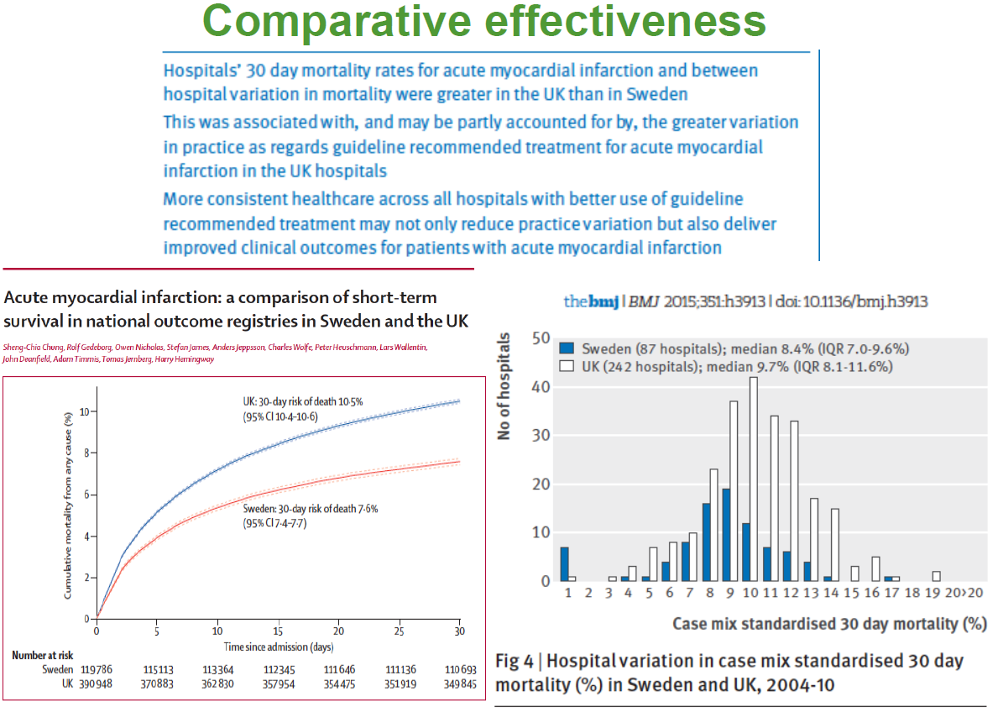
Comparative effectiveness studies

Slide 47
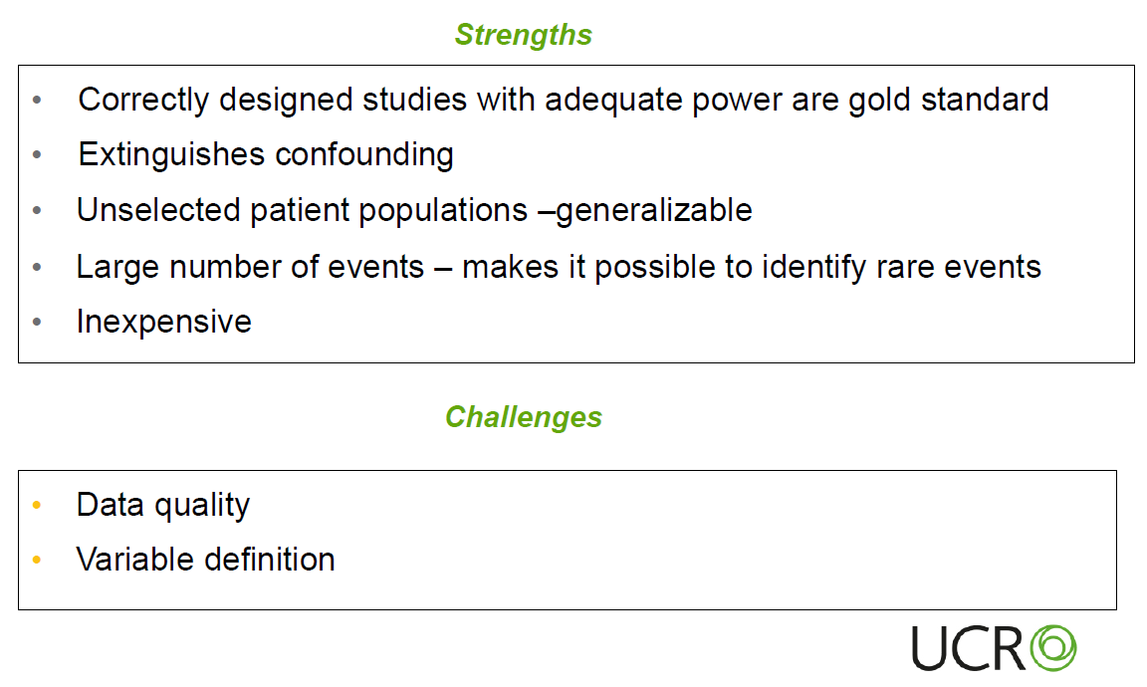
Registry based RCT (R-RCT)
R-RCT …

Slide 48
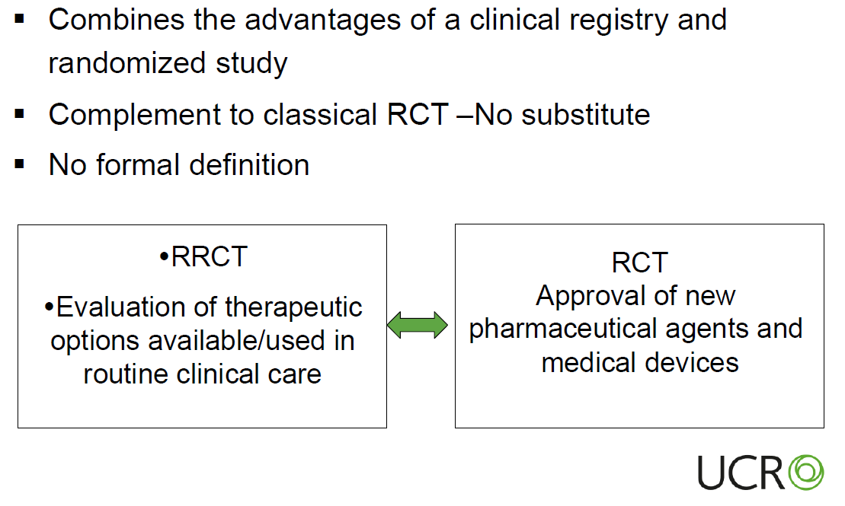
R-RCT vs. classical RCT

Slide 49
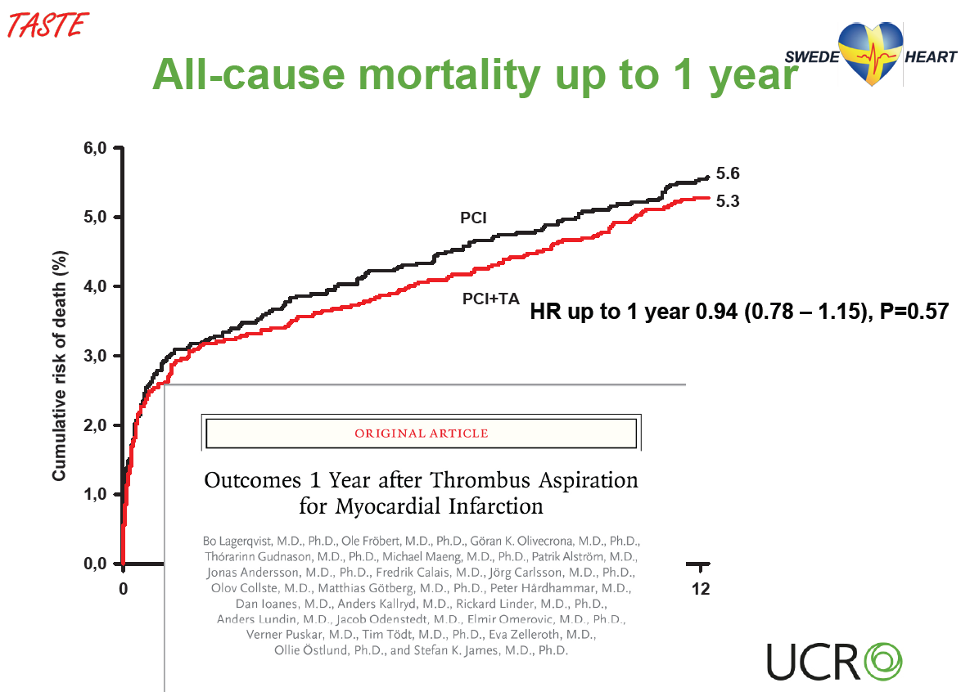
TASTE with R-RCT

Slide 50
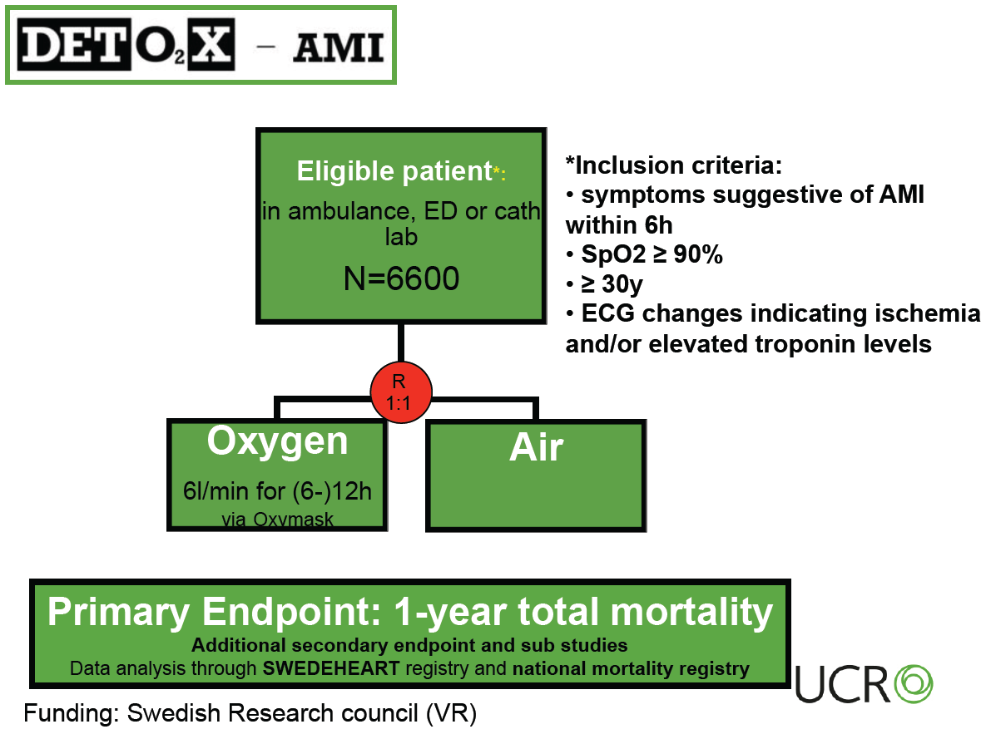
DETOX in AMI with R-RCT

Slide 51
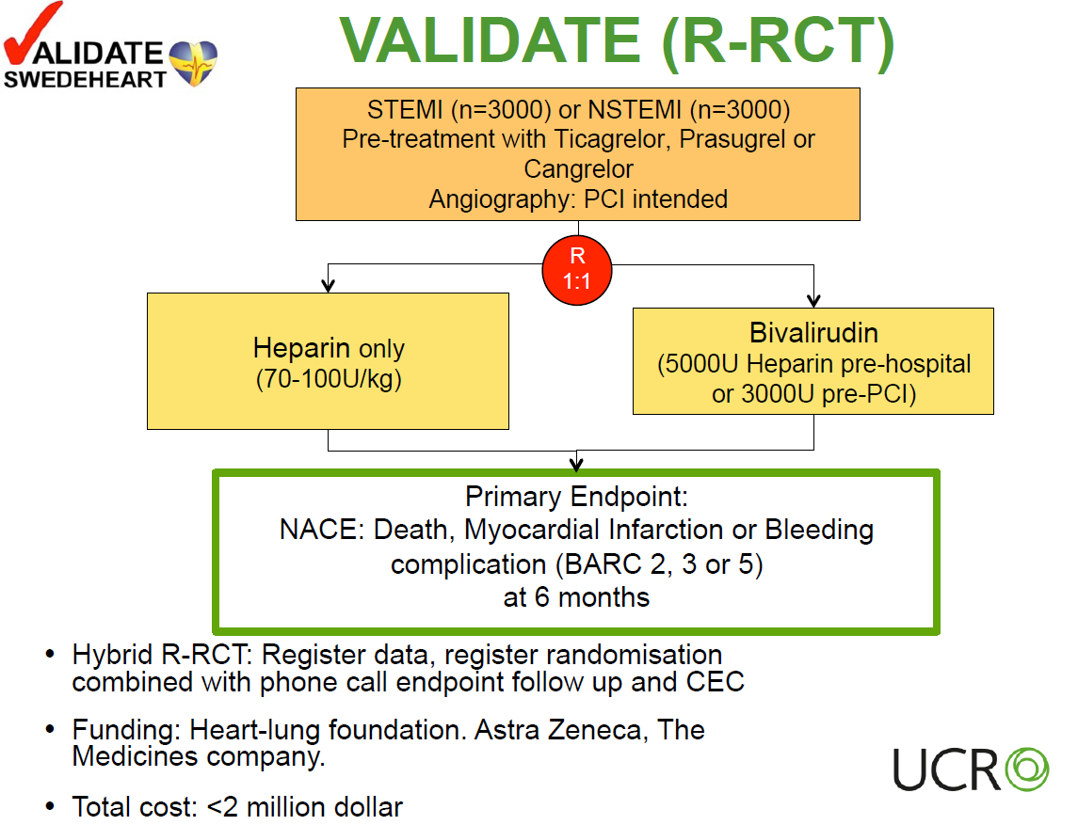
VALIDATE with R-RCT

Slide 52
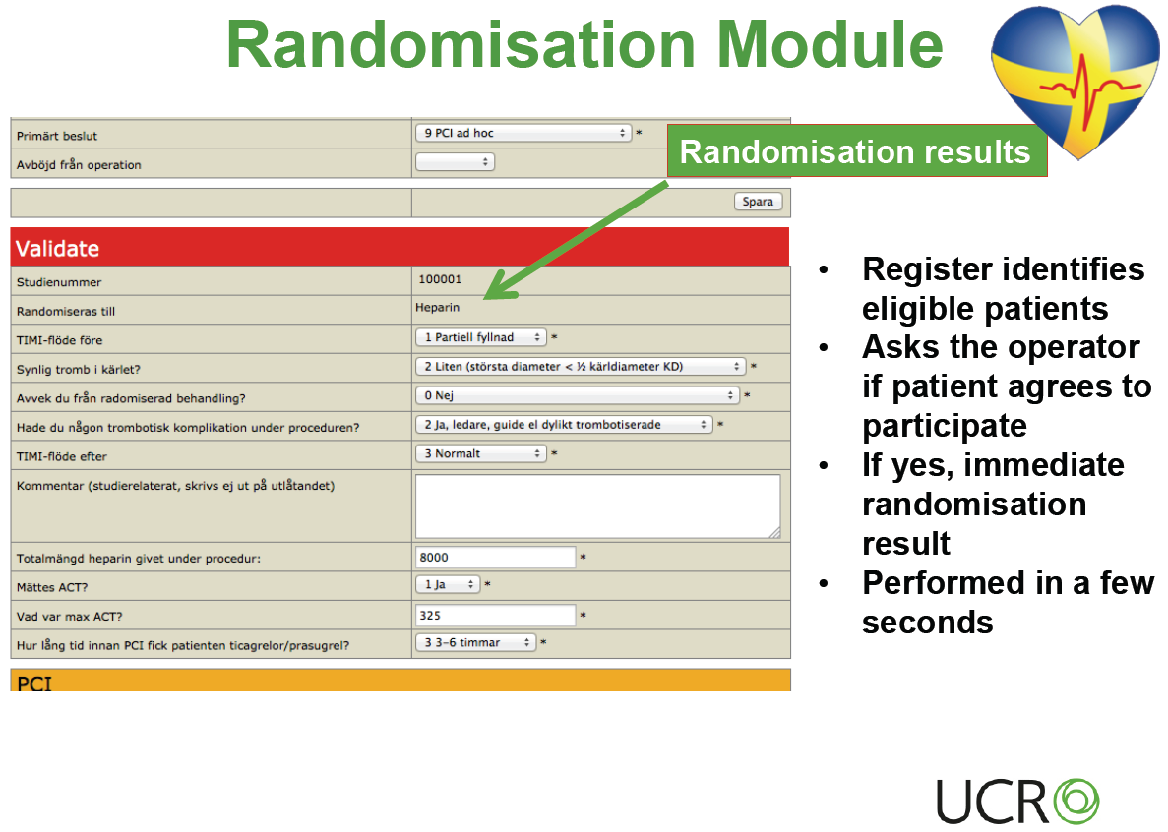
VALIDATE with R-RCT

Slide 53
Conclusion
Bottom-up is key points.
  Healthcare providers dedicate.
  Central/Local governments make budgets.
  Data will be opened for publics.
Direct linking with national data statistics.
  Starts with number of citizens.
  Connects among registries.
Evaluation is essential, but Incentive/disincentive will ruin.
  Find weak points, then help them positively.

Slide 54
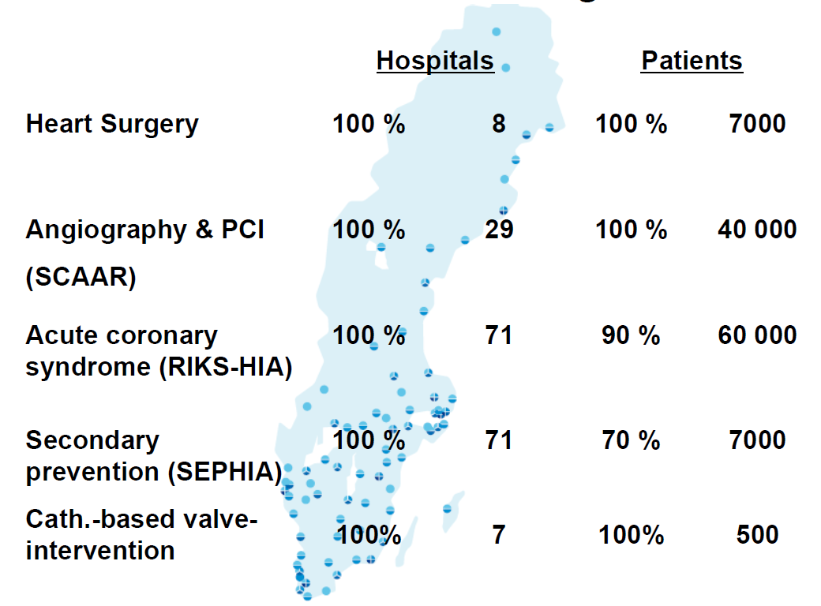
SwedeHeart – organizations
Coverage
Cardiogenetic registry New

Slide 55
So many things on BVS
Discovered truth
Unveiled truth
Unreasonable optimism
Irrational pessimism
They came from ignorance of it.
If we knew the limitations of BVS, we would overcome it.
Notes:
Insuline IV injection에도 혈당에는 큰 변화가 없고 맥박에도 큰 변화가 없이 혈압의 강하가 재현됨.

Slide 56
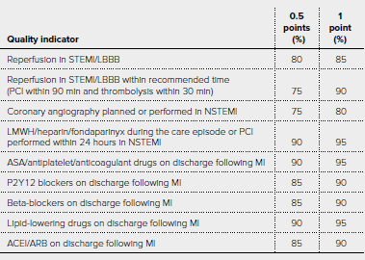
Annual report of the SwedeHeart
The RIKS-HIA Quality Index
  For STEMI
http://www.ucr.uu.se/swedeheart/arsrapport-2015

Slide 57
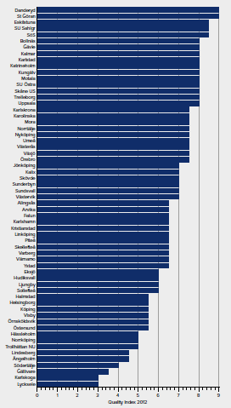
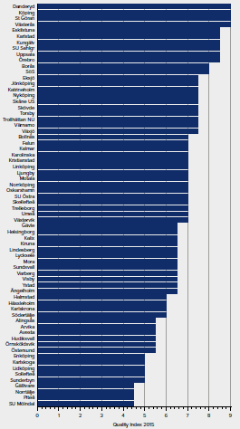
Annual report of the SwedeHeart
The RIKS-HIA Quality Index
2012
2015
http://www.ucr.uu.se/swedeheart/arsrapport-2015

