Slide 1
Impact of Alcohol Drinking on Acetylcholine Induced Coronary Artery Spasm
Seung-Woon Rha, Byoung Geol Choi, Sung Min Sohn, Se Yeon Choi,
Jae Kyeong Byun, Hu Li, Min Suk Shim, Woohyeun Kim, Jun Hyuk Kang,
Eun Jin Park, Sung Hun Park, Jah Yeon Choi, Sunki Lee, Jin Oh Na,
Cheol Ung Choi, Hong Euy Lim, Eung Ju Kim, Chang Gyu Park,
Hong Seog Seo, and Dong Joo Oh
Department of Medicine, Korea University Graduate School, Seoul, Korea
Cardiovascular Center, Korea University Guro Hospital, Seoul, Korea

Slide 2
Disclosure Information
I have nothing to disclose.
Correspondence to Dr Rha
; swrha617@yahoo.co.kr

Slide 3
Background
Coronary artery spasm (CAS) refers to an abnormal condition where the epicardial coronary artery contracts.
The relationship between alcohol consumption and CAS is even more ambiguous.

Slide 4
Purpose
We evaluated drinking patterns such as current drinking status, weekly drinking amount, and drinking frequency on CAS and their varying effects.

Slide 5
Methods
Study Population
  A total of 5,491 consecutive patients (pts) underwent acetylcholine (Ach) provocation test, and pts without significant CAD were enrolled.
Study Groups
  Current alcohol drinkers; CA (n = 1792 Pts)
  Non-CA; (n = 3699 Pts)

Slide 6
Methods
Intracoronary Ach Provocation Test
  Ach was injected by incremental doses of 20μg (A1), 50 μg (A2) and 100 μg (A3) into the left coronary artery.
  Significant CAS was defined as transient >70% luminal narrowing with/without ischemic ST-T Change or chest pain.

Slide 7
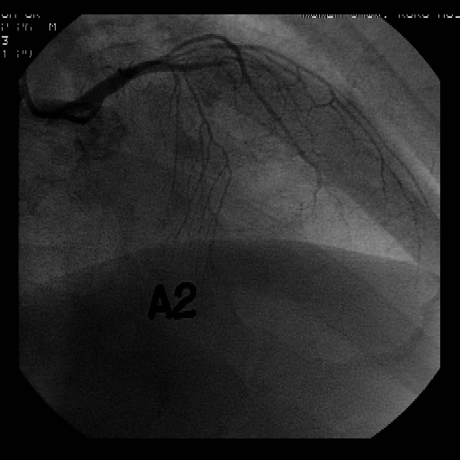
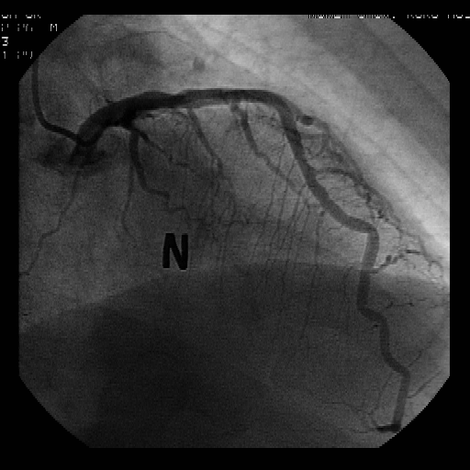
Methods
Coronary Angiogram with Positive Acetylcholine (Ach) Provocation Test in a Patient
A; Acetylcholine, N; Nitroglycerin
** Total occlusion at mid LAD with A2 injection

Slide 8
Statistics
All statistical analyses were performed using SPSS 20.0.
Continuous variables were expressed as means ± standard deviation and were compared using Student’s t-test.
Categorical data were expressed as percentages and were compared using chi-square statistics or Fisher’s exact test.
A P-value of 0.05 was considered statistically significant.
To adjust for potential confounders, propensity score matching (PSM) analysis was performed using the logistic regression model

Slide 9
Statistics
We tested all available variables that could be of potential relevance: Age, male, cardiovascular risk factors (hypertension, dyslipidemia, current smokers and current alcoholics) and myocardial bridge.
Patients with the CA group were then 1-to-1 matched to the non-CA group according to propensity scores with the nearest available pair matching method.
Subjects were matched with a caliper width equal to 0.01.
Various 5-year clinical outcomes were estimated with Kaplan-Meier method, and differences between groups were compared with log-rank test.

Slide 10
Results

Slide 11
Baseline Characteristics
 | Entire Patients |  |  |  | Matched Patients
Variables, N (%) | CA (n=1792) | Non-CA (n=3699) | P value |  | CA (n=1391) | Non-CA (n=1391) | P value
Baseline characteristics
Gender (male) | 1384 (77.2) | 1122 (30.3) | < 0.01 |  | 984 (70.7) | 1003 (72.1) | 0.425
Age | 51.4 ± 11.7 | 56.9 ± 12.3 | < 0.01 |  | 52.7 ± 11.4 | 52.8 ± 13.1 | 0.397
Body mass index | 24.4 ± 3.1 | 24.2 ± 3.2 | 0.003 |  | 24.4 ± 3.0 | 24.2 ± 3.1 | 0.058
Left Ventricular ejection fraction, % | 59.1 ± 3.7 | 59.1 ± 3.8 | 0.461 |  | 59.1 ± 3.7 | 59.3 ± 3.4 | 0.367
Factors of risk
Hypertension | 746 (41.6) | 1646 (44.5) | 0.044 |  | 591 (42.5) | 586 (42.1) | 0.848
Diabetes mellitus | 257 (14.3) | 585 (15.8) | 0.155 |  | 198 (14.2) | 205 (14.7) | 0.706
New-onset diabetes mellitus | 62 (3.5) | 136 (3.7) | 0.686 |  | 40 (2.9) | 36 (2.6) | 0.642
Insulin | 21 (1.2) | 65 (1.8) | 0.101 |  | 18 (1.3) | 19 (1.4) | 0.869
Medication | 165 (9.2) | 363 (9.8) | 0.475 |  | 130 (9.3) | 135 (9.7) | 0.747
Dietary | 19 (1.1) | 49 (1.3) | 0.406 |  | 17 (1.2) | 19 (1.4) | 0.737
Dyslipidemia | 512 (28.6) | 1024 (27.7) | 0.492 |  | 385 (27.7) | 361 (26.0) | 0.304
Current smokers | 731 (40.8) | 403 (10.9) | < 0.01 |  | 428 (30.8) | 367 (26.4) | 0.010
History alcohol drinkers | 0 (0.0) | 155 (4.2) | < 0.01 |  | 0 (0.0) | 105 (7.5) | < 0.01
Alcohol drinking amount, g | 55.4 ± 36.5 |  | < 0.01 |  | 51.7 ± 34.7 |  | < 0.01
Moderate consumption | 133 (7.4) | 0 (0.0) |  |  | 120 (8.6) | 0 (0.0)
High consumption | 387 (21.6) | 0 (0.0) |  |  | 289 (20.8) | 0 (0.0)
Unknown | 1272 (71) | 0 (0.0) |  |  | 982 (70.6) | 0 (0.0)
Data are presented as N (%) or mean ± standard deviation
SD, standardized difference; LV, left ventricular; HDL, high-density lipoprotein; LDL, low-density lipoprotein; CRP, C-reactive protein.
Moderate consumption was defined as following: < 40g/day in men and < 20g/day in women. High consumption was defined as following: ≥40g/day in men and ≥20g/day in women. Unknown was defined as following: the CA group but had no information for drinking pattern detail.

Slide 12
Angiographic and Clinical Parameterd during Acetylcholine Provocation Test
 | Entire Patients |  |  |  |  | Matched Patients
Variables, N (%) | CA (n=1792) | Non-CA (n=3699) | P value | SD |  | CA (n=1391) | Non-CA (n=1391) | P value | SD
Angiographic and Clinical Outcomes at Acetylcholine Provocation Test
CAS positive | 1111 (62.0) | 1999 (54.0) | < 0.01 | -1.05 |  | 871 (62.6) | 809 (58.2) | 0.016 | -0.58
Spontaneous spasm | 399 (22.3) | 701 (19.0) | 0.004 | -0.73 |  | 306 (22.0) | 245 (17.6) | 0.004 | -0.99
Myocardial bridge | 384 (21.4) | 606 (16.4) | < 0.01 | -1.16 |  | 283 (20.3) | 286 (20.6) | 0.888 | 0.05
EKG change | 83 (4.6) | 147 (4.0) | 0.254 | -0.32 |  | 65 (4.7) | 47 (3.4) | 0.083 | -0.65
ST-segment elevation | 23 (1.3) | 48 (1.3) | 0.965 | 0.01 |  | 16 (1.2) | 10 (0.7) | 0.237 | -0.45
ST-segment depression | 28 (1.6) | 51 (1.4) | 0.592 | -0.15 |  | 23 (1.7) | 21 (1.5) | 0.761 | -0.11
T-inversion | 20 (1.1) | 26 (0.7) | 0.115 | -0.43 |  | 16 (1.2) | 5 (0.4) | 0.016 | -0.91
Atrial fibrillation | 14 (0.8) | 29 (0.8) | 0.991 | 0.00 |  | 12 (0.9) | 13 (0.9) | 0.841 | 0.08
Chest pain | 822 (45.9) | 1647 (44.5) | 0.348 | -0.20 |  | 645 (46.4) | 593 (42.6) | 0.047 | -0.56
AV Block | 453 (25.3) | 1012 (27.4) | 0.102 | 0.41 |  | 348 (25.0) | 365 (26.2) | 0.460 | 0.24
Insignificant stenosis
Mild (< 30%) | 835 (46.6) | 1823 (49.3) | 0.062 | 0.39 |  | 652 (46.9) | 656 (47.2) | 0.879 | 0.04
Mild (30-50%) | 157 (8.8) | 297 (8.0) | 0.356 | -0.25 |  | 123 (8.8) | 112 (8.1) | 0.453 | -0.27
Moderate (50-70%) | 121 (6.8) | 202 (5.5) | 0.057 | -0.52 |  | 92 (6.6) | 90 (6.5) | 0.878 | -0.06
Data are presented as N (%)
SD, standardized difference; CAS, coronary artery spasm; ACH, acetylcholine; AV, atrioventricular

Slide 13
Angiographic Characteristics in Patients with Acetylcholine induced Coronary Artery Spasm
 | Entire Patients |  |  |  |  | Matched Patients
Variables, n (%) | CA (n=1111) | Non-CA (n=1999) | P value | SD |  | CA (n=871) | Non-CA (n=809) | P value | SD
Quantitative coronary angiography; QCA
MND, mm (during ACH Test) | 0.69 ± 0.36 | 0.71 ± 0.35 | 0.030 | -0.07 |  | 0.68 ± 0.36 | 0.70 ± 0.34 | 0.278 | -0.04
MND, % (during ACH Test) | 71.6 ± 13.2 | 69.6 ± 12.6 | < 0.01 | 0.15 |  | 71.4 ± 13.4 | 70.7 ± 12.2 | 0.166 | 0.05
RD, mm (after NTG injection) | 2.45 ± 0.58 | 2.37 ± 0.76 | < 0.01 | 0.12 |  | 2.43 ± 0.58 | 2.39 ± 0.53 | 0.248 | 0.07
Acetylcholine dose
A1 (20ug/min) | 65 (5.9) | 98 (4.9) | 0.256 | -0.41 |  | 51 (5.9) | 45 (5.6) | 0.796 | -0.12
A2 (50ug/min) | 392 (35.3) | 692 (34.6) | 0.709 | -0.11 |  | 308 (35.4) | 286 (35.4) | 0.997 | 0.00
A3 (100ug/min) | 654 (58.9) | 1209 (60.5) | 0.379 | 0.21 |  | 512 (58.8) | 478 (59.1) | 0.900 | 0.04
Multi-vessel spasm | 400 (36.0) | 618 (30.9) | 0.004 | -0.88 |  | 324 (37.2) | 252 (31.1) | 0.009 | -1.04
Spasm site
Left arterial descending | 1045 (94.1) | 1875 (93.8) | 0.770 | -0.03 |  | 826 (94.8) | 756 (93.4) | 0.226 | -0.14
Left circumflex | 458 (41.2) | 718 (35.9) | 0.003 | -0.86 |  | 363 (41.7) | 294 (36.3) | 0.025 | -0.86
Diffuse spasm | 954 (85.9) | 1715 (85.8) | 0.954 | -0.01 |  | 754 (86.6) | 692 (85.5) | 0.543 | -0.11
Spasm location
Prox to distal | 507 (45.6) | 773 (38.7) | < 0.01 | -1.08 |  | 408 (46.8) | 317 (39.2) | 0.002 | -1.17
Mid to distal | 387 (34.8) | 808 (40.4) | 0.002 | 0.91 |  | 302 (34.7) | 312 (38.6) | 0.098 | 0.64
Proximal only | 83 (7.5) | 149 (7.5) | 0.986 | -0.01 |  | 64 (7.3) | 61 (7.5) | 0.881 | 0.07
Mid only | 114 (10.3) | 234 (11.7) | 0.221 | 0.44 |  | 81 (9.3) | 109 (13.5) | 0.007 | 1.24
Distal only | 20 (1.8) | 35 (1.8) | 0.920 | -0.04 |  | 16 (1.8) | 10 (1.2) | 0.319 | -0.48
Data are presented as N (%) or mean ± standard deviation
SD, standardized difference; MND, Minimum narrowing diameter; ACH, Acetylcholine; RD, Reference diameter; NTG, nitroglycerin

Slide 14
Predictors for Acetylcholine induced Coronary Artery Spasm by Univariate Cox-Regression Analysis
 | Entire Patients |  |  |  | Matched Patients
Variables | No. of CAS patients | Hazard ratio [95% C.I] | p Value |  | No. of CAS patients | Hazard ratio [95% C.I] | p Value
Current alcohol drinking | 1111/1792 | 1.38 [1.23 - 1.55] | < 0.01 |  | 871/1391 | 1.20 [1.03 - 1.40] | 0.016
Alcohol drinking amount |  |  | < 0.01 |  |  |  | 0.011
Non-CA | 1999/3699 | - |  |  | 809/1391 | -
Moderate consumption | 79/133 | 1.24 [0.87 - 1.76] | 0.224 |  | 69/120 | 0.97 [0.66 - 1.41] | 0.888
High consumption | 249/387 | 1.53 [1.23 - 1.90] | < 0.01 |  | 197/289 | 1.54 [1.17 - 2.01] | 0.002
Unknown | 783/1272 | 1.36 [1.19 - 1.55] | < 0.01 |  | 605/982 | 1.15 [0.97 - 1.36] | 0.092
CAS, coronary artery spasm; C.I, Confidence interval

Slide 15
Summary
After PSM analysis, 2 propensity-matched groups (1,391 pairs, n = 2,782) were generated.
After PSM, baseline characteristics of both groups were balanced.
The CA group showed a higher incidence of CAS by Ach provocation test than the non-CA group (62.6 % vs. 58.2%, HR; 1.20, 95% C.I; 1.03-1.40, p=0.016).
Among these patients, excessive alcohol consumption (HR; 1.54, 95% C.I; 1.17-2.01, p=0.002) showed a higher risk of CAS than the non-CA group.

Slide 16
Conclusion
  Current alcohol drinkers and heavy consumption exhibited a higher incidence of CAS compared with the non-alcohol drinkers.
  Abstinence from drinking paired with intensive medical therapy and close clinical follow-up can help to prevent CAS associated cardiovascular events.

Slide 17
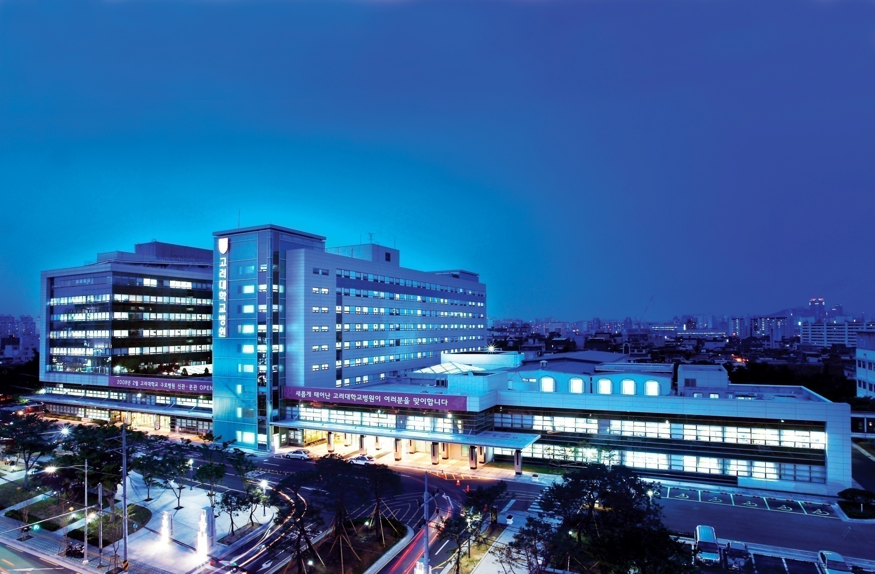
Thank you for your attention
Korea University Guro Hospital

